Slide 1


Volume
Volume Cube & Cuboid
Volume of a Prism
www.mathsrevision.com
Volume of a Cylinder
Capacity

Slide 2
Starter Questions
Q1. Find the area of the triangle.
10cm
3cm
Q2. Expand out and simplify 2w² – 3(2w – 5)
4cm
www.mathsrevision.com
Q3. True or false
Q4. Rearrange into the form y =
2y – 3x + 7 = 0

Slide 3
Volume
Learning Intention
Success Criteria
  We are revising volume of a cuboid.
  Know formulae.
Use formulae correctly.
www.mathsrevision.com
Show working and
appropriate units.

Slide 4
Volume of a cuboid
18 cubes fit the base.
4cm
3cm
6cm
www.mathsrevision.com
= 1 centimetre cube = 1 cm³
4 layers of 18 cubes
= 4 x 18
= 72 centimetre cubes
= 72 cm³

Slide 5
A short cut !
height
4cm
Area of rectangle
breadth
3cm
6cm
www.mathsrevision.com
length
Volume =
6
x 3
x 4
= 72 cm³
Volume =
length
x breadth
x height

Slide 6
Example
Working
Volume = l x b x h
V = 18 x 5 x 27
V = 2430 cm³
27cm
Heilander’s
Porridge Oats
5 cm
18 cm

Slide 7
Example
Working
Volume = l x b x h
V = 2 x 2 x 2
V = 8 cm³
2cm
www.mathsrevision.com

Slide 8
Find the volume of the composite shape.
7 cm
V_{T} = V₁ + V₂
5 cm
V_{T} = 105 + 720
3 cm
V_{T} = 825 cm³
9 cm
V₁ = l x b x h
www.mathsrevision.com
= 3 x 5 x 7
= 105 cm³
10 cm
V₂ = l x b x h
= 8 x 10 x 9
8 cm
= 720 cm³

Slide 9
Find the length the cuboid
This just an equation.
We know how to solve them !
4 cm
Volume = L x B x H
V=200cm³
5 cm
200 = L x 5 x 4
www.mathsrevision.com
200 = 20L
10 cm
L
20L = 200
L = 10

Slide 10
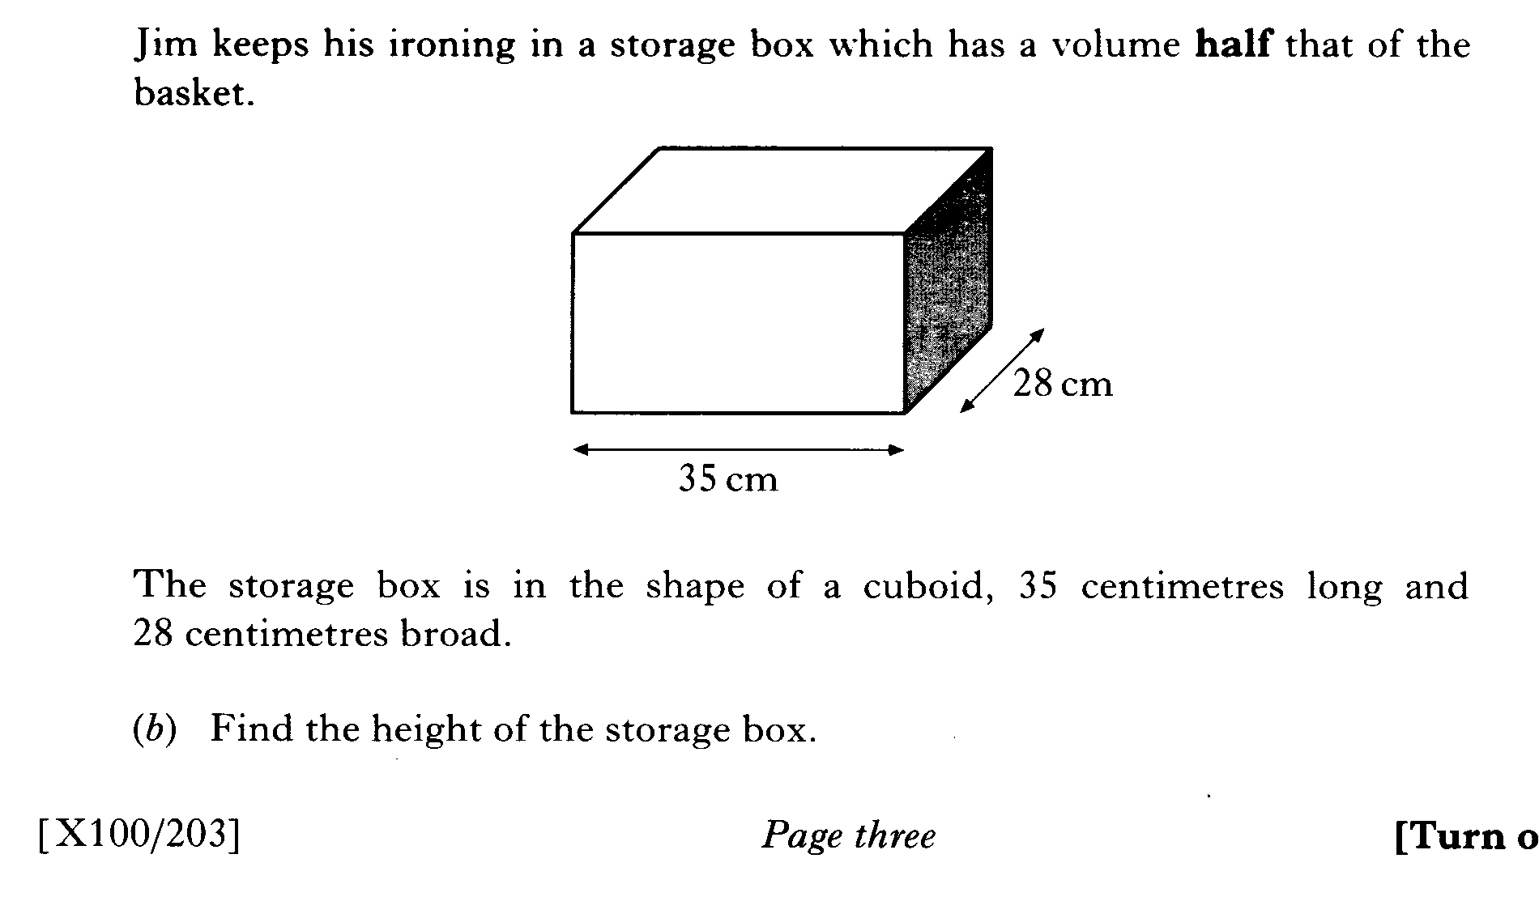

Slide 11
Example
Liquid Volume
Working
Volume = l x b x h
V = 100 x 30 x 50
V = 150 000 cm³
50 cm
= 150 000 ml
30 cm
= 150 litres
100 cm
How much water can this fish tank hold in litres?
1cm³ = 1 ml
1000 ml = 1 litre
So the fish tank can hold 150 litres of water.

Slide 12

Volume
Now try
N5 Lifeskills
Ex 1
Ch8 (page 74)
www.mathsrevision.com

Slide 13
Starter Questions
Q1. True or false 2(x – 6) - 2(x + 6) = 0
Q2. Does 2.5 + 1.25 x 20 = 27.55 Explain your answer
www.mathsrevision.com
Q3. Factorise 2y² + 3y +2
Q4. Calculate

Slide 14
Volume of Prisms
Learning Intention
Success Criteria
  We are learning how to calculating volume of any
  prism given area.
1. Calculate the volume for
various prisms.
2. Solution must include
appropriate units and working.
www.mathsrevision.com

Slide 15
Volume of Prisms
Definition : A prism is a solid shape with
uniform cross-section
www.mathsrevision.com
Hexagonal Prism
Cylinder
(circular Prism)
Triangular Prism
Pentagonal Prism
Volume = Area of Cross section x length

Slide 16
Volume of Prisms
Definition : A prism is a solid shape with
uniform cross-section
www.mathsrevision.com
Hexagonal Prism
Cylinder
(circular Prism)
Triangular Prism
Pentagonal Prism
Volume = Area of Cross section x length

Slide 17
Volume of Solids
Definition : A prism is a solid shape with
uniform cross-section
Q. Find the volume the triangular prism.
www.mathsrevision.com
Triangular Prism
Volume = Area x length
= 20 x 10 = 200 cm³
10cm
20cm²

Slide 18
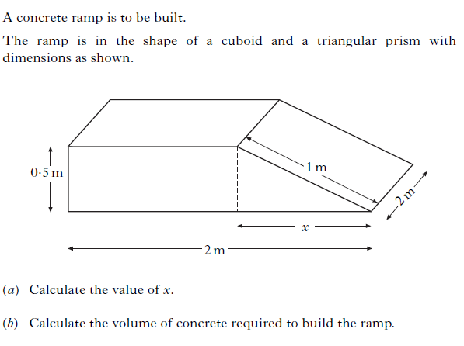

Slide 19
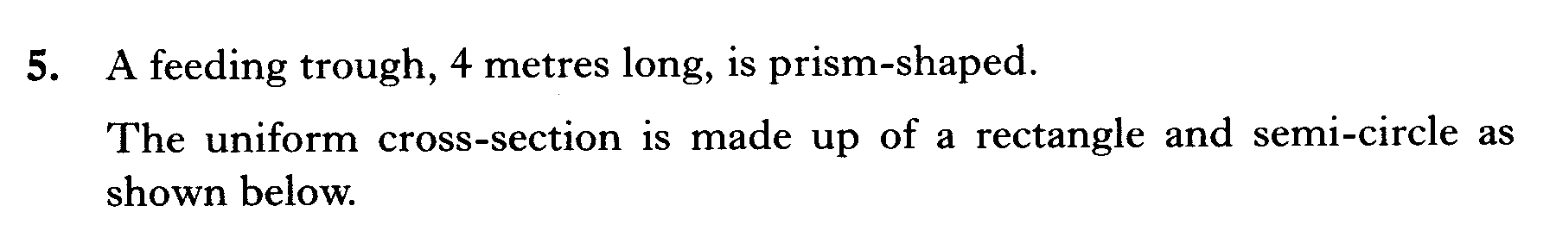
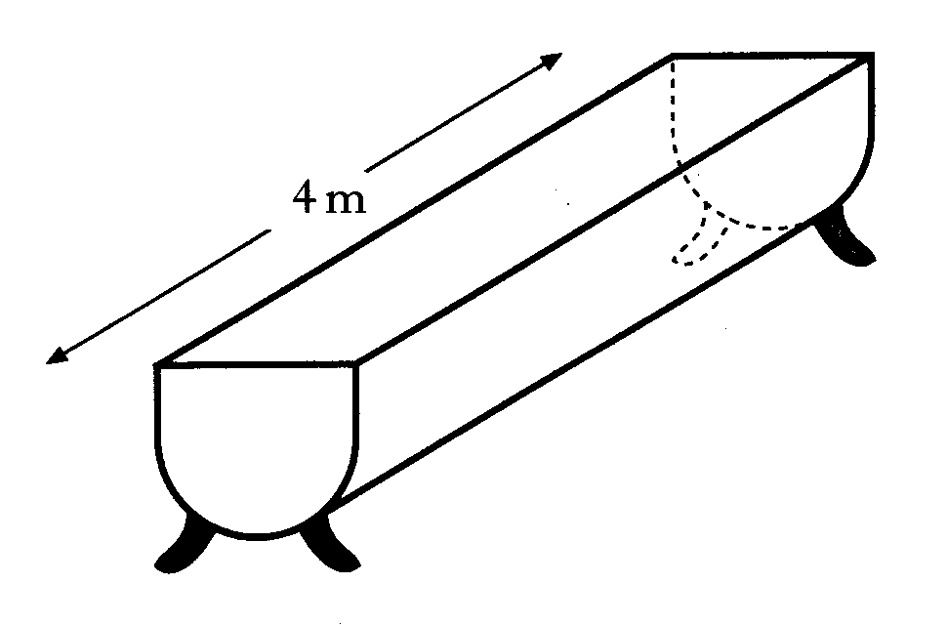
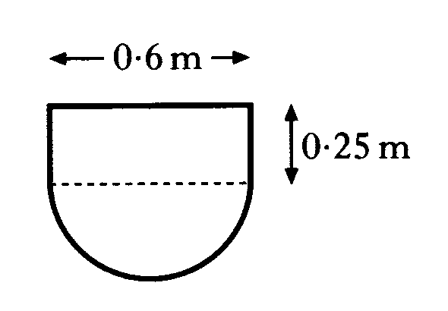

Slide 20
Volume of Prisms
Now try
N5 Lifeskills
Ex 2
Ch8 (page 75)
www.mathsrevision.com

Slide 21
Starter Questions
Q1. Find the area of the parallelogram
7
Q2. Factorise
4x + 40
7
www.mathsrevision.com
Q3. A can of beans is reduce by 15% to 25p.
Find the price before the reduction.
Q4. The speed of light is 300000000 metres per sec.
True or false in scientific notation 3 x 10⁸.

Slide 22
Volume of a Cylinder
Learning Intention
Success Criteria
  We are learning how to derive the formula for the volume of a cylinder and apply it to solve problems.
  To know formula.
Apply formula correctly.
www.mathsrevision.com
Work backwards using formula.

Slide 23
Volume of a Cylinder
The volume of a cylinder can be thought as being a pile
of circles laid on top of each other.
Volume = Area x height
h
www.mathsrevision.com
= πr²
x h
Cylinder
(circular Prism)
= πr²h

Slide 24
Volume of a Cylinder
Example : Find the volume of the cylinder below.
5cm
V = πr²h
10cm
www.mathsrevision.com
= π(5)²x10
Cylinder
(circular Prism)
= 250π cm³
= 784.5 cm³

Slide 25
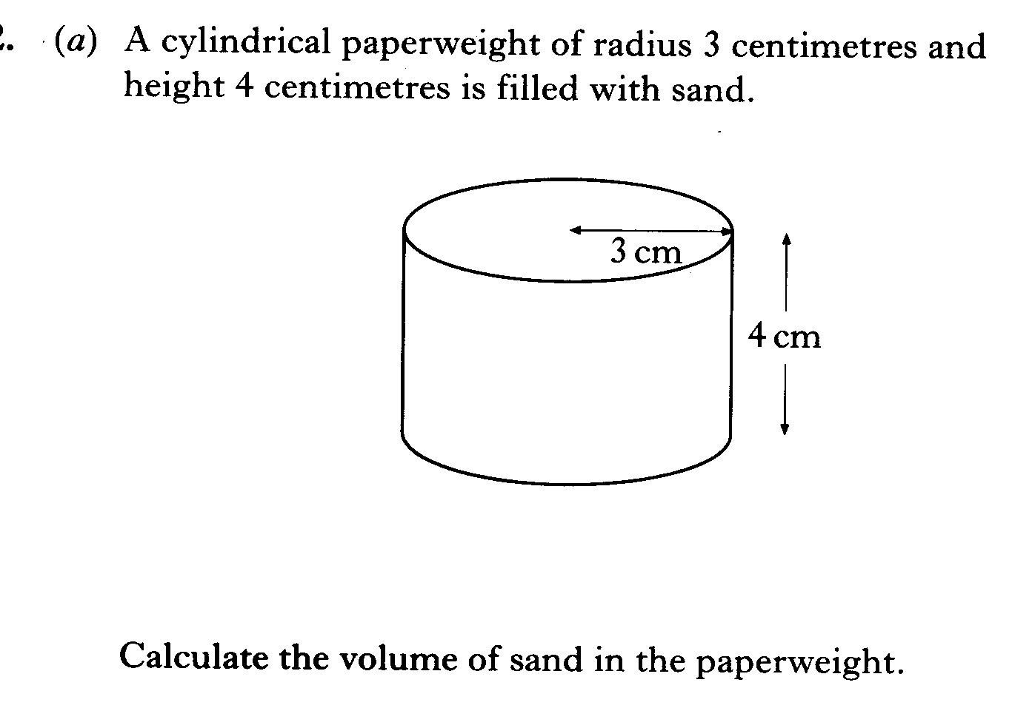

Slide 26
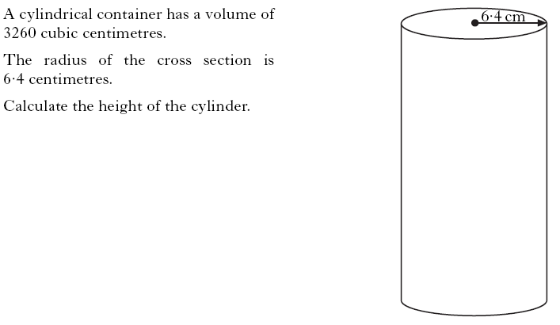

Slide 27
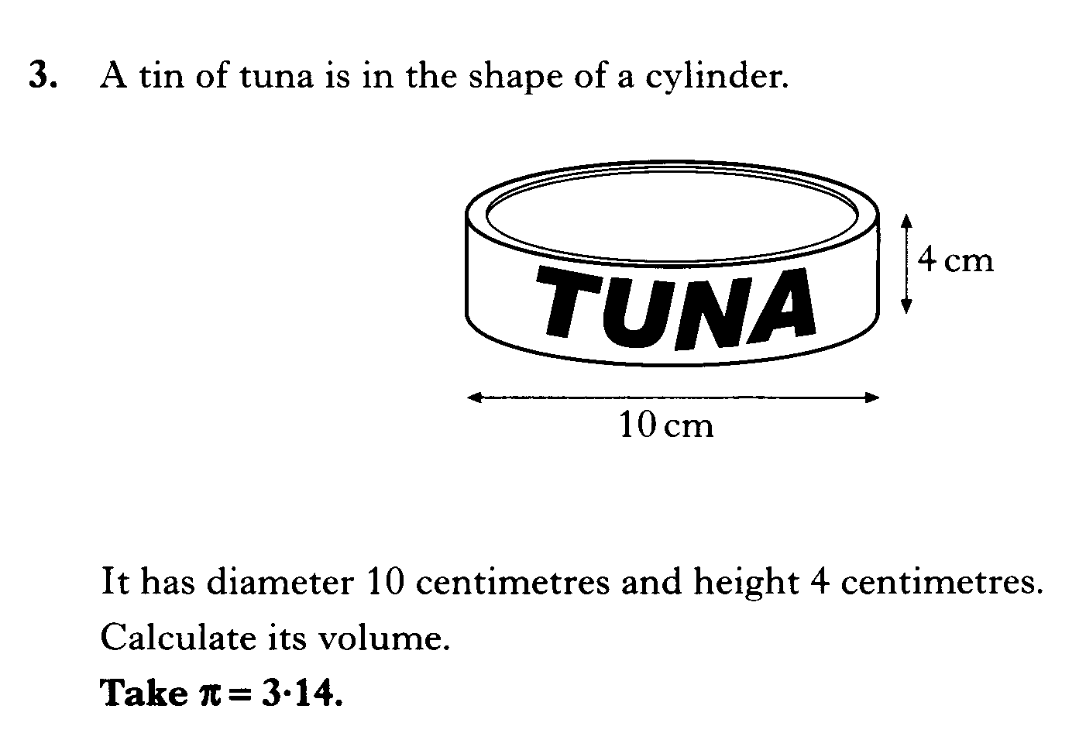

Slide 28
Volume of a Cylinder
Now try
N5 Lifeskills
Ex 3
Ch8 (page 77)
www.mathsrevision.com

Slide 29
Starter Questions
7cm
www.mathsrevision.com
Exchange Rate
£1 =$1.50

Slide 30
Liquid Volume
Learning Intention
Success Criteria
  We are learning the
  term liquid volume using millilitres and litres.
  Unerstand the term liquid volume.
Calculate volumes using 1ml and litres.
www.mathsrevision.com
Answer to contain
appropriate units.

Slide 31

Liquid Volume
I’m a very small duck!
How much water does this hold?
1 cm
1 cm
1 cm
Volume =
x b
x h
l
= 1 cm³
A cube with volume 1cm³ holds exact 1 millilitre of liquid.
A volume of 1000 ml = 1 litre.

Slide 32
Example 1
Liquid Volume
Working
Volume = l x b x h
V = 6 x 3 x 12
12 cm
V = 216 cm³
Orange
Flavour
= 216 ml
3 cm
www.mathsrevision.com
6 cm
So the carton can hold
216 ml of orange juice.
Remember:
1 cm³ = 1 ml
How much juice can
this carton hold?

Slide 33
Example 2
Liquid Volume
Working
Volume = l x b x h
V = 100 x 30 x 50
V = 150 000 cm³
50 cm
= 150 000 ml
30 cm
= 150 litres
100 cm
How much water can this fish tank hold in litres?
1cm³ = 1 ml
1000 ml = 1 litre
So the fish tank can hold 150 litres of water.

Slide 34
Liquid Volume
Now try
N5 Lifeskills
Ex 4
Ch8 (page 80)
www.mathsrevision.com

