Slide 1


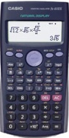
Percentages
Percentage With and Without a Calculator.
Expressing one number as a % of Another
www.mathsrevision.com
Compound Interest
Appreciation & Depreciation

Slide 2
Starter Questions
www.mathsrevision.com

Slide 3
Percentages
Learning Intention
Success Criteria
1. We are reviewing basic percentages.
  Remember the basic percentages.
www.mathsrevision.com
Calculate a basic percentage without a calculator.

Slide 4
Simple Percentages
Copy down and learn the following basic percentages
www.mathsrevision.com

Slide 5
Simple Percentages
Copy down and learn the following basic percentages
www.mathsrevision.com

Slide 6
Percentages
Q. Find 30% of £40
www.mathsrevision.com

Slide 7
Percentages
Q. Find 75% of £600
www.mathsrevision.com

Slide 8
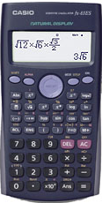
of
means multiple
Percentages
With a Calculator
Find 17% of £450
www.mathsrevision.com
Remember money
2 decimal places

Slide 9
Percentages
With a Calculator
Find 4% of £70
www.mathsrevision.com
Remember !! money
2 decimal places

Slide 10

Percentages
With & Without a Calculator
Now try
N5 Lifeskills
Ex 1
Ch3 (page 27)
www.mathsrevision.com

Slide 11
Percentages
Learning Intention
Success Criteria
1. We are learning to convert a fraction / decimal to a percentage and use them in context.
  To know how to convert a fraction / decimal to a percentage.
www.mathsrevision.com
Be able to compare percentages in context.

Slide 12
Percentages
Converting a fraction to a percentage
Do the division
x 100
Fraction
Decimal
Percentage
www.mathsrevision.com
Do the division
x 100
0.75
75%

Slide 13
Percentages
Convert these percentages to fraction and simply
www.mathsrevision.com

Slide 14
Percentages
Write the following percentages as a fraction.
17% =
www.mathsrevision.com
81% =
40% =

Slide 15
Percentages
Covert these fractions to percentages
www.mathsrevision.com

Slide 16
Percentages
Comparing Percentages
Write the following fractions as percentages.
= 27%
www.mathsrevision.com
= 15%
= 29%

Slide 17
Franchesca has the best result.
Percentages
Franchesca got 45 out of 60 in her Maths exam
and Michael got 21 out of 30 in an English exam.
Who got the best result.

Slide 18

Percentages
Comparing Percentages
Paul scored :
24 out of 30 in English and 36 out of 40 in Maths.
By finding the percentage score for each, which is his
best subject ?
English
Maths
www.mathsrevision.com

Slide 19
Percentages
Now try
N5 Lifeskills
Ex 2
Ch3 (page 29)
www.mathsrevision.com
Are you on Target ?
I can ?

Slide 20
Starter Questions
www.mathsrevision.com
10cm
8cm

Slide 21
Compound Interest
Learning Intention
Success Criteria
  We are learning how to use the compound formula for appropriate problems.
  To know when to use compound formula.
Solve problems involving compound formula.
www.mathsrevision.com

Slide 22
Interest calculated on new value every year
Compound Interest
Real life Interest is not a fixed quantity year after year. One year’s interest becomes part of the next year’s amount. Each year’s interest is calculated on the amount at the start of the year.
Initial value
Example
www.mathsrevision.com
Daniel has £400 in the bank. He leaves it in the bank for 3 years. The interest is 7% each year. Calculate the simply interest and then the compound interest after 3 years.

Slide 23
Compound Interest
Interest calculated on new value every year
Daniel has £400 in the bank. He leaves it in the bank for 3 years. The interest is 7% each year. Calculate the compound interest and the amount he has in the bank after 3 years.
Simple Interest
Y1 : Interest = 7% of £400 = £28
Amount = £400 + £28 = £428
Interest = 7% of £400 = £28
Y 2 : Interest = 7% of £428 = £29.96
3 x 28 = £84
www.mathsrevision.com
Amount = £428 + £29.96 = £457.96
Y 3 : Interest = 7% of £457.96 = £32.06
Amount = £457.06 + £32.06 = £490.02
Simple Interest is only £84
Compound is £490.02 - £400 = £90.02

Slide 24
Compound Interest
This is called the multiplier.
Easier Method
n = period of time
Days, months years
www.mathsrevision.com
IMPORTANT
Can only use this when percentage is fixed
I = initial value
± = increase or decrease
V = Value

Slide 25
Compound Interest
Calculate the money in the bank after 3 years if the compound interest rate is 7% and the initial value is £400.
n = 3
I =400
www.mathsrevision.com
± = increase 1+0.07=1.07
V= 400 x (1.07)³ = £490.02

Slide 26
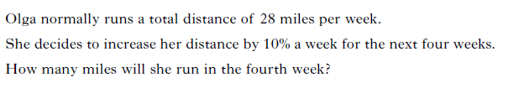

Slide 27
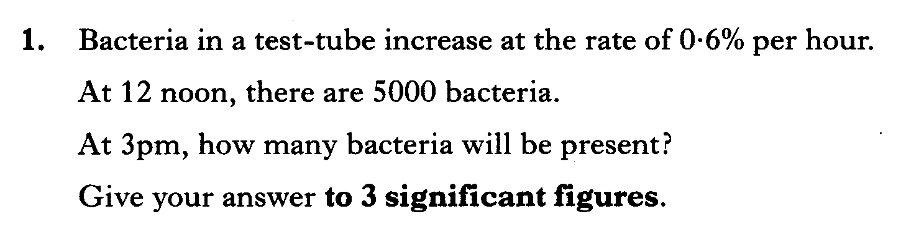

Slide 28
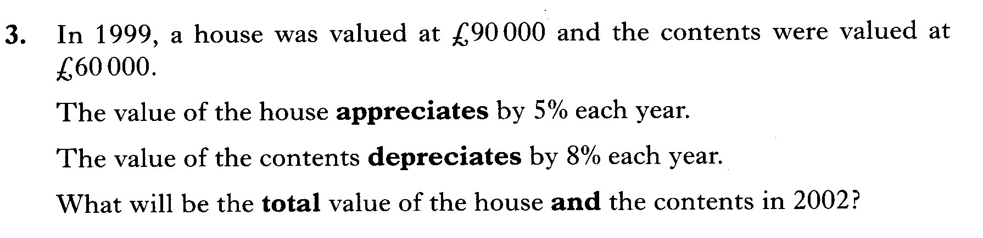

Slide 29
Percentages
Compound Interest
Now try
N5 Lifeskills
Ex 3
Ch3 (page 31)
www.mathsrevision.com

Slide 30
Starter Questions
www.mathsrevision.com

Slide 31
Appreciation & Depreciation
Learning Intention
Success Criteria
  We are learning about the terms appreciation and depreciation.
  To know the terms appreciation and depreciation.
Show appropriate working
when solving problems containing appreciation and depreciation.
www.mathsrevision.com

Slide 32
Appreciation & Depreciation
Appreciation : Going up in value e.g. House value
www.mathsrevision.com
Depreciation : Going down in value e.g. car value

Slide 33





Quicker Method
Easier
% £
100 ⇨ 64995
179 ⇨
Average house price in Ayr has appreciated by 79% over past 10 years.
If you bought the house for £64995 ten years ago in 2005 how much would the house be worth in 2015 ?
Appreciation = 79% x £ 64995
  = 0.79 x £64995
        = £ 51346.05
New value = Old Value + Appreciation
= £64995 + £51346.05
        = £ 116341.05
Just working out percentages

Slide 34

Appreciation & Depreciation
A Mini Cooper cost £14625 in 2014
At the end 2015 it depreciated by 23%
At the end 2016 it will depreciate by a further 16%
What will the mini cooper worth at end 2016?
End 2003
Depreciation = 23% x £14625
      = 0.23 x £14625
        = £3363.75
New value = Old value - Depreciation
      = £14625 - £3363.75
= £11261.25
www.mathsrevision.com

Slide 35
Appreciation & Depreciation
End 2015
Depreciation = 23% x £14625
      = 0.23 x £14625
        = £3363.75
New value = Old value - Depreciation
      = £14625 - £3363.75
    = £11261.25
End 2016
Depreciation = 16% x £11261.25
    = 0.16 x £11261.25
    = £1801.80
New Value = £11261.25 - £1801.80
    = £9459.45
www.mathsrevision.com

Slide 36
Have you updated your Learning Log ?
Percentages
Comparing Percentages
Now try lifeskills
Ex 4
Ch3 (page 29)
www.mathsrevision.com
Are you on Target ?
I can ?

