Slide 1


Decimals
Rounding Decimal Places
Significant Figures
Basic Operations
www.mathsrevision.com
x ÷ 10 , 100 and 1000
x ÷ 20 , 300 and 5000
Problem Solving

Slide 2
Starter Questions
The answer to the question is
60
www.mathsrevision.com
Write down as many questions as you can

Slide 3
Rounding
Rounding to Any Number of Decimal Places
Learning Intention
Success Criteria
1. Use previous knowledge to help round to any number of decimal places.
  1. We are learning to round to any number of decimal places.
www.mathsrevision.com

Slide 4
Rounding
Rounding to Any Number of Decimal Places
When rounding to :
  1 decimal place look at 2nd decimal figure
e.g. 2.46
  2 decimal place look at 3rd decimal figure
e.g. 6.456
  3 decimal place look at 4th decimal figure
e.g. 3.7846
www.mathsrevision.com
  4 decimal place look at 5th decimal figure
e.g. 13.1146

Slide 5
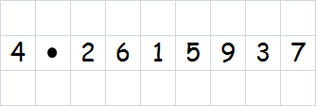
Rounding
Rounding to Any Number of Decimal Places
Example :
  Rounded to 1 decimal place, the number is
4.3
  Rounded to 2 decimal place, the number is
4.26
www.mathsrevision.com
  Rounded to 3 decimal place, the number is
4.262
  Rounded to 4 decimal place, the number is
4.2616

Slide 6

Rounding
Rounding to Any Number of Decimal Places
Example : Use your calculator to find the answers to
62.73
134.59
www.mathsrevision.com
4.29
Round your answers to 2 decimal places.

Slide 7

Rounding
Rounding to Any Number of Decimal Places
Now try
TJ N5 Lifeskills
Ex 1
Ch2 (page 18)
www.mathsrevision.com

Slide 8
Starter Questions
www.mathsrevision.com

Slide 9
Significant Numbers
Learning Intention
Success Criteria
  We are learning about the term significant figure.
  Understand what the term significant figure means.
www.mathsrevision.com
Apply knowledge to problems.

Slide 10
Significant Numbers
In mathematics a figure or digit is significant
if it gives an idea of both:
Quantity
Accuracy
IMPORTANT : If zero’s are employed just to position the decimal point
then they are considered NOT significant.
www.mathsrevision.com
e.g.
5836
→ 5800 to 2 Sig. Figs.
13404
→ 13400 to 3 Sig. Fisg.
7.5521
→ 7.6 to 2 Sig. Figs.
0.00506
→ 0.005 to 1 Sig. Fig.

Slide 11
Significant Figures
Example : Round to the given Significant Figures.
533 (1)
500
0.8023 (2)
0.80
36.207 (3)
36.2
www.mathsrevision.com
0.0039405 (1)
0.004
0.0403765 (3)
0.0404

Slide 12
Rounding
Rounding using Significant Figures
Now try
TJ N5 Lifeskills
Ex 2
Ch2 (page 19)
www.mathsrevision.com

Slide 13
Starter Questions
www.mathsrevision.com
34º

Slide 14
Decimal Numbers
Basic Operations
Learning Intention
Success Criteria
  1. We are learning the importance of layout when doing basic operations.
  Using and understanding layout for basic operations.
  2. Be able to solve context problems involving basic operations.
www.mathsrevision.com

Slide 15
Are there any errors in these sums.
Decimal Numbers
Basic Operations
There are many reasons why pupils do not get
the correct answer to addition and subtraction sums.
23
2.3
2.3 + 9
+0.9
0.9
www.mathsrevision.com
54
0.8
5.4 - 8
-0.8
-5.4

Slide 16
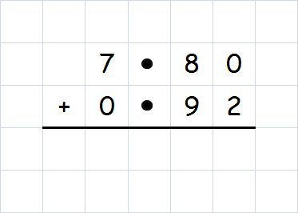
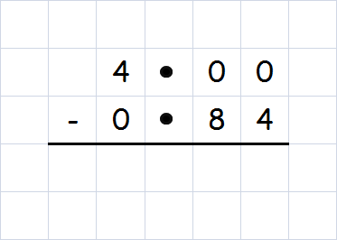
Remember !
1 number 1 box
Decimal Numbers
Basic Operations
Calculate the following
www.mathsrevision.com
8 7 2
3 1 6

Slide 17
Are there any errors in these sums.
Decimal Numbers
Basic Operations
There are many reasons why pupils do not get
the correct answer to division sums.
586 ÷ 9
www.mathsrevision.com

Slide 18
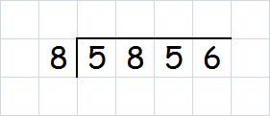
Remember !
1 number 1 box
Decimal Numbers
Basic Operations
Use the following layout for dividing by a single digit.
Example :
7 3 2
www.mathsrevision.com

Slide 19
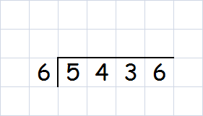
Decimal Numbers
Basic Operations
Example : £54.36 is to be split evenly between
6 pupils. How much will each get ?
www.mathsrevision.com
9 0 6

Slide 20
Are there any errors in these sums.
Decimal Numbers
Basic Operations
There are many reasons why pupils do not get
the correct answer to multiplication sums.
2.3
2.3
2.3 x 9
x 9
9
www.mathsrevision.com

Slide 21
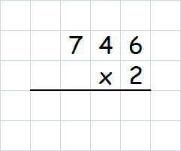
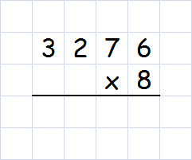
Remember !
1 number 1 box
Decimal Numbers
Basic Operations
To be able to multiply by a single digit you need to
know your tables.
Examples
www.mathsrevision.com
1 4 9 2
2 6 2 0 8

Slide 22
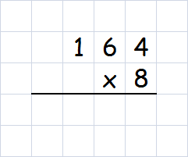
Remember !
1 number 1 box
Decimal Numbers
Basic Operations
Example : A water tank holds 16.4 litres of water.
How many litres will 8 tanks hold ?
www.mathsrevision.com
1 3 1 2

Slide 23
Basic Operations
Now try
TJ N5 Lifeskills
Ex 3
Ch2 (page 20)
www.mathsrevision.com

Slide 24
Starter Questions
Make up your own
Addition / Subtraction
Question
www.mathsrevision.com

Slide 25
Decimal Numbers
Multiply or Divide by 10, 100, 1000
Learning Intention
Success Criteria
1. Understand the two step process to multiply or divide by 10, 100 etc…
  1 We are learning how to multiply / divide by 10, 100, etc..
www.mathsrevision.com

Slide 26
If you do not see the decimal point its at the end of the number
Decimal Numbers
Multiply by 10, 100, 1000
To multiply by 10 move point 1 place to the right
To multiply by 100 move point 2 places to the right
To multiply by 1000 move point 3 places to the right
www.mathsrevision.com
Example : Multiply 36 by 10, 100, 1000.
3.6 x 10 =
36
3.6 x 100 =
360
3.6 x 1000 =
3600
Guess rule for 1000

Slide 27

Decimal Numbers
Multiply by 10, 100, 1000
Ex : A packet of crisps contain 4.8g of fat.
How much fat in 1000 packets ?
www.mathsrevision.com
4 8 0 0

Slide 28
Decimal Numbers
Try and write down rule for 100, 1000
Divide by 10, 100, 1000
To Divide by 10, 100, 1000
To divide by 10 move point one place to the left
To divide by 100 move point 2 places to the left
To divide by 1000 move point 3 places to the left
www.mathsrevision.com
Example : Divide 543 by 10, 100, 1000.
543 ÷ 10 =
54.3
543 ÷ 100 =
5.43
543 ÷ 1000 =
0.543

Slide 29
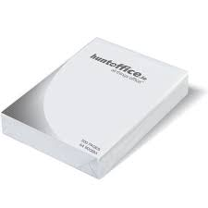

Decimal Numbers
Divide by 10, 100, 1000
Ex : A stack of 100 A4 sheets measure 1cm high.
What is the high of one sheet ?
www.mathsrevision.com
0 0 1

Slide 30
Multiplying / Dividing
x / ÷ 10 , 100 etc...
Now try
TJ N5 Lifeskills
Ex 4
Ch2 (page 21)
www.mathsrevision.com

Slide 31
Starter Questions
www.mathsrevision.com
42º

Slide 32
Decimal Numbers
Multiply or Divide by 20, 300, 5000
Learning Intention
Success Criteria
1. Understand the two step process to multiply or divide by 30, 500 etc…
  1 We are learning how to multiply / divide by 20, 300, etc..
www.mathsrevision.com

Slide 33
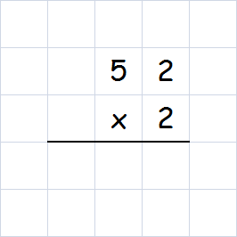
Decimal Numbers
Multiply or Divide by 20,300,4000
1 0 4
By combining our knowledge so far of
“multiplying / dividing by 10, 100, 1000”
and
“multiplying / dividing by a single digit”
we can do harder calculations.
We use a TWO step process.
www.mathsrevision.com
Example : Calculate 20 x 5.2
20 can be written as 2 x 10 so we have :
2 x 10 x 5.2 =
Step 1 : 10 x 5.2 =
52
Step 2 : 2 x 52 =

Slide 34
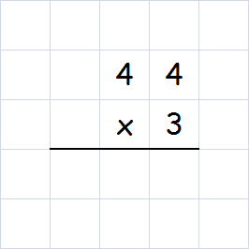
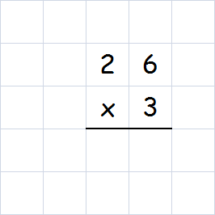
Decimal Numbers
Multiply or Divide by 20, 300, 4000
1 3 2
7 8
Example : Calculate 4.4 x 30
30 can be written as 10 x 3 so we have :
4.4 x 10 x 3 =
Step 1 : 4.4 x 10 =
44
Step 2 : 44 x 3 =
www.mathsrevision.com
Example : Calculate 300 x 0.026
300 can be written as 3 x 100 so we have :
3 x 100 x 0.026
Step 1 : 100 x 0.026 =
2.6
Step 2 : 2.6 x 3 =

Slide 35
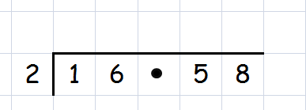
Decimal Numbers
Multiply or Divide by 20,300,4000
Example : Calculate 1658 ÷ 200
Since 200 divide by 100 then divide by 2:
1658 ÷ 100 ÷ 2
www.mathsrevision.com
Step 1 : 1658 ÷ 100 =
16.58
Step 2 :
8 2 9

Slide 36
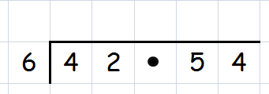
Decimal Numbers
Multiply or Divide by 20,300,4000
Example : Calculate 42540 ÷ 6000
Since 6000 divide by 1000 then divide by 6:
42540 ÷ 1000 ÷ 6
www.mathsrevision.com
Step 1 : 42540 ÷ 1000 =
42.54
7 0 9
Step 2 :

Slide 37
Multiplying / Dividing
x / ÷ 20 , 300 etc...
Now try
TJ N5 Lifeskills
Ex 5
Ch2 (page 22)
www.mathsrevision.com

Slide 38
Starter Questions
www.mathsrevision.com

Slide 39
Problem Solving
Learning Intention
Success Criteria
1. Using knowledge so far to context questions.
  1 We are learning to apply knowledge so far to context questions.
www.mathsrevision.com

Slide 40
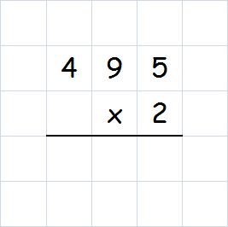
Problem Solving
9 9 0
Daniel runs the 400metes in an average time of 49.5s.
Calculate his time for 20 laps giving answer to 1 sig. fig.
49.5 x 20
www.mathsrevision.com
= 49.5 x 10 x 2
= 495 x 2
= 1000 secs (to 1 sig. fig.)

Slide 41
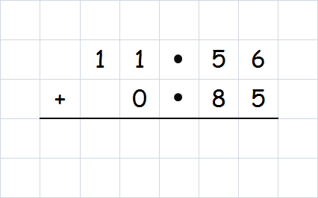
Problem Solving
Abdi won the a 100m race in a time of 11.56 secs.
Douglas was second and 0.85 secs behind him.
What was Douglas’s time for the 100m.
www.mathsrevision.com
1 2 4 1

Slide 42

Have you updated your Learning Log ?
Problem Solving
Now try
TJ N5 Lifeskills
Ex 6
Ch2 (page 23)
www.mathsrevision.com
Are you on Target ?
I can ?
Are you on Target ?
I can ?

