Slide 1


Whole Numbers
Basic Operations
Integers
www.mathsrevision.com

Slide 2
Starter Questions
www.mathsrevision.com
34º

Slide 3
Whole Numbers
Basic Operations
Learning Intention
Success Criteria
  1. We are learning the importance of layout when doing basic operations.
  Using and understanding layout for basic operations.
  2. Be able to solve context problems involving basic operations.
www.mathsrevision.com

Slide 4
Are there any errors in these sums.
Whole Numbers
Basic Operations
There are many reasons why pupils do not get
the correct answer to addition and subtraction sums.
23
23
23 + 9
+9
9
www.mathsrevision.com
54
8
54 - 8
-8
-54

Slide 5
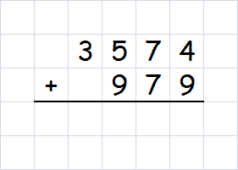
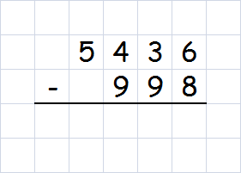
Remember !
1 number 1 box
Whole Numbers
Basic Operations
Find the answers to
www.mathsrevision.com
4 5 5 3
4 4 3 8

Slide 6
Are there any errors in these sums.
Whole Numbers
Basic Operations
There are many reasons why pupils do not get
the correct answer to division sums.
586 ÷ 9
www.mathsrevision.com

Slide 7
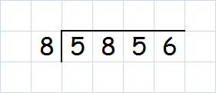
Remember !
1 number 1 box
Whole Numbers
Basic Operations
Use the following layout for dividing by a single digit.
Example :
7 3 2
www.mathsrevision.com

Slide 8
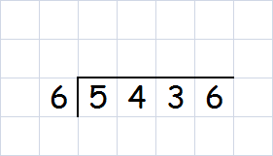
Whole Numbers
Basic Operations
Example : A carton can hold 6 eggs.
How many cartons are needed
for 5436 eggs.
www.mathsrevision.com
9 0 6

Slide 9
Are there any errors in these sums.
Whole Numbers
Basic Operations
There are many reasons why pupils do not get
the correct answer to multiplication sums.
23
23
23 x 9
x 9
9
www.mathsrevision.com

Slide 10
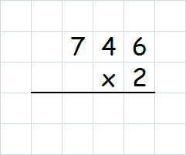
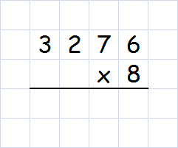
Remember !
1 number 1 box
Whole Numbers
Basic Operations
To be able to multiply by a single digit you need to
know your tables.
Examples
www.mathsrevision.com
1 4 9 2
2 6 2 0 8

Slide 11
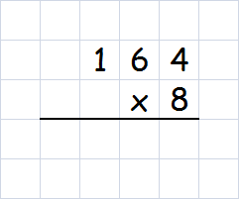
Remember !
1 number 1 box
Whole Numbers
Basic Operations
Example : A palette holds 164 tins of paint.
How many tins in 8 palettes.
www.mathsrevision.com
1 3 1 2

Slide 12
Bacteria grows at a rate of 6572 every minute.
How many would that be after 1 hour ?
6572 x 60 =
394320

Slide 13
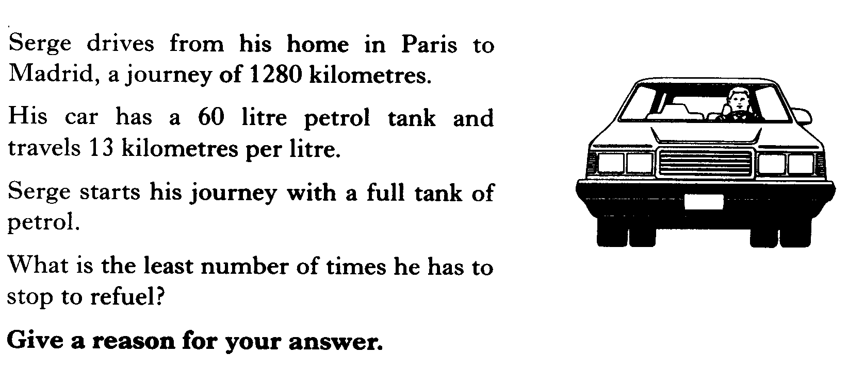
60 x 13 =
780 km
1280 ÷ 780 =
1.64
So needs to stop once

Slide 14
Mr Lafferty earns £3.5 million last year.
(a) Write this number out in full.
£ 3500000
He paid one fifth in Tax.
(b) How much did he pay in Tax.
3500000 ÷ 5 =
£ 700000
(c) How much did he have left after paying his Tax.
3500000 - 700000 =
£ 2800000

Slide 15
BODMAS
Calculations MUST BE done in a certain order.
We can use BODMAS to help us remember the order.
B -
O -
D -
M -
A -
S -
Brackets
Other
x and ÷
same priority
www.mathsrevision.com
Division
Multiplication
Addition
+ and -
same priority
Subtraction

Slide 16
BODMAS
200 – 25 x 2
9 – half of 10 + 2
= 200 – 50
= 9 – 5 + 2
= 4 + 2
= 150
www.mathsrevision.com
= 6

Slide 17
BODMAS
80 ÷ (8 – 3)
4 x ( 48 + 12) + 10
= 80 ÷ 5
= 4 x 60 + 10
= 16
= 240 + 10
www.mathsrevision.com
= 250

Slide 18
BODMAS
8² – 3²
(8 - 3) ²
= 64 - 9
= 5²
= 55
= 25
www.mathsrevision.com

Slide 19

Basic Operations
Now try
N5 Lifeskills
Ex 1
Ch1 (page 11)
www.mathsrevision.com
Are you on Target ?
I can ?
Mind Map

Slide 20
Starter Questions
www.mathsrevision.com

Slide 21
Integers
Learning Intention
Success Criteria
  1 We are learning how to use integers in context.
Understand how integers are used in real-life.
www.mathsrevision.com

Slide 22
Integers
Definition : An INTEGER is a negative or positive
whole number, including 0.
e.g. -2, -1, 0, 5, 100
Note : -2.5, -1.2, 23.5
Are NOT INTEGERS
www.mathsrevision.com
Write down 3 places where Integers are used
Bank
Sea-Level
Height
Weather

Slide 23
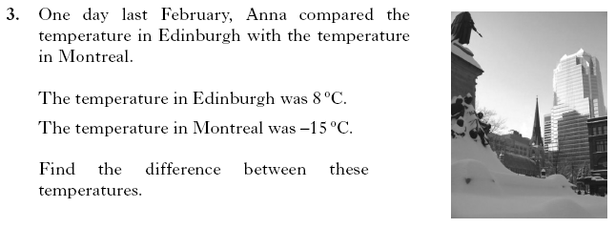
23 ºC

Slide 24
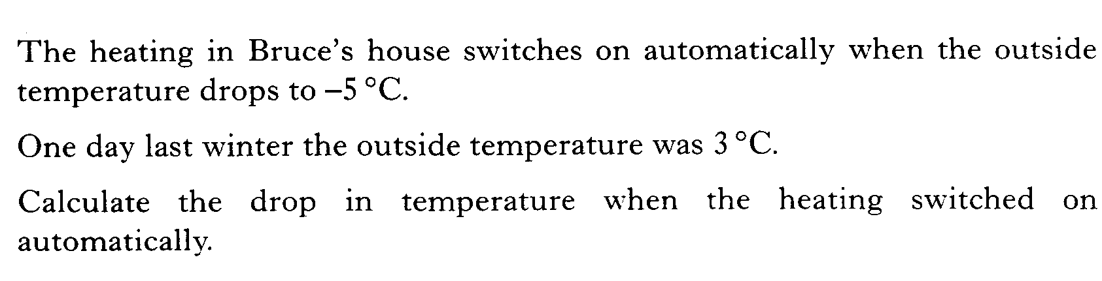
8 ºC

Slide 25
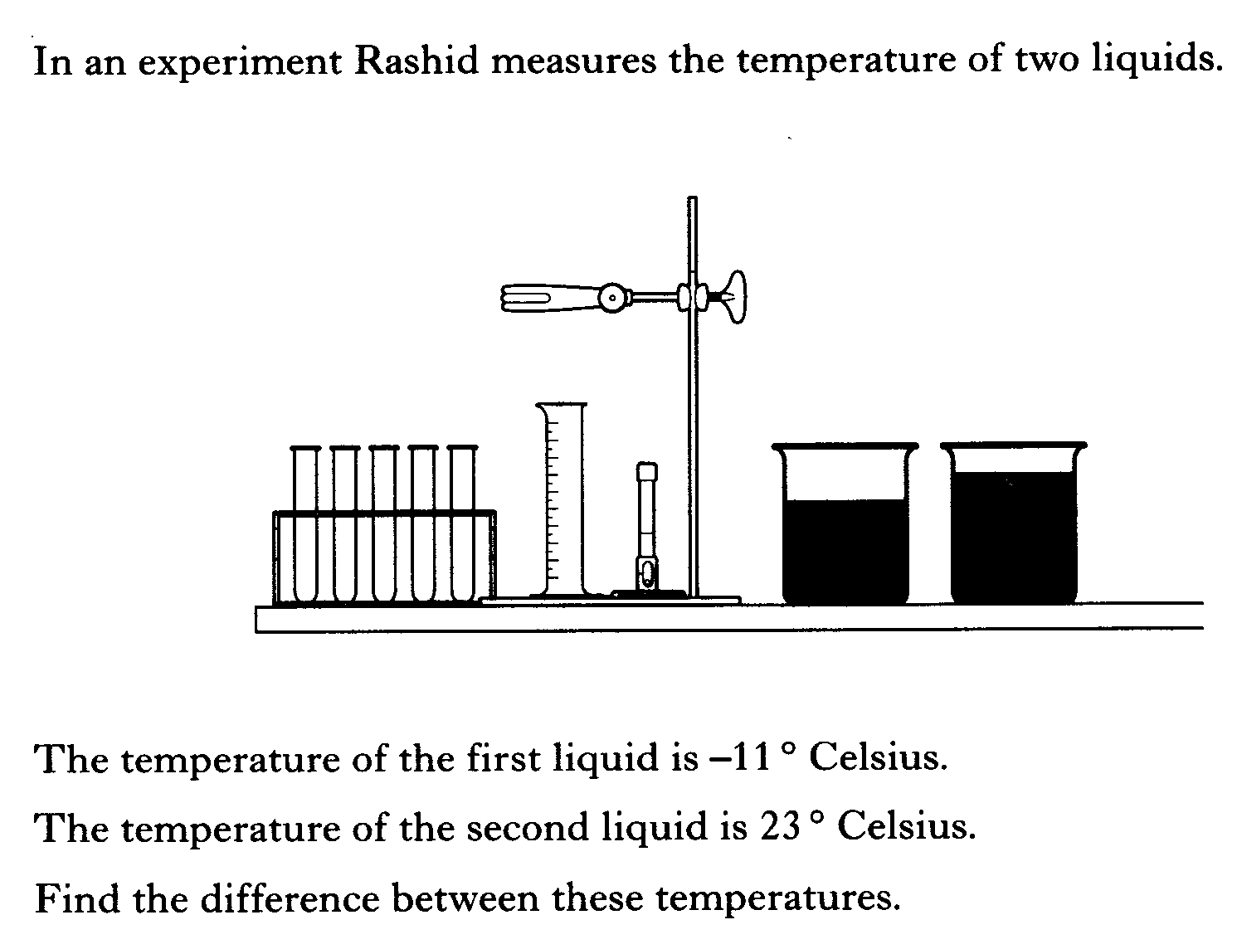
34 ºC

Slide 26
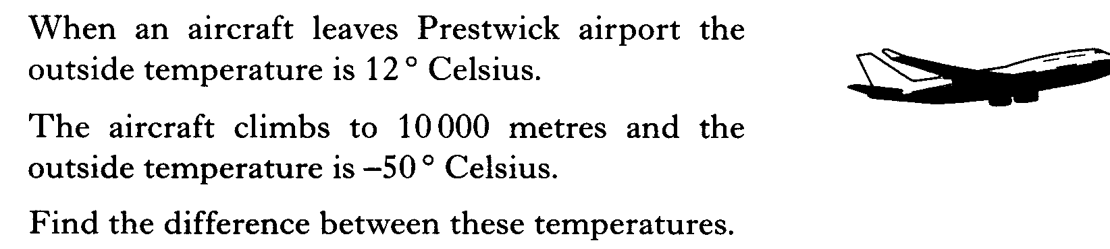
62 ºC

Slide 27
Negative
Numbers
24
22
20
18
16
14
12
(a) 4ºC up from 12 º C
10
8
12 + 4 = 16
6
4
UP +
(b) 8ºC down from 10 º C
2
0
10 - 8 = 2
-2
-4
(c) 3ºC up from -2 º C
-6
www.mathsrevision.com
-8
Down -
-2 + 3 = 1
-10
-12
(d) 6ºC down from 2 º C
-14
-16
2 - 6 = -4
-18
-20
-22
-24

Slide 28
Rule
Adding a negative is
the same as subtracting
“+ -” = -
Negative
Numbers
24
22
20
18
16
14
12
(a) 12 + 4 =
16
10
8
6
Go up 4
4
UP +
Start at 12
2
0
-2
(b) 10 + (-8) =
2
-4
-6
www.mathsrevision.com
-8
Down -
Start at 10
Go down 8
-10
-12
-14
(c) 7 - 10 =
-3
-16
-18
-20
-22
Start at 7
Go down 10
-24

Slide 29
Integers
Examples
(1) 3 - 7
= -4
(2) 4 + (-9)
= -5
(3) -7 - 8
= -15
www.mathsrevision.com
(4) -2 + (-12)
= -14
Remember Rule !
(5) -5 - 25
= -30
(6) (-8) + (-9)
= -17

Slide 30

Have you updated your Learning Log ?
Integers
Now try
N5 Lifeskills
Ex 2
Ch1 (page 13)
www.mathsrevision.com
Are you on Target ?
I can ?

