Slide 1


Statistics
Scatter Graphs
Line of Best Fit
www.mathsrevision.com

Slide 2
Starter Questions
In pairs write down the type of questions on
Wages & Salaries
that could be asked in the exam.
www.mathsrevision.com

Slide 3
Scattergraphs
Construction of Scattergraphs
Learning Intention
Success Criteria
Be able to construct and understand the Key-Points of a scattergraph.
  We are learning to display data in the form of a scattergraph .
www.mathsrevision.com
2. Know the term positive and negative correlation.

Slide 4
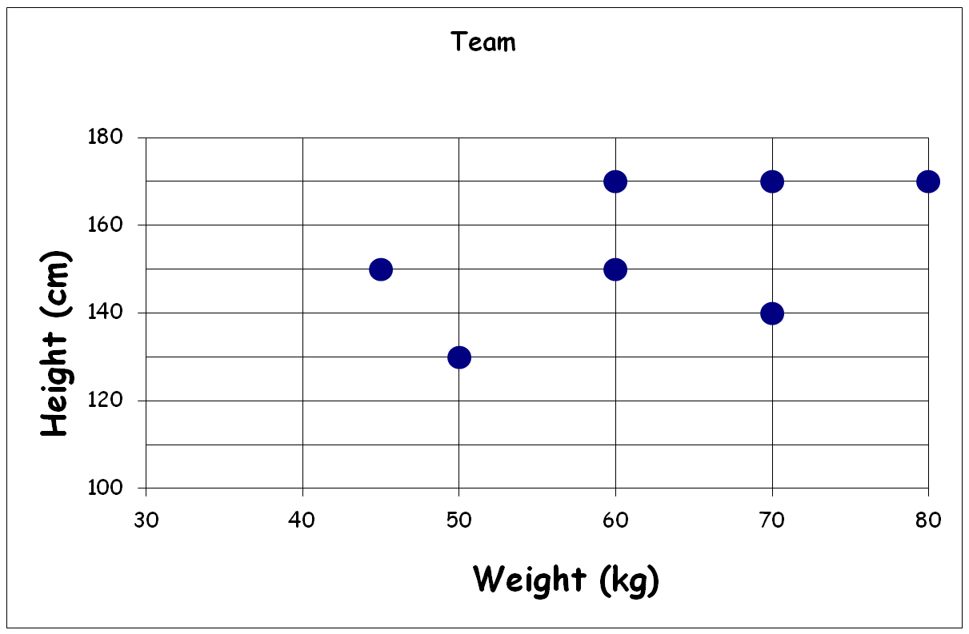
This scattergraph shows the heights and weights of a sevens football team
Scattergraphs
Write down height and weight of each player.
Bob
Tim
Joe
Sam
Gary
www.mathsrevision.com
Dave
Jim

Slide 5
Scattergraphs
When two quantities are strongly connected we say there is a
strong correlation between them.
Best fit line
x
x
x
x
x
x
x
x
x
x
x
x
www.mathsrevision.com
Best fit line
Strong positive
correlation
Strong negative
correlation

Slide 6
The table shows how long the heating is
on based on the outside temperature.
Heating (Hrs) | Temp ºC
0 | 19
1 | 16
3 | 16
3 | 12
5 | 13
5 | 10
6 | 6
8 | 6
10 | 1
20
18
16
14
12
Temperature ºC
10
8
6
4
2
0
1
2
3
4
5
6
7
8
9
10
No. Of Hours
Heating on
(a) Construct a scattergraph.
≈12ºC
(b) Estimate the outside temperature for 4 hours.
≈7 hrs
(c) Estimate the no. of hours for outside temperature of 8 ºC.

Slide 7

Scattergraphs
Now Try
TJ N5 Lifeskills
Ex 25.1
Ch25 (page 246)
www.mathsrevision.com

Slide 8
Starter Questions
N5 LS
The points ( 5, 7) and (7, 21) lie on the same line.
Find the gradient.
www.mathsrevision.com

Slide 9
Best Fit Line
N5 LS
Learning Intention
Success Criteria
We are how to fit a line of best fir to a set of data.
  Understand why we use the line of best fit.
www.mathsrevision.com
  Be able to fit a line of best fit to a set of data.

Slide 10
Data was collected on pupils weight and height. Data is plotted below.
(a) Is there a correlation between height and weight.
Yes, a positive correlation
h
(b) Draw a line of best fit for the data.
200
180
160
140
120
Height (cms)
100
80
60
40
20
w
0
10
20
30
40
50
60
70
80
90
100
Weight (Kgs)
(c) Estimate the height of a pupils who weights 40 kgs ?
≈ 100cms
(d) Estimate the weight of pupil with height 150cms.
≈ 60kgs

Slide 11
A survey was carried out on the value of cars depending on their age
The data is plotted below.
(a) Is there a correlation between value and age.
Yes, a negative correlation
v
20
(b) Draw a line of best fit for the data.
18
16
14
12
10
value £ ‘ 000
8
6
4
2
0
1
2
3
4
5
6
7
8
9
10
Years
(c) Estimate the cost of a car after 4 years ?
≈ £13 000
(d) Estimate the age of a car valued at £7000.
≈ 9 years

Slide 12

Have you updated your Learning Log ?
Line of Best Fit
Scattergraphs
Now Try
TJ N5 Lifeskills
Ex 25.2
Ch25 (page 248)
www.mathsrevision.com

