Slide 1


Scales & Drawing
Enlarge & Reduce Shapes
Scale Drawing to find Length
Making Basic Scale Drawings
www.mathsrevision.com
Scale Drawings using Protractor
Scale Drawings with Bearings

Slide 2
Starter Questions
www.mathsrevision.com

Slide 3
Scaled Drawings
Learning Intention
Success Criteria
1. Using the scale to draw accurately a basic scale drawing.
  1. We are learning to draw a basic scale drawing given suitable information.
www.mathsrevision.com

Slide 4
Scaled Drawings
Problem
A garden is rectangular in shape and
has length 12m and breadth 8m.
Make rough sketch of the garden.
12m
Draw an accurate
scaled drawing of the garden
Use a scale of
1cm represents 2m
www.mathsrevision.com
8m

Slide 5
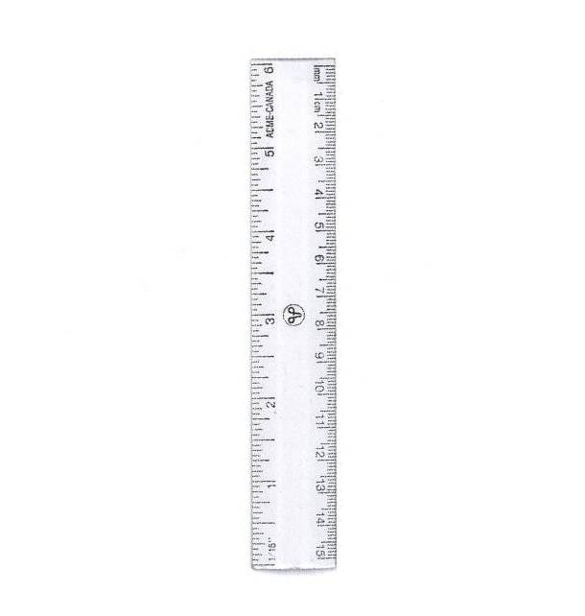
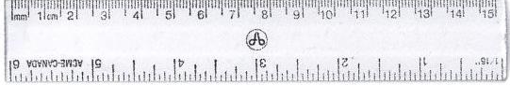
Scaled Drawings
Use a scale of
1cm represents 2m
1cm represents 2m
12m
8m
12m
www.mathsrevision.com
8m

Slide 6
Scaled Drawings
Problem
A road junction is triangular in shape.
A rough sketch is given below.
Draw an accurate
scaled drawing of the junction
Use a scale of
1cm represents 2m
www.mathsrevision.com
20m
12m

Slide 7
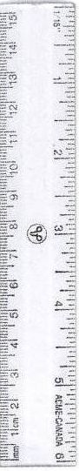
Scaled Drawings
Use a scale of
1cm represents 2m
1cm represents 2m
Find the real life length of the 3rd side
20m
20m
www.mathsrevision.com
12m
2 x 11.6 =
23.2m
12m

Slide 8
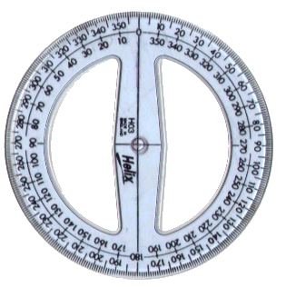
Drawing Bearings
Draw a bearing of 050º.
N
050º
www.mathsrevision.com

Slide 9
Drawing Bearings
Draw a bearing of 285º.
N
www.mathsrevision.com
285º

Slide 10

Scale Drawings
N5 LS
Now Try
TJ N5 Lifeskills
Revision Ex
Ch13 (page 125)
www.mathsrevision.com

Slide 11
Starter Questions
www.mathsrevision.com

Slide 12
Scales & Drawing
Learning Intention
Success Criteria
1. Interpret information in a problem to create a suitable scale drawing.
  1. We are learning to solve real-life problems using scale drawings.
www.mathsrevision.com
2. Apply a scale drawing methods to solve a given problem.

Slide 13
Scales & Drawing
Problem
The sketch shows a flag-pole YT supported by
a wire. The distance from X to Y is 6m and
angle TXY = 55º.
T
www.mathsrevision.com
Make a scale drawing and work
Out the real height of the pole.
Use a scale of 1cm = 2m
X
55º
Y
6m

Slide 14
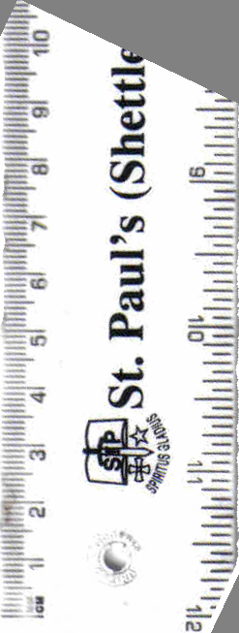
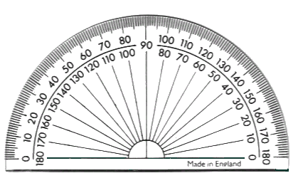
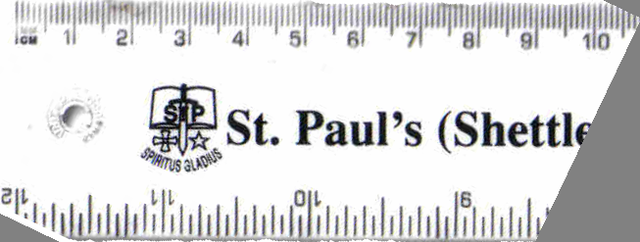
T
Scale Drawings
X
55º
Y
6m
Solution
Using a scale of 1cm = 2m
T
Step 1: Draw line XY=3cm
Step 2: Draw a line straight up from Y.
Step 3: Measure angle 55º from X.
Step 4: Draw line from X to vertical line
and mark T at crossover point.
www.mathsrevision.com
Step 5: Measure length YT.
4.3cm
Step 6: Multiply length YT.
by scale factor.
X
Y

Slide 15
Scales & Drawing
Are we expecting more or less
Make bigger fraction
Drawing Real-Life
1 → 2
www.mathsrevision.com
4.3 →
4-Jul-26

Slide 16
Scale Drawings
N5 LS
Now Try
TJ N5 Lifeskills
Ex 1
Ch13 (page 126)
www.mathsrevision.com

Slide 17
Starter Questions
www.mathsrevision.com

Slide 18
Scales & Drawing
Bearings
Learning Intention
Success Criteria
1. Remember the steps on how to work out a bearing.
  We are learning how to calculate a bearing and apply it to problems.
2. Apply knowledge to problems.
St. Andrew’s Secondary

Slide 19
Bearings
360/000º
N
1. Measured from North.
060º
2. In a clockwise direction.
60º
270º
W
E
090º
3. Written as 3 figures.
S
180º
N
N
N
315º
W
145º
E
W
E
W
E
230º
315º
145º
230º
S
S
S

Slide 20
Bearings
360/000º
350º
N
020º
315º
045º
NW
NE
290º
080º
270º
W
E
090º
250º
110º
SW
SE
225º
210º
135º
S
160º
180º

Slide 21
Scaled Drawings using Bearings
At the beginning of an orienteering competition two runners set off in different directions.
Runner 1 runs NE for 350m.
Runner 2 runs on a bearing of 150º for 200m.
By making an accurate scale drawing,
how far apart are the two runners.
N
www.mathsrevision.com
R₁
045º
350m
150º
200m
R₂

Slide 22
Scaled Drawings using Bearings
Make an accurate drawing of the plane journey
1cm represents 50m
N
R₁
7cm
045º
www.mathsrevision.com
S
150º
9cm
4cm
R₂

Slide 23
Scales & Drawing
Are we expecting more or less
Make bigger fraction
Drawing Real-Life
1 → 50
www.mathsrevision.com
9 →
4-Jul-26

Slide 24

Have you updated your Learning book ?
Scale Drawings
Now Try
TJ N5 Lifeskills
Ex 2
Ch13 (page 129)
www.mathsrevision.com

