Slide 1


Formulae
N5 LS
Formulae expressed in words
Evaluating Formulae
www.mathsrevision.com
Exam Type Questions

Slide 2
Starter Questions
N5 LS
5 cm
3 cm
3 cm
2.5 cm
4 cm
www.mathsrevision.com

Slide 3
Formulae
N5 LS
Learning Intention
Success Criteria
  We are learning how to work with formulae expressed in words.
  Understand formulae expressed in words.
  2. Solve problems given formulae in words.
www.mathsrevision.com

Slide 4
Formulae
N5 LS
Sometimes formulae are expressed in words.
To find the area of a triangle do the following
“half the base value and multiply by the height”
A = ½bh
A = ½x12x7
A = 6x7
7 m
A = 42m²
12 m

Slide 5
Formulae
N5 LS
To find the area of a quarter of a circle do the following
“Multiply the radius of the circle by itself and multiply by 3.14 and then divide answer by four.”
A =¼Πr²
A = ¼x3.14x10²
10 m
A = ¼x3.14x100
A = 78.5m²

Slide 6

Formulae
N5 LS
Now Try
TJ N5 Lifeskills
Ex 1
Ch12 (page 118)

Slide 7
Starter Questions
N5 LS
1. Does 3 + 2 x 4 = 11 or 20

Slide 8
Formulae
N5 LS
Learning Intention
Success Criteria
  We are learning how to evaluate formulae
  Understand the term
  formulae.
  2. Be able to substitute values into formulae and evaluate properly using BODMAS.
www.mathsrevision.com

Slide 9
Formulaec
N5 LS
A formula is the process of calculating a quantity based on a known relationship e.g. Length, Area, Volume etc.....
It is VERY important that we remember a keypoint
when working with formulae.
B
Brackets
O
Other ⇨ squares and square root etc....
D
Divide
M
Multiplication
A
Addition
S
Subtraction

Slide 10
BODMAS
Formulae
Given the following information find the values of :-
d = 3 ; e = 4 and f = 1
ef
d + f
¾(d + f²)
√(16e)
4x1
= ¾(3 + 1²)
= √(16x4)
=
3+1
= ¾(4)
= √64
4
=
4
= 3
= 8
= 1

Slide 11
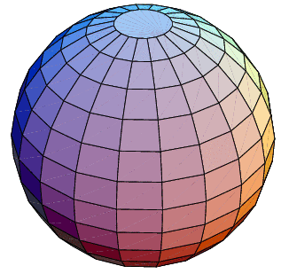
Formulae for the
Volume of a Sphere
N5 LS
D = diameter
r
D
www.mathsrevision.com
Q. If the above sphere has radius 10cm.
Calculate it’s volume.

Slide 12
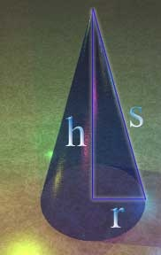
Formulae for
Volume of a Cone
N5 LS
h
r
www.mathsrevision.com
If the above cone has radius 15cm and height
of 10 cm. Calculate it’s volume.

Slide 13

Have you updated your Learning Log ?
Formulae
N5 LS
Now Try
TJ N5 Lifeskills
Ex 2&3
Ch12 (page 120)

Slide 14
3 RE

Slide 15
2 KU

Slide 16
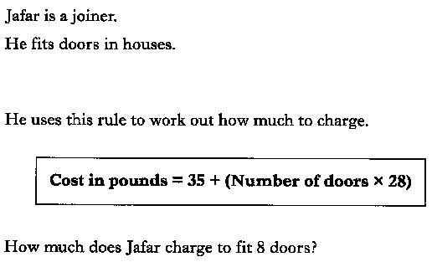

Slide 17
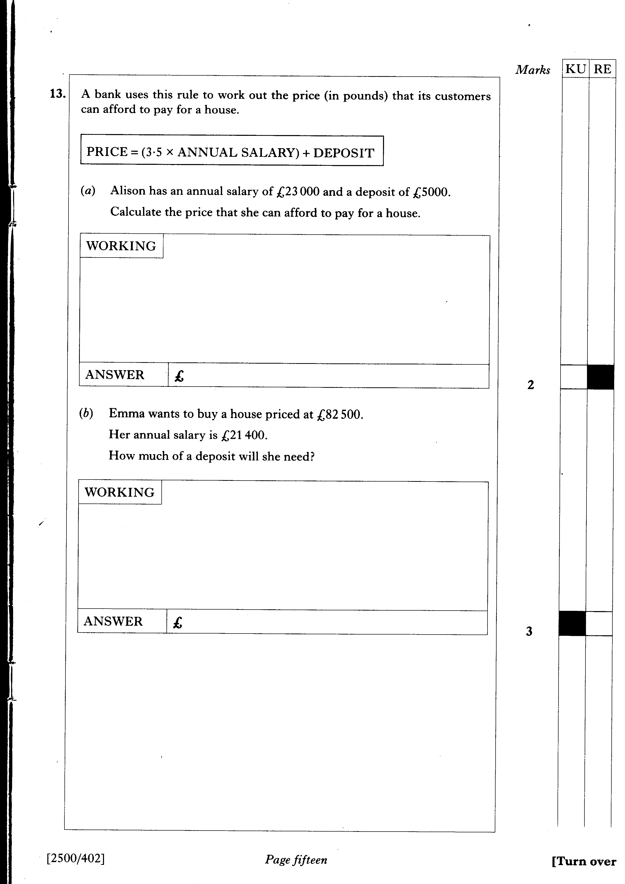

Slide 18
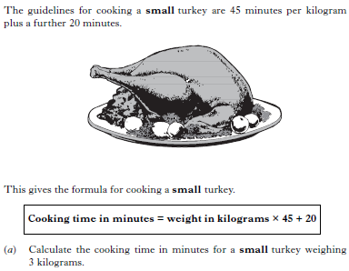
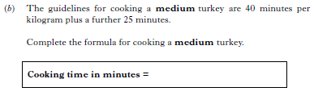

Slide 19
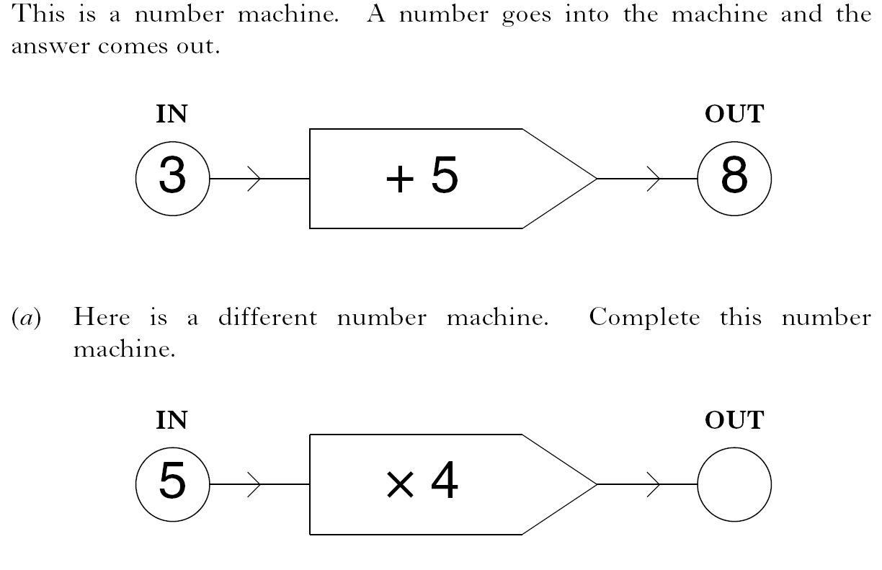
1 KU
2 RE

Slide 20
The current, C amps, of an electrical appliance is calculated using the formula:
where P watts is the power rating.
A hairdryer has a power rating of 850 watts.
The fuse used should be the one just bigger than the calculated current.
The choice of fuses is 3 amp, 5 amp and 1 3 amp.
Which fuse should be used?

