Slide 1


Pythagoras Theorem
N5 LS
Revision of simple Pythagoras Theorem
Problem Solving Pythagoras Theorem
www.mathsrevision.com
Exam Questions

Slide 2
Starter Questions
N5 LS
Calculate the following :
3² + 9² = 3² - 9² =
www.mathsrevision.com

Slide 3
Revision of Pythagoras Theorem
N5 LS
Learning Intention
Success Criteria
  We are revising Pythagoras Theorem
1. Be able to use Pythagoras Theorem to solving basic problems.
www.mathsrevision.com

Slide 4
Revision of Pythagoras Theorem
N5 LS
Two key points when dealing with
right-angled triangles
The longest side in a right-angled triangle is called
The HYPOTENUSE
The HYPOTENUSE is ALWAYS opposite the right angle
www.mathsrevision.com
c² = a² + b²
(xz)² = (xy)² + (yz)²
c
b
x
a
y
z

Slide 5
Pythagoras Theorem
N5 LS
Finding hypotenuse c
Finding
shorter side b
c
b
www.mathsrevision.com
a
Finding shorter side a

Slide 6
Solving Real-Life Problems
N5 LS
When coming across a problem involving finding a missing side in a right-angled triangle, you should consider using Pythagoras’ Theorem to calculate its length.
Example : Find the length of the longest side.
www.mathsrevision.com
15m
8m

Slide 7
Length of the smaller side
N5 LS
To find the length of the smaller side of a right- angled
triangle we simply rearrange Pythagoras Theorem.
Example : Find the length of side a ?
Check answer ! Always smaller than hypotenuse
www.mathsrevision.com
20cm
12cm
a cm

Slide 8
Length of the smaller side
N5 LS
Example : Find the length of side b ?
10cm
b cm
Check answer ! Always smaller than hypotenuse
www.mathsrevision.com
8 cm

Slide 9

Pythagoras Theorem
N5 LS
Now Try
TJ N5 Lifeskills
Revision Ex
Ch15 (page 143)
www.mathsrevision.com

Slide 10
Starter Questions
N5 LS
Calculate the perimeter and area of the triangle.
18m
18m
20m
www.mathsrevision.com
18m

Slide 11
Revision of Pythagoras Theorem
N5 LS
Learning Intention
Success Criteria
  We are problem solving using Pythagoras Theorem
1. Be able to use Pythagoras Theorem to calculate both perimeter and are.
www.mathsrevision.com

Slide 12
Revision of Pythagoras Theorem
N5 LS
Problem : Find the perimeter this shape.
Find length BD first
B
h
C
15
www.mathsrevision.com
12
A
D
13

Slide 13
Perimeter
= 15 + 23.2 + 12 +13
= 63.2
Revision of Pythagoras Theorem
N5 LS
Problem : Find the perimeter out this shape
Now find h
B
h
C
15
19.85
www.mathsrevision.com
12
A
D
13

Slide 14
Questions involving Perimeter
Area
N
G
H
O
C
D
E
F
A
M
P
L
K
C
A
I
J
B
B
Q
R
T
S
A
D
C

Slide 15
Perimeter
= 5 + 8.94 + 11
= 24.94 cm
Calculate the perimeter of this triangle.
B
4cm
A
D
8cm
C
3cm
(AB)² = (AD)² ⁺ (DB)²
(BC)² = (CD)² ⁺ (DB)²
(AB)² = (3)² ⁺ (4)²
(BC)² = (8)² ⁺ (4)²
(AB)² = 25
(BC)² = 80
AB = √25
BC = √80
8.94 cm
AB = 5 cm
AB = 8.94 cm
5 cm

Slide 16
Mr Lafferty has to replace the grass on his lawn.
It costs £4.99 for 2m² of grass.
Calculate the total cost.
12m
Q
R
h² = (SR)² – (½QR)²
h² = (10)² – (6)²
h
10m
10m
h² = 64
h = √64
S
h = 8m
8m

Slide 17
Mr Lafferty has to replace the grass on his lawn.
It costs £4.99 for 2m² of grass.
Calculate the total cost.
Cost
12m
Q
R
A = ½bh
48
A = ½x(12)x8
X 4.99
8m
2
h
10m
10m
A = 48m²
= £ 119.76
S

Slide 18
Mr Young is going to put a fencing all the way around
his garden . It costs £7.50 per metre of fence.
Calculate the total cost.
9m
P
3m
K
L
(IL)² = (LP)² + (PL)²
4m
4m
(IL)² = (4)² + (3)²
I
J
6m
(IL)² = 25
IL = √25
IL = 5m
5m

Slide 19
Mr Young is going to put a fencing all the way around
his garden . It costs £7.50 per metre of fence.
Calculate the total cost.
9m
Cost
L
P
3m
K
P = 9 + 5 + 6 + 4
= 24
4m
4m
5m
I
J
6m
24 x 7.50 = £ 180

Slide 20
Two towns D and E are 0.7km apart.
A bypass is is built round each.
Calculate the length of the bypass CGHF.
G
H
0.6 km
C
0.5 km
D
E
F
0.8 km
(CG)² = (CD)² + (DG)²
(HF)² = (EF)² + (EH)²
Total Distance
(CG)² = (0.5)² + (0.6)²
(HF)² = (0.8)² + (0.6)²
D = 0.78 + 1 + 0.7
(CG)² = 0.61
(HF)² = 1
D = 2.48 km
CG = √0.61
HF = √1
CG = 0.78km
0.78km
HF = 1km
1km

Slide 21
Pythagoras Theorem
N5 LS
Now Try
TJ N5 Lifeskills
Ex 15.1
Ch15 (page 144)
www.mathsrevision.com

Slide 22
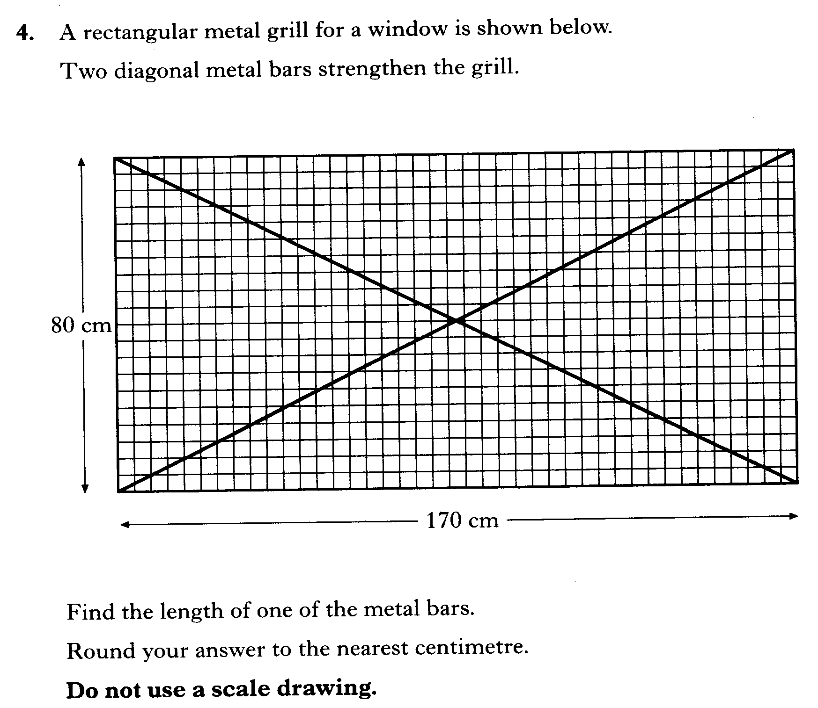

Slide 23
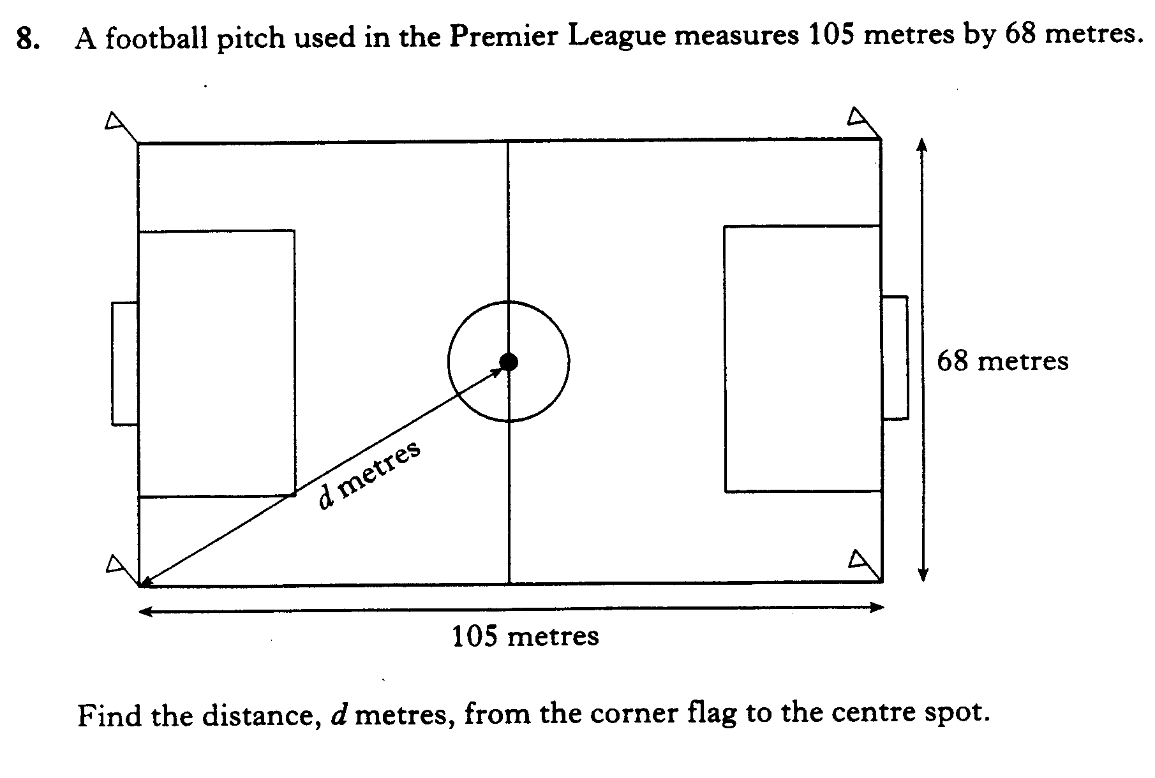

Slide 24
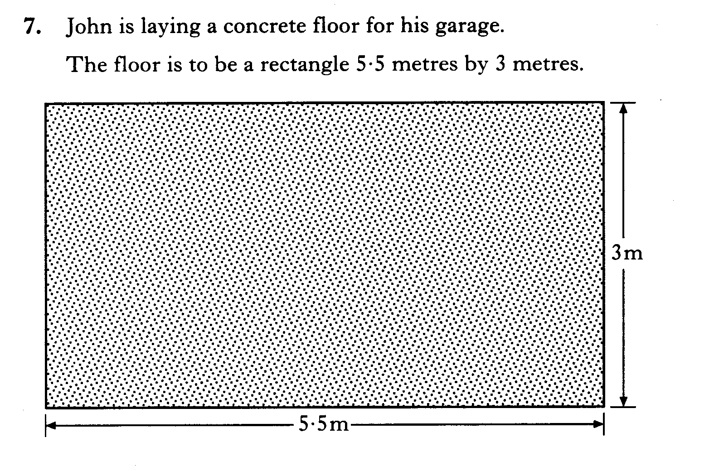
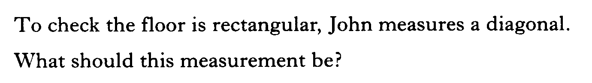

Slide 25
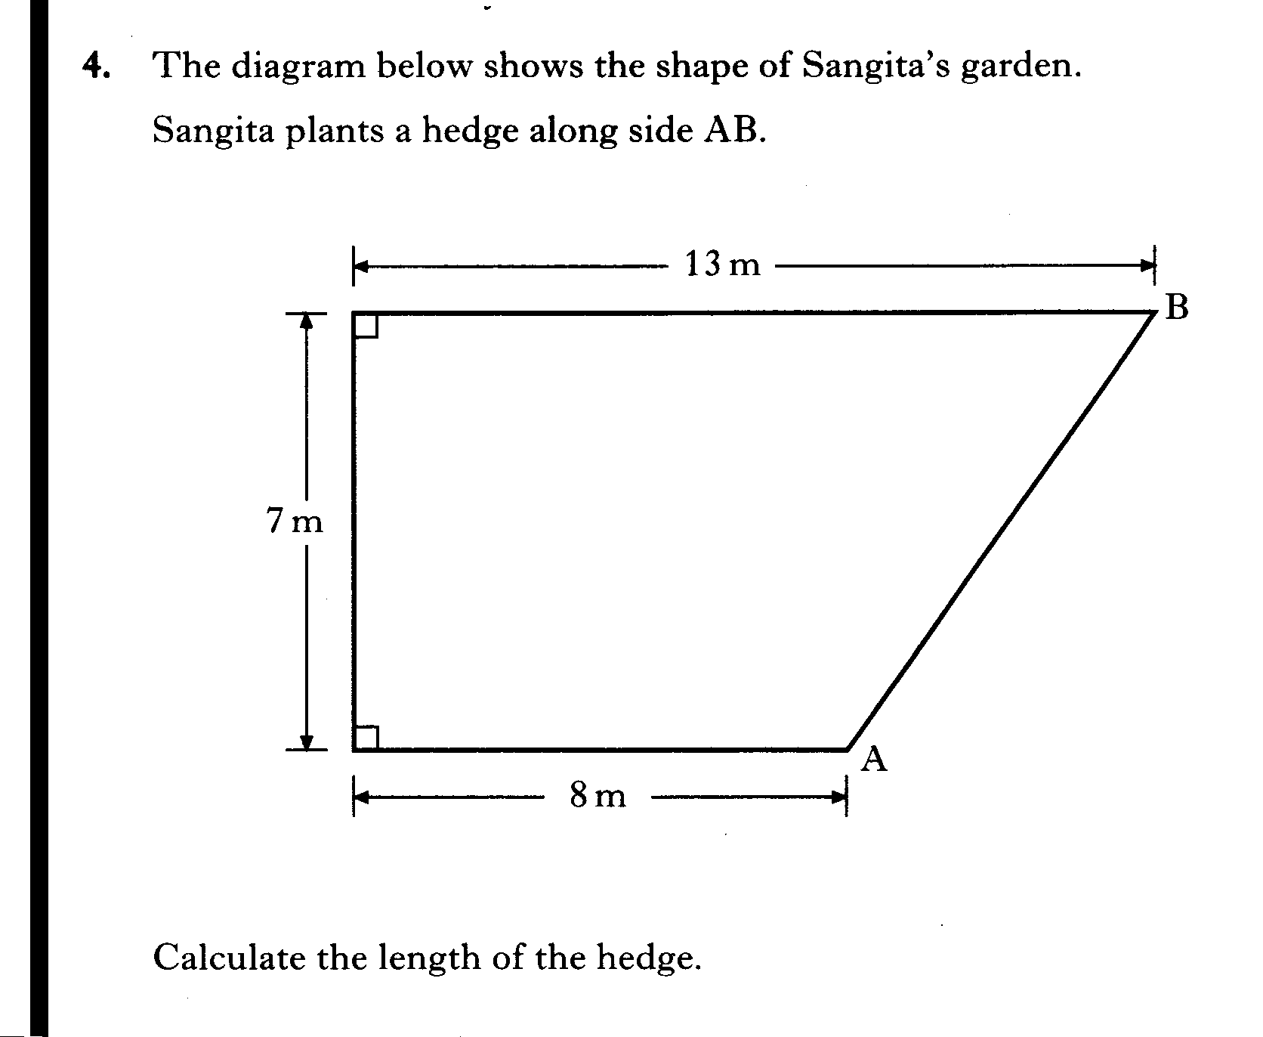

Slide 26
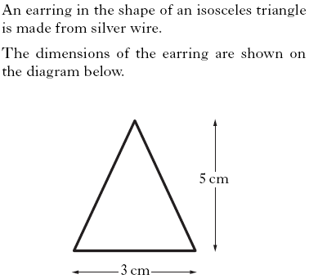
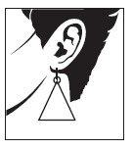


Slide 27
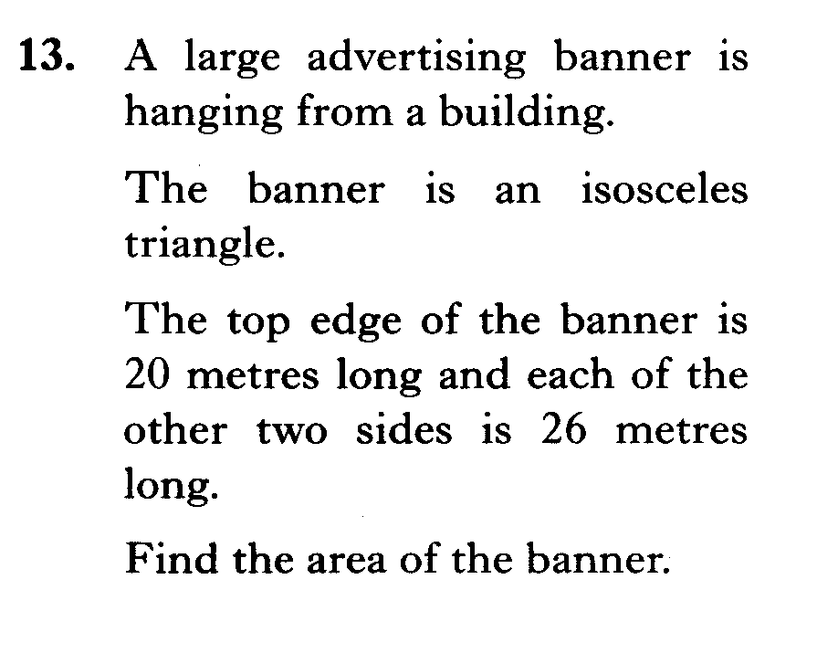
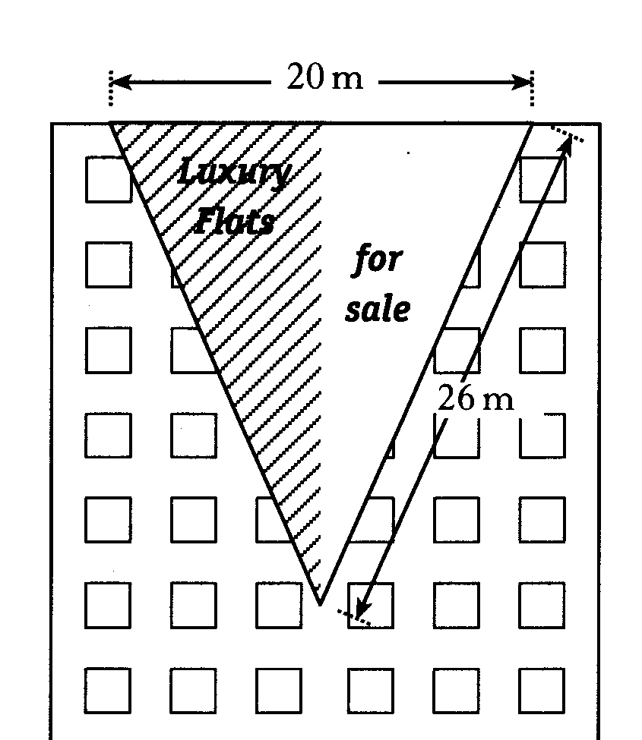

Slide 28
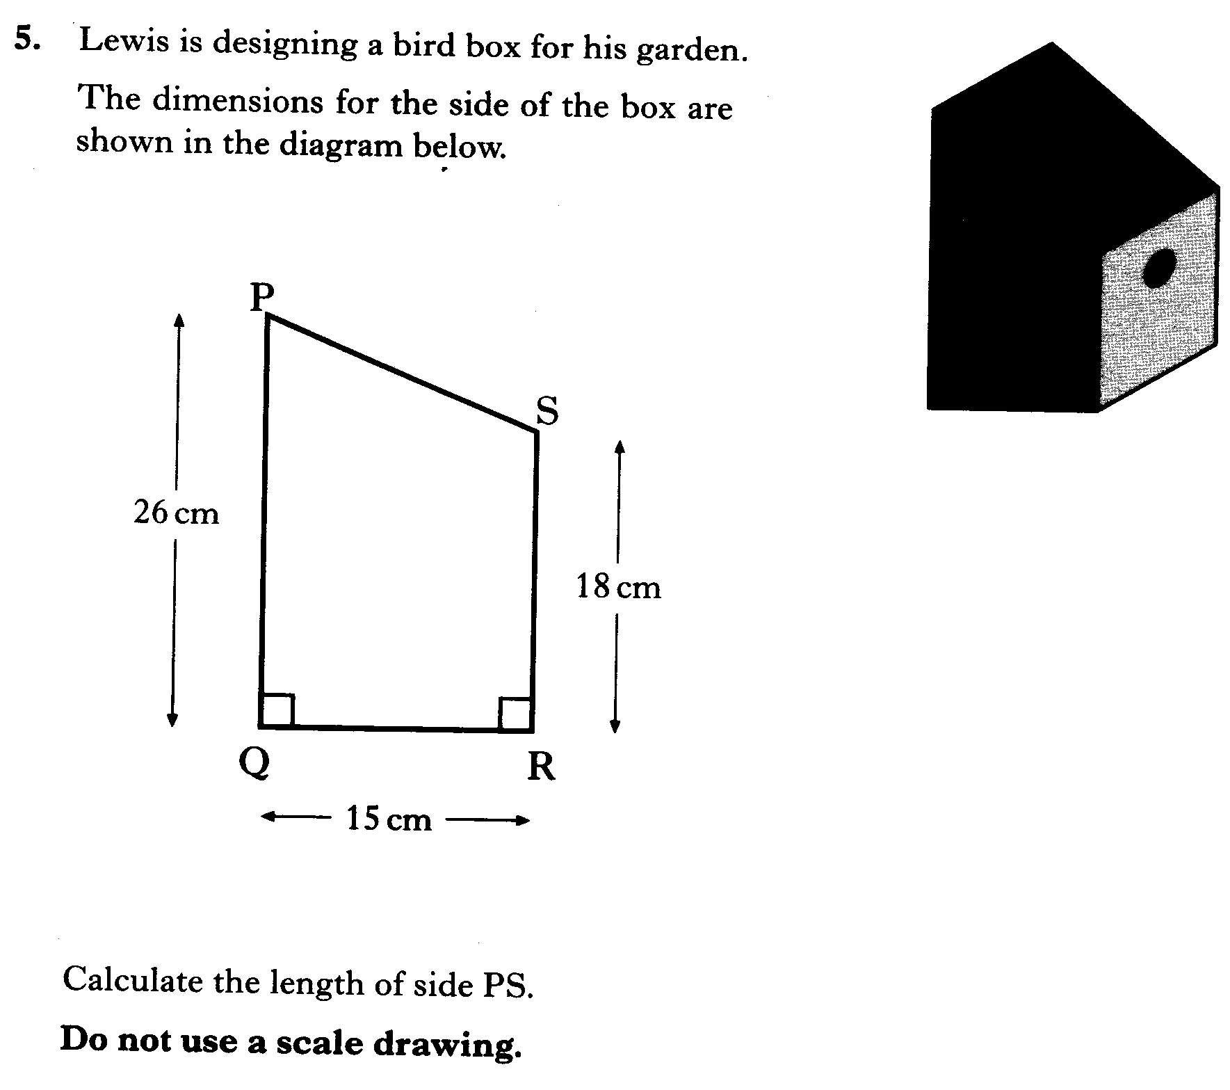

Slide 29
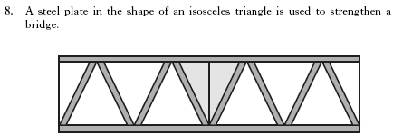
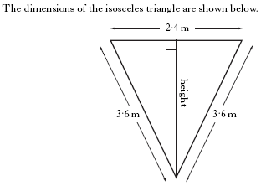


Slide 30
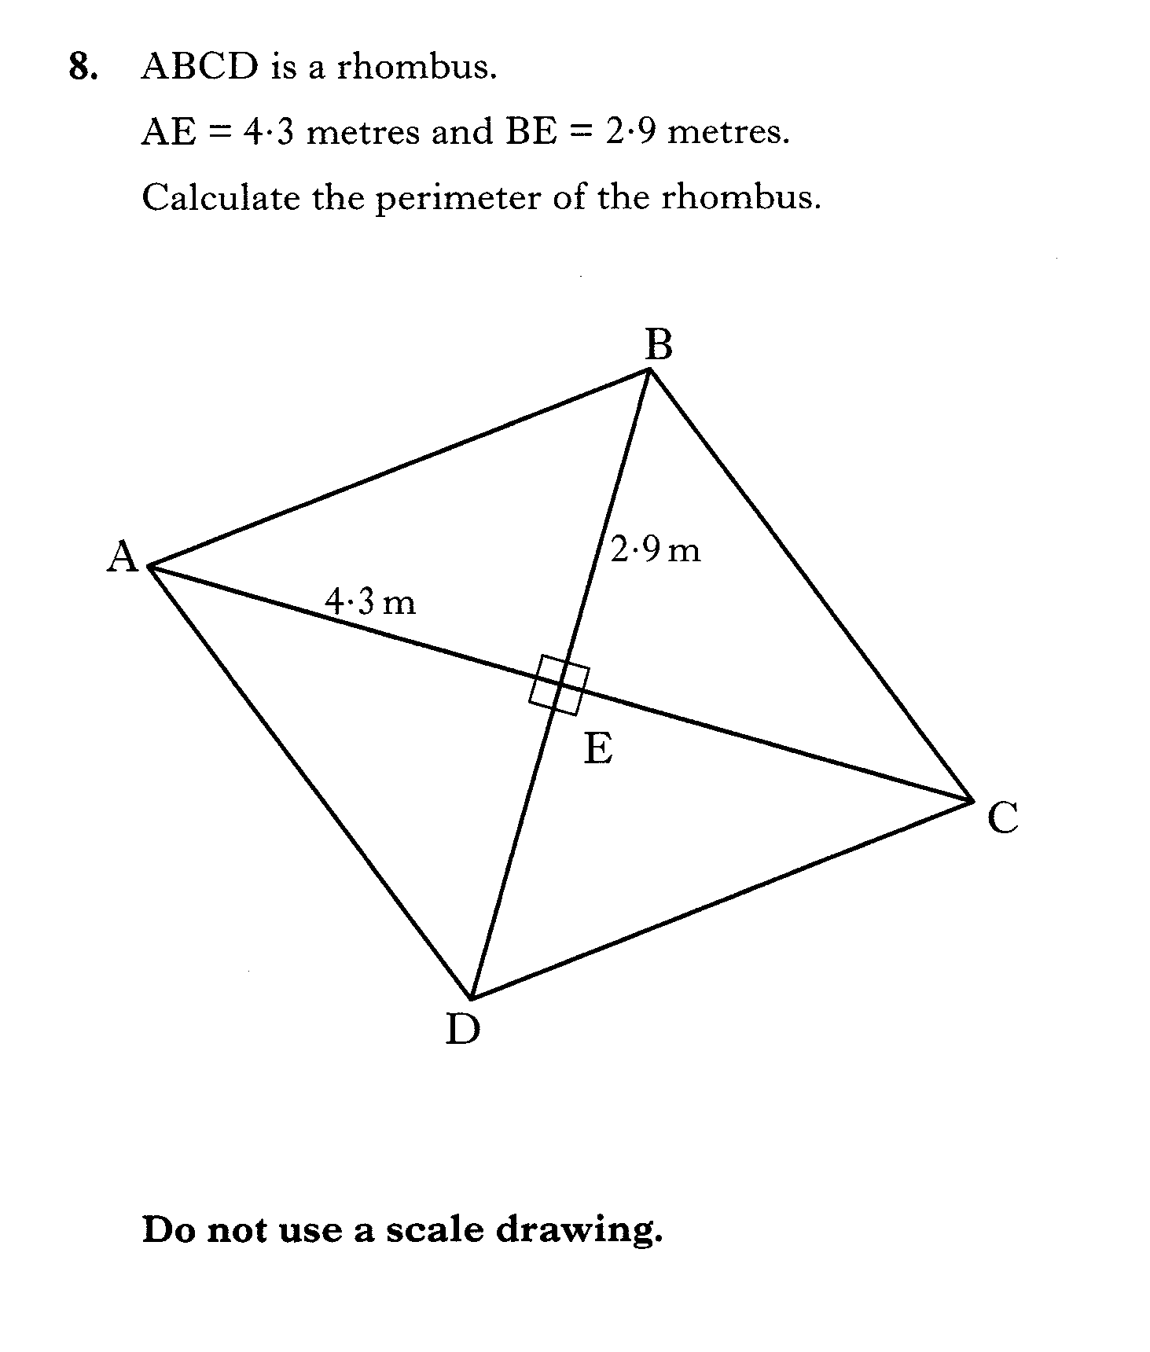

Slide 31

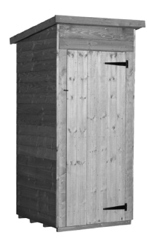
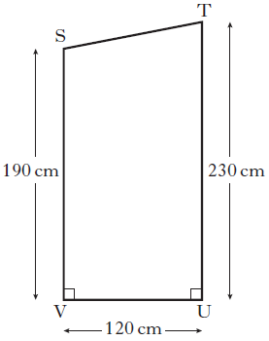
4 marks

