Slide 1


Money
VAT
Hire Purchase
Building & Life Insurance
Profit & Loss
Foreign Exchange
www.mathsrevision.com
Simple Interest
Compound Interest
Borrowing Money
Exam Type Questions
Notes:
<number>

Slide 2
Starter Questions
Two numbers add to give 12 and divide to give 3. Find the two numbers.
2. Two numbers subtract to give 5 and
multiply to 24. Find the two numbers.
3. Make your own question up.
www.mathsrevision.com
4 Jul 2026
Created by Mr. Lafferty Maths Dept.

Slide 3
VAT
Learning Intention
Success Criteria
  We are learning about VAT.
  To understand the term VAT.
Solve problems involving VAT.
www.mathsrevision.com
Saturday, July 4, 2026
created by Mr. lafferty @ www.mathsrevision.com
<number>

Slide 4
VAT – 20%
The term VAT means Value Added Tax.
Bills
White Goods
www.mathsrevision.com
Petrol

Slide 5
VAT
Are we expecting more or less
The Adams family paid £90 for a family meal before tax.
What was the actual cost of the meal.
Method
% £
100 ⇨ 90
120
www.mathsrevision.com
$\frac{\text{120}}{\text{100}}×\text{90}=£\text{108}$
Saturday, July 4, 2026
created by Mr. lafferty @ www.mathsrevision.com
<number>

Slide 6
VAT – 20%
Are we expecting more or less
Example
The value of a car is £2550 + VAT.
What was total cost of the car.
Method
% £
100 ⇨ 2550
120
www.mathsrevision.com
$\frac{\text{120}}{\text{100}}×\text{2550}=£\text{3060}$
Saturday, July 4, 2026
created by Mr. lafferty @ www.mathsrevision.com
<number>

Slide 7

VAT
N5 LS
Now Try
TJ N5 Lifeskills
Ex 21.1
Ch21 (page 202)
www.mathsrevision.com

Slide 8
Starter Questions
N5 LS
Q1. Expand out 2j (k – 5g + 4jk)
Q2. Find all the missing angles
25º
Q3.
www.mathsrevision.com
Q4.
4 Jul 2026
Created by Mr. Lafferty Maths Dept.

Slide 9
Hire Purchase
Learning Intention
Success Criteria
  We are learning the
  the meaning of the term Hire Purchase.
  To know the meaning of the term HIRE PURCHASE.
www.mathsrevision.com
Apply the process of working out the Hire Purchase for everyday products.
4 Jul 2026
Created by Mr. Lafferty Maths Dept.

Slide 10
Hire Purchase
Hire Purchase : When you pay for goods by
putting down a deposit and then
paying the rest up in small fixed
payments over a period of time.
www.mathsrevision.com
Normally you pay more for the goods using this method.
4 Jul 2026
Created by Mr. Lafferty Maths Dept.

Slide 11
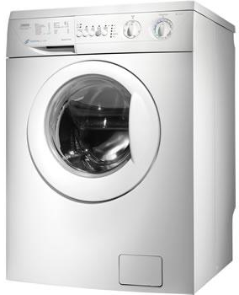
Hire Purchase
Buying Products
Washing Machine Cash Price £365.50
or
by H.P. £75 deposit + 12 Payment £28.80
www.mathsrevision.com
How much more do you pay by using Hire Purchase
Total H.P. price =
£75
+ 12 x £28.80 = £420.60
Difference in price =
£420.60 - £365.50 = £55.10
4 Jul 2026
Created by Mr. Lafferty Maths Dept.

Slide 12

Deposit
10% of £120
120 ÷ 10
= £12
Hire Purchase
Buying Products
Hoover Cash Price £120
or
by H.P. 10% deposit + 12 Payment £11
www.mathsrevision.com
How much more do you pay by using Hire Purchase
Total H.P. price =
£12
+ 12 x £11 = £144
Difference in price =
£144 - £120 = £24
4 Jul 2026
Created by Mr. Lafferty Maths Dept.

Slide 13
Hire Purchase
N5 LS
Now Try
TJ N5 Lifeskills
Ex 21.2
Ch21 (page 204)
www.mathsrevision.com

Slide 14
Starter Questions
www.mathsrevision.com
4 Jul 2026
Created by Mr. Lafferty
Maths Dept

Slide 15
Building & Life Insurance
Learning Intention
Success Criteria
  To calculate Building & Life Insurance from a table of values taking account various factors.
  1. Read information from a chart.
  2. Calculate Building & Life Insurance taking in various factors.
www.mathsrevision.com
4 Jul 2026
Created by Mr.Lafferty Maths Dept

Slide 16
Roof, walls, floor etc...
Building & Life Insurance
TV, DVD, Washing Machine
You NEED to buy building insurance in case anything
goes wrong with your house.
Jewellery,
very expensive gifts.
It is a good idea to buy content insurance in case your
house gets broken into or items breakdown.
www.mathsrevision.com
It is a good idea to valuables insurance in case your
house gets broken into.
4 Jul 2026
Created by Mr. Lafferty
Maths Dept

Slide 17
Building & Life Insurance
Items | Charge
Building per £1000 | £0.73
Contents per £1000 | £3.57
Valuables per £100 | £4.75
www.mathsrevision.com
* Building & Contents 10% discount for each year no claims
** Maximum discount 30%
4 Jul 2026
Created by Mr.Lafferty Maths Dept

Slide 18
Are we expecting more or less
Building & Life Insurance
Example : How much is the House Insurance for a
house valued at £40 000.
Value Premium
1000 ⇨ 0.73
40000
www.mathsrevision.com
4 Jul 2026
Created by Mr. Lafferty
Maths Dept

Slide 19
Are we expecting more or less
Building & Life Insurance
Example : I decided to increase my insurance from
£40 000 to £50 000 cover.
How much more did it have to pay.
Value Premium
1000 ⇨ 0.73
10000
www.mathsrevision.com
4 Jul 2026
Created by Mr. Lafferty
Maths Dept

Slide 20
Building & Life Insurance
Example : How much for Buildings insurance and
contents insurance if a house is valued at £80 000 and contents are valued at £5 000 and no claims for 2 years.
Buildings insurance :
£58.40
www.mathsrevision.com
Contents insurance :
£ 17.85
Total : £76.25
Discount 20% of £76.25 = 0.2 x £76.26 = £15.25
Total : £61.00
4 Jul 2026
Created by Mr. Lafferty
Maths Dept

Slide 21
Age,
Male or Female, smoker
or Non- smoker
What factors affect the cost of Life Insurance
Building & Life Insurance
Table shows monthly premiums.
The sum assured is £10000 (with Profits) for the term 20 years.
Age | Male smoker | Female smoker | Male non-smoker | Female non-smoker
20 | 1.25 | 1.02 | 0.77 | 0.57
25 | 1.36 | 1.11 | 0.86 | 0.66
30 | 1.48 | 1.20 | 0.96 | 0.75
www.mathsrevision.com
4 Jul 2026
Created by Mr.Lafferty Maths Dept

Slide 22
Building & Life Insurance
Table shows monthly premiums.
The sum assured is £10000 (with Profits) for the term 20 years.
Age | Male smoker | Female smoker | Male non-smoker | Female non-smoker
20 | 1.25 | 1.02 | 0.77 | 0.57
25 | 1.36 | 1.11 | 0.86 | 0.66
30 | 1.48 | 1.20 | 0.96 | 0.75
www.mathsrevision.com
Kerry is 25 years old and takes out a fixed term policy. She does not smoke. She wants to leave £150 000 to her dependants should she die. What is her monthly premium and how much will she pay over 20 years.
4 Jul 2026
Created by Mr.Lafferty Maths Dept

Slide 23
Building & Life Insurance
Monthly premium = 150000 ÷ 10000 x 0.66 = £9.90
Total paid over 20 years = £9.90 x 12 x 20 = £2376
www.mathsrevision.com
4 Jul 2026
Created by Mr.Lafferty Maths Dept

Slide 24
Insurance
N5 LS
Now Try
TJ N5 Lifeskills
Ex 21.3
Ch21 (page 206)
www.mathsrevision.com

Slide 25
Starter Questions
Q1. 0.5 + 5 x 8
Q2. Multiply out the brackets and simplify
www.mathsrevision.com
Q3.
4 Jul 2026
Created by Mr. Lafferty Maths Dept.

Slide 26
Profit and Loss
Learning Intention
Success Criteria
  To understand the
  terms profit and loss.
  To know the meaning of the terms PROFIT and LOSS.
www.mathsrevision.com
Apply knowledge to calculations.
4 Jul 2026
Created by Mr. Lafferty Maths Dept.

Slide 27
Profit and Loss
Profit : When you sell something for
MORE than you bought it.
Loss : When you sell something for
LESS than you bought it.
www.mathsrevision.com
4 Jul 2026
Created by Mr. Lafferty Maths Dept.

Slide 28
Profit and Loss
Example
If I buy a Playstation for £100 and sell it for £120.
I have made a PROFIT of
£120-£100 = £20
Example
I bought a bunch of flowers for £5.50 and tried to sell them for a profit. But I found it difficult to sell them. I sold them for £4.00 before they went off.
www.mathsrevision.com
I made a LOSS of
£5.50 - £4.00 = £1.50
4 Jul 2026
Created by Mr. Lafferty Maths Dept.

Slide 29
Profit and Loss
2014
2015
$\frac{\text{26}}{\text{100}}×\text{300000}=£\text{78000}$
$\frac{\text{60}}{\text{100}}×\text{222000}=£\text{133200}$
$\text{300000}−\text{78000}=£\text{222000}$
$\text{222000}−\text{133200}=£\text{88800}$
A large company made the following profit.
2013 | £300 000
2014 | 26% down on previous year
2015 | 60% down on 2014
2016 | LOSS of £500 000
www.mathsrevision.com
Over the 4 years did they make a profit or loss
and how much ?
Profit to 2015
Over 4 years to 2016
$£\text{610800}$
$\text{610800}−\text{500000}=£\text{110800}$
4 Jul 2026
Created by Mr. Lafferty Maths Dept.

Slide 30
Profit & Loss
N5 LS
Now Try
TJ N5 Lifeskills
Ex 21.4
Ch21 (page 207)
www.mathsrevision.com

Slide 31
Starter Questions
If a = 7 b = 4 and c = 10
Write down as many equations as you can
www.mathsrevision.com
e.g. a + b = 11
4 Jul 2026
Created by Mr. Lafferty Maths Dept.

Slide 32
Foreign Currency
Converting to another currency
Learning Intention
Success Criteria
  We are learning how to convert £’s to another currency and vice versa.
  1. Understand the term exchange rate and the proportion method.
www.mathsrevision.com
  2. Convert £’s to another currency and vice versa.
4 Jul 2026
Created by Mr.Lafferty Maths Dept

Slide 33
Foreign Currency
Converting to another currency
Up until 1st January 2002, all the countries in Europe
had their own type of money (currency).
The euro was introduced and the other currencies were
no longer accepted.
Britain still uses the pound (£) and when you go to Europe
on holiday you have to change your pounds to euros.
www.mathsrevision.com
A euro is divided into 100 parts and each part is called a cent
4 Jul 2026
Created by Mr.Lafferty Maths Dept

Slide 34
Are we expecting more or less
Foreign Currency
Level 2
Converting to another currency
Example : How many Dollars
will I get for £50.
Exchange rate £1 =
Euro €
1.44
Dollar $
1.51
Proportion method
£ $
1 ⇨ 1.51
50
Yen
190
www.mathsrevision.com
(more)
$\frac{\text{50}}{1}×1\text{.}\text{51}=$
$\$\text{75}\text{.}\text{50}$
4 Jul 2026
Created by Mr.Lafferty Maths Dept

Slide 35
Are we expecting more or less
Foreign Currency
Converting to another currency
Example : A iPod costs £300 in
Scotland and 420 € in Spain.
Which is the better buy ?
Exchange rate £1 =
Proportion method
£ €
1 ⇨ 1.44
300
Euro €
1.44
Dollar $
1.51
Yen
190
(more)
www.mathsrevision.com
$\frac{\text{300}}{1}×1\text{.}\text{44}=$
$\text{432}$
Should buy in Spain and save 12 €
4 Jul 2026
Created by Mr.Lafferty Maths Dept

Slide 36
Are we expecting more or less
Foreign Currency
Converting back to £’s
Exchange rate £1=
Example : How many £’s will
I get for 20 € .
Euro €
1.44
Dollar $
1.51
Proportion method
£ €
1 ⇨ 1.44
⇦ 20
Yen
190
www.mathsrevision.com
(more)
$\frac{\text{20}}{1\text{.}\text{44}}×1=$
$£\text{13}\text{.}\text{89}$
4 Jul 2026
Created by Mr.Lafferty Maths Dept

Slide 37

Are we expecting more or less
Foreign Currency
Converting back to £’s
Example : A business man returns
from America with $450.
He converts them back to £’s.
How much will he get back ?
Exchange rate £1 =
Euro €
1.44
Dollar $
1.50
Yen
190
Proportion method
£ $
1 ⇨ 1.50
⇦ 450
www.mathsrevision.com
(more)
$\frac{\text{450}}{1\text{.}5}×1=$
$£\text{300}$
4 Jul 2026
Created by Mr.Lafferty Maths Dept
Notes:
<number>

Slide 38
Foreign Exchange
N5 LS
Now Try
TJ N5 Lifeskills
Ex 21.5
Ch21 (page 209)
www.mathsrevision.com

Slide 39
Starter Questions
Two numbers add to give 10 and divide to give 4. Find the two numbers.
2. Two numbers subtract to give 5 and
multiply to 66. Find the two numbers.
www.mathsrevision.com
4 Jul 2026
Created by Mr. Lafferty Maths Dept.

Slide 40
Simple Interest
Learning Intention
Success Criteria
  We are learning the term simple interest and how to calculate it.
  To understand the term simple interest.
Calculate simply interest.
www.mathsrevision.com
4 Jul 2026
Compiled by Mr. Lafferty Maths Dept.

Slide 41
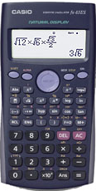
of
means multiple
Revision of Percentages
Q. Find 17% of £450
Remember money
2 decimal places
17
x 450
100
www.mathsrevision.com
= £ 76.50
4 Jul 2026
Compiled by Mr. Lafferty Maths Dept.

Slide 42
of
means multiple
Revision of Percentages
Q. Find 4% of £70
4
Remember !! money
2 decimal places
x 70
100
www.mathsrevision.com
= £ 2.80
4 Jul 2026
Compiled by Mr. Lafferty Maths Dept.

Slide 43
Simple Interest
Just working out percentages
David has £400 in the Bank.
If he receives 7.2% p.a. interest per year
.
How much interest does he receive after 1 year ?
How much does he have now in the bank ?
7.2
www.mathsrevision.com
= £ 28.80
Interest :
x 400
100
Total in Bank now :
£400 + £28.80 = £428.80
Saturday, July 4, 2026
created by Mr. Lafferty @ www.mathsrevision.com

Slide 44
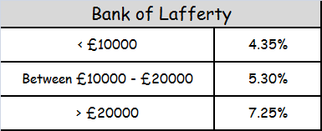
Simple Interest
Leah has saved £12,500.
She decides to put it in the Bank of Lafferty.
How much interest will she receive after 1 year ?
How much does she have now ?
5.3
www.mathsrevision.com
= £ 662.50
Interest :
x 12500
100
Total in Bank now :
£12500 + £662.50 = £13162.50
Saturday, July 4, 2026
created by Mr. Lafferty @ www.mathsrevision.com

Slide 45
Savings & Interest
Just working out percentages
Simple Interest
I have £400 in the Bank. At the end of each year
I receive 7% of £400 in interest. How much interest
do I receive after 3 years. How much do I now have?
www.mathsrevision.com
created by Mr. lafferty @ www.mathsrevision.com
<number>
Saturday, July 4, 2026

Slide 46
Simple Interest
N5 LS
Now Try
TJ N5 Lifeskills
Ex 21.6
Ch21 (page 212)
www.mathsrevision.com

Slide 47
Starter Questions
www.mathsrevision.com
4 Jul 2026
Created by Mr. Lafferty Maths Dept.

Slide 48
Compound Interest
Learning Intention
Success Criteria
  We are learning how to use the compound formula for appropriate problems.
  To know when to use compound formula.
Solve problems involving compound formula.
www.mathsrevision.com
Saturday, July 4, 2026
created by Mr. lafferty @ www.mathsrevision.com
<number>

Slide 49
Interest calculated on new value every year
Compound Interest
Real life Interest is not a fixed quantity year after year. One year’s interest becomes part of the next year’s amount. Each year’s interest is calculated on the amount at the start of the year.
Initial value
Example
www.mathsrevision.com
Daniel has £400 in the bank. He leaves it in the bank for 3 years. The interest is 7% each year. Calculate the simply interest and then the compound interest after 3 years.
Saturday, July 4, 2026
created by Mr. lafferty @ www.mathsrevision.com
<number>

Slide 50
Compound Interest
Interest calculated on new value every year
Daniel has £400 in the bank. He leaves it in the bank for 3 years. The interest is 7% each year. Calculate the compound interest and the amount he has in the bank after 3 years.
Simple Interest
Y1 : Interest = 7% of £400 = £28
Amount = £400 + £28 = £428
Interest = 7% of £400 = £28
Y 2 : Interest = 7% of £428 = £29.96
3 x 28 = £84
www.mathsrevision.com
Amount = £428 + £29.96 = £457.96
Y 3 : Interest = 7% of £457.96 = £32.06
Amount = £457.06 + £32.06 = £490.02
Simple Interest is only £84
Compound is £490.02 - £400 = £90.02
Saturday, July 4, 2026
created by Mr. lafferty @ www.mathsrevision.com
<number>

Slide 51
Compound Interest
This is called the multiplier.
Easier Method
$V=I{\left(1±\frac{\text{\%}}{\text{100}}\right)}^{n}$
n = period of time
Days, months years
www.mathsrevision.com
IMPORTANT
Can only use this when percentage is fixed
I = initial value
± = increase or decrease
V = Value
Saturday, July 4, 2026
created by Mr. lafferty @ www.mathsrevision.com
<number>

Slide 52
Compound Interest
Calculate the money in the bank after 3 years if the compound interest rate is 7% and the initial value is £400.
n = 3
$V=I{\left(1±\frac{\text{\%}}{\text{100}}\right)}^{n}$
I =400
www.mathsrevision.com
± = increase 1+0.07=1.07
V= 400 x (1.07)³ = £490.02
Saturday, July 4, 2026
created by Mr. lafferty @ www.mathsrevision.com
<number>

Slide 53
Compound Interest
N5 LS
Now Try
TJ N5 Lifeskills
Ex 21.7
Ch21 (page 213)
www.mathsrevision.com

Slide 54
Starter Questions
www.mathsrevision.com
4 Jul 2026
Created by Mr. Lafferty Maths Dept.

Slide 55
Burrowing Money
Learning Intention
Success Criteria
  1. We are learning way to burrow money and to calculate monthly payments.
  Understand and compare loan deals.
www.mathsrevision.com
  2. Be able to choose best deal by comparing monthly payments.
4 Jul 2026
Created by Mr. Lafferty Maths Dept.

Slide 56
Burrowing Money
Michael needs a loan of £850 for his holiday
in Barcelona. He takes out the loan for 1 year
@ a rate of 11.6% APR.
Calculate the total he needs to pay back and the monthly
repayments.
www.mathsrevision.com
11.6
x 850
= £ 98.60
100
Pay back total :
£850 + £98.60 = £948.60
Monthly payment :
£948.60 ÷ 12 =
£79.05
4 Jul 2026
Created by Mr.Lafferty Maths Dept

Slide 57
Burrowing Money
Alistair takes out a loan for £5000 for a car.
Calculate the total paid back for each option.
 | APR % | Loan Term
Loan payment Option 1 | 9.8 | 12 months
Loan payment Option 2 | 8.4 | 6 months
www.mathsrevision.com
9.8
Option 1 :
= £ 490
x 5000
100
Pay back total :
£5000 + £490 = £5490
Monthly payment :
£5490 ÷ 12 =
£457.50
4 Jul 2026
Created by Mr.Lafferty Maths Dept

Slide 58
Burrowing Money
Alistair takes out a loan for £5000 for a car.
Calculate the total paid back for each option.
 | APR % | Loan Term
Loan payment Option 1 | 9.8 | 12 months
Loan payment Option 2 | 8.4 | 6 months
www.mathsrevision.com
9.8
Option 1 :
= £ 490
x 5000
100
Pay back total :
£5000 + £490 = £5490
Monthly payment :
£5490 ÷ 12 =
£457.50
4 Jul 2026
Created by Mr.Lafferty Maths Dept

Slide 59
Burrowing Money
 | APR % | Loan Term
Loan payment Option 1 | 9.8 | 12 months
Loan payment Option 2 | 8.4 | 6 months
8.4 ÷ 2
= 4.2
Option 2 :
4.2
x 5000
= £ 210
www.mathsrevision.com
100
Pay back total :
£5000 + £210 = £5210
Monthly payment :
£5210 ÷ 6 =
£868.33
4 Jul 2026
Created by Mr.Lafferty Maths Dept

Slide 60
Why might someone pick option 2 ?
Burrowing Money
Monthly payment Option 1 :
£457.50
Monthly payment Option 2 :
£868.33
www.mathsrevision.com
4 Jul 2026
Created by Mr.Lafferty Maths Dept

Slide 61
Borrowing Money
N5 LS
Now Try
TJ N5 Lifeskills
Ex 21.8
Ch21 (page 214)
www.mathsrevision.com

Slide 62
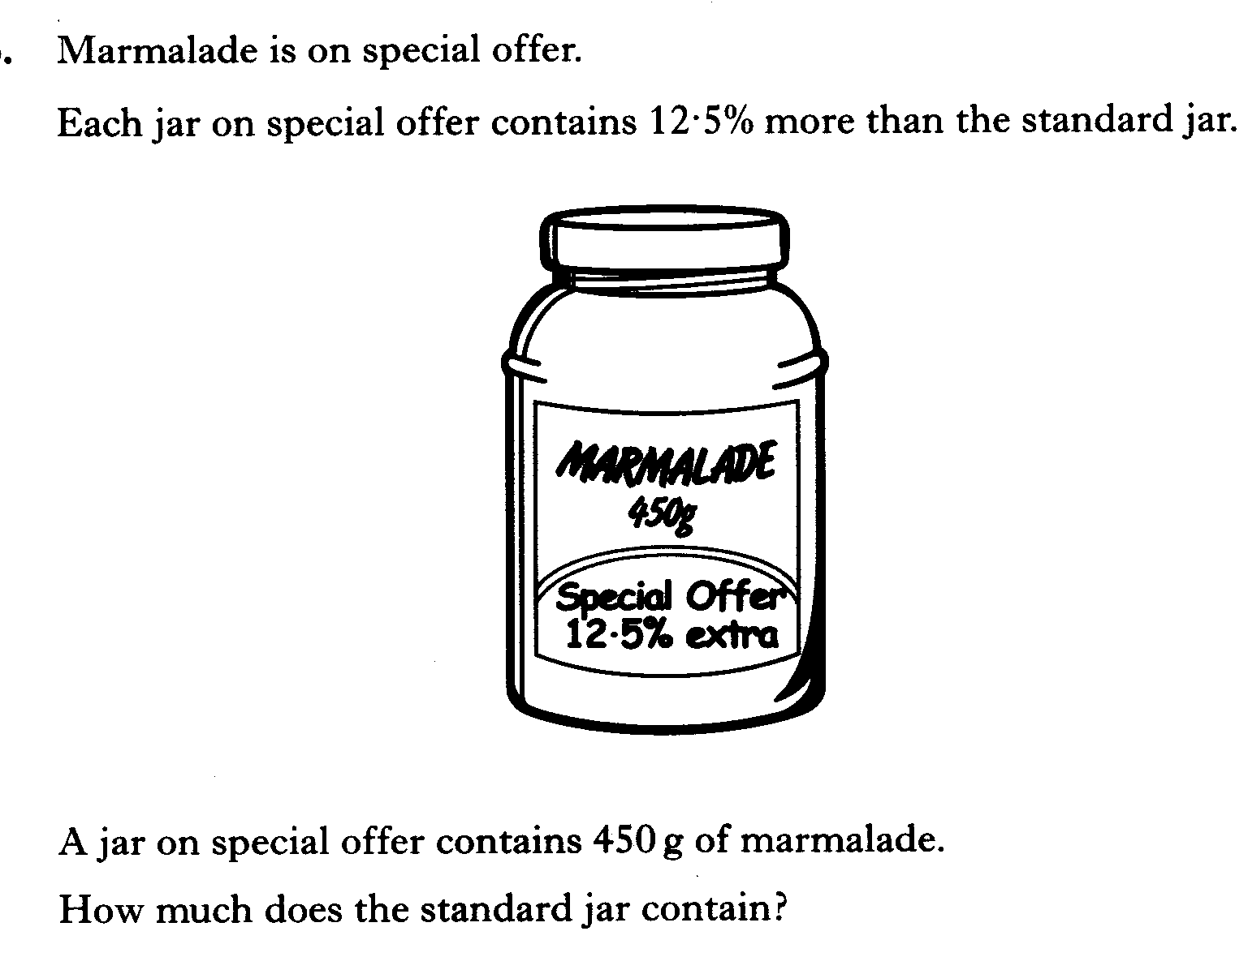

Slide 63
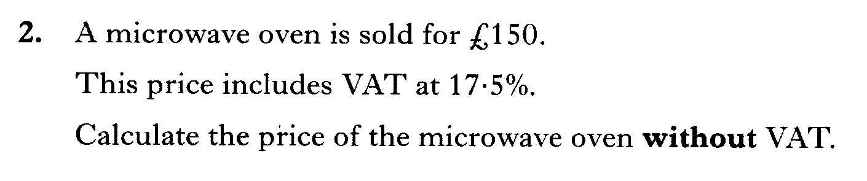

Slide 64
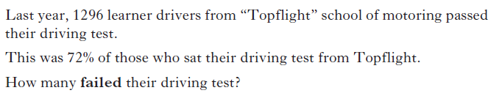

Slide 65
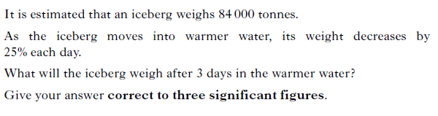

Slide 66
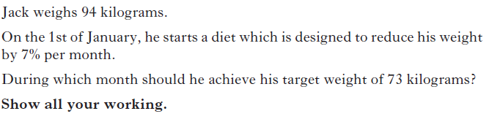

Slide 67
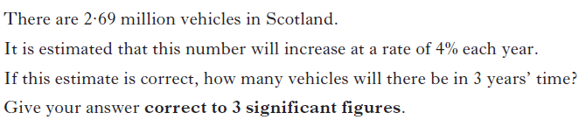

Slide 68
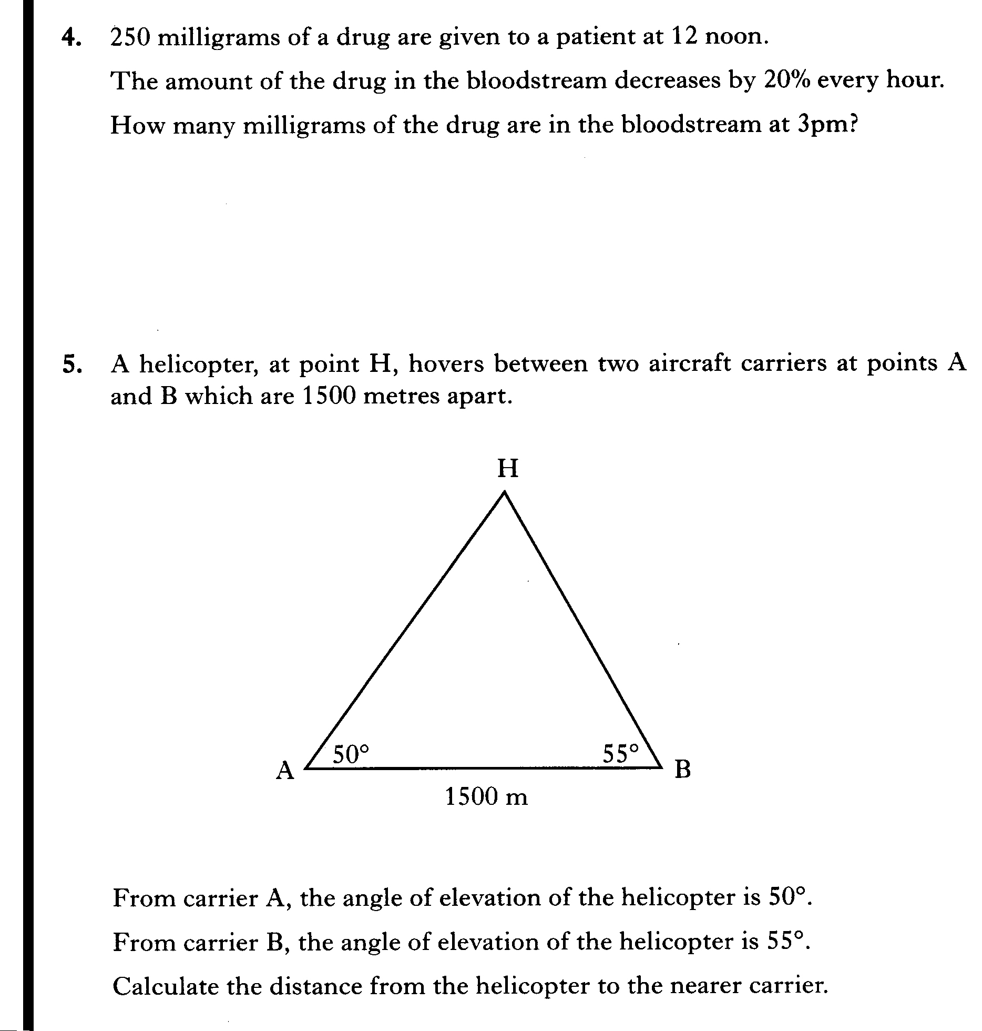

Slide 69
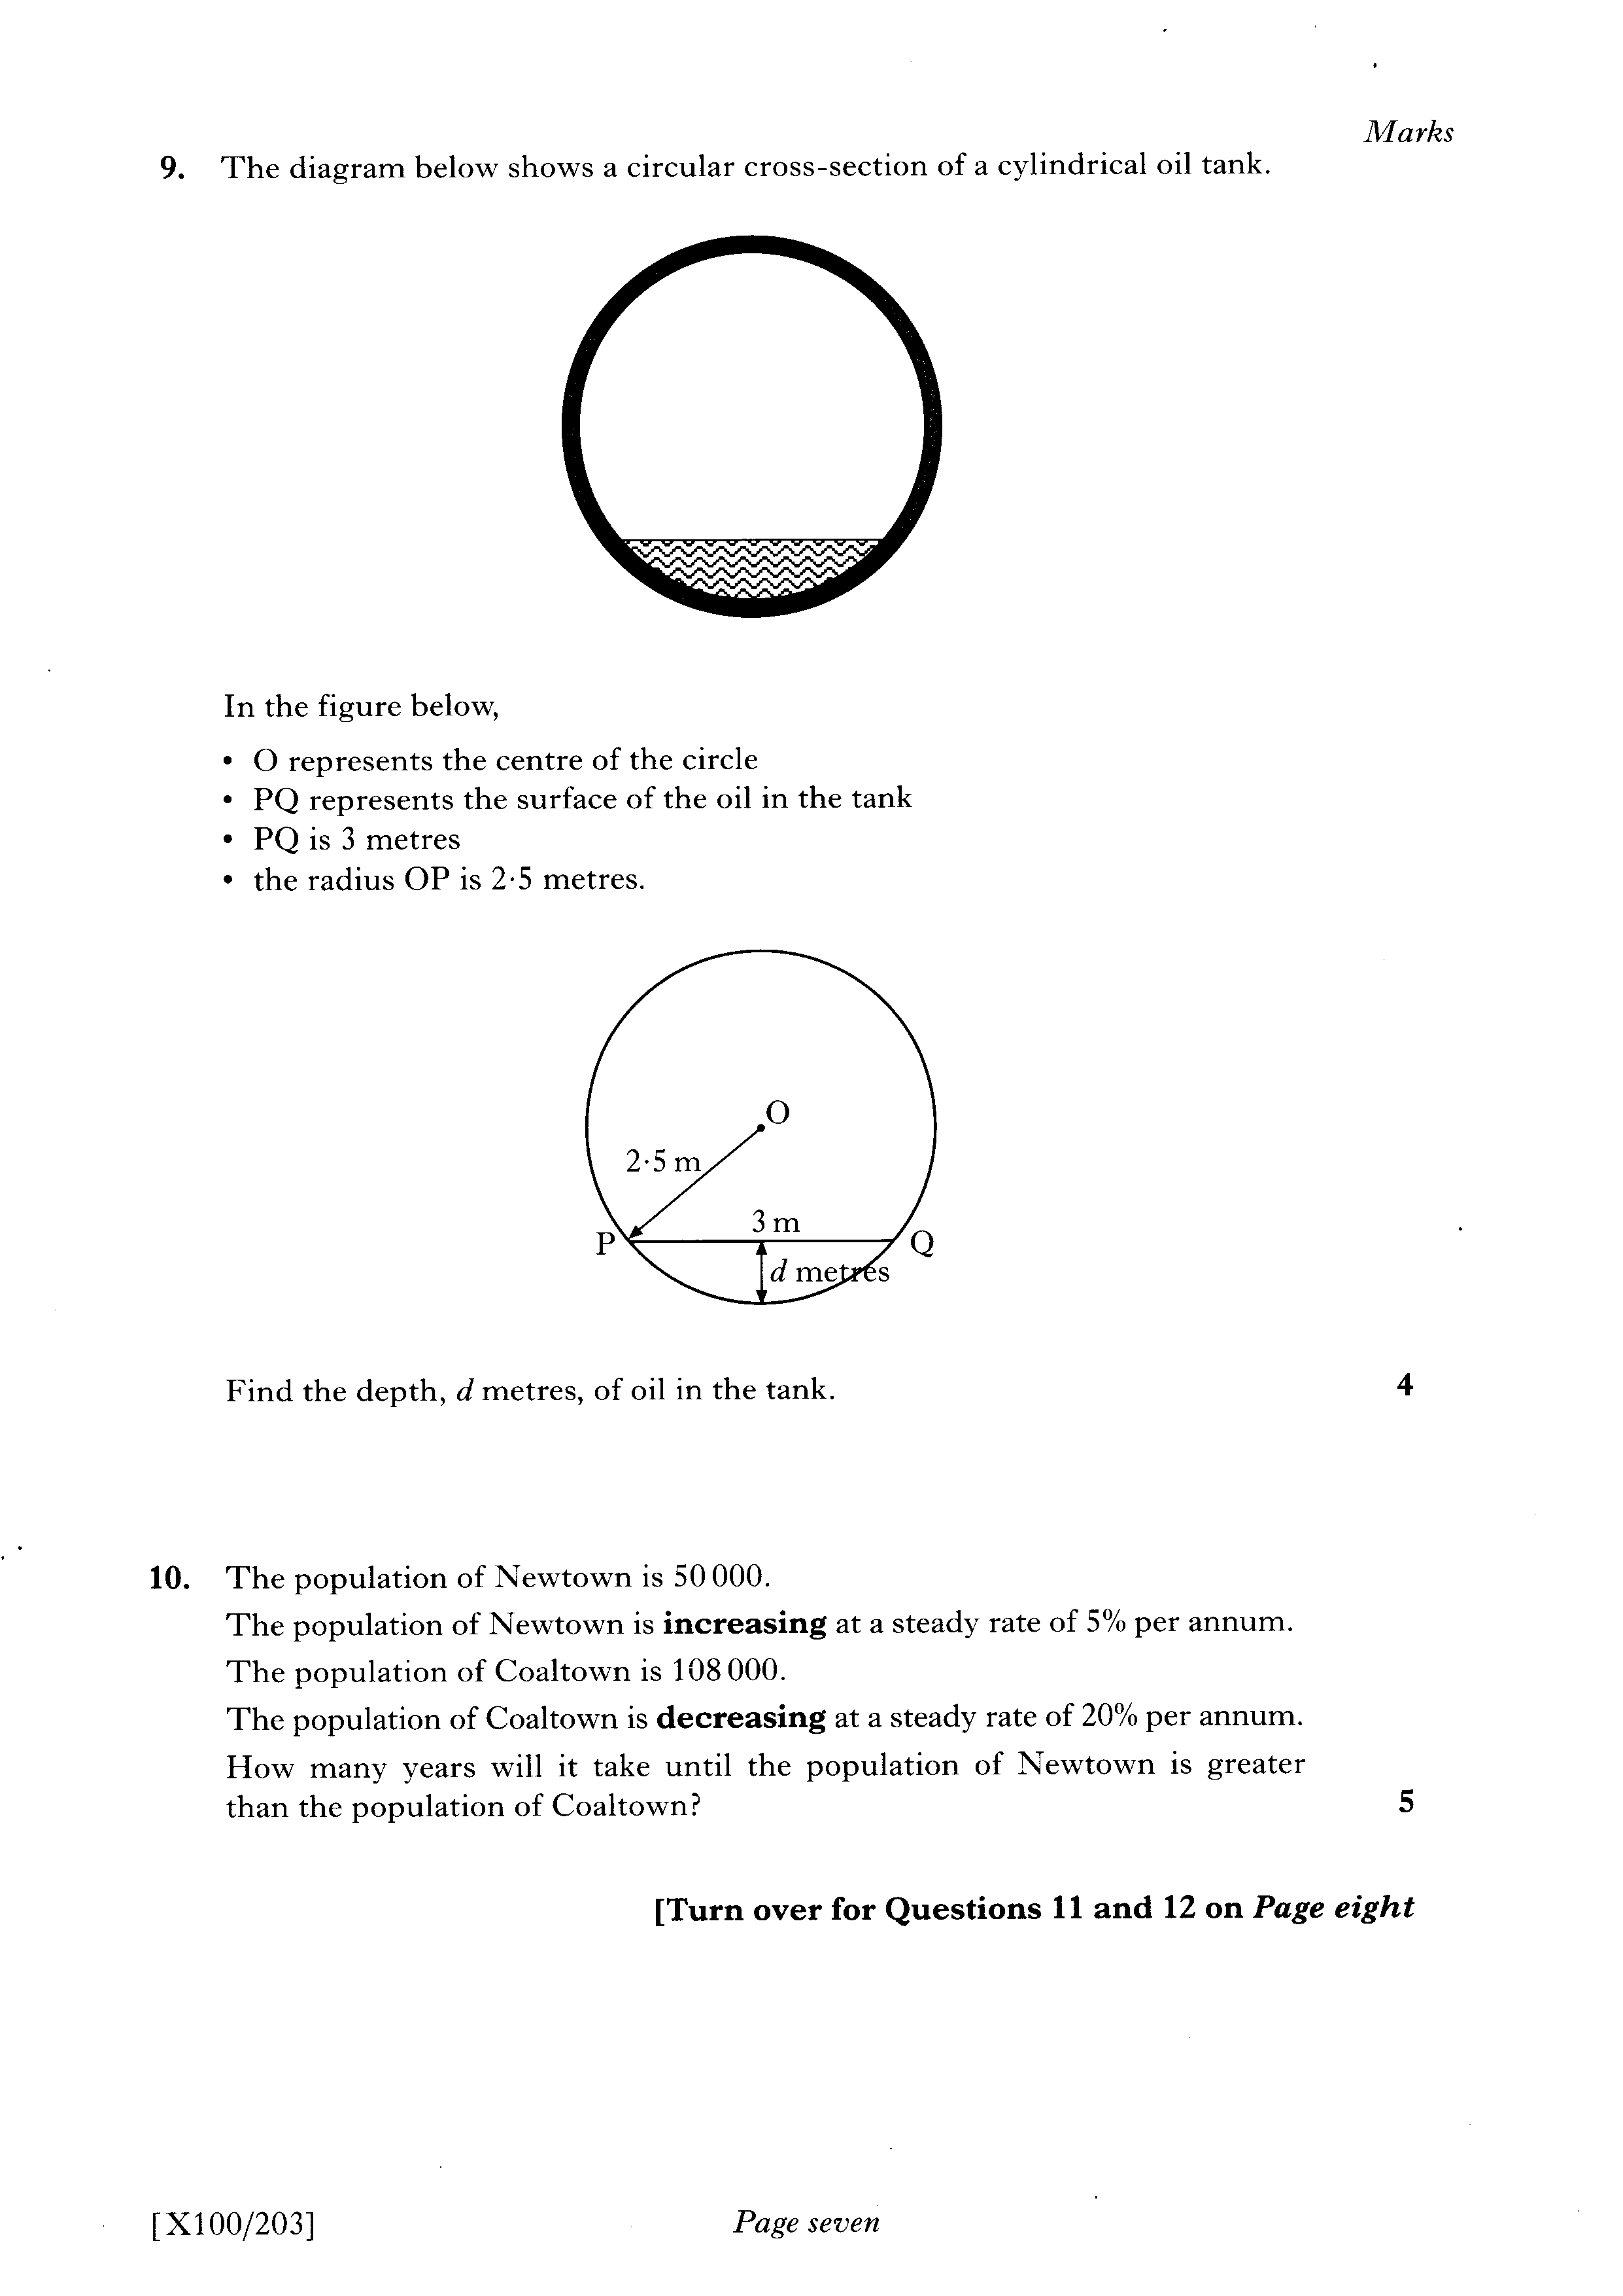

Slide 70
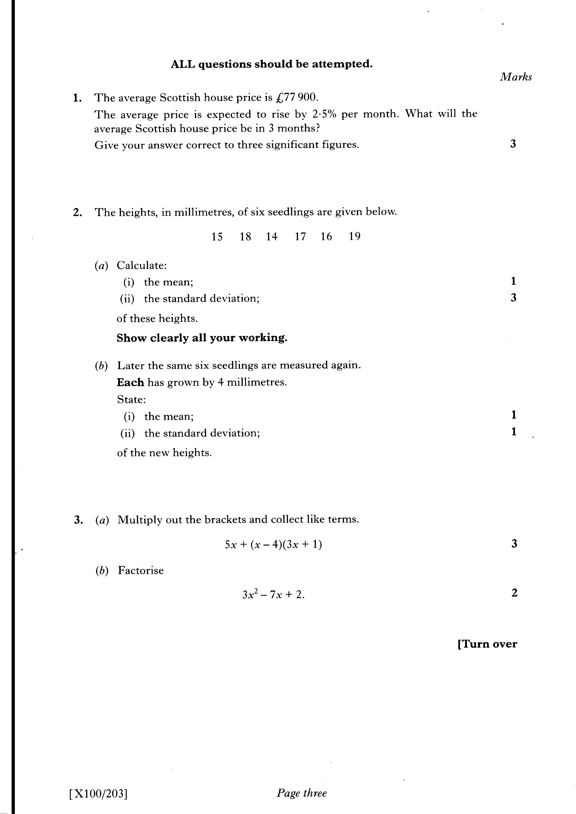

Slide 71
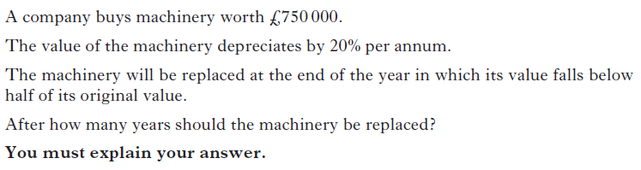

Slide 72
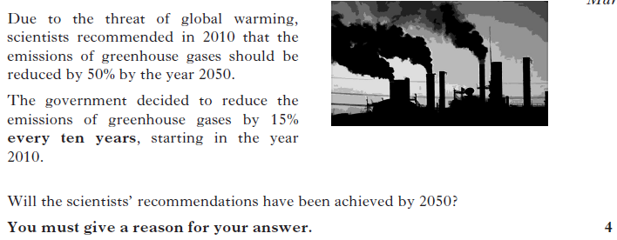

Slide 73
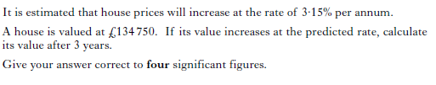

Slide 74
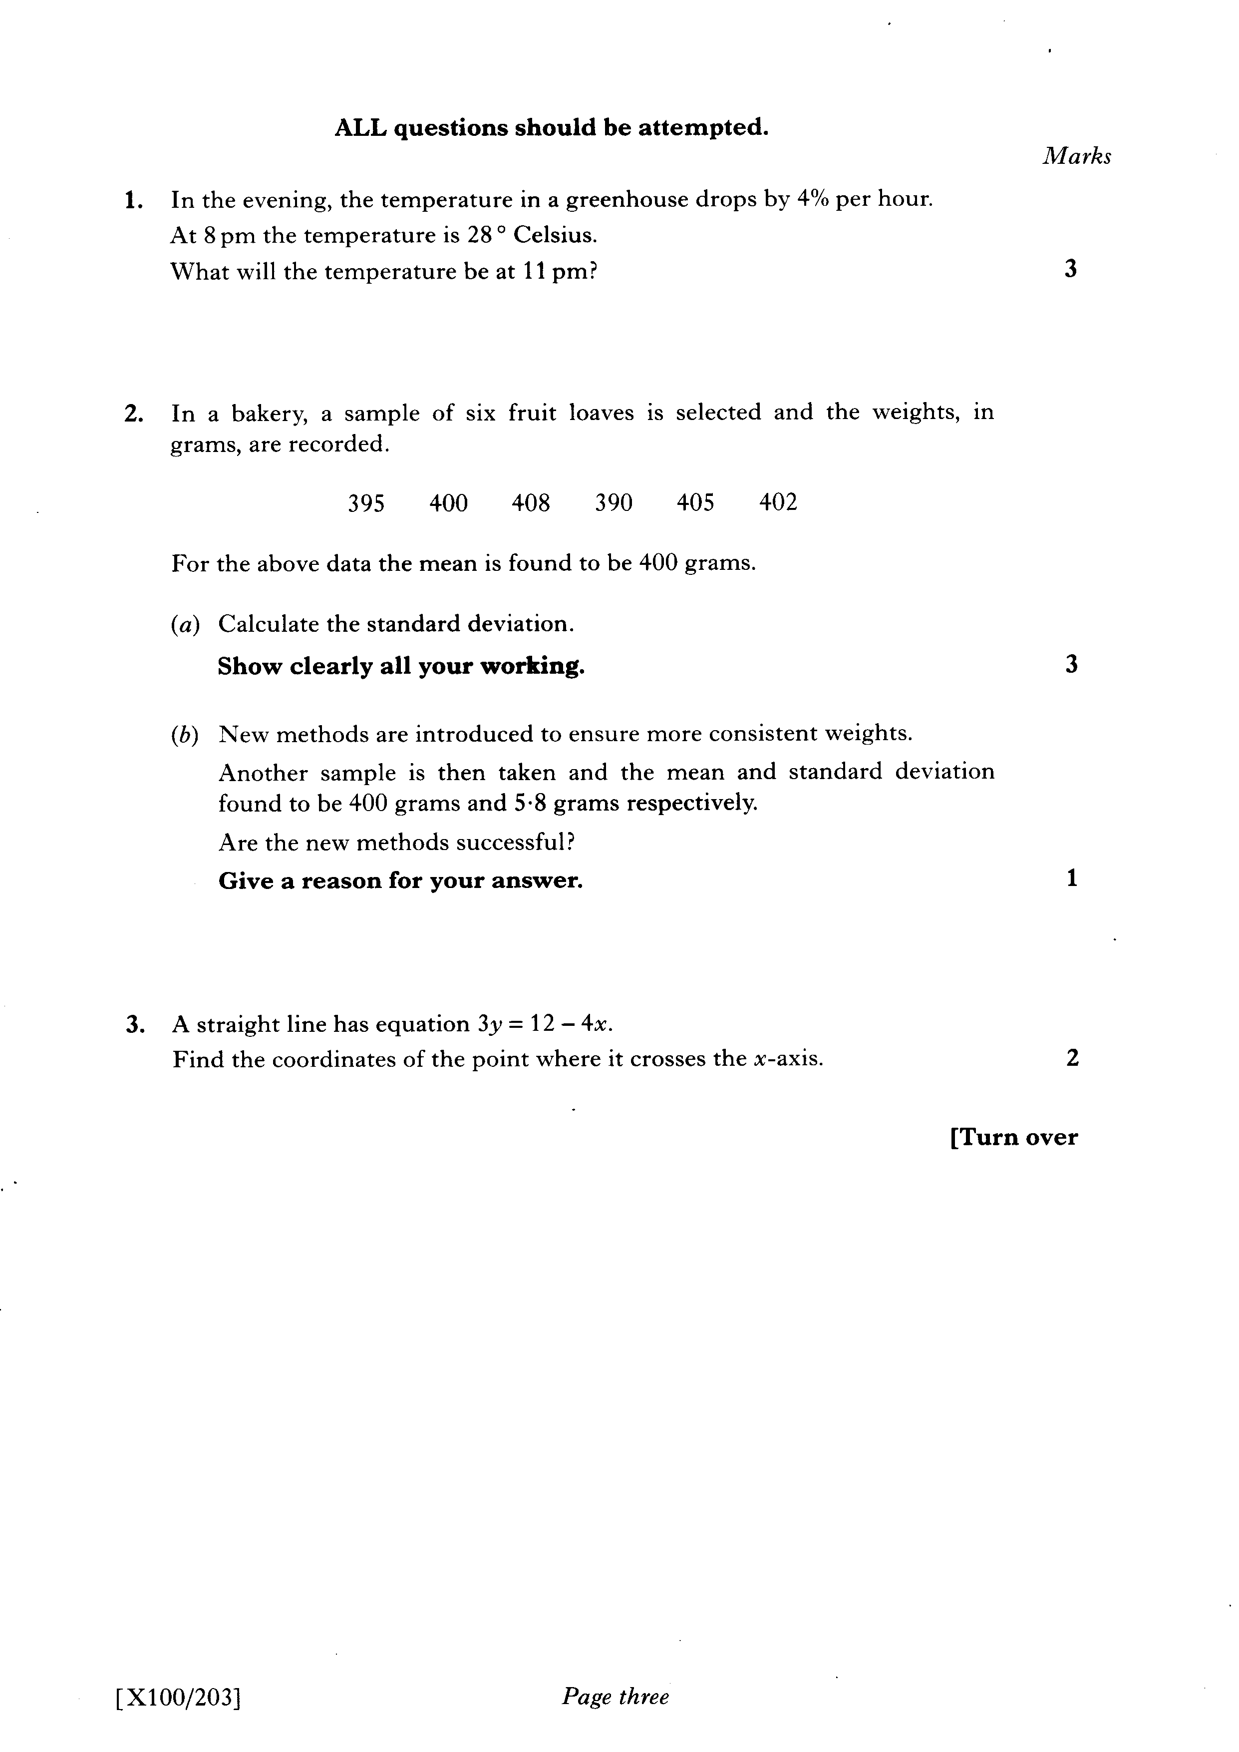

Slide 75
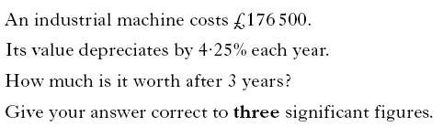

Slide 76
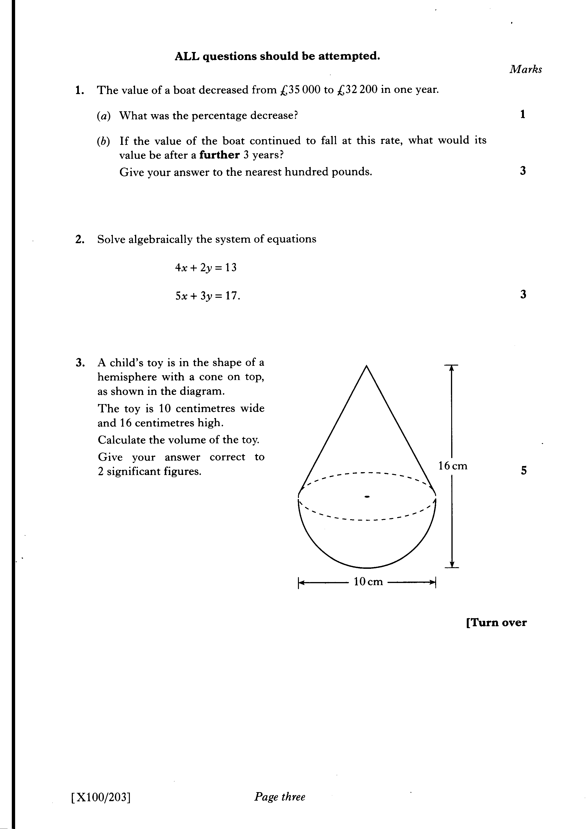

Slide 77
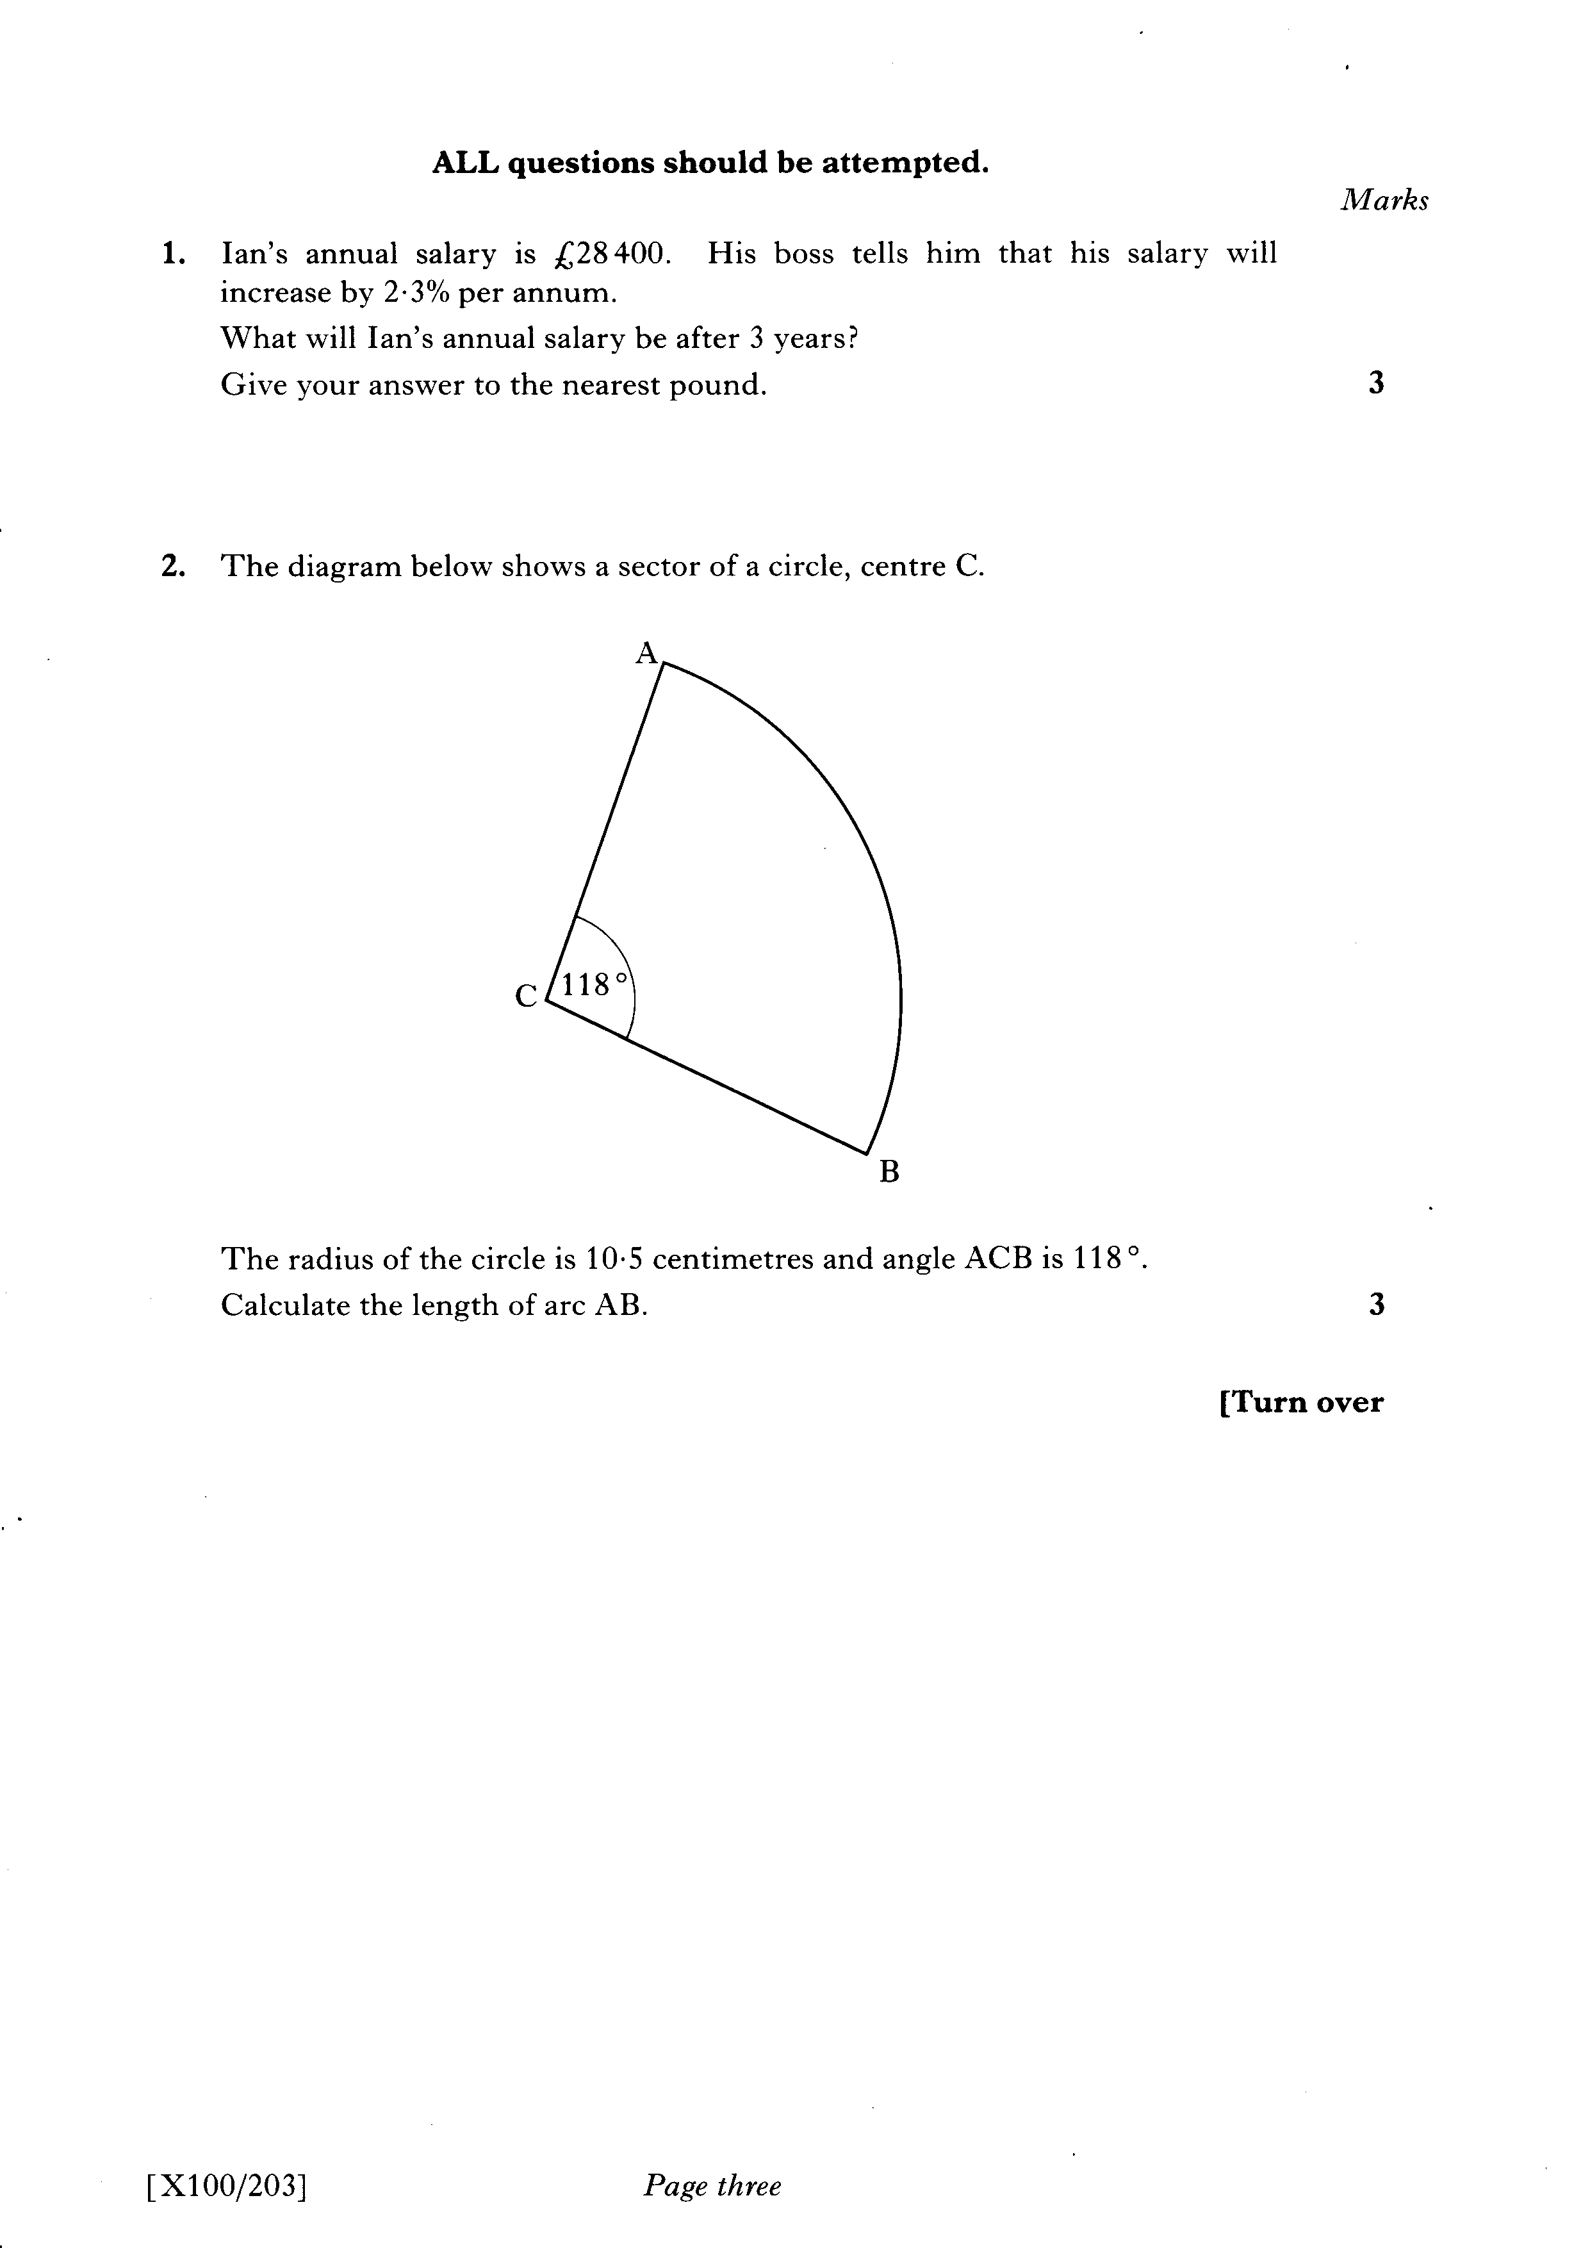

Slide 78
