Slide 1


Wages & Salaries
Revision of Basic Wages & Salaries
Gross – Deductions = NET pay
www.mathsrevision.com
Income Tax
Exam Type Questions

Slide 2
Starter Questions
www.mathsrevision.com

Slide 3
Wages & Salaries
Learning Intention
Success Criteria
  We are revising basic wages and salaries.
1. Understand the terms wages, salary, overtime and commission.
www.mathsrevision.com
Calculate wage / salary.

Slide 4
Salaries & Overtime
Wages / Salary : How much a person is paid to do a job.
Can be measured weekly, monthly or
annually.
www.mathsrevision.com
Hourly rate : How much you get paid for
an hours work.

Slide 5
Salaries & Overtime
Example :
Adam is a joiner his hourly rate of pay is £10.50.
He works 40 hours a week. What is his basic pay?
www.mathsrevision.com
Pay is =
£10.50 x 40 = £420.00

Slide 6
Salaries & Overtime
Example :
Chris starts a new job and is promised a hourly rate of
£4.90. His wage for the week was £153.60 for 32 hours
of work.
Was the employers promise true.
www.mathsrevision.com
Pay is =
£153.60 ÷ 32 = £4.80
False !

Slide 7
Salaries & Overtime
Annual Wage / Salary
How much a person is paid in a year.
12 months in a year
www.mathsrevision.com
52 weeks in a year

Slide 8
Salaries & Overtime
Example :
A mechanic gets paid £1 100 a month.
A bus driver gets paid £260 a week.
Who gets the better annual salary.
www.mathsrevision.com
Mechanic :
Annual Salary =
£1 100 x 12 = £ 13 200
Bus Driver :
Annual Salary =
£260 x 52 = £ 13 520
Bus driver has better annual wage

Slide 9
Salaries & Overtime
Overtime : When you do extra work above your basic hours.
You get a better hourly rate for overtime.
Write down the two common rates of overtime
www.mathsrevision.com
Double time (x2)
Time and a half (x1.5)

Slide 10

Salaries & Overtime
Example :
Jordan the gardener works a basic 40 hours a week.
He does 5 hours overtime at ‘double time’ on Saturday.
His hourly rate is £8 per hour.
Work out his overtime pay and then his total pay.
www.mathsrevision.com
5 hours overtime is =
5 x £8 x 2 = £80.00
40 hours basic time is =
40 x £8 = £320.00
Total pay is = £320 + £80 = £400

Slide 11
Salaries & Overtime
Example :
Tim the shop assistance works a basic 30 hours a week.
He does 4 hours overtime at ‘time and a half’ on Sunday.
His hourly rate is £6 per hour.
Work out his overtime pay and then his total pay.
www.mathsrevision.com
4 hours overtime is =
4 x £6 x 1.5 = £36.00
30 hours basic time is =
30 x £6 = £180.00
Total pay is = £36 + £180 = £216.00

Slide 12
Salaries & Overtime
Commission : Money earned based on how much you sell. Usually expressed as a percentage.
Write some people who get commission
www.mathsrevision.com
Car sales person
Double glazing sales person

Slide 13
Salaries & Overtime
Example :
Liam sells double glazing.
He is paid a commission of 15% on any windows he sells.
Last month he sold £ 30 000 worth of windows.
How much commission was he paid ?
www.mathsrevision.com
Commission :
15 ÷ 100 x £30 000 = £ 4500

Slide 14
Salaries & Overtime
Example :
Caitlin is a door to door cosmetic saleswoman.
She gets 7% commission on everything over £500
she sells. During the Christmas period she sold £6500
Worth of products. How much commission was she paid ?
www.mathsrevision.com
Value over £ :
£6500 – £500 = £ 6000
Commission :
7 ÷ 100 x £6 000 = £ 420

Slide 15

Wages & Salaries
Now Try
TJ N5 Lifeskills
Ex 20.1
Ch20 (page 191)
www.mathsrevision.com

Slide 16
Starter Questions
Two numbers add to give 12 and divide to give 3. Find the two numbers.
2. Two numbers subtract to give 5 and
multiply to 24. Find the two numbers.
3. Make your own question up.
www.mathsrevision.com

Slide 17
Wages & Salaries
Learning Intention
Success Criteria
  To explain how to work out NET pay.
1. Understand the terms Gross, Deductions and NET pay.
www.mathsrevision.com
2. Calculate NET pay.

Slide 18
Salaries & Overtime
Write down some
Gross Pay : What you are paid by the employer.
Deductions : Taken off your wages.
Net Pay : Your take home pay.
Tax
www.mathsrevision.com
National Insurance
Pension

Slide 19
Salaries & Overtime
Example :
Calculate the Net wage for the following :
Gross | Deductions | Net Wage
£15 550 | £3 400
£13 025 | £2 905
£22 430 | £5 094
£12 150
www.mathsrevision.com
£10 120
£17 336

Slide 20
Salaries & Overtime
Example :
Calculate the Net wage for this payslip :
704.00
www.mathsrevision.com
149.00
555.00

Slide 21
Salaries & Overtime
Example :
Calculate the Net wage for this payslip :
739.15
www.mathsrevision.com
207.76
531.39

Slide 22
Salaries & Overtime
Example :
Lisa pays 6% of her Gross pay in National Insurance.
This comes to £3600 per annum.
How much is her Gross pay.
% £
6 ⇨ 3600
100 ⇨
www.mathsrevision.com

Slide 23
Wages & Salaries
Now Try
TJ N5 Lifeskills
Ex 20.2
Ch20 (page 195)
www.mathsrevision.com

Slide 24
Starter Questions
In pairs, write down important
Points about Pythagoras Theorem
www.mathsrevision.com

Slide 25
Income Tax
Learning Intention
Success Criteria
  To explain how to work out Income Tax calculations.
Understand the term
Income Tax.
www.mathsrevision.com
2. Calculate Income Tax for a given salary.

Slide 26
Income Tax
If your income in a tax year is below a certain value you do not pay tax. The tax allowance is made up of a personal allowance plus other special allowances.
Special clothing
equipment
www.mathsrevision.com
Membership of professional bodies

Slide 27
Rate of Tax 2015
Taxable income | Rate of Tax
First £31785 | 20%
£31786 - £150000 | 40%
Over - £150000 | 45%
Calculate Paul’s Income Tax if his taxable income
is £27 000 a year.
www.mathsrevision.com
Tax @ 20% : 20% of £27000
= 2700 x 2
= £5400

Slide 28
150000
– 31785
£118215
Rate of Tax 2015
Taxable income | Rate of Tax
First £31785 | 20%
£31786 - £150000 | 40%
Over - £150000 | 45%
www.mathsrevision.com
Calculate Mr Lafferty’s Income Tax if his taxable income
is £500 000 a year.
Tax @ 20% : 20% of £31785
= 3178.5 x 2 = £6357
= £500000 - £31785 = £468215
Tax @ 40% : 40% of £118215
= 0.4 x 118215 = £47286

Slide 29
Rate of Tax 2015
£500000 - £ 150000 = £350000
Tax @ 45% : 45% of £350000
= 0.45 x £350000
=£157500
www.mathsrevision.com
Total Income Tax = £157500 + £47286 + £6357
= £211143

Slide 30

Have you updated your Learning Log ?
Wages & Salaries
Now Try
TJ N5 Lifeskills
Ex 20.3
Ch20 (page 198)
www.mathsrevision.com

Slide 31
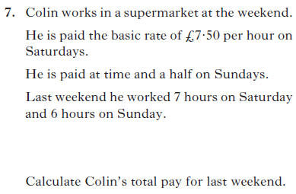

3 marks

Slide 32
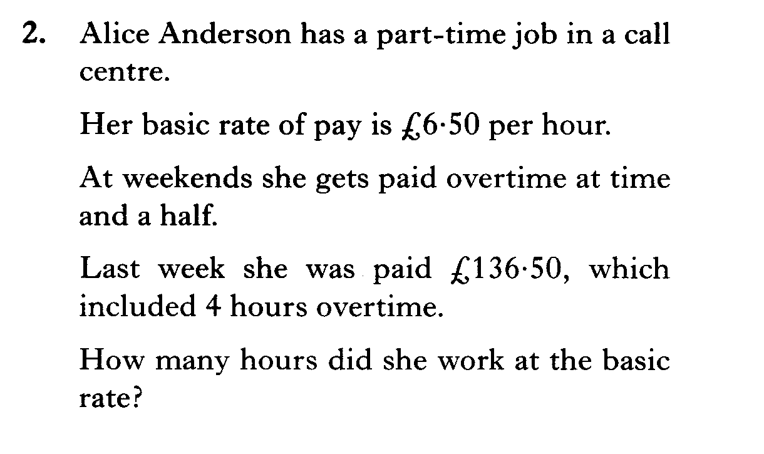

Slide 33
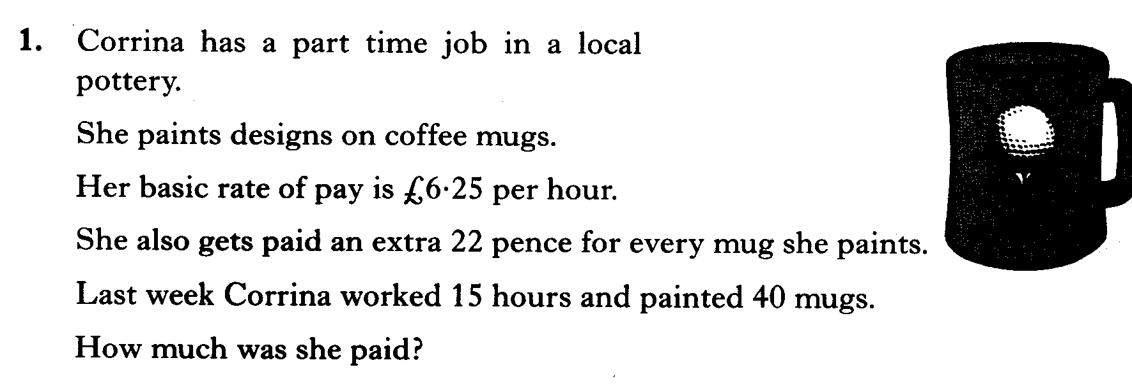

Slide 34
