Slide 1


Time Distance Speed
Converting Hour Minutes to Decimal Time
Converting Decimal Time to Hour Minutes
www.mathsrevision.com
Exam Type Questions

Slide 2
Starter Questions
www.mathsrevision.com

Slide 3
Hrs Mins to Decimal Time
Converting Hrs Mins to Decimal Time
Learning Intention
Success Criteria
1. Remember that decimal time MUST be used in formulae.
  1. We are learning how to convert hours and minutes to decimal time.
www.mathsrevision.com
2. Convert from hours and mins to decimal time.

Slide 4
Hrs Mins to Decimal Time
Converting Hrs Mins to Decimal Time
To convert minutes to decimal hours
we simply divide minutes by 60.
Example :
48 minutes to decimal is
= 0.8 hr
www.mathsrevision.com
Example :
2hr 15 minutes to decimal is
= 2.25 hr

Slide 5
Hrs Mins to Decimal Time
Converting Hrs Mins to Decimal Time
Calculate the decimal hour value for minutes below.
0.7hrs
0.3hrs
0.6hrs
0.5hrs
0.2hrs
0.1hrs
www.mathsrevision.com
0.4hrs
0.9hrs

Slide 6
Hrs Mins to Decimal Time
Converting Hrs Mins to Decimal Time
Try and remember the more common decimal hours
6 mins → 0.1 hrs
12 mins → 0.2 hrs
18 mins → 0.3 hrs
24 mins → 0.4 hrs
www.mathsrevision.com
30 mins → 0.5 hrs
36 mins → 0.6 hrs
42 mins → 0.7 hrs
48 mins → 0.8 hrs
54 mins → 0.9 hrs

Slide 7


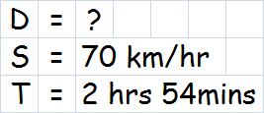

Time Distance Speed
Mixed Problems
Example : A train travelled at 70 km/hr for 2hrs 54mins.
How far did it travel in this time.
Working
www.mathsrevision.com
D
S
T

Slide 8

DST
N5 LS
Now Try
TJ N5 Lifeskills
Ex 1
Ch14 (page 134)
www.mathsrevision.com

Slide 9
Starter Questions
www.mathsrevision.com

Slide 10
Starter Questions
www.mathsrevision.com

Slide 11
Hrs Mins to Decimal Time
Converting Decimal Time to Hrs Mins
Learning Intention
Success Criteria
1. Apply the rule for converting back from decimal time to hours and mins.
  1. We are learning how to convert back from decimal time to hours and minutes.
www.mathsrevision.com

Slide 12
Hrs Mins to Decimal Time
Converting Decimal Time to Hrs Mins
You should already know :
To change minutes to a decimal time ‘divide by 60’
www.mathsrevision.com
To convert back to and minutes we do the opposite :
To change decimal time to minutes ‘multiply by 60’

Slide 13
Hrs Mins to Decimal Time
Converting Decimal Time to Hrs Mins
To change decimal time to minutes ‘multiply by 60’
Example :
0.7 hrs to minutes is
= 42 mins
www.mathsrevision.com
Example :
3.4 hrs to hours and minutes is
= 3 hrs 24 mins

Slide 14
Hrs Mins to Decimal Time
Converting Decimal Time to Hrs Mins
Calculate the hours and minutes for theses decimal hours
4hrs 42mins
1hr 48mins
4hrs 36mins
www.mathsrevision.com
1hr 24mins
3hrs 18mins

Slide 15

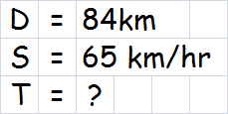



Time Distance Speed
Mixed Problems
Example : The Distance between Glasgow and Edinburgh is 84km.
If I travelled at an average speed of 70km/hr.
How long did the journey take to the nearest minute ?
Working
D
www.mathsrevision.com
S
T

Slide 16

Have you updated your Learning Log ?
DST
N5 LS
Now Try
TJ N5 Lifeskills
Ex 2
Ch14 (page 136)
www.mathsrevision.com

Slide 17
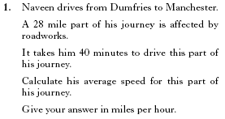


Slide 18
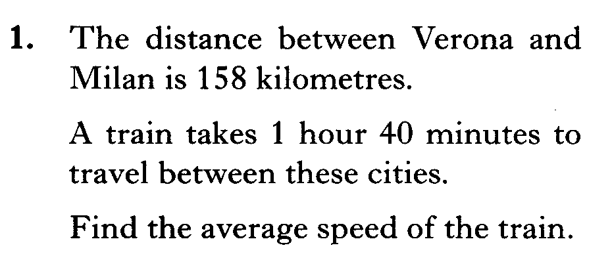


Slide 19
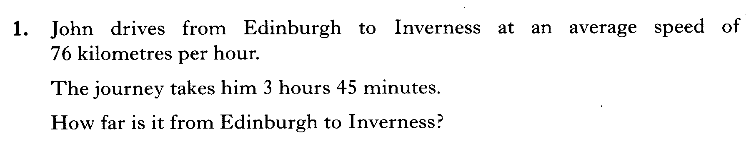

Slide 20
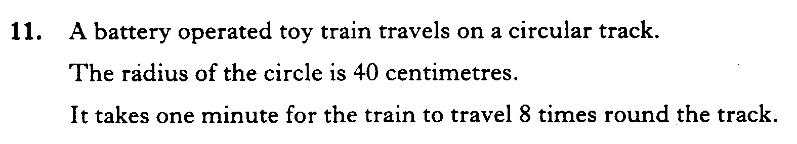
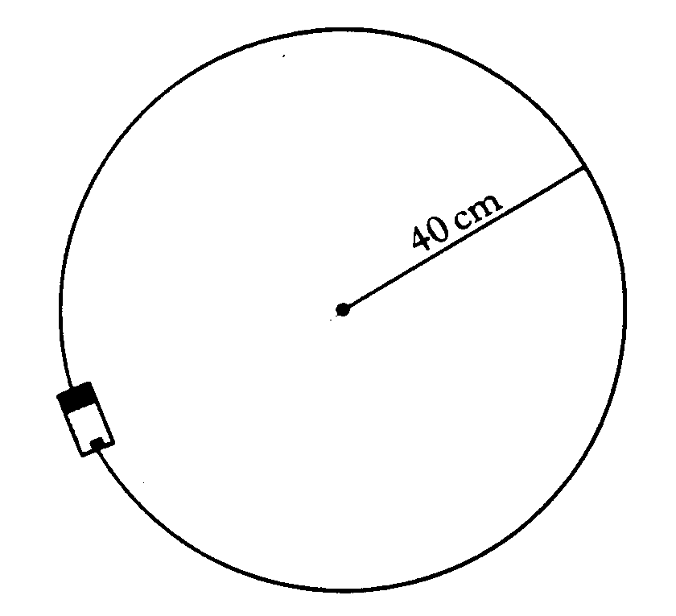
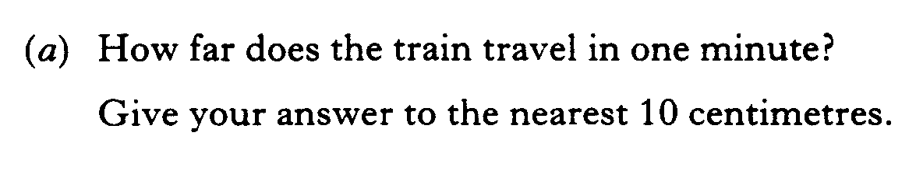
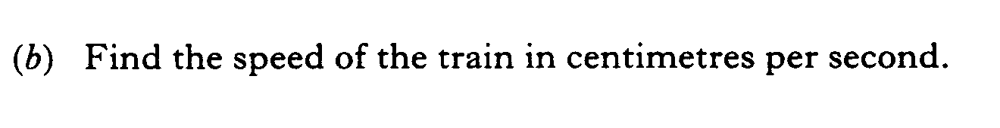

Slide 21
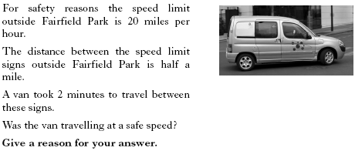

Slide 22
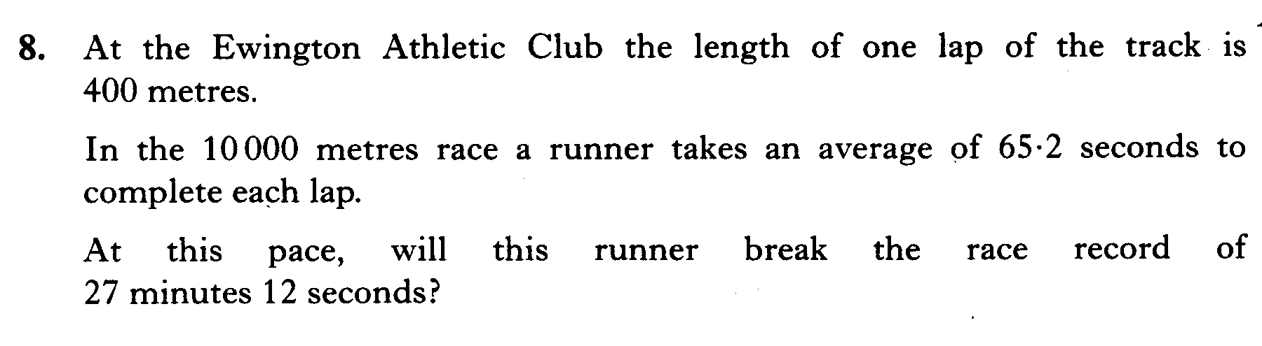

Slide 23
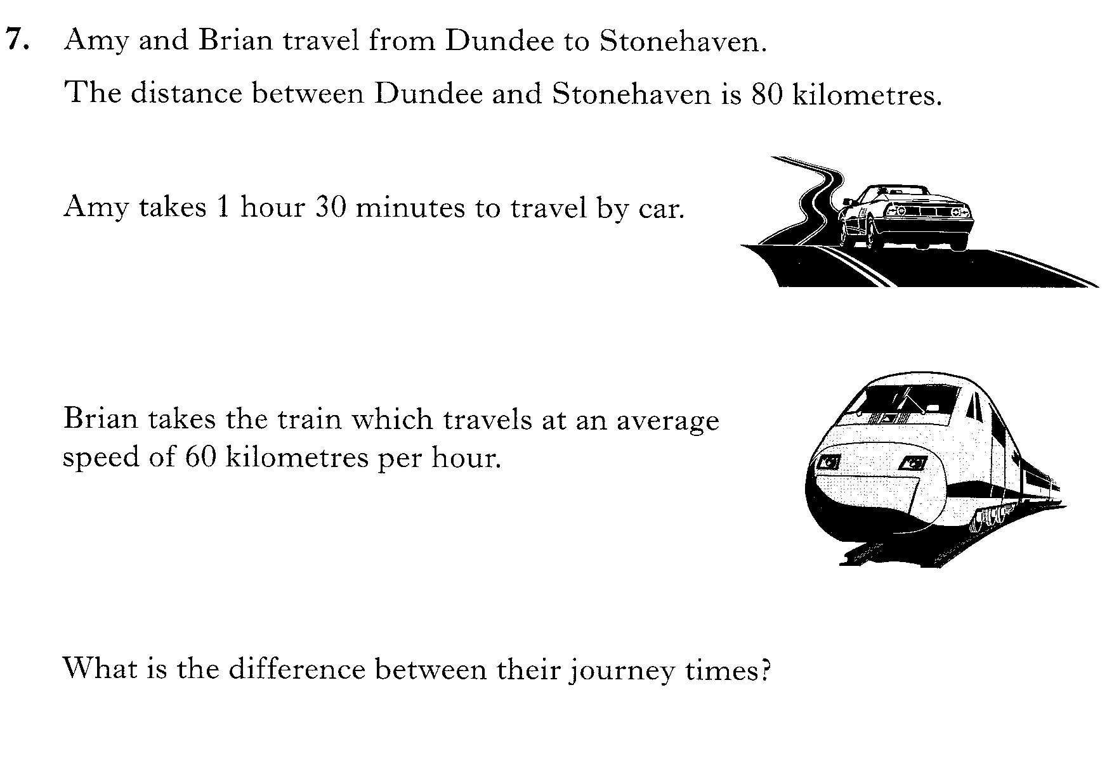

Slide 24
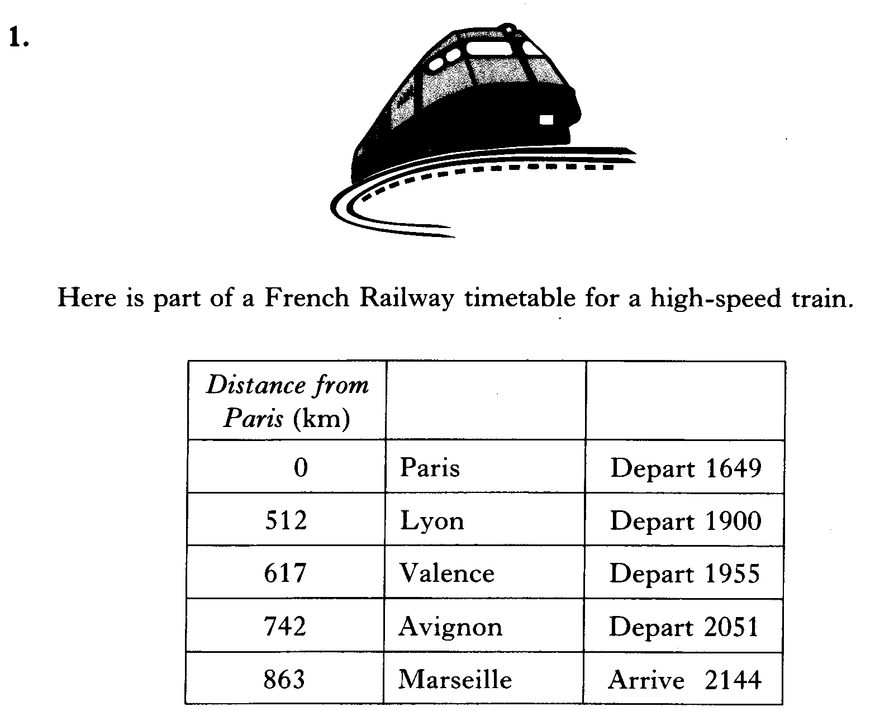
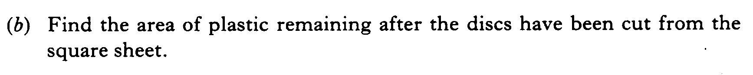

Slide 25
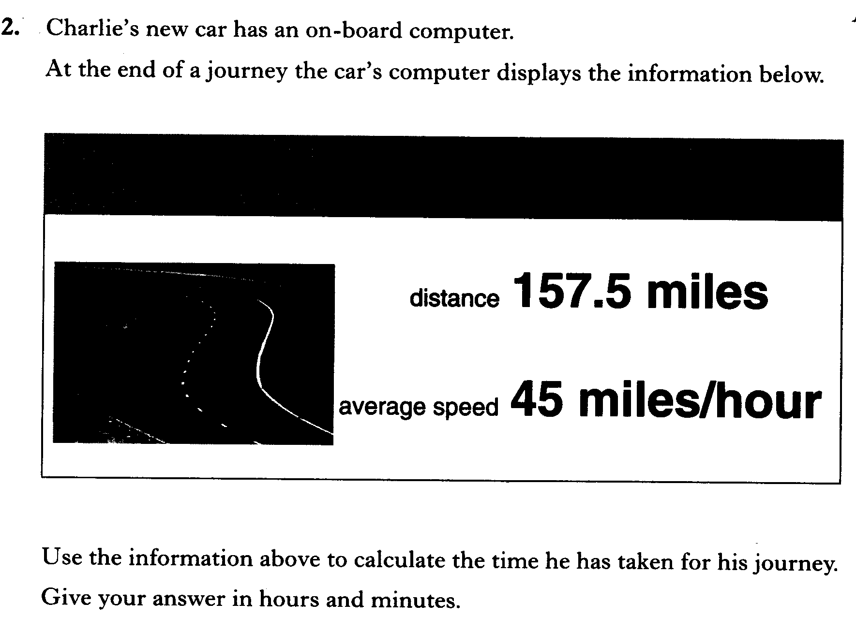

Slide 26
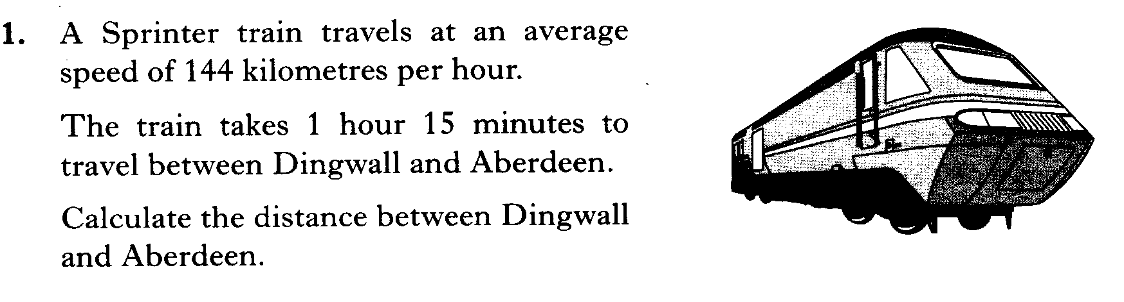

Slide 27
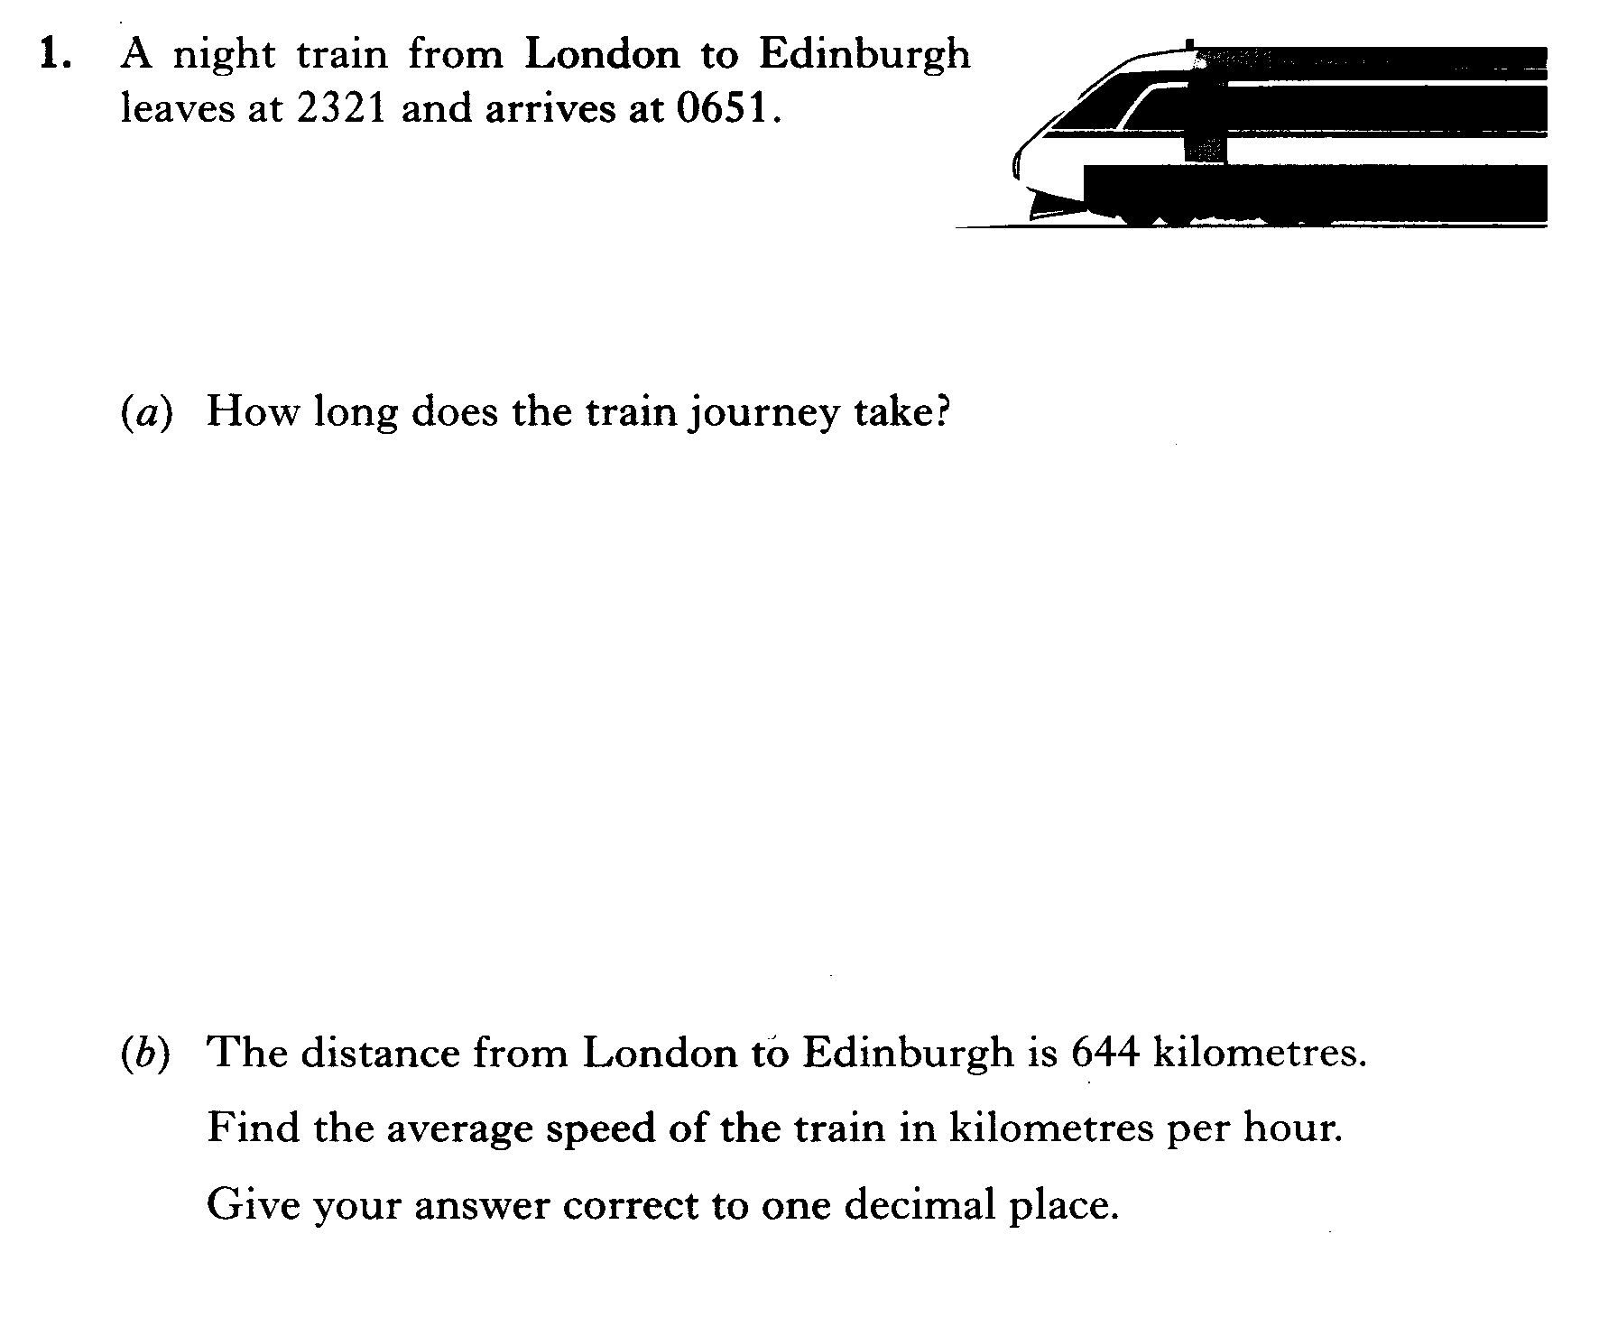

Slide 28


3 marks
Still need more practice on Speed Distance Time Click Here

Slide 29
DST
N5 LS
Now Try
TJ N5 Lifeskills
Ex 3
Ch14 (page 138)
www.mathsrevision.com

