Slide 1


Budgeting
Budgeting Problems
Monthly Budgeting
Savings Accounts
www.mathsrevision.com
Credit & Borrowing
Exam Questions

Slide 2
Starter Questions
Two numbers add to give 12 and divide to give 3. Find the two numbers.
2. Two numbers subtract to give 5 and
multiply to 24. Find the two numbers.
3. Make your own question up.
www.mathsrevision.com

Slide 3
Budgeting
Savings
Learning Intention
Success Criteria
  We are learning to manage money.
  To understand the important of managing money.
Solve simple problems involving saving money.
www.mathsrevision.com

Slide 4
Budgeting
Savings
Computer game
For something in the future
New bike
Why save ?
www.mathsrevision.com
Phone
Holidays
Trainers

Slide 5
Budgeting
Savings
Kayleigh saves £20 a week so she can buy a new bicycle
costing £450.
(a) Can she afford it after 22 weeks ?
No !
Savings total =
19 x 20
= £ 380
www.mathsrevision.com
(b) For how many more week does she need to save.
70÷20 = 3.5
Another 4 weeks
450 - 380 = £70

Slide 6


Kyle got item first by a week.
Budgeting
Savings
Kyle saves £25 a week to buy a £198 jacket.
Hannah saves £30 a week to buy a £270 dress.
Who will be able to buy their item first
and by how many weeks ?
Kyle
Hannah
www.mathsrevision.com
198 ÷ 25
270 ÷ 30
= 7.92 weeks
= 9 weeks

Slide 7

Budgeting
Savings
Now Try
TJ N4 Lifeskills
Ex 23.1
Ch23 (page 224)
www.mathsrevision.com

Slide 8
Starter
Don’t fritter your money away
Save for a rainy day
What do these phrases mean ?
Better in your pocket than theirs.
www.mathsrevision.com
They are not your pals

Slide 9
Budgeting
Monthly
Learning Intention
Success Criteria
1. Understand the key features of a monthly budget.
  1. We are learning how to mange a monthly budgets.
www.mathsrevision.com
2. Be able to work with monthly budgets.

Slide 10
What does
Income and Expenditure mean ?
Budgeting
Monthly Savings
Most people who have a job get paid monthly or 4 weekly.
Most of their wages are taken up with expenses.
Everyone needs to manage their money so they don’t get
into debt which can lead to serious problems.
www.mathsrevision.com
Spreadsheets are one of the best ways to track
your Income and Expenditure over a monthly period.

Slide 11
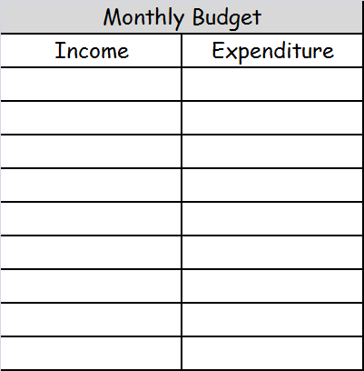
Give some examples of
Income and Expenditure
Budgeting
Monthly
Wages
Food
Child Benefit
Gas & Electric
Child Tax Credit
Rent
Working Tax Credit
TV Internet
www.mathsrevision.com
Mobile Phone
Car Loan & Petrol
Insurance
Credit Card
Clothes

Slide 12
Budgeting
Needs & Wants
Work in pairs
to complete the sheet
www.mathsrevision.com

Slide 13
Budgeting
Monthly
Now Try
TJ N5 Lifeskills
Ex 23.2
Ch23 (page 225)
www.mathsrevision.com

Slide 14
Starter Questions
In pairs
What is the best thing to do if you can regularly save money.
www.mathsrevision.com

Slide 15
Simple Interest
Learning Intention
Success Criteria
  We are learning the term simple interest and how to calculate it.
  To understand the term simple interest.
Calculate simply interest.
www.mathsrevision.com

Slide 16
Money
What type of accounts can you get?
Are there other places to put your money?
Why put your money in a bank?
Premium Bonds
Interest p.a.
(per annum)
Building Society
St Ninian’s Savings Bank
www.mathsrevision.com
Current account
Supersaver account
Savings account
High Interest account

Slide 17
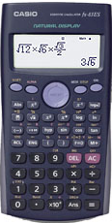
of
means multiple
Revision of Percentages
Q. Find 17% of £450
Remember money
2 decimal places
17
x 450
100
www.mathsrevision.com
= £ 76.50

Slide 18
of
means multiple
Revision of Percentages
Q. Find 4% of £70
4
Remember !! money
2 decimal places
x 70
100
www.mathsrevision.com
= £ 2.80

Slide 19
of
means multiple
Revision of Percentages
Q. Find 4% of £70
4
Remember !! money
2 decimal places
x 70
100
www.mathsrevision.com
= £ 2.80

Slide 20
Simple Interest
Just working out percentages
David has £400 in the Bank.
If he receives 7.2% p.a. interest per year
.
How much interest does he receive after 1 year ?
How much does he have now in the bank ?
7.2
www.mathsrevision.com
= £ 28.80
Interest :
x 400
100
Total in Bank now :
£400 + £28.80 = £428.80

Slide 21
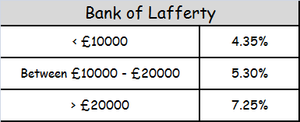
Simple Interest
Hannah has saved £12,500.
She decides to put it in the Bank of Lafferty.
How much interest will she receive after 1 year ?
How much does she have now ?
5.3
www.mathsrevision.com
= £ 662.50
Interest :
x 12500
100
Total in Bank now :
£12500 + £662.50 = £13162.50

Slide 22
Banking
Simple Interest
Now Try
TJ N5 Lifeskills
Ex 23.3
Ch23 (page 226)
www.mathsrevision.com

Slide 23
Starter Questions
www.mathsrevision.com

Slide 24
Managing a Budget
Borrowing Money
Learning Intention
Success Criteria
  1. We are learning way to burrow money and to calculate monthly payments.
  Understand and compare loan deals.
www.mathsrevision.com
  2. Be able to choose best deal by comparing monthly payments.

Slide 25
Managing a Budget
Borrowing Money
Michael needs a loan of £850 for his holiday
in Barcelona. He takes out the loan for 1 year
@ a rate of 11.6% APR.
Calculate the total he needs to pay back and the monthly
repayments.
www.mathsrevision.com
11.6
x 850
= £ 98.60
100
Pay back total :
£850 + £98.60 = £948.60
Monthly payment :
£948.60 ÷ 12 =
£79.05

Slide 26
Managing a Budget
Borrowing Money
Alistair takes out a loan for £5000 for a car.
Calculate the total paid back for each option.
 | APR % | Loan Term
Loan payment Option 1 | 9.8 | 12 months
Loan payment Option 2 | 8.4 | 6 months
www.mathsrevision.com
9.8
Option 1 :
= £ 490
x 5000
100
Pay back total :
£5000 + £490 = £5490
Monthly payment :
£5490 ÷ 12 =
£457.50

Slide 27
Managing a Budget
Borrowing Money
 | APR % | Loan Term
Loan payment Option 1 | 9.8 | 12 months
Loan payment Option 2 | 8.4 | 6 months
8.4 ÷ 2
= 4.2
Option 2 :
4.2
x 5000
= £ 210
www.mathsrevision.com
100
Pay back total :
£5000 + £210 = £5210
Monthly payment :
£5210 ÷ 6 =
£868.33

Slide 28
Why might someone pick option 2 ?
Managing a Budget
Borrowing Money
Monthly payment Option 1 :
£457.50
Monthly payment Option 2 :
£868.33
www.mathsrevision.com

Slide 29

Have you updated your Learning Log ?
Managing a Budget
Borrowing Money
Now Try
TJ N Lifeskills
Ex 23.4
Ch23 (page 228)
www.mathsrevision.com

Slide 30
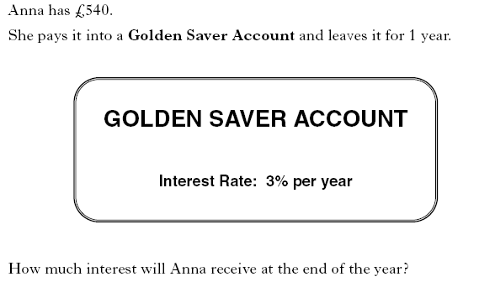
2 KU

Slide 31
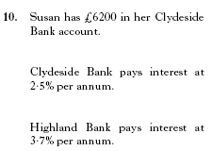
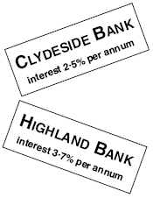

Slide 32
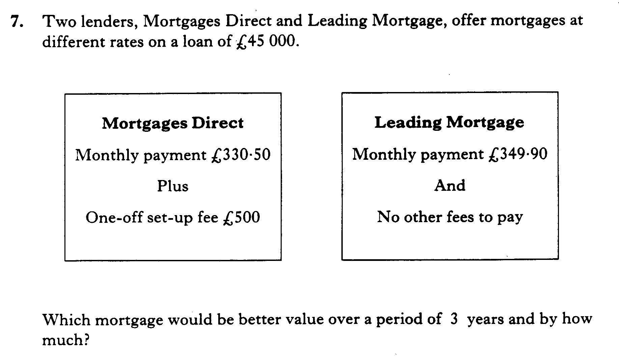

Slide 33
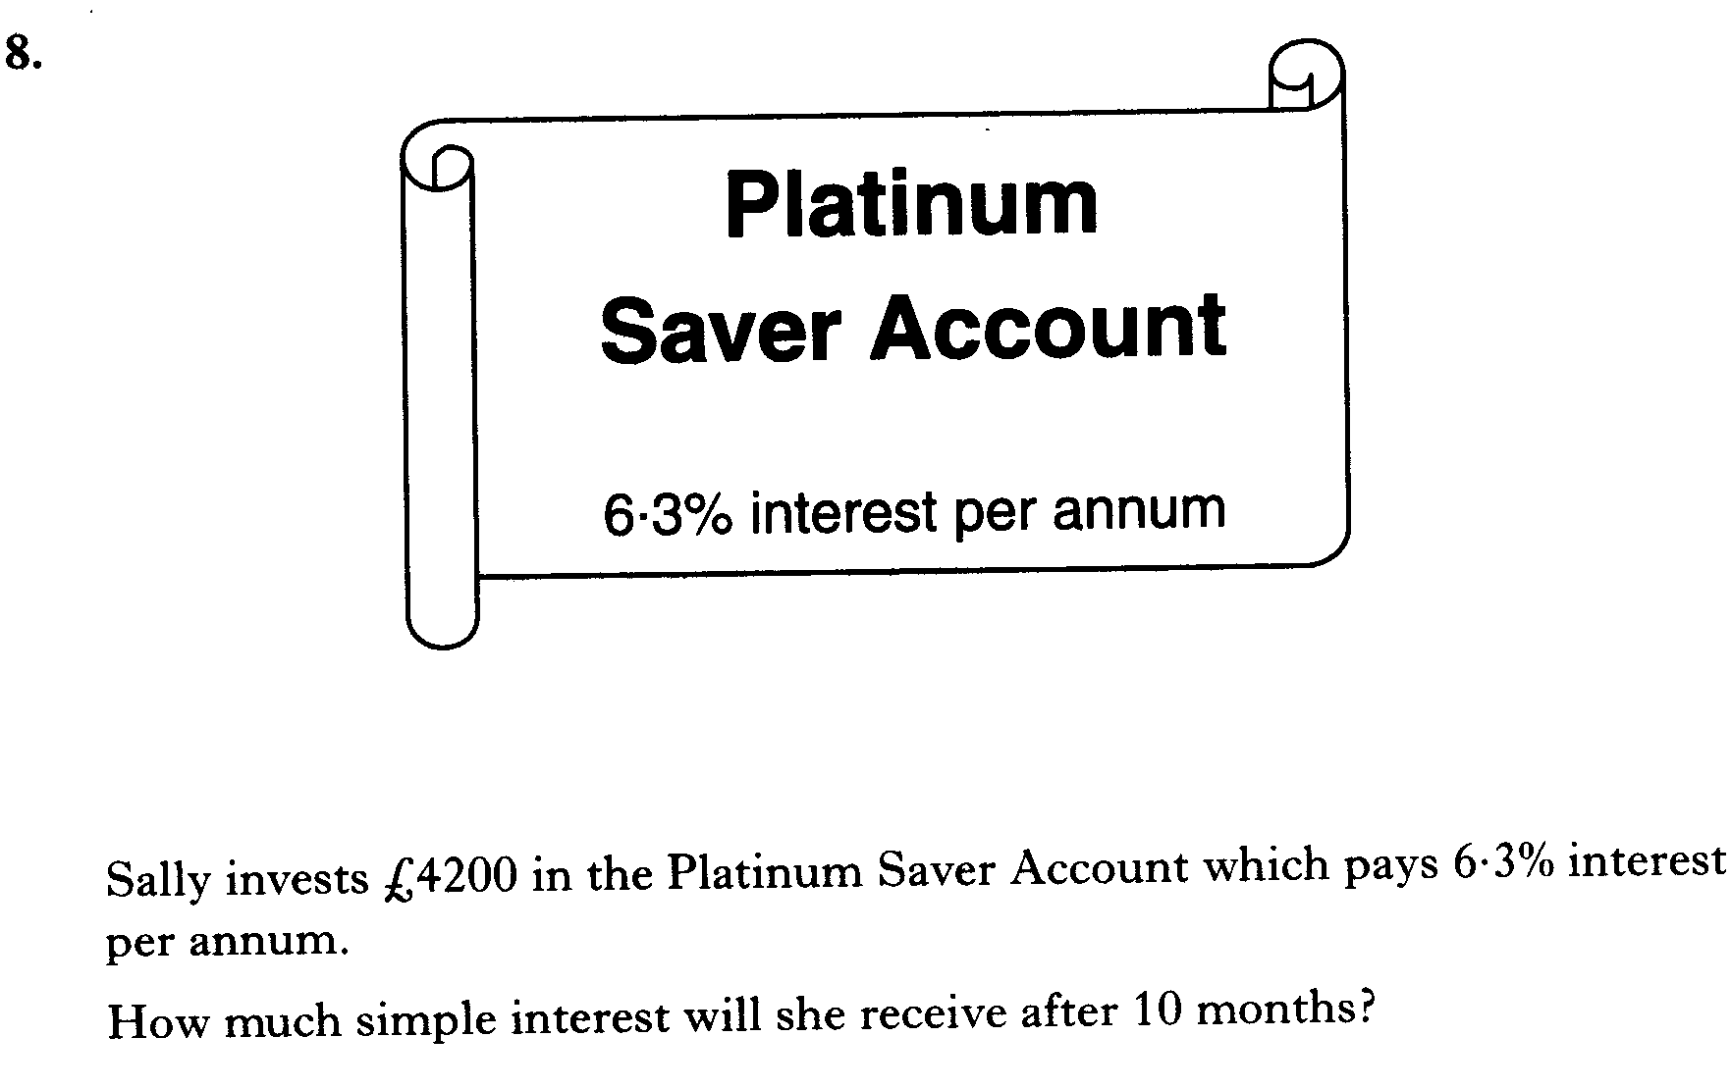

Slide 34
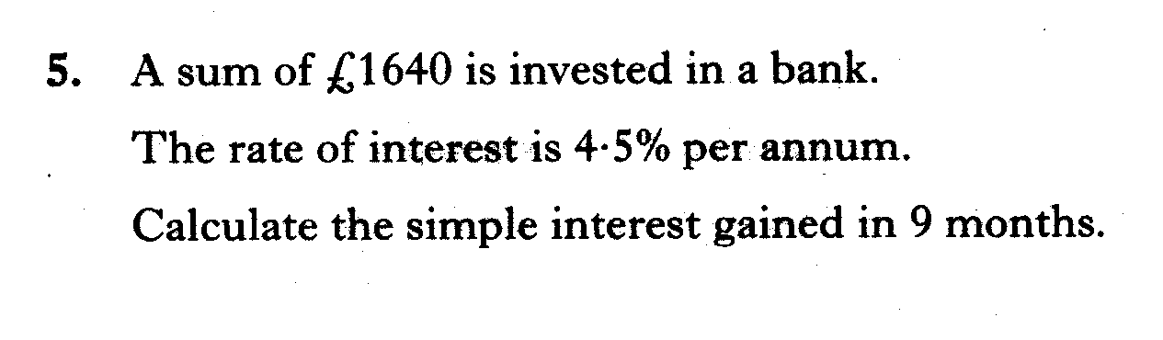

Slide 35
Jamie invests £1440 in a savings account.
The rate of interest is 5% per annum.
Calculate the interest he should receive after 3 months.

Slide 36
Charlie invests £4200 in a bank account.
The rate of interest is 1.3% per annum.
Calculate the interest he should receive after 9 months.

Slide 37
Ralph invests £2600 in a building society account.
The rate of interest is 4.5% per annum.
Calculate the interest he should receive after 8 months.

Slide 38
Sam invests £7600 in a bank account.
• The rate of interest is 4.8% per annum.
• The bank deducts 20% tax from the interest.
Calculate the interest Sam receives for one year after tax has been deducted.

Slide 39
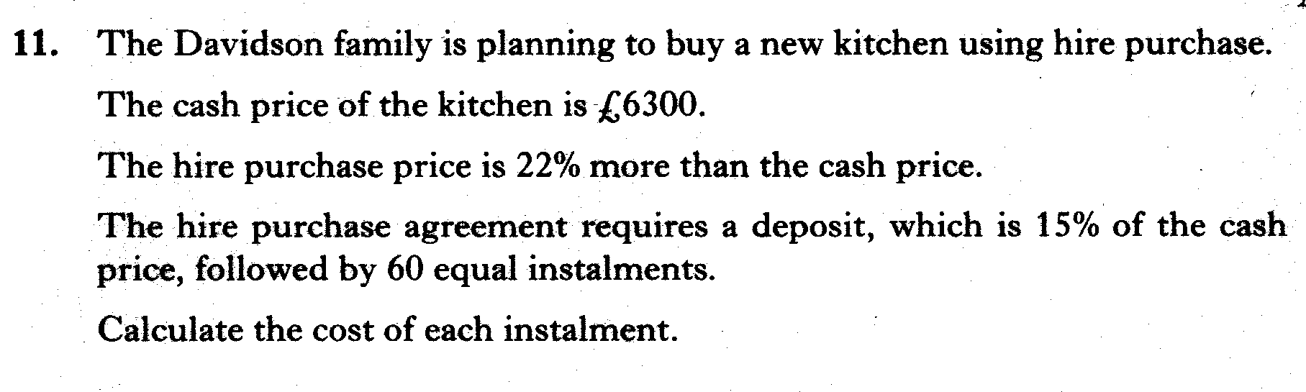

Slide 40
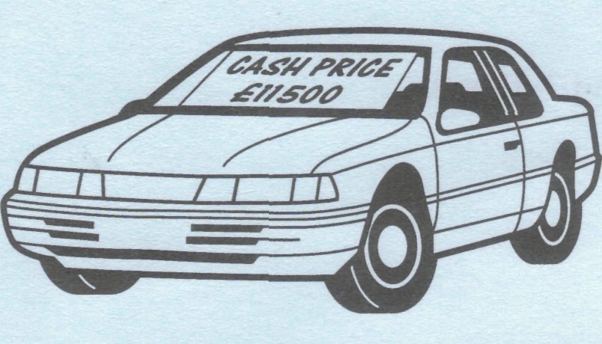
Jenna is buying a car. The cash price is £11500. It can be bought on hire purchase by paying a deposit of 20% of the cash price and 36 instalments of £300.
Find the total hire purchase price of the car.

Slide 41
Gail wants to insure her computer for £2400.
The insurance company charges an annual premium of £1.25 for each £100 insured.
(a) Calculate the annual premium.
(b) Gail can pay her premium monthly.
If she does this she is charged an extra 4%. Calculate the monthly premium.

