Slide 1


Best Deal
Best Deal
www.mathsrevision.com
Exam Type Questions
4 Jul 2026
Created by Mr. Lafferty Maths Dept.

Slide 2
Starter Questions
In pairs
Make a list of important things to think about when buying goods.
www.mathsrevision.com
4 Jul 2026
Created by Mr. Lafferty Maths Dept.

Slide 3
Best Deal
Money Management
Learning Intention
Success Criteria
  1. We are learning to calculate the best deal for everyday items.
  De able to compare deals by finding the cost per unit.
www.mathsrevision.com
4 Jul 2026
Created by Mr. Lafferty Maths Dept.

Slide 4
Are we expecting more or less
Best Deal
Money Management
Ex : What is the best deal for Petrol.
Deal 2 - Proportion method
l £
60 ⇨ 65.40
1
Deal 1 | Deal 2
60 litres | 38 litres
£65.40 | £40.66
www.mathsrevision.com
(less)
4 Jul 2026
Created by Mr.Lafferty Maths Dept

Slide 5
Are we expecting more or less
Best Deal
Money Management
Ex : What is the best deal for Petrol.
Deal 2 - Proportion method
l £
38 ⇨ 40.66
1
Deal 1 | Deal 2
60 litres | 38 litres
£65.40 | £40.66
www.mathsrevision.com
(less)
Deal 2 is Best
by 2p per litre
4 Jul 2026
Created by Mr.Lafferty Maths Dept

Slide 6
Are we expecting more or less
Best Deal
Money Management
Ex : What is the best deal for tennis balls ?
Deal 1 - Proportion method
T £
10 ⇨ 5.40
1
Deal 1 | Deal 2 | Deal 3
10 balls | 15 balls | 48 balls
£5.40 | £7.50 | £24.48
www.mathsrevision.com
(less)
4 Jul 2026
Created by Mr.Lafferty Maths Dept

Slide 7
Are we expecting more or less
Best Deal
Money Management
Ex : What is the best deal for tennis balls ?
Deal 2 - Proportion method
T £
15 ⇨ 7.50
1
Deal 1 | Deal 2 | Deal 3
10 balls | 15 balls | 48 balls
£5.40 | £7.50 | £24.48
www.mathsrevision.com
(less)
4 Jul 2026
Created by Mr.Lafferty Maths Dept

Slide 8
Are we expecting more or less
Best Deal
Money Management
Ex : What is the best deal for tennis balls ?
Deal 3 - Proportion method
T £
48 ⇨ 24.48
1
Deal 1 | Deal 2 | Deal 3
10 balls | 15 balls | 48 balls
£5.40 | £7.50 | £24.48
www.mathsrevision.com
(less)
Deal 2 is Best
£0.50 per ball
4 Jul 2026
Created by Mr.Lafferty Maths Dept

Slide 9
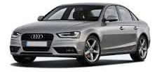
Best Deal
CASH PRICE - £20 000
John has decided to buy new Audi A4 car.
He has 3 options to consider.
Pay 15% deposit and 36 months @ £ 495
www.mathsrevision.com
Pay 12.5% deposit and 48 months @ £ 395
Pay NO deposit and 60 months @ £ 500
Which deal should he choose to minimise his cost.
4 Jul 2026
Created by Mr.Lafferty Maths Dept

Slide 10
Best Deal
CASH PRICE - £20 000
Option 1 to consider.
Pay 15% deposit and 36 months @ £ 495
$\frac{\text{15}}{\text{100}}×\text{20000}=$
$£3\text{000}$
Total cost
www.mathsrevision.com
£3 000
+ £17 820
36 x 495 =
£17 820
£20 820
4 Jul 2026
Created by Mr.Lafferty Maths Dept

Slide 11
Best Deal
CASH PRICE - £20 000
Option 2 to consider.
Pay 12.5% deposit and 48 months @ £ 395
$\frac{\text{12}\text{.}5}{\text{100}}×\text{20000}=$
$£2\text{ 5}\text{00}$
Total cost
www.mathsrevision.com
£2 500
+ £18 960
48 x 395 =
£18 960
£21 460
4 Jul 2026
Created by Mr.Lafferty Maths Dept

Slide 12

Best Deal
CASH PRICE - £20 000
Option 3 to consider.
Pay NO deposit and 60 months @ £ 500
60 x 500 =
£30 000
www.mathsrevision.com
Option 1
Option 2
Option 3
£20 820
£21 460
£30 000
4 Jul 2026
Created by Mr.Lafferty Maths Dept

Slide 13
What is the minimum he will need to spent if he buys one of each item.
Best Deal
Daniel is buying furniture for his flat.
Retailer | Table | Mirror | Bed | TV | Lamp
B & E | £123 | £84 | £405 | £650 | £49
Coney’s | £109 | £90 | £450 | £434 | £65
Texco | £103 | £82 | £367 | £436 | £55
Masda | £136 | £76 | £319 | £498 | £39
Dido | £132 | £84 | £421 | £555 | £40
www.mathsrevision.com
103 + 76 + 319 + 434 + 39 =
£971
4 Jul 2026
Created by Mr.Lafferty Maths Dept

Slide 14


Have you updated your Learning Log ?
Dest Deal
Now Try
TJ N5 Lifeskills
Ex 22.1
Ch22 (page 219)
www.mathsrevision.com
4 Jul 2026
Created by Mr. Lafferty Maths Dept.

Slide 15
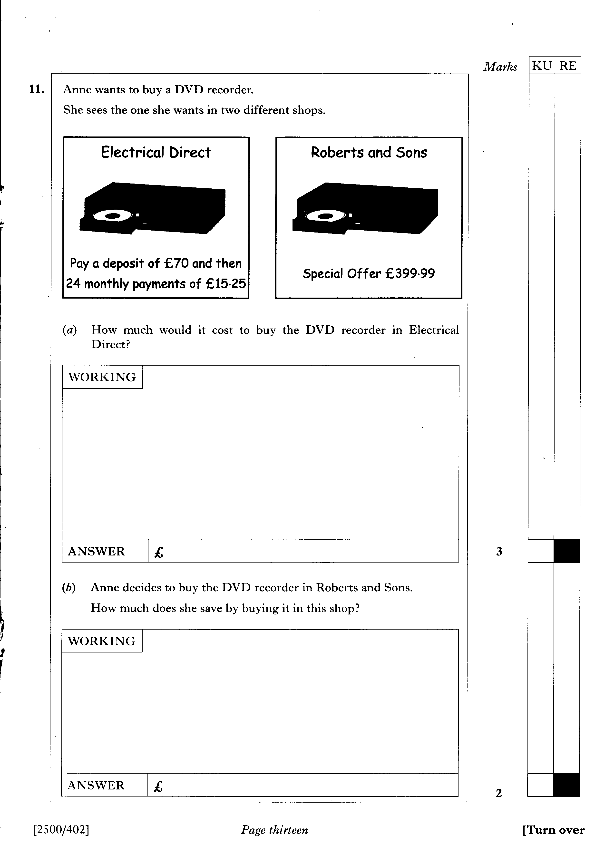

Slide 16
1 KU
3 RE

Slide 17
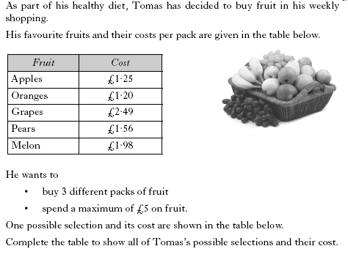
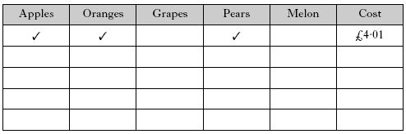

Slide 18
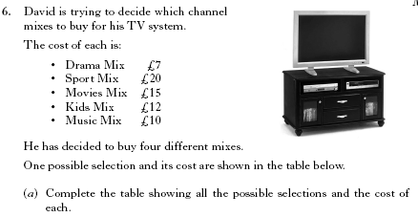
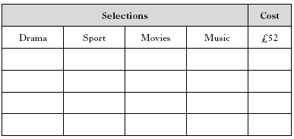


Slide 19


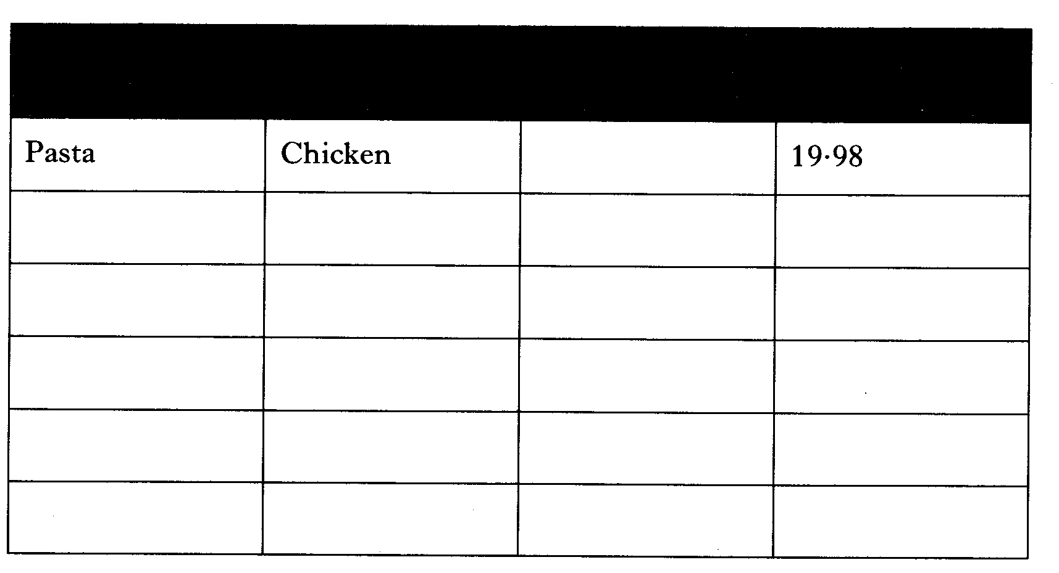
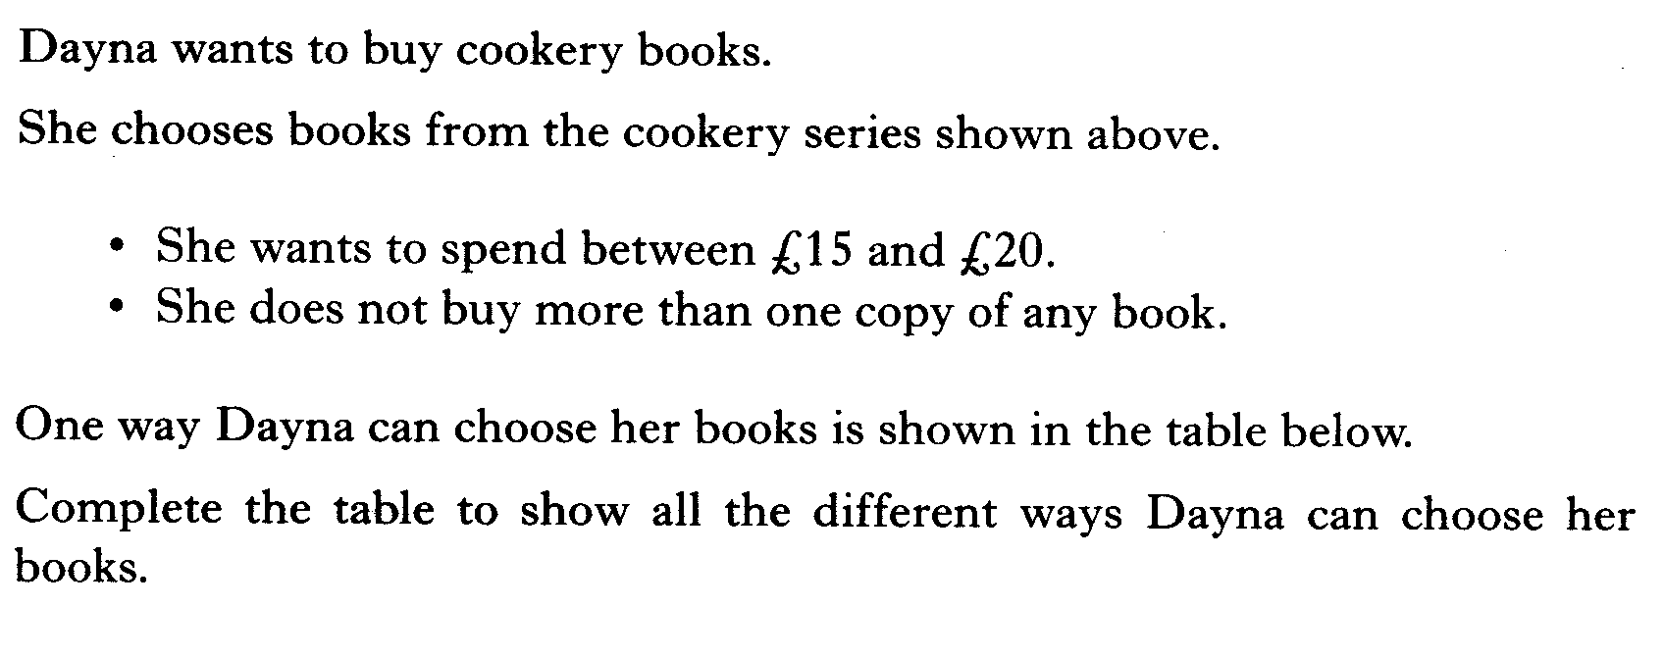
Book Title
Book Title
Book Title
Total Cost

Slide 20
2 KU
4 RE

Slide 21
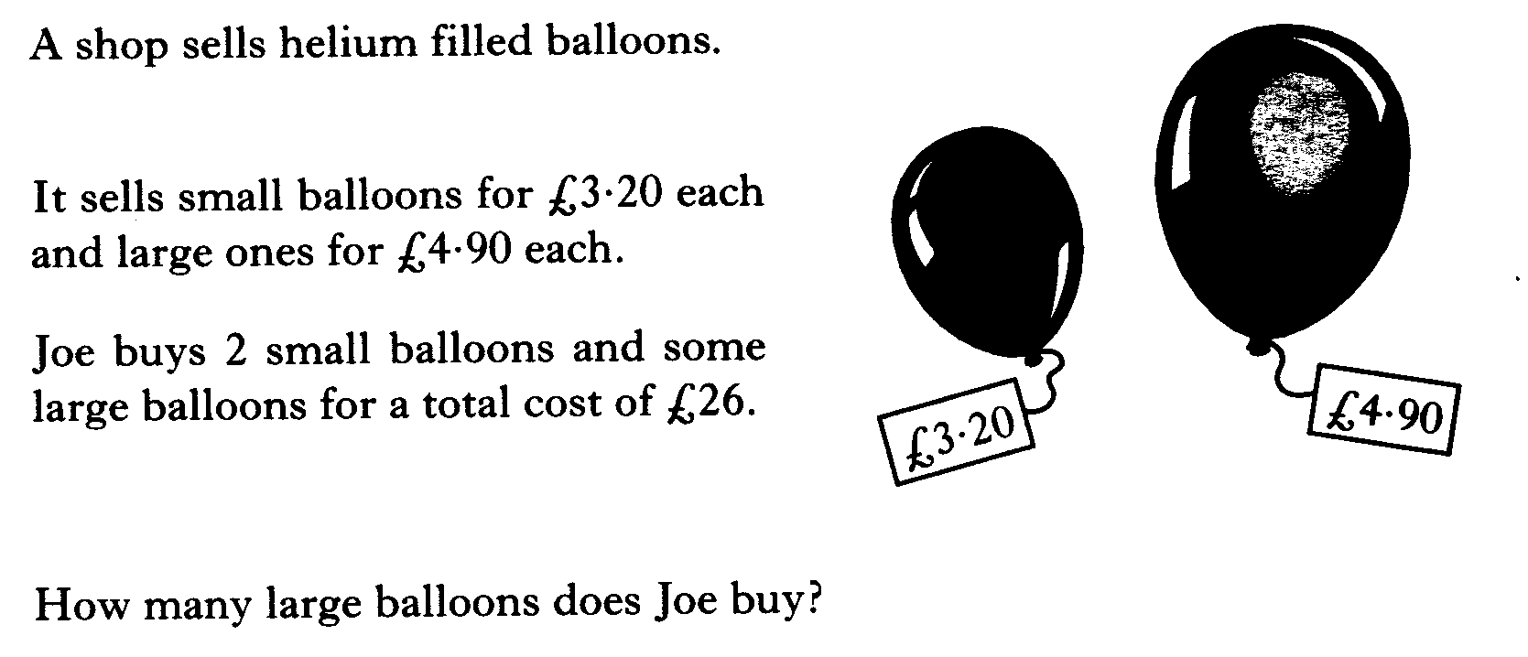

Slide 22
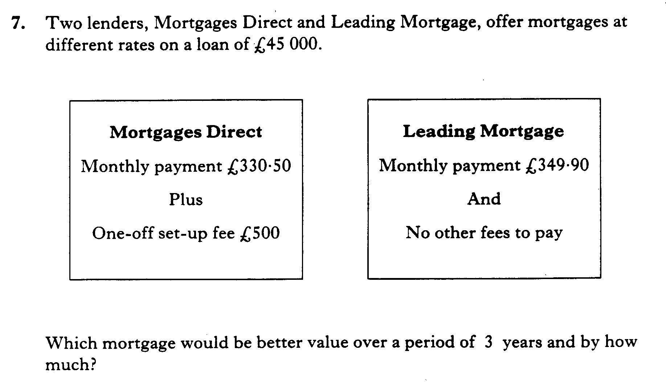

Slide 23
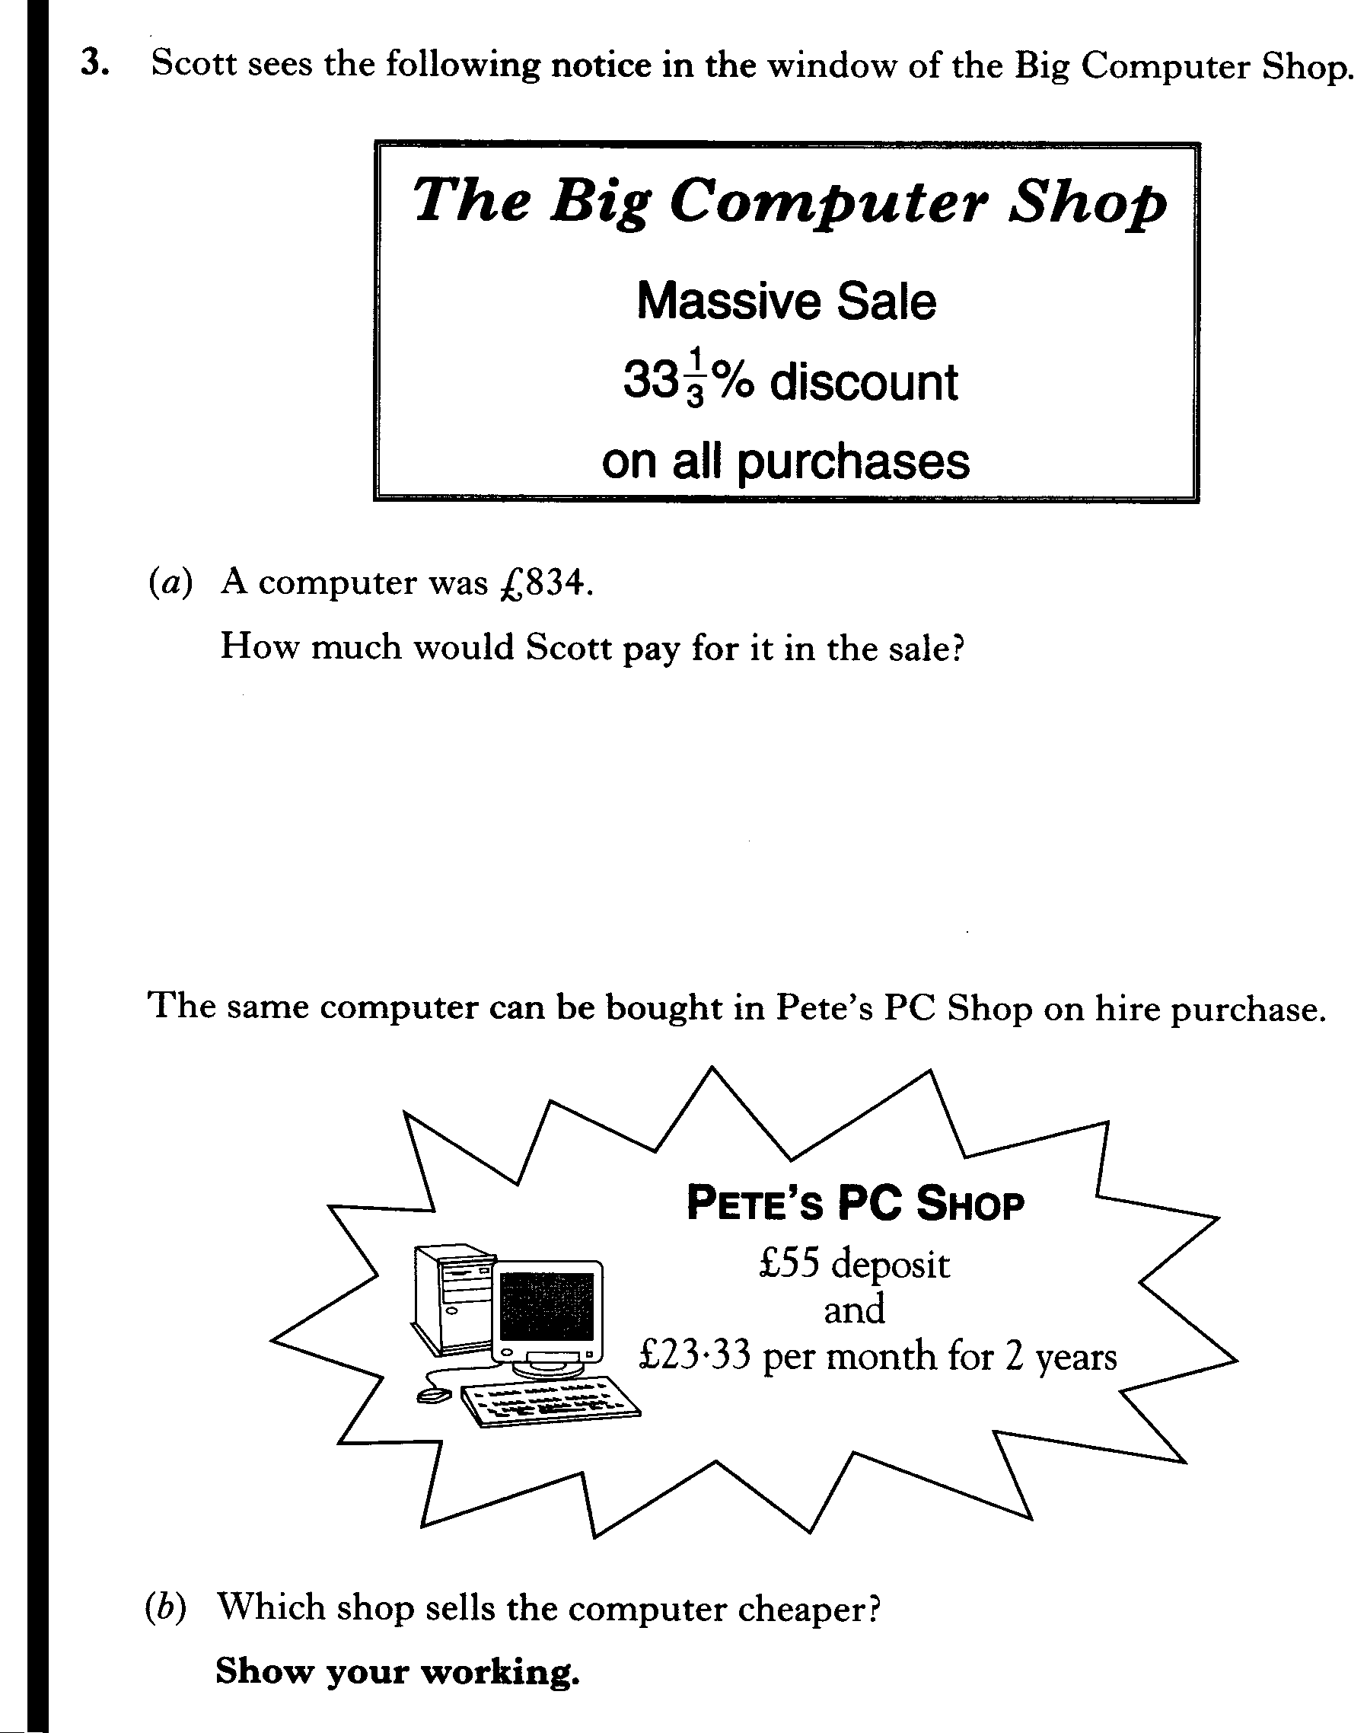

Slide 24


Scott sees the following notice in the window
of the Big Computer Shop.
(a) A computer was £834.
How much would Scott pay for it in the sale?
The same computer can be bought in Pete's PC Shop on hire purchase.
(b)Which shop sells the computer cheaper? Show your working.
$(a)\frac{2}{3} \text{x £834}$
$=£\text{556}$
$\begin{aligned}\text{Big} \text{Computer} \text{Shop} \\ \text{Cheaper} \text{by} \\ £\text{58}\text{.}\text{92}\end{aligned}$
$(b)£\text{55} +\text{ 24} x \text{£23}\text{.}\text{33}$
$=£\text{614}\text{.}\text{92}$

Slide 25
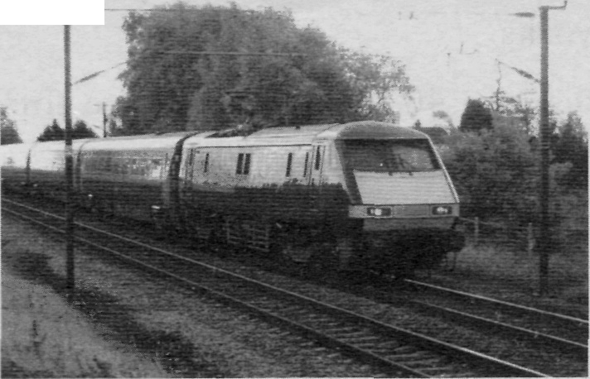
Helen travels between Glasgow and Edinburgh by train.
She buys a monthly TravelPass which costs £264.30.
A daily return ticket would cost £16.90.
Last month Helen made 19 return journeys.
How much did she save by buying the TravelPass?
19 x £16.90=£321.10
Saving=£321.10-£264.30
=£56.80

Slide 26

Andrea sees this advertisement for a computer in CompCo.
CompCo SPECIAL OFFER £779 + VAT (17.5%)
(a) Andrea buys the
computer from CompCo.
VAT is 17.5%.
What is the total cost of the computer?
Round your answer to the
nearest penny
OUR PROMISE :
If you find the same computer at a cheaper price within 1 month, we will refund double the difference.
(a) £77.90+£38.95+£19.48
VAT=£136.33
TOTAL=£136.33+£779
=£915.33
(b) One week later, Andrea sees the
same computer in a different shop
at £900 including VAT.
She remembers the promise in the
CompCo advertisement and returns
to the shop to claim a refund.
How much money should be
refunded to her?
$(b) £\text{15}\text{.}\text{33} x 2=£\text{30}\text{.}\text{66}$
4 Jul 2026
Created by Mr. Lafferty Maths Dept.

Slide 27
A basic cable television package, which includes 30 channels, costs £8.75 per month.
The cost of installation is £75 which will be included in the first month's bill.
Additional channels can be added to the basic service.
The movie channels package costs £12-50 per month.
The music channels package costs £7.50 per month.
The sports channels package costs £14.50 per month.
The Mackie family's first bill after having cable television installed was £98.25.
They chose the basic cable television package plus one additional channels package.
Which additional package did they choose? Give a reason for your answer.
$\text{98}\text{.}\text{25}−8\text{.}\text{75}=\text{89}\text{.}\text{50} (\text{basic})$
$\text{89}\text{.}\text{50}−\text{75}=\text{14}\text{.}\text{50} (\text{installation})$
$⇒\text{Sports} \text{Channels}$

Slide 28
Mara travels 1850 miles every month.
Currently her car runs on unleaded petrol, which costs 76.9p per litre and her car travels 8.5 miles per litre.
(a) What is her monthly petrol bill?
Mara is thinking of having her car converted to run on Liquid Petroleum Gas (LPG).LPG costs 38.9p per litre and using this fuel her car will travel 7.8 miles per litre.
(b) What will be her monthly saving if she converts her car to run on LPG?
(c) The cost of converting Mara's car to run on LPG is £800.
How many months of savings will it take to recover the cost of the conversion?
$(a)\frac{\text{1850}}{8\text{.}5} \text{x 76}\text{.}\text{9p}$
$\begin{aligned}(c) \frac{\text{800}}{\text{75}\text{.}\text{11}} \\ =\text{10}\text{.}\text{65} \\ ⇒\text{11} \text{months}\end{aligned}$
$=\text{16737}p=£\text{167}\text{.}\text{37}$
$(b)\frac{\text{1850}}{7\text{.}8} \text{x 38}\text{.}\text{9p}$
$=£\text{92}\text{.}\text{26}$
$⇒£\text{75}\text{.}\text{11}$

