Slide 1


Mathematical
Similarity
Calculating Scale Factor
Similar Triangles
Parallel Line Triangles
Scale Factor in 2D (Area)
www.mathsrevision.com
Scale Factor 3D (Volume)
Exam Questions

Slide 2
Starter Questions
Q1. Solve 4sin x – 1 = 0
Q2. Find the mini point for f(x) = (2 + x)(4 – x)
www.mathsrevision.com
Q3. Factorise
4d² – 100k²
Q4. Find the mean and standard deviation for the data
4 10 2 3 6

Slide 3
Similarity
Learning Intention
Success Criteria
  We are learning what the term scale factor is and how it applies to shape.
1. Understand the term scale factor.
www.mathsrevision.com
2. Solve problems using scale factor.

Slide 4
Conditions for similarity
Two shapes are similar only when:
Corresponding sides are in proportion and
Corresponding angles are equal
All rectangles are not similar to one another since only condition number 2 is true.

Slide 5

If two objects are similar then one is an enlargement of the other
The rectangles below are similar:
Find the scale factor of enlargement that maps A to B
8 cm
Not to scale!
5 cm
A
16 cm
Scale factor = x2
Note that B to A
would be x ½
10 cm
B

Slide 6
Scale Factor applies to ANY SHAPES that are mathematically similar.
1.4 cm
7 cm
2cm
y
z
3 cm
15 cm
6 cm
Given the shapes are similar, find the values y and z ?
15
1
Scale factor =
ESF =
= 5
Scale factor =
RSF =
= 0.2
3
5
y
is 2 x 5 = 10
z
is 6 x 0.2 = 1.2

Slide 7
Scale Factor applies to ANY SHAPES that are mathematically similar.
b
a
7.5 cm
4 cm
3 cm
8 cm
2cm
10 cm
Given the shapes are similar, find the values a and b ?
4
10
Scale factor =
RSF =
= 0.4
Scale factor =
ESF =
= 2.5
10
4
a
is 8 x 0.4 = 3.2
b
is 2 x 2.5 = 5

Slide 8

Scale Factor
Now try TJ 4+
Ex 20.1
Ch 20 (page 167)
www.mathsrevision.com

Slide 9
Starter Questions
Q1. Find the roots to 1 decimal place
Q2. A freezer is reduced by 20% to £200 in a sale.
What was the original price.
www.mathsrevision.com
Q3. Calculate

Slide 10
Similar Triangles
Learning Intention
Success Criteria
  We are learning how the scale factor applies to similar triangles.
1. Understand how the scale factor applies to similar triangles.
www.mathsrevision.com
2. Solve problems using scale factor .

Slide 11
Similar Triangles
www.mathsrevision.com

Slide 12
These two triangles are similar since they are equiangular.
65º
70º
45º
70º
45º
50º
50º
55º
75º
These two triangles are similar since they are equiangular.
If 2 triangles have 2 angles the same then they must be equiangular
= 180 – 125 = 55

Slide 13
Scale factors
Enlargement Scale factor?
3
ESF =
=
8cm
2
8
8
12
12cm
12
Reduction Scale factor?
www.mathsrevision.com
5cm
2
RSF =
=
3
7.5cm
Can you see the relationship
between the two scale factors?

Slide 14
Scale factors
Find a given ESF = 3
a
ESF = 3
=
9cm
9
a
27cm
By finding the RSF
Find the value of b.
www.mathsrevision.com
b
5cm
1
b
5
RSF =
=
=
15cm
3
15
15

Slide 15
Scale Factor
Now try TJ 4+
Ex 20.2
Ch 20 (page 169)
www.mathsrevision.com

Slide 16
Starter Questions
Q1. A 42” TV is reduced by 10% to £540 in a sale.
What was the original price.
www.mathsrevision.com
Q3. Calculate

Slide 17
Parallel Triangles
Learning Intention
Success Criteria
  We are learning how to use scale factor for parallel triangles.
1. Understand how the scale factor applies to parallel triangles.
www.mathsrevision.com
2. Solve problems using scale factor for parallel triangles.

Slide 18
If BC is parallel to DE, explain why triangles ABC and ADE are similar
A
Angle BAC = angle DAE (common to both triangles)
B
C
Angle ABC = angle ADE (corresponding angles between parallels)
D
E
Angle ACB = angle AED (corresponding angles between parallels)
A line drawn parallel to any side of a triangle produces 2 similar triangles.
A
A
B
B
D
E
D
E
C
C
Triangles EBC and EAD are similar
Triangles DBC and DAE are similar

Slide 19
The two triangles below are similar:
Find the distance y.
C
B
20 cm
y
A
5 cm
E
45 cm
D
AE
5
1
RSF =
=
=
AD
50
10
1 x 20
y =
=
2 cm
10

Slide 20
In the diagram below BE is parallel to CD and all measurements are as shown.
Calculate the length CD
Calculate the perimeter of the Trapezium EBCD
A
A
4.5 m
6 m
7.5 cm
10 m
B
E
4.8 m
3 cm
4 m
C
D
8 cm
C
8 cm
D
So perimeter
= 3 + 8 + 4 + 4.8
= 19.8 cm

Slide 21
In a pair of similar triangles the ratio of the corresponding sides is
constant, always producing the same enlargement or reduction.
Find the values of x given that the triangles are similar.
T
Corresponding sides are in proportion
TS
8
Q
x
ESF
=
=
6.4
PQ
5
5
R
8 x 4
RT = x
=
8
5
4
x
=
6.4
P
S

Slide 22
Parallel Triangles
Now try TJ 4+
Ex 20.3
Ch 20 (page 171)
www.mathsrevision.com

Slide 23
Starter Questions
Q1. Find the mean and standard deviation for the data
www.mathsrevision.com
Q2. Solve the equation

Slide 24
Area of Similar Shape
Learning Intention
Success Criteria
  We are learning how the scale factor applies to area.
1. Understand how the scale factor applies to area.
www.mathsrevision.com
2. Solve area problems using scale factor.

Slide 25
Area of Similar Shape
Draw an area with
sides 2 units long.
Draw an area with sides 4 units long.
2
y
4
2
y
x
Area = 2 x 2 = 4
4
Area = 4 x 4 = 16
www.mathsrevision.com
x
It should be quite clear that second area is four times the first.
The scaling factor in 2D (AREA) is (SF)².
For this example we have this case SF = 2 (2)² = 4.

Slide 26
Another example of similar area ?
Work out the area of each shape
and try to link AREA and SCALE FACTOR
Connection ?
2cm
6cm
4cm
12cm
Small Area = 4 x 2 = 8cm²
Large Area = 12 x 6 = 72cm²
Scale factor =
ESF =
12
= 3
4
Large Area = (3)² x 8 =
9 x 8 =
72cm²

Slide 27
Example
The following two shapes are said to be similar.
If the smaller shape has an area of 42cm².
Calculate the area of the larger shape.
3cm
Working
4cm
ESF =
So area S.F =
Area of 2nd shape =
X 42
=
X 42
= 74.67cm²

Slide 28
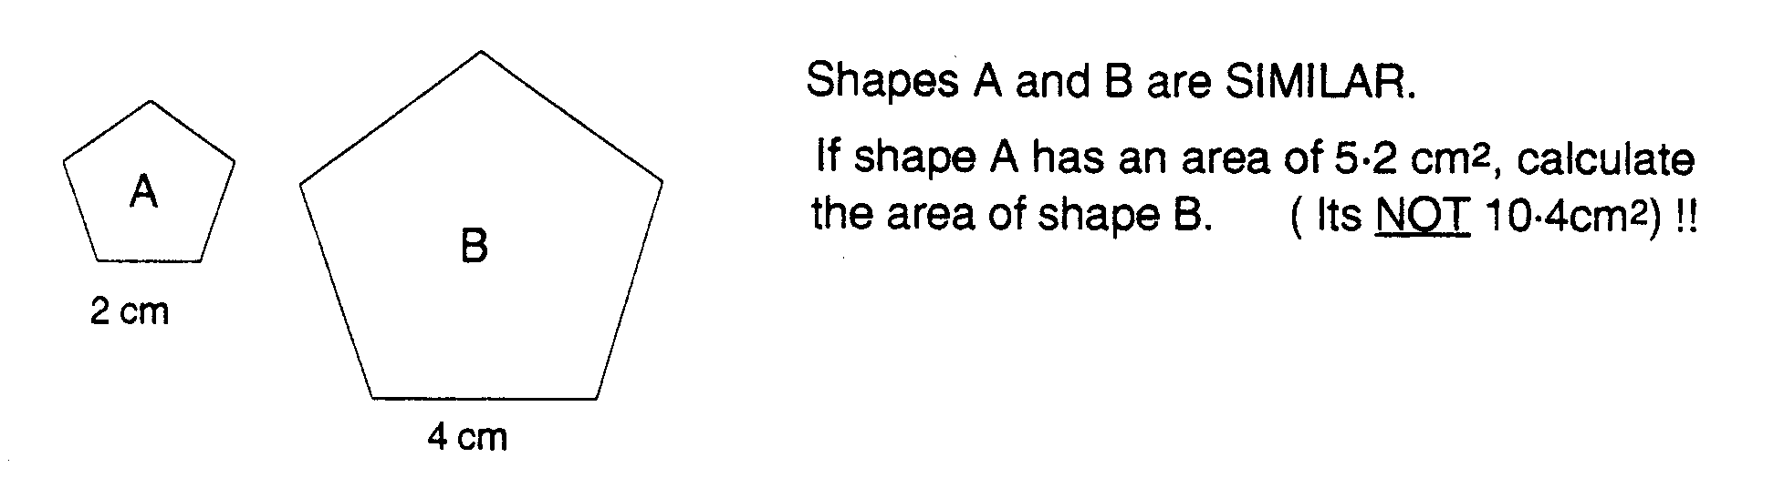
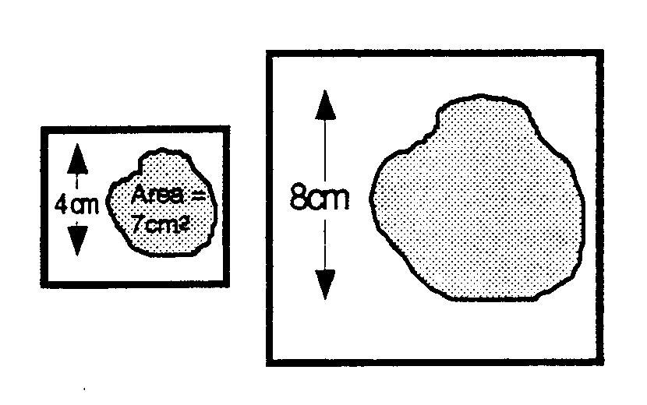
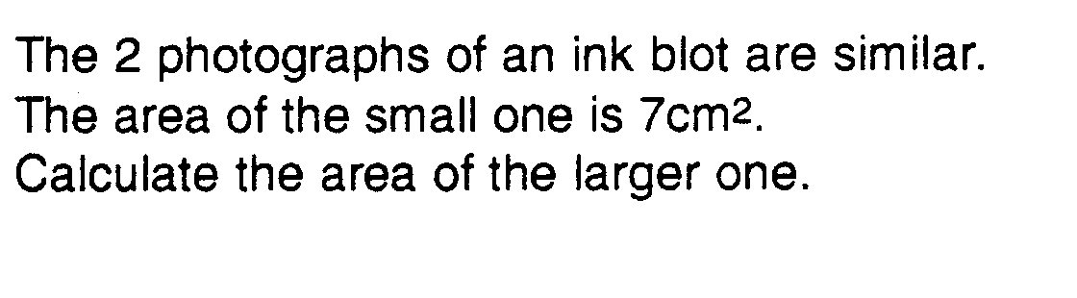
Questions
1.
2.

Slide 29
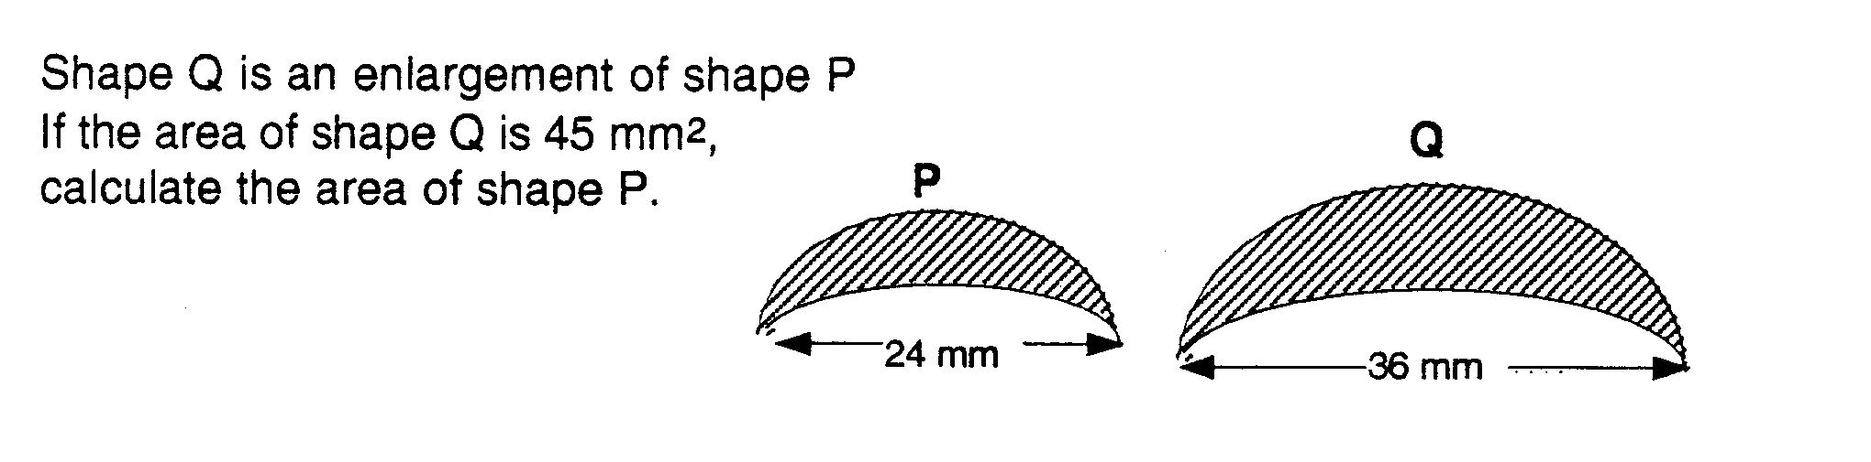
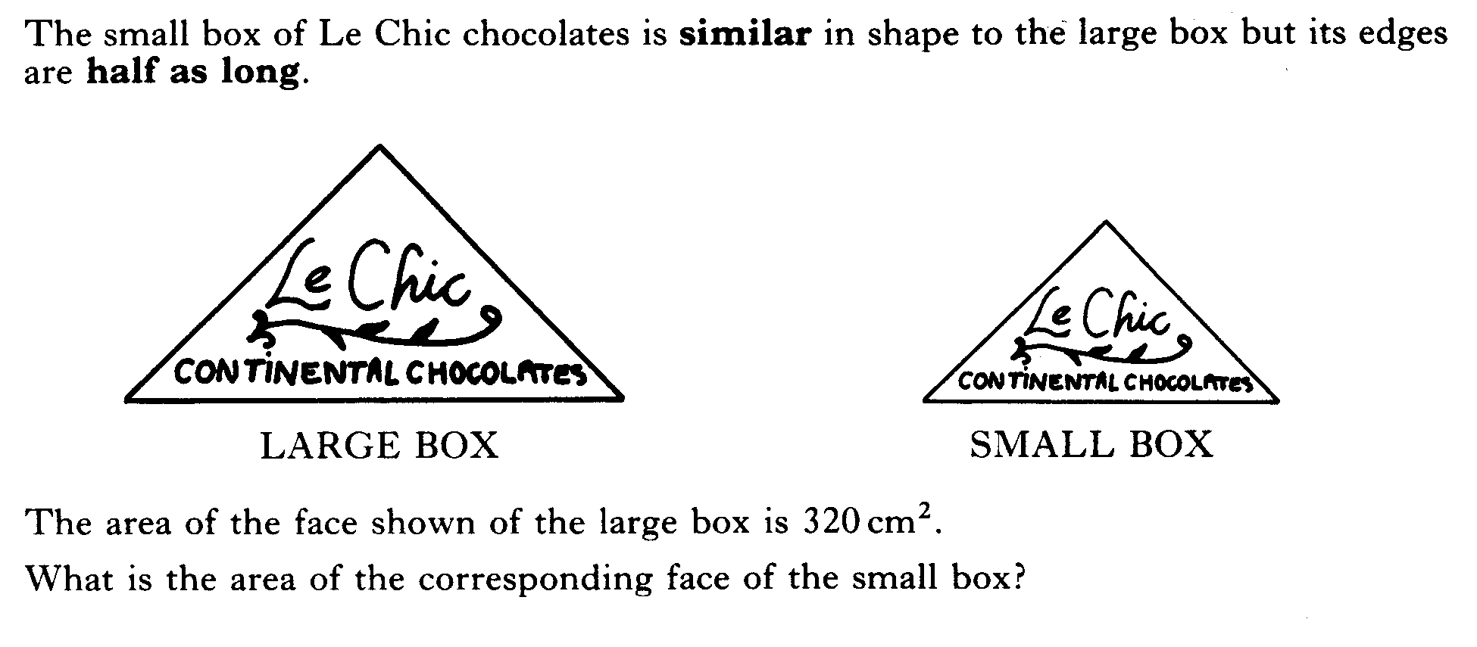
3.
4.

Slide 30
Area Similarity
Now try TJ 4+
Ex 20.4
Ch 20 (page 173)
www.mathsrevision.com

Slide 31
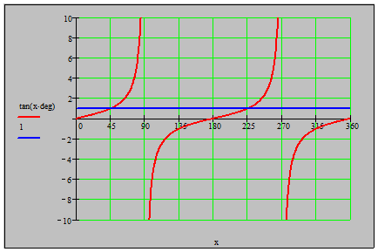
Starter Questions
Q1. Draw a box plot to represent the data.
www.mathsrevision.com
Q2. Find the
coordinates
where the line
and curve meet.

Slide 32
Volumes of Similar Solids
Learning Intention
Success Criteria
  We are learning how the scale factor applies to volume.
1. Understand how the scale factor applies to 3D – volume.
www.mathsrevision.com
2. Solve volume problems using scale factor.

Slide 33
Volumes of Similar Solids
Draw a cube with sides 2 units long.
2
Draw a cube with sides 4 units long.
y
z
2
2
x
4
Volume = 2 x 2 x 2 = 8
y
z
www.mathsrevision.com
4
4
x
Volume = 4 x 4 x 4 = 64
Scale factor =
ESF =
4
= 2
2
Using our knowledge from AREA section, (SF)².
For VOLUME the scale factor is (SF)³ = (2)³ = 8

Slide 34
Another example of similar volumes ?
Work out the volume of each shape
and try to link volume and scale factor
Connection ?
4cm
2cm
2cm
4cm
3cm
6cm
V = 3 x 2 x 2 = 12cm³
V = 6 x 4 x 4 = 96cm³
Scale factor =
ESF =
6
= 2
3
Large Volume = (2)³ x 12 =
8 x 12 =
96cm³

Slide 35
Given that the two boxes are similar, calculate the volume of the large box if the small box has a volume of 15ml
2cm
6cm
6
ESF =
=
3
2
So volume of large box =
=
= 405 ml

Slide 36
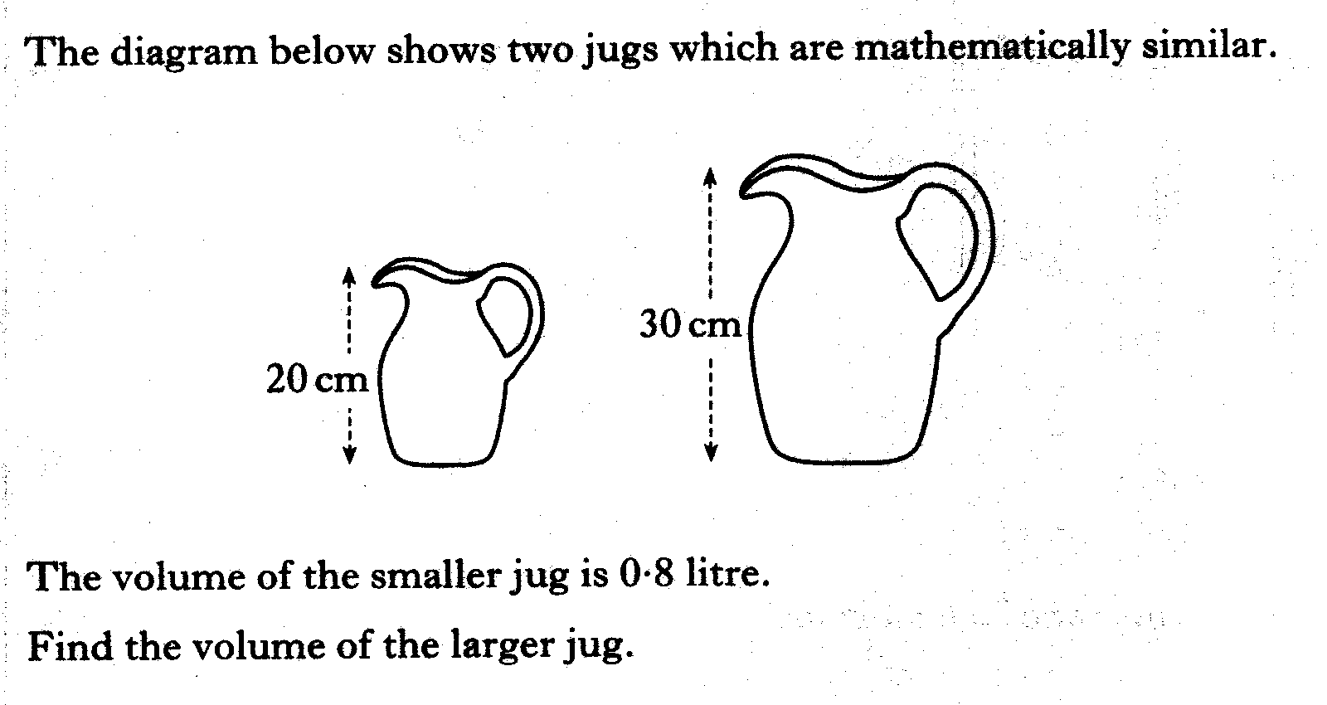
Example
ESF =
So volume of large jug =
=
= 2.7 litres

Slide 37
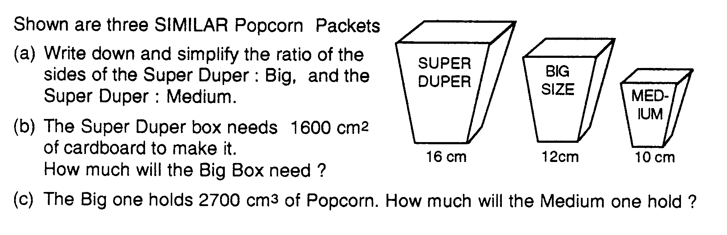
(a) SD : B = 4 : 3
SD : M = 8 : 5
(b) RSF =
900cm²
(c) RSF =
1562.5cm³

Slide 38
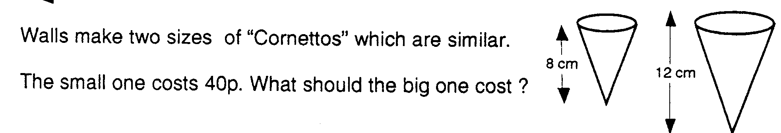
ESF =
So volume of large jug =
=
= £1.35

Slide 39
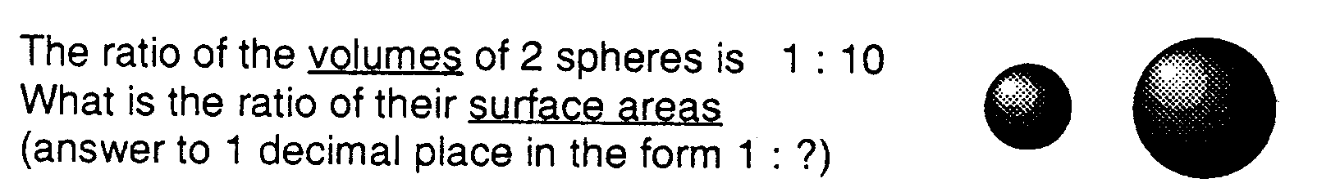
(SF )³ =
SF = 2.1544
So surface area ratio = (SF)² =
= 4.64
Ratio of their surface area is 1 : 4.6 (to 1 d.p.)

Slide 40
Volume Similarity
Now try TJ 4+
Ex 20.5
Ch 20 (page 175)
www.mathsrevision.com

Slide 41
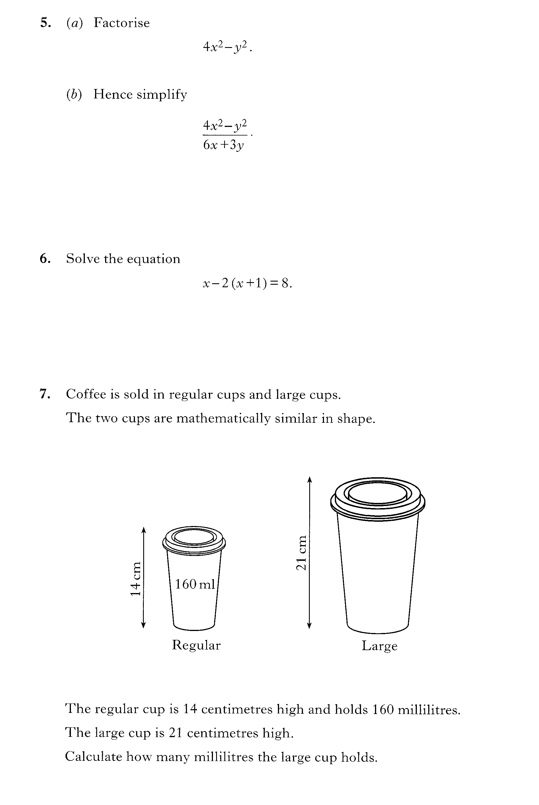

Slide 42

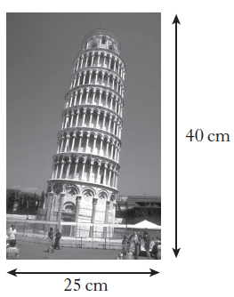
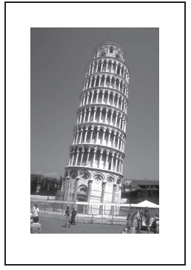

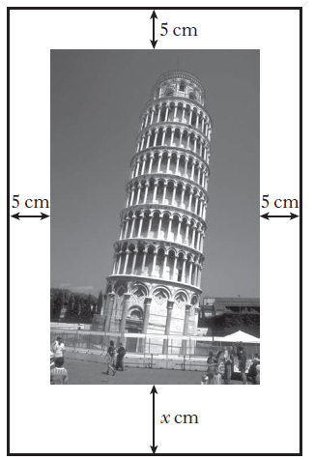
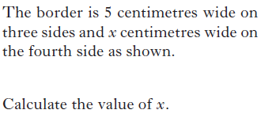

Slide 43
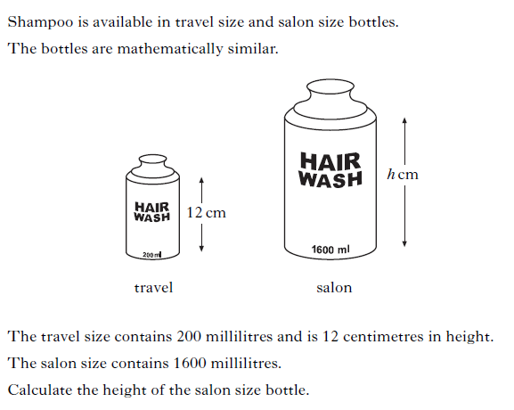

Slide 44



Slide 45
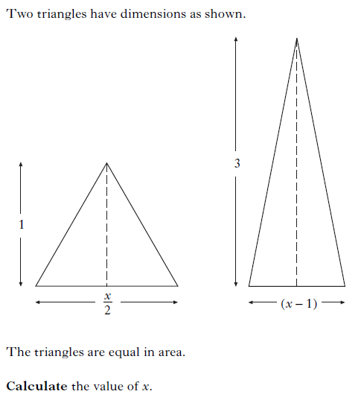

Slide 46
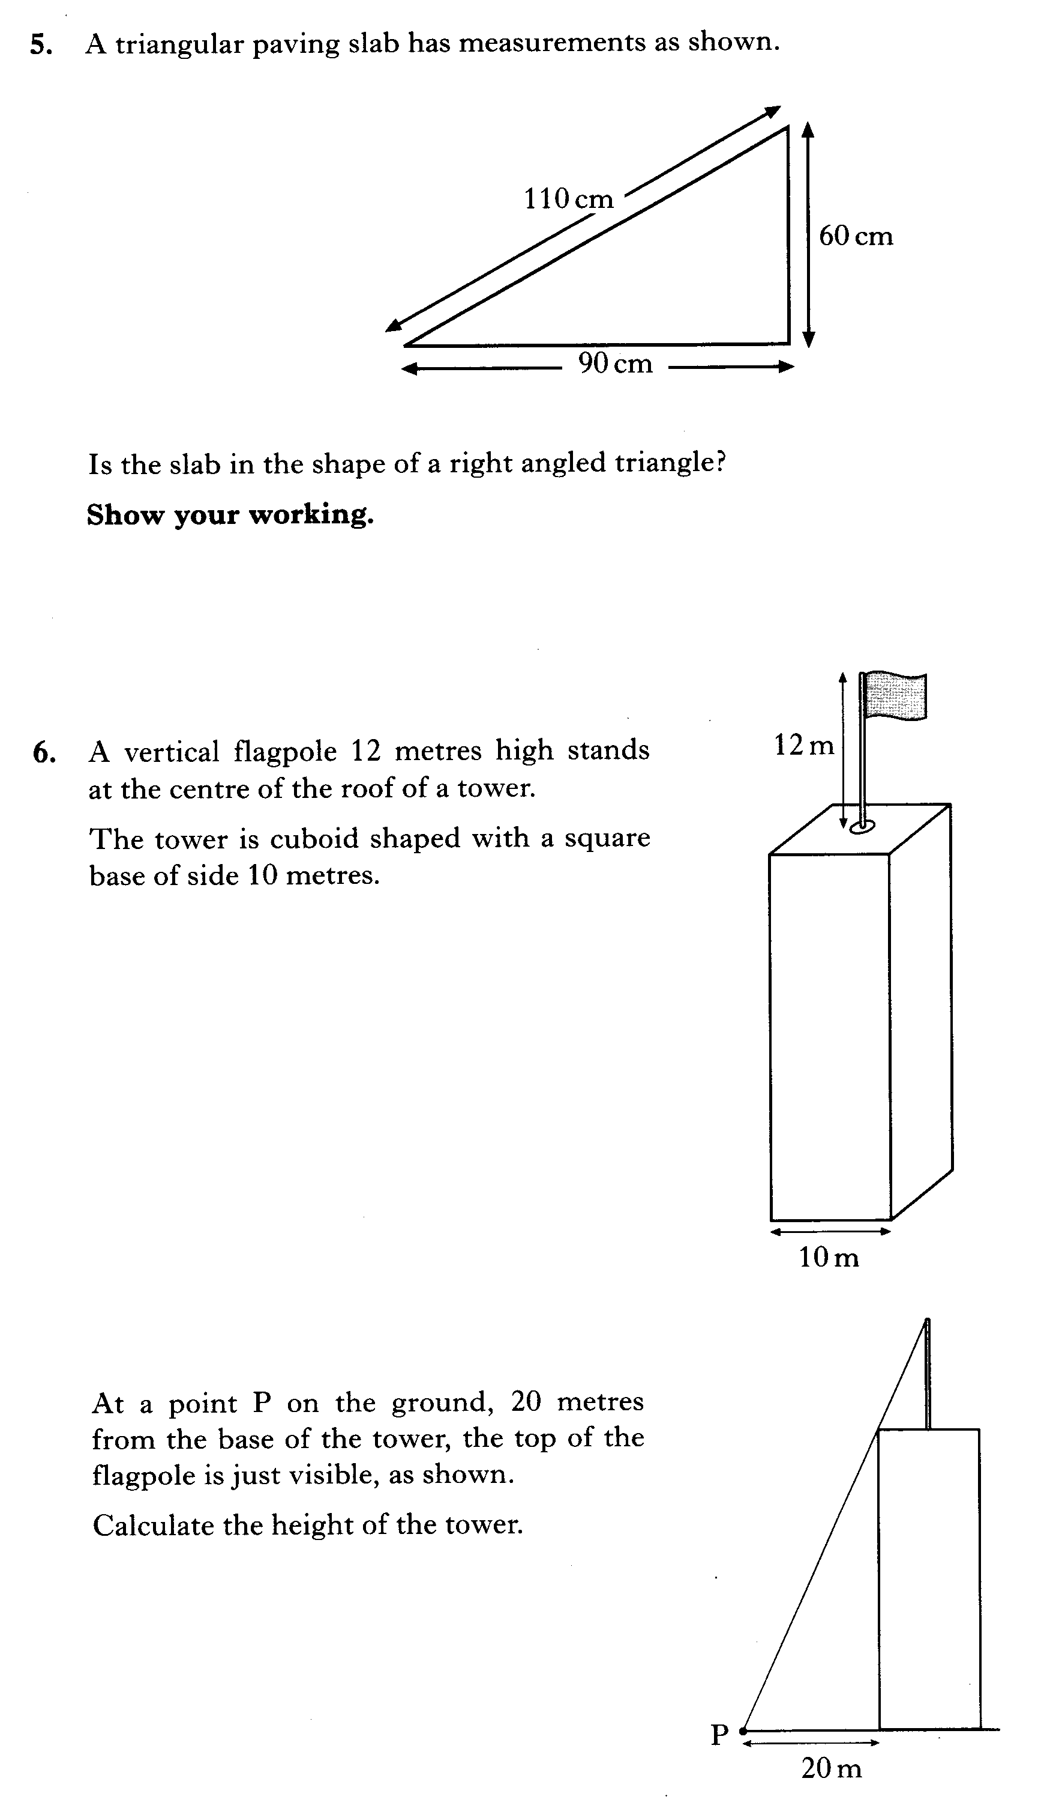

Slide 47
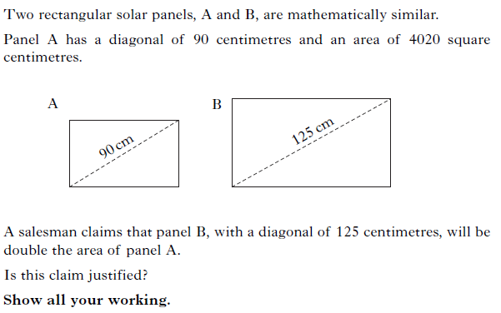

Slide 48
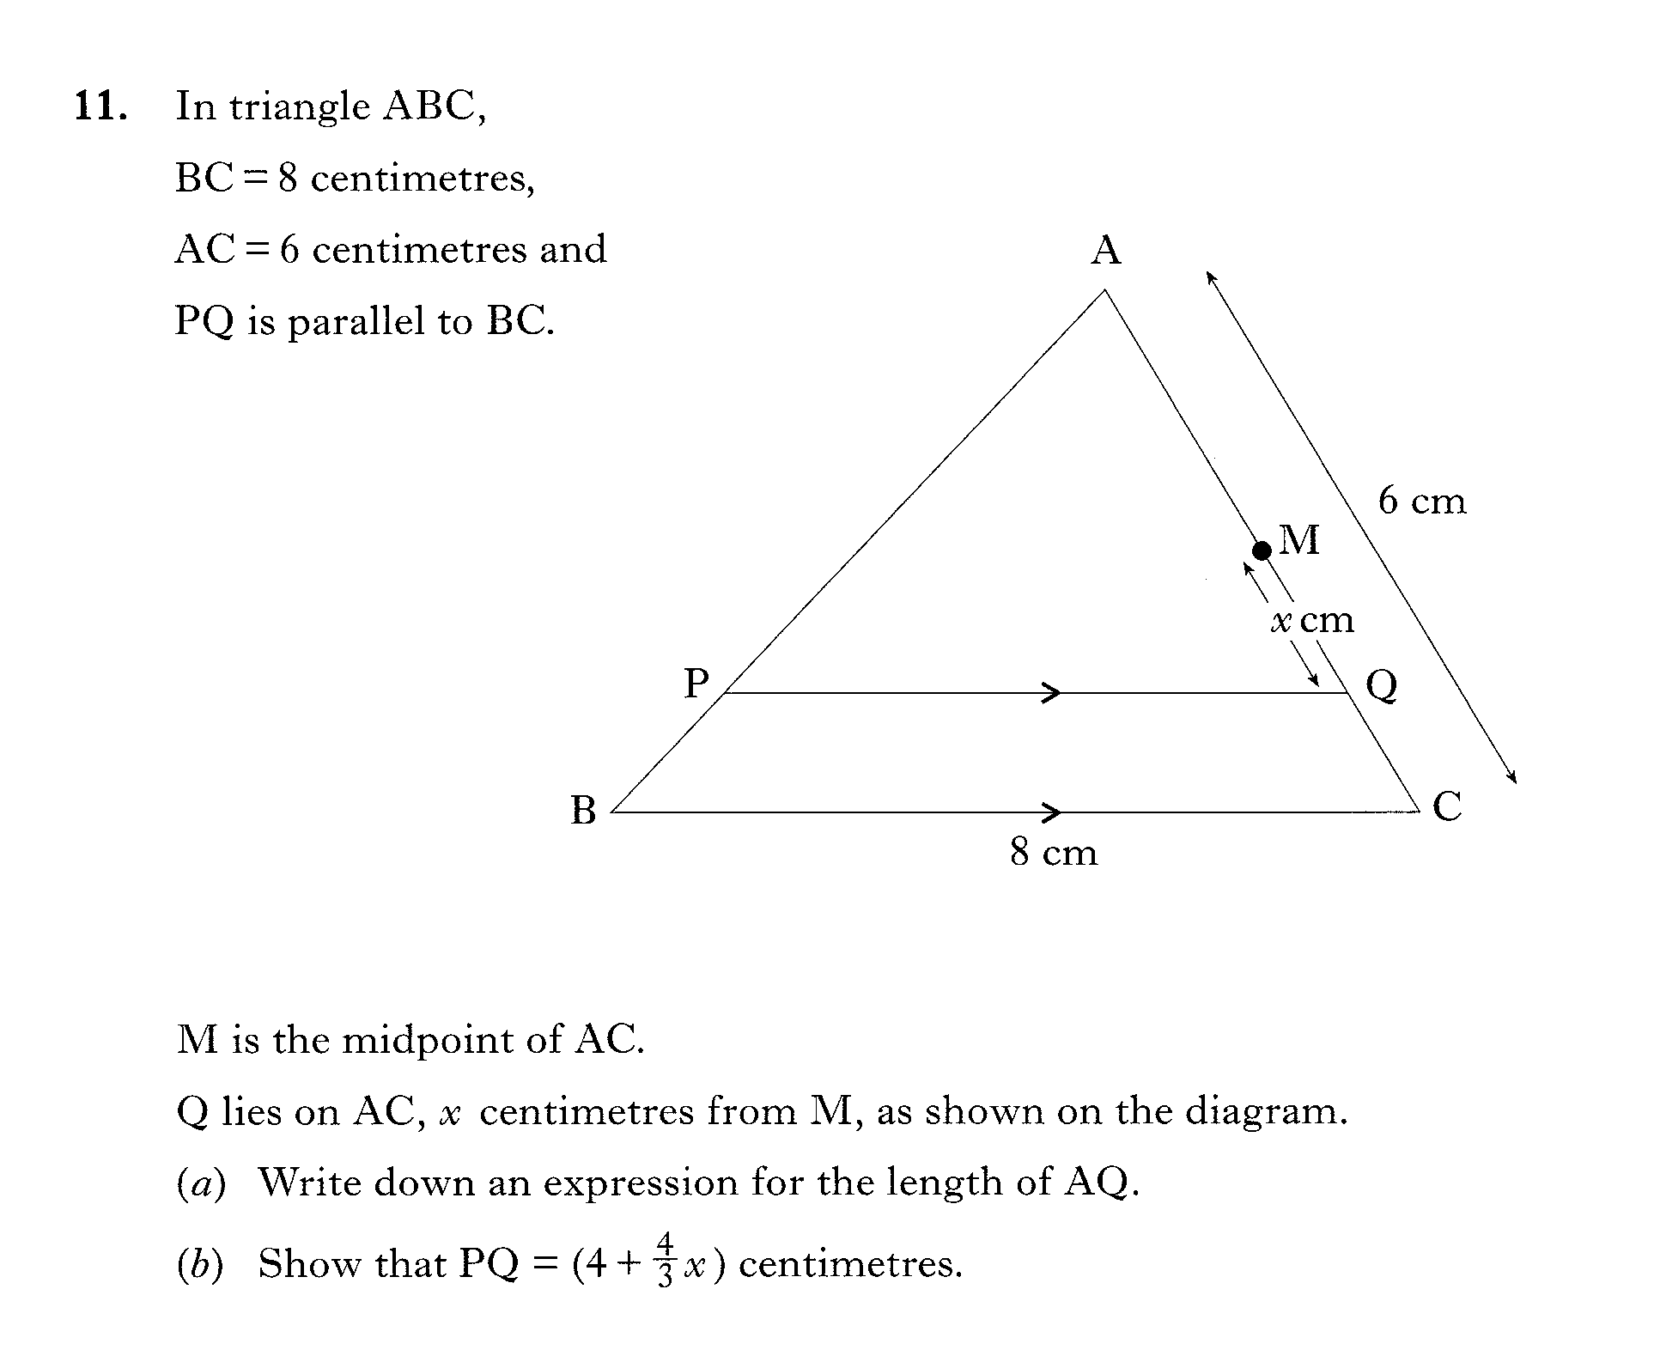

Slide 49
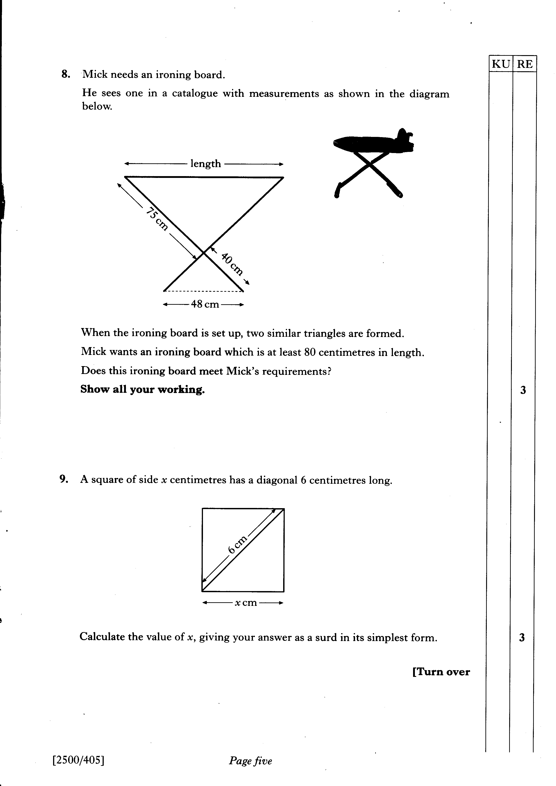

Slide 50
