Slide 1


Algebraic Fractions
Equivalent and Simplifying Fractions
Factorising and Simplifying Fractions
Adding & Subtracting Fractions
Multiplication & Division of Fractions
Exam Type Questions
www.mathsrevision.com

Slide 2
S3 Starter Questions
www.mathsrevision.com
11 Jul 2026
Compiled by Mr. Lafferty Maths Dept.

Slide 3
Algebraic Fractions
Learning Intention
Success Criteria
  We are learning how to simplify algebraic fractions.
  Understand term
  Highest Common Factor.
  2. Simplify algebraic fractions by identifying HCF.
www.mathsrevision.com
www.mathsrevision.com

Slide 4
Equivalent Fractions
Multiply top and bottom by any number
Multiply top and bottom by any number or letter
We already know how to create an equivalent fraction for numerical fractions.
The exact same process is used for algebraic fractions.
Numerical Fraction
Algebraic Fraction
www.mathsrevision.com

Slide 5
Equivalent Fractions
Common Denominator for 2 fractions
Numerical Fraction
Algebraic Fraction
www.mathsrevision.com

Slide 6
Algebraic Fractions
We can sometimes reduce fractions to a simpler form if the numerator and denominator have a number or letter in common.
Examples
HCF = 3
HCF = Y
www.mathsrevision.com

Slide 7
We can only simplify if fraction is a product of factors.
Algebraic Fractions
Examples
1
1
1
1
3
1
3
1
6
1
1
1
1
1
1
1
1
1
www.mathsrevision.com

Slide 8
We can only simplify if fraction is a product of factors.
Algebraic Fractions
Examples
1
1
1
1
1
1
www.mathsrevision.com

Slide 9
We can only simplify if fraction is a product of factors.
Algebraic Fractions
Examples
1
1
3
1
4
1
www.mathsrevision.com

Slide 10
What Goes In The Box ?
Nat 5
Factorise first
www.mathsrevision.com

Slide 11

Algebraic Fractions
Nat 5
Now try N5 TJ
Ex 9.1
Ch9 (page 90)

Slide 12
Starter Questions
In pairs,
write down the three types of factorising
and show an example of each.
11 Jul 2026
Compiled by Mr. Lafferty Maths Dept.

Slide 13
Algebraic Fractions
Learning Intention
Success Criteria
  We are learning how to simplify algebraic fractions by first factorising.
  Know the three types of factorisations.
  2. Simplify algebraic fractions by first factorising.
www.mathsrevision.com
www.mathsrevision.com

Slide 14
Algebraic Fractions
Type 1
1
3
1
1
www.mathsrevision.com

Slide 15
Algebraic Fractions
Type 2
1
1
1
1
www.mathsrevision.com

Slide 16
Algebraic Fractions
Type 3
1
1
1
1
www.mathsrevision.com

Slide 17
Algebraic Fractions
Nat 5
Now try N5 TJ
Ex 9.2
Ch9 (page 92)

Slide 18
Starter Questions
Nat 5
Q1. Explain why 4 + 6 x 5 = 34 and not 50
Q2. Calculate
Q3. Does x² – 121 factorise to (x – 11) (x - 11)
Q4. The cost of an iPod is £80 including VAT.
How much is the iPod BEFORE VAT.
11 Jul 2026
Compiled by Mr. Lafferty Maths Dept.

Slide 19
Algebraic Fractions
Addition
Learning Intention
Success Criteria
  We are learning how to add & subtract algebraic fractions.
  Know how to add and subtract algebraic fractions using equivalent fractions.
www.mathsrevision.com
www.mathsrevision.com

Slide 20
Algebraic Fractions
Nat 5
Addition
LCM = 4
LCM = d
Example
Example
2
+
1
3
+
1
4
4
d
d
www.mathsrevision.com

Slide 21
Algebraic Fractions
Nat 5
Subtraction
LCM = 20
LCM = pm
Example
Example
15
-
8
3m
p
-
20
20
pm
pm
www.mathsrevision.com

Slide 22
Algebraic Fractions
LCM = (x-1)(x+1)
Nat 5
Addition
LCM = 4x
Example
Example
12
+
x²
3(x + 1)
+
x(x - 1)
4x
4x
(x - 1)(x + 1)
(x - 1)(x + 1)
12 + x²
3x + 3 + x² – x
4x
(x - 1)(x + 1)
x² + 2x + 3
(x - 1)(x + 1)
www.mathsrevision.com

Slide 23
Algebraic Fractions
LCM = x(x+5)
Nat 5
Subtraction
LCM = 5g
Example
Example
15
fg
3(x + 5)
x
-
-
5g
5g
x(x + 5)
x(x + 5)
3x + 15
-
x
15 - fg
x(x + 5)
5g
2x + 15
www.mathsrevision.com
x(x + 5)

Slide 24
What Goes In The Box ?
Nat 5
www.mathsrevision.com

Slide 25
What Goes In The Box ?
Nat 5
www.mathsrevision.com

Slide 26
Algebraic Fractions
Nat 5
Addition & Subtraction
Now try N5 TJ
Ex 9.3 Q1 ...Q9
Ch6 (page 93)

Slide 27
Fraction Equations
Nat 5
Multiply EVERY term to get rid of fractional term.
and then apply
‘Balancing Method’
Example
x + 2
+ 5 = 8
4
(x 4)
x + 2 + 20 = 32
Tidy Up !
www.mathsrevision.com
x + 22 = 32
- 22
- 22
x = 10
11 Jul 2026
Created by Mr. Lafferty Maths Dept.

Slide 28
Fraction Equations
MTH 3-15a
MTH 4-15a
Example
2
22x = 132
3
(2x – 4) + x = 16
2
3
(÷ 22)
(x 6)
x = 6
(2x – 4) + x = 96
9
4
www.mathsrevision.com
Tidy Up !
18x
- 36
+ 4x = 96
22x - 36 = 96
+ 36
+ 36
11 Jul 2026
Created by Mr. Lafferty Maths Dept.

Slide 29
Algebraic Fractions
Nat 5
Addition & Subtraction
Now try N5 TJ
Ex 9.3 Q10
Ch6 (page 94)

Slide 30
Starter Questions
11 Jul 2026
Compiled by Mr. Lafferty Maths Dept.

Slide 31
Algebraic Fractions
Multiplication & Division
Learning Intention
Success Criteria
  We are learning how to multiply and divide algebraic fractions.
  Know rules for multiplying and dividing fractions.
www.mathsrevision.com
  2. Apply knowledge to algebraic fractions.
www.mathsrevision.com

Slide 32
Remember you can simplify top and bottom and diagonally first to make things easier
Algebraic Fractions
Nat 5
Multiplication & Division
Numerical fraction
Algebraic Fraction
3
5
1
10
1
2
www.mathsrevision.com

Slide 33
Be careful !!! ONLY at the multiplication stage can you simplify to make things easier
Algebraic Fractions
Nat 5
Multiplication & Division
Numerical Fraction
Algebraic Fraction
8
1
15
1
www.mathsrevision.com

Slide 34
Remember you can simplify top and bottom and diagonally first to make things easier
Algebraic Fractions
Nat 5
Multiplication & Division
Example 2
Example 3
1
1
1
1
www.mathsrevision.com

Slide 35
Be careful !!! ONLY at the multiplication stage can you simplify to make things easier
Algebraic Fractions
Nat 5
Multiplication & Division
Example 2
Example 3
4
3
www.mathsrevision.com

Slide 36
Be careful !!! ONLY at the multiplication stage can you simplify to make things easier
Algebraic Fractions
Nat 5
Multiplication & Division
Example 4
1
1
1
1
1
1

Slide 37
What Goes In The Box ?
Nat 5
Multiplication & Division
www.mathsrevision.com

Slide 38
What Goes In The Box ?
Nat 5
Multiplication & Division
www.mathsrevision.com

Slide 39
Algebraic Fractions
Nat 5
Multiplication & Division
Now try N5 TJ
Ex 9.4
Ch9 (page 95)

Slide 40
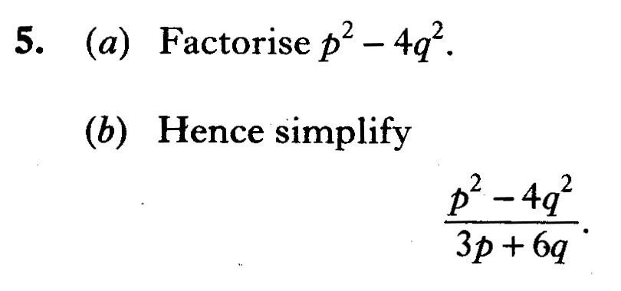

Slide 41
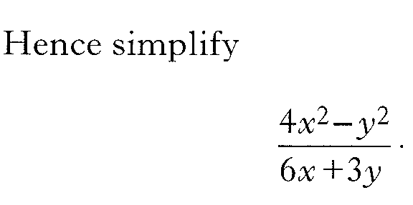

Slide 42
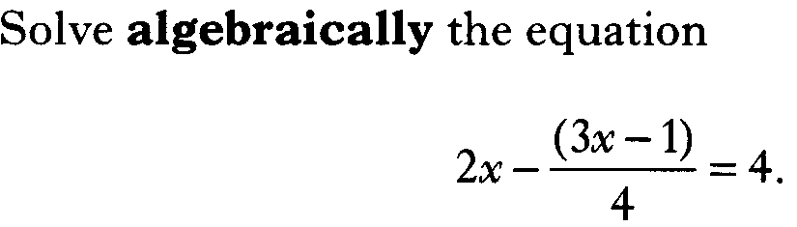

Slide 43
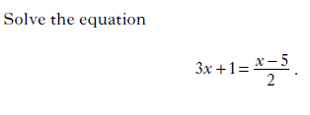

Slide 44
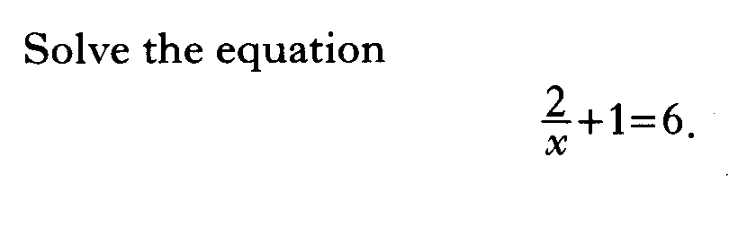

Slide 45
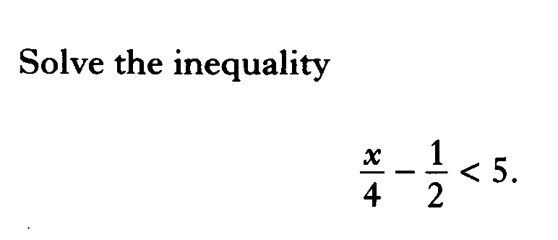

Slide 46
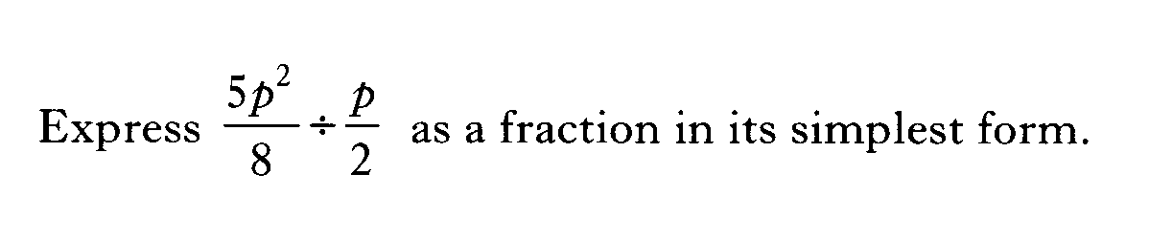

Slide 47
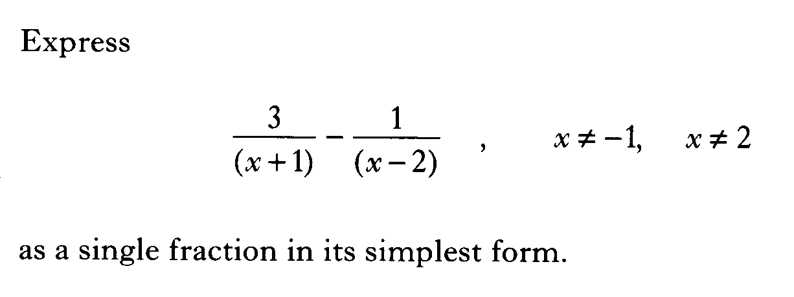

Slide 48
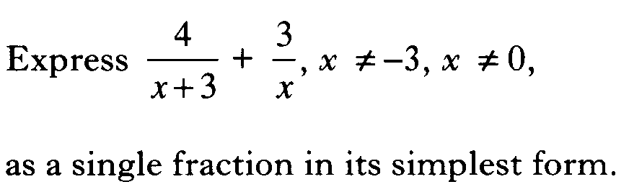

Slide 49
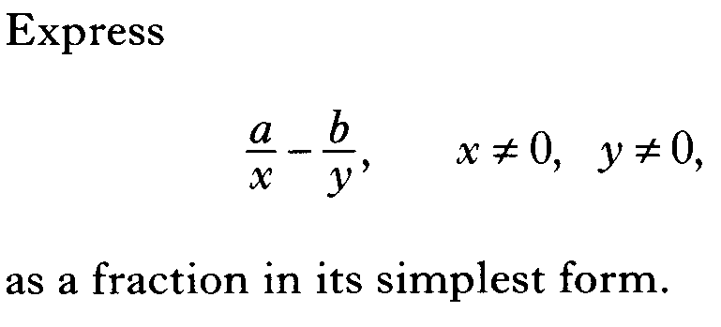

Slide 50
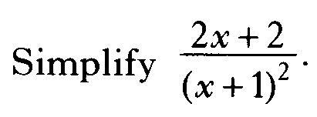

Slide 51
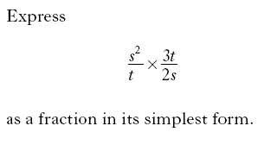

Slide 52


Slide 53
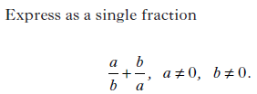

Slide 54


Slide 55


Slide 56
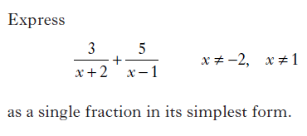

Slide 57
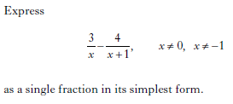

Slide 58
