Slide 1


Trigonometry
Nat 5
Revision (S^{O}H)(C^{A}H)(T^{O}A)
Area of ANY Triangle
Sine Rule Finding a length
Sine Rule Finding an Angle
www.mathsrevision.com
Cosine Rule Finding a Length
Cosine Rule Finding an Angle
Mixed Problems
Exam Type Questions

Slide 2
Starter Questions
Nat 5
www.mathsrevision.com
xº
10
6
8

Slide 3
Angles & Triangles
Nat 5
Learning Intention
Success Criteria
  We are revising S^{O}HC^{A}HT^{O}A process.
  1. Know the tree ratios for S^{O}HC^{A}HT^{O}A.
www.mathsrevision.com
  2. Use S^{O}HC^{A}HT^{O}A to finding an angle or length given a right-angled triangle.

Slide 4


The Three Ratios
Nat 5
opposite
adjacent
Cosine
Tangent
Sine
hypotenuse
Sine
adjacent
adjacent
Cosine
www.mathsrevision.com
Cosine
Tangent
hypotenuse
opposite
opposite
Sine
Sine
hypotenuse

Slide 5
Nat 5
Opp
Adj
Opp
Sin x° =
Cos x° =
Tan x° =
Hyp
Hyp
Adj
S^{O}H
C^{A}H
T^{O}A

Slide 6

Nat 5
Process
1. Write down
S^{O}H C^{A}H T^{O}A
2.
Identify what you want to find
3.
what you know
Copy this!

Slide 7
S^{O}H C^{A}H T^{O}A
(4 marks)

Slide 8
S^{O}H C^{A}H T^{O}A

Slide 9
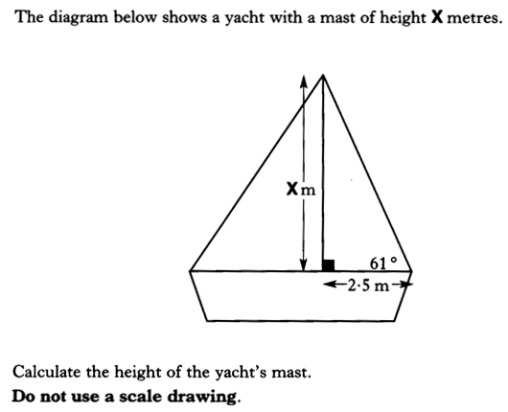
S^{O}H C^{A}H T^{O}A

Slide 10
S^{O}H C^{A}H T^{O}A
(4marks)

Slide 11

Now try N5 TJ
Ex8.1 Q3 onwards
Ch8 (page 71)

Slide 12
Starter Questions
Nat 5
www.mathsrevision.com

Slide 13
Area of ANY Triangle
Nat 5
Learning Intention
Success Criteria
  1. We are learning how to apply the Area formula for ANY triangle.
  Know the formula for the area of any triangle.
  2. Use formula to find area of any triangle given two length and angle in between.
www.mathsrevision.com

Slide 14
Labelling Triangles
Nat 5
In Mathematics we have a convention for labelling triangles.
B
B
a
c
C
C
www.mathsrevision.com
b
A
A
Small letters a, b, c refer to distances
Capital letters A, B, C refer to angles

Slide 15
Labelling Triangles
Nat 5
Have a go at labelling the following triangle.
E
E
d
f
F
F
www.mathsrevision.com
e
D
D

Slide 16
General Formula for
Area of ANY Triangle
Nat 5
Cº
Consider the triangle below:
b
a
h
Aº
Bº
c
Area = ½ x base x height
What does the sine of Aº equal
www.mathsrevision.com
Change the subject to h.
h = b sinAº
Substitute into the area formula

Slide 17
Area of ANY Triangle
Key feature
To find the area
you need to know
2 sides and the angle in between (SAS)
Nat 5
The area of ANY triangle can be found
by the following formula.
B
B
a
Another version
c
C
C
www.mathsrevision.com
b
Another version
Demo
A
A

Slide 18
Area of ANY Triangle
Nat 5
Example : Find the area of the triangle.
B
The version we use is
B
20cm
c
C
30º
C
www.mathsrevision.com
25cm
A
A

Slide 19
Area of ANY Triangle
Nat 5
Example : Find the area of the triangle.
E
The version we use is
10cm
60º
8cm
F
www.mathsrevision.com
D

Slide 20
What Goes In The Box ?
Key feature
Remember (SAS)
Nat 5
Calculate the areas of the triangles below:
(1)
12.6cm
A = 36.9cm²
23º
15cm
www.mathsrevision.com
(2)
5.7m
71º
A = 16.7m²
6.2m

Slide 21
Now try N5 TJ
Ex 8.2
Ch8 (page 73)

Slide 22
Starter Questions
Nat 5
www.mathsrevision.com

Slide 23
Sine Rule
Nat 5
Learning Intention
Success Criteria
  1. We are learning how to use the sine rule to solve REAL LIFE problems involving finding the length of a side of a triangle .
  Know how to use the sine rule to solve REAL LIFE problems involving lengths showing ALL appropriate working.
www.mathsrevision.com

Slide 24
Sine Rule
Nat 5
Works for any Triangle
The Sine Rule can be used with ANY triangle
as long as we have been given enough information.
B
a
www.mathsrevision.com
c
C
b
A
Demo

Slide 25

The Sine Rule
Deriving the rule
Consider a general triangle ABC.
C
a
b
P
B
c
A
Draw CP perpendicular to BA
This can be extended to
or equivalently

Slide 26
Calculating Sides
Using The Sine Rule
Nat 5
Example 1 : Find the length of a in this triangle.
B
a
10m
34º
41º
C
A
Match up corresponding sides and angles:
www.mathsrevision.com
Rearrange and solve for a.
Demo

Slide 27
Calculating Sides
Using The Sine Rule
Nat 5
Example 2 : Find the length of d in this triangle.
D
10m
133º
37º
E
C
d
Match up corresponding sides and angles:
www.mathsrevision.com
Rearrange and solve for d.
= 12.14m
Demo

Slide 28
What goes in the Box ?
Nat 5
Find the unknown side in each of the triangles below:
12cm
(1)
(2)
b
47º
a
32º
www.mathsrevision.com
72º
93º
16mm
A = 6.7cm
B = 21.8mm

Slide 29
Now try N5 TJ
Ex 8.3
Ch8 (page 76)

Slide 30
Starter Questions
Nat 5
www.mathsrevision.com

Slide 31
Sine Rule
Nat 5
Learning Intention
Success Criteria
  1. We are learning how to use the sine rule to solve problems involving finding an angle of a triangle .
  Know how to use the sine rule to solve problems involving angles.
www.mathsrevision.com

Slide 32
Calculating Angles
Using The Sine Rule
Nat 5
B
Example 1 :
Find the angle Aº
45m
38m
23º
C
A
Match up corresponding sides and angles:
www.mathsrevision.com
Rearrange and solve for sin Aº
= 0.463
Use sin⁻¹ 0.463 to find Aº
Demo

Slide 33
Calculating Angles
Using The Sine Rule
Nat 5
Example 2 :
Find the angle Xº
75m
Z
X
143º
38m
Y
Match up corresponding sides and angles:
www.mathsrevision.com
Rearrange and solve for sin Xº
= 0.305
Use sin⁻¹ 0.305 to find Xº
Demo

Slide 34
What Goes In The Box ?
Nat 5
Calculate the unknown angle in the following:
(1)
8.9m
(2)
100º
12.9cm
Bº
Aº
14.5m
www.mathsrevision.com
Aº = 37.2º
14º
14.7cm
Bº = 16º

Slide 35
Now try N5 TJ
Ex 8.4
Ch8 (page 79)

Slide 36
Starter Questions
Nat 5
www.mathsrevision.com

Slide 37
Cosine Rule
Nat 5
Learning Intention
Success Criteria
  1. We are learning when to use the cosine rule to solve problems involving finding the length of a side of a triangle .
  Know when to use the cosine rule to solve problems.
  2. Solve problems that involve finding the length of a side.
www.mathsrevision.com

Slide 38
Cosine Rule
Nat 5
Works for any Triangle
The Cosine Rule can be used with ANY triangle
as long as we have been given enough information.
B
a
www.mathsrevision.com
c
C
b
A

Slide 39

The Cosine Rule
The Cosine Rule generalises Pythagoras’ Theorem and takes care of the 3 possible cases for Angle A.
1
Deriving the rule
Consider a general triangle ABC. We require a in terms of b, c and A.
A
B
a² = b² + c²
BP² = a² – (b – x)²
Also: BP² = c² – x²
a² – (b – x)² = c² – x²
a² – (b² – 2bx + x²) = c² – x²
a² – b² + 2bx – x² = c² – x²
a² = b² + c² – 2bx*
a² = b² + c² – 2bcCosA
2
c
a
A
P
A
x
b
b - x
C
a² > b² + c²
b
3
Draw BP perpendicular to AC
*Since Cos A = x/c ⇒ x = cCosA
A
When A = 90º, CosA = 0 and reduces to a² = b² + c²
1
Pythagoras
When A > 90º, CosA is negative, ⇒ a² > b² + c²
2
Pythagoras + a bit
a² < b² + c²
When A < 90º, CosA is positive, ⇒ a² > b² + c²
3
Pythagoras - a bit

Slide 40
The Cosine Rule
The Cosine rule can be used to find:
1. An unknown side when two sides of the triangle and the included angle are given (SAS).
2. An unknown angle when 3 sides are given (SSS).
B
Finding an unknown side.
a² = b² + c² – 2bcCosA
c
a
Applying the same method as earlier to the other sides produce similar formulae for b and c. namely:
A
b
C
b² = a² + c² – 2acCosB
c² = a² + b² – 2abCosC

Slide 41
Cosine Rule
Nat 5
Works for any Triangle
How to determine when to use the Cosine Rule.
Two questions
1. Do you know ALL the lengths.
SAS
OR
www.mathsrevision.com
2. Do you know 2 sides and the angle in between.
If YES to any of the questions then Cosine Rule
Otherwise use the Sine Rule

Slide 42
Using The Cosine Rule
Nat 5
Works for any Triangle
Example 1 : Find the unknown side in the triangle below:
5m
L
Demo
43º
12m
Identify sides a,b,c and angle Aº
a =
L
b =
5
c =
12
Aº =
43º
www.mathsrevision.com
a² =
b²
+
c²
-2bccosAº
Write down the Cosine Rule.
a² =
5²
+
12²
- 2 x 5 x 12 cos 43º
Substitute values to find a².
a² =
25 + 144
-
(120 x
0.731 )
a² =
81.28
Square root to find “a”.
a = L = 9.02m

Slide 43
Using The Cosine Rule
Nat 5
Works for any Triangle
17.5 m
Example 2 :
Find the length of side M.
137º
12.2 m
M
a = M
b = 12.2
C = 17.5
Aº = 137º
Identify the sides and angle.
a² =
b²
+
c²
-2bccosAº
Write down Cosine Rule
www.mathsrevision.com
a² = 12.2² + 17.5² – ( 2 x 12.2 x 17.5 x cos 137º )
a² = 148.84 + 306.25 – ( 427 x – 0.731 )
Notice the two negative signs.
a² = 455.09 + 312.137
a² = 767.227
Demo
a = M = 27.7m

Slide 44
What Goes In The Box ?
Nat 5
Find the length of the unknown side in the triangles:
43cm
(1)
78º
31cm
L = 47.5cm
L
www.mathsrevision.com
(2)
5.2m
M
38º
M =5.05m
8m

Slide 45
Now try N5 TJ
Ex 8.5
Ch8 (page 81)

Slide 46
Starter Questions
Nat 5
www.mathsrevision.com
54º

Slide 47
Cosine Rule
Nat 5
Learning Intention
Success Criteria
  1. We are learning when to use the cosine rule to solve REAL LIFE problems involving finding an angle of a triangle .
  Know when to use the cosine rule to solve REAL LIFE problems.
www.mathsrevision.com
  2. Solve REAL LIFE problems that involve finding an angle of a triangle.

Slide 48
Cosine Rule
Nat 5
Works for any Triangle
The Cosine Rule can be used with ANY triangle
as long as we have been given enough information.
B
a
www.mathsrevision.com
c
C
b
A

Slide 49
Finding Angles
Using The Cosine Rule
Nat 5
Works for any Triangle
Consider the Cosine Rule again:
a² =
b²
+
c²
-2bccosAº
We are going to change the subject of the formula to cos Aº
b² + c² – 2bc cos Aº = a²
Turn the formula around:
-2bc cos Aº = a² – b² – c²
Take b² and c² across.
www.mathsrevision.com
Divide by – 2 bc.
Divide top and bottom by -1
You now have a formula for finding an angle if you know all three sides of the triangle.

Slide 50
Finding Angles
Using The Cosine Rule
Nat 5
Works for any Triangle
Example 1 : Calculate the
unknown angle Aº .
9cm
11cm
Aº
16cm
Write down the formula for cos Aº
Aº = ?
a = 11
b = 9
c = 16
Label and identify Aº and a , b and c.
www.mathsrevision.com
Substitute values into the formula.
Cos Aº =
0.75
Calculate cos Aº .
Demo
Aº = 41.4º
Use cos⁻¹ 0.75 to find Aº

Slide 51
Finding Angles
Using The Cosine Rule
Nat 5
Works for any Triangle
yº
13cm
15cm
Example 2: Find the unknown
Angle yº in the triangle:
26cm
Write down the formula.
Aº = yº
a = 26
b = 15
c = 13
www.mathsrevision.com
Identify the sides and angle.
Find the value of cosAº
The negative tells you the angle is obtuse.
cosAº =
- 0.723
Aº = yº =
136.3º
Demo

Slide 52
What Goes In The Box ?
Nat 5
Calculate the unknown angles in the triangles below:
(1)
(2)
Aº
7m
12.7cm
5m
Bº
www.mathsrevision.com
7.9cm
8.3cm
10m
Aº =111.8º
Bº = 37.3º

Slide 53
Now try N5 TJ
Ex 8.6
Ch8 (page 84)

Slide 54
Starter Questions
Nat 5
www.mathsrevision.com
61º

Slide 55
Mixed problems
Nat 5
Learning Intention
Success Criteria
  1. We are learning to use our knowledge gained so far to solve various trigonometry problems.
  Be able to recognise the correct trigonometric formula to use to solve a problem involving triangles.
www.mathsrevision.com

Slide 56
Exam Type Questions
The angle of elevation of the top of a building measured from point A is 25º. At point D which is 15m closer to the building, the angle of elevation is 35º Calculate the height of the building.
Angle TDA =
180 – 35 = 145º
Angle DTA =
180 – 170 = 10º
T
10º
36.5
35º
145º
25º
B
D
15 m
A
S^{O}H C^{A}H T^{O}A

Slide 57
Exam Type Questions
A fishing boat leaves a harbour (H) and travels due East for 40 miles to a marker buoy (B). At B the boat turns left and sails for 24 miles to a lighthouse (L). It then returns to harbour, a distance of 57 miles.
Make a sketch of the journey.
Find the bearing of the lighthouse from the harbour. (nearest degree)
L
57 miles
H
24 miles
A
40 miles
B

Slide 58
Exam Type Questions
The angle of elevation of the top of a column measured from point A, is 20º. The angle of elevation of the top of the statue is 25º. Find the height of the statue when the measurements are taken 50 m from its base
T
Angle ATC =
Angle ACT =
180 – 115 = 65º
180 – 110 = 70º
180 – 70 = 110º
Angle BCA =
65º
110º
C
70º
53.21 m
5º
S^{O}H C^{A}H T^{O}A
25º
20º
A
50 m
B

Slide 59
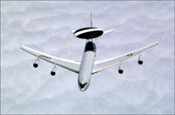
Exam Type Questions
An AWACS aircraft takes off from RAF Waddington (W) on a navigation exercise. It flies 530 miles North to a point (P) as shown, It then turns left and flies to a point (Q), 670 miles away. Finally it flies back to base, a distance of 520 miles.
Find the bearing of Q from point P.
P
Not to Scale
670 miles
530 miles
Q
520 miles
W

Slide 60
Now try N5 TJ
Ex 8.7 & 8.8
Ch8 (page 85)

Slide 61
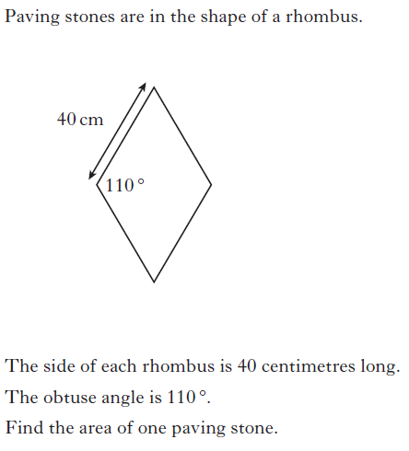

Slide 62
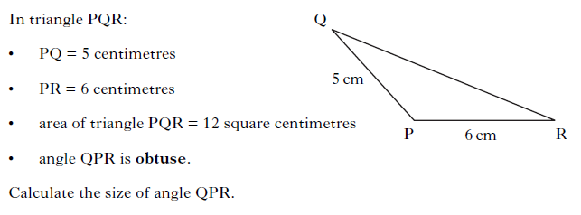

Slide 63
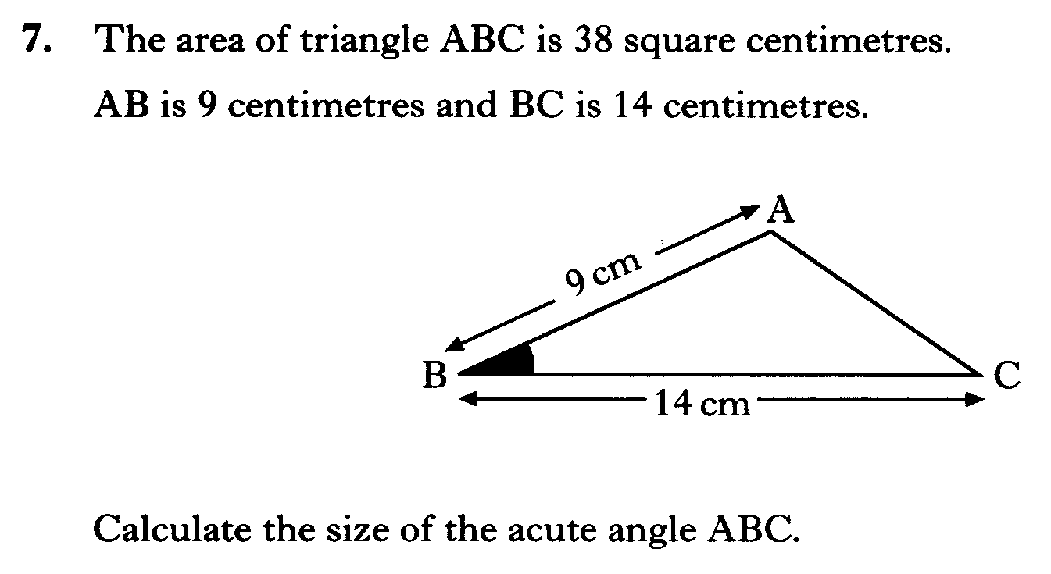

Slide 64
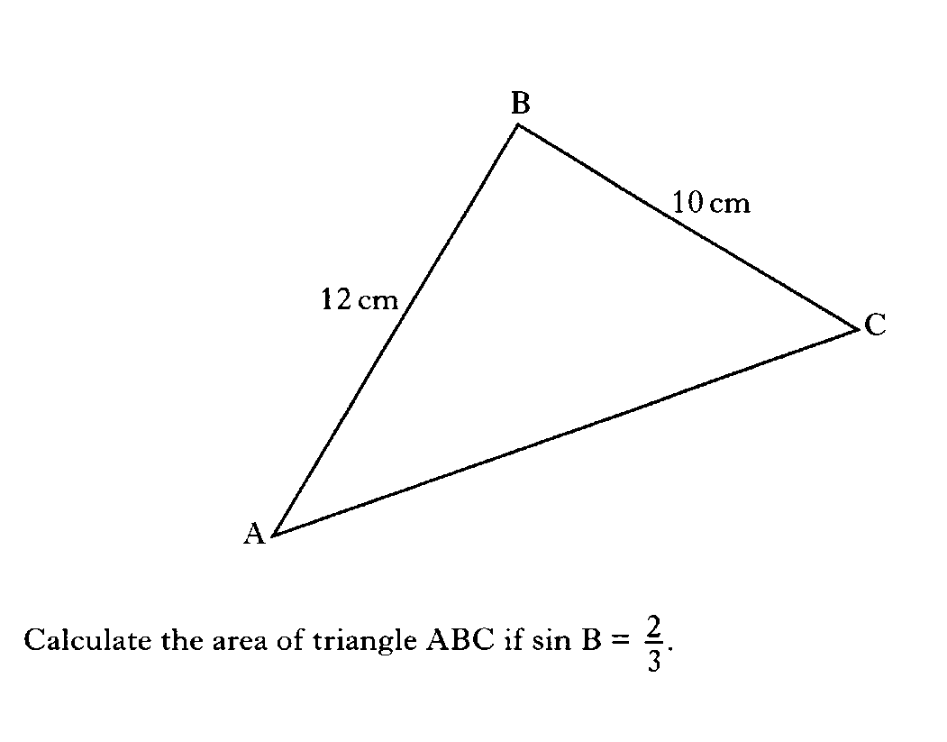

Slide 65
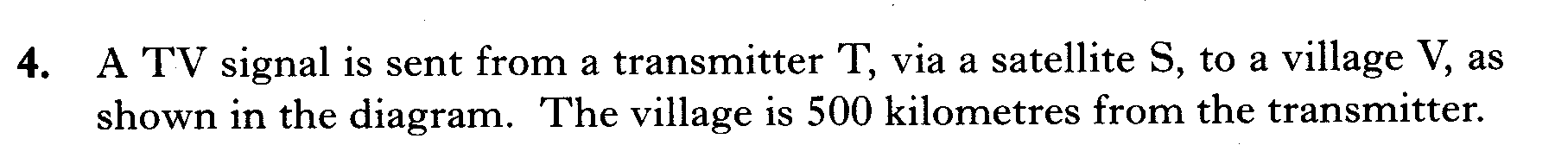
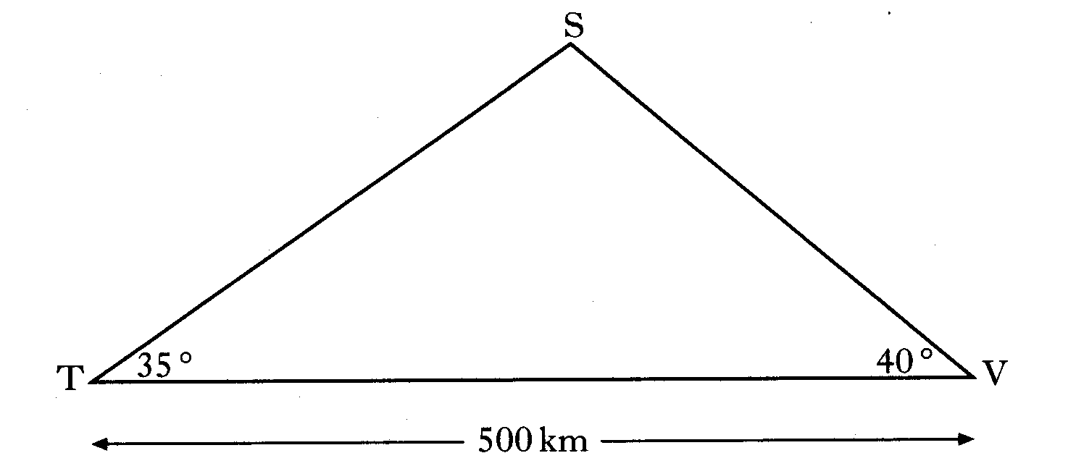
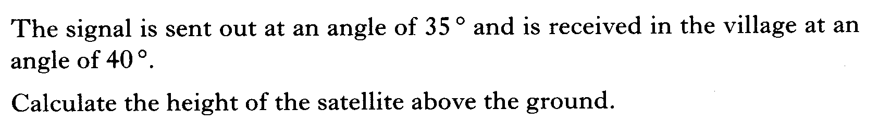

Slide 66
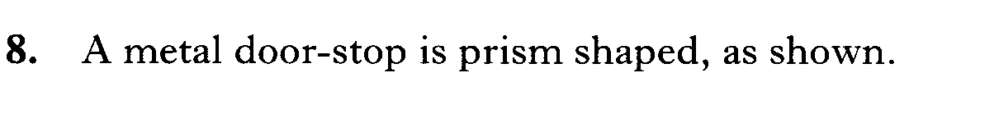
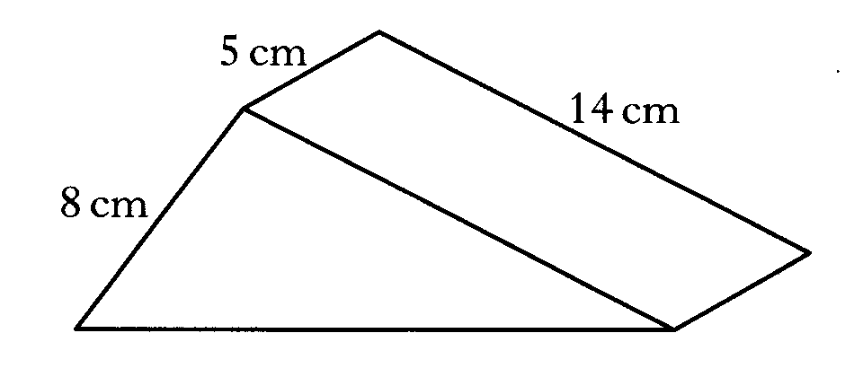
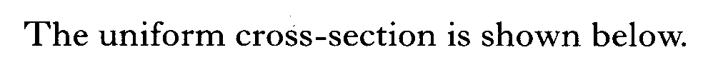
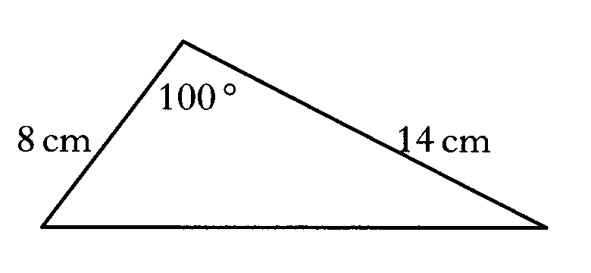

Slide 67
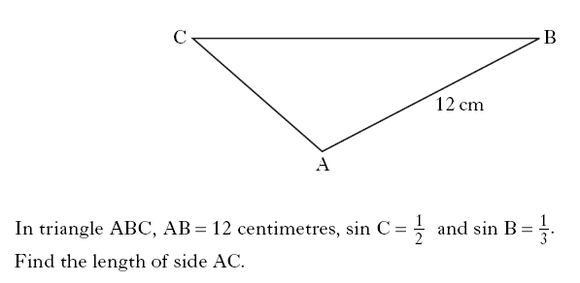

Slide 69
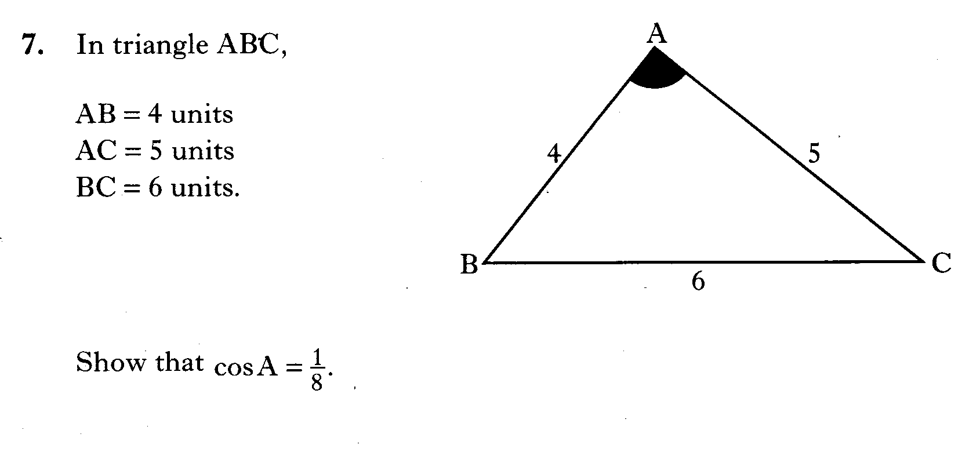

Slide 70
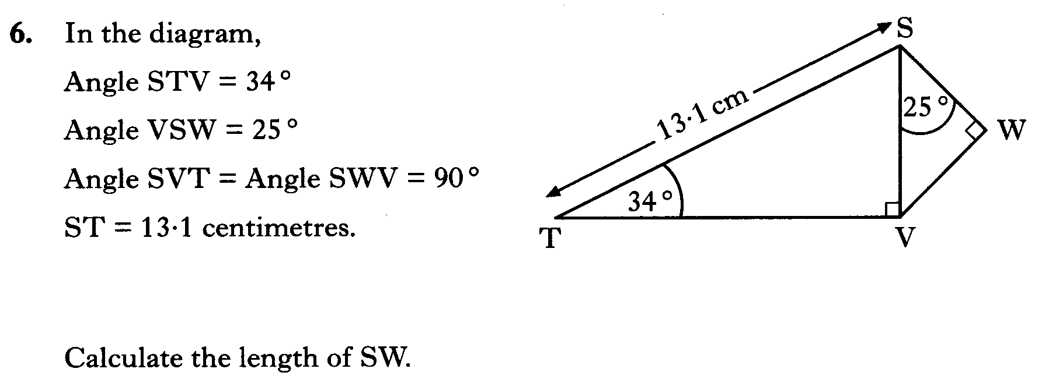

Slide 71
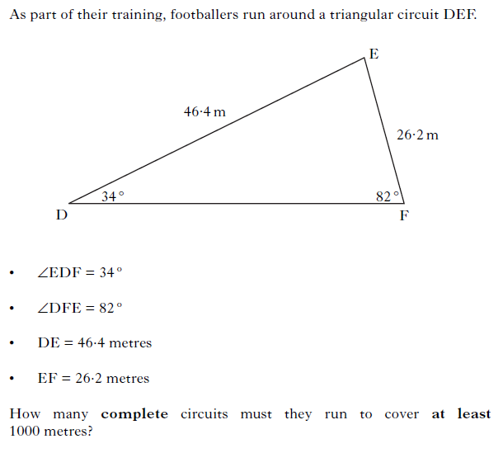

Slide 72
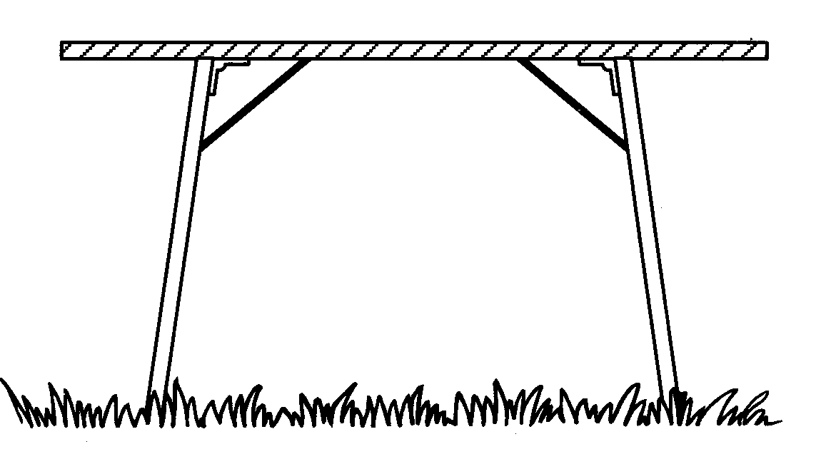
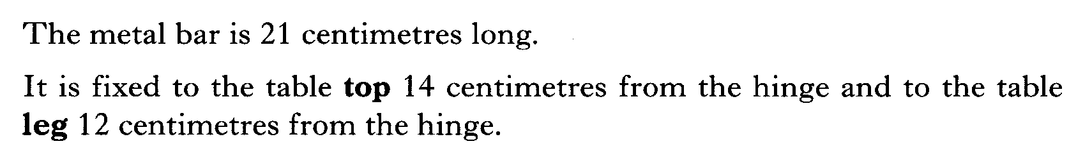
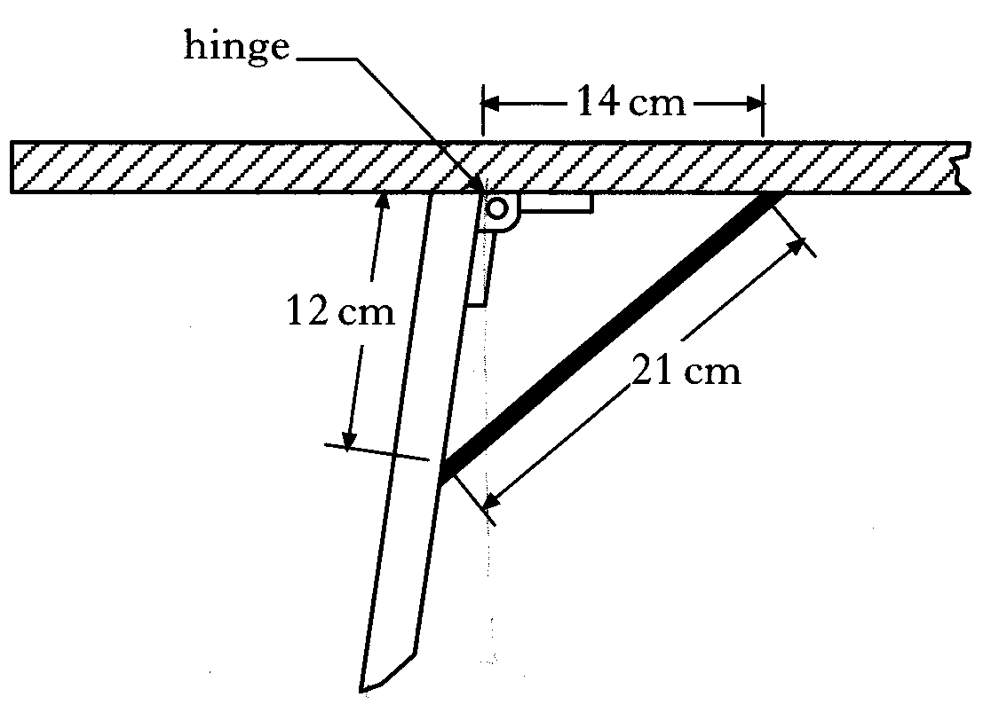
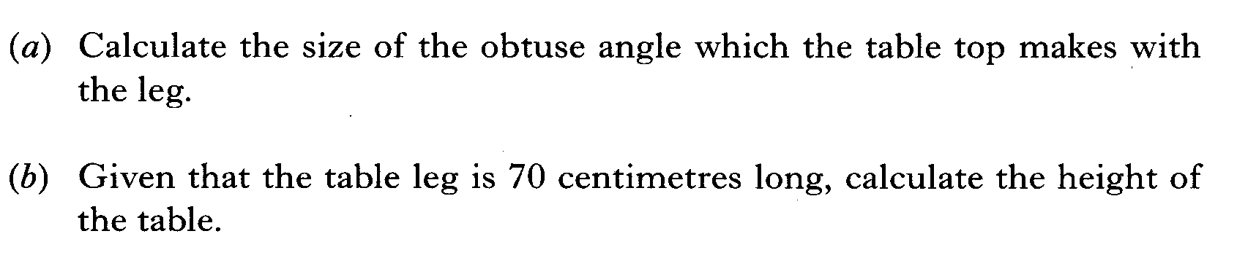

Slide 73

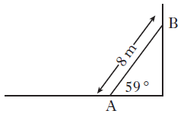

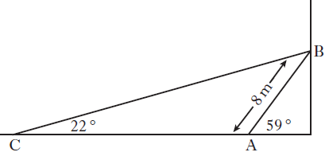

Slide 74
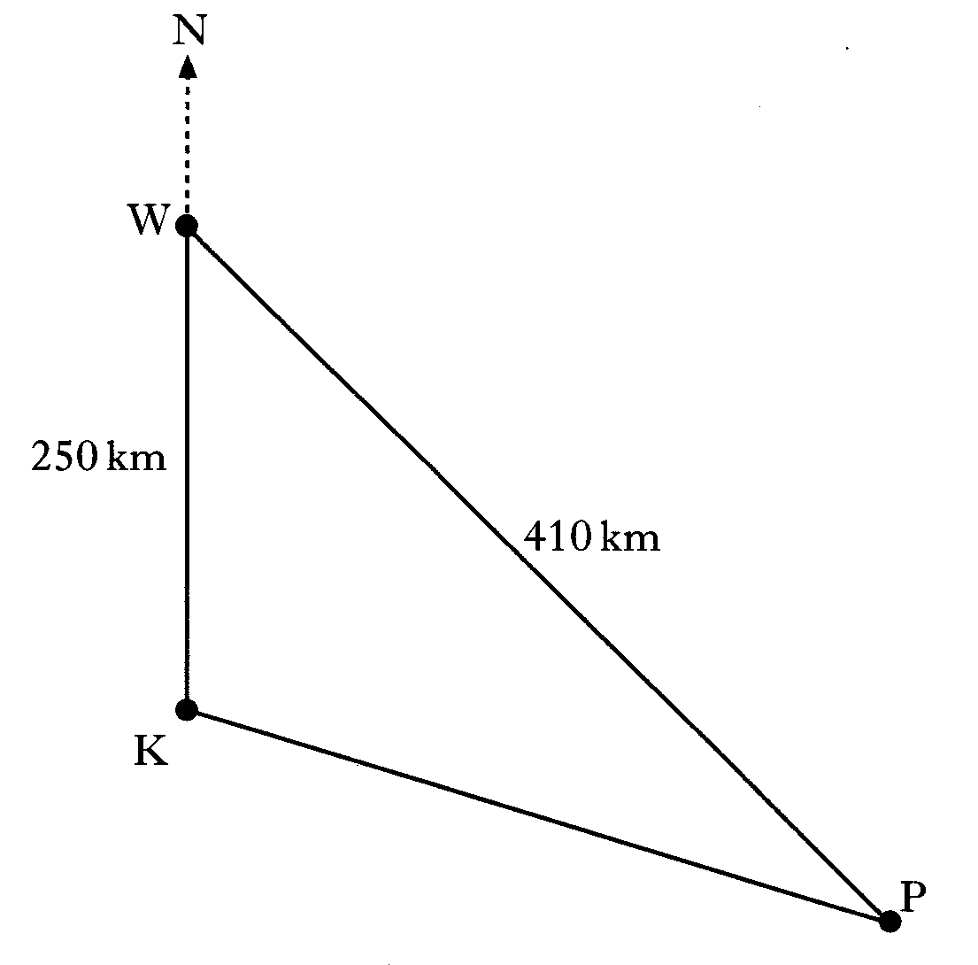
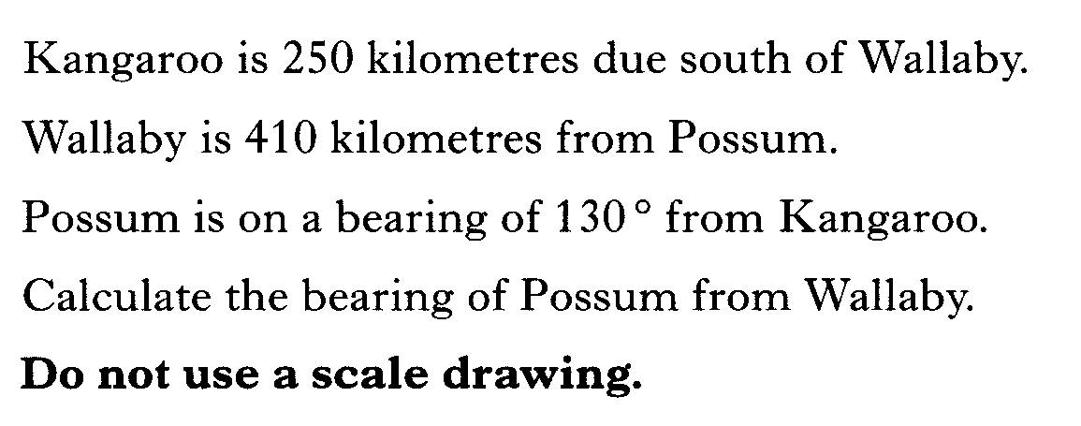

Slide 75
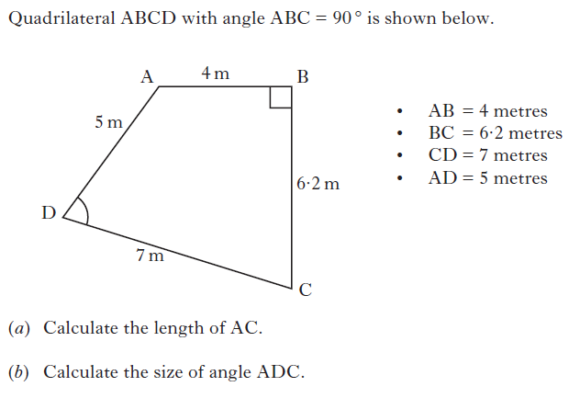

Slide 76
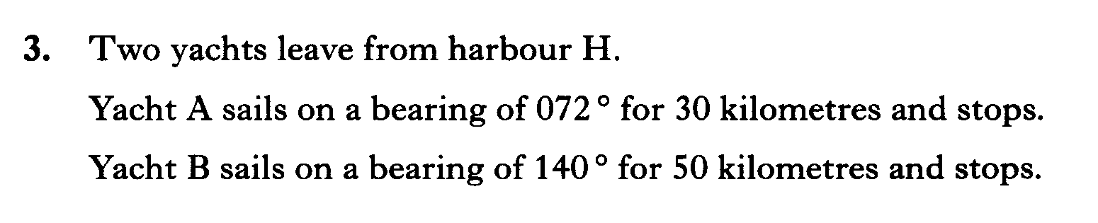
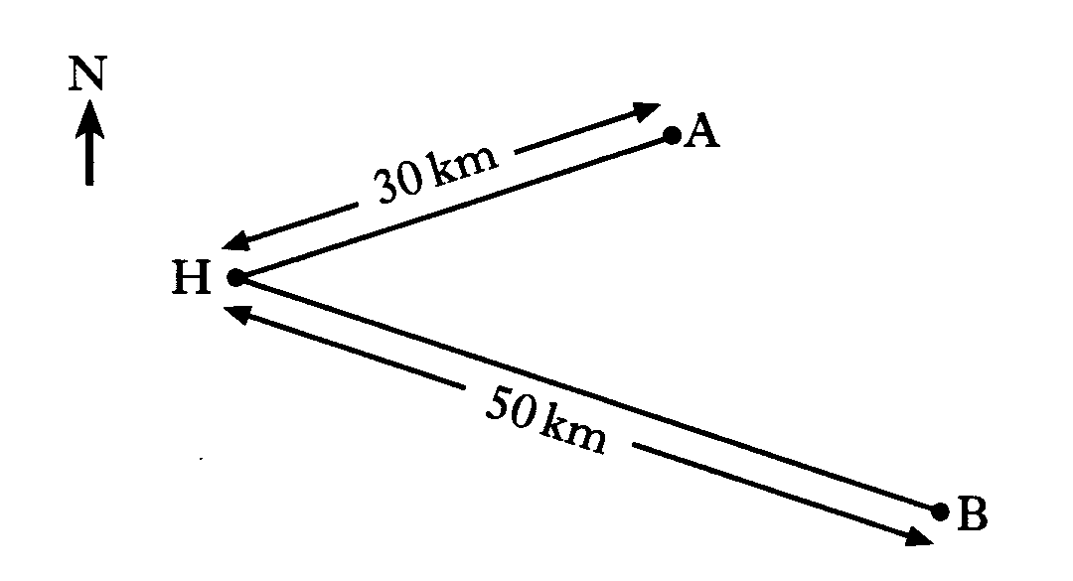
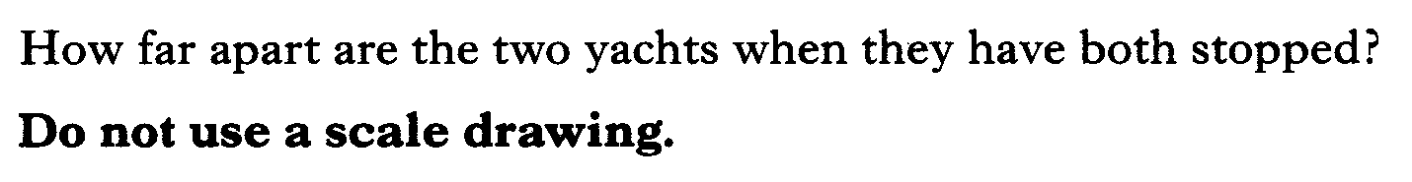

Slide 77
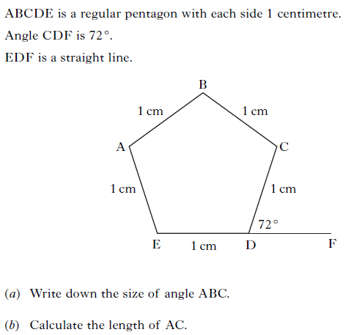

Slide 78
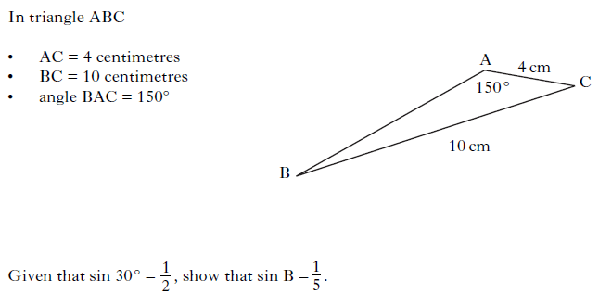

Slide 79
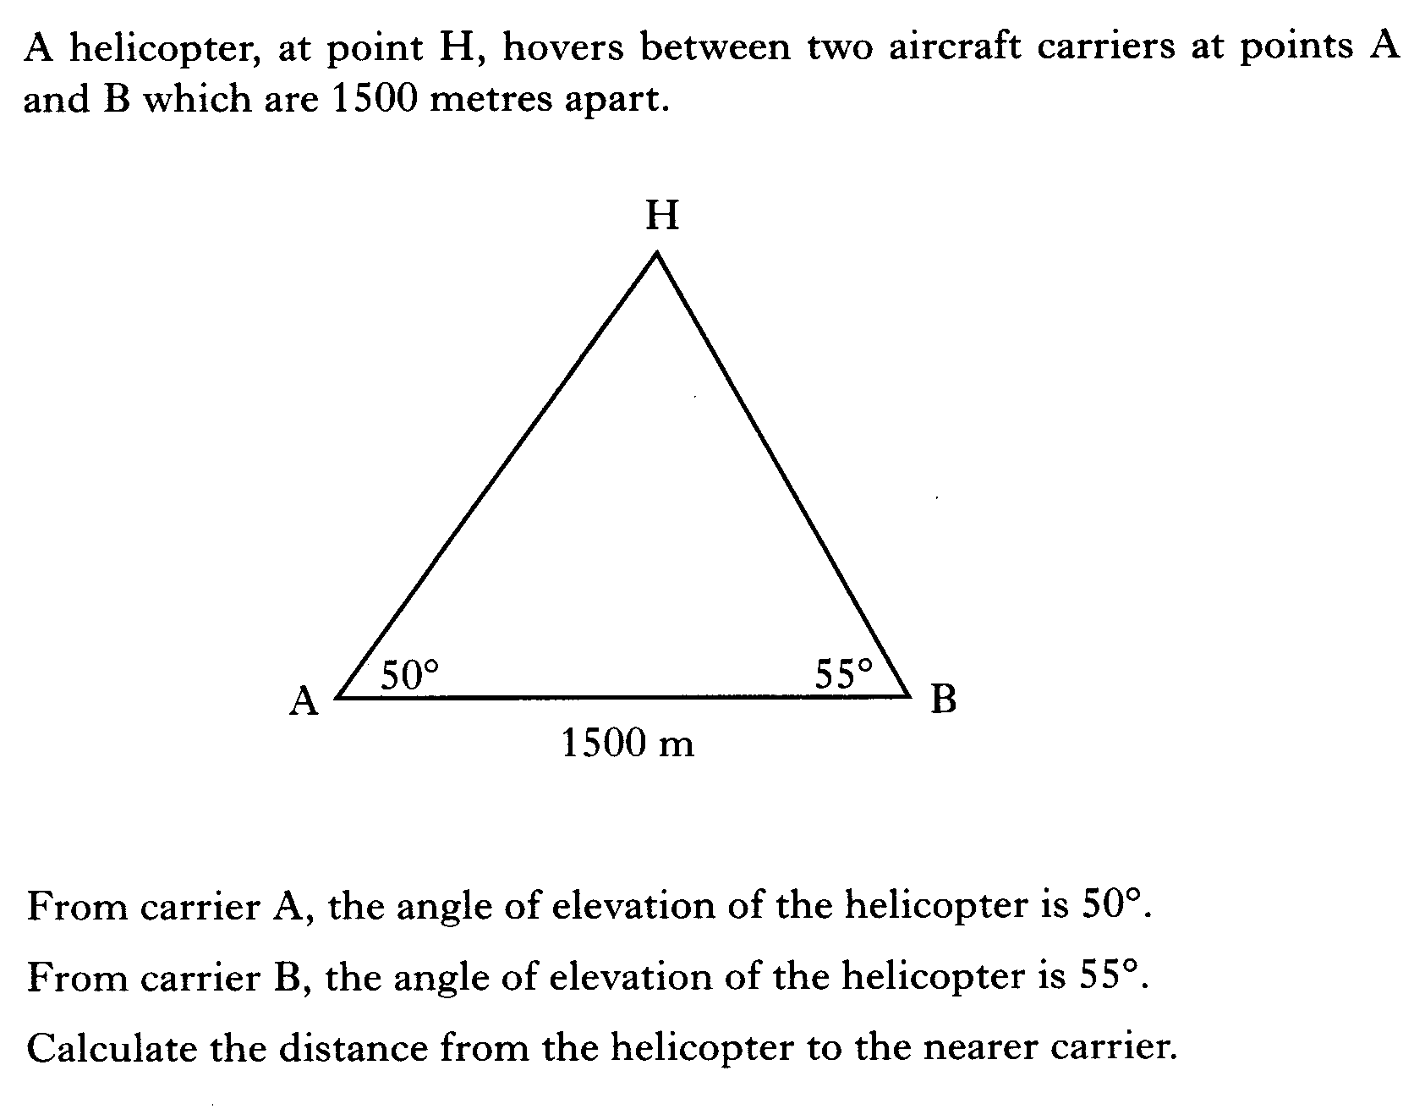

Slide 80
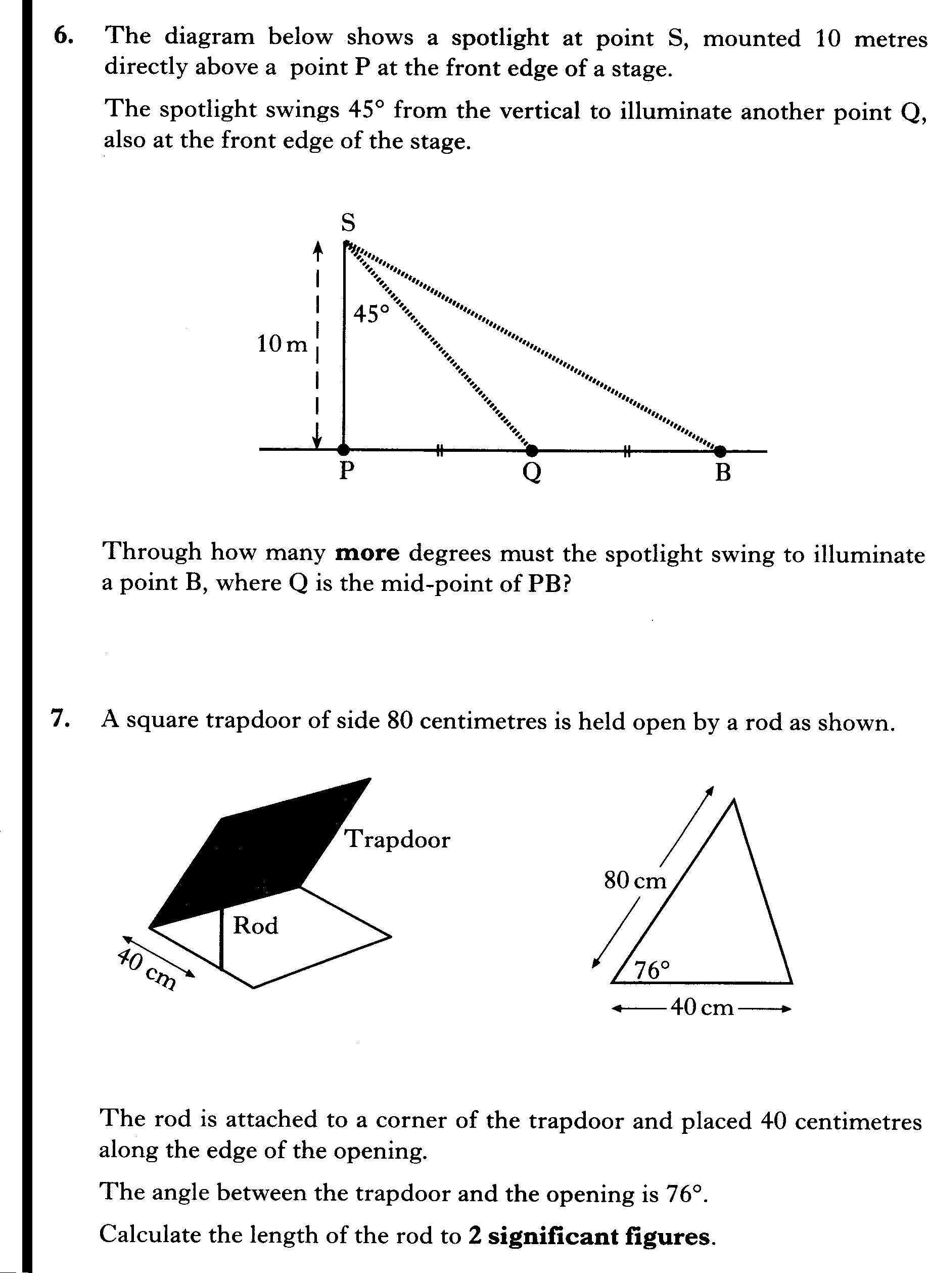

Slide 82
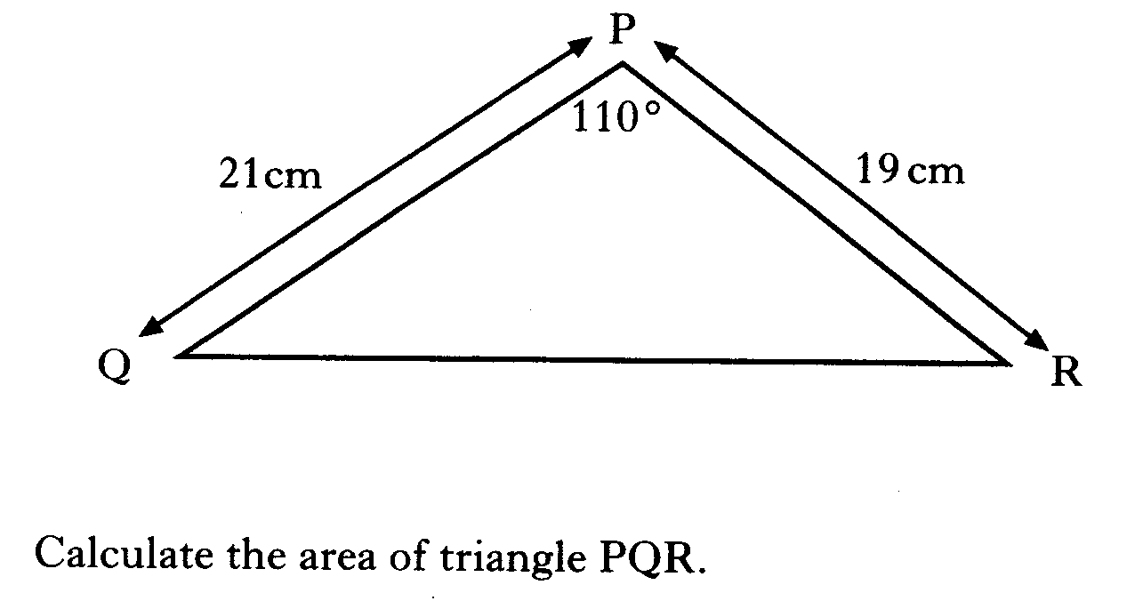

Slide 83
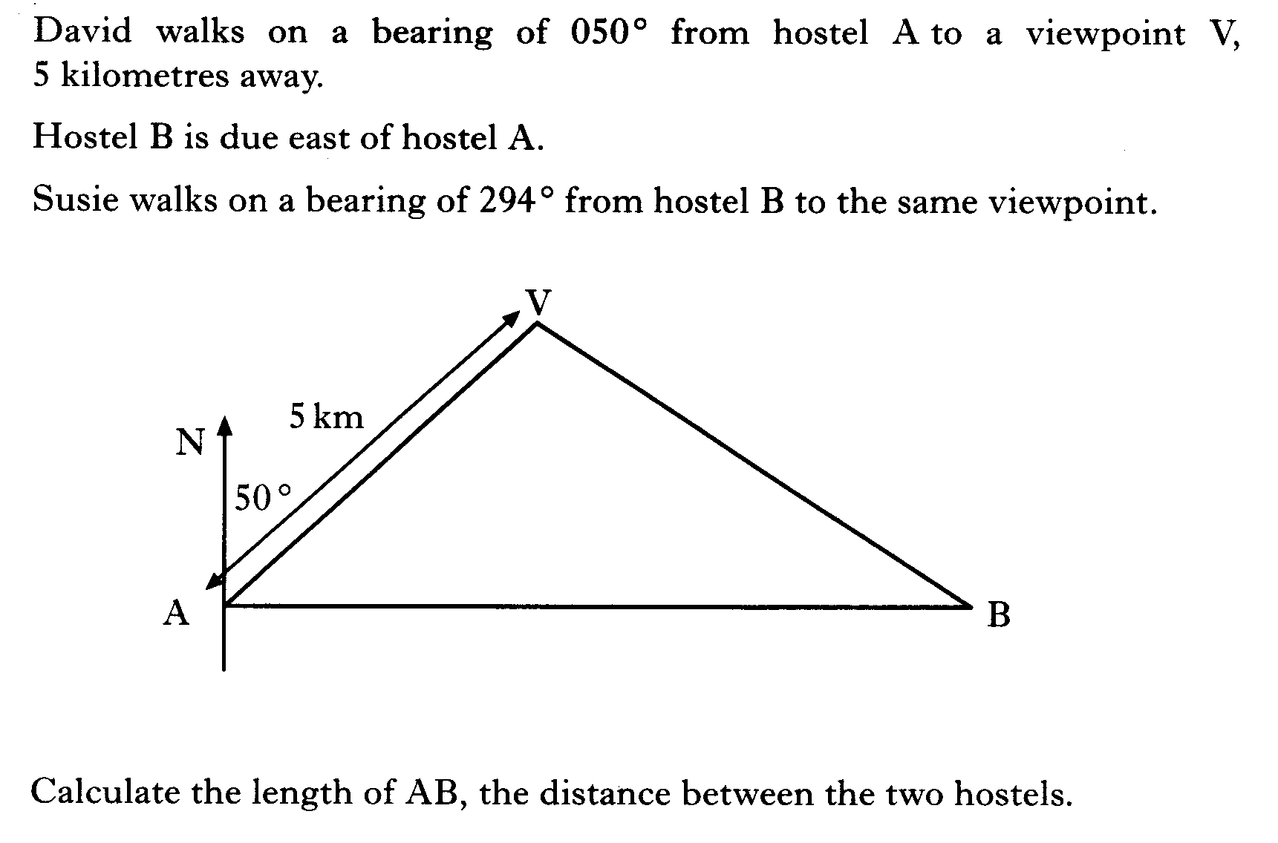

Slide 84
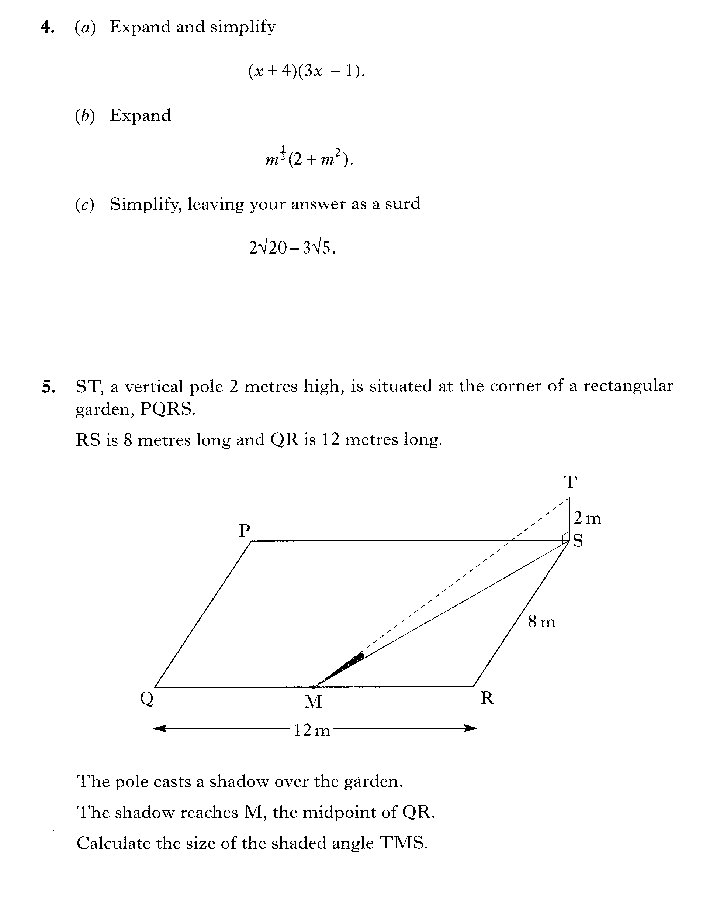

Slide 85
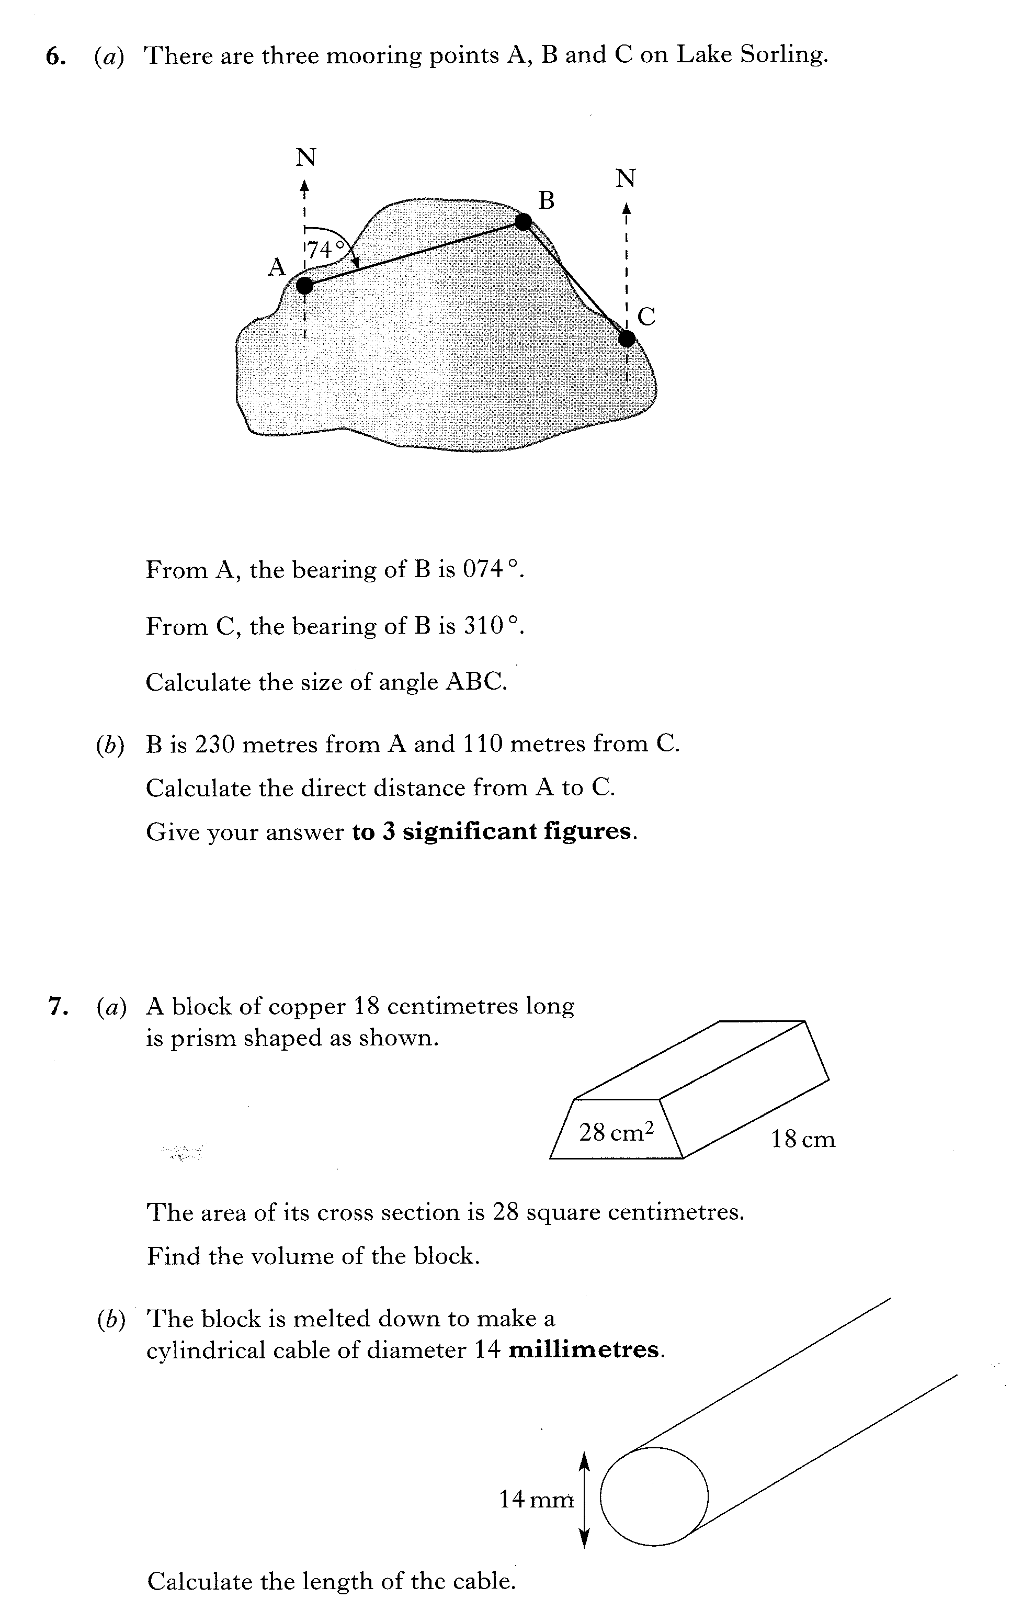

Slide 86
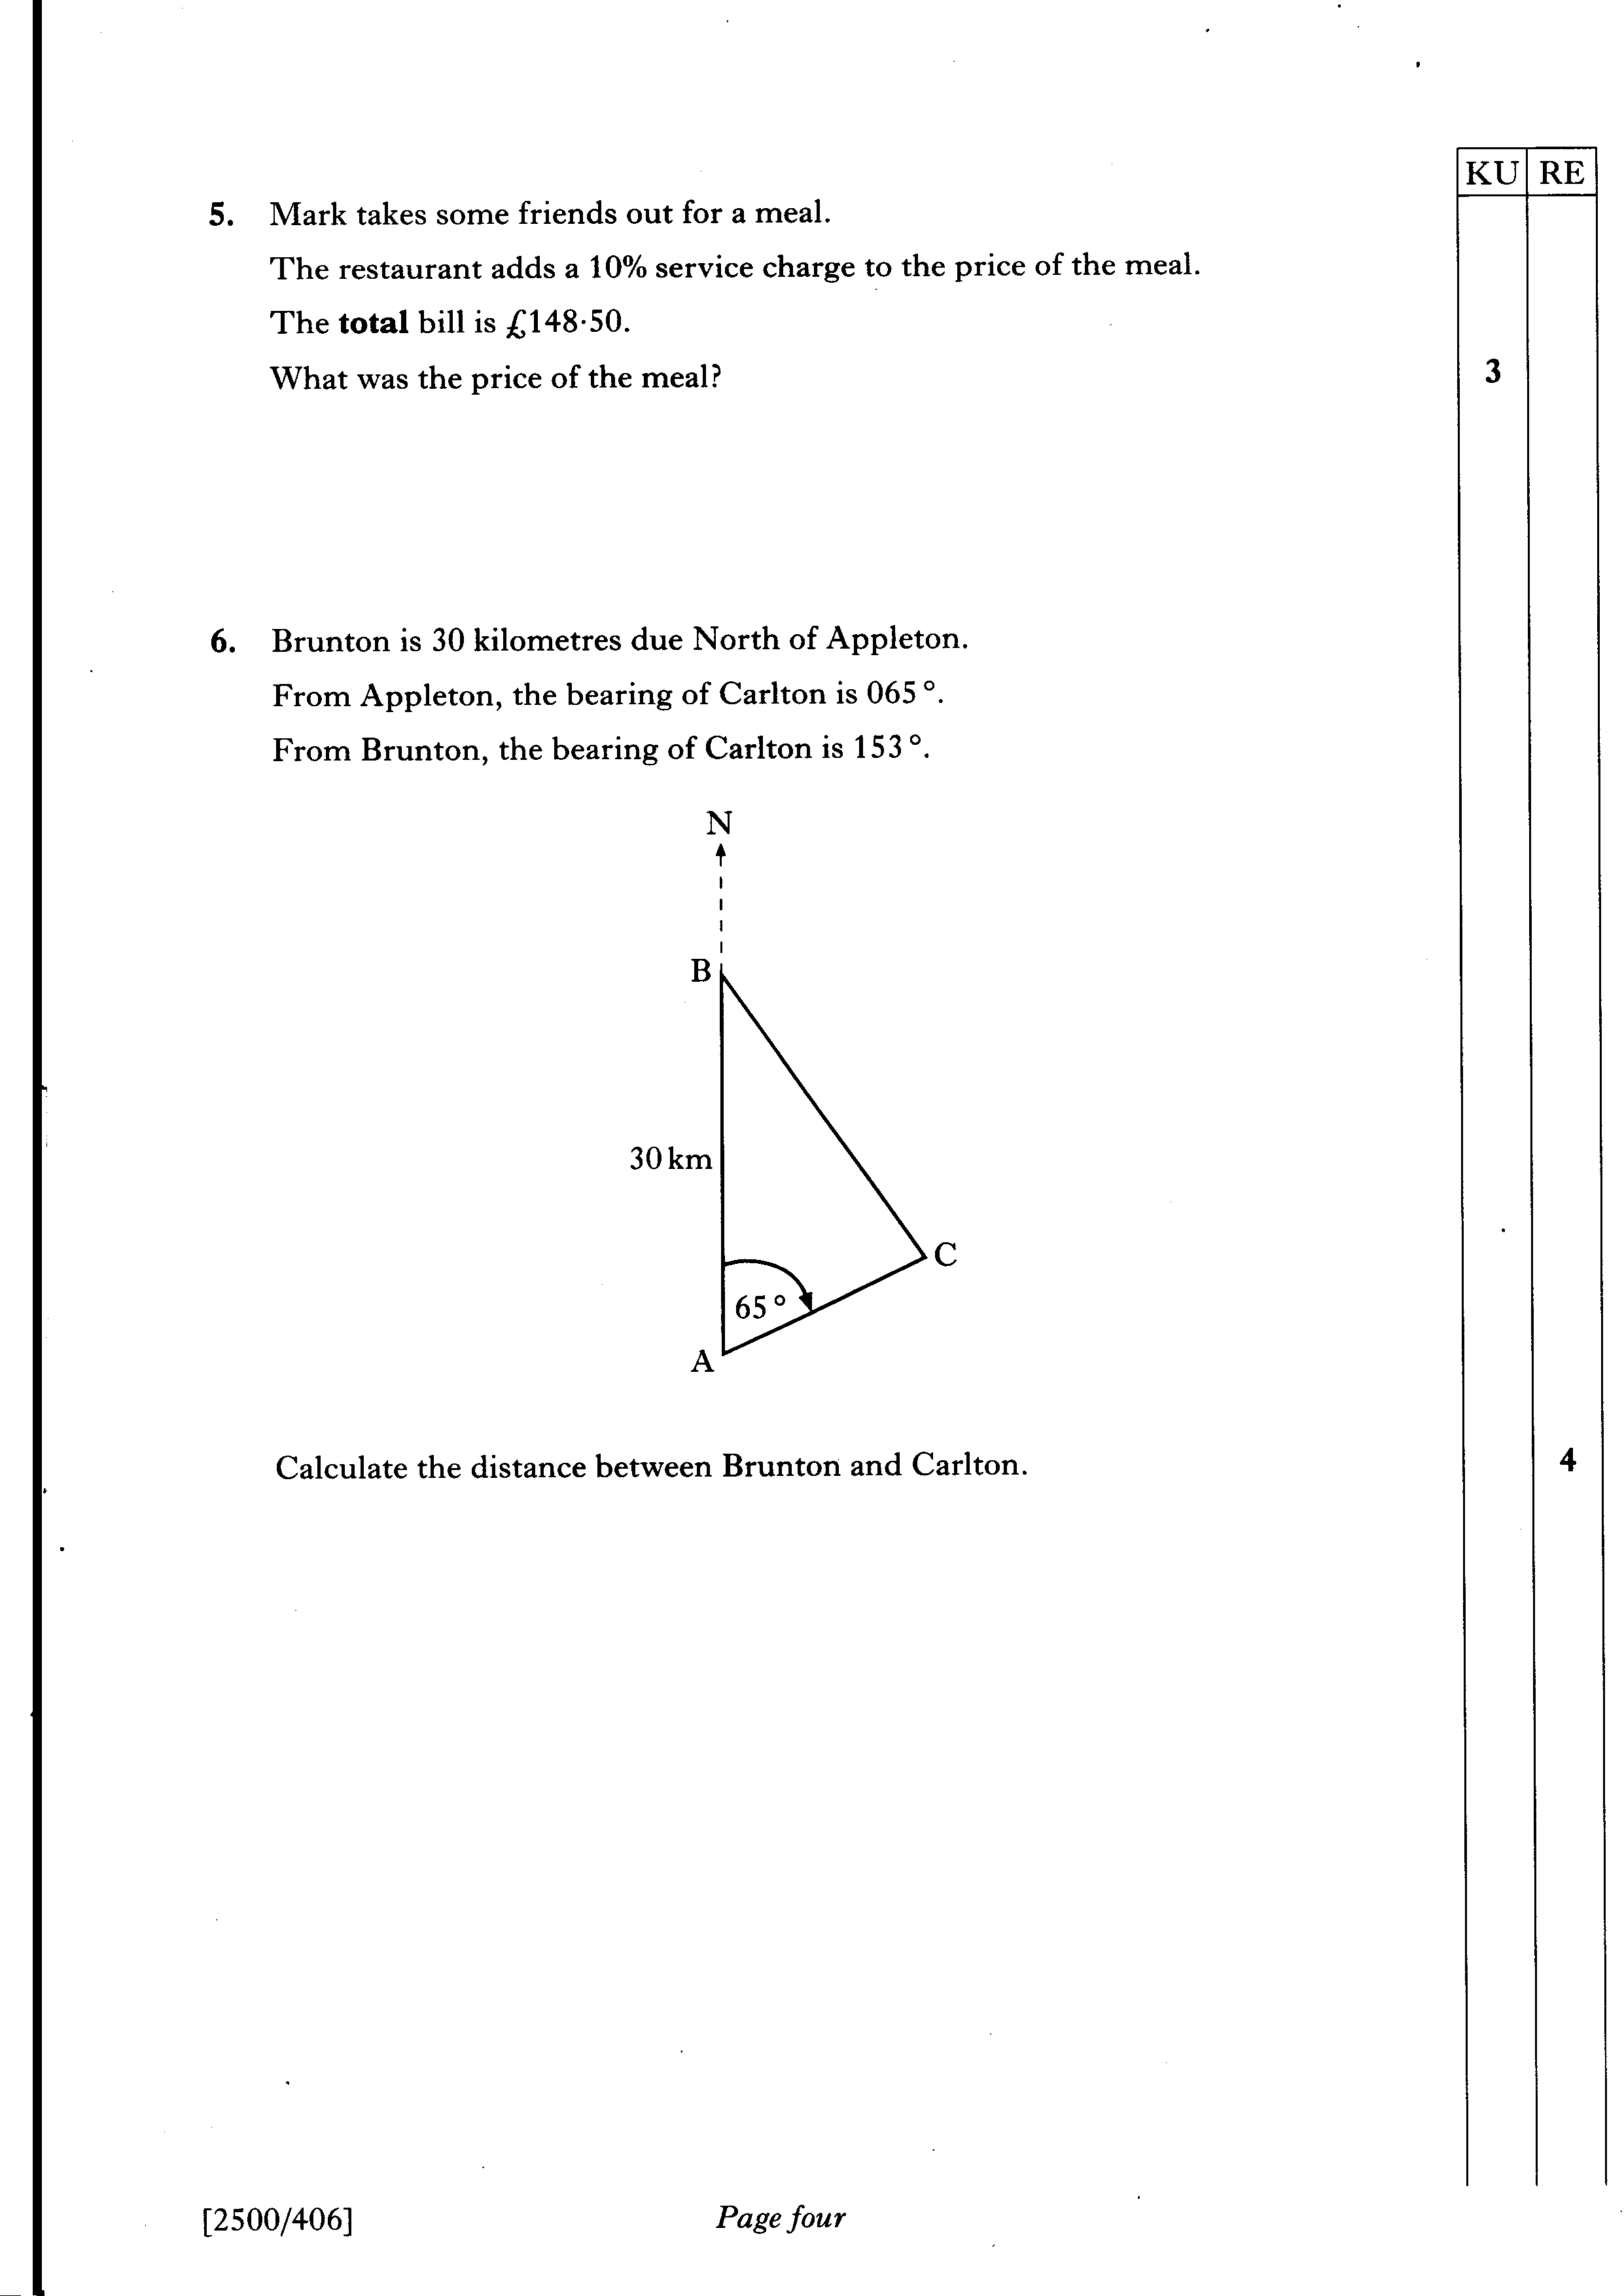

Slide 87
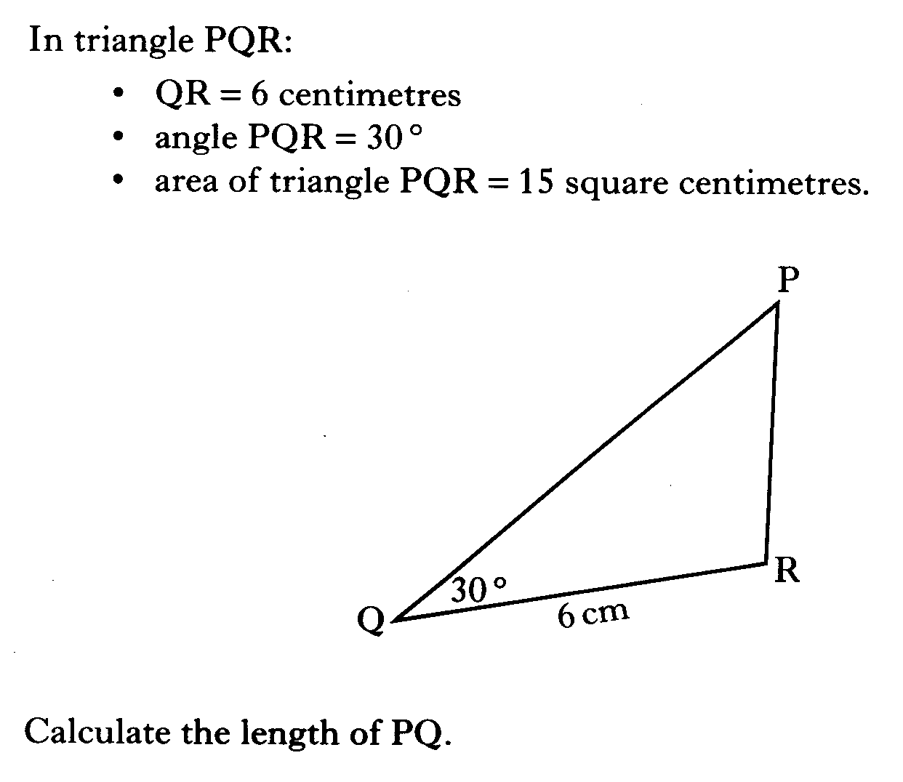

Slide 88
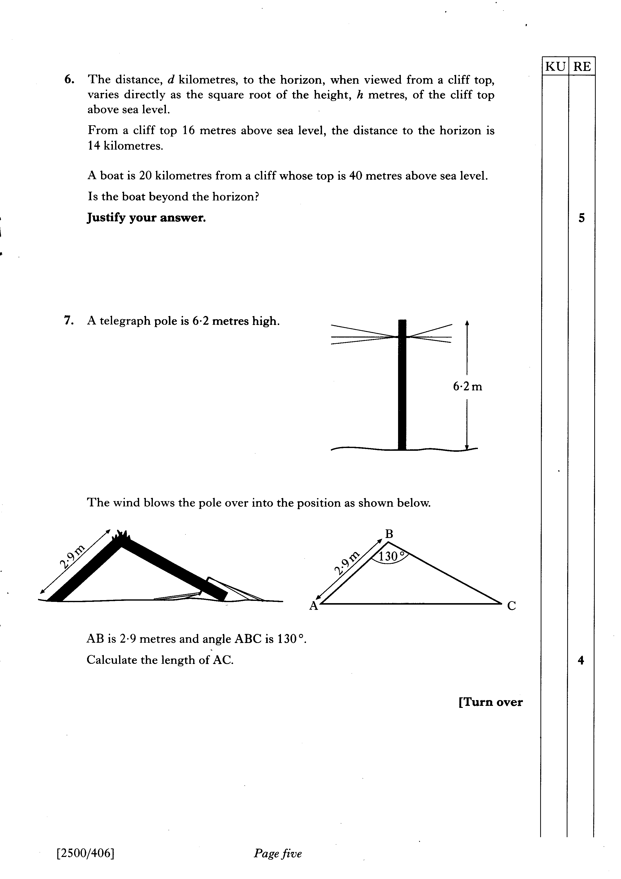

Slide 89
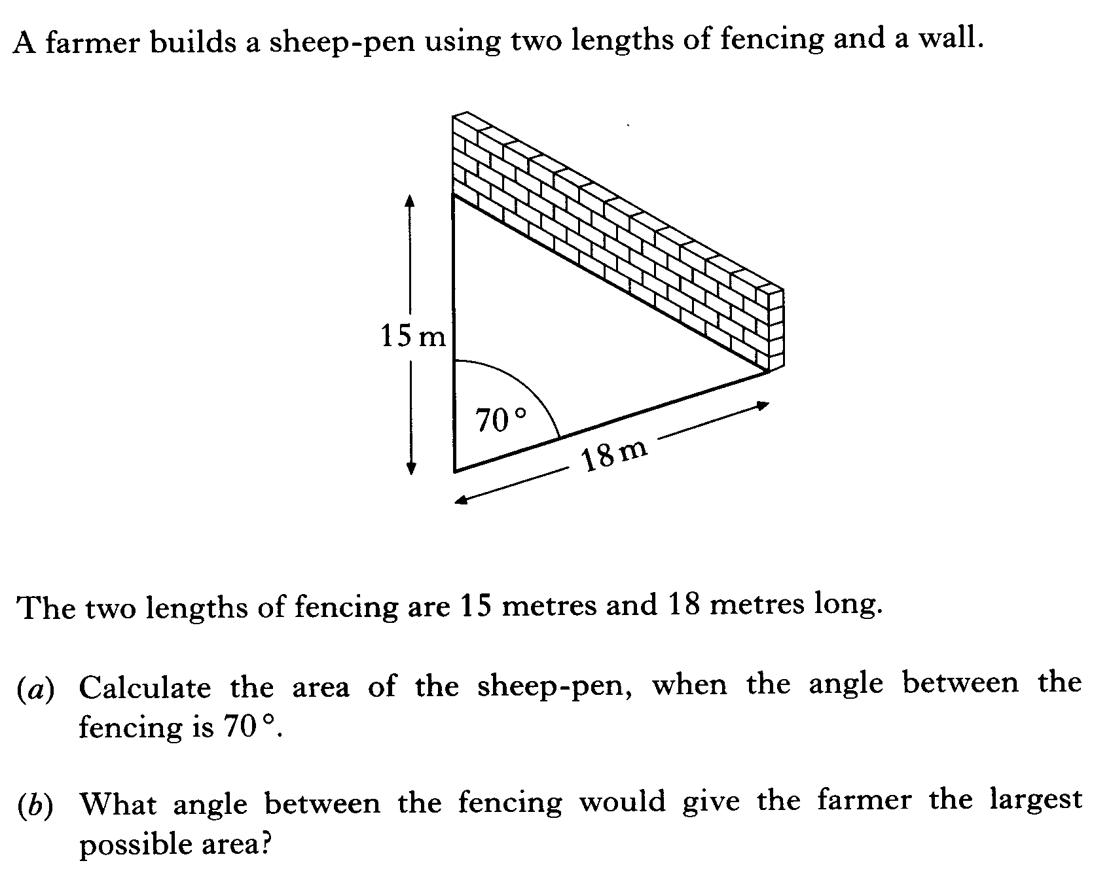

Slide 90
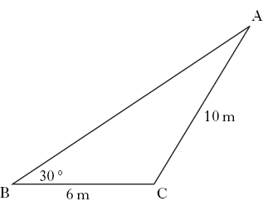
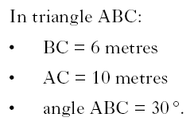

Slide 91
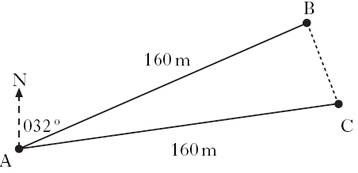
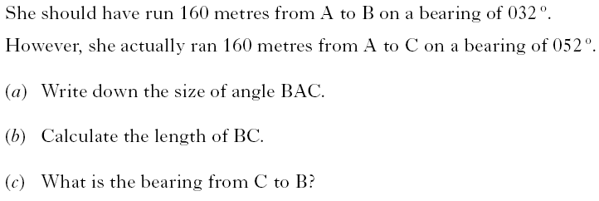

Slide 92
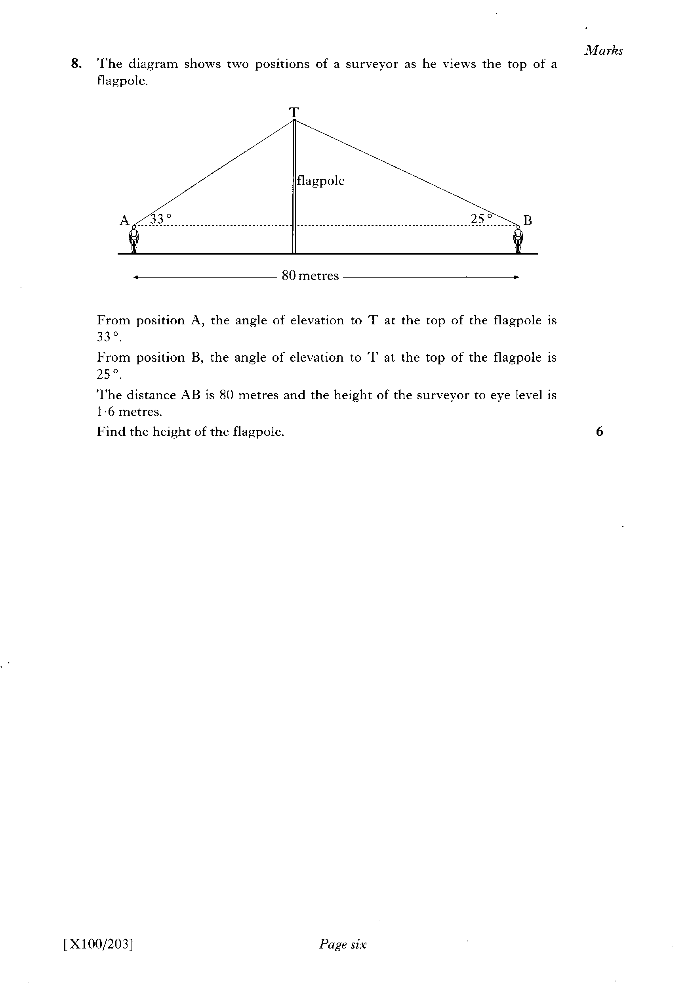

Slide 93
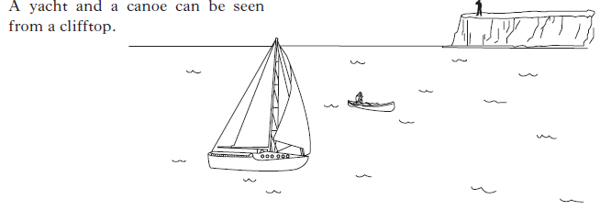
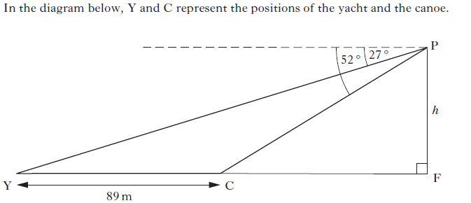
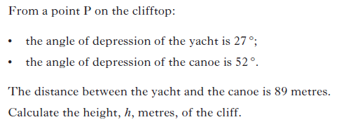

Slide 94
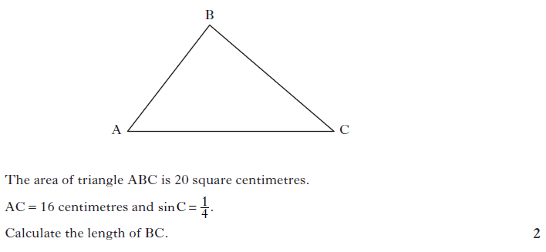

Slide 95


Slide 96


Slide 97


Slide 98


Slide 100


