Slide 1


Straight Line
Nat 5
Simple Gradient
Equation of a line gradient and y-intercept
Equation given any two points
Straight line in real-life
Gradient Revision
www.mathsrevision.com
Higher Form of straight Line y – b = m(x – a)
The General Equation of a straight line.
Best – fitting straight line
Exam Type Questions

Slide 2
Starter Questions
Nat 5
In pairs
“Explain the rules for fractions”
www.mathsrevision.com
11 Jul 2026
Created by Mr.Lafferty Maths Dept

Slide 3
The Gradient of a Line
S4
Learning Intention
Success Criteria
  We are learning to calculate simple gradient using a right angle triangle
  Gradient is :
  change in vertical height divided by
  change in horizontal distance
www.mathsrevision.com
  2. Calculate simple gradients.
11 Jul 2026
Created by Mr.Lafferty Maths Dept

Slide 4
The Gradient
Difference in
y -coordinates
S4
The gradient is the measure of steepness of a line
Change in vertical height
Change in horizontal distance
www.mathsrevision.com
Difference in
x -coordinates
The steeper a line the bigger the gradient
11 Jul 2026
Created by Mr.Lafferty Maths Dept

Slide 5
The Gradient
S4
3
4
3
2
www.mathsrevision.com
3
5
2
6
11 Jul 2026
Created by Mr.Lafferty Maths Dept

Slide 6

Straight Line
Nat 5
Now try N5 TJ
Ex 6.1
Ch6 (page 50)
www.mathsrevision.com
11 Jul 2026
Created by Mr.Lafferty Maths Dept

Slide 7
Starter Questions
Nat 5
Q1. Is this triangle right angled ?
Explain
9
8
5
www.mathsrevision.com
11 Jul 2026
Created by Mr.Lafferty Maths Dept

Slide 8
Straight line
Nat 5
Learning Intention
Success Criteria
  We are learning to find the equation of a straight line.
  Understand how to calculate the gradient and identify y-intercept.
www.mathsrevision.com
  2. Be able to write down equation of a straight line in the format y = mx + c.
11 Jul 2026
Created by Mr.Lafferty Maths Dept

Slide 9
lines are parallel if same gradient
Straight Line Equation
Nat 5
Almost all straight lines have the equation of the form
Slope left to right upwards positive gradient
y = mx + c
www.mathsrevision.com
y - intercept
Gradient
y intercept is were line cuts y axis
Slope left to right downwards negative gradient
11 Jul 2026
Created by Mr.Lafferty Maths Dept

Slide 10
The gradient
using coordinates
Nat 5
m = gradient
y-axis
y₂
www.mathsrevision.com
y₁
O
x₁
x-axis
x₂
Jul 11, 2026
www.mathsrevision.com
<number>
Notes:
Mr. Lafferty
<number>
We start by find the equation of a circle centre the origin.
First draw set axises x,y and then label the origin O.
Next we plot a point P say, which as coordinates x,y.
Next draw a line from the origin O to the point P and label
length of this line r.
If we now rotate the point P through 360 degrees keep the Origin fixed we trace out a circle with radius r and centre O.
Remembering Pythagoras’s Theorem from Standard grade
a square plus b squared equal c squares we can now write down the equal of any circle with centre the origin.

Slide 11
Remember parallel means same gradient
The gradient
using coordinates
Nat 5
The gradient formula is :
www.mathsrevision.com
It is a measure of how steep a line is
A line sloping up from left to right is a positive gradient
A line sloping down from left to right is a negative gradient
11 Jul 2026
Created by Mr.Lafferty Maths Dept

Slide 12
The gradient
using coordinates
Nat 5
Find the gradient of the two lines.
y-axis
O
x-axis
Jul 11, 2026
www.mathsrevision.com
<number>
Notes:
Mr. Lafferty
<number>
We start by find the equation of a circle centre the origin.
First draw set axises x,y and then label the origin O.
Next we plot a point P say, which as coordinates x,y.
Next draw a line from the origin O to the point P and label
length of this line r.
If we now rotate the point P through 360 degrees keep the Origin fixed we trace out a circle with radius r and centre O.
Remembering Pythagoras’s Theorem from Standard grade
a square plus b squared equal c squares we can now write down the equal of any circle with centre the origin.

Slide 13
The gradient
using coordinates
Nat 5
Write down the gradient and y intercept for each line.
(a) y = -3x - 5
m = - 3
c = - 5
(b) 4y - 8x = 24
m = 2
c = 6
Challenge 1
Write the equation given the gradient and y intercept.
(a) m = 1.5 c = 1
y = 1.5x + 1
Challenge 2
(b) m = -2 c = - 4
y = -2x - 4
Jul 11, 2026
www.mathsrevision.com
<number>
Notes:
Mr. Lafferty
<number>
We start by find the equation of a circle centre the origin.
First draw set axises x,y and then label the origin O.
Next we plot a point P say, which as coordinates x,y.
Next draw a line from the origin O to the point P and label
length of this line r.
If we now rotate the point P through 360 degrees keep the Origin fixed we trace out a circle with radius r and centre O.
Remembering Pythagoras’s Theorem from Standard grade
a square plus b squared equal c squares we can now write down the equal of any circle with centre the origin.

Slide 14
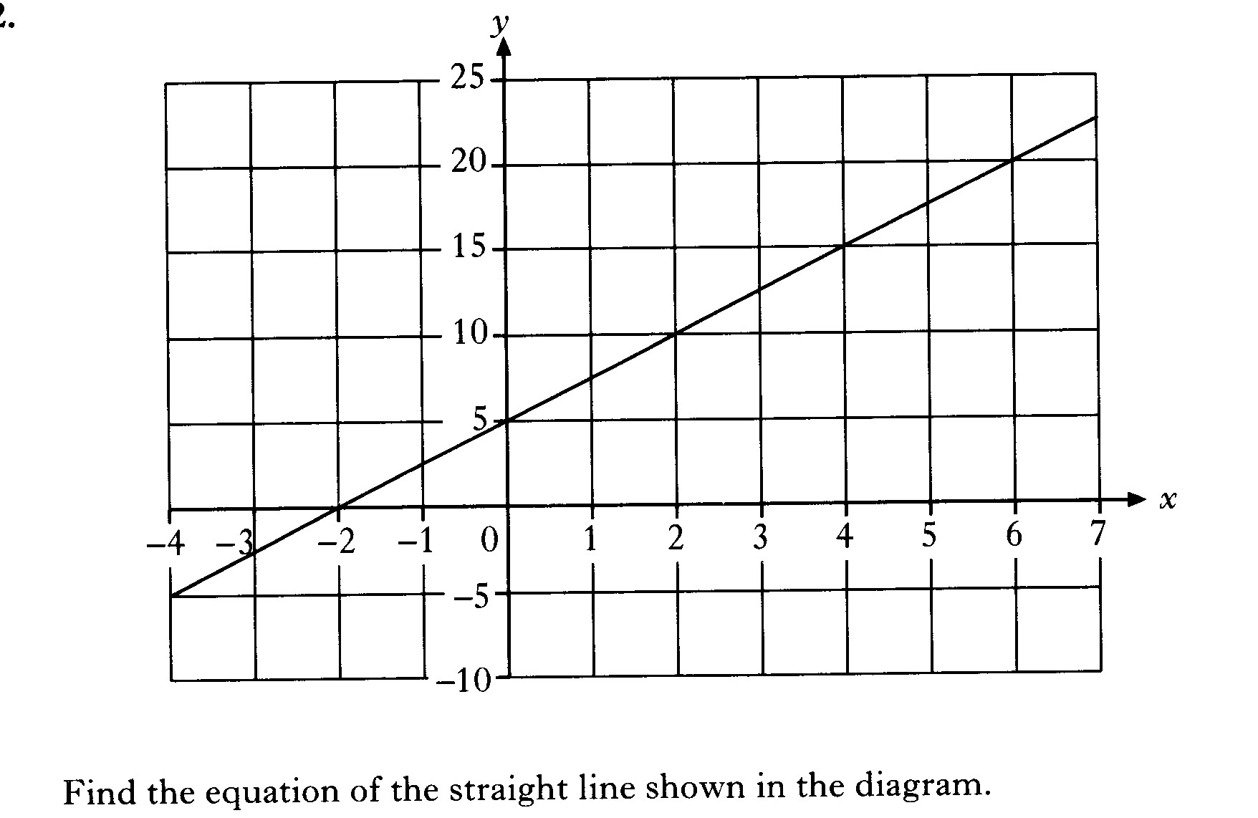

Slide 15
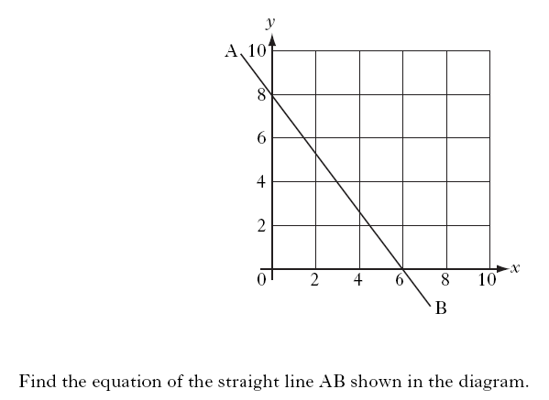

Slide 16
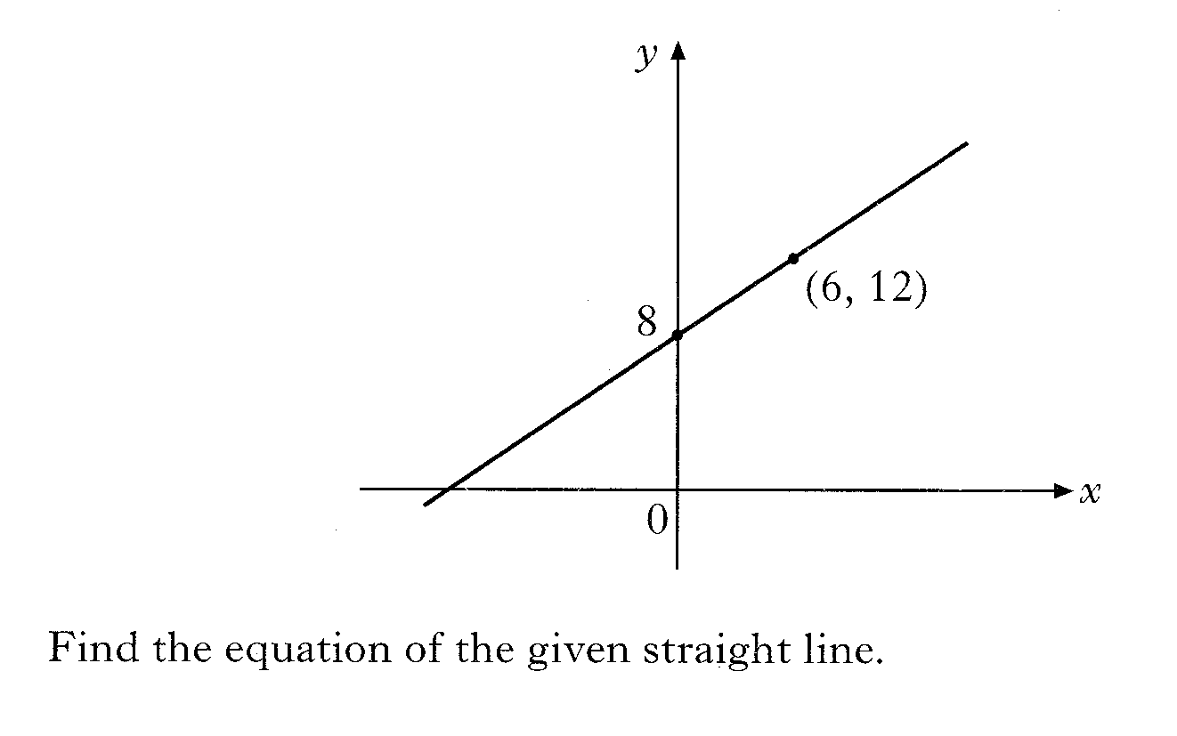

Slide 17
Straight Line
Nat 5
Now try N5 TJ
Ex 6.2
Ch6 (page 52)
www.mathsrevision.com
11 Jul 2026
Created by Mr.Lafferty Maths Dept

Slide 18
Starter Questions
Nat 5
Q1. A house 4 years ago is valued at £50 000.
Calculate it’s value if it has increased by 5%.
Q2. Calculate 3.36 x 70 to 2 significant figures.
www.mathsrevision.com
Q3. Write down the 3 ways of factorising.
11 Jul 2026
Created by Mr.Lafferty Maths Dept

Slide 19
Straight Line
Nat 5
Learning Intention
Success Criteria
  We are learning to find the equation of a straight line given any two points.
  Know how to calculate the gradient using formula.
  2. Know how to find y-intercept using substitution . Be able to write down straight line equation in y = mx + c format.
www.mathsrevision.com
11 Jul 2026
Created by Mr.Lafferty Maths Dept

Slide 20
Equation of a Straight Line
y = mx + c
Nat 5
To find the equation of a straight line we need to know
Two points that lie on the line
( x₁, y₁) and ( x₂, y₂)
OR
The gradient and a point on the line
m and (a,b)
www.mathsrevision.com
We will look at this later
Jul 11, 2026
www.mathsrevision.com

Slide 21
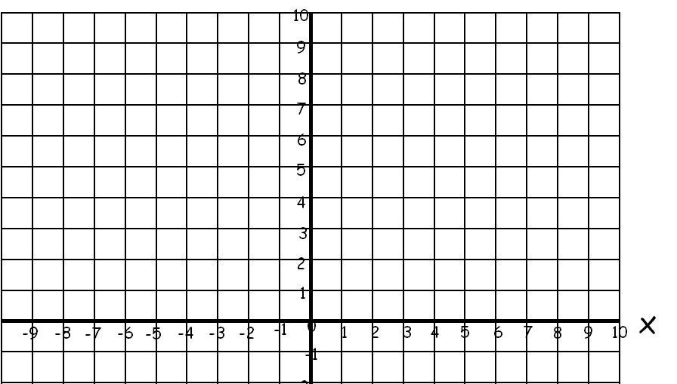
Find the equations of the straight lines below given the coordinates.
(4,1) and (8,5)
y
using
x y
Sub (4,1) into
y = mx + c
-10
1 = 1x4 + c
x y
(-6,7) and (-2,3)
Sub (-2,3) into y = mx + c
c = 1 - 4
c = -3
y = x -3
c = 3 - 2
c = 1
Demo
11 Jul 2026
y = -x + 1

Slide 22
Equation of a Straight Line
y = mx + c
Nat 5
Find the equation of the straight line passing through the points (4, 4) and (8,24).
Solution
www.mathsrevision.com
Using the point (4,4) and the gradient m = 5
sub into straight line equation
y = mx + c
⇨
4 = 5 x 4 + c
⇨
c = 4 - 20 = -16
Equation :
y = 5x - 16
Notes:
Mr. Lafferty
<number>
We are now in a position to find the equation of any circle with centre A,B.
All we have to do is repeat the process in shown in slide 2, but this time the centre is chosen to be (a,b).
First plot a point C and label it’s coordinates (a,b), next we plot another point P and label it’s coordinates (x,y).
Next draw a line from C to P and call this length (r).
(r) will be the radius of our circle with centre (a,b).
Again we rotate the point P through 360 degrees keeping the point C fixed.
Using Pythagoras Theorem a squared plus b squared equal c squared we can write down the equation of any circle with centre (a,b) and radius (r).
The equation is (x - a) all squared plus (y-b) all squared equals (r) squared.
Finally to write down the equation of a circle we need to know the co-ordinates of the centre and the length of the radius or co-ordinates of the centre and the co-ordinates of a point on the circumference of the circle.

Slide 23
Straight Line
Nat 5
Now try N5 TJ
Ex 6.3
Ch6 (page 54)
www.mathsrevision.com
11 Jul 2026
Created by Mr.Lafferty Maths Dept

Slide 24
Starter Questions
Nat 5
Q1. The points ( 1, 4) and (3, 11) lie on a line.
Find the gradient of the line.
Q2. Are the two lines parallel. Explain your answer
www.mathsrevision.com
y = x + 2 and y = 2x + 2
11 Jul 2026
Created by Mr.Lafferty Maths Dept

Slide 25
Modelling Using Straight Line Equation
Nat 5
Learning Intention
Success Criteria
We are learning to model real life situations using straight line theory
  Be able to work out gradient and y intercept using a graph.
www.mathsrevision.com
  Form an equation for any straight line graph.
11 Jul 2026
Created by Mr.Lafferty Maths Dept

Slide 26
Real – Life Straight Line
Nat 5
A LINEAR equation can and is usually written in the form
y = mx + c
v = ut + a
Note : Other letters can be used
www.mathsrevision.com
The following equations are NOT linear
y = mx² + c
Why ?
v = ut² + a
Not allowed powers greater than 1
Notes:
Mr. Lafferty
<number>
We are now in a position to find the equation of any circle with centre A,B.
All we have to do is repeat the process in shown in slide 2, but this time the centre is chosen to be (a,b).
First plot a point C and label it’s coordinates (a,b), next we plot another point P and label it’s coordinates (x,y).
Next draw a line from C to P and call this length (r).
(r) will be the radius of our circle with centre (a,b).
Again we rotate the point P through 360 degrees keeping the point C fixed.
Using Pythagoras Theorem a squared plus b squared equal c squared we can write down the equation of any circle with centre (a,b) and radius (r).
The equation is (x - a) all squared plus (y-b) all squared equals (r) squared.
Finally to write down the equation of a circle we need to know the co-ordinates of the centre and the length of the radius or co-ordinates of the centre and the co-ordinates of a point on the circumference of the circle.

Slide 27
John earns £2 an hour
Using the table draw a graph of P against h
Find the gradient and
P- intercept
Real-Life Straight Line
Write down a formula connecting P and h.
How much did he get paid for working 48 hours.
Nat 5
h | 0 | 1 | 2 | 3
P | 0 | 2 | 4 | 6
P
6
5
m = 2
(0,0)
(2,4)
4
(1,2)
(3,6)
c = 0
3
www.mathsrevision.com
P = 2h
2
P = 2x48
1
P = £96
0
1
2
3
h

Slide 28
Pick any 2 points
Modelling Real – life
The cost for hiring a plumber per hour is shown below
10
V
(7,100)
(a) Calculate the gradient.
100
90
What is the value of V
when T = 0
80
70
30
Cost £
30
60
50
Write down an equation
connecting V and T.
40
(0,30)
30
20
10
T
V =
T
+
0
1
2
3
4
5
6
7
8
9
10
Time (hours)
(d) Find the cost for a plumber for 10 hours?
T = 10
C = 10x10 + 30 = £130

Slide 29
Pick any 2 points
Modelling Real – life
The graph shows how a the volume of water tank drains over time.
-5
V
(a) Calculate the gradient.
100
(0,80)
90
What is the value of V
when T = 0
80
70
80
Volume
80
60
50
(8,40)
Write down an equation
connecting V and T.
40
30
20
10
T
V =
T
+
0
1
2
3
4
5
6
7
8
9
10
Time (mins)
(d) How long before the tank is empty?
V = 0
0 = -5xT + 80
T = (-80) ÷(–5) = 16mins

Slide 30
Real – Life
Straight Line
Nat 5
Now try N5 TJ
Ex 6.4
Ch6 (page 55)
www.mathsrevision.com
11 Jul 2026
Created by Mr.Lafferty Maths Dept

Slide 31
Starter Questions
Nat 5
Q1. Prove that the coordinates ( 1,1) (2, 2) and (3,3)
lie on the same line.
Q2. Are the two lines parallel. Explain answer
www.mathsrevision.com
y = -4x + 1 and 6y - 24x = 12
11 Jul 2026
Created by Mr.Lafferty Maths Dept

Slide 32
Gradient - Revision
Nat 5
Learning Intention
Success Criteria
We are revising gradient.
  Use gradient formula to calculate gradient.
www.mathsrevision.com
11 Jul 2026
Created by Mr.Lafferty Maths Dept

Slide 33
Remember parallel means same gradient
The gradient
using coordinates
Nat 5
The gradient formula is :
www.mathsrevision.com
It is a measure of how steep a line is
A line sloping up from left to right is a positive gradient
A line sloping down from left to right is a negative gradient
11 Jul 2026
Created by Mr.Lafferty Maths Dept

Slide 34

Sloping left to right up has +ve gradient
m > 0
Sloping left to right down has -ve gradient
m < 0
Horizontal line has zero gradient.
m = 0
y = c
Vertical line has undefined gradient.
x = a
www.mathsrevision.com
Jul 11, 2026
<number>

Slide 35
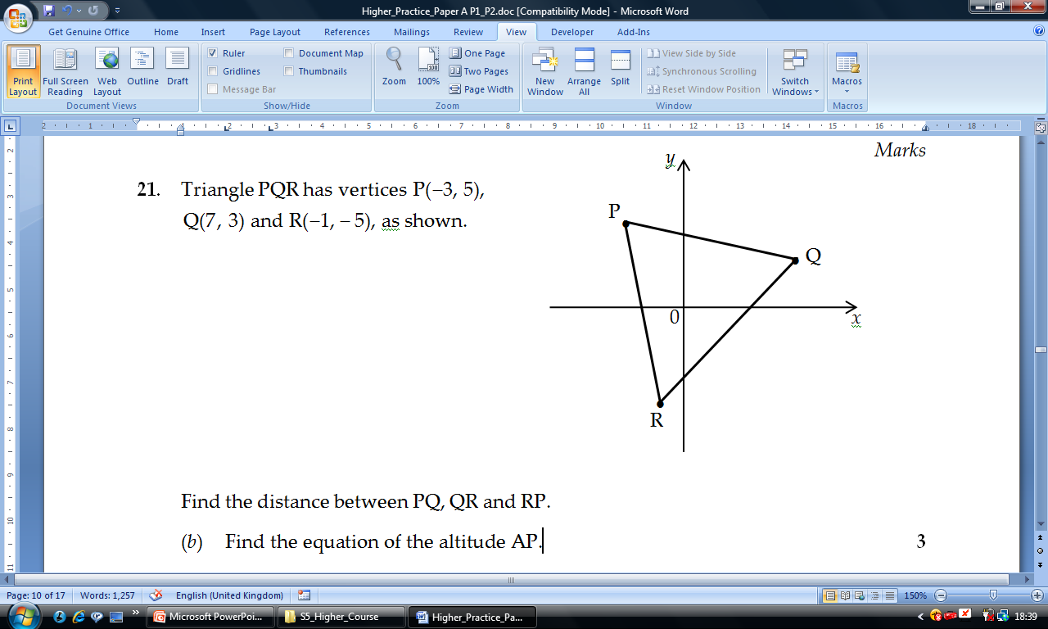
Gradient - Revision
Find gradients PQ , QR and RP

Slide 36
Gradient Revision
Nat 5
Now try N5 TJ
Ex 6.5
Ch6 (page 58)
www.mathsrevision.com
11 Jul 2026
Created by Mr.Lafferty Maths Dept

Slide 37
Starter Questions
Nat 5
Q1. Prove that the coordinates ( 1,1) (2, 2) and (3,3)
lie on the same line.
Q2. Are the two lines parallel. Explain answer
www.mathsrevision.com
y = -4x + 1 and 6y - 24x = 12
11 Jul 2026
Created by Mr.Lafferty Maths Dept

Slide 38
Higher Form of
Straight Line Equation
Nat 5
Learning Intention
Success Criteria
We are learning alternative way to find straight line equation.
  Know Nat 5 version of straight line equation
  y – b = m(x – a)
www.mathsrevision.com
  Form an straight equation from information given.
11 Jul 2026
Created by Mr.Lafferty Maths Dept

Slide 39
Equation of a Straight Line
y = mx + c
Nat 5
To find the equation of a straight line we need to know
Two points that lie on the line
( x₁, y₁) and ( x₂, y₂)
OR
The gradient and a point on the line
m and (a,b)
www.mathsrevision.com
Jul 11, 2026
www.mathsrevision.com

Slide 40
The Equation of the Straight Line y – b = m (x - a)
Demo
The equation of any line can be found if we know
the gradient and one point on the line.
y
y
P (x, y)
y - b
=
m =
m
(x – a)
m
y - b
y - b
A (a, b)
b
x – a
x - a
a
x
Gradient, m
O
x
Point (a, b)
y – b = m ( x – a )
Point on the line ( a, b )

Slide 41
Equation of a Straight Line
y - b = m(x – a)
Nat 5
Find the equation of the straight line passing through the points (3, -5) and (6,4).
Solution
$m=\frac{y_{2}−y_{1}}{x_{2}−x_{1}}=\frac{4−(−5)}{6−3}=\frac{9}{3}=3$
www.mathsrevision.com
Using the point (6,4) and the gradient m = 3
sub into straight line equation
y – b = m(x - a)
y – b = m(x - a)
OR
y – 4 = 3(x - 6)
y – (-5) = 3(x - 3)
Equation :
y = 3x - 14
Equation :
y = 3x - 14
Notes:
Mr. Lafferty
<number>
We are now in a position to find the equation of any circle with centre A,B.
All we have to do is repeat the process in shown in slide 2, but this time the centre is chosen to be (a,b).
First plot a point C and label it’s coordinates (a,b), next we plot another point P and label it’s coordinates (x,y).
Next draw a line from C to P and call this length (r).
(r) will be the radius of our circle with centre (a,b).
Again we rotate the point P through 360 degrees keeping the point C fixed.
Using Pythagoras Theorem a squared plus b squared equal c squared we can write down the equation of any circle with centre (a,b) and radius (r).
The equation is (x - a) all squared plus (y-b) all squared equals (r) squared.
Finally to write down the equation of a circle we need to know the co-ordinates of the centre and the length of the radius or co-ordinates of the centre and the co-ordinates of a point on the circumference of the circle.

Slide 42
Real – Life
Straight Line
Nat 5
Now try N5 TJ
Ex 6.6
Ch6 (page 59)
www.mathsrevision.com
11 Jul 2026
Created by Mr.Lafferty Maths Dept

Slide 43
Starter Questions
Nat 5
Q1. Find the equation of the straight line
passing through and (4, 5) and parallel to the line
2x + y = 1
Q2. Expand (x - 2)(x² + 3x + 1)
www.mathsrevision.com
11 Jul 2026
Created by Mr.Lafferty Maths Dept

Slide 44
General Equation of a Straight Line
Nat 5
Learning Intention
Success Criteria
We are learning the general form for a straight line.
  Know the format for the general form of a straight line.
www.mathsrevision.com
  Be able to rearrange general form.
11 Jul 2026
Created by Mr.Lafferty Maths Dept

Slide 45
Straight Line Facts
Another version of the straight line general formula is:
ax + by + c = 0
You need to be able to arrange this form to identify
Key information
i.e. Gradient and y–intercept.
Demo

Slide 46
Find the gradient and y-intercept for equations below
x - y – 4 = 0 and 4x + 2y + 12 = 0
Rearrange ( BALANCING METHOD) x – y – 4 = 0
y = x - 4
m = 1 c = - 4
www.mathsrevision.com
Rearrange ( BALANCING METHOD) 4x + 2y + 12 = 0
y = -2x - 3
m = -2 c = - 6
11 Jul 2026
Created by Mr. Lafferty Maths Department

Slide 47
Real – Life
Straight Line
Nat 5
Now try N5 TJ
Ex 6.7
Ch6 (page 61)
www.mathsrevision.com
11 Jul 2026
Created by Mr.Lafferty Maths Dept

Slide 48
Starter Questions
Nat 5
Q1. The points ( 5, 7) and (7, 21) lie on the same line.
Find the gradient of the line.
Q2. Are the two lines parallel. Explain answer
www.mathsrevision.com
y = -2x + 1 and y = 2x + 1
11 Jul 2026
Created by Mr.Lafferty Maths Dept

Slide 49
Best Fit
Straight Line Equation
Nat 5
Learning Intention
Success Criteria
How to model real life situations using straight line theory
  Be able to work out gradient and y intercept using a graph.
www.mathsrevision.com
  Form an equation for any straight line graph.
11 Jul 2026
Created by Mr.Lafferty Maths Dept

Slide 50
Best-Fitting Straight Line
Data was collected on pupils weight and height. Data is plotted below.
Pick any 2 points
(a) Is there correlation between height and weight.
Yes, a positive correlation
h
Draw in the best-fit line and
find an equation relating
height and weight.
200
x
(70,180)
180
160
140
120
Height (cms)
2.57
100
80
60
c = 0
0
40
(0,0)
20
x
w
h =
w
+
0
10
20
30
40
50
60
70
80
90
100
Weight (Kgs)
(d) What height is a pupils who weights 40 kgs?
w = 40
h = 2.57x40 = 102.8 cms

Slide 51
Best-Fitting Straight Line
A survey was carried out on the value of cars depending on their age
The data is plotted below.
Pick any 2 points
(a) Is there correlation between value and age.
Yes, a negative correlation
v
Draw in the best-fit line and
find an equation relating
value and year.
20
(0,18)
x
18
16
14
12
value £ ‘ 000
-1.25
10
x
(8,8)
8
6
c = 18
18
4
2
y
v =
y
+
0
1
2
3
4
5
6
7
8
9
10
Years
(d) What is the cost of a car after 4years?
y = 4
v = -1.25x 4 + 18 = 13
Value = £13 000

Slide 52
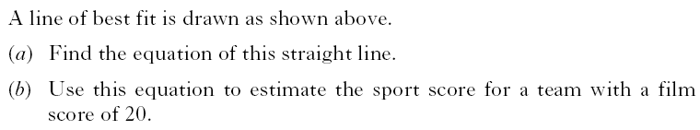

Slide 53
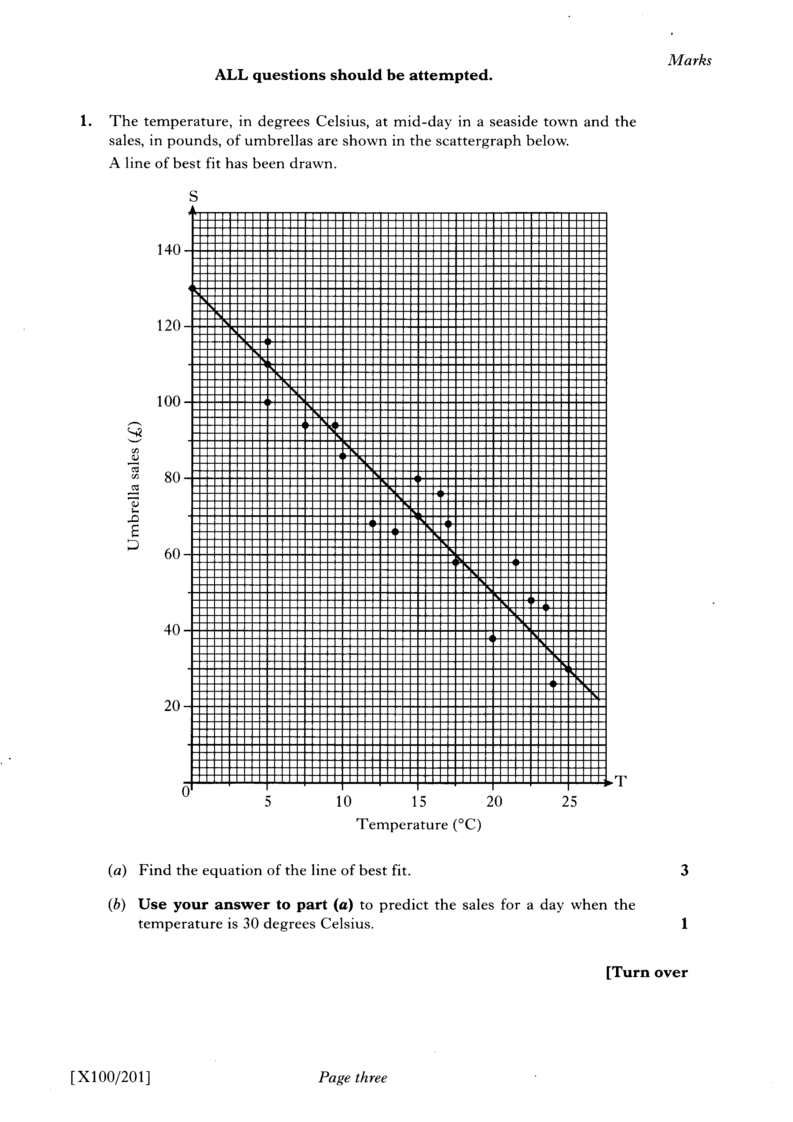

Slide 54
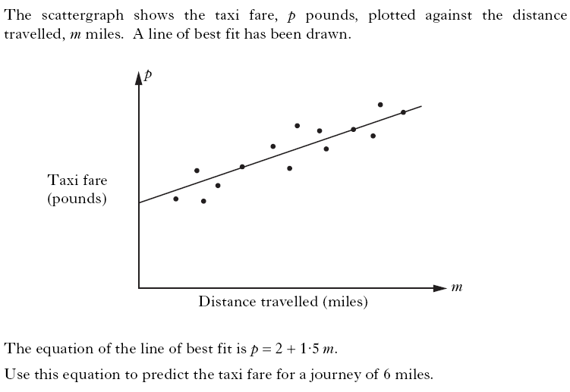

Slide 55
Best Fit
Straight Line Equation
Nat 5
Now try Sheet provided
www.mathsrevision.com
11 Jul 2026
Created by Mr.Lafferty Maths Dept

Slide 56
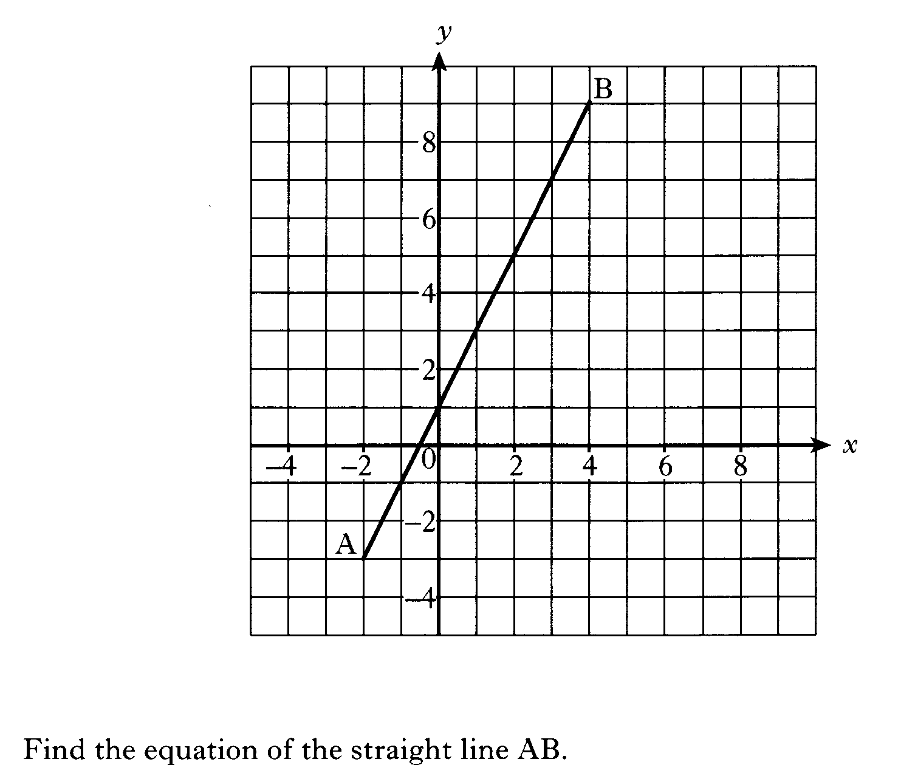

Slide 58
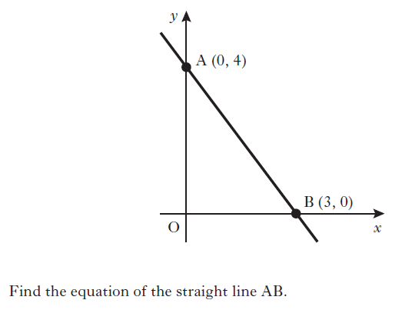

Slide 59
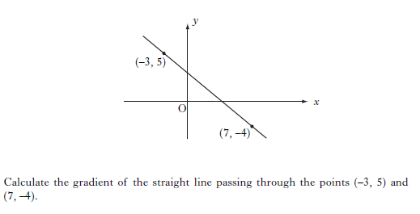

Slide 60
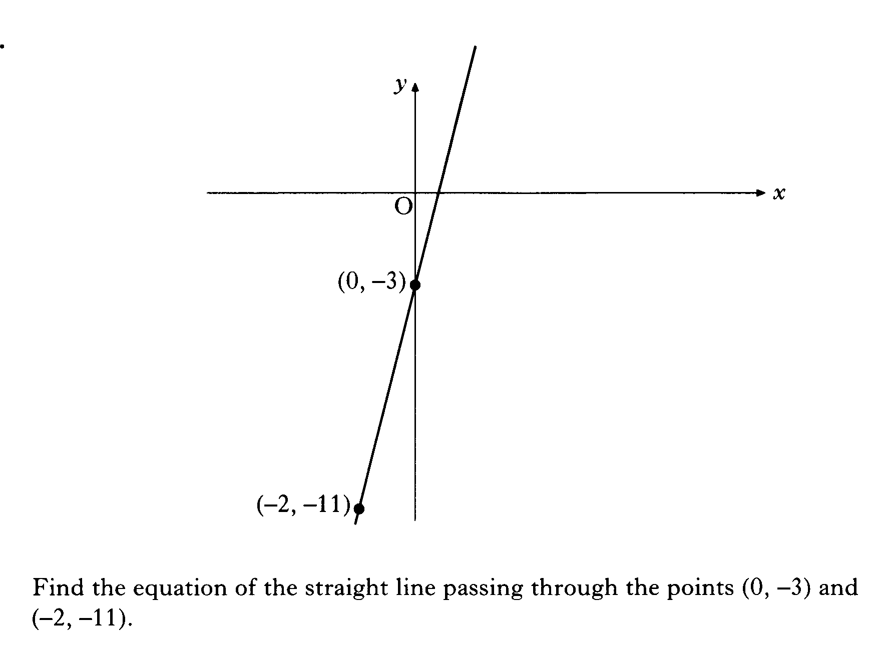

Slide 61
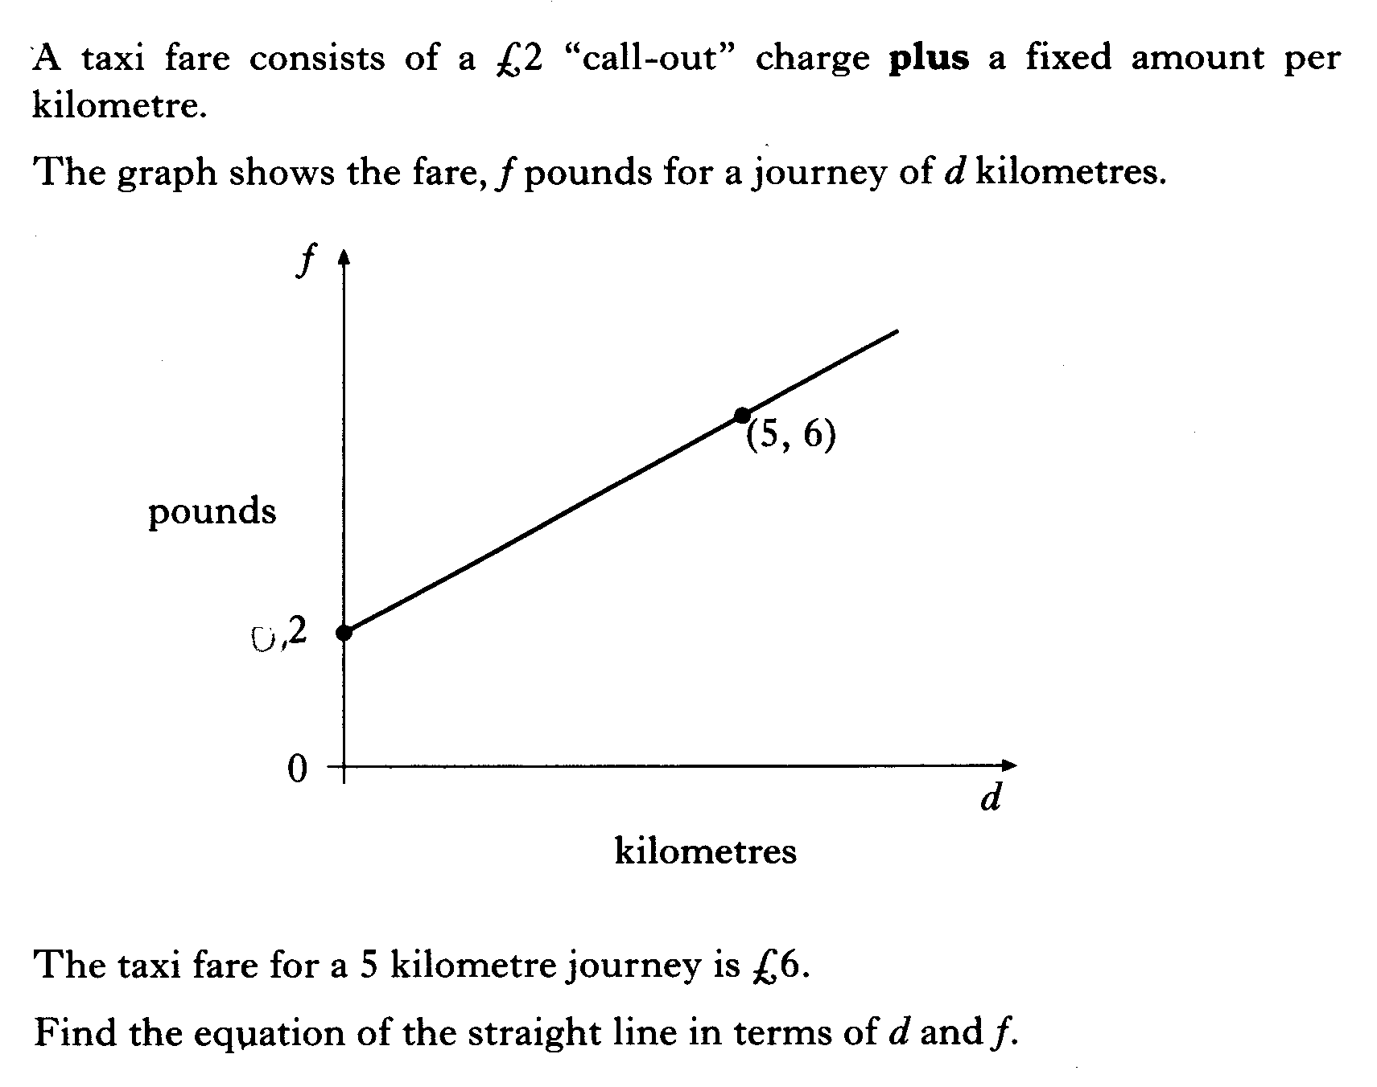

Slide 62
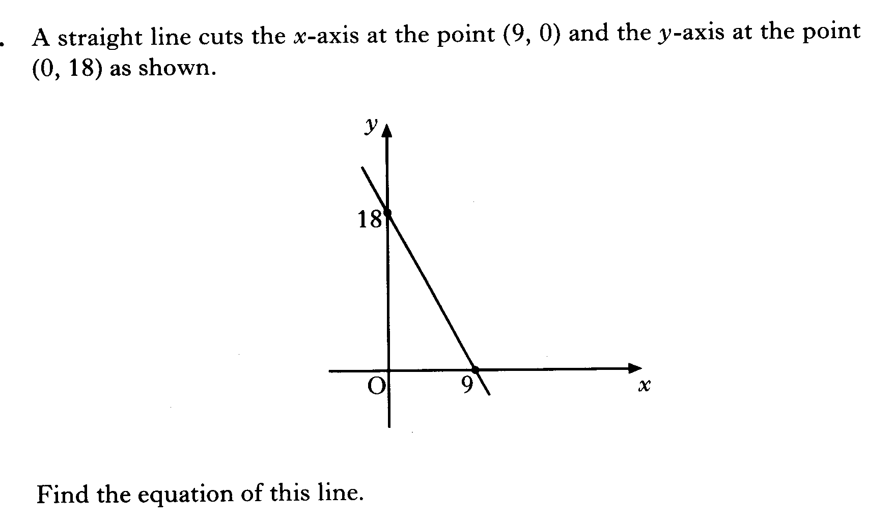

Slide 63
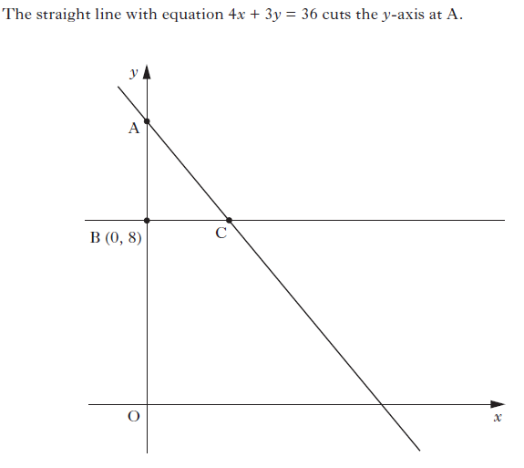
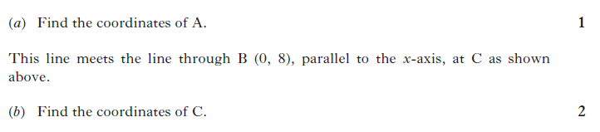

Slide 64
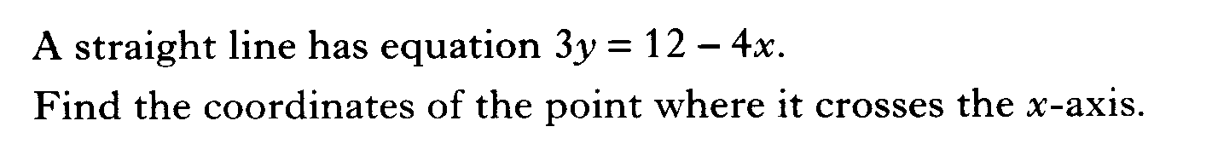

Slide 65
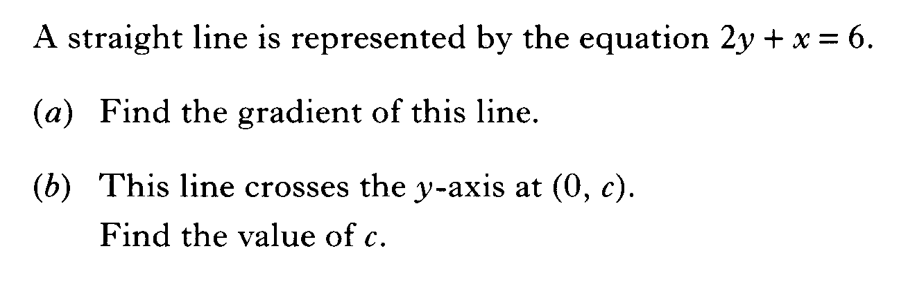

Slide 66
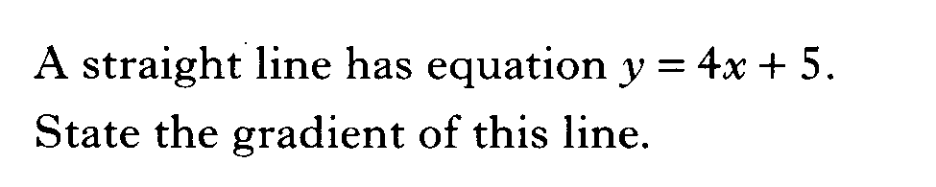

Slide 67
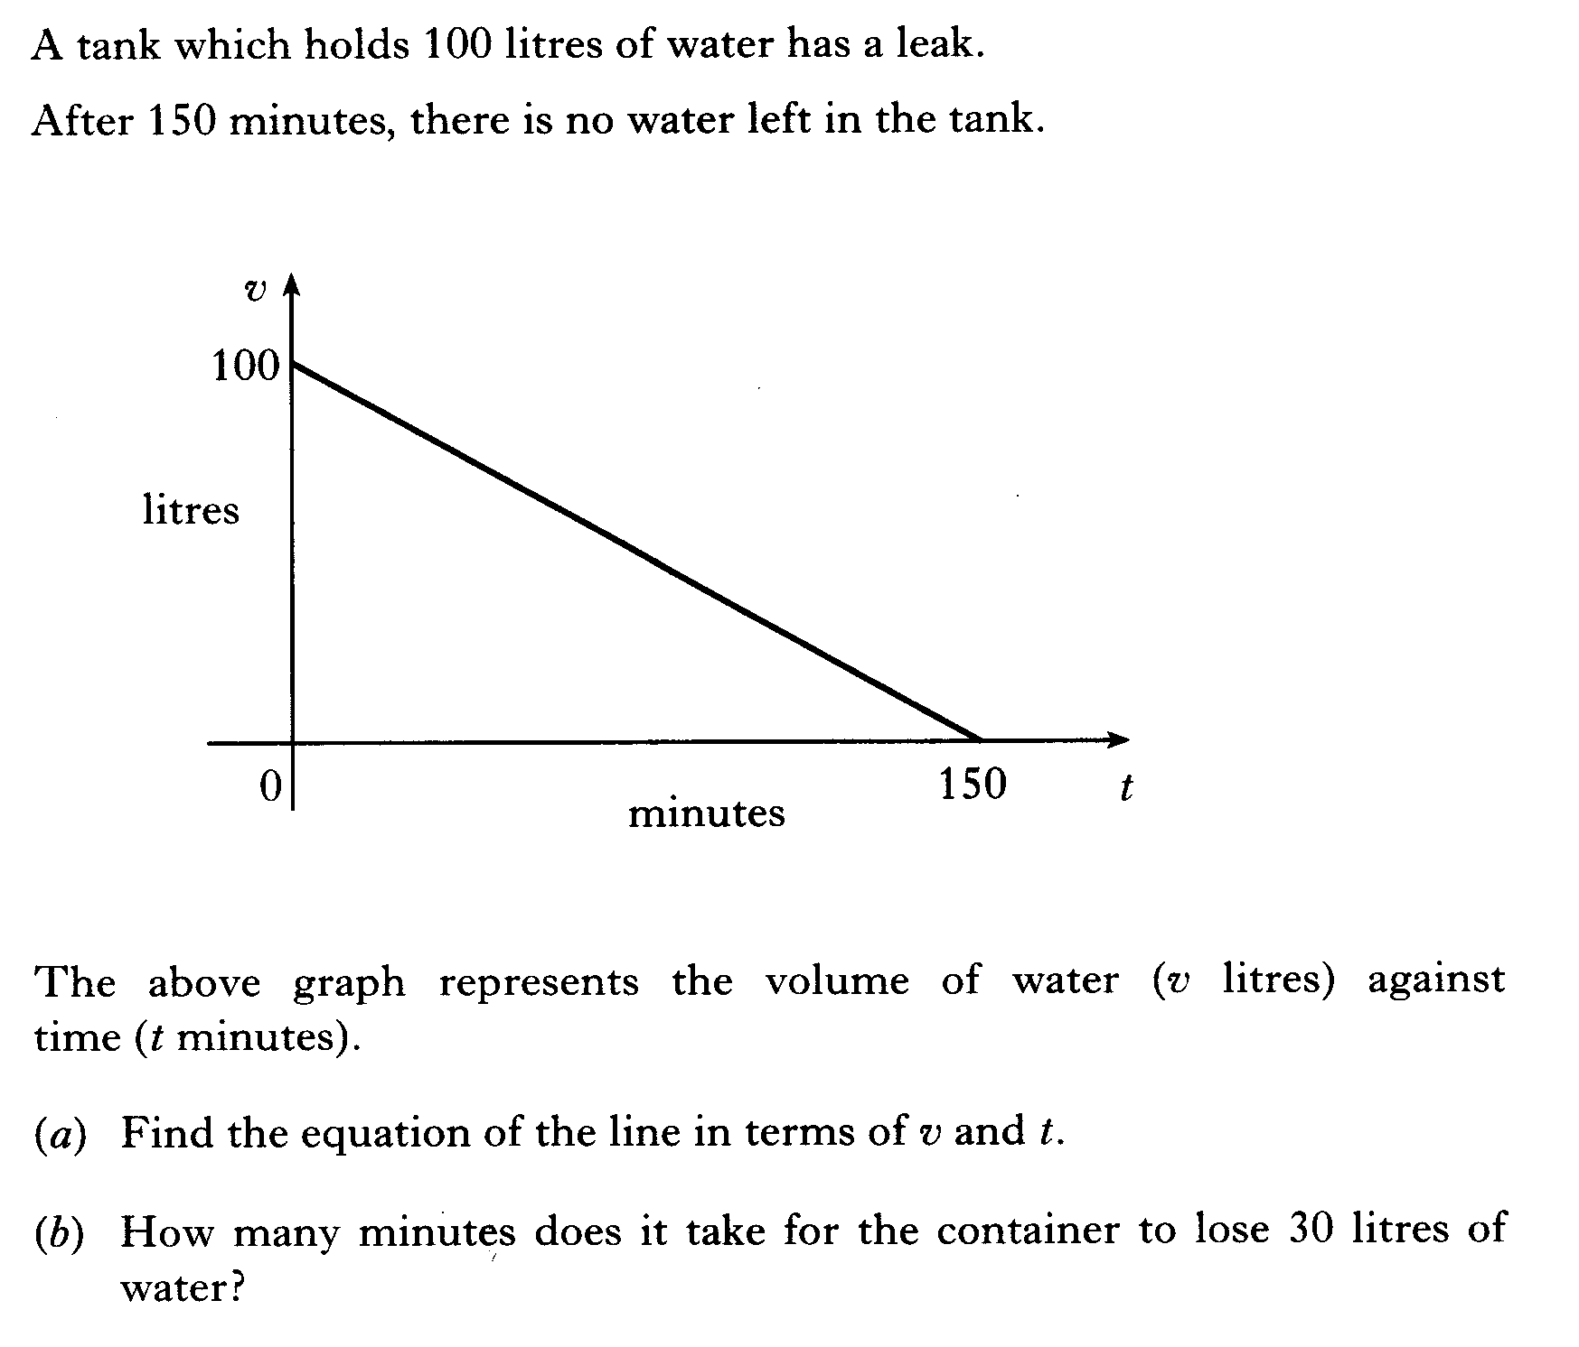

Slide 68
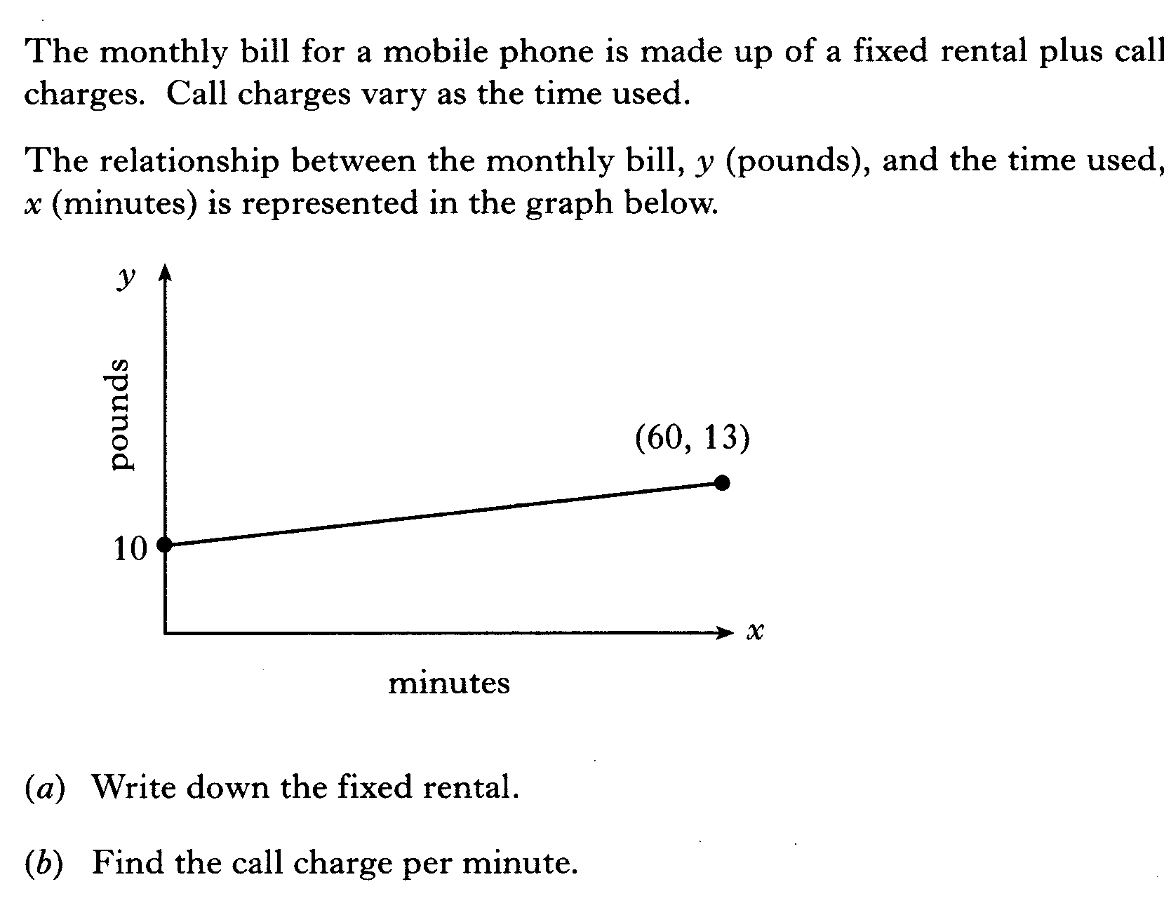

Slide 70
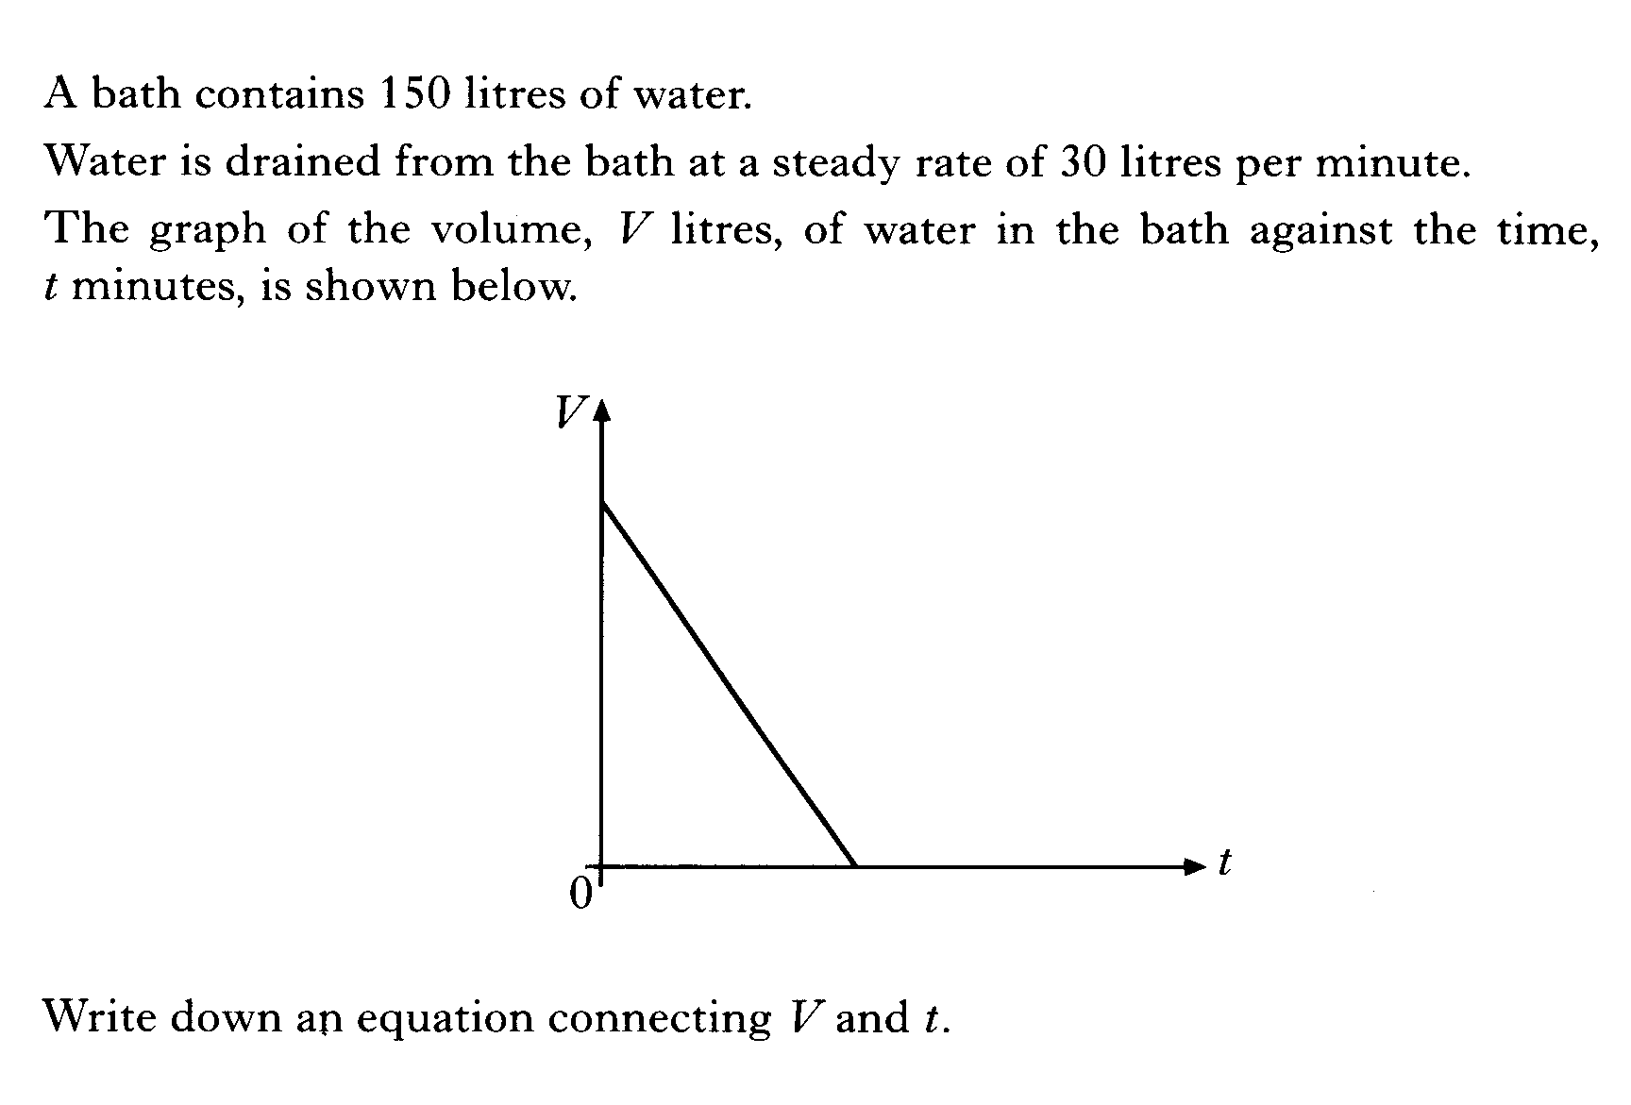

Slide 71
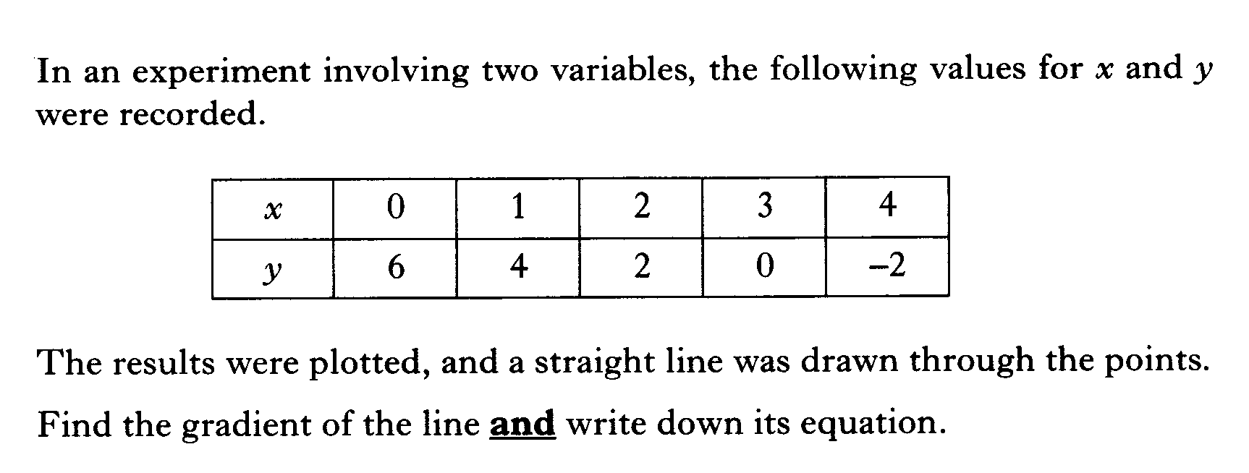

Slide 72
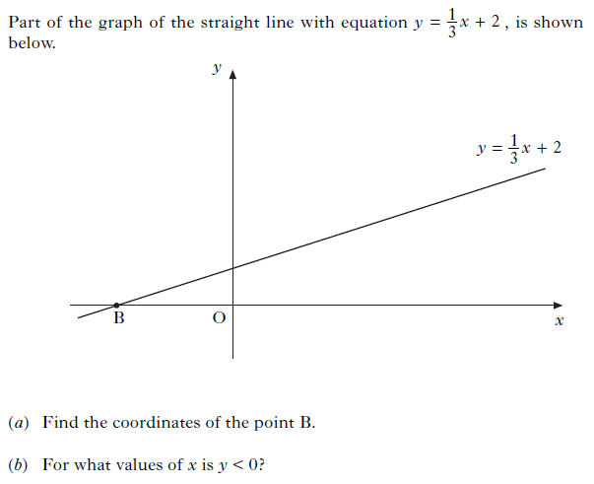

Slide 73
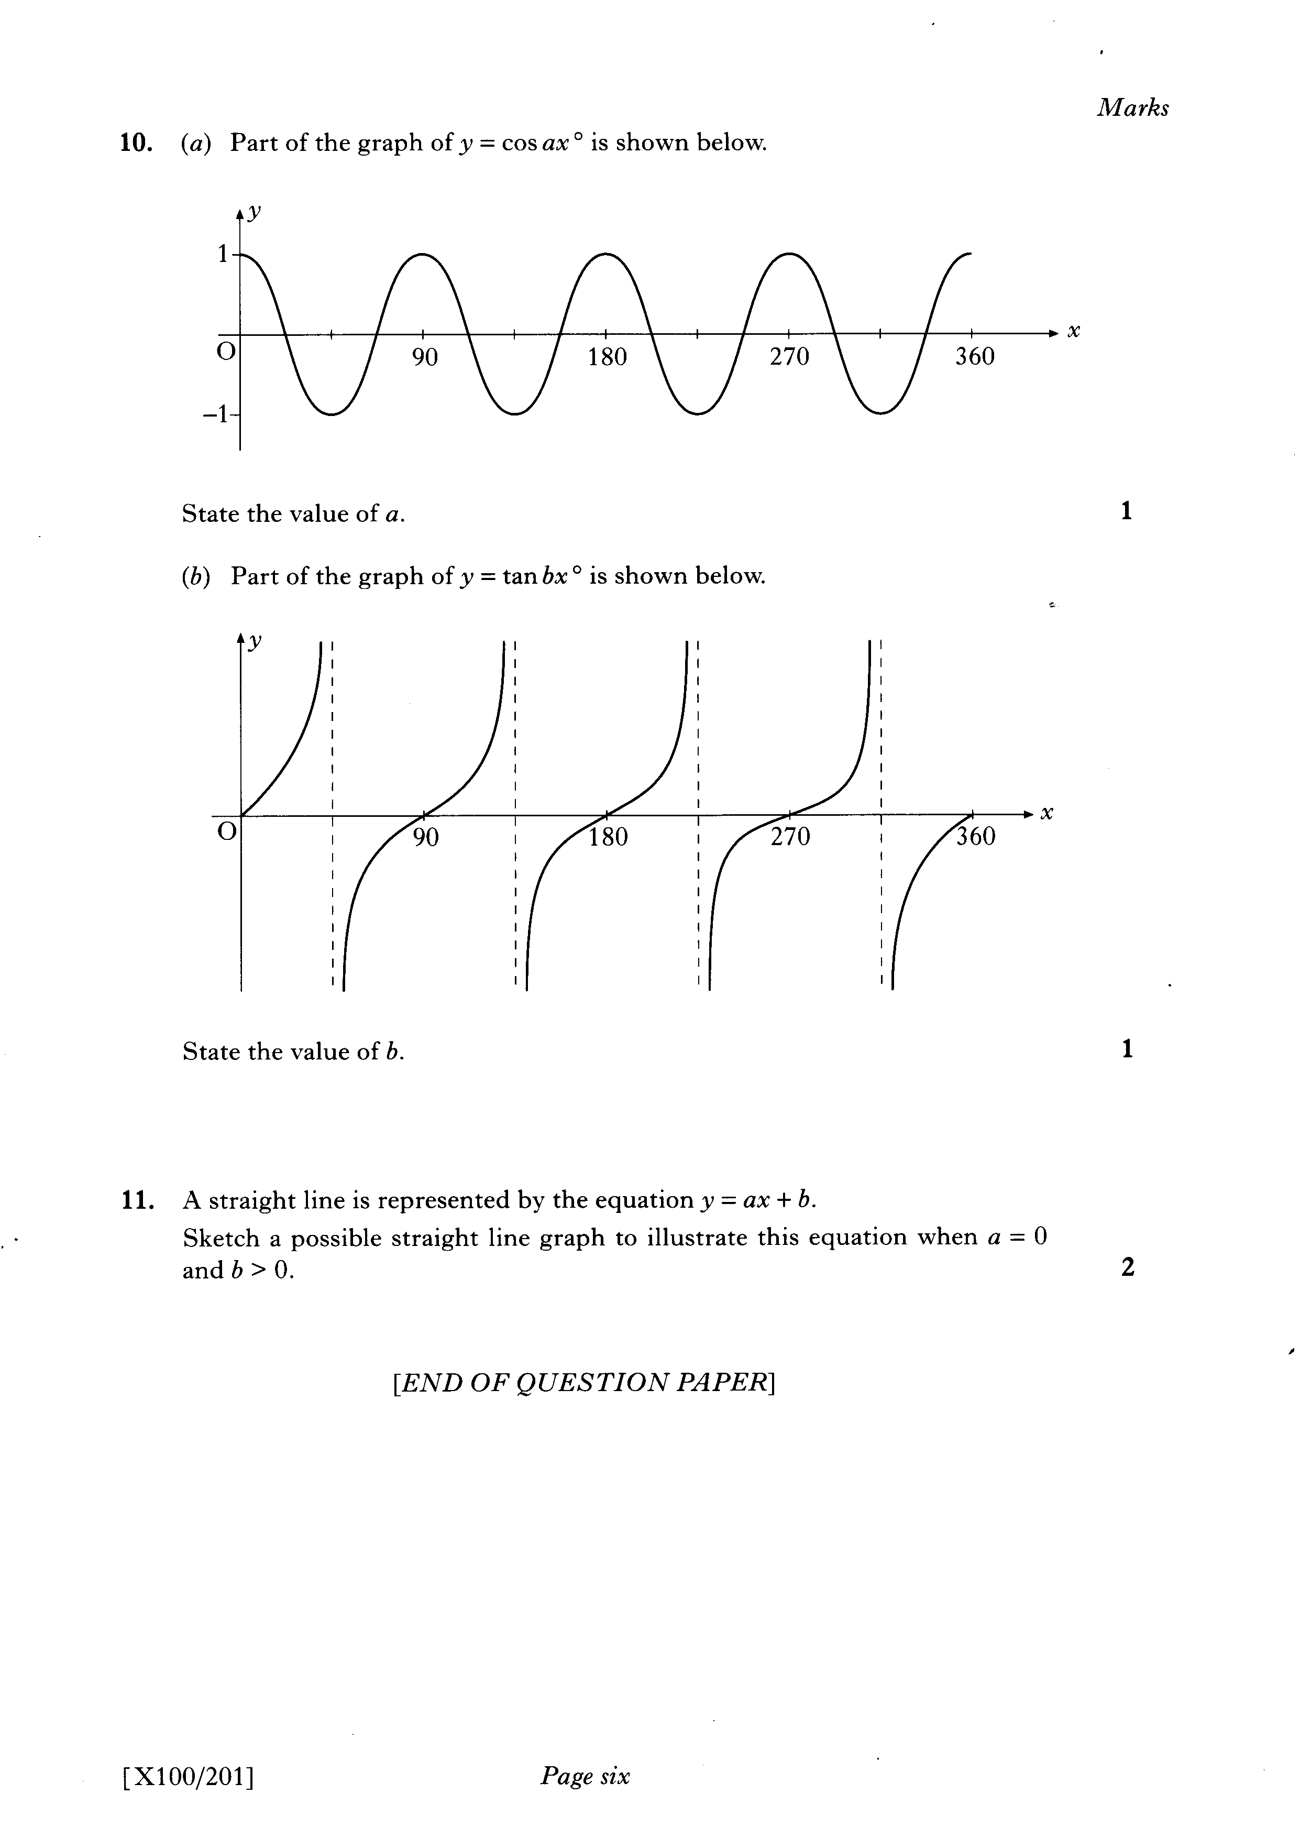

Slide 74


Slide 75


Slide 76
