Slide 1


Pythagoras Theorem
Nat 5
Revision of simple Pythagoras Theorem
Converse of Pythagoras Theorem
3D - Pythagoras Theorem
www.mathsrevision.com
Exam Questions

Slide 2
Starter Questions
Nat 5
Given the two straight lines
3y + 2x - 12 = 0 4x + 6y = -24
In pairs explain what they have in common
And where each cross the x-axis and y-axis.
www.mathsrevision.com

Slide 3
Revision of Pythagoras Theorem
Nat 5
Learning Intention
Success Criteria
  We are revising Pythagoras Theorem
  Know the term hypotenuse “ the longest side”
Use Pythagoras Theorem to calculate both the hypotenuse and smaller sides of a right-angled triangle.
www.mathsrevision.com

Slide 4
Revision of Pythagoras Theorem
Nat 5
Two key points when dealing with
right-angled triangles
The longest side in a right-angled triangle is called
The HYPOTENUSE
The HYPOTENUSE is ALWAYS opposite the right angle
www.mathsrevision.com
c² = a² + b²
(xz)² = (xy)² + (yz)²
c
b
x
a
y
z

Slide 5
Revision of Pythagoras Theorem
Nat 5
When coming across a problem involving finding a missing side in a right-angled triangle, you should consider using Pythagoras’ Theorem to calculate its length.
Example : A steel rod is used to support a tree
which is in danger of falling down.
What is the height of the tree ?
www.mathsrevision.com
17m
a
c
rod
8m
b

Slide 6
Revision of Pythagoras Theorem
Nat 5
Example 2
A garden has a fence around its perimeter and
along its diagonal as shown below.
What is the length of the fence from D to C.
A
B
www.mathsrevision.com
5m
13m
D
C
b m

Slide 7
Discuss with your partner how we might find the length of the line.
Finding the
Length of a Line
MTH 4-16a
8
(7,7)
7
6
3
5
5
4
(2,4)
www.mathsrevision.com
3
2
1
0
1
2
3
4
5
6
7
8
9
10

Slide 8
Pythagoras Theorem to find the length of a Line
MTH 4-16a
8
7
(0,6)
6
5
4
5
www.mathsrevision.com
3
2
(9,1)
9
1
0
1
2
3
4
5
6
7
8
9
10

Slide 9
Revision of Pythagoras Theorem
Nat 5
Problem : Find the length of h.
Find length BD first
B
h
C
15
www.mathsrevision.com
12
A
D
13

Slide 10
Revision of Pythagoras Theorem
Nat 5
Problem : Find the length of length y.
Now find h
B
h
C
15
www.mathsrevision.com
12
A
D
13

Slide 11
Revision of Pythagoras Theorem
Nat 5
NOTE !!!!
Pythagoras Theorem
tends to pop up within circle type question
www.mathsrevision.com

Slide 12
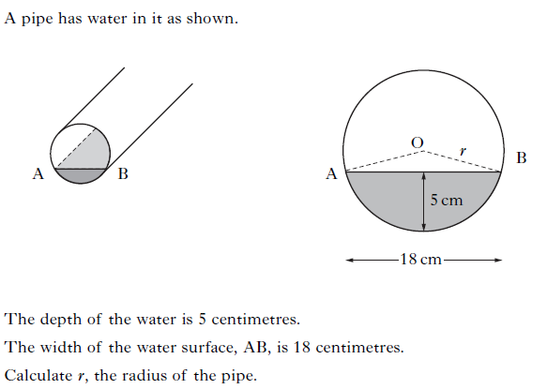

Slide 13
N
G
H
O
C
D
E
F
M
P
L
K
A
r
P(x,y)
I
J
C
o
Q
R
U
V
T
A
W
Z
S
B

Slide 14

Revision of Pythagoras Theorem
Nat 5
Now try N5 TJ
Ex5.1
Ch5 (page 44)
www.mathsrevision.com

Slide 15
Starter Questions
Nat 5
www.mathsrevision.com

Slide 16
Converse of Pythagoras Theorem
Nat 5
Learning Intention
Success Criteria
1. We are learning the converse of Pythagoras Theorem to prove a triangle is right-angled.
  Apply the converse of Pythagoras Theorem to prove a triangle is
  right-angled.
www.mathsrevision.com

Slide 17
Converse¹ – talk
Converse² – opposite, reverse
Converse of Pythagoras Theorem
Nat 5
Converse Theorem states that if
c
b
a
www.mathsrevision.com
1. Then triangle MUST be right-angled.
2. Right-angle is directly opposite C.
Hypotenuse

Slide 18
Since 117 ≠ 100 then by the Converse Theorem of Pythagoras triangle IS NOT right-angled.
Converse of Pythagoras Theorem
Nat 5
Problem : Is this triangle right-angled ? Explain Answer
If it is then Pythagoras Theorem will be true.
c
10cm
www.mathsrevision.com
6 cm
a
9 cm
b

Slide 19
Since 2500 = 2500 then by the Converse Theorem of Pythagoras triangle IS right-angled.
Converse of Pythagoras Theorem
Nat 5
Problem : A picture frame manufacturer claims that his
are rectangular is his claim true.
If it is then Pythagoras Theorem will be true
a
50cm
40 cm
c
www.mathsrevision.com
30 cm
b

Slide 20
Converse of Pythagoras Theorem
Nat 5
Now try N5 TJ
Ex5.2
Ch5 (page 46)
www.mathsrevision.com

Slide 21
Starter Questions
Nat 5
www.mathsrevision.com

Slide 22
3D Pythagoras Theorem
Nat 5
Learning Intention
Success Criteria
1. We are learning how to apply knowledge already gained on Pythagoras Theorem to solve 3D problems.
  Use the appropriate form of Pythagoras Theorem to solving 3D problems.
www.mathsrevision.com
  2. Show all working.

Slide 23
3D Pythagoras Theorem
Nat 5
Problem : Find the diagonal length of the cuboid AG.
Find AH first
F
G
B
C
7cm
www.mathsrevision.com
E
H
10cm
6cm
A
D
8cm

Slide 24
3D Pythagoras Theorem
Nat 5
Problem : Find the diagonal length of the cuboid AG.
Now find AG
F
G
B
C
7cm
www.mathsrevision.com
E
H
10cm
6cm
A
D
8cm

Slide 25
3D Pythagoras Theorem
Nat 5
Now try N5 TJ
Ex5.3
Ch5 (page 47)
www.mathsrevision.com

Slide 26
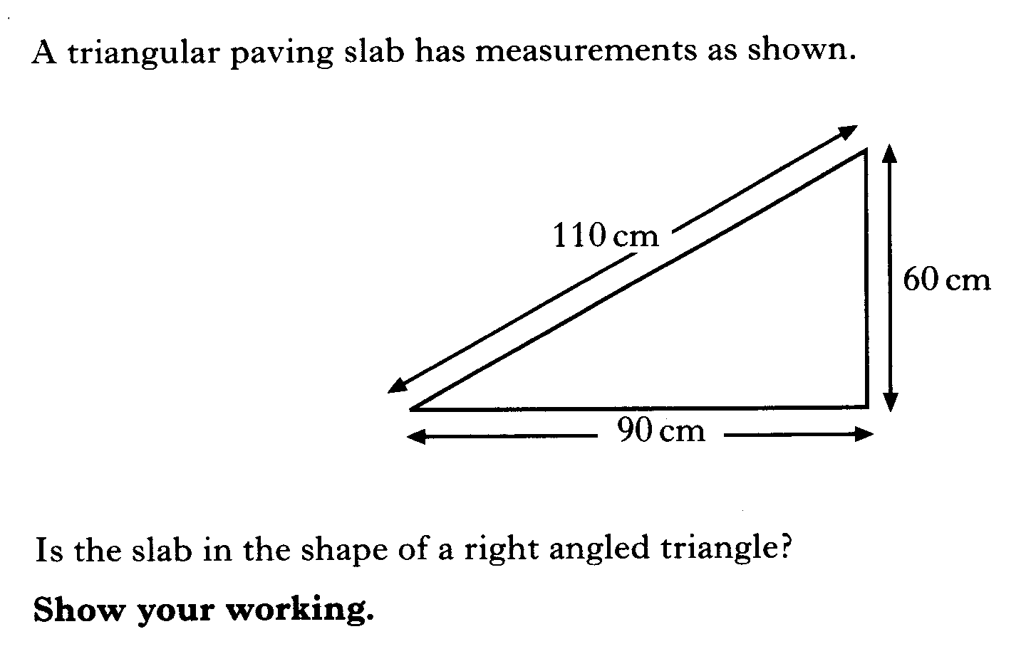

Slide 27
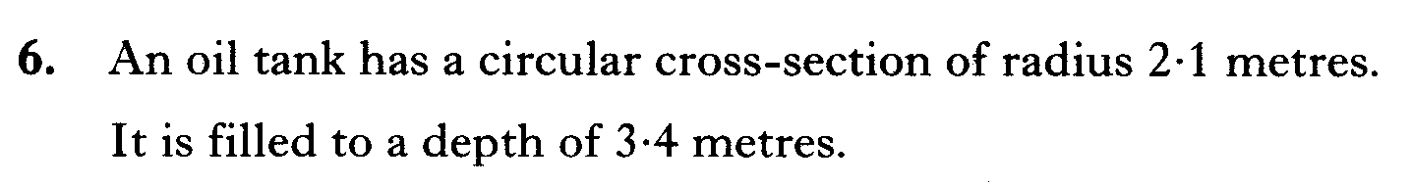
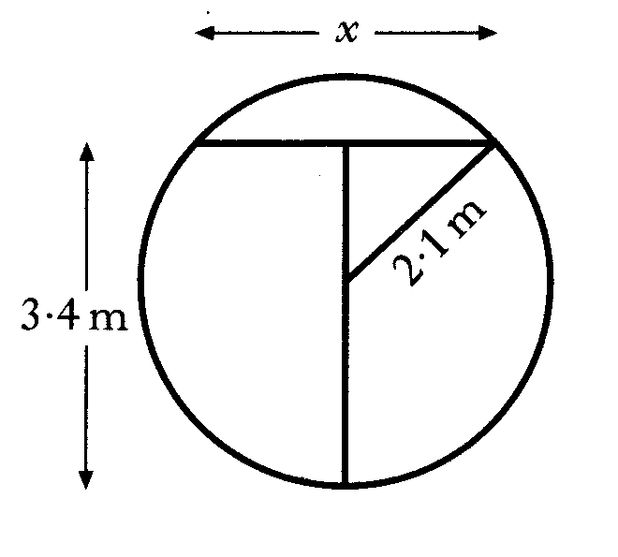
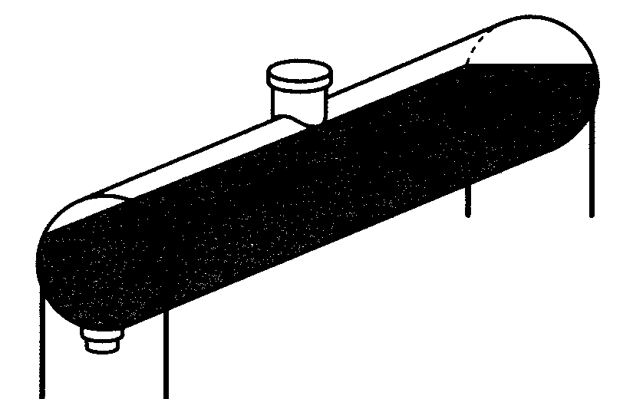
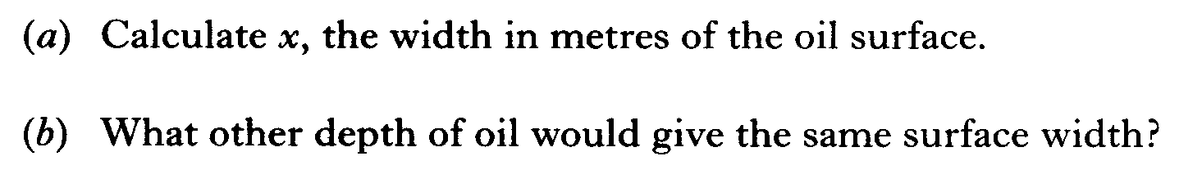

Slide 28
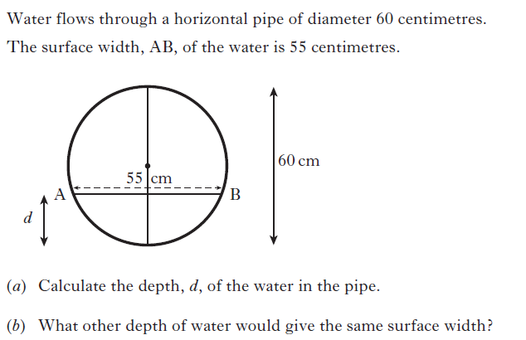

Slide 29
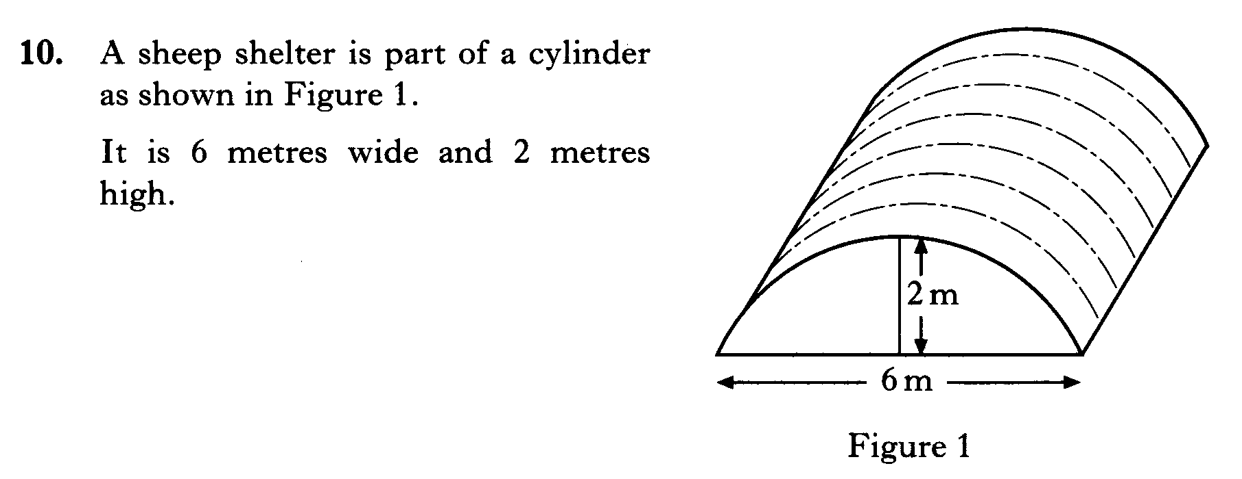
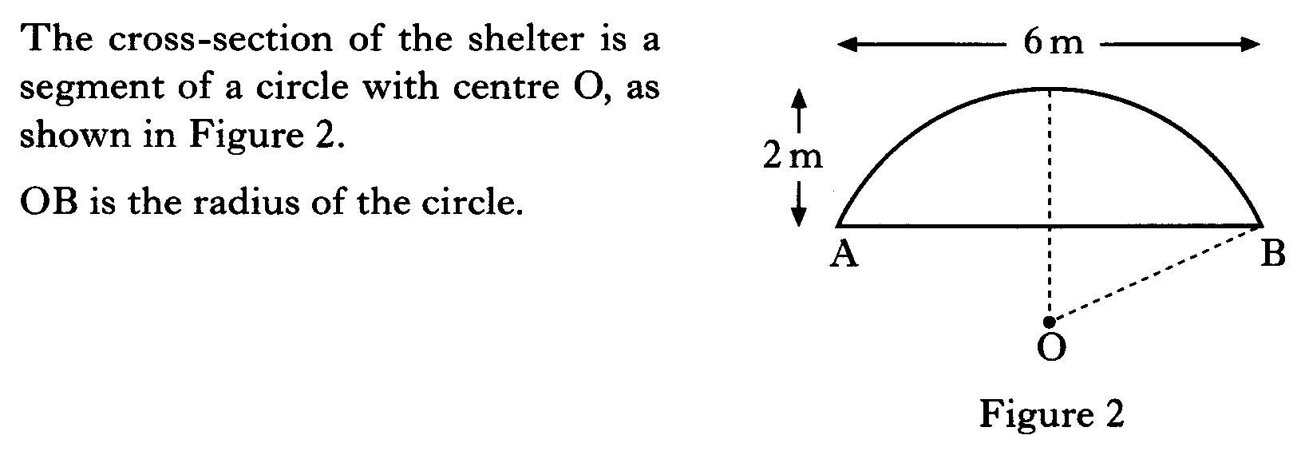
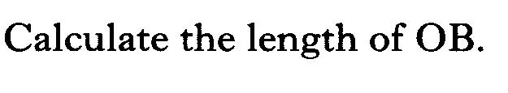

Slide 30
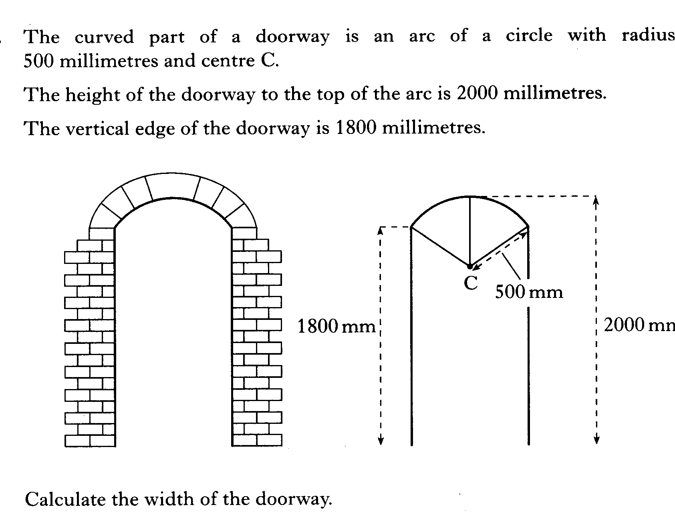

Slide 31
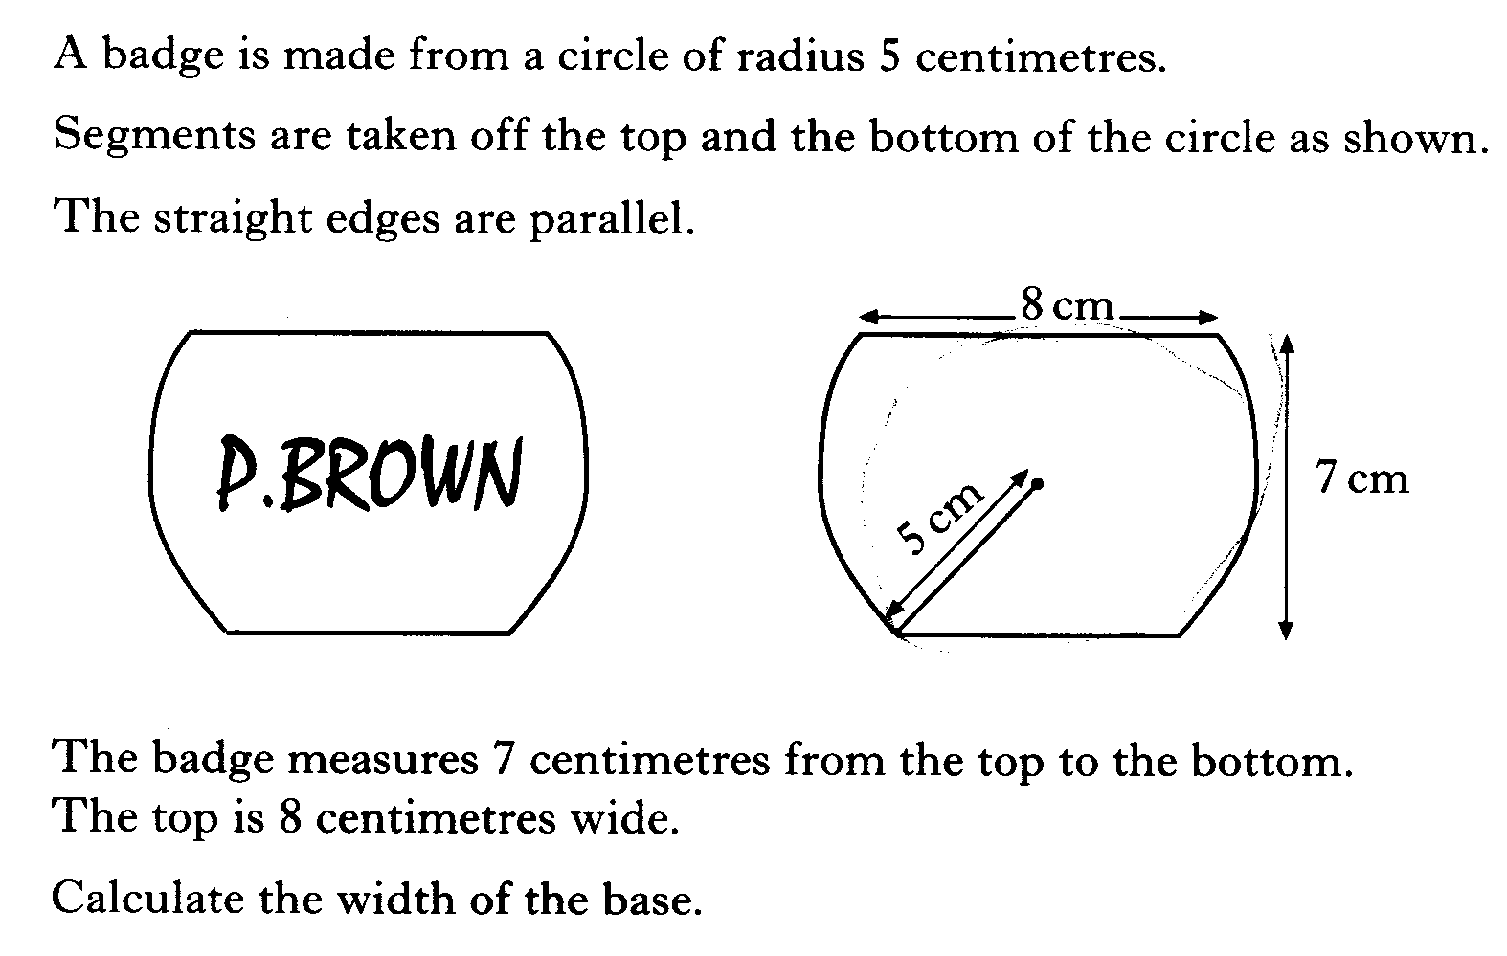

Slide 32
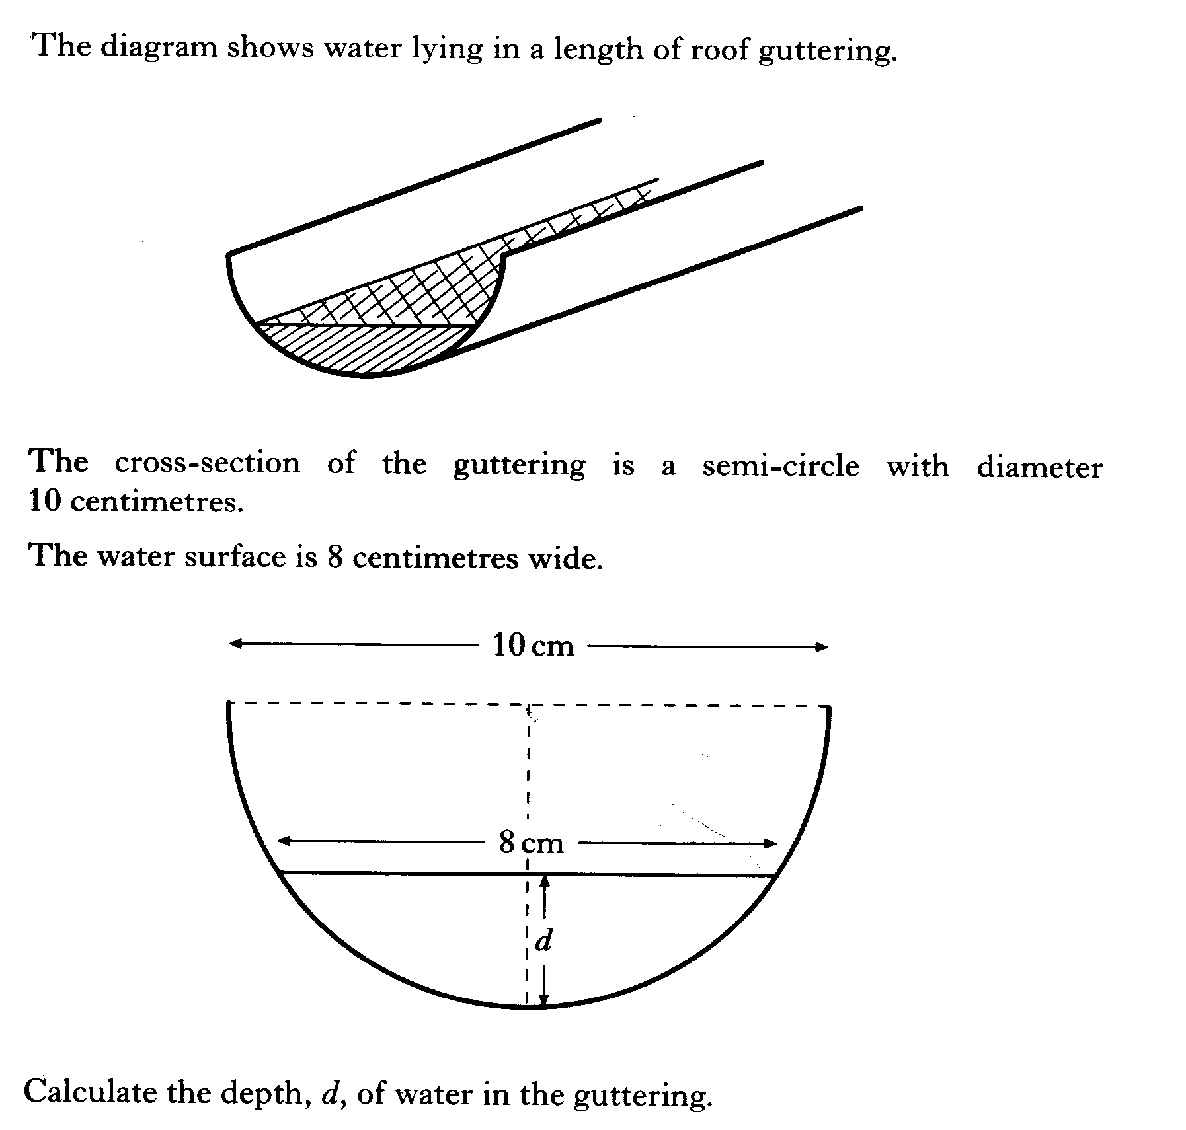

Slide 33
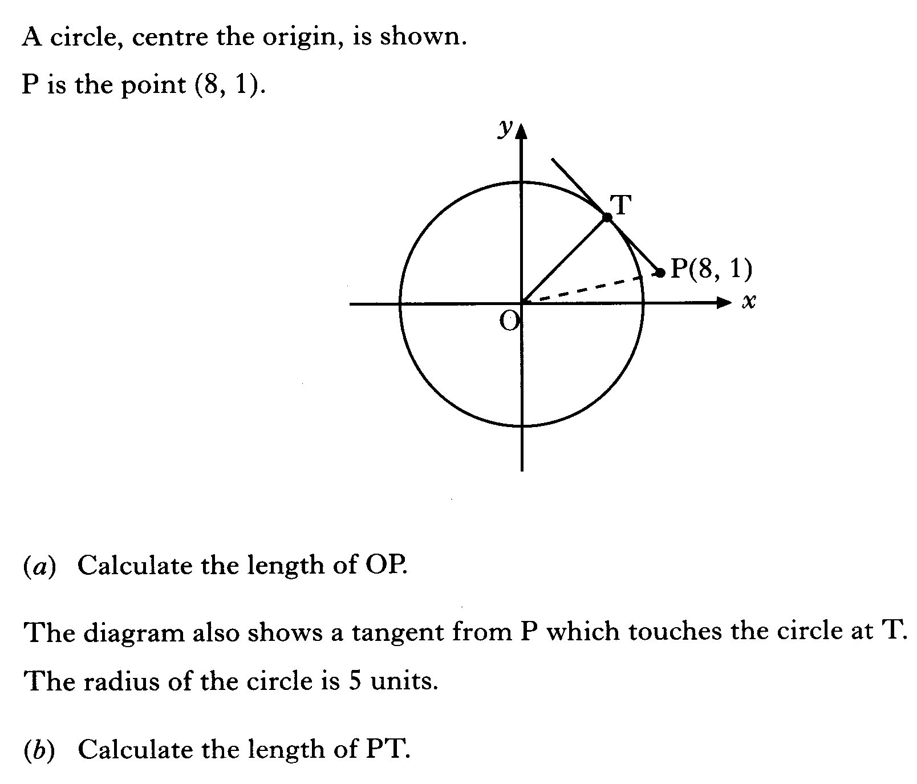

Slide 34
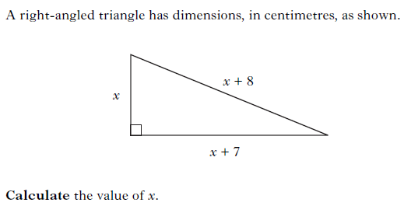

Slide 35
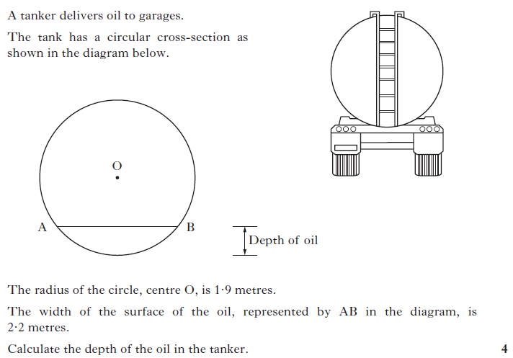

Slide 36
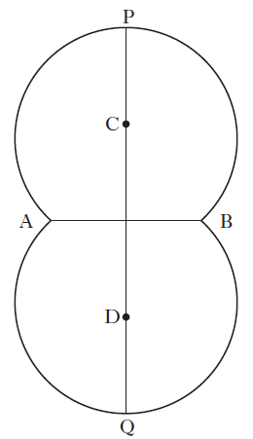
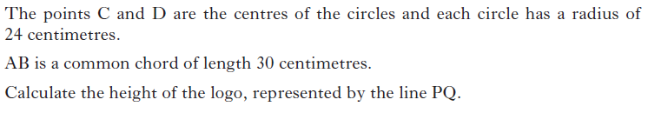

Slide 37
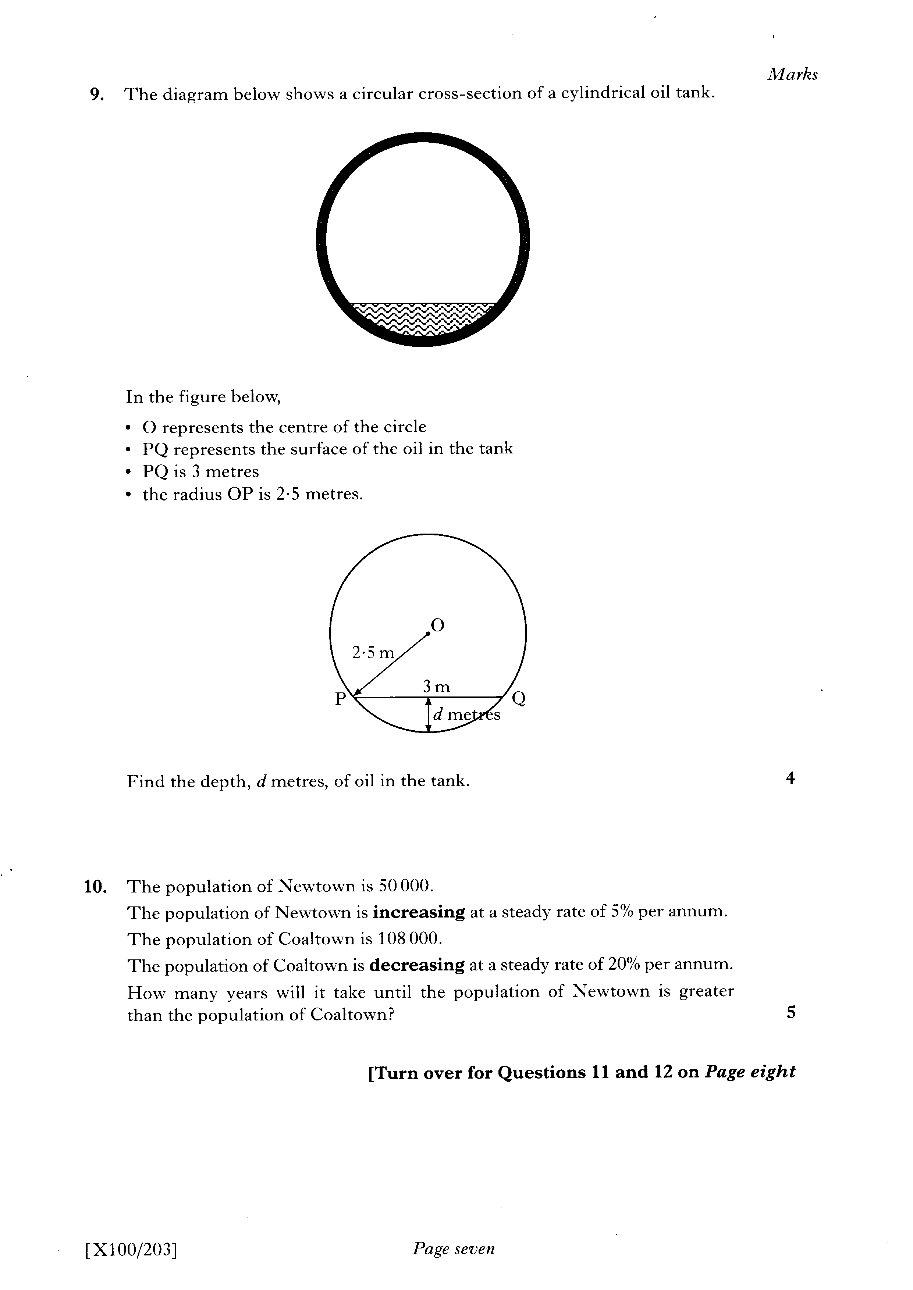

Slide 38
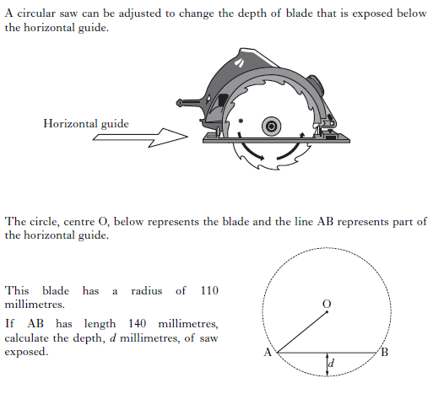

Slide 39
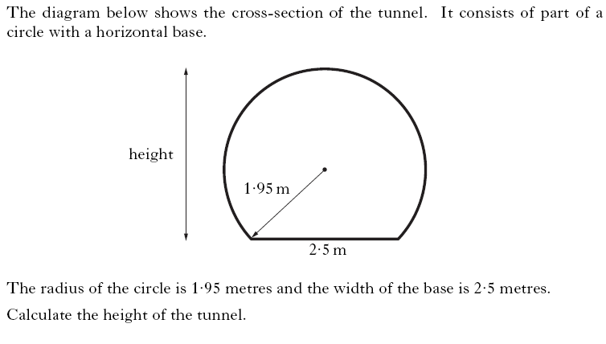

Slide 40
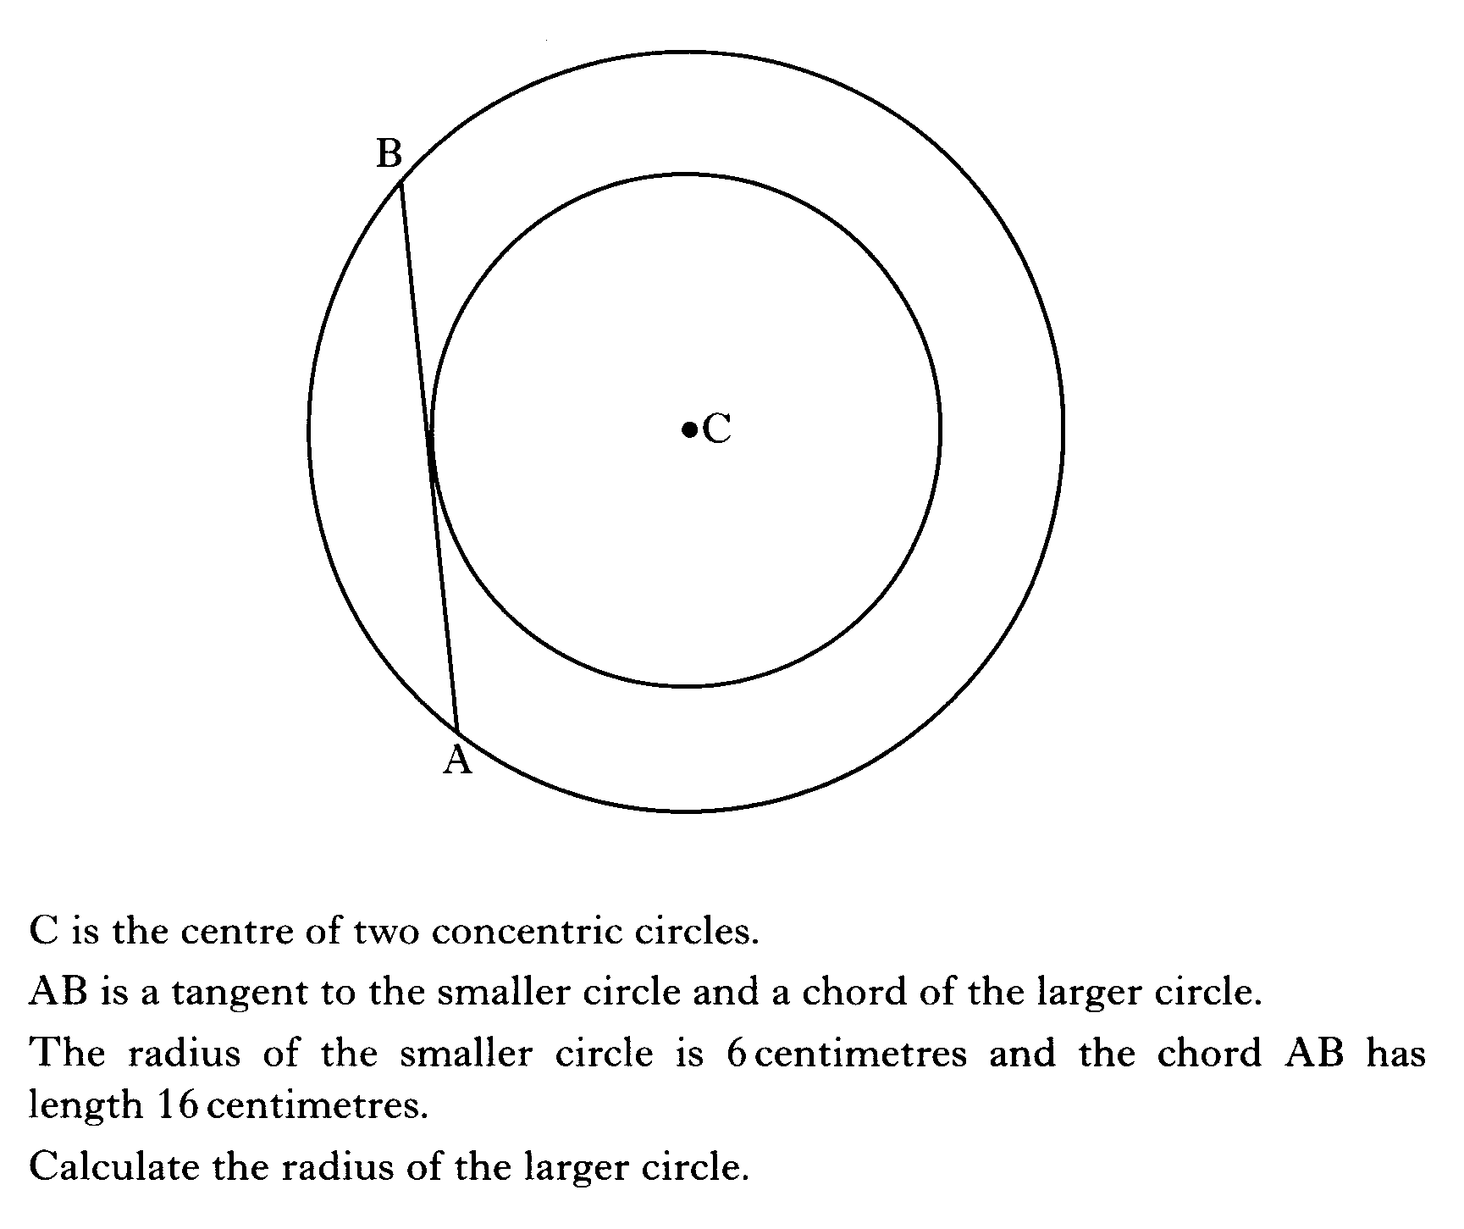

Slide 41
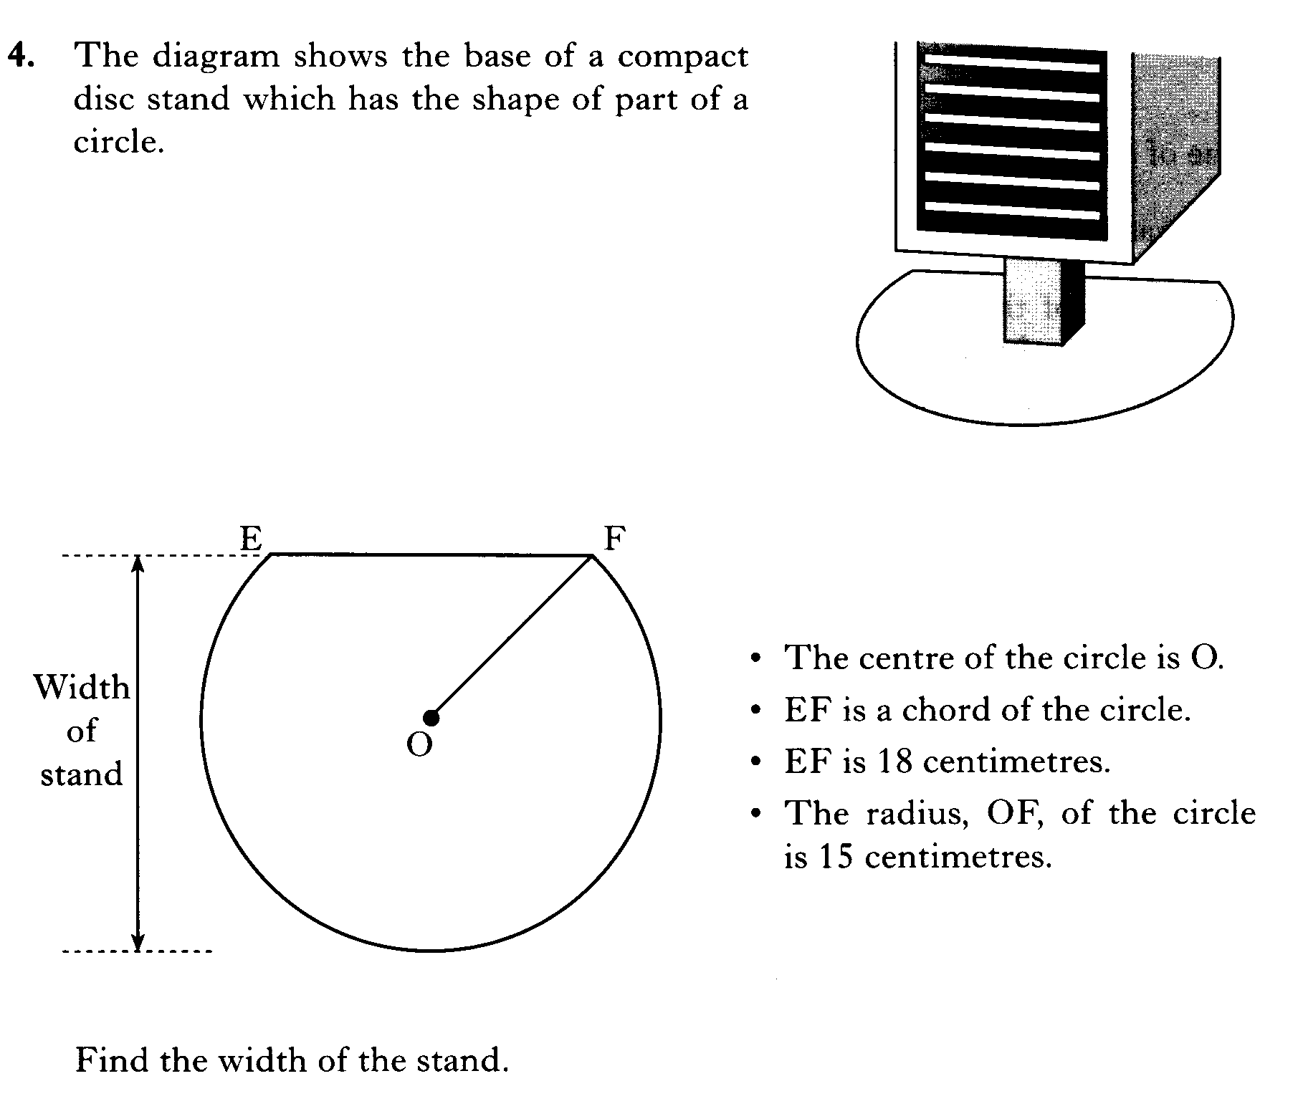

Slide 42
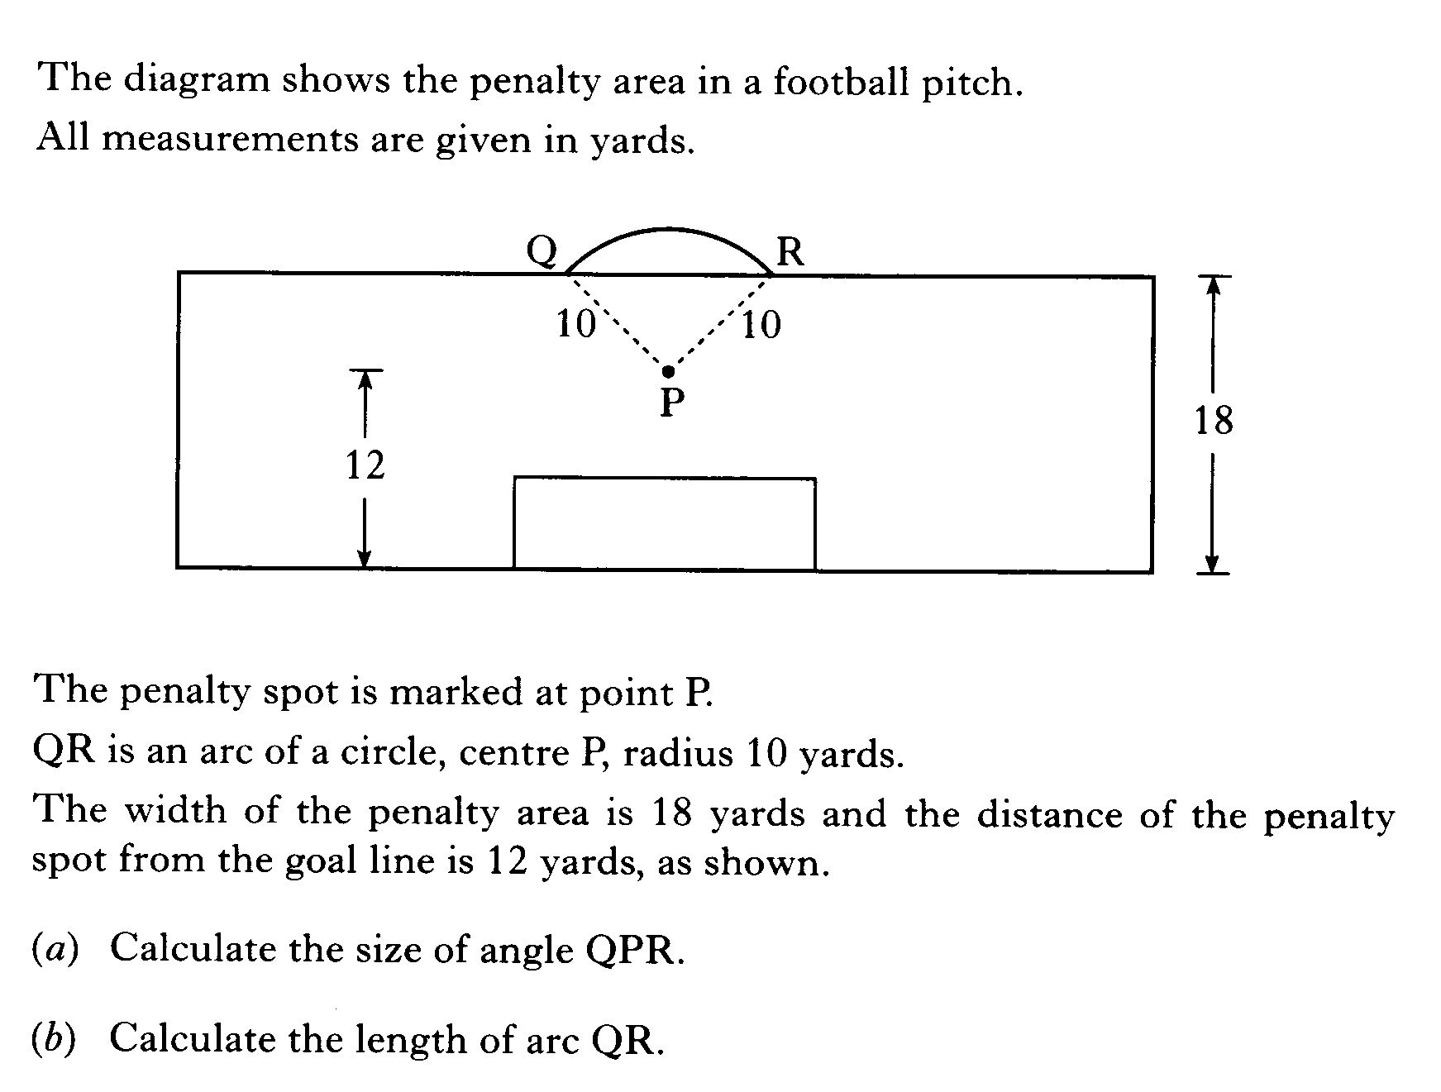

Slide 43
