Slide 1


Simultaneous Equations
Nat 5
Sketching straight line graphs
Solving Sim. Equations Graphically
Solving Simple Sim. Equations by elimination
www.mathsrevision.com
Solving harder type Sim. equations
Using Sim. Equations to solve problems
Exam Questions

Slide 2
Starter Questions
Nat 5
In pairs you have 3 minutes
Detail the main feature
of a coordinate grid.
www.mathsrevision.com

Slide 3
Simultaneous Equations
Nat 5
Straight Lines
Learning Intention
Success Criteria
  We are learning how to sketch a graph of a straight line function.
Understand the steps to draw a straight line function.
Be able to sketch a straight line graph.
www.mathsrevision.com

Slide 4
Sketch the straight line function
x - 2y – 4 = 0
First find x = 0 and y = 0 for line x – 2y – 4 = 0
x = 0 0 – 2y = 4 y = -2 (0,-2)
y = 0 x – 2 x 0 = 4 x = 4 (4,0)
www.mathsrevision.com

Slide 5
x - 2y – 4 = 0
( 0, -2) (4, 0)
10
9
8
7
6
5
4
3
2
1
x
-10
-9
-8
-7
-6
-5
-4
-3
-2
-1
0
1
2
3
4
5
6
7
8
9
10
-1
-2
-3
-4
-5
-6
-7
-8
-9
-10

Slide 6
Sketch the straight line function
x + 2y + 2 = 0
Next find x = 0 and y = 0 for line x + 2y + 2 = 0
x = 0 0 + 2y = -2 y = -1 (0,-1)
y = 0 x + 2 x 0 = -2 x = -2 (-2,0)
www.mathsrevision.com

Slide 7
x + 2y + 2 = 0
( 0, -1) (-2, 0)
10
9
8
7
6
5
4
3
2
1
x
-10
-9
-8
-7
-6
-5
-4
-3
-2
-1
0
1
2
3
4
5
6
7
8
9
10
-1
-2
-3
-4
-5
-6
-7
-8
-9
-10

Slide 8

Now try N5 TJ
Ex 4.1
Ch4 (page 35)
www.mathsrevision.com

Slide 9
Starter Questions
Nat 5
www.mathsrevision.com

Slide 10
Simultaneous Equations
Nat 5
Straight Lines
Learning Intention
Success Criteria
  We are learning how to find the intersection point between two line equations using graphical methods.
Draw line graphs using two points.
Find the coordinates where
two lines intersect ( meet)
www.mathsrevision.com

Slide 11
There is a quick way of sketching a straight line.
We need only find two points and then draw a line through them.
Normally the easier points to find are
x = 0 and y = 0
www.mathsrevision.com

Slide 12
Example : Solve graphically x - 2y = 4 and x + 2y = -2
First find x = 0 and y = 0 for line x – 2y = 4
x = 0 0 – 2y = 4 y = -2 (0,-2)
y = 0 x – 2 x 0 = 4 x = 4 (4,0)
www.mathsrevision.com
Next find x = 0 and y = 0 for line x + 2y = -2
x = 0 0 + 2y = -2 y = -1 (0,-1)
y = 0 x + 2 x 0 = -2 x = -2 (-2,0)

Slide 13
x - 2y – 4 = 0
x + 2y + 2 = 0
Solution
(1, -1.5)
( 0, -2) (4, 0)
( 0, -1) (-2, 0)
10
9
8
Check !
x – 2y - 4
1 – 2x(-1.5) - 4
= 0
7
6
5
4
3
2
1
x
-10
-9
-8
-7
-6
-5
-4
-3
-2
-1
0
1
2
3
4
5
6
7
8
9
10
-1
-2
Check !
x + 2y + 2
1 + 2x(-1.5) + 2
= 0
-3
-4
-5
-6
-7
-8
-9
-10

Slide 14
Key points for quick method for graphical solution
1. Find two points that lie on each of the two lines.
Normally easy to find x = 0 and y =0 coordinates for both lines
Plot the two coordinates for each line and join them up.
www.mathsrevision.com
Extend each line if necessary so they cross over.
Read off solution where lines meet and check that it satisfies both equations.

Slide 15
Now try N5 TJ
Ex 4.2
Ch4 (page 36)
www.mathsrevision.com

Slide 16
Starter Questions
Nat 5
www.mathsrevision.com

Slide 17
Simultaneous Equations
Nat 5
Straight Lines
Learning Intention
Success Criteria
  To solve simultaneous equations of 2 variables by elimination.
Understand the term simultaneous equation.
Understand the process for solving simultaneous equation of two variables by elimination method.
3. Solve simple equations
www.mathsrevision.com

Slide 18
Example 1
Solve the equations
x + 2y = 14
x + y = 9
by elimination

Slide 19
Step 1: Label the equations
x + 2y = 14 (A)
x + y = 9 (B)
Step 2: Decide what you want to eliminate
Eliminate x by subtracting (B) from (A)
x + 2y = 14 (A)
x + y = 9 (B)
y = 5

Slide 20

Step 3: Sub into one of the equations to get other variable
Substitute y = 5 in (B)
x + y = 9
x + 5 = 9
x = 9 - 5
x = 4
The solution is x = 4
y = 5
Step 4: Check answers by substituting into both equations
x + 2y = 14
x + y = 9
( 4 + 10 = 14)
( 4 + 5 = 9)

Slide 21
Example 2
Solve the equations
2x - y = 11
x - y = 4
by elimination

Slide 22
Step 1: Label the equations
2x - y = 11 (A)
x - y = 4 (B)
Step 2: Decide what you want to eliminate
Eliminate y by subtracting (B) from (A)
2x - y = 11 (A)
x - y = 4 (B)
x = 7

Slide 23
Step 3: Sub into one of the equations to get other variable
Substitute x = 7 in (B)
x - y = 4
7 - y = 4
y = 7 - 4
The solution is x = 7
y = 3
y = 3
Step 4: Check answers by substituting into both equations
2x - y = 11
x - y = 4
( 14 - 3 = 11)
( 7 - 3 = 4)

Slide 24
Example 3
Solve the equations
2x - y = 6
x + y = 9
by elimination

Slide 25
Step 1: Label the equations
2x - y = 6 (A)
x + y = 9 (B)
Step 2: Decide what you want to eliminate
Eliminate y by adding (A) from (B)
2x - y = 6 (A)
x + y = 9 (B)
3x = 15
x = 15 ÷ 3 = 5

Slide 26
Step 3: Sub into one of the equations to get other variable
Substitute x = 5 in (B)
x + y = 9
5 + y = 9
y = 9 - 5
The solution is x = 5
y = 4
y = 4
Step 4:
Check answers by substituting into both equations
2x - y = 6
x + y = 9
( 10 - 4 = 6)
( 5 + 4 = 9)

Slide 27
Now try N5 TJ
Ex 4.3
Ch4 (page 37)
www.mathsrevision.com

Slide 28
Starter Questions
Nat 5
www.mathsrevision.com

Slide 29
Simultaneous Equations
Nat 5
Straight Lines
Learning Intention
Success Criteria
  We are learning to solve harder simultaneous equations of two variables.
1. Apply the process for solving simultaneous equations to harder examples.
www.mathsrevision.com

Slide 30
Example 1
Solve the equations
2x + y = 9
x - 3y = 1
by elimination

Slide 31
Step 1: Label the equations
2x + y = 9 (A)
x -3y = 1 (B)
Step 2: Decide what you want to eliminate
Adding
Eliminate y by :
2x + y = 9
x -3y = 1
(A) x3
6x + 3y = 27 (C)
x - 3y = 1 (D)
(B) x1
7x =28
x = 28 ÷ 7 = 4

Slide 32
Step 3: Sub into one of the equations to get other variable
Substitute x = 4 in equation (A)
2 x 4 + y = 9
y = 9 – 8
y = 1
The solution is x = 4
y = 1
Step 4:
Check answers by substituting into both equations
2x + y = 9
x -3y = 1
( 8 + 1 = 9)
( 4 - 3 = 1)

Slide 33
Example 2
Solve the equations
3x + 2y = 13
2x + y = 8
by elimination

Slide 34
Step 1: Label the equations
3x + 2y = 13 (A)
2x + y = 8 (B)
Step 2: Decide what you want to eliminate
Subtract
Eliminate y by :
3x + 2y = 13
2x + y = 8
(A) x1
3x + 2y = 13 (C)
4x + 2y = 16 (D)
(B) x2
-x = -3
x = 3

Slide 35
Step 3: Sub into one of the equations to get other variable
Substitute x = 3 in equation (B)
2 x 3 + y = 8
y = 8 – 6
y = 2
The solution is x = 3
y = 2
Step 4:
Check answers by substituting into both equations
3x + 2y = 13
2x + y = 8
( 9 + 4 = 13)
( 6 + 2 = 8)

Slide 36
Now try N5 TJ
Ex 4.4
Ch4 (page 38)
www.mathsrevision.com

Slide 37
Starter Questions
Nat 5
www.mathsrevision.com

Slide 38
Simultaneous Equations
Nat 5
Straight Lines
Learning Intention
Success Criteria
  We are learning to use simultaneous equations to solve real life problems.
1. Apply the process for solving simultaneous equations to solve real life problems.
www.mathsrevision.com

Slide 39
A jeweller uses two different arrangements of beads and pearls
The first arrangement consists of 3 beads and 6 pearls.
It has an overall length of 10.8 cm.
The second arrangement consists of 6 beads and 4 pearls.
It has an overall length of 12 cm.
Find the length of one bead and the length of one pearl.

Slide 40
Example 1
Solve the equations
3x + 6y = 10.8
6x + 4y = 12
by elimination

Slide 41
Step 1: Label the equations
3x + 6y = 10.8 (A)
6x + 4y = 12 (B)
Subtracting
Step 2: Decide what you want to eliminate
Eliminate x by :
6x + 12y = 21.6
6x + 4y = 12
(A) x2
6x + 12y = 21.6 (C)
6x + 4y = 12 (D)
(B) x1
8y = 9.6
y = 9.6 ÷ 8 = 1.2

Slide 42
Step 3: Sub into one of the equations to get other variable
Substitute y = 1.2 in equation (A)
3x + 6 x 1.2 = 10.8
3x = 10.8 - 7.2
3x = 3.6
The solution is
x = 1.2
y = 1.2
x = 1.2
Step 4:
Check answers by substituting into both equations
3x + 6y = 10.8
6x + 4y = 12
( 3.6 + 7.2 = 10.8 )
( 7.2 + 4.8 = 12 )

Slide 43
One evening 4 adults and 6 children visited the sports centre.
The total collected in entrance fees was £97.60
The next evening 7 adults and 4 children visited the sports centre.
The total collected in entrance fees was £126.60
Calculate the cost of an adult price and a child price.

Slide 44
Example 1
Solve the equations
4x + 6y = 97.60
7x + 4y = 126.60
by elimination

Slide 45
Step 1: Label the equations
4x + 6y = 97.6 (A)
7x + 4y = 126.6 (B)
Subtracting
Step 2: Decide what you want to eliminate
Eliminate x by :
16x + 24y = 390.4
42x + 24y = 759.6
(A) x4
16x + 24y =390.4 (C)
42x + 24y =759.6 (D)
(B) x6
-26x =-369.2
x = (-369.2) ÷ (-26) = £14.20

Slide 46
Step 3: Sub into one of the equations to get other variable
Substitute y = 14.20 in equation (A)
4 x 14.20 + 6y = 97.60
6y = 97.60 – 56.80
6y = 40.80
The solution is x = adult price = £14.20
y = child price = £6.80
y = £6.80
Step 4:
Check answers by substituting into both equations
4x + 6y = 97.60
7x + 4y = 126.60
( 56.80 + 40.80 = £97.60 )
( 99.40 + 27.20 = £ 126.60 )

Slide 47
Now try N5 TJ
Ex 4.5
Ch4 (page 40)
www.mathsrevision.com

Slide 48
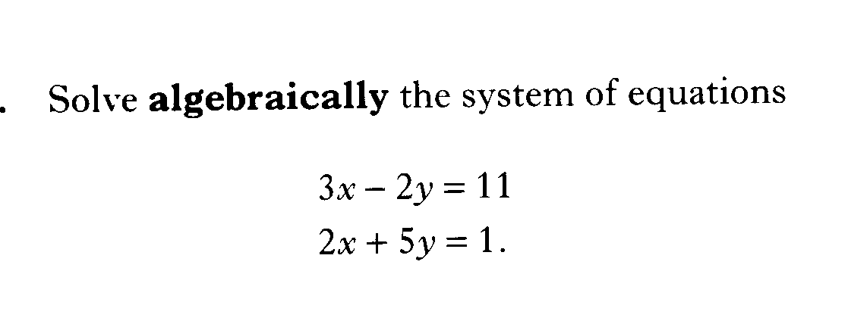

Slide 49
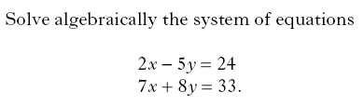

Slide 50
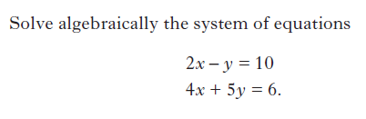

Slide 51
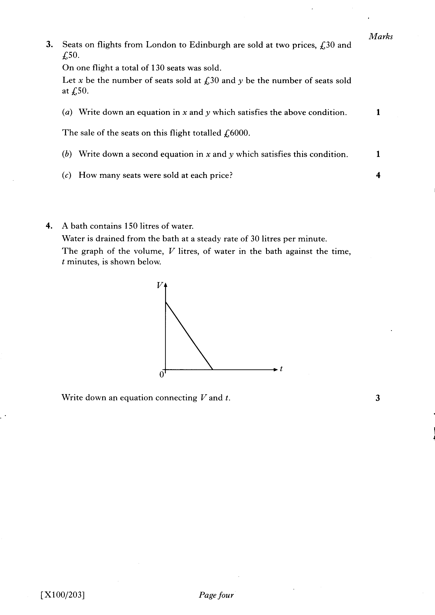

Slide 53
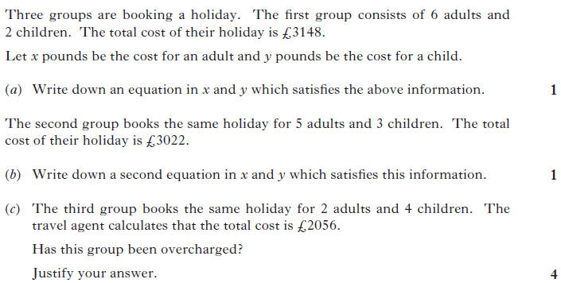

Slide 54
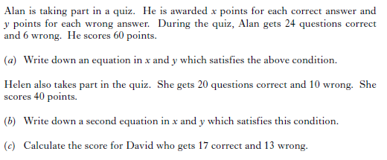

Slide 55
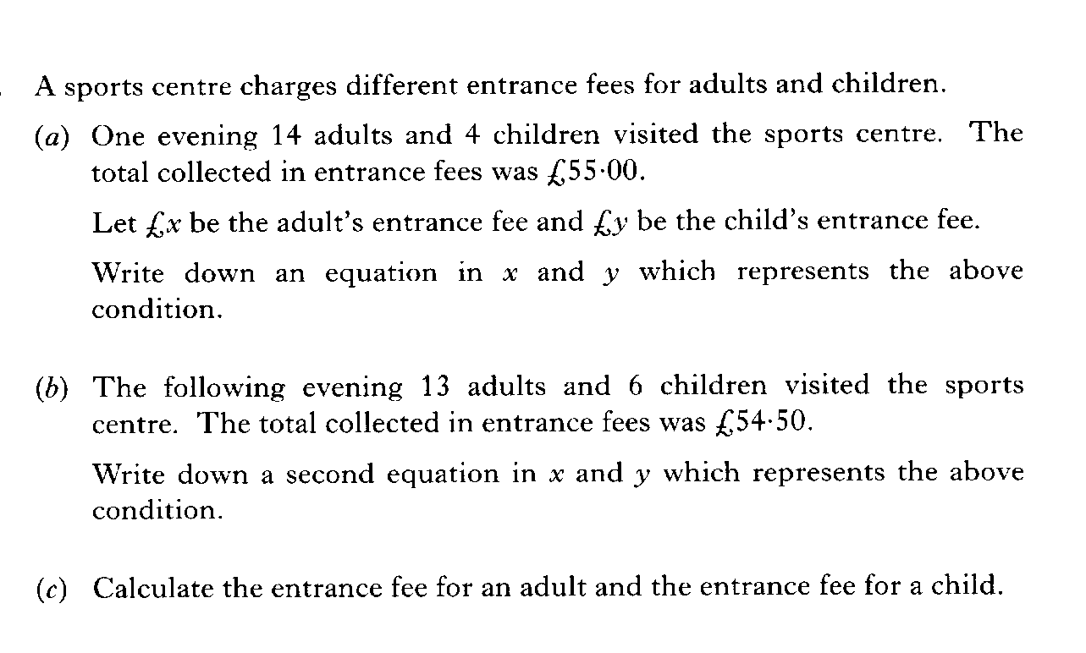

Slide 57
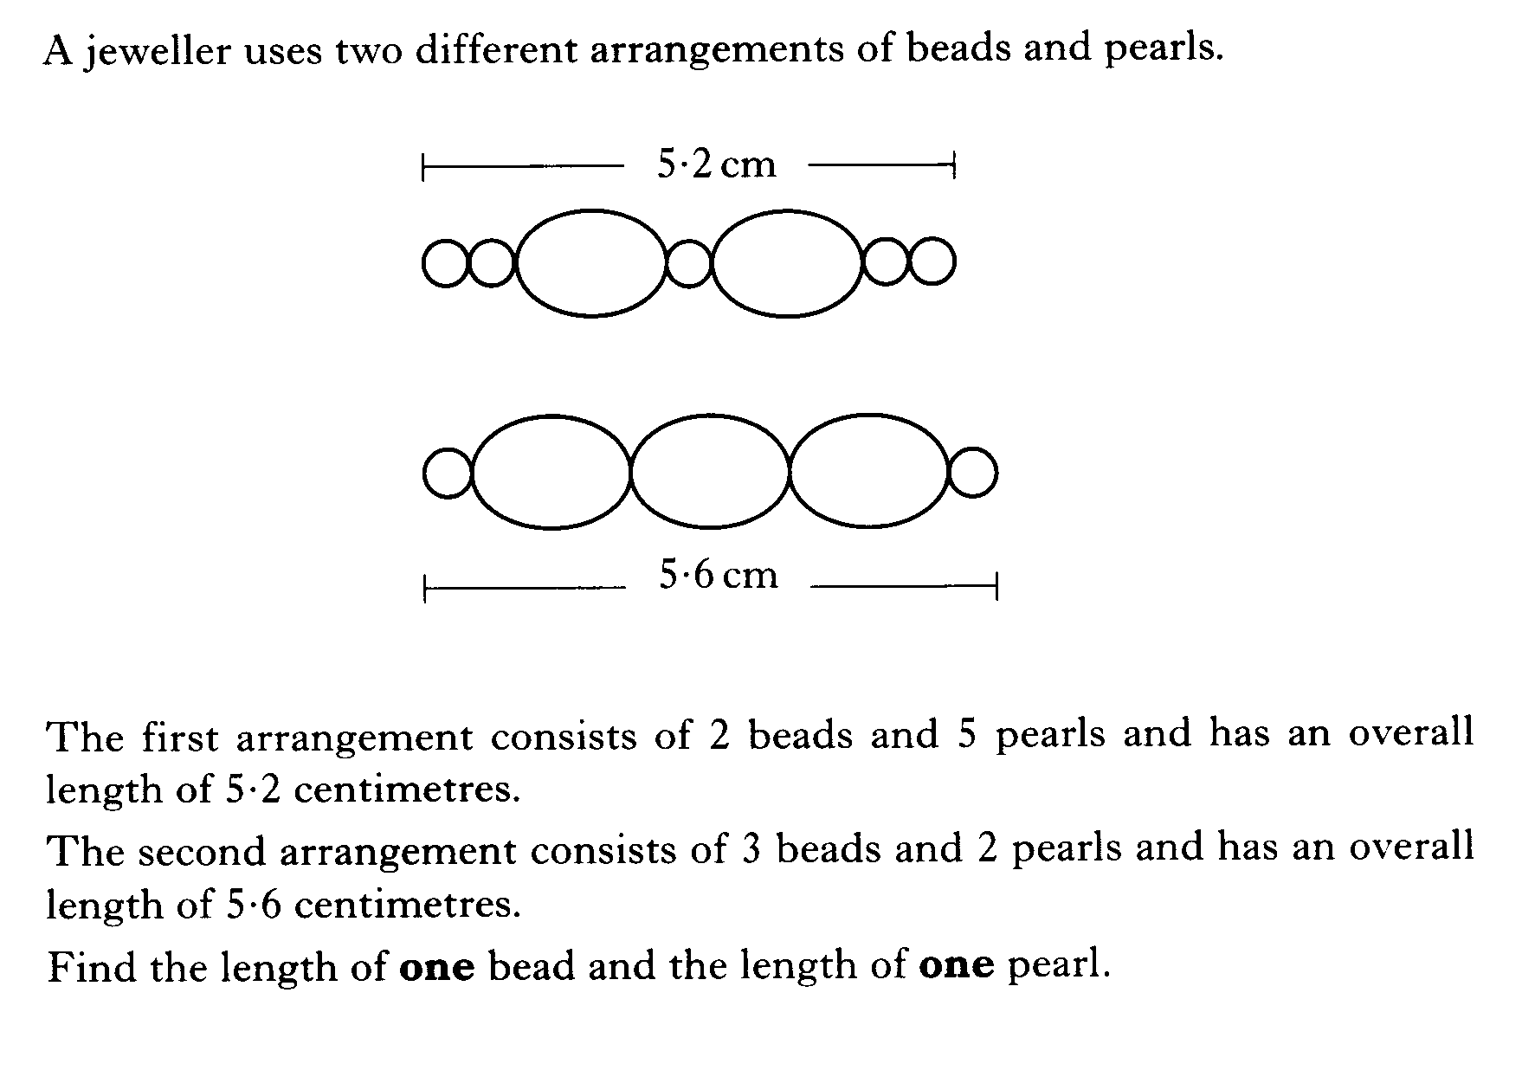

Slide 58
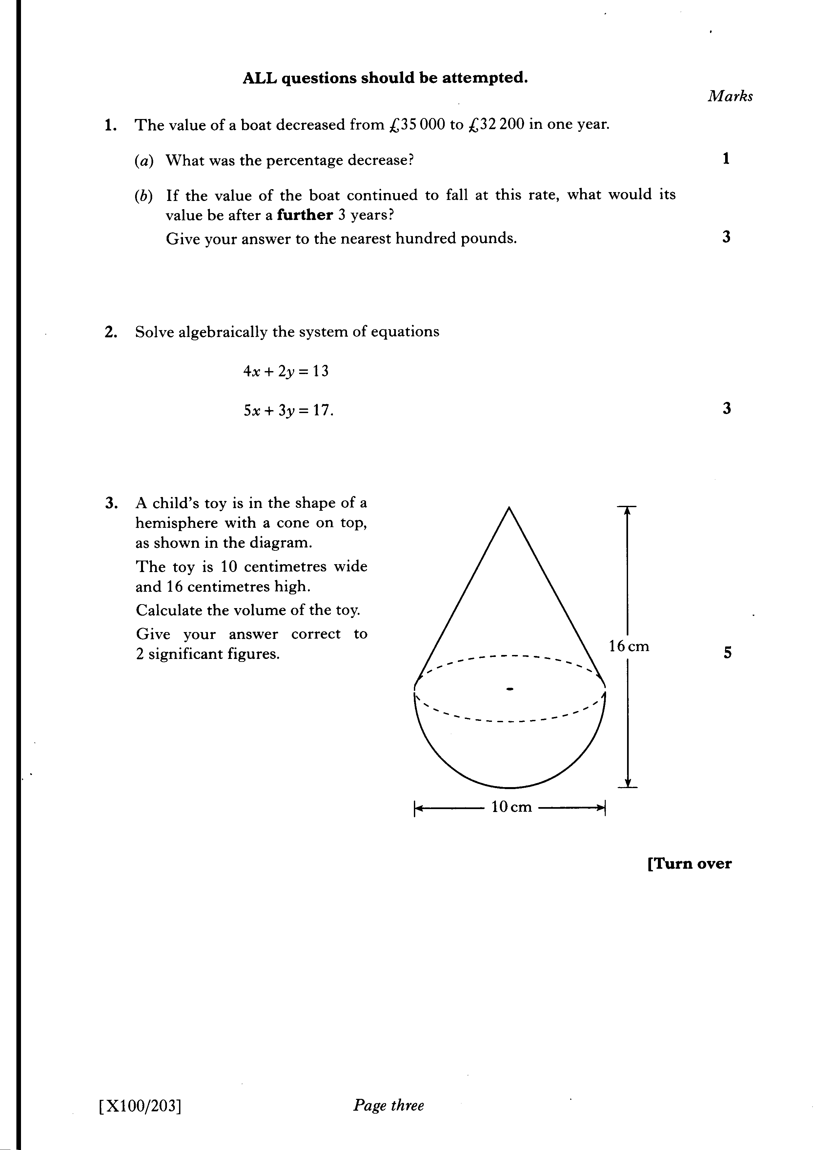

Slide 59
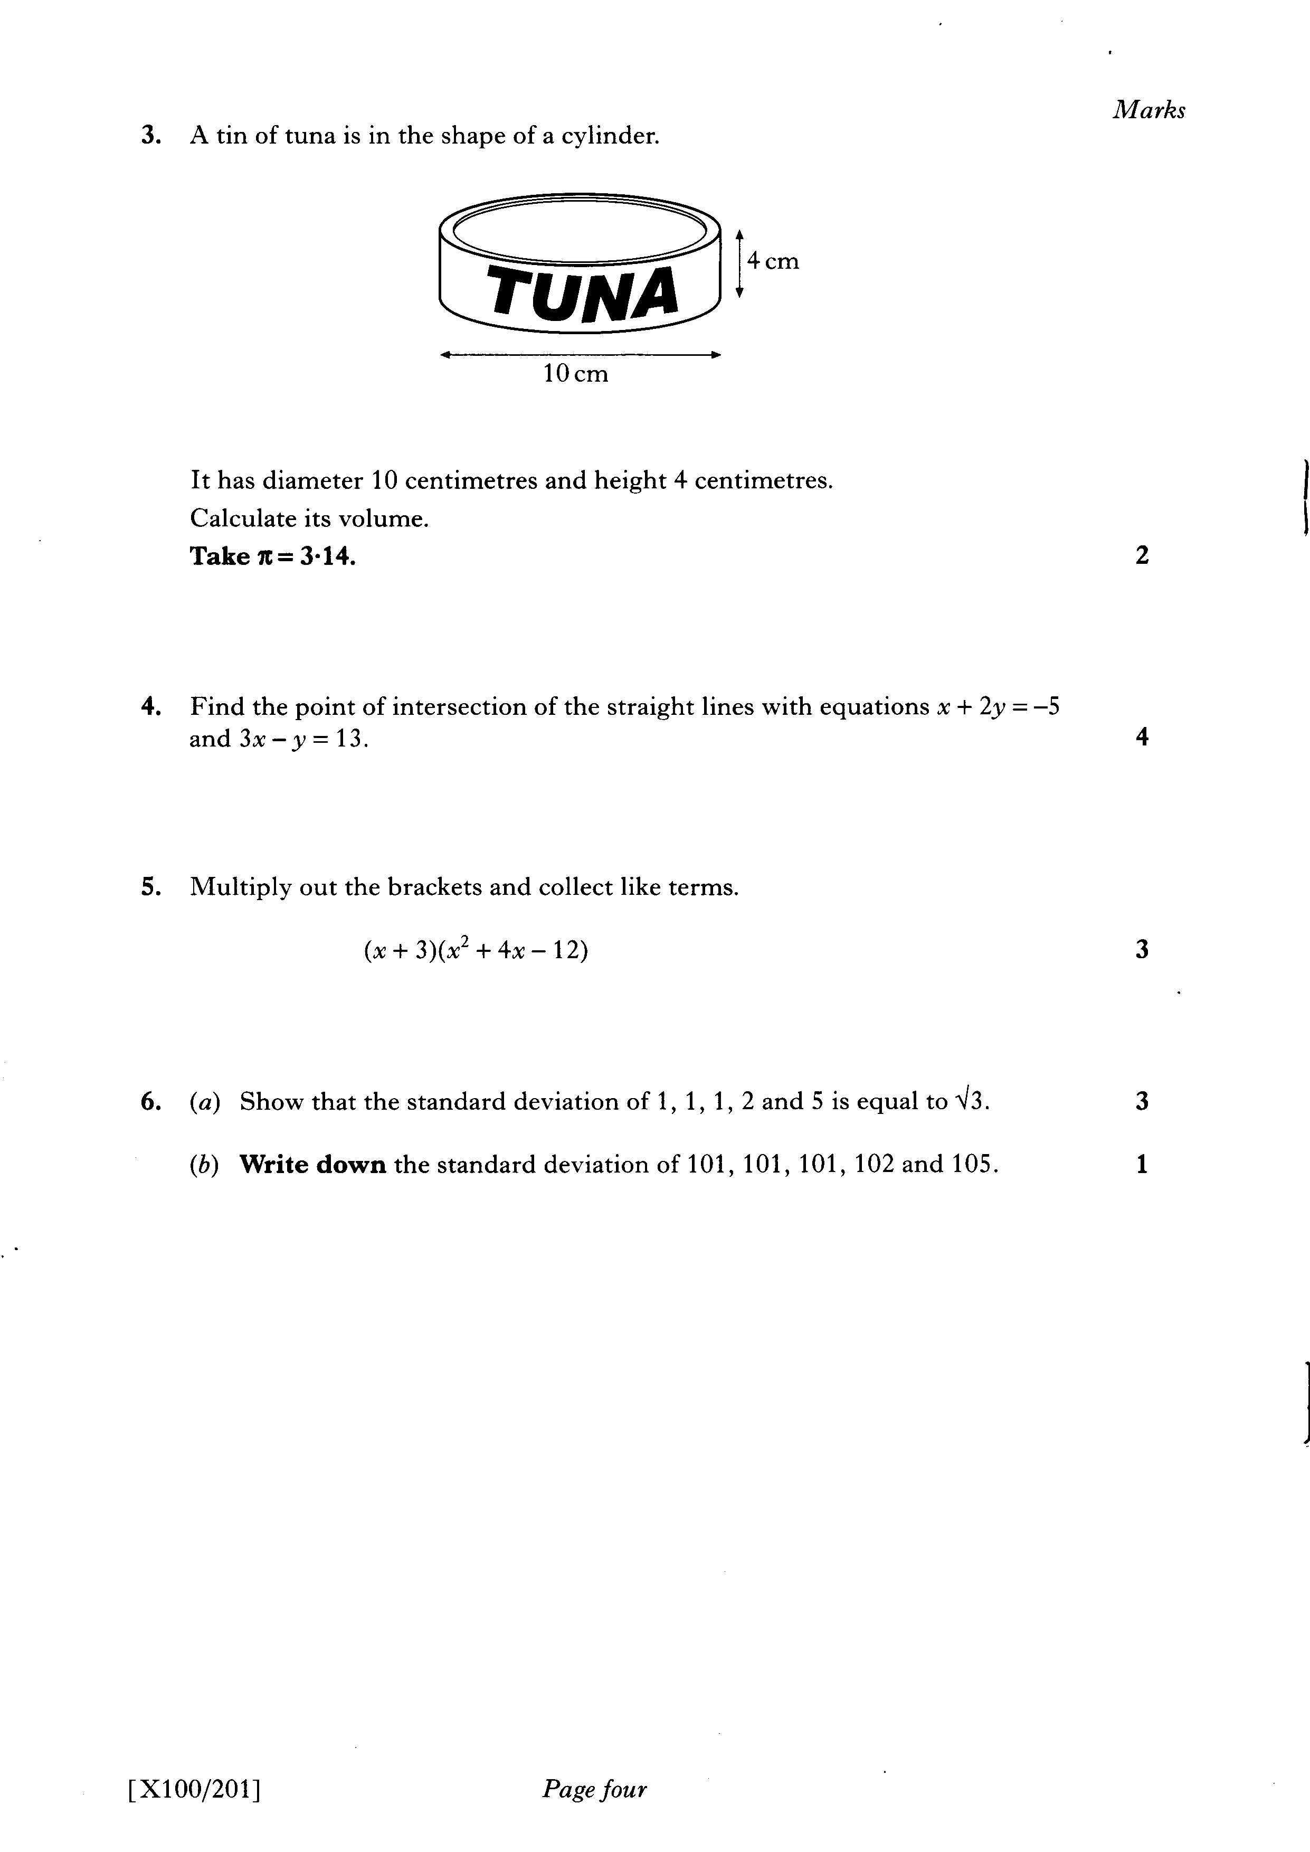

Slide 62
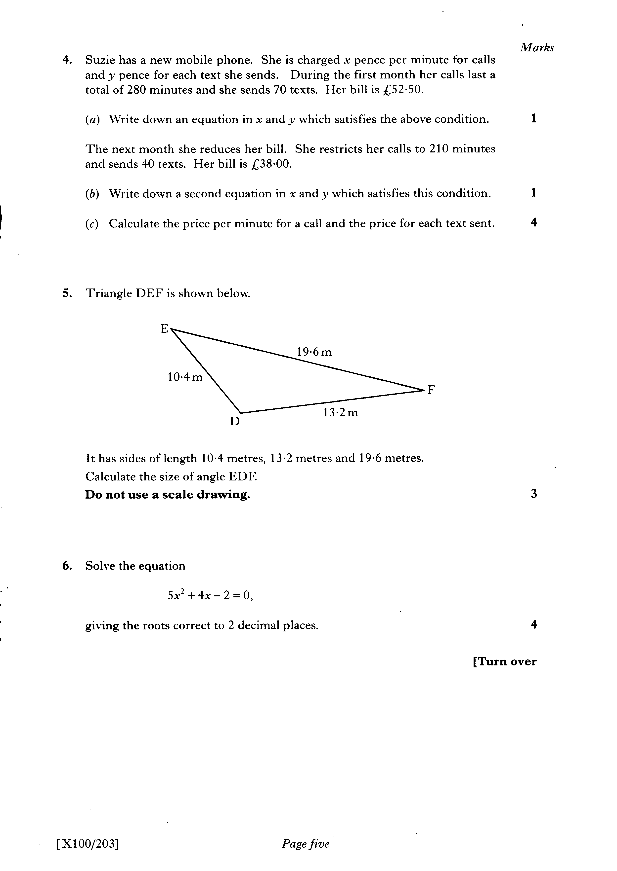

Slide 63
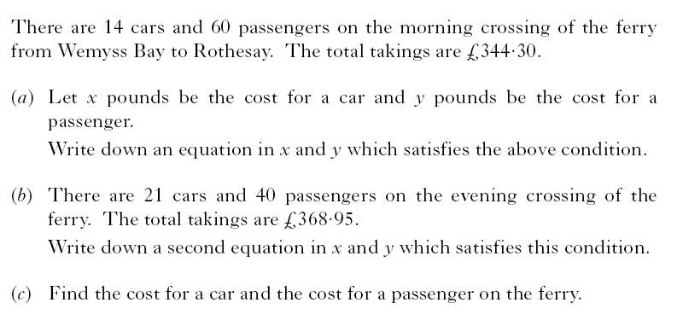

Slide 64
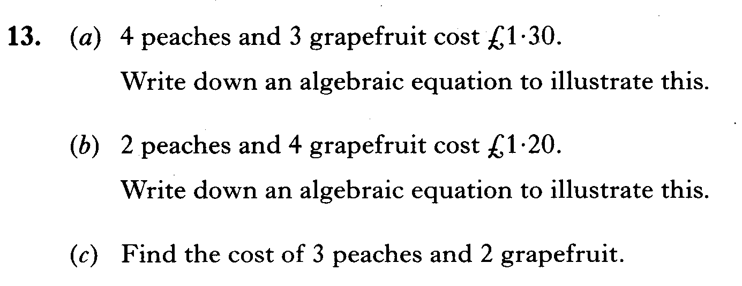

Slide 65
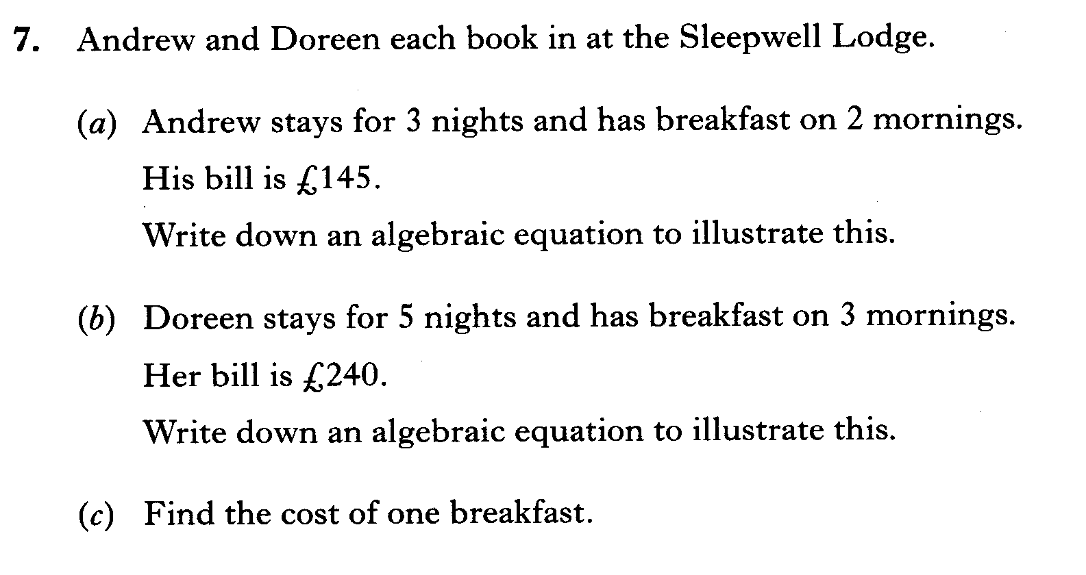

Slide 66
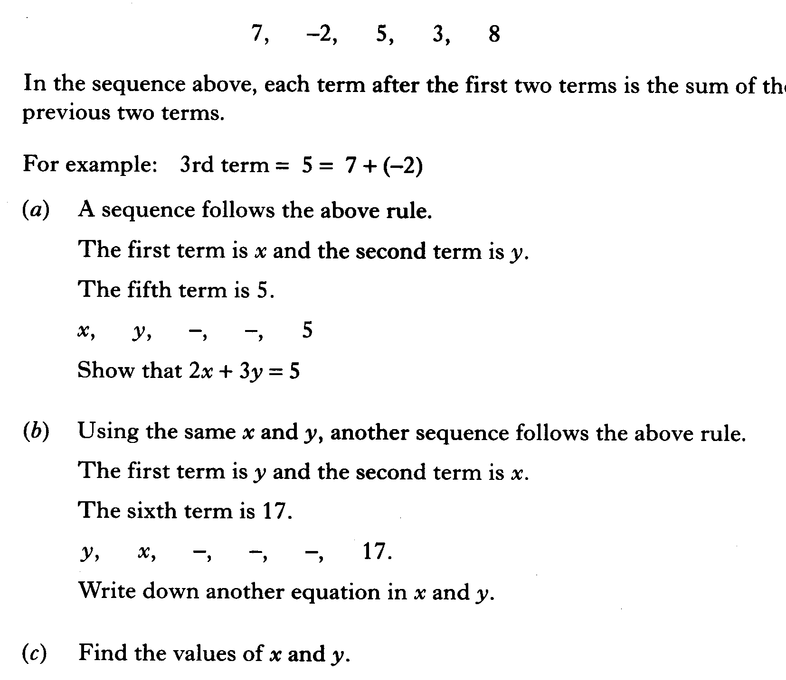

Slide 67

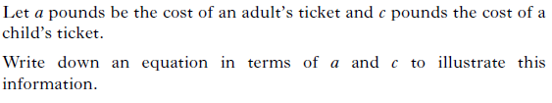
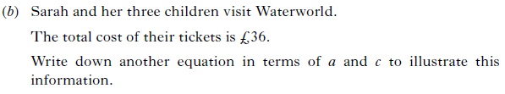


Slide 68
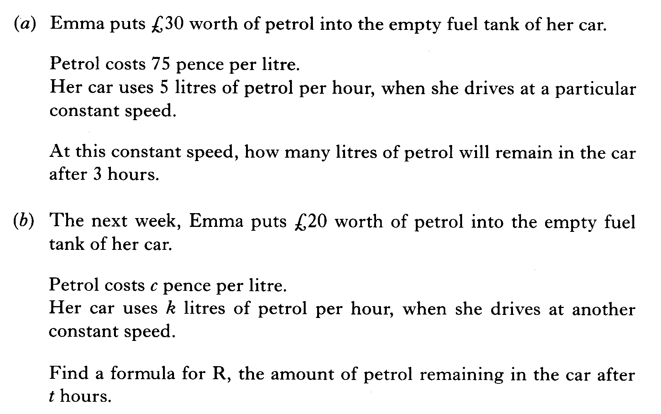

Slide 69
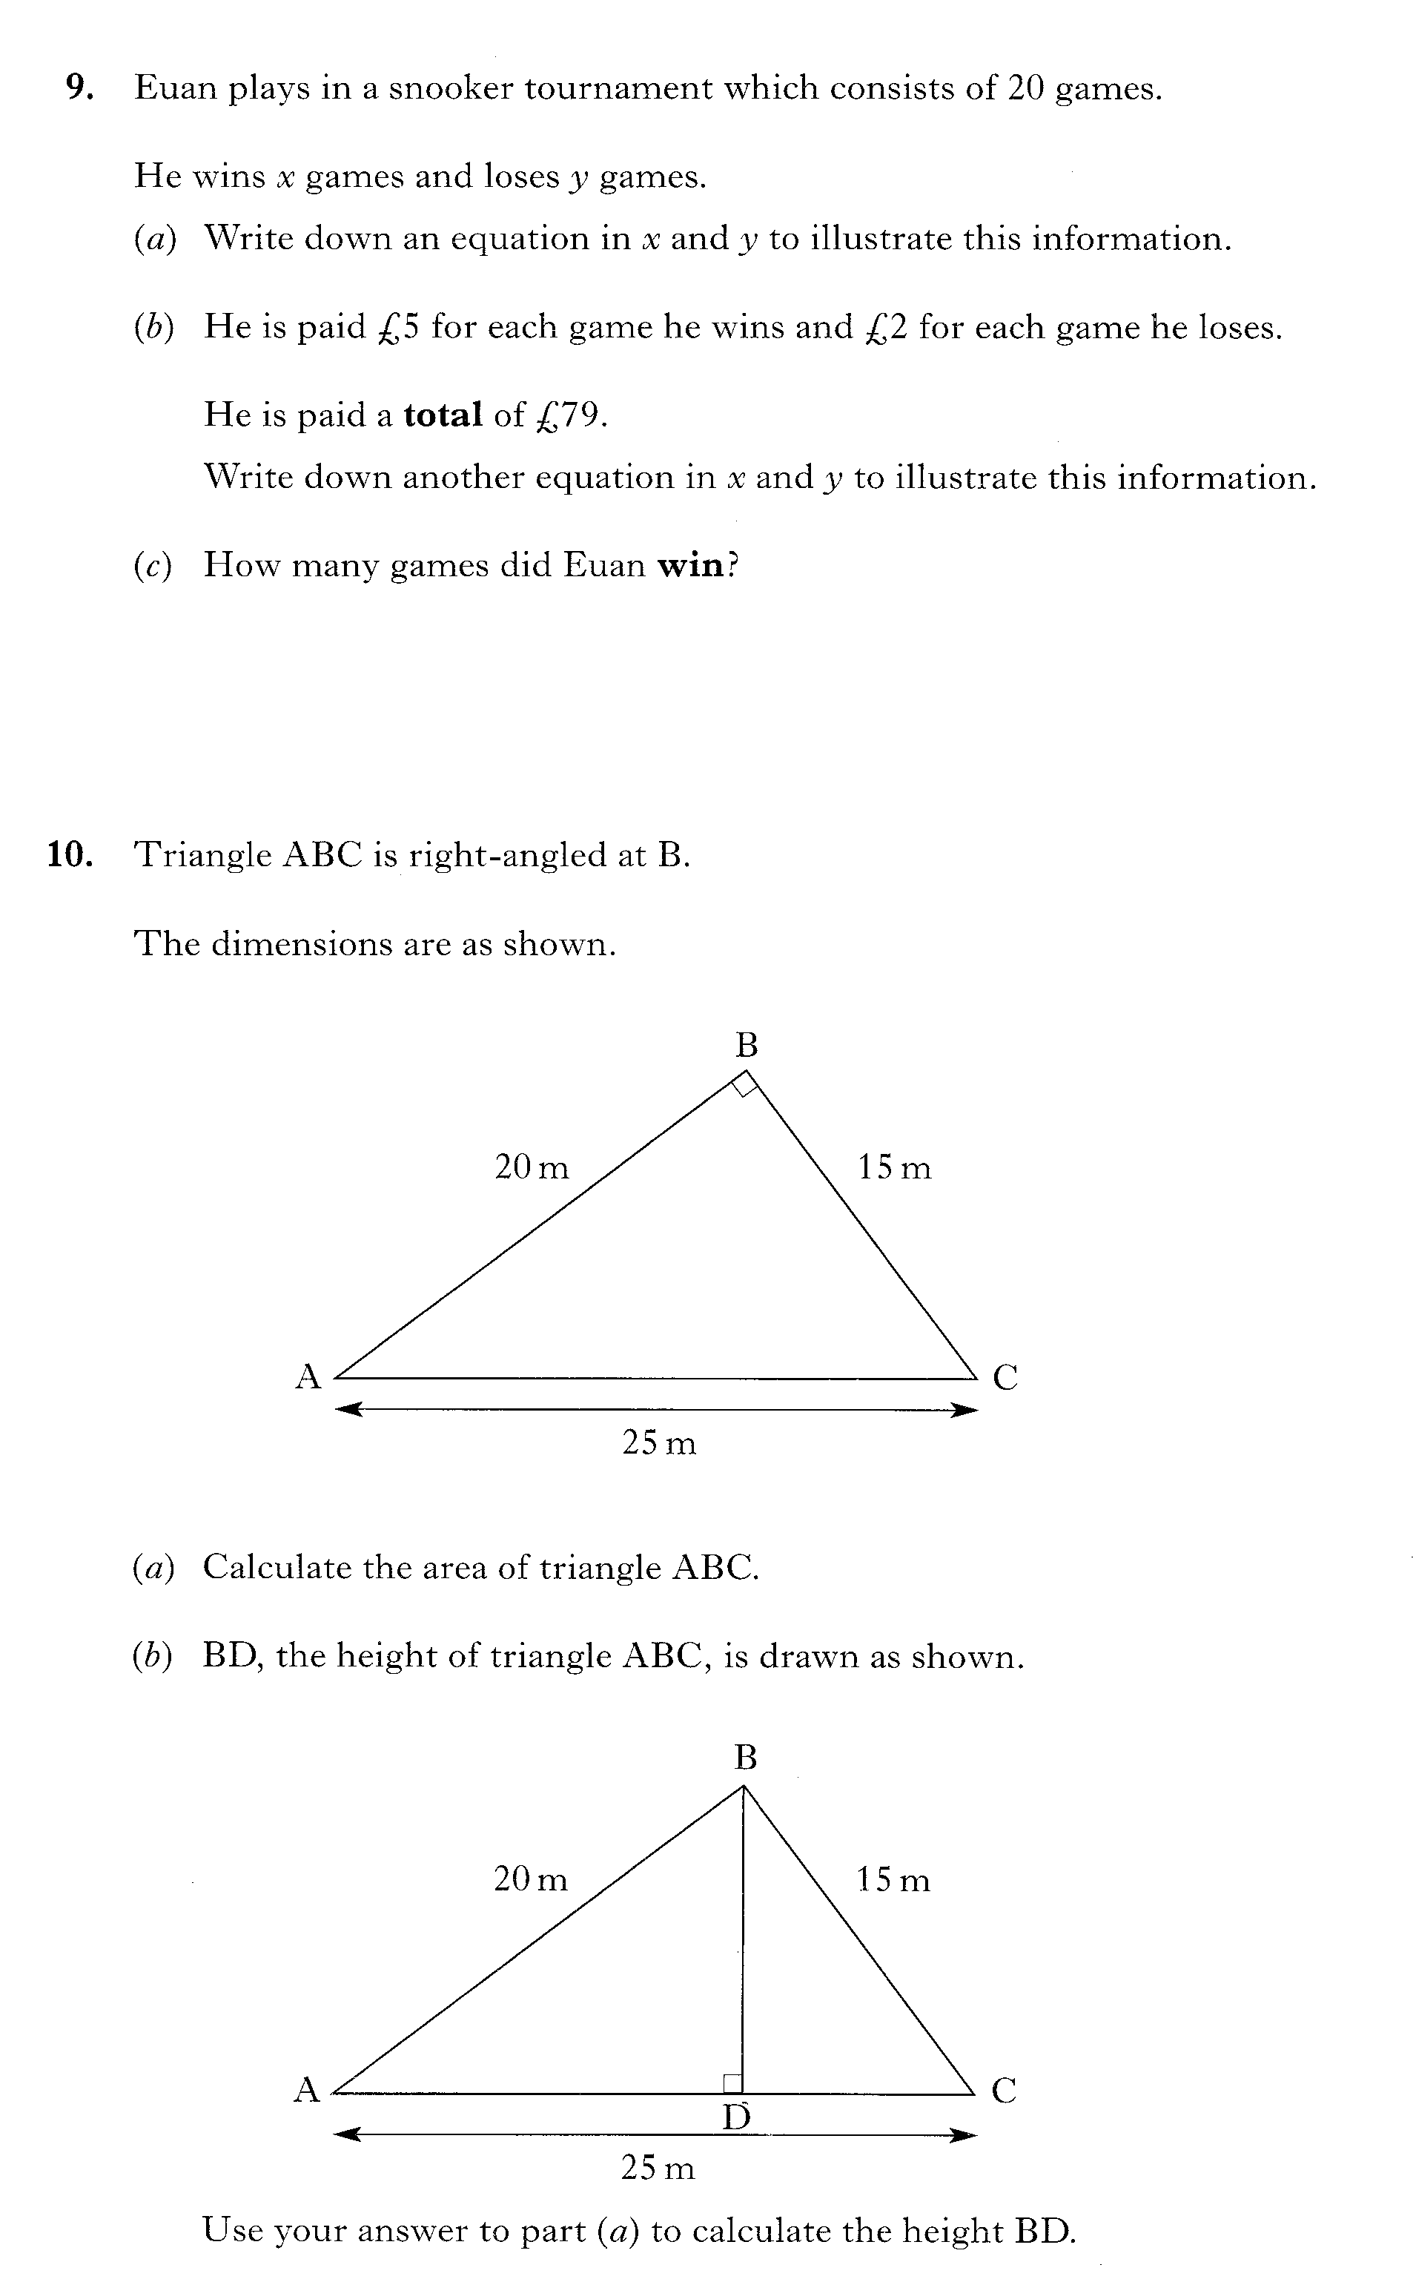

Slide 70
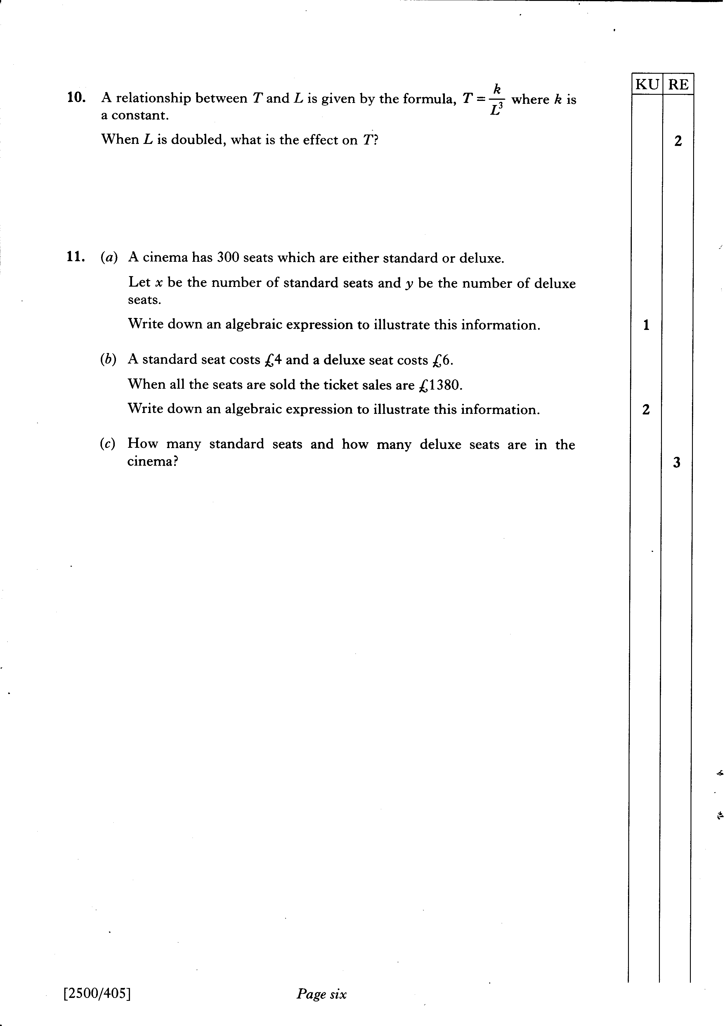

Slide 71
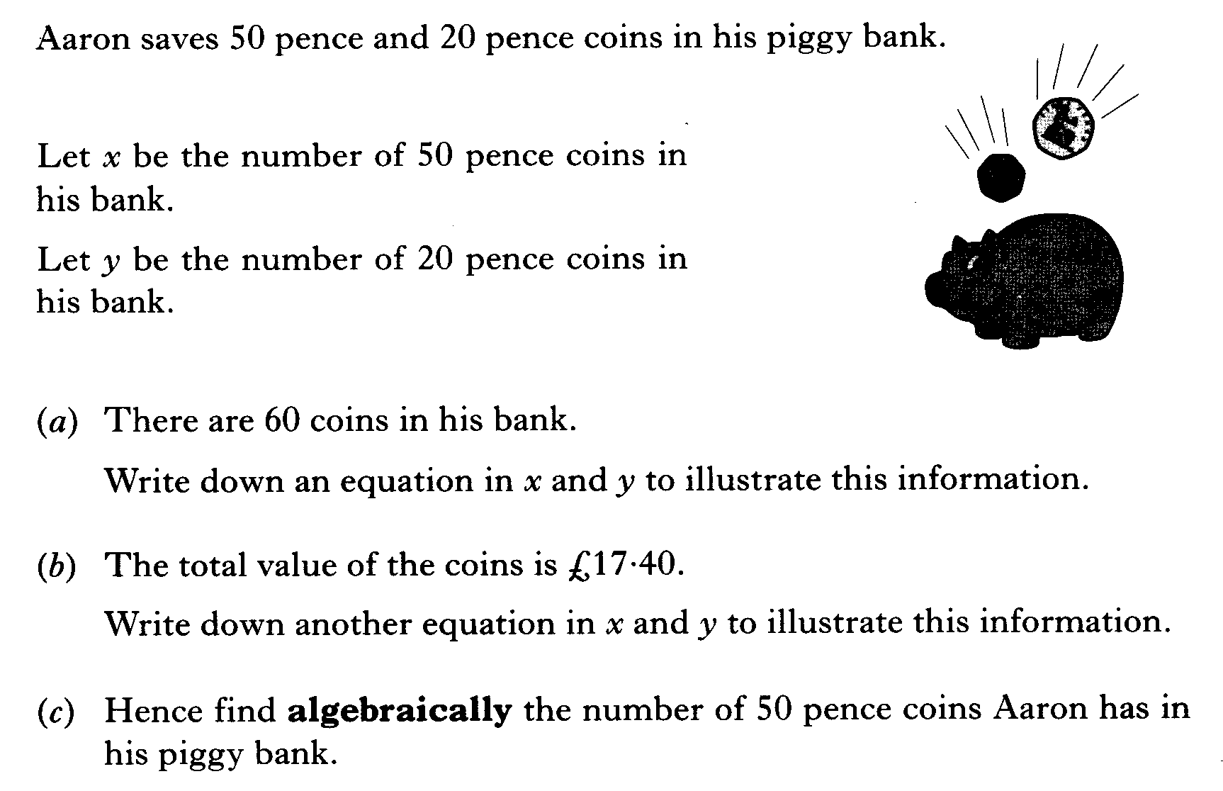

Slide 72
