Slide 1


Money
Gross Pay , Net Pay and Deductions
Income Tax
Building & Life Insurance
Compound Interest
www.mathsrevision.com
Appreciation & Depreciation
Working Backwards
Exam Type Questions
Notes:
<number>

Slide 2
Starter Questions
Two numbers add to give 12 and divide to give 3. Find the two numbers.
2. Two numbers subtract to give 5 and
multiply to 24. Find the two numbers.
3. Make your own question up.
www.mathsrevision.com
11 Jul 2026
Created by Mr. Lafferty Maths Dept.

Slide 3
Gross Pay , Net Pay
Learning Intention
Success Criteria
  To explain how to work out NET pay.
1. Understand the terms Gross, Deductions and NET pay.
www.mathsrevision.com
2. Calculate NET pay.
11 Jul 2026
Created by Mr. Lafferty Maths Dept.

Slide 4
Gross Pay , Net Pay
Write down some
Gross Pay : What you are paid by the employer.
Deductions : Taken off your wages.
Net Pay : Your take home pay.
Tax
www.mathsrevision.com
National Insurance
Pension
11 Jul 2026
Created by Mr. Lafferty Maths Dept.

Slide 5
Gross Pay , Net Pay
Example 1 :
Calculate the Net wage for the following :
Gross | Deductions | Net Wage
£15 550 | £3 400
£13 025 | £2 905
£22 430 | £5 094
£12 150
www.mathsrevision.com
£10 120
£17 336
11 Jul 2026
Created by Mr. Lafferty Maths Dept.

Slide 6
Gross Pay , Net Pay
Example 2 :
Calculate the Net wage for this payslip :
704.00
www.mathsrevision.com
149.00
555.00
11 Jul 2026
Created by Mr. Lafferty Maths Dept.

Slide 7
Gross Pay , Net Pay
Example 3 :
Calculate the Net wage for this payslip :
739.15
www.mathsrevision.com
207.76
531.39
11 Jul 2026
Created by Mr. Lafferty Maths Dept.

Slide 8

Gross Pay , Net Pay
Now try 4+
Ex 4.2
Ch 4 (page 23)
www.mathsrevision.com
11 Jul 2026
Created by Mr. Lafferty Maths Dept.

Slide 9
Starter Questions
In pairs, write down important
Points about Pythagoras Theorem
www.mathsrevision.com
Saturday 11 July 2026

Slide 10
Income Tax
Learning Intention
Success Criteria
  To explain how to work out Income Tax calculations.
Understand the term
Income Tax.
www.mathsrevision.com
2. Calculate Income Tax for a given salary.
11 Jul 2026
Created by Mr. Lafferty Maths Dept.

Slide 11
Income Tax
If your income in a tax year is below a certain value you do not pay tax. The tax allowance is made up of a personal allowance plus other special allowances.
Special clothing
equipment
www.mathsrevision.com
Membership of professional bodies

Slide 12
Income Tax
Rate of Tax 2014
Taxable income | Rate of Tax
First £32010 | 20%
£32011 - £150000 | 40%
Over - £150000 | 45%
www.mathsrevision.com

Slide 13
Rate of Tax 2014
Taxable income | Rate of Tax
First £32010 | 20%
£32011 - £150000 | 40%
Over - £150000 | 45%
Calculate Paul’s Income Tax if his taxable income
is £27 000 a year.
www.mathsrevision.com
Tax @ 20% : 20% of £27000
= 2700 x 2
= £5400

Slide 14
150000
– 32010
£117990
Rate of Tax 2014
Taxable income | Rate of Tax
First £32010 | 20%
£32011 - £150000 | 40%
Over - £150000 | 45%
www.mathsrevision.com
Calculate Mr Lafferty’s Income Tax if his taxable income
is £500 000 a year.
Tax @ 20% : 20% of £32010
= 3201 x 2 = £6402
= £500000 - £32010 = £467990
Tax @ 40% : 40% of £117990
= 0.4 x 117990 = £47196

Slide 15
Rate of Tax 2014
£467990 - £ 117990 = £350000
Tax @ 45% : 45% of £350000
= 0.45 x £350000
=£157500
www.mathsrevision.com
Total Income Tax = £157500 + £47196 + £6402
= £211098

Slide 16
Income Tax
Now try 4+
Ex 4.3
Ch 4 (page 24)
www.mathsrevision.com
11 Jul 2026
Created by Mr. Lafferty Maths Dept.

Slide 17
Starter Questions
www.mathsrevision.com
11 Jul 2026
Created by Mr. Lafferty
Maths Dept

Slide 18
Building & Life Insurance
Learning Intention
Success Criteria
  To calculate Building & Life Insurance from a table of values taking account various factors.
  1. Read information from a chart.
  2. Calculate Building & Life Insurance taking in various factors.
www.mathsrevision.com
11 Jul 2026
Created by Mr.Lafferty Maths Dept

Slide 19
Roof, walls, floor etc...
Building & Life Insurance
TV, DVD, Washing Machine
You NEED to buy building insurance in case anything
goes wrong with your house.
Jewellery,
very expensive gifts.
It is a good idea to buy content insurance in case your
house gets broken into or items breakdown.
www.mathsrevision.com
It is a good idea to valuables insurance in case your
house gets broken into.
11 Jul 2026
Created by Mr. Lafferty
Maths Dept

Slide 20
Building & Life Insurance
Items | Charge
Building per £1000 | £0.73
Contents per £1000 | £3.57
Valuables per £100 | £4.75
www.mathsrevision.com
* Building & Contents 10% discount for each year no claims
** Maximum discount 30%
11 Jul 2026
Created by Mr.Lafferty Maths Dept

Slide 21
Are we expecting more or less
Building & Life Insurance
Example 1 : How much is the House Insurance for a
house valued at £40 000.
Value Premium
1000 ⇨ 0.73
40000
www.mathsrevision.com
11 Jul 2026
Created by Mr. Lafferty
Maths Dept

Slide 22
Are we expecting more or less
Building & Life Insurance
Example 2 : I decided to increase my insurance from
£40 000 to £50 000 cover.
How much more did it have to pay.
Value Premium
1000 ⇨ 0.73
10000
www.mathsrevision.com
11 Jul 2026
Created by Mr. Lafferty
Maths Dept

Slide 23
Building & Life Insurance
Example : How much for Buildings insurance and
contents insurance if a house is valued at £80 000 and contents are valued at £5 000 and no claims for 2 years.
Buildings insurance :
£58.40
www.mathsrevision.com
Contents insurance :
£ 17.85
Total : £76.25
Discount 20% of £76.25 = 0.2 x £76.26 = £15.25
Total : £61.00
11 Jul 2026
Created by Mr. Lafferty
Maths Dept

Slide 24
Age,
Male or Female, smoker
or Non- smoker
What factors affect the cost of Life Insurance
Building & Life Insurance
Table shows monthly premiums.
The sum assured is £10000 (with Profits) for the term 20 years.
Age | Male smoker | Female smoker | Male non-smoker | Female non-smoker
20 | 1.25 | 1.02 | 0.77 | 0.57
25 | 1.36 | 1.11 | 0.86 | 0.66
30 | 1.48 | 1.20 | 0.96 | 0.75
www.mathsrevision.com
11 Jul 2026
Created by Mr.Lafferty Maths Dept

Slide 25
Building & Life Insurance
Table shows monthly premiums.
The sum assured is £10000 (with Profits) for the term 20 years.
Age | Male smoker | Female smoker | Male non-smoker | Female non-smoker
20 | 1.25 | 1.02 | 0.77 | 0.57
25 | 1.36 | 1.11 | 0.86 | 0.66
30 | 1.48 | 1.20 | 0.96 | 0.75
www.mathsrevision.com
Kerry is 25 years old and takes out a fixed term policy. She does not smoke. She wants to leave £150 000 to her dependants should she die. What is her monthly premium and how much will she pay over 20 years.
11 Jul 2026
Created by Mr.Lafferty Maths Dept

Slide 26
Building & Life Insurance
Monthly premium = 150000 ÷ 10000 x 0.66 = £9.90
Total paid over 20 years = £9.90 x 12 x 20 = £2376
www.mathsrevision.com
11 Jul 2026
Created by Mr.Lafferty Maths Dept

Slide 27
Building & Life Insurance
Now try 4+
Ex4.6
Ch4 (page 28)
www.mathsrevision.com
11 Jul 2026
Created by Mr.Lafferty Maths Dept

Slide 28
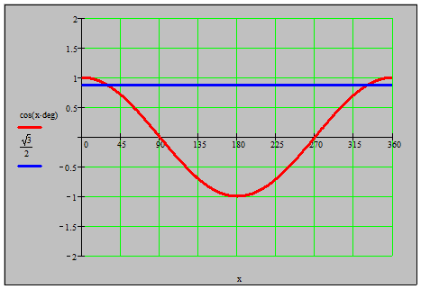
Starter Questions
Q1. Find the standard deviation for the data below
www.mathsrevision.com
Q2. Find the
coordinates
where the line
and curve meet.
Saturday 11 July 2026

Slide 29
Compound Interest
Learning Intention
Success Criteria
  We are learning how to use the compound formula for appropriate problems.
  To know when to use compound formula.
Solve problems involving compound formula.
www.mathsrevision.com
Saturday, July 11, 2026
created by Mr. lafferty @ www.mathsrevision.com
<number>

Slide 30
Interest calculated on new value every year
Compound Interest
Real life Interest is not a fixed quantity year after year. One year’s interest becomes part of the next year’s amount. Each year’s interest is calculated on the amount at the start of the year.
Initial value
Example
www.mathsrevision.com
Daniel has £400 in the bank. He leaves it in the bank for 3 years. The interest is 7% each year. Calculate the simply interest and then the compound interest after 3 years.
Saturday, July 11, 2026
created by Mr. lafferty @ www.mathsrevision.com
<number>

Slide 31
Compound Interest
Interest calculated on new value every year
Daniel has £400 in the bank. He leaves it in the bank for 3 years. The interest is 7% each year. Calculate the compound interest and the amount he has in the bank after 3 years.
Simple Interest
Y1 : Interest = 7% of £400 = £28
Amount = £400 + £28 = £428
Interest = 7% of £400 = £28
Y 2 : Interest = 7% of £428 = £29.96
3 x 28 = £84
www.mathsrevision.com
Amount = £428 + £29.96 = £457.96
Y 3 : Interest = 7% of £457.96 = £32.06
Amount = £457.06 + £32.06 = £490.02
Simple Interest is only £84
Compound is £490.02 - £400 = £90.02
Saturday, July 11, 2026
created by Mr. lafferty @ www.mathsrevision.com
<number>

Slide 32
Compound Interest
This is called the multiplier.
Easier Method
$V=I{\left(1±\frac{\text{\%}}{\text{100}}\right)}^{n}$
n = period of time
Days, months years
www.mathsrevision.com
IMPORTANT
Can only use this when percentage is fixed
I = initial value
± = increase or decrease
V = Value
Saturday, July 11, 2026
created by Mr. lafferty @ www.mathsrevision.com
<number>

Slide 33
Compound Interest
Calculate the money in the bank after 3 years if the compound interest rate is 7% and the initial value is £400.
n = 3
$V=I{\left(1±\frac{\text{\%}}{\text{100}}\right)}^{n}$
I =400
www.mathsrevision.com
± = increase 1+0.07=1.07
V= 400 x (1.07)³ = £490.02
Saturday, July 11, 2026
created by Mr. lafferty @ www.mathsrevision.com
<number>

Slide 34
Compound Interest
Now try N5 TJ
Ex 2.4
Ch2 (page 24)
www.mathsrevision.com
Saturday, July 11, 2026
created by Mr. lafferty @ www.mathsrevision.com
<number>

Slide 35
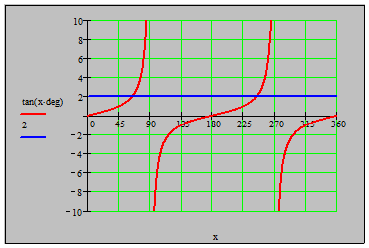
Starter Questions
Q1. Solve the equations
www.mathsrevision.com
Q2. Find the
coordinates
where the line
and curve meet.
Saturday 11 July 2026

Slide 36
Appreciation & Depreciation
Learning Intention
Success Criteria
  We are learning about the terms appreciation and depreciation.
  To know the terms appreciation and depreciation.
Show appropriate working
when solving problems containing appreciation and depreciation.
www.mathsrevision.com
Saturday, July 11, 2026
created by Mr. lafferty @ www.mathsrevision.com
<number>

Slide 37
Appreciation & Depreciation
Appreciation : Going up in value e.g. House value
www.mathsrevision.com
Depreciation : Going down in value e.g. car value
Saturday, July 11, 2026
created by Mr. lafferty @ www.mathsrevision.com
<number>

Slide 38
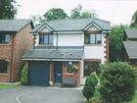
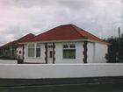
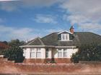
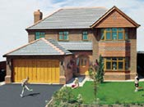
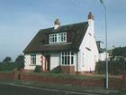
Quicker Method
Easier
% £
100 ⇨ 64995
179 ⇨
Average house price in Ayr has appreciated by 79% over past 10 years.
If you bought the house for £64995 ten years ago in 1994 how much would the house be worth now ?
Appreciation = 79% x £ 64995
  = 0.79 x £64995
        = £ 51346.05
New value = Old Value + Appreciation
= £64995 + £51346.05
        = £ 116341.05
$\frac{\text{179}}{\text{100}}×\text{64995}=£\text{116341}\text{.}\text{05}$
Just working out percentages
Saturday, July 11, 2026
created by Mr. lafferty @ www.mathsrevision.com
<number>

Slide 39

Appreciation & Depreciation
A Mini Cooper cost £14 625 in 2002
At the end 2003 it depreciated by 23%
At the end 2004 it will depreciate by a further 16%
What will the mini cooper worth at end 2004?
End 2003
Depreciation = 23% x £14625
      = 0.23 x £14625
        = £3363.75
New value = Old value - Depreciation
      = £14625 - £3363.75
= £11261.25
www.mathsrevision.com
Saturday, July 11, 2026
created by Mr. lafferty @ www.mathsrevision.com
<number>

Slide 40
Appreciation & Depreciation
End 2003
Depreciation = 23% x £14625
      = 0.23 x £14625
        = £3363.75
New value = Old value - Depreciation
      = £14625 - £3363.75
    = £11261.25
End 2004
Depreciation = 16% x £11261.25
    = 0.16 x £11261.25
    = £1801.80
New Value = £11261.25 - £1801.80
    = £9459.45
www.mathsrevision.com
Saturday, July 11, 2026
created by Mr. lafferty @ www.mathsrevision.com
<number>

Slide 41
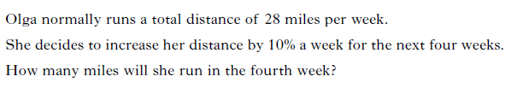

Slide 42
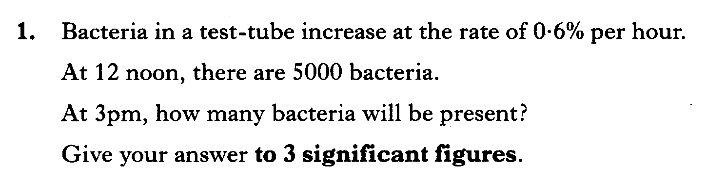

Slide 43
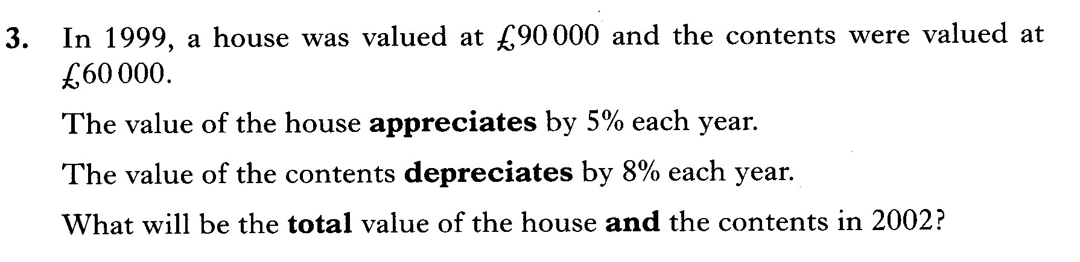

Slide 44
Appreciation & Depreciation
Now try N5 TJ
Ex 2.5
Ch2 (page 26)
www.mathsrevision.com
Saturday, July 11, 2026
created by Mr. lafferty @ www.mathsrevision.com
<number>

Slide 45
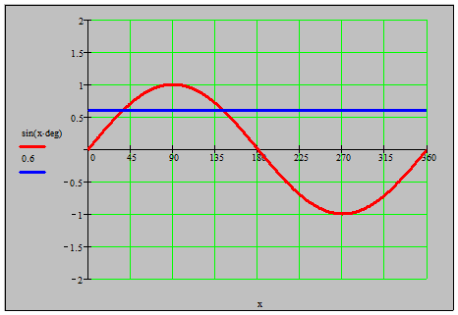
Starter Questions
Q1. Solve the equations
www.mathsrevision.com
Q2. Solve the
coordinates
where the line
and curve meet.
Saturday 11 July 2026

Slide 46
Work Backwards
Learning Intention
Success Criteria
  We are learning how to work backwards to find the original/Initial value.
  To understand the process of work backwards.
Solve problems using backwards process.
www.mathsrevision.com
Saturday, July 11, 2026
created by Mr. lafferty @ www.mathsrevision.com
<number>

Slide 47
Work Backwards
Are we expecting more or less
After a 10% increase the price of a house is £88 000.
What was the price before the increase.
Method
% £
110 ⇨ 88 000
100
www.mathsrevision.com
$\frac{\text{100}}{\text{110}}×\text{88000}=£\text{80000}$
Saturday, July 11, 2026
created by Mr. lafferty @ www.mathsrevision.com
<number>

Slide 48
Work Backwards
Are we expecting more or less
Example 2
The value of a car depreciated by 15%. It is now valued
at £2550. What was it’s original price.
Method
% £
85 ⇨ 2550
100
www.mathsrevision.com
$\frac{\text{100}}{\text{85}}×\text{2550}=£\text{3000}$
Saturday, July 11, 2026
created by Mr. lafferty @ www.mathsrevision.com
<number>

Slide 49
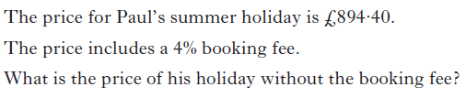

Slide 50
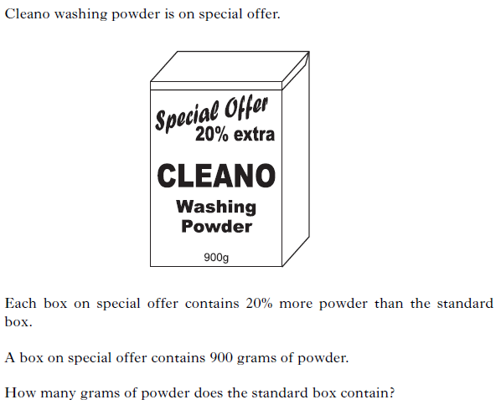

Slide 51
Work Backwards
Now try N5 TJ
Ex 2.6
Ch2 (page 27)
www.mathsrevision.com
Saturday, July 11, 2026
created by Mr. lafferty @ www.mathsrevision.com
<number>

Slide 52
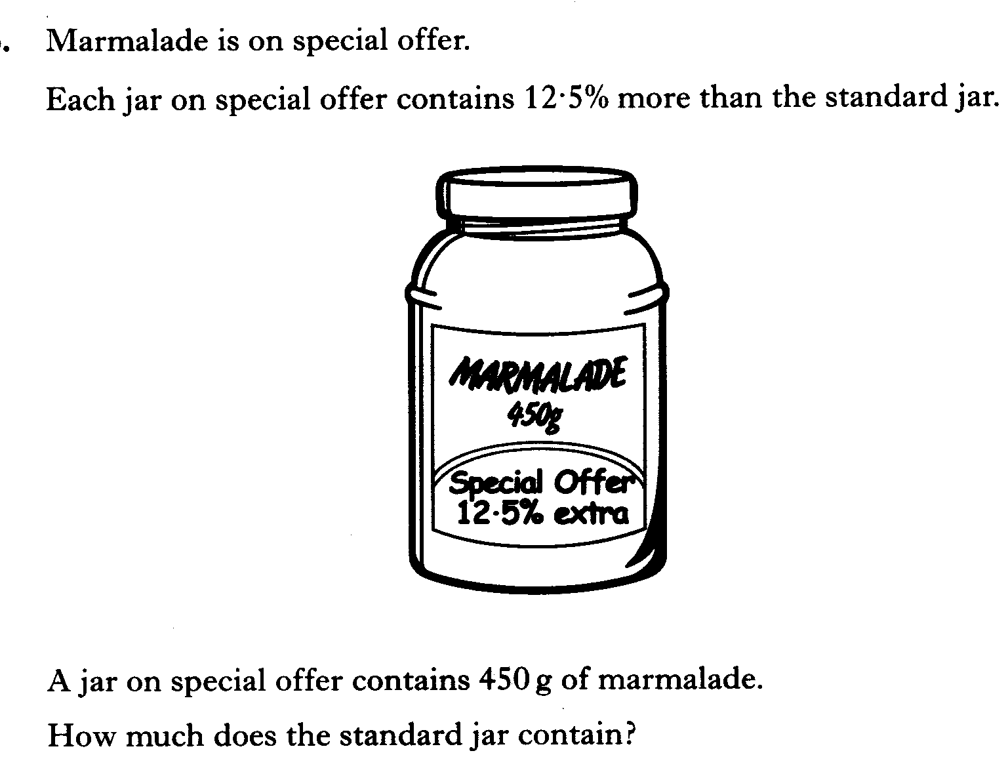

Slide 53
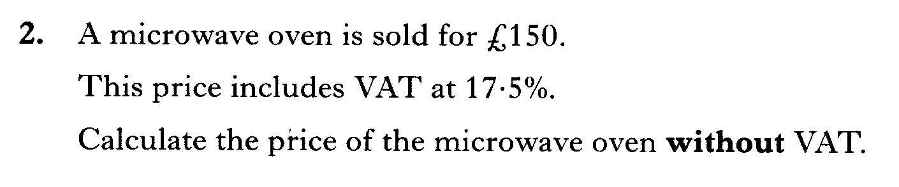

Slide 54
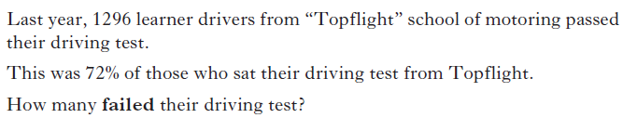

Slide 55
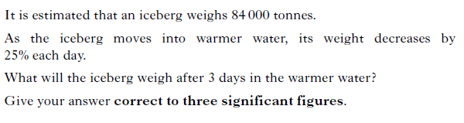

Slide 56
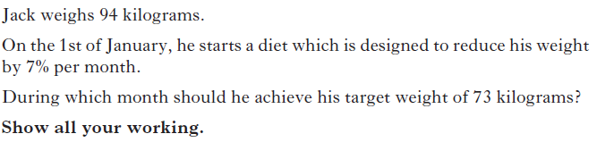

Slide 57
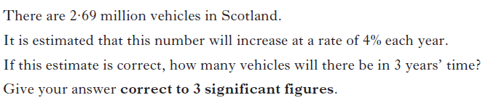

Slide 58
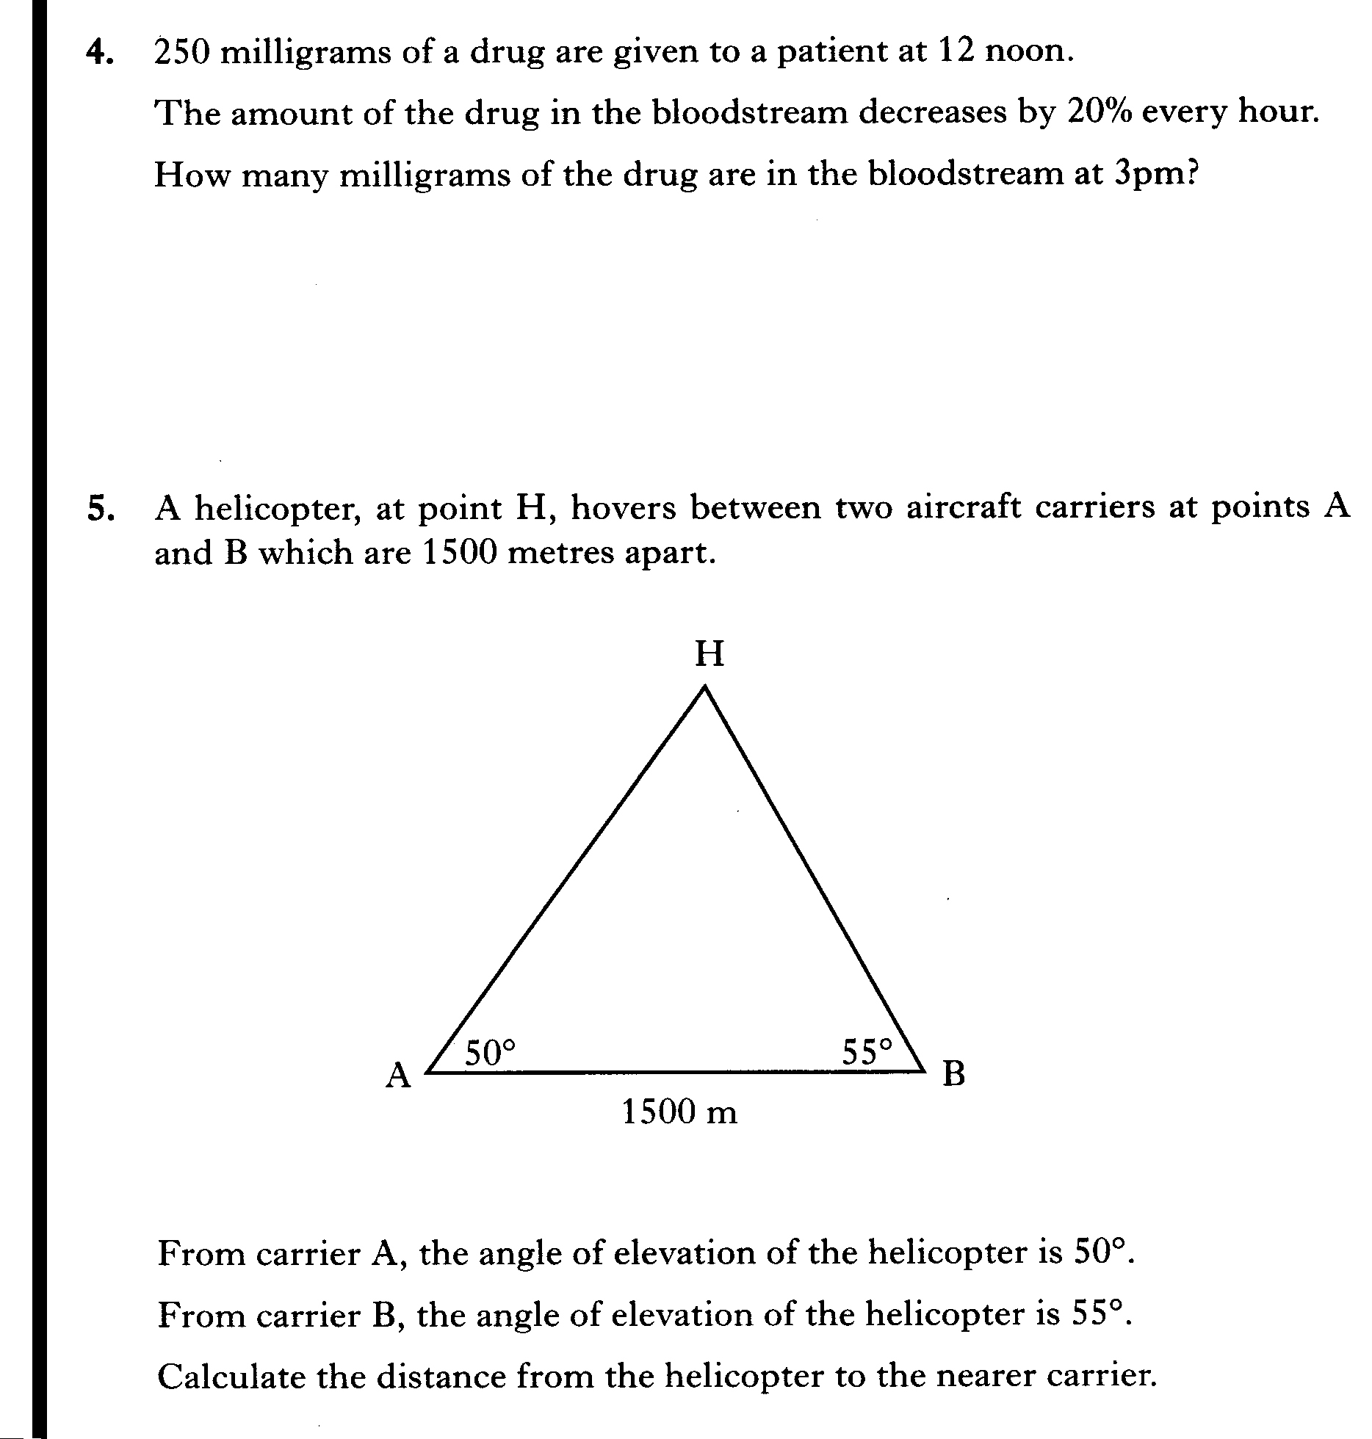

Slide 59
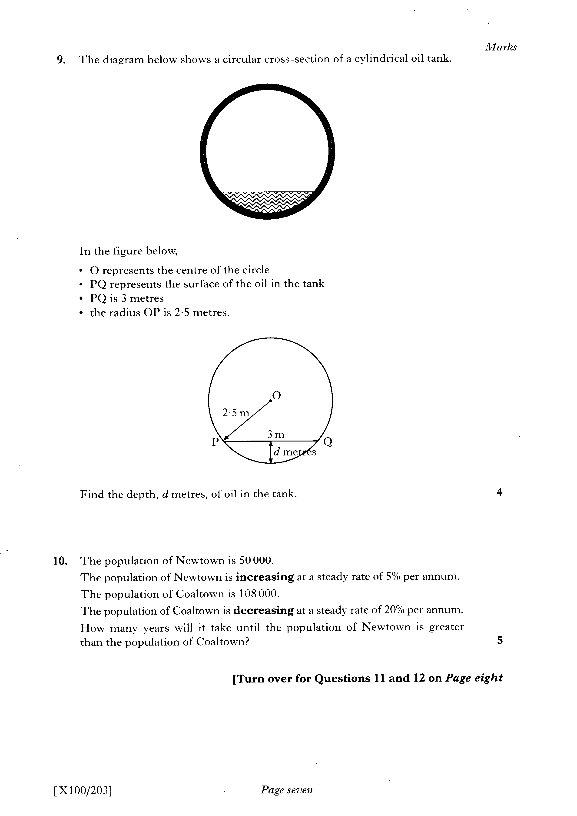

Slide 60
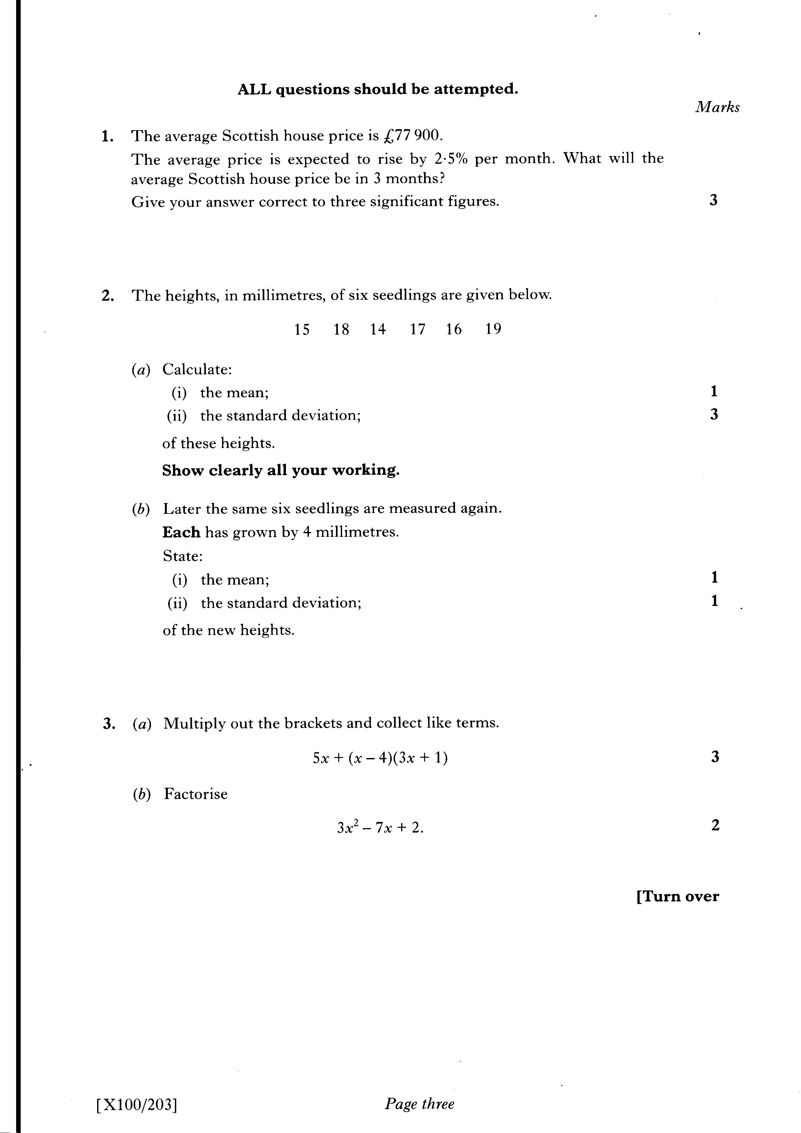

Slide 61
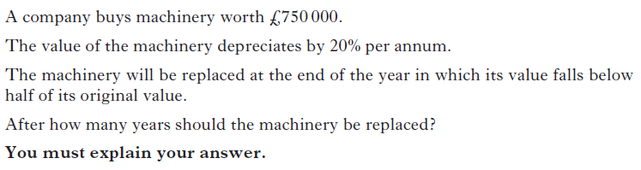

Slide 62
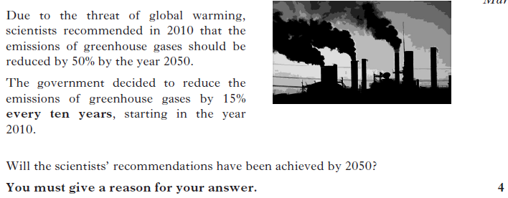

Slide 63
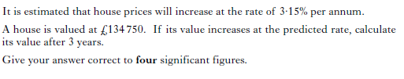

Slide 64
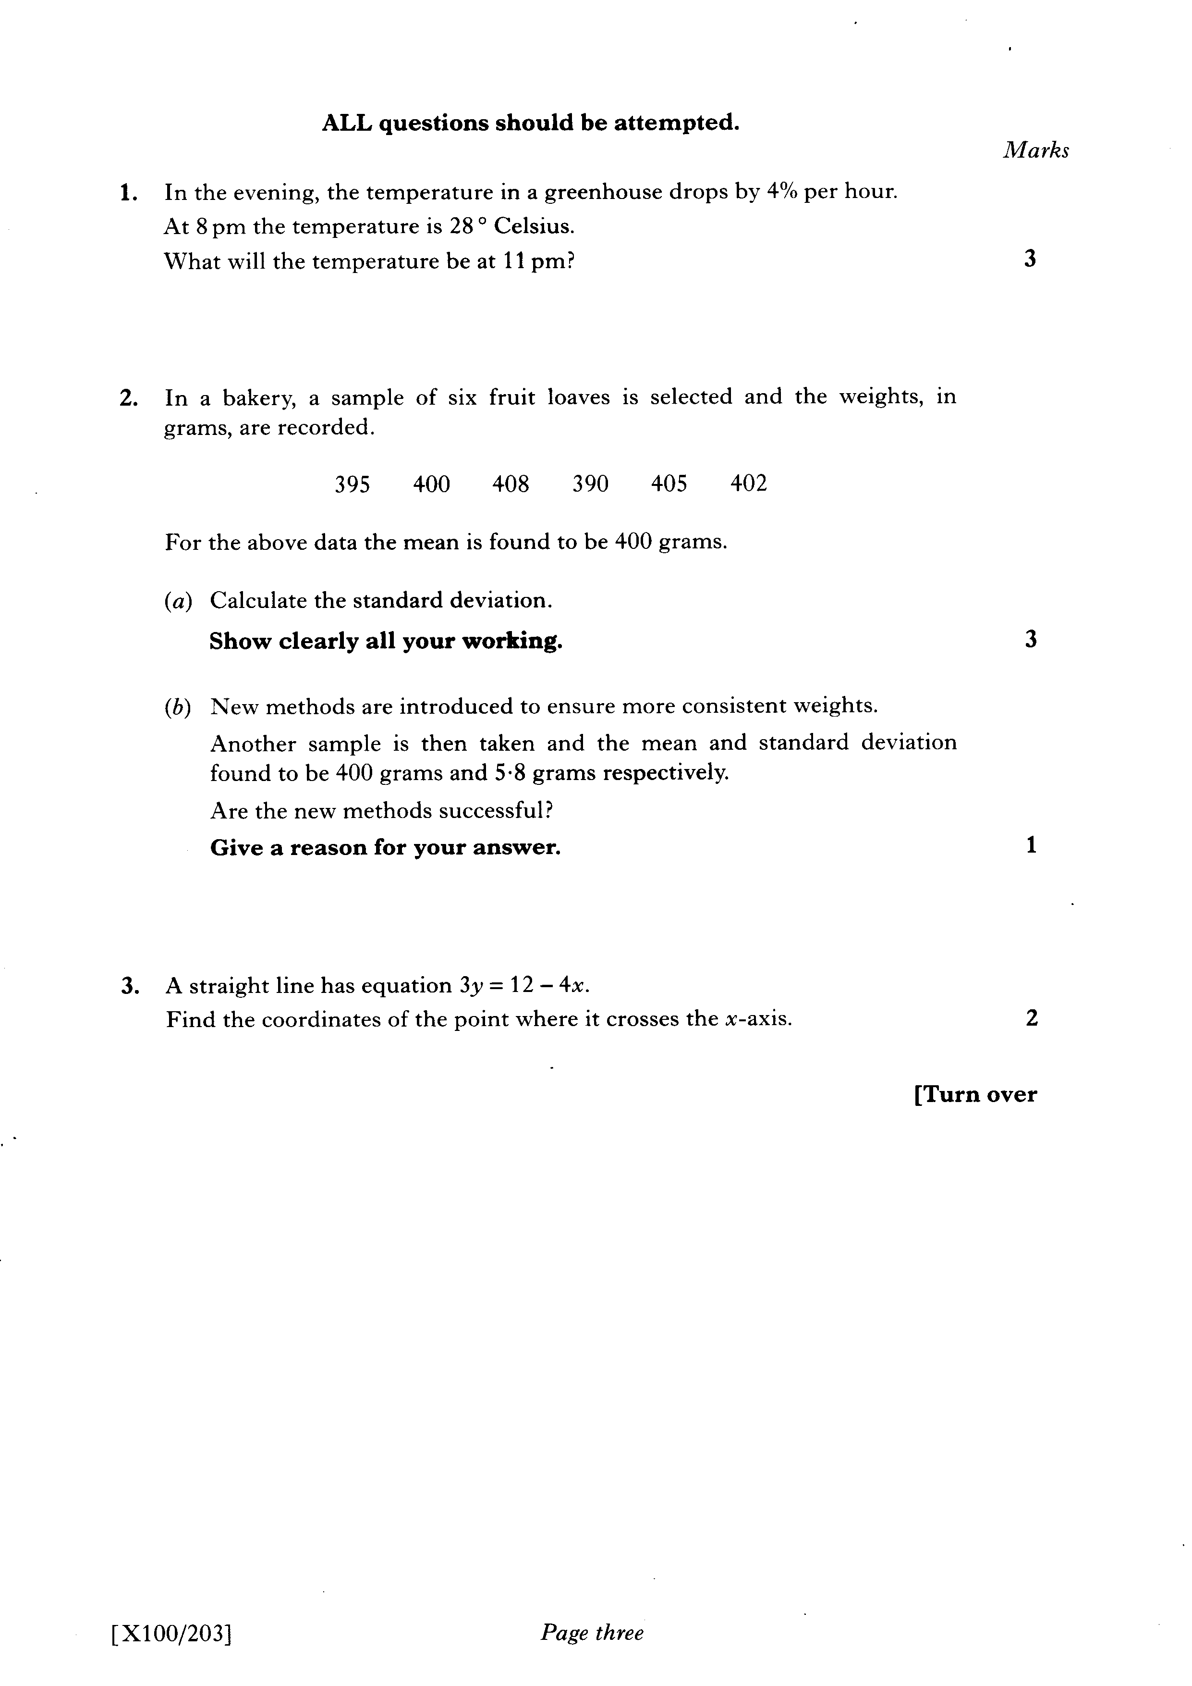

Slide 65
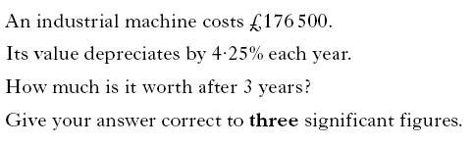

Slide 66
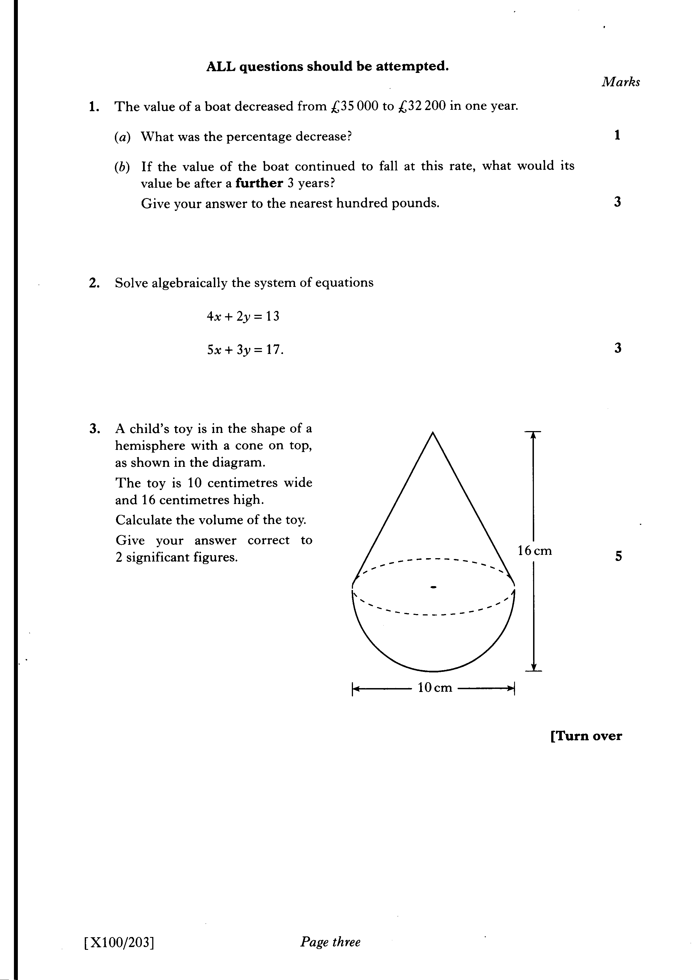

Slide 67
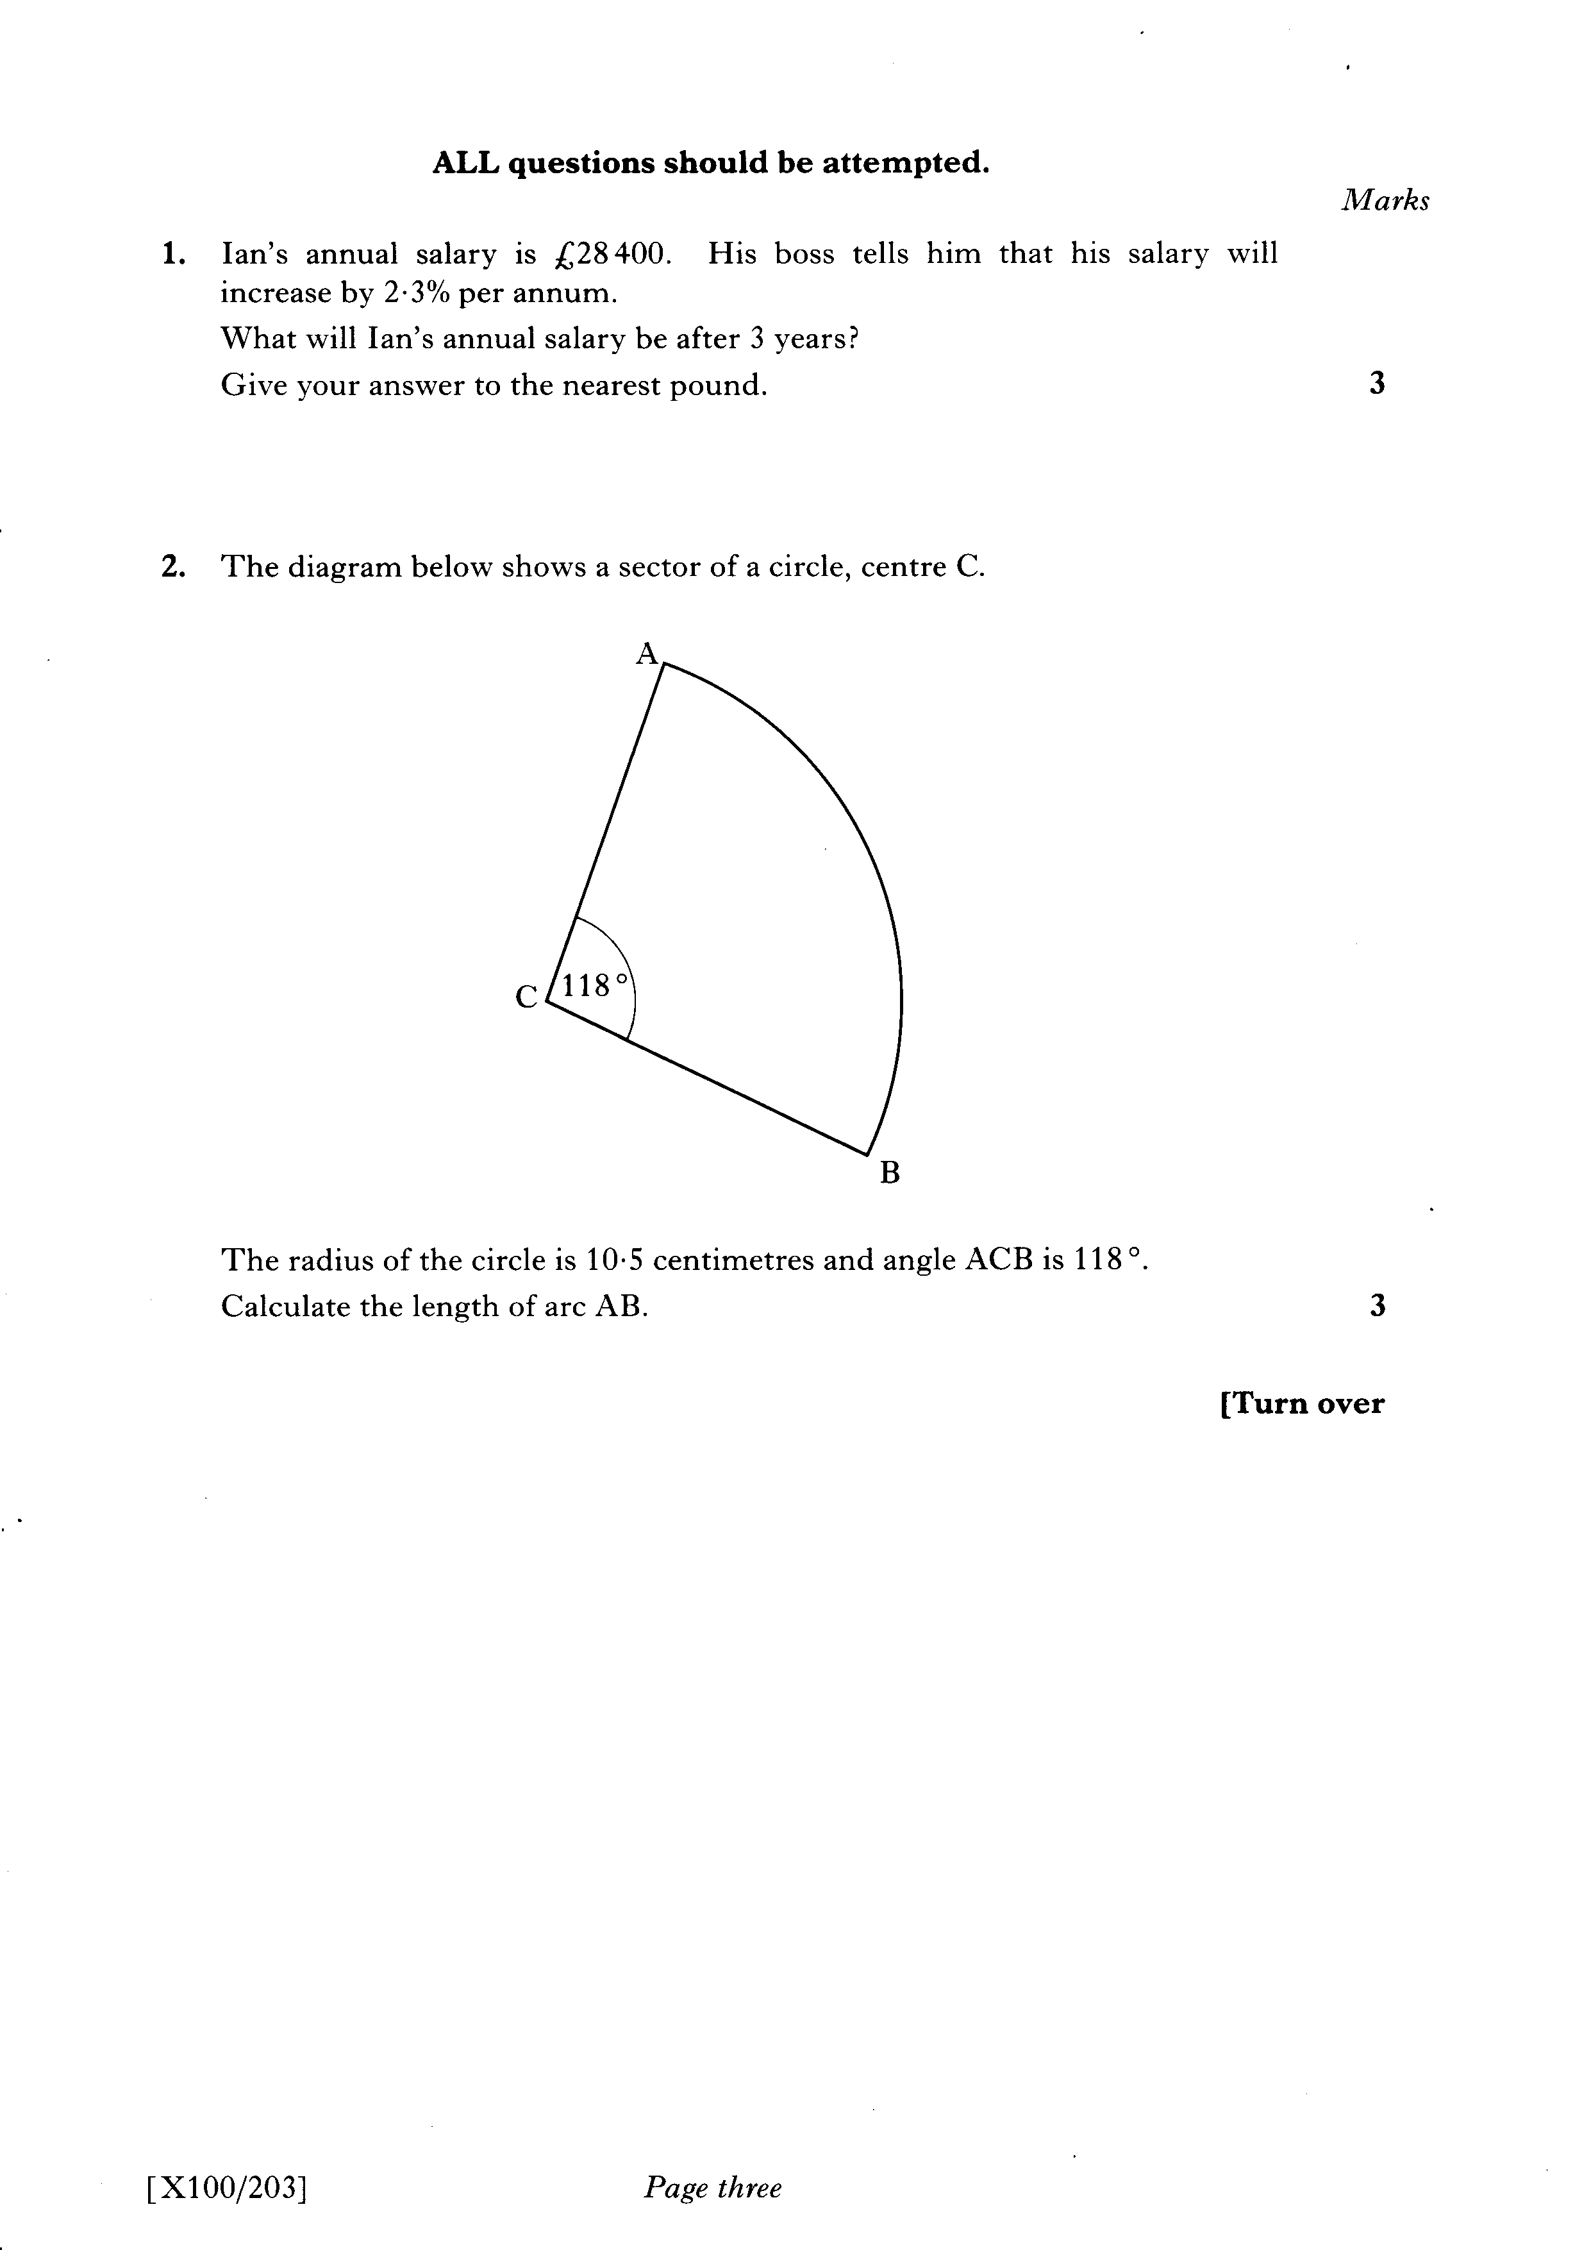

Slide 68
