Slide 1


Trigonometry Equations
National 5
Trig Function and Circle Connection
Solving Trig Equations
Negative Cosine
www.mathsrevision.com
Special Trig Relationships
Exam Type Questions

Slide 2
Starter
National 5
Q1. How can we tell if two lines are parallel.
Q2. Write down the three ratios connecting
the circle , arc length and area of a sector.
www.mathsrevision.com

Slide 3
Solving Trig Equations
National 5
Learning Intention
Success Criteria
  We are investigating the connect between the circle and trig functions.
  Understand the connection between the circle and sine, cosine and tan functions.
  Solve trig equations using graphically.
www.mathsrevision.com

Slide 4
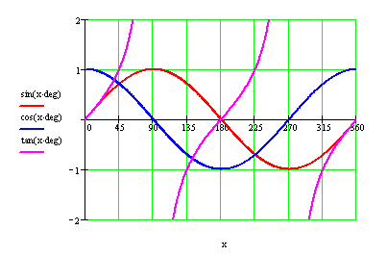
Trig and Circle Connection
National 5
Sin +ve
All +ve
180º - xº
180º + xº
360º - xº
www.mathsrevision.com
Tan +ve
Cos +ve
1
2
3
4
Sine Graph Construction
Cosine Graph Construction
Tan Graph Construction
Demo

Slide 5
Solving Trig Equations
National 5
Learning Intention
Success Criteria
  We are learning how to solve trig equations of the form
  a sin xº + 1 = 0
  Use the balancing method to trig equation
  a sin xº + 1 = 0
  Realise that there are many solutions to trig equations depending on domain.
www.mathsrevision.com

Slide 6
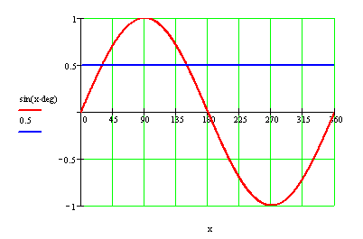
Solving Trig Equations
Graphically what are we trying to solve
a sin xº + b = 0
National 5
Example :
Solving the equation sin xº = 0.5 in the range 0º to 360º
Demo
sin xº = (0.5)
xº = sin⁻¹(0.5)
www.mathsrevision.com
xº = 30º
There is another solution
xº = 150º
1
2
3
4
(180º – 30º = 150º)

Slide 7
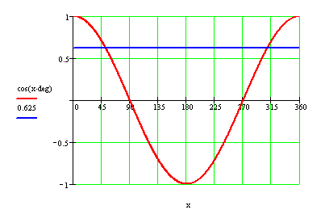
Solving Trig Equations
Graphically what are we trying to solve
a cos xº + b = 0
National 5
Demo
Example :
Solving the equation cos xº = 0.625 in the range 0º to 360º
cos xº = 0.625
xº = cos ⁻¹ 0.625
www.mathsrevision.com
xº = 51.3º
There is another solution
(360º - 53.1º = 308.7º)
1
2
3
4

Slide 8

Solving Trig Equations
National 5
Now try N5 TJ
Ex20.1 upto Q4
Ch 20 (Page 198)
www.mathsrevision.com

Slide 9
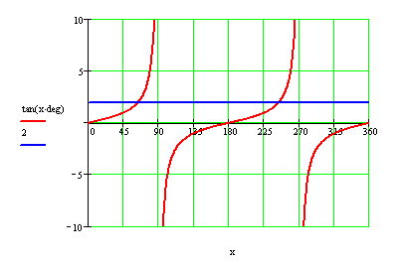
Solving Trig Equations
Graphically what are we trying to solve
a tan xº + b = 0
National 5
Example :
Solving the equation tan xº – 2 = 0 in the range 0º to 360º
Demo
tan xº = 2
xº = tan ⁻¹(2)
www.mathsrevision.com
xº = 63.4º
There is another solution
x = 180º + 63.4º = 243.4º
1
2
3
4

Slide 10
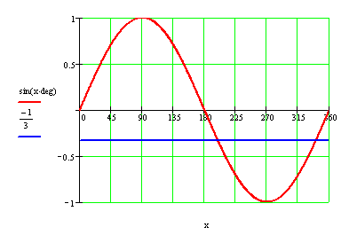
Solving Trig Equations
Graphically what are we trying to solve
a sin xº + b = 0
National 5
Demo
Example :
Solving the equation 3sin xº + 1 = 0 in the range 0º to 360º
sin xº = -1/3
www.mathsrevision.com
Calculate first Quad value
xº = 19.5º
x = 180º + 19.5º = 199.5º
There is another solution
1
2
3
4
( 360º - 19.5º = 340.5º)

Slide 11
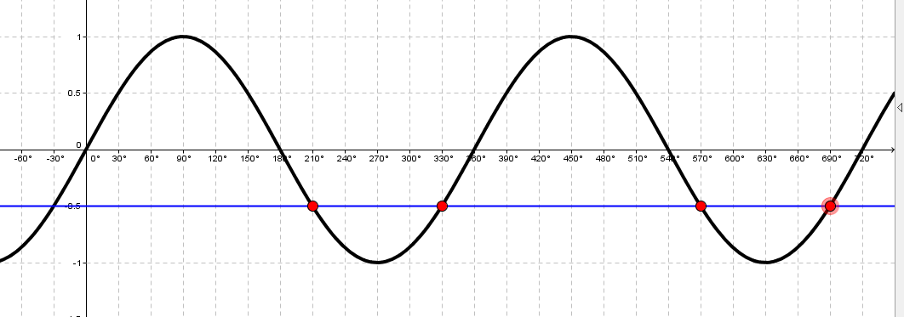
Solving Trig Equations
Graphically what are we trying to solve
a sin xº + b = 0
National 5
Demo
Example :
Solving the equation 2sin xº + 1 = 0 in the range 0º to 720º
sin xº = -1/2
Calculate first Quad value
xº = 30º
www.mathsrevision.com
xº = 210º and 330º
There are further solutions at
360º + 210º = 570º
360º + 330º = 690º

Slide 12
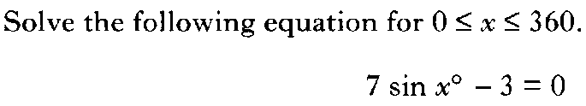

Slide 13


Slide 14

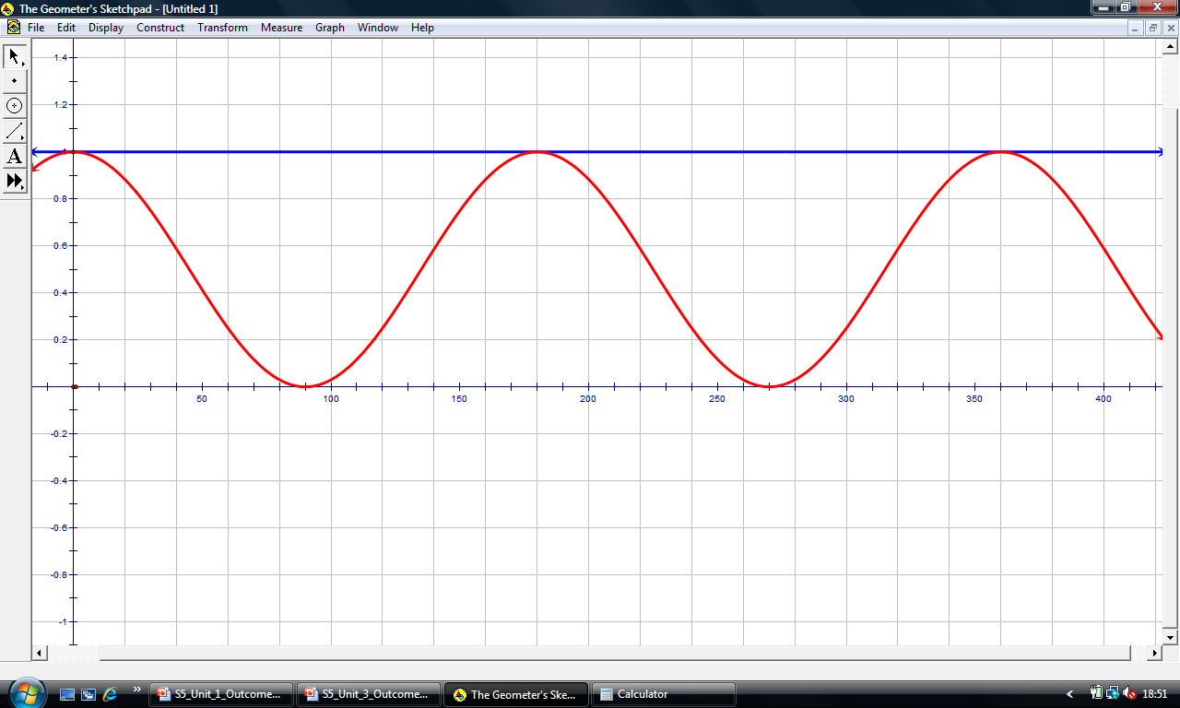
Solving Trig Equations
Graphically what are we trying to solve
90º
S
A
180º
0º
Example
Solving the equation cos²x = 1 in the range 0º to 360º
T
C
270º
cos² xº = 1
cos xº = ± 1
cos xº = 1
xº = 0º and 360º
cos xº = -1
xº = 180º

Slide 15
Solving Trig Equations
National 5
Now try N5 TJ
Ex20.1 Q4 onwards
Ch 20 (Page 198)
www.mathsrevision.com

Slide 16
Starter Questions
Nat 5
www.mathsrevision.com
54º

Slide 17
Cosine Rule
Nat 5
Learning Intention
Success Criteria
  1. We are learning what a negative cosine ratio means with respect to the angle.
  Know what a negative cosine ratio means.
www.mathsrevision.com
  2. Solve REAL LIFE problems that involve finding an angle of a triangle.

Slide 18
Cosine Rule
Nat 5
Works for any Triangle
The Cosine Rule can be used with ANY triangle
as long as we have been given enough information.
B
a
www.mathsrevision.com
c
C
b
A

Slide 19
Cosine Rule
Nat 5
Works for any Triangle
How to determine when to use the Cosine Rule.
Two questions
1. Do you know ALL the lengths.
SAS
OR
www.mathsrevision.com
2. Do you know 2 sides and the angle in between.
If YES to any of the questions then Cosine Rule
Otherwise use the Sine Rule

Slide 20
Finding Angles
Using The Cosine Rule
Nat 5
Works for any Triangle
Consider the Cosine Rule again:
a² =
b²
+
c²
-2bc cosAº
We are going to change the subject of the formula to cos Aº
b² + c² – 2bc cos Aº = a²
Turn the formula around:
-2bc cos Aº = a² – b² – c²
Take b² and c² across.
www.mathsrevision.com
Divide by – 2 bc.
Divide top and bottom by -1
You now have a formula for finding an angle if you know all three sides of the triangle.

Slide 21
Finding Angles
Using The Cosine Rule
Works for any Triangle
D
Nat 5
Example : Calculate the
unknown angle Fº .
8cm
10cm
f
e
E
F
12cm
d
Write down the formula for cos Fº
Fº = ?
d = 12
e = 10
f = 8
Label and identify Fº and d , e and f.
www.mathsrevision.com
Substitute values into the formula.
Cos Fº =
0.75
Calculate cos Fº .
Fº = 41.4º
Use cos⁻¹ 0.75 to find Fº

Slide 22
Finding Angles
Using The Cosine Rule
Nat 5
Works for any Triangle
A
15cm
13cm
Example : Find the unknown
Angle in the triangle:
c
b
B
C
a
26cm
Write down the formula.
Aº = yº
a = 26
b = 15
c = 13
www.mathsrevision.com
Identify the sides and angle.
Find the value of cosAº
The negative tells you the angle is obtuse.
cosAº =
- 0.723
Aº =
136.3º

Slide 23
Solving Trig Equations
National 5
Now try N5 TJ
Ex20.2
Ch 20 (Page 200)
www.mathsrevision.com

Slide 24
Starter
National 5
www.mathsrevision.com

Slide 25
Solving Trig Equations
National 5
Learning Intention
Success Criteria
  To explain some special trig relationships
  sin ² xº + cos ² xº = ?
  and
  tan xº and sin x
  cos x
  Know and learn the two special trig relationships.
  Apply them to solve problems.
www.mathsrevision.com

Slide 26
Solving Trig Equations
National 5
Lets investigate
sin ²xº + cos ² xº = ?
Calculate value for x = 10, 20, 50, 250
www.mathsrevision.com
sin ²xº + cos ² xº = 1
Learn !
sin ²xº = 1 - cos ² xº
cos²xº = 1 - sin² xº

Slide 27
Solving Trig Equations
National 5
Lets investigate
sin xº
tan xº
and
cos xº
Calculate value for x = 10, 20, 50, 250
www.mathsrevision.com
sin xº
tan xº
=
Learn !
cos xº

Slide 28
3
Given that sin xº = .
Find cos xº .
5
cos²xº = 1 - sin²xº
(
2
3
(
cos²xº = 1 -
5
9
cos²xº = 1 -
25
16
cos²xº =
25
√
4
cosxº =
5

Slide 29
6
Given that cos xº = .
Find sin xº and tanxº.
10
sin xº
sin²xº = 1 - cos²xº
tan xº
=
cos xº
(
2
sin²xº = 1 -
6
(
8
10
10
36
=
sin²xº = 1 -
100
6
10
sin²xº =
64
8
100
=
6
√
8
sinxº =
4
10
tan xº
=
3

Slide 30
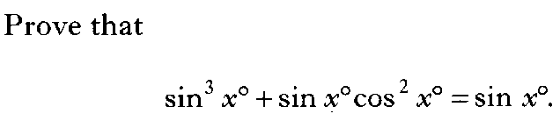
LHS
= sinxsin²x + sinxcos²x
= sinx(sin²x + cos²x)
(sin²x + cos²x) = 1
= sinx = RHS

Slide 31

sinx
cosx
cosx
=
sinx
sinx
=
sinx
= 1

Slide 32

LHS
1 – sin²A = cos²A
sin²A
=
cos²A
= tan²A = RHS

Slide 33
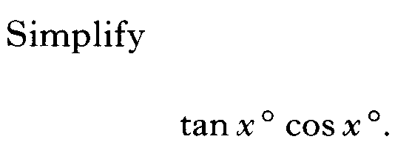

Slide 34
Solving Trig Equations
National 5
Now try N5 TJ
Ex20.3
Ch 20 (Page 201)
www.mathsrevision.com

Slide 35
Are you on Target !
Update you log book
Make sure you complete and correct
ALL of the Trigonometry questions in the past paper booklet.

Slide 36
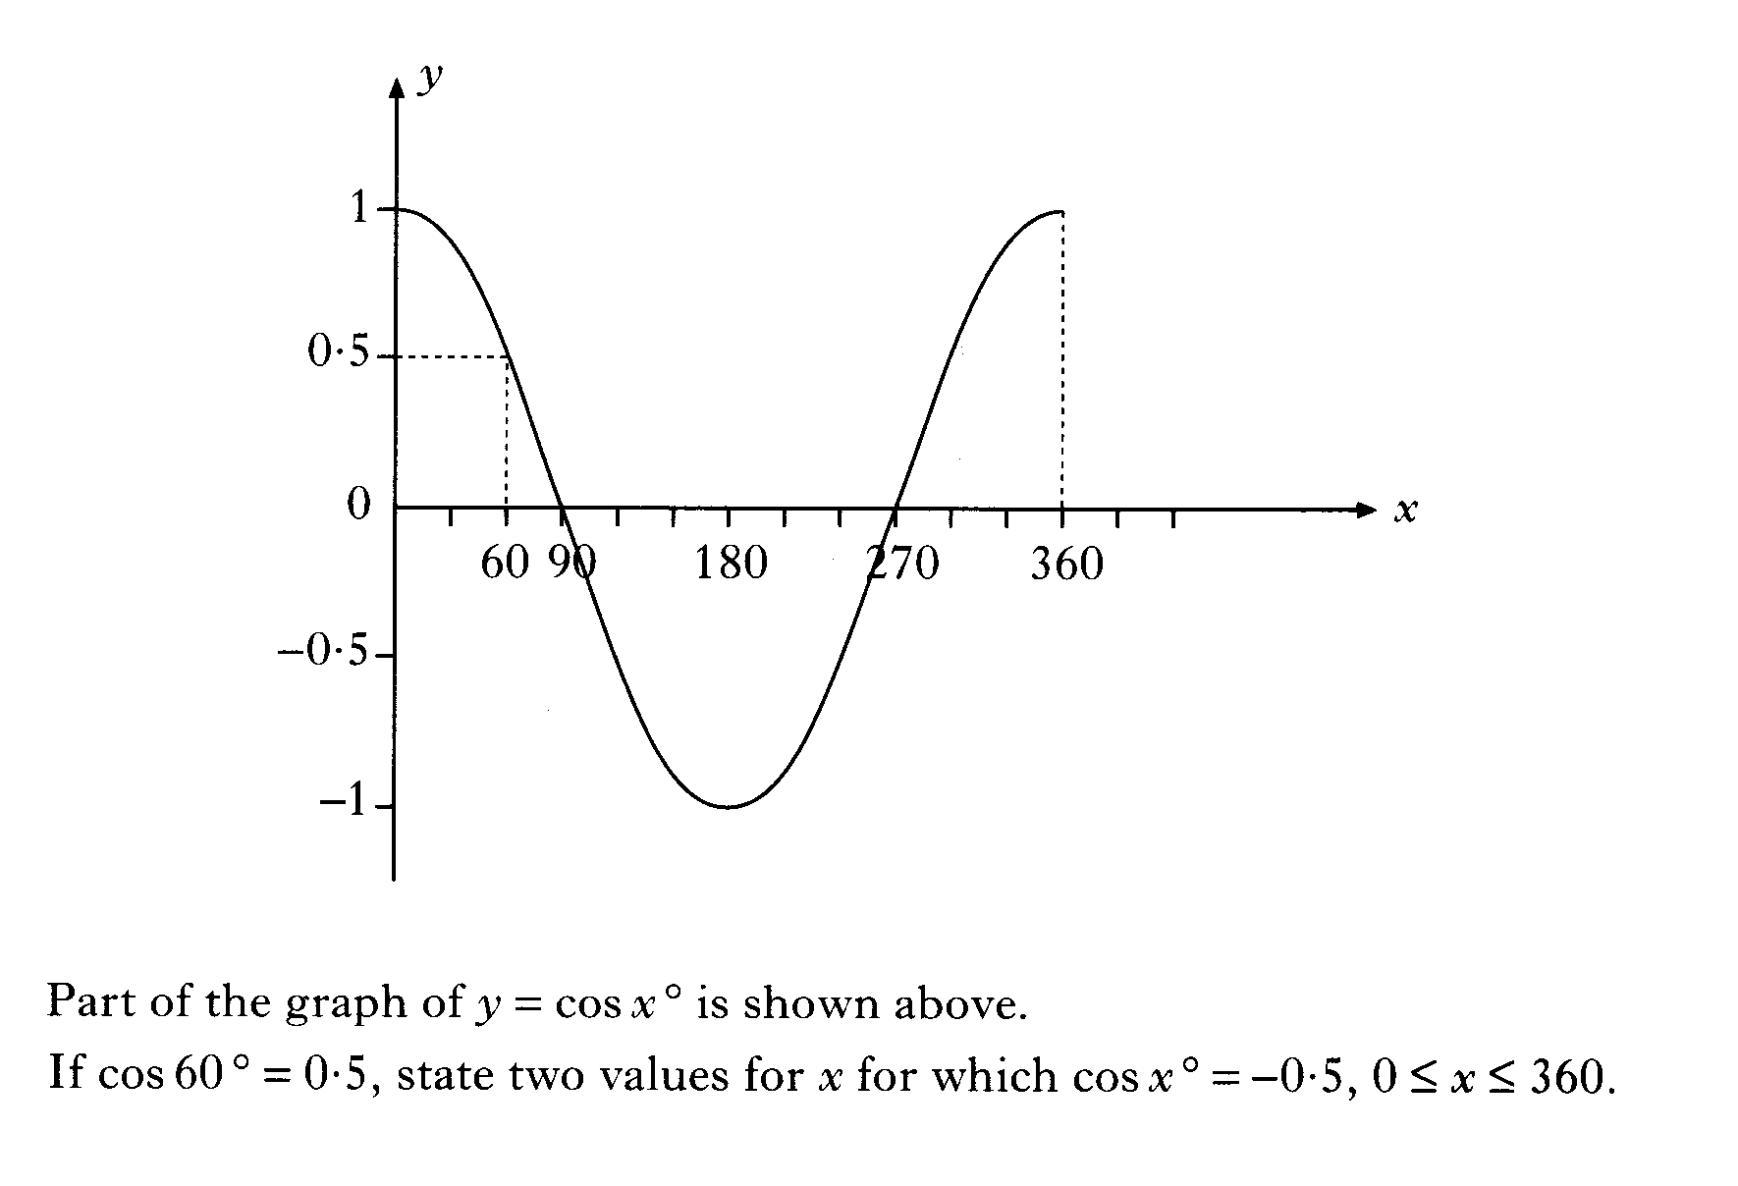

Slide 39
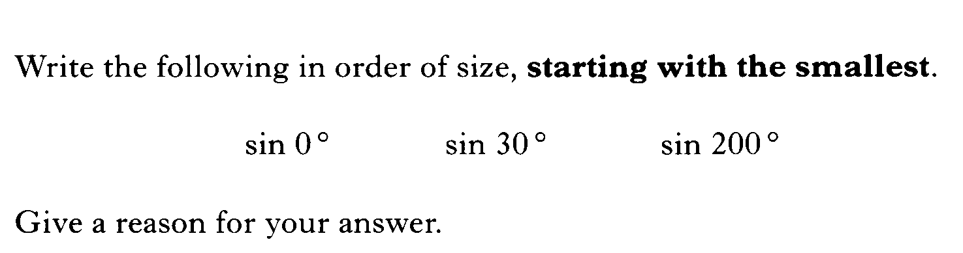

Slide 40
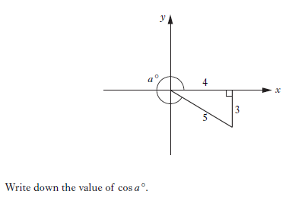

Slide 41
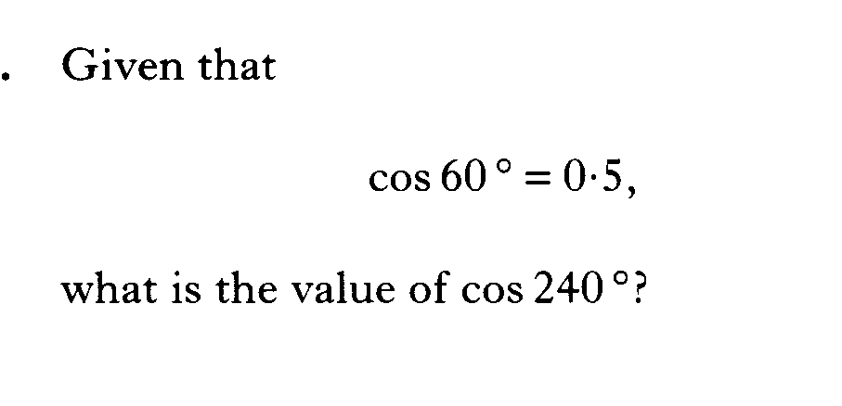

Slide 42
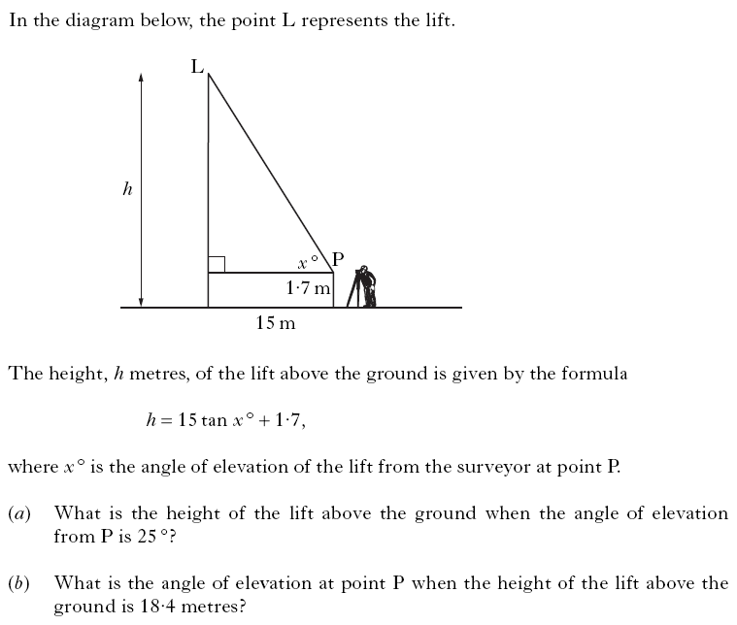

Slide 43
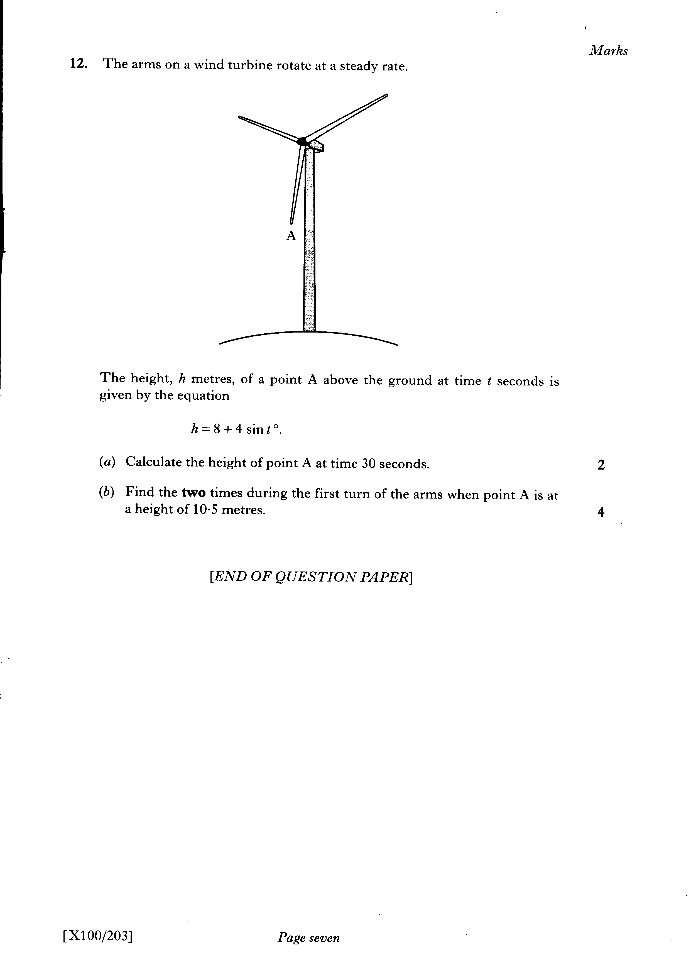

Slide 44
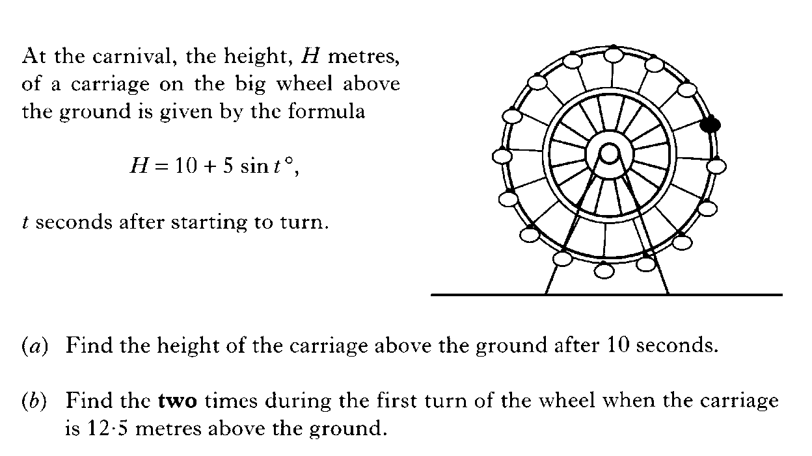

Slide 45
