Slide 1
Algebraic Operations
Removing Single Brackets - Revision
Removing Double Brackets (ax+b)(cx+d)
Alternative Method FOIL – (NOT TAUGHT)
Removing Harder Double Brackets
Tidying up and Cubing (x+2)³
Solving More equations (x+2)² =x² +64
Exam Questions
Jul 11, 2026
Created by Mr. Lafferty@mathsrevision.com
Notes:
<number>

Slide 2


Starter Questions
Nat 5
Q1. Is the following true or false
(a) (-3a) x 5a = -15a (a) (-6x) x (-7y) =-42xy
Q2. Are the 2 answers the same ?
(a) (-3h)² = (b) -(3d)² =
www.mathsrevision.com
Q3. Spilt £64 pounds into the ratio 7:9
Q4. Explain why 0.0675 is equal to 6.75x10⁻²
Jul 11, 2026
Created by Mr. Lafferty@mathsrevision.com

Slide 3
Removing a
Single Bracket
Nat 5
Learning Intention
Success Criteria
  We are learning how to multiply out (remove) various single brackets.
  Understand the keypoints of multiplying out an expression with a single bracket.
www.mathsrevision.com
Jul 11, 2026
Created by Mr. Lafferty@mathsrevision.com

Slide 4
Removing a
Single Bracket
Example 1
3(b + 5) =
3b
+ 15
Example 2
4(w - 2) =
4w
- 8
Jul 11, 2026
Created by Mr. Lafferty@mathsrevision.com

Slide 5
Removing a
Single Bracket
Example 3 : Write down an expression
for the amount indicate below
in two difference ways.
x+3
x+3
3(x + 3)
=3x
+ 9
x+3
Jul 11, 2026
Created by Mr. Lafferty@mathsrevision.com

Slide 6
Removing a
Single Bracket
Example 8 : Write down an expression
for the amount indicate below
in two difference ways.
y-2
y-2
y-2
5(y - 2)
= 5y
- 10
y-2
y-2
Jul 11, 2026
Created by Mr. Lafferty@mathsrevision.com

Slide 7
Removing a
Single Bracket
Example 4
a(b + 5) =
ab
+ 5a
Example 5
p(w - 2) =
pw
- 2p
Jul 11, 2026
Created by Mr. Lafferty@mathsrevision.com

Slide 8
Removing a
Single Bracket
Example 6
y(y - 1) =
y²
- y
Example 7
7w(w - 3) =
7w²
- 21w
Jul 11, 2026
Created by Mr. Lafferty@mathsrevision.com

Slide 9
Removing a
Single Bracket
Example 8
-(x + y) =
-x
- y
Example 9
-5(a - 7) =
-5a
+ 35
Jul 11, 2026
Created by Mr. Lafferty@mathsrevision.com

Slide 10
Removing a
Single Bracket
Tidy Up
Example 10
7 + 3(4 - y) =
7 +
12
- 3y
= 19 - 3y
Tidy Up
Example 11
9 - 3(8 - y) =
9
- 24
+ 3y
= -15 + 3y
Jul 11, 2026
Created by Mr. Lafferty@mathsrevision.com

Slide 11
Removing Two Single Brackets
Tidy Up
Example 12
4(m - 3) - (m + 2) =
4m - 12
- m - 2
= 3m - 14
Tidy Up
Example 13
7(y - 1) - 2(y + 4) =
7y - 7
- 2y - 8
= 5y - 15
Jul 11, 2026
Created by Mr. Lafferty@mathsrevision.com

Slide 12

Removing a
Single Bracket
Nat 5
Now try Ex 1.1
Ch1 N5 TJ (page 13)
www.mathsrevision.com
11 Jul 2026
Created by Mr. Lafferty@mathsrevision.com

Slide 13
Starter Questions
Nat 5
Q1. Find the area of the shape given
(w – 5)
3
Q2. Is the following true
-2a( b – a) = -2ab +4a
www.mathsrevision.com
Q3. Write down the two numbers that multiply
to give 8 and subtract to give 2.
Jul 11, 2026
Created by Mr. Lafferty@mathsrevision.com

Slide 14
Removing
Double Brackets
Int 2
Learning Intention
Success Criteria
  We are learning how to multiply out a pair of brackets using the multiplication table method.
  Understand the keypoints of multiplying out paired brackets.
  Be able to multiply out paired brackets using the multiplication table method.
www.mathsrevision.com
Jul 11, 2026
Created by Mr. Lafferty@mathsrevision.com

Slide 15
What is the total area of the downstairs house?
Removing
Double Brackets
Below is a floor plan of the down stairs of a house.
y
5
y
Living
Room
y²
5y
Tidy up !
Bedroom
3
3y
15
Bathroom
Kitchen
y²
+ 8y
+ 15
Jul 11, 2026
Created by Mr. Lafferty@mathsrevision.com

Slide 16
Removing
Double Brackets
Double brackets are used in AREA calculations
Multiplication table for brackets
Example 1
(y + 3)(y + 5)
y
+ 3
y
+ 5
Tidy up !
y²
+5y
+3y
+15
y²
+ 8y
+ 15
Jul 11, 2026
Created by Mr. Lafferty@mathsrevision.com

Slide 17
Removing
Double Brackets
Be careful with the negative signs
Example 2
(2x - 1)(x + 3)
2x
- 1
x
+ 3
Tidy up !
2x²
+6x
-x
-3
2x²
+ 5x
- 3
Jul 11, 2026
Created by Mr. Lafferty@mathsrevision.com

Slide 18
Squaring Brackets
Example 3 : (x + 1)²
Multiply out the brackets and Simplify
= (x + 1)(x + 1)
(x + 1)(x + 1)
x
+ 1
x
+ 1
Tidy up !
x²
+ x
+ x
+ 1
x²
+ 2x
+ 1
Jul 11, 2026
Created by Mr. Lafferty@mathsrevision.com

Slide 19
Harder Brackets
Example 4 : Find the area of the square.
(2x - 3y)(2x - 3y)
2x
- 3y
2x
- 3y
(2x-3y)
Tidy up !
4x²
-6xy
-6xy
+9y²
4x²
- 12xy
+ 9y²
Jul 11, 2026
Created by Mr. Lafferty@mathsrevision.com

Slide 20
Harder
Double Brackets
Just a bigger
Multiplication Table
Example 5
(x + 4)(x² + 3x + 2)
x
+ 4
x²
+ 3x
+ 2
Tidy up !
x³
+3x²
+2x
+12x
+8
x³
+ 7x²
+ 14x
+ 8
+4x²
Jul 11, 2026
Created by Mr. Lafferty@mathsrevision.com

Slide 21
Removing
Double Brackets
Just a bigger
Multiplication Table
Example 6
(2x - 1)(x² + 2x - 1)
2x
- 1
x²
+ 2x
- 1
Tidy up !
2x³
+4x²
-2x
-2x
+1
2x³
+ 3x²
- 4x
+ 1
-x²
Jul 11, 2026
Created by Mr. Lafferty@mathsrevision.com

Slide 22
Harder Brackets
1
2
Example 7 :
(
2a
-
(
2a
1
1
(
1
(
1
-
(
(
-
-
2a
2a
-
2a
2a
2a
2a
2a
2a
Tidy up !
4a²
-1
1
- 1
1
4a²
- 2
+
4a²
4a²
Jul 11, 2026
Created by Mr. Lafferty@mathsrevision.com

Slide 23
Removing a
Single Bracket
Nat 5
Now try Ex 1.2
Ch1 N5 TJ (page 14)
www.mathsrevision.com
11 Jul 2026
Created by Mr. Lafferty@mathsrevision.com

Slide 24
Starter Questions
Nat 5
Q1. 0.00897 is in scientific notation is this statement True or False?
Q2. Does (w + 2)(w + 1) = w² + 3w + 2
www.mathsrevision.com
Q3.
Jul 11, 2026
Created by Mr. Lafferty@mathsrevision.com

Slide 25
Removing
Double Brackets
Int 2
Learning Intention
Success Criteria
  We are learning how to multiply out a pair of brackets using FOIL.
  Understand the keypoints of multiplying out double brackets using FOIL.
  Be able to multiply out double brackets using FOIL.
www.mathsrevision.com
Jul 11, 2026
Created by Mr. Lafferty@mathsrevision.com

Slide 26
Removing a
Single Bracket
Nat 5
Now try Ex 1.3
Ch1 N5 TJ (page 17)
www.mathsrevision.com
11 Jul 2026
Created by Mr. Lafferty@mathsrevision.com

Slide 27
Removing
Double Brackets
We can use the F O I L method to multiply out DOUBLE brackets.
FOIL Method
Simply remember the word
F
O
I
L
Multiply
First 2
Multiply
Last 2
Multiply
Outside 2
Multiply
Inside 2
Jul 11, 2026
Created by Mr. Lafferty@mathsrevision.com

Slide 28
Removing
Double Brackets
Try again using multiplication table
Example 1 :
Multiply out the brackets and Simplify
(x + 1)(x + 2)
1. Write down F O I L
x²
+ 2x
+ x
+ 2
2. Tidy up !
x² + 3x + 2
Jul 11, 2026
Created by Mr. Lafferty@mathsrevision.com

Slide 29
Removing Double Brackets
Try again using multiplication table
Example 2 :
Multiply out the brackets and Simplify
(x - 1)(x + 2)
1. Write down F O I L
x²
+ 2x
- x
- 2
2. Tidy up !
x² + x - 2
Jul 11, 2026
Created by Mr. Lafferty@mathsrevision.com

Slide 30
Squaring Brackets
FOIL method is very limited
therefore from now on we will use
the multiplication table method.
Jul 11, 2026
Created by Mr. Lafferty@mathsrevision.com

Slide 31
Removing
Double Brackets
(x + 1)(x - 2)
x² - x - 2
(x - 1)(x - 2)
x² - 3x + 2
(x + 3)(x + 2)
x² + 5x + 6
(x - 3)(x + 2)
x² - x - 6
(x + 3)(x - 2)
x² + x - 6
Jul 11, 2026
Created by Mr. Lafferty@mathsrevision.com

Slide 32
Removing a
Single Bracket
Nat 5
Now try Ex 1.2
Ch1 N5 TJ (page 14)
www.mathsrevision.com
11 Jul 2026
Created by Mr. Lafferty@mathsrevision.com

Slide 33
Starter Questions
Nat 5
Q1. Does (x - 4)² = x² + 8x + 16
Q2. 3 + (-4) x 5
www.mathsrevision.com
Q3. Is it true
Jul 11, 2026
Created by Mr. Lafferty@mathsrevision.com

Slide 34
Simplifying Expressions
Nat 5
Learning Intention
Success Criteria
  We are learning how to expand and tidy up complicated expressions that include squared and cubed brackets.
  Use techniques learned so far to simplify complicated brackets.
www.mathsrevision.com
Jul 11, 2026
Created by Mr. Lafferty@mathsrevision.com

Slide 35
Use multiplication table to remove brackets.
YOU need to be VERY CAREFUL !!
Simplifying Expressions
Example 1
(2m - 3)(3m + 1) – (m - 1)²
6m² - 7m - 3
-
( m² – 2m + 1 )
6m² - 7m - 3
- m² + 2m – 1
Tidy up
5m² – 5m - 4
Jul 11, 2026
Created by Mr. Lafferty@mathsrevision.com

Slide 36
Use multiplication table for first two brackets.
Simplifying Expressions
Example 1
(5y – 2)³
(5y – 2)(5y – 2)(5y – 2)
Use
multiplication table again
(25y² – 20y + 4)
( 5y – 2)
125y³ – 150y² + 60y - 8
Jul 11, 2026
Created by Mr. Lafferty@mathsrevision.com

Slide 37
Simplifying Expressions
Nat 5
Now try Ex 1.3
Ch1 N5 TJ (page 17)
www.mathsrevision.com
11 Jul 2026
Created by Mr. Lafferty@mathsrevision.com

Slide 38
Starter Questions
Nat 5
Q1. Does (x + 3)² = x² + 9
Q2. The sun is 92 million mile away from
the earth. Write this in standard form.
www.mathsrevision.com
Q3. Is it true
Jul 11, 2026
Created by Mr. Lafferty@mathsrevision.com

Slide 39
Equations and brackets
Nat 5
Learning Intention
Success Criteria
  We are learning how to solve equations that have paired or squared brackets.
  Be able to solve equations that contain paired or squared brackets using multiplication table and balancing method.
www.mathsrevision.com
Jul 11, 2026
Created by Mr. Lafferty@mathsrevision.com

Slide 40

Multiplication table
Equations and brackets
12
12
Example 1
m(m + 4) =
(m + 1)(m+2)
Balancing Method
m² + 4m
= m² + 3m + 2
4m
= 3m + 2
Check !
m = 2
Jul 11, 2026
Created by Mr. Lafferty@mathsrevision.com

Slide 41
Multiplication table
Equations and brackets
25
25
Example 2
(x + 5)² =
(x - 5)²
(x + 5)(x + 5)
= (x - 5)(x - 5)
Balancing Method
x² + 10x + 25
= x² – 10x + 25
10x + 25
= -10x + 25
20x
= 0
Check !
20
20
x = 0
Jul 11, 2026
Created by Mr. Lafferty@mathsrevision.com

Slide 42

Equations and brackets
Example 3 : The two areas are equal. Find the value of x.
A = (x + 7)(x – 2)
(x – 2)
(x + 2)
A = (x + 2)²
400
400
(x + 7)
Multiplication table
(x + 2)
(x + 2)² = (x + 7)(x - 2)
x² + 4x + 4
= x² + 5x - 14
Swap !
Balancing Method
4x + 4
= 5x - 14
Check !
5x - 14
= 4x + 4
x = 18
Jul 11, 2026
Created by Mr. Lafferty@mathsrevision.com

Slide 43
Equations and Brackets
Nat 5
Now try Ex 1.4
Ch1 N5 TJ (page 18)
www.mathsrevision.com
11 Jul 2026
Created by Mr. Lafferty@mathsrevision.com

Slide 44
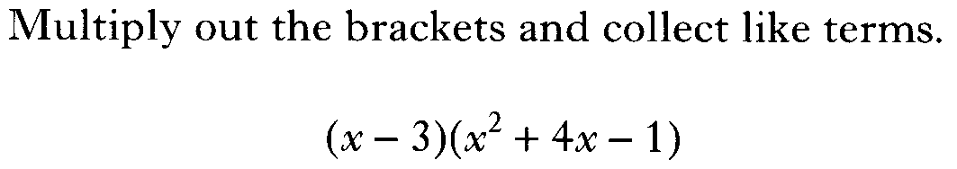

Slide 45


Slide 46
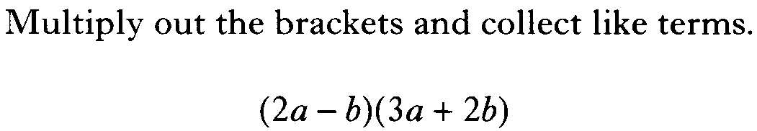

Slide 47


Slide 48
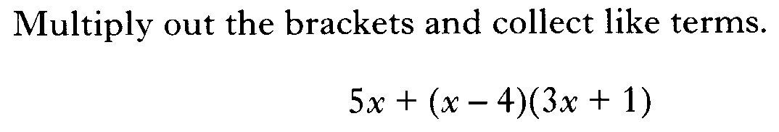

Slide 49


Slide 50
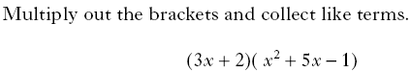

Slide 51
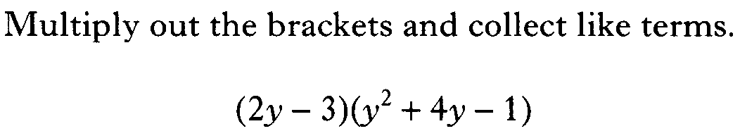

Slide 52
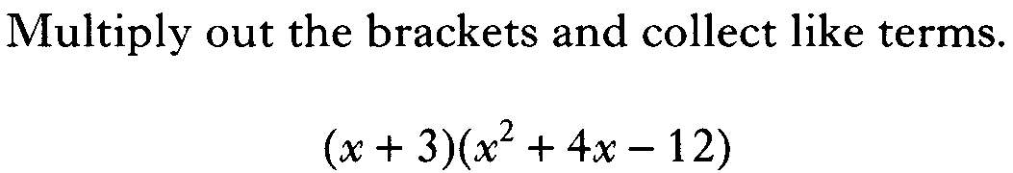

Slide 53
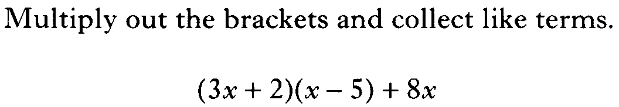

Slide 55
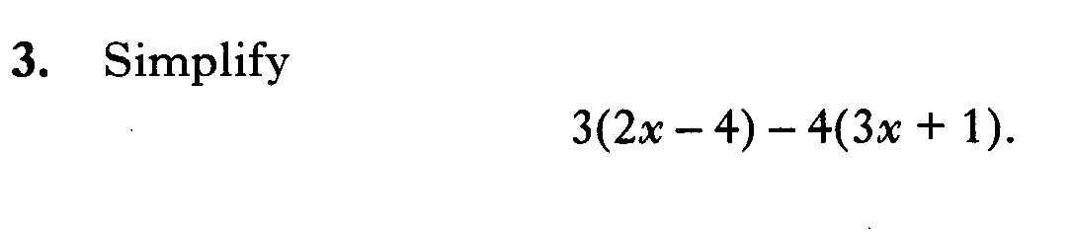

Slide 56


Slide 57


Slide 58
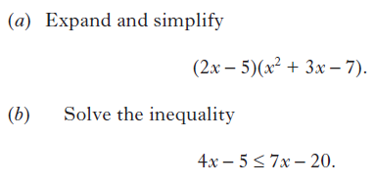

Slide 59


Slide 60
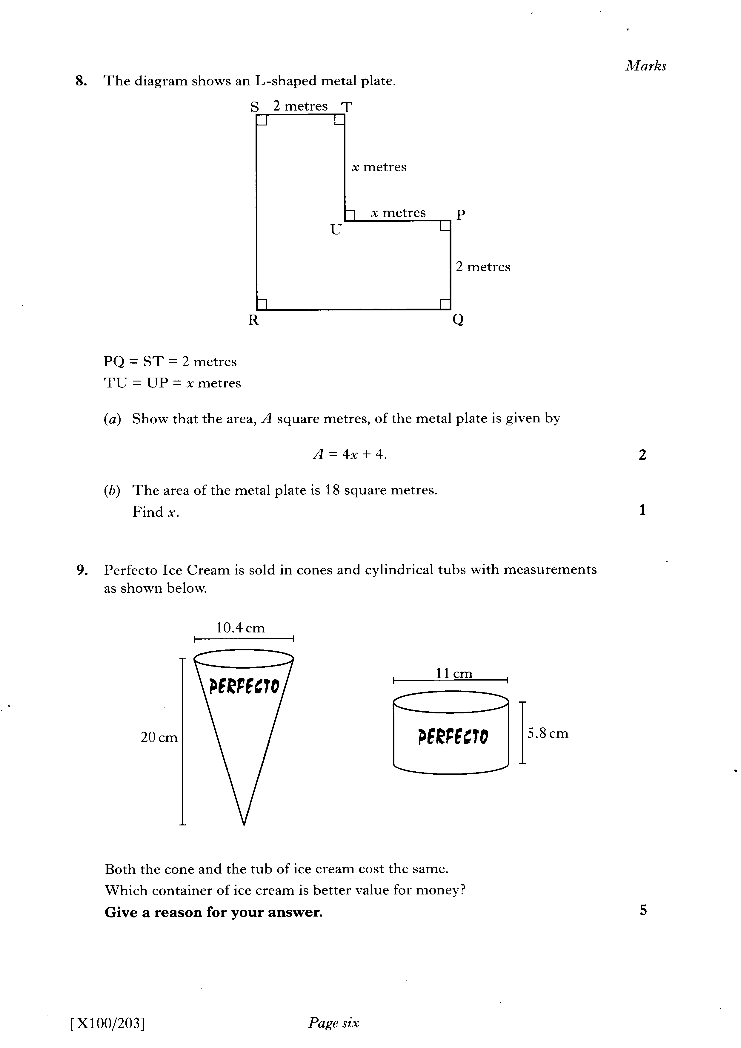

Slide 61
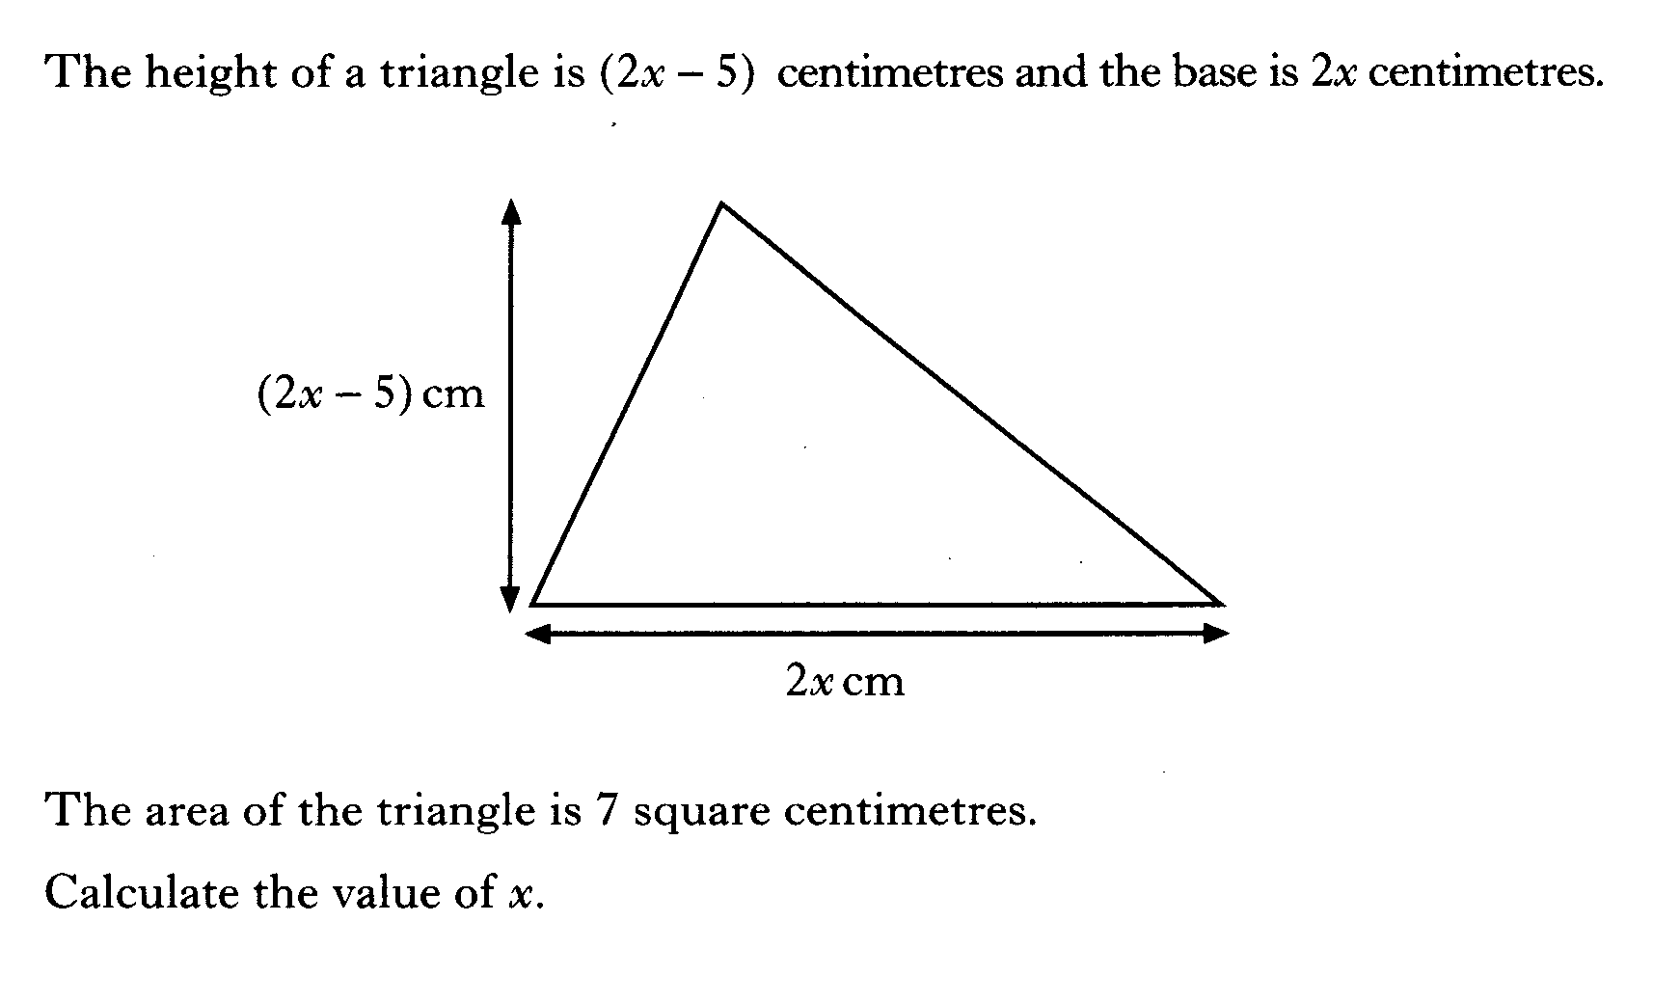

Slide 62
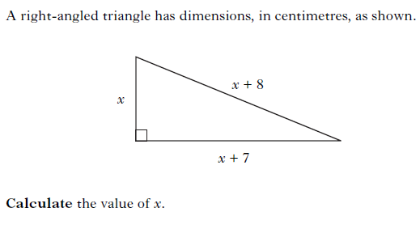

Slide 63
