Slide 1


Quadratic Function 2
Completing the Square
Quadratic Graphs (completing the square format)
Harder Completing the Square
Quadratics of the form y = ax²
Quadratic Formula
Discriminant
Exam Questions

Slide 2
Starter
Which two equations are equal
3y – 4x + 6 = 0
6y = 8x + 2
0 = -3y - 4x + 6
6y = 8x - 12

Slide 3
Completing a Square
Learning Intention
Success Criteria
  We are learning the process of completing the square.
  Be able to do the process of completing the square.

Slide 4
Completing the Square
This is a method for changing the format
of a quadratic equation of the form f(x) = ax² + bx +c
so we can easily sketch or read off key information
Completing the square format looks like
f(x) = a(x + b)² + c
Warning ! The a,b and c values are different
from the a ,b and c in the general quadratic function

Slide 5
Completing the Square
Complete the square for x² + 2x + 3
and hence sketch function.
f(x) = a(x + b)² + c
x² + 2x + 3
Half the x term and square the coefficient.
x² + 2x + 3
Compensate
a = 1
b = 1
c = 2
Tidy up !
-1
(x² + 2x + 1) + 3
(x + 1)² + 2

Slide 6
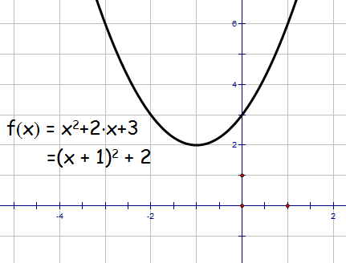
Completing the Square
sketch function.
f(x) = a(x + b)² + c
= (x + 1)² + 2
(0,3)
Mini. Pt. ( -1, 2)
(-1,2)
Demo

Slide 7
Completing the Square
Complete the square for x² - 4x + 6
and hence sketch function.
f(x) = a(x + b)² + c
x² - 4x + 6
Half the x term and square the coefficient.
x² - 4x + 6
Compensate
a = 1
b = 2
c = 2
Tidy up !
- 4
(x² - 4x + 4) + 6
(x - 2)² + 2

Slide 8
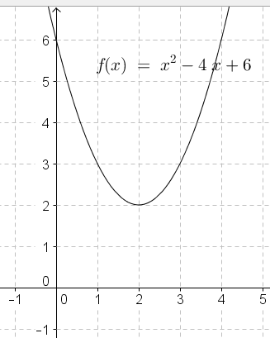
Completing the Square
sketch function.
(0,6)
f(x) = a(x + 2)² + c
= (x - 2)² + 2
(2,2)
Mini. Pt. ( 2, 2)
Demo

Slide 9
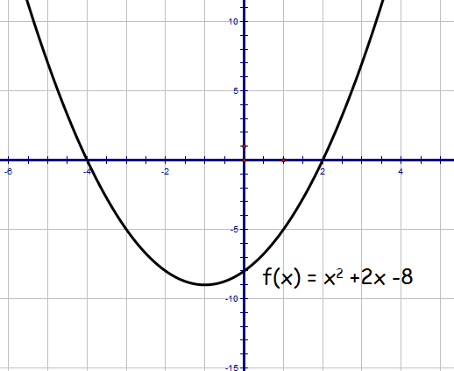
Quadratic Theory Nat 5
Given , express in the form
Hence sketch function.
(0,-8)
(-1,-9)

Slide 10
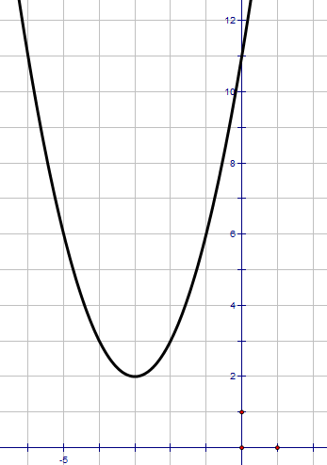
Quadratic Theory Nat 5
a) Write in the form
b) Hence or otherwise sketch the graph of
(0,11)
a)
(-3,2)
b)
For the graph of
moved 3 places to left and 2 units up.
minimum t.p. at (-3, 2)
y-intercept at (0, 11)

Slide 11

Completing the Square
Now try N5 TJ
Ex 19.1
(page 187)

Slide 12
Starter
f(x)
(5,25)
x

Slide 13
Quadratic Functions
Learning Intention
Success Criteria
  We are learning the basic properties of the quadratic function
  y = a(x - b)² + c
  when a > 0
  To know the properties of a quadratic function.
Understand the links between the graph of the form
y = x²
and
y = a(x - b)² + c

Slide 14
Quadratic Graphs
Every quadratic function can be written in the form
y = a(x - b)² + c
The curve y = f(x) is a parabola
axis of symmetry at x = b
Y - intercept
Vertex or turning point at (b,c)
(b,c)
Cuts y-axis when
x = 0 y = a(x – b)² + c
x = b
a > 0 minimum turning point
a < 0 maximum turning point

Slide 15
Quadratic Graphs
y = a(x - b)² + c
Example 1 Sketch the graph y = (x - 3)² + 2
a = 1
b = 3
c = 2
Vertex / turning point is (b,c)
= (3,2)
y
Axis of symmetry at b = 3
(0,11)
y = (0 - 3)² + 2
= 11
(3,2)
Demo
x

Slide 16
Quadratic Graphs
y = a(x - b)² + c
Example Sketch the graph y = (x + 2)² + 1
a = 1
b = -2
c = 1
Vertex / turning point is (b,c)
= (-2,1)
y
(0,5)
Axis of symmetry at b = -2
(-2,1)
y = (0 + 2)² + 1
= 5
x
Demo

Slide 17
Quadratic Graphs
y = a(x - b)² + c
Example Given a = 1 write down equation of the curve
Since a > 0 so minimum turning point
(-3,5)
Vertex / turning point is (-3, 5)
b = -3
c = 5
Demo
y = (x + 3)² + 5

Slide 18
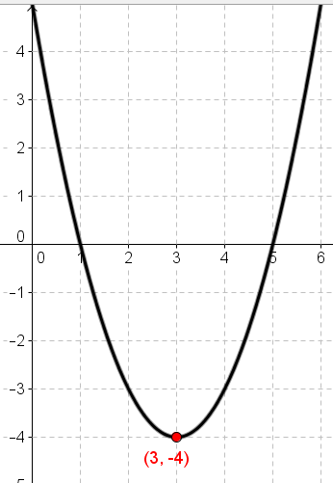
Find the Equation
Given the graph has equation
of the form a = 1
y = a(x – b)² + c
Write down equation.
y = (x – 3)² - 4

Slide 19
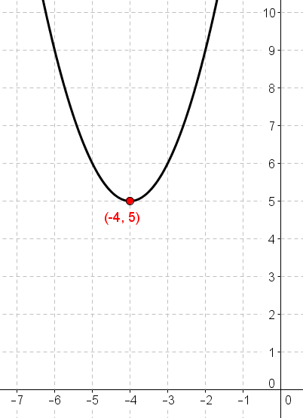
Find the Equation
Given the graph has equation
of the form a = 1
y = a(x – b)² + c
Write down equation.
y = (x + 4)² + 5

Slide 20
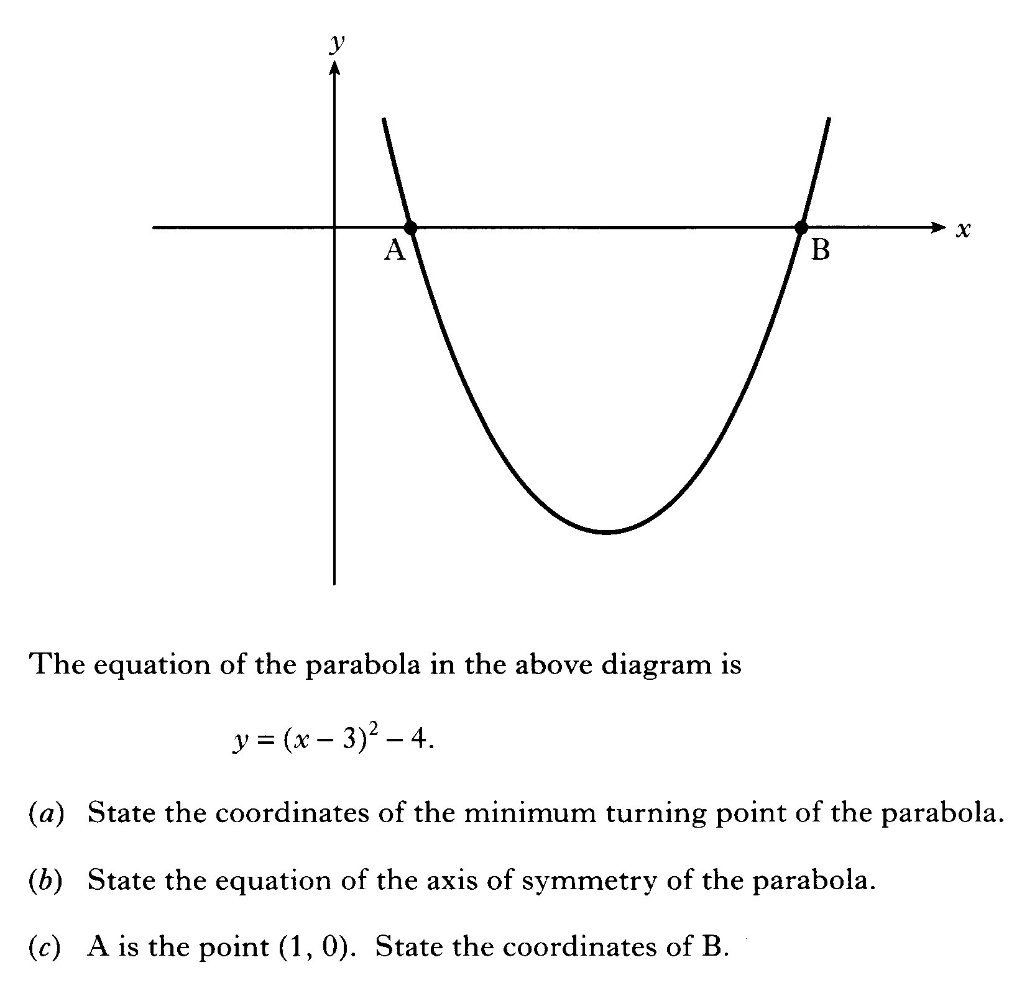

Slide 21
Quadratic Graphs
Now try N5 TJ
Ex 19.2
(page 189)

Slide 22
Starter
f(x)
(4,16)
x

Slide 23
Quadratic Functions
Learning Intention
Success Criteria
  We are learning the basic properties of the quadratic function
  y = a(x - b)² + c
  when a < 0
  To know the properties of a quadratic function.
Understand the links between the graph of the form
y = x²
and
y = a(x - b)² + c

Slide 24
Quadratic Functions
Since max point
a < 0
Every quadratic function can be written in the form
y = a(x - b)² + c
The curve y = f(x) is a parabola
Y - intercept
axis of symmetry at x = b
Vertex or turning point at (b,c)
(b,c)
Cuts y-axis when
x = 0 y = a(x – b)² + c
x = b
a > 0 minimum turning point
a < 0 maximum turning point

Slide 25
Completing the Square
Complete the square for 4x – x²
and hence sketch function.
f(x) = a(x + b)² + c
-x² + 4x
In your head multiply out squared bracket and compensate
half 6 and put into squared bracket.
-(x² - 4x)
Take out -1
to make
things easier).
-(x - 2)²
+ 4
Tidy up
a = -1
b = -2
c = 4
-(x - 2)² + 4

Slide 26
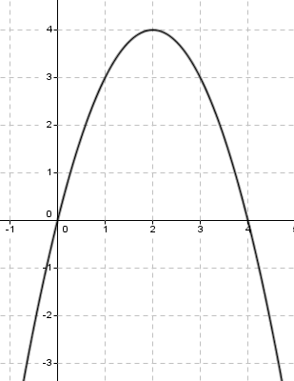
Completing the Square
Sketch function.
(2,4)
f(x) = a(x + b)² + c
= -(x - 2)² + 4
(0,0)
Mini. Pt. ( 2, 4)
Demo

Slide 27
Completing the Square
Complete the square for 7 + 6x – x²
and hence sketch function.
f(x) = a(x + b)² + c
-x² + 6x + 7
In your head multiply out squared bracket and compensate
half 6 and put into squared bracket.
-x² + 6x + 7
Take out -1
to make
things easier).
-(x² - 6x) + 7
Tidy up
a = -1
b = 3
c = 16
+ 9
-(x - 3)² + 7
-(x - 3)² + 16

Slide 28
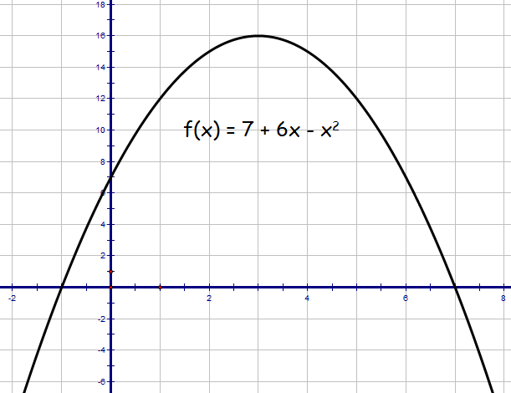
Completing the Square
Sketch function.
f(x) = a(x + b)² + c
(3,16)
= -(x - 3)² + 16
(0,7)
Mini. Pt. ( 3, 16)
Demo

Slide 29
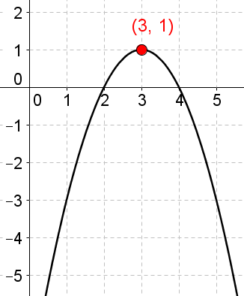
Find the Equation
Given the graph has equation
of the form where a = -1
y = a(x – b)² + c
Write down equation.
y = -(x – 3)² + 1

Slide 30
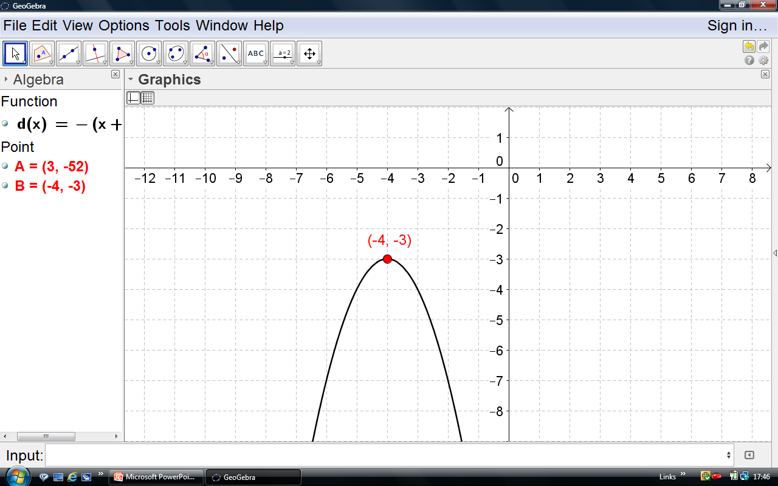
Find the Equation
Given the graph has equation
of the form where a = -1
y = a(x – b)² + c
Write down equation.
y = -(x + 4)² - 3

Slide 31
Quadratic Graphs
Now try N5 TJ
Ex 19.3
(page 190)

Slide 32
Starter
In pairs write down the effect that a, b and c
has on the quadratic of the form.
y = a(x – b)² + c

Slide 33
Quadratic Functions
Learning Intention
Success Criteria
  To explain the main properties of the basic quadratic function y = ax²
  using graphical methods.
  To know the properties of a quadratic function.
Understand the links between graphs of the form y = x² and y = ax²

Slide 34
Quadratic Functions
A function of the form
f(x) = a x² + b x + c
is called a quadratic function
The simplest quadratics have the form
f(x) = a x²
Lets investigate
Demo

Slide 35
Quadratic of the form f(x) = ax²
Key Features
Symmetry about x =0
Vertex at (0,0)
The bigger the value of a the steeper the curve.
-x² flips the curve about x - axis

Slide 36
Quadratic Functions
Example
The parabola has the form y = ax² graph opposite.
The point (3,36) lies on the graph.
Find the equation of the function.
(3,36)
Solution
f(3) = 36
36 = a x 9
a = 36 ÷ 9
a = 4
f(x) = 4x²

Slide 37
Quadratic Functions
Now try N5 TJ
Ex 19.4
(page 191)

Slide 38
Starter
Q1. Write down the equation of the quadratic.
f(x) = ax²
(2,100)
Solution
f(2) = 100
100 = a x 4
a = 100 ÷ 4
a = 25
f(x) = 25x²
(x-4)(x-3)

Slide 39
Quadratic Formula
Learning Intention
Success Criteria
  To explain how to find the roots (solve) quadratic equations by use quadratic formula.
  To be able to solve quadratic equations using quadratic formula.

Slide 40
Quadratic Formula
When we cannot factorise or solve graphically
quadratic equations we need to use the
quadratic formula.
ax² + bx + c

Slide 41
Quadratic Formula
Example : Solve x² + 3x – 3 = 0 to 1 d.p.
ax² + bx + c
1
3
-3

Slide 42
Quadratic Formula
and
x = 0.79
x = -3.79
x = 0.8
x = -3.8

Slide 43
Quadratic Formula
Use quadratic formula to solve the following to 1 d.p.
2x² + 4x + 1 = 0
x² + 3x – 2 = 0
x = -1.7, -0.3
x = -3.6, 0.6
5x² - 9x + 3 = 0
3x² - 3x – 5 = 0
x = 1.4, 0.4
x = 1.9, -0.9

Slide 44
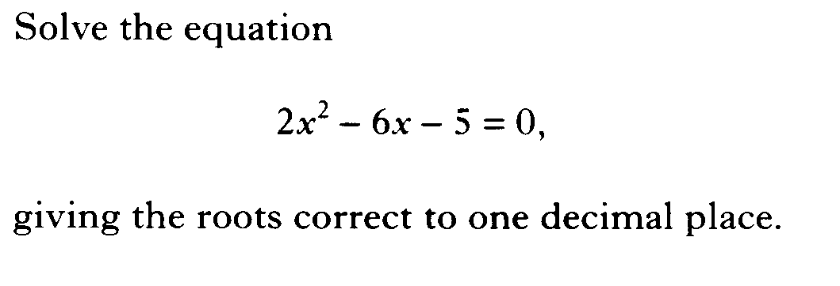

Slide 45
Quadratic Formula
Now try N5 TJ
Ex19.5
(page 193)

Slide 46
Starter
Q. Write down the function represented by the
graphs below given that they are of the form
and a is either 1 or -1.
y = a(x - b)² + c
f(x)
f(x)
(1,4)
x
x
(0,-2)
(-2,-4)
(2,-2)

Slide 47
Discriminant
Learning Intention
Success Criteria
  We are learning the usefulness of the discriminant.
  To be able to determine the nature of the roots for any quadratic function.

Slide 48
Using Discriminants
Given the general form for a quadratic function.
f(x) = ax² + bx + c
We can calculate the value of the discriminant
b² – 4ac
This gives us valuable information about the roots of the quadratic function

Slide 49
Roots of a quadratic Function
There are 3 possible scenarios
2 real and
distinct roots
2 equal real roots
No real roots
discriminant
discriminant
discriminant
(b²- 4ac > 0)
(b²- 4ac = 0)
(b²- 4ac < 0)
To determine whether a quadratic function has 2 real roots,
2 equal real roots or no real roots we calculate the discriminant.

Slide 50
Discriminant
Determine the nature of the roots of x² + 2x + 3 = 0
a = 1 b = 2 c = 3
b² – 4ac
= 2² – 4 x 1 x 3
= 4 – 12
= -8
Since b² – 4ac < 0 no real roots

Slide 51
Discriminant
Determine the nature of the roots of x² + 5x - 6 = 0
a = 1 b = 5 c = -6
b² – 4ac
= 5² – 4 x 1 x (-6)
= 25 + 24
= 49
Since b² – 4ac > 0 two real and distinct roots

Slide 52
Discriminant
Determine the nature of the roots of x² + 6x + 9 = 0
a = 1 b = 6 c = 9
b² – 4ac
= 6² – 4 x 1 x 9
= 36 – 36
= 0
Since b² – 4ac = 0 hence 2 equal real roots

Slide 53
Discriminant
Find the value p given that 2x² + 4x + p = 0 has real roots
a = 2 b = 4 c = p
For real roots b² – 4ac ≥ 0
16 – 8p ≥ 0
-8p ≥ -16
p ≤ 2
The equation has real roots when p ≤ 2.

Slide 54
Discriminant
Now try N5 TJ
Ex19.6
(page 194)

Slide 55
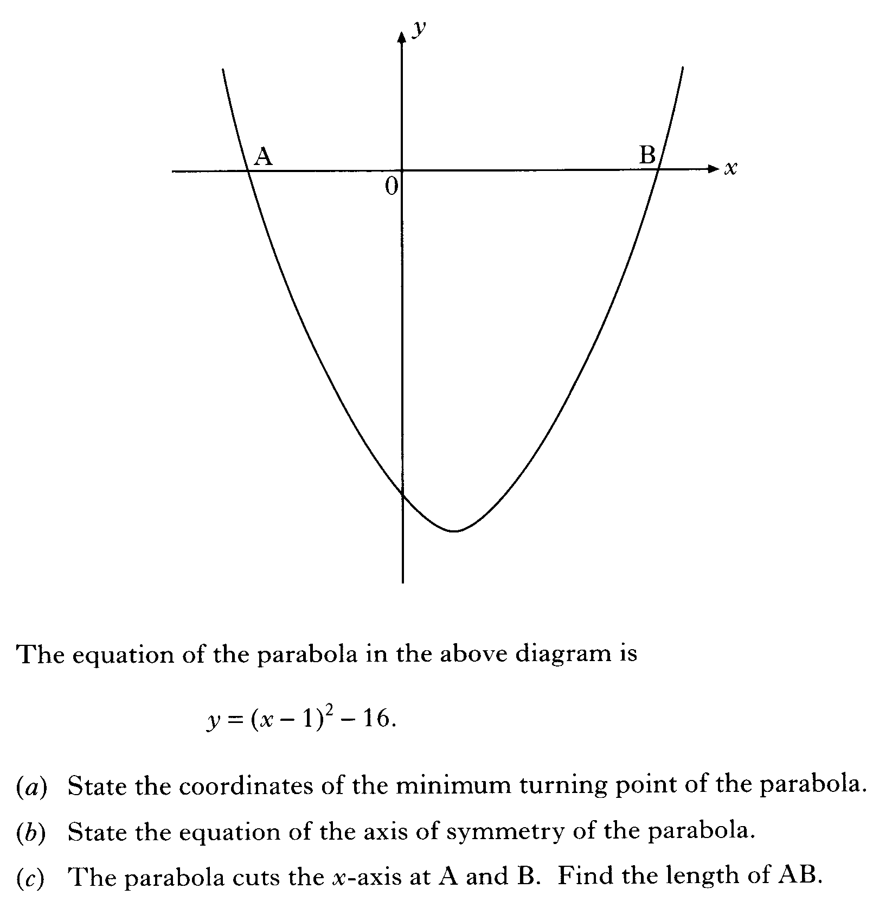

Slide 56
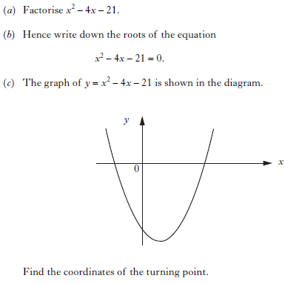

Slide 57
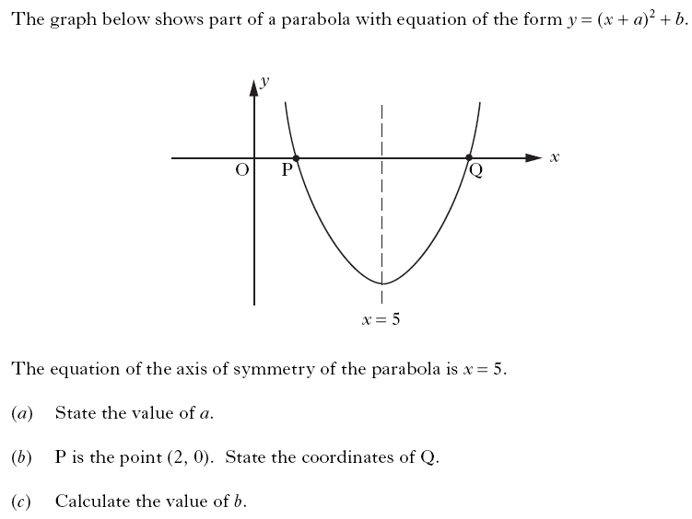

Slide 58
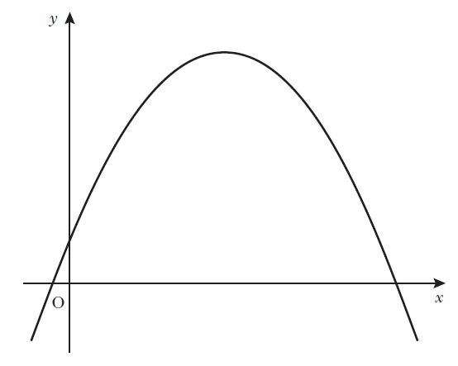


Slide 59
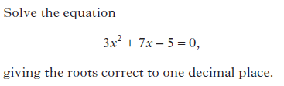

Slide 60
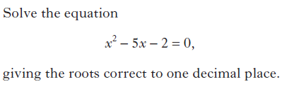

Slide 61
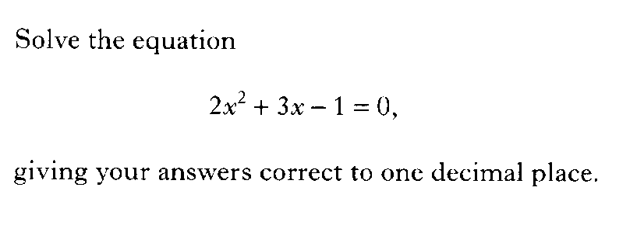

Slide 62
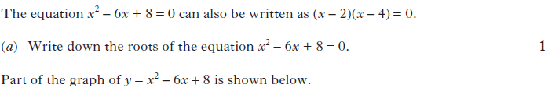
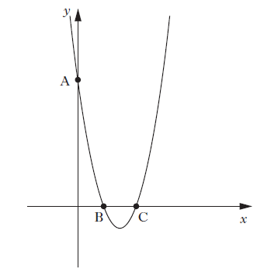


Slide 63
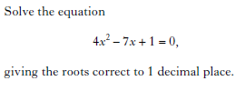

Slide 64
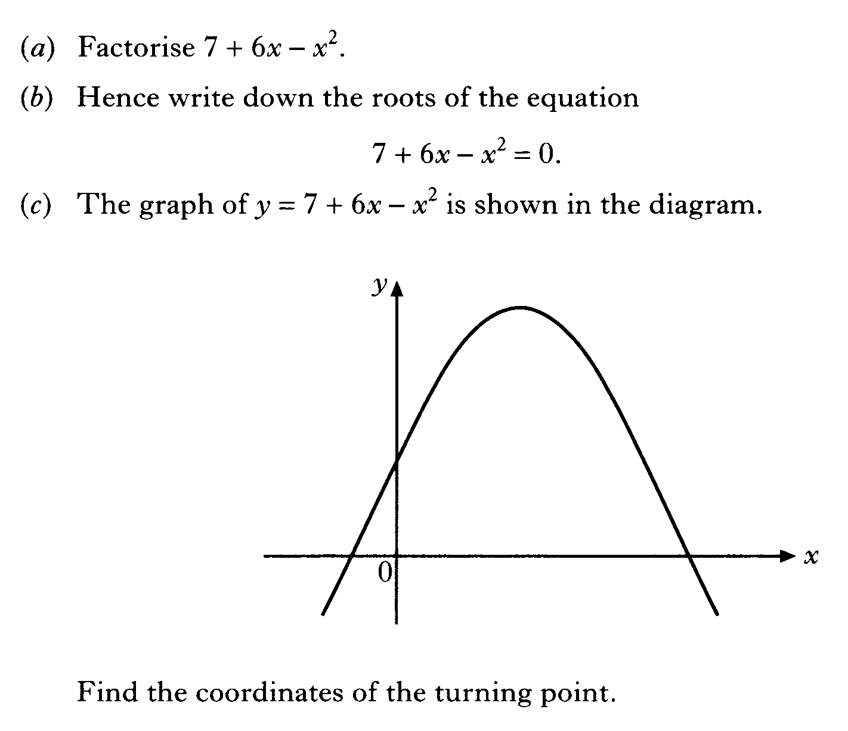

Slide 65
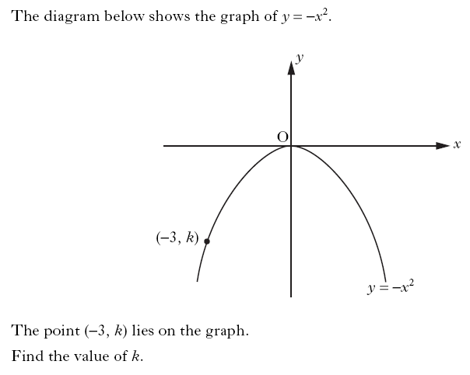

Slide 66
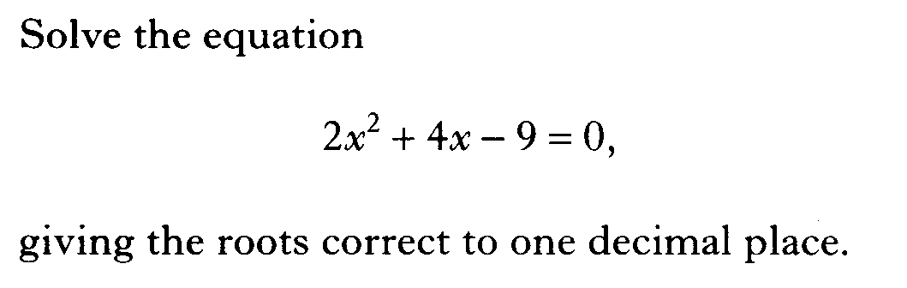

Slide 67
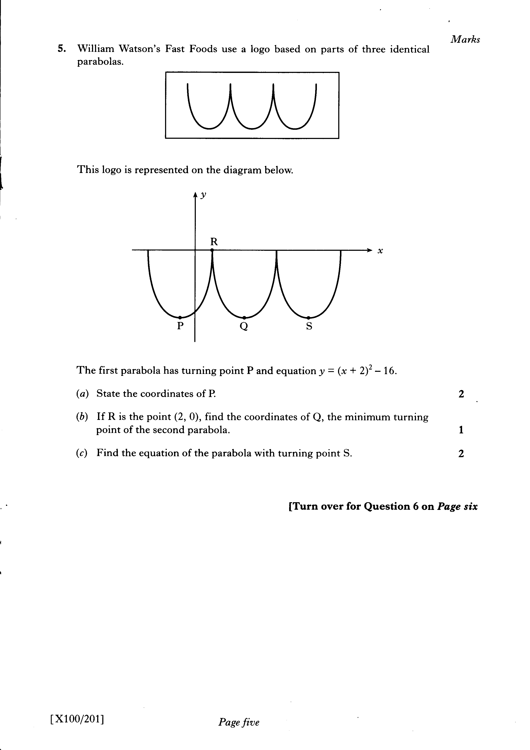

Slide 68
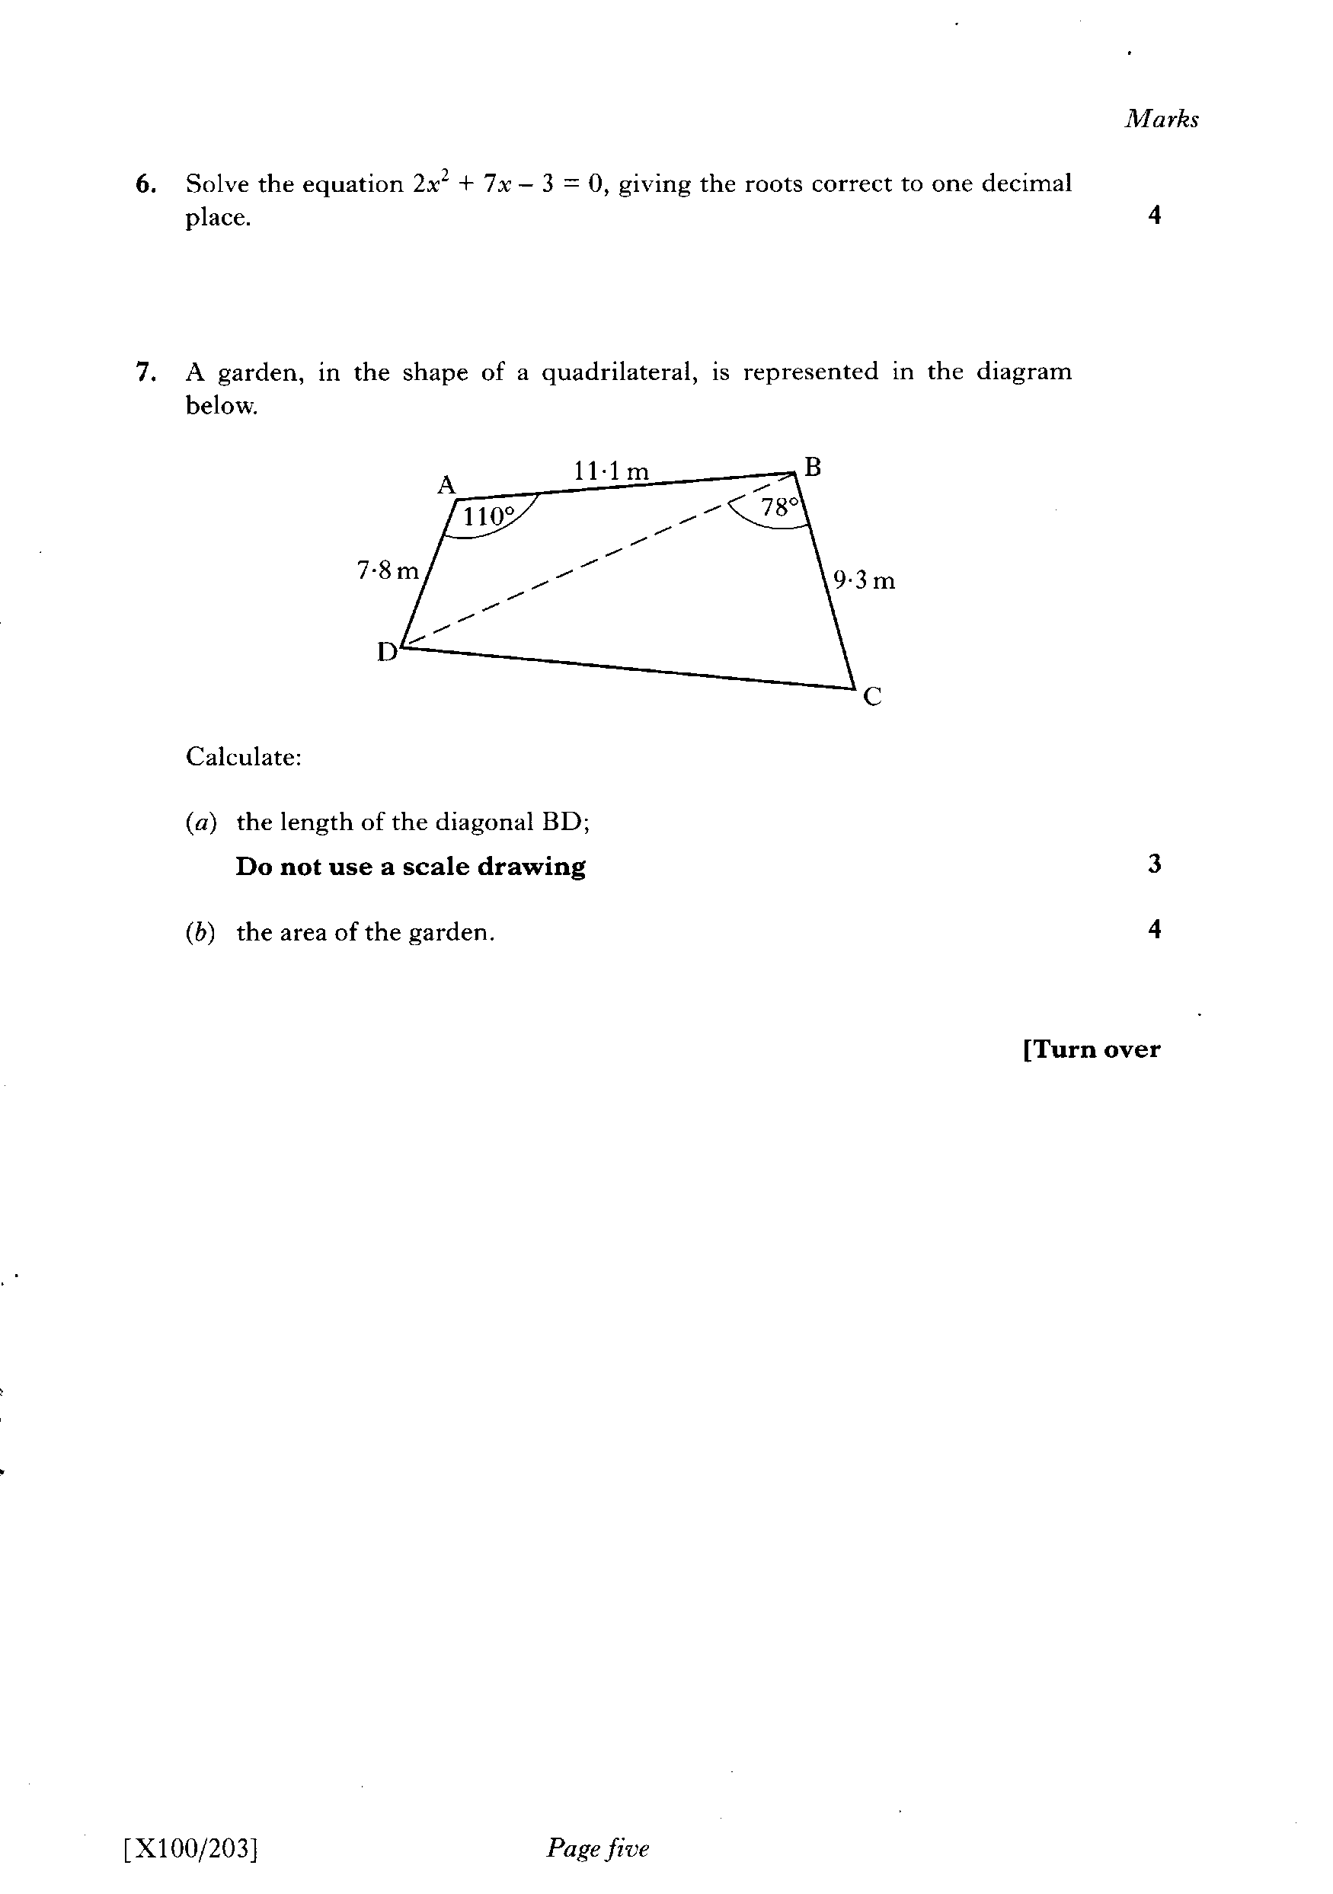

Slide 69
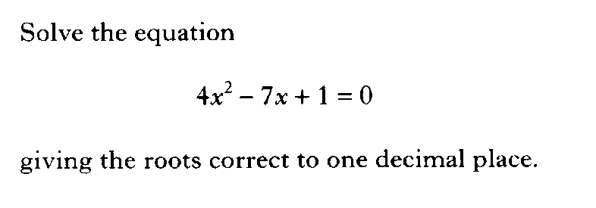

Slide 70
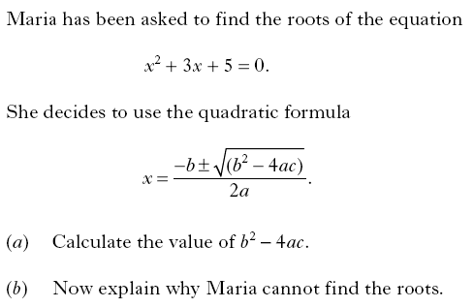

Slide 71
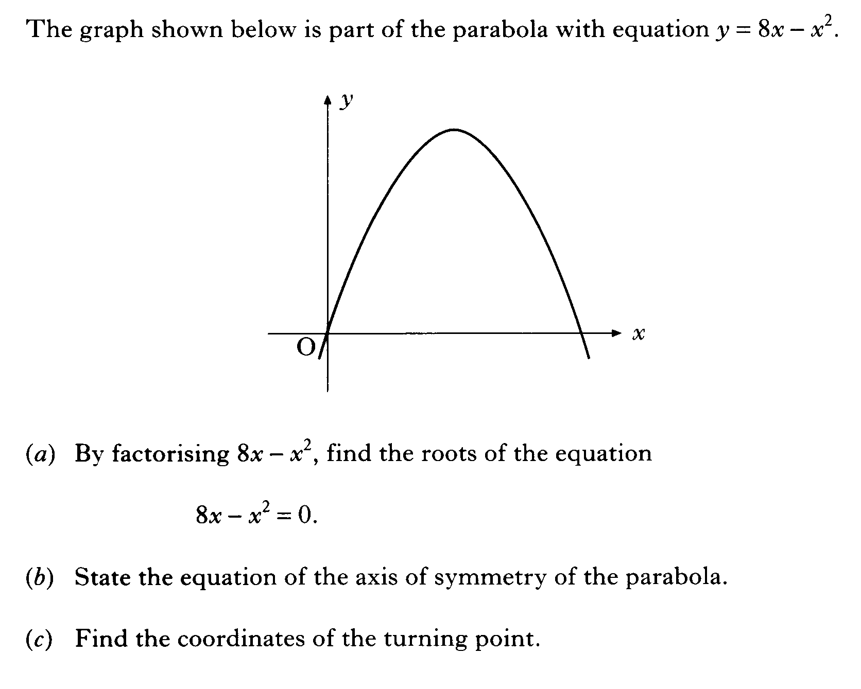

Slide 72
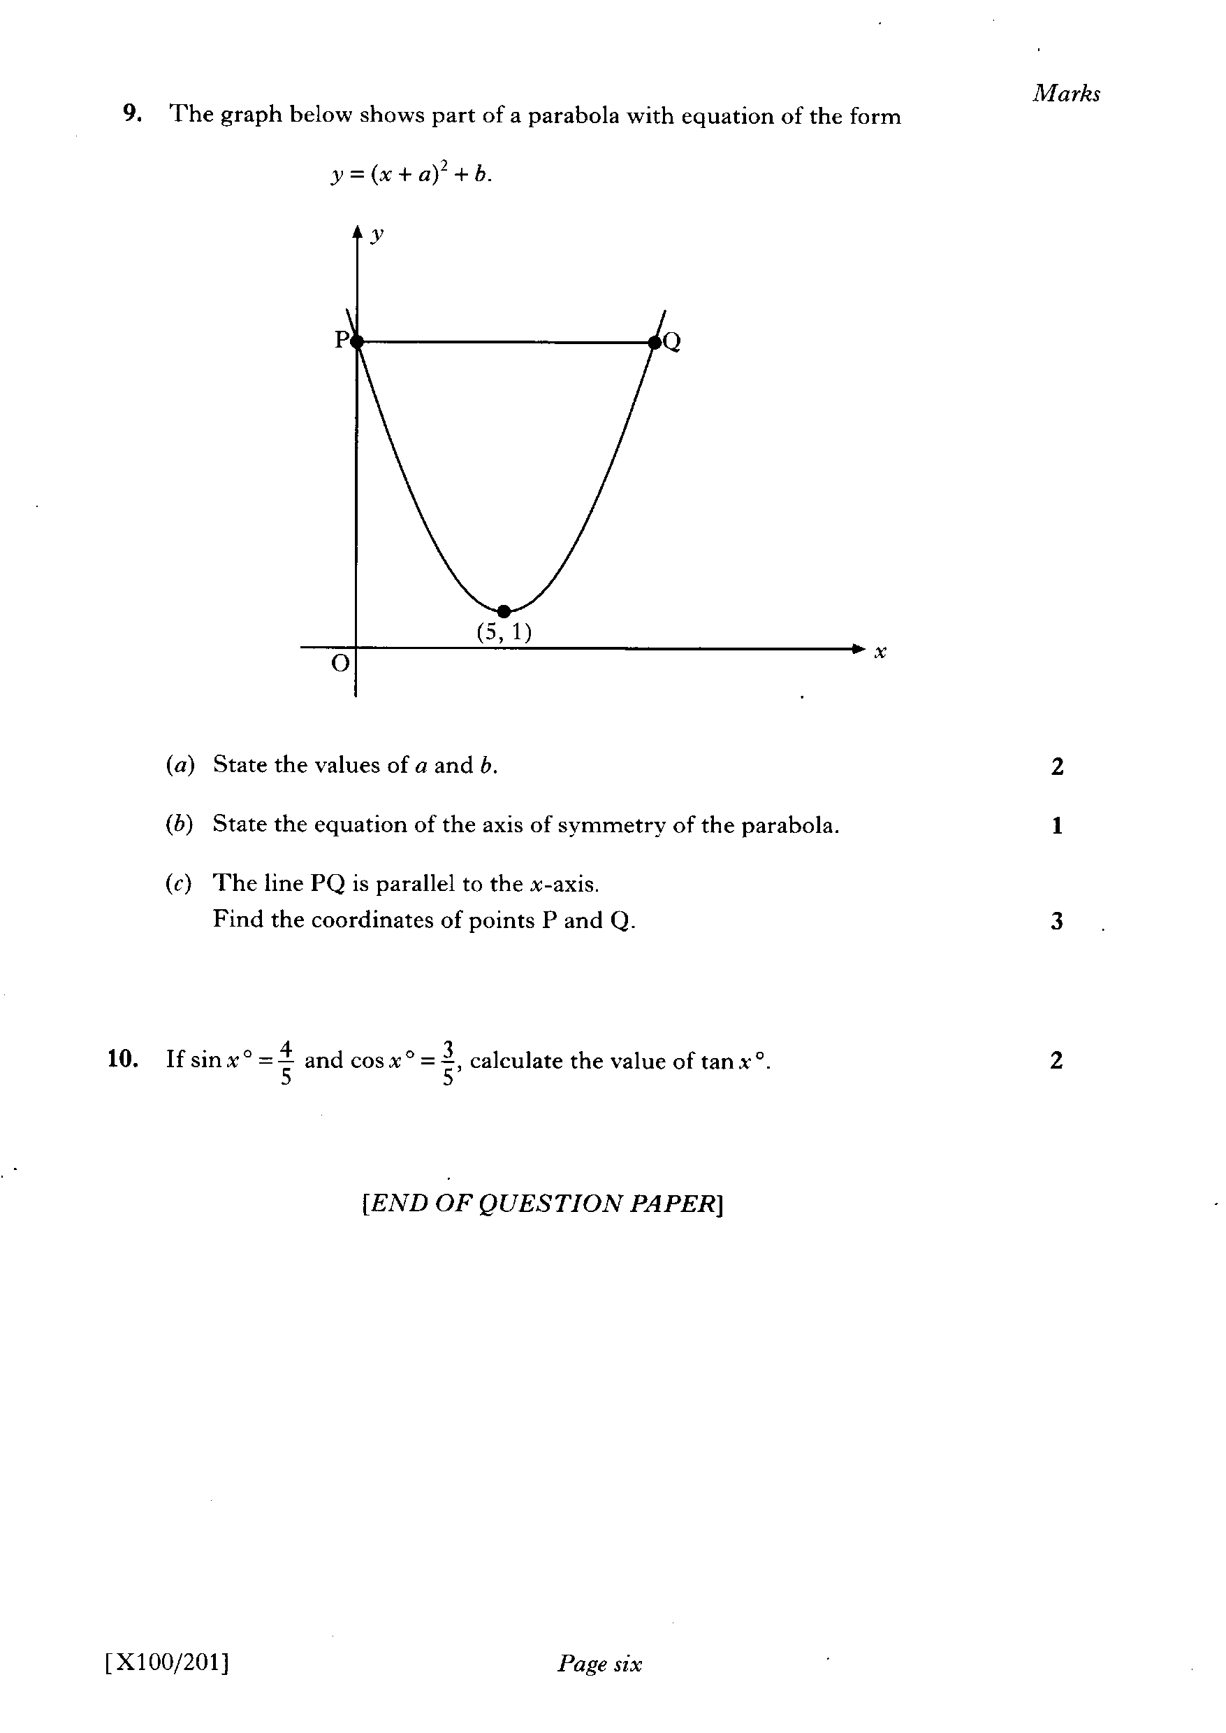

Slide 73
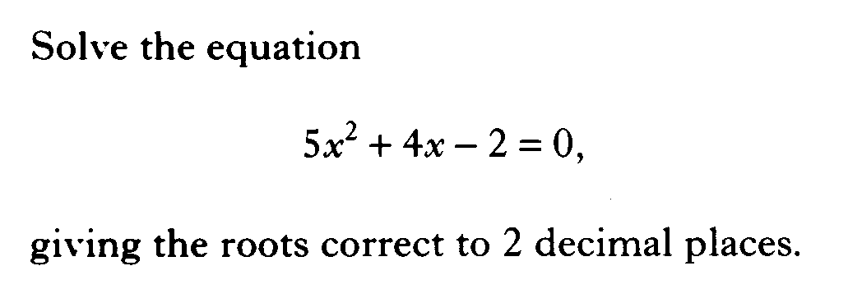

Slide 74
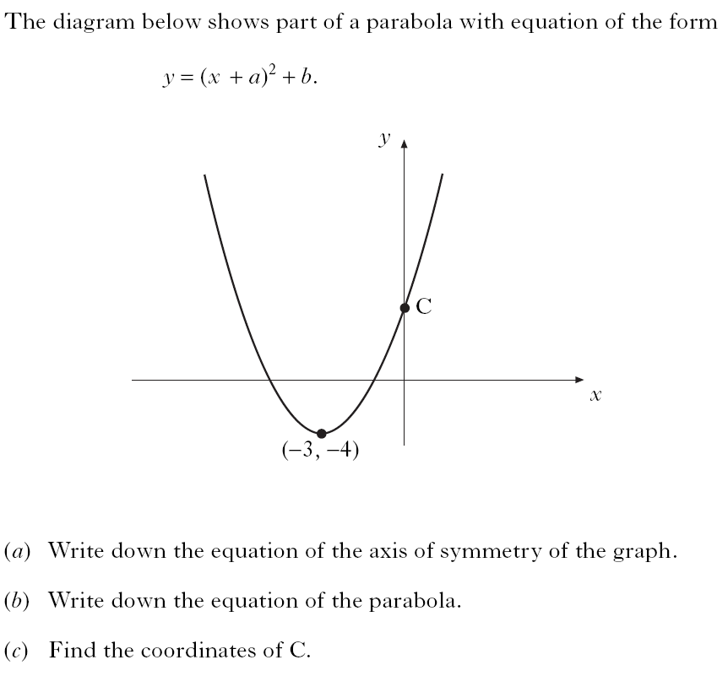

Slide 75
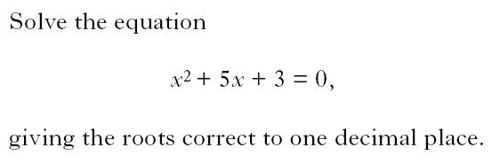

Slide 76
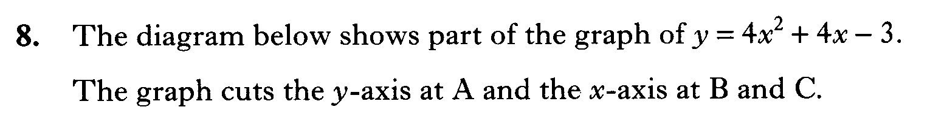
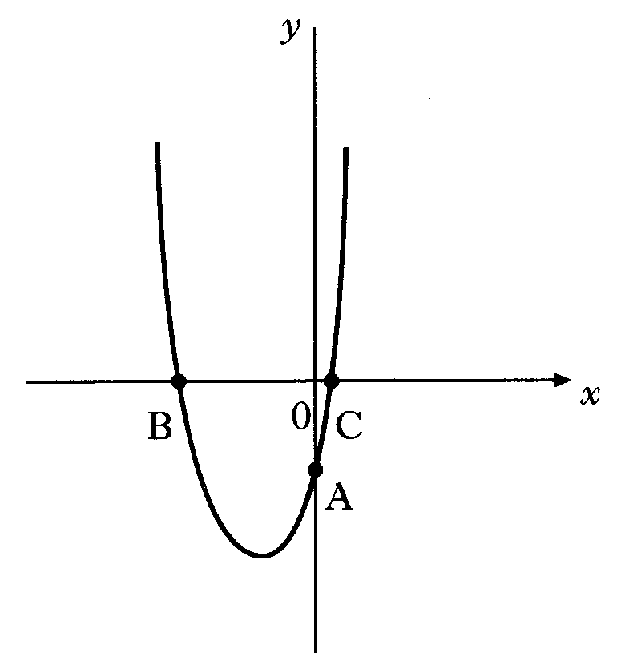
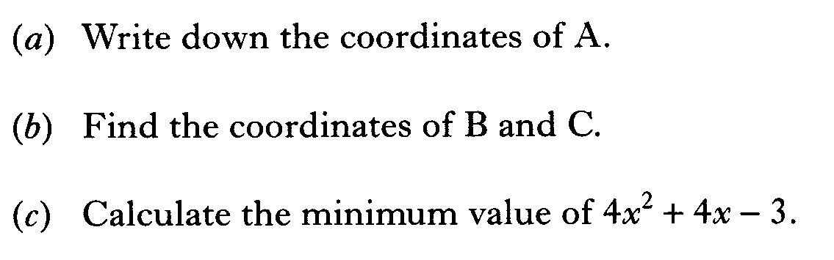

Slide 77
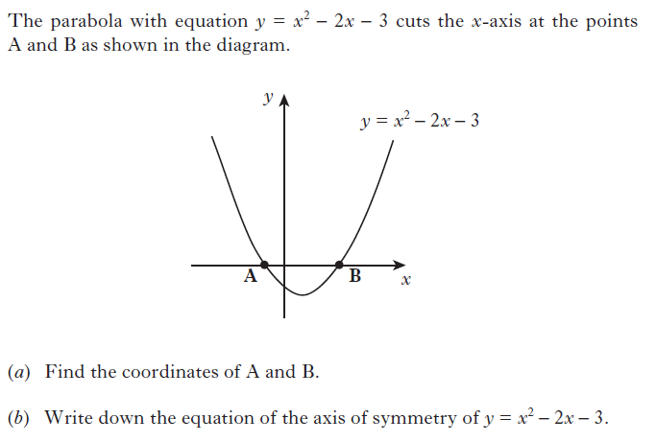

Slide 78
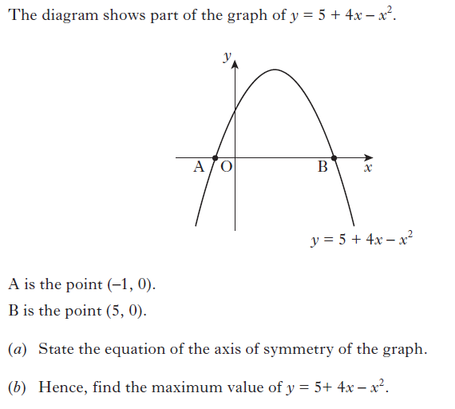

Slide 79
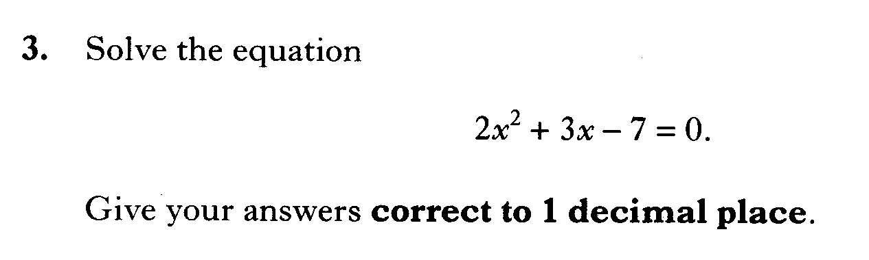

Slide 80
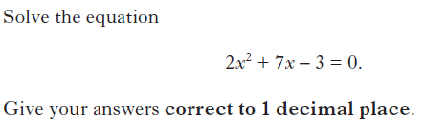

Slide 81
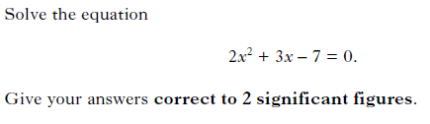

Slide 82
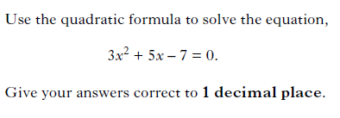

Slide 83
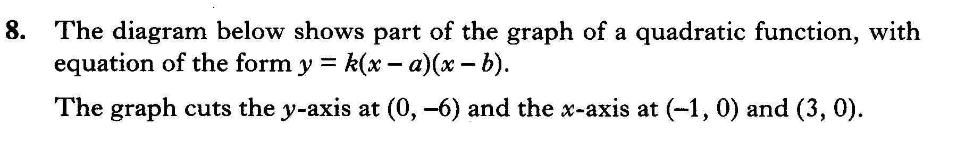
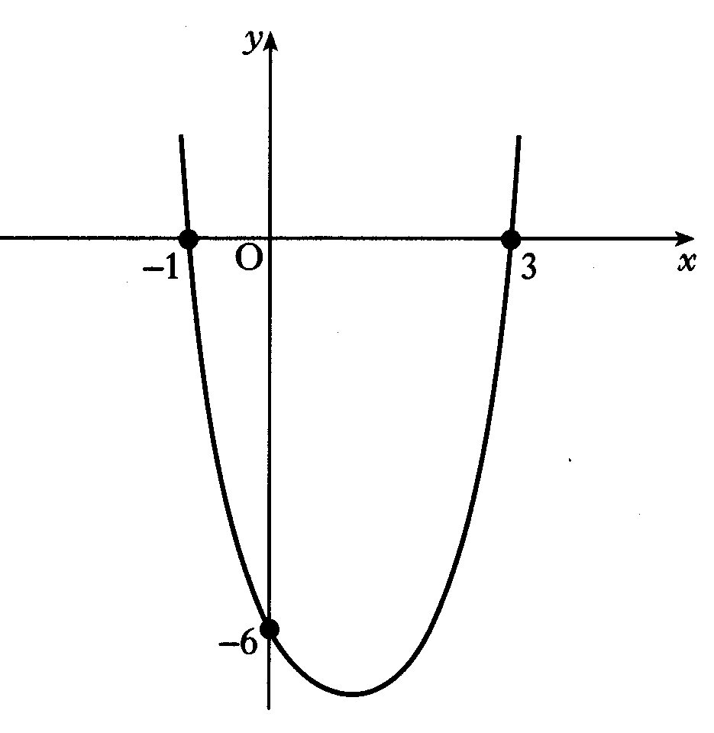
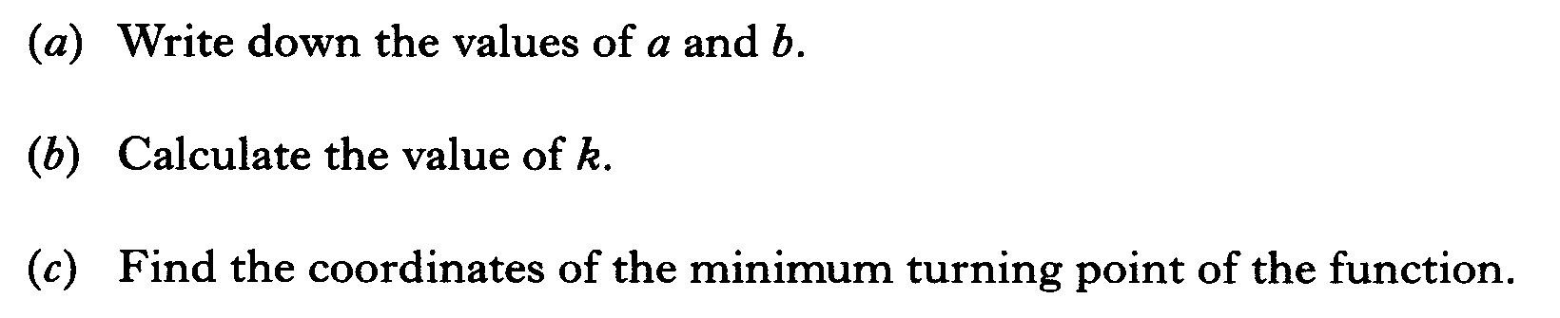

Slide 84
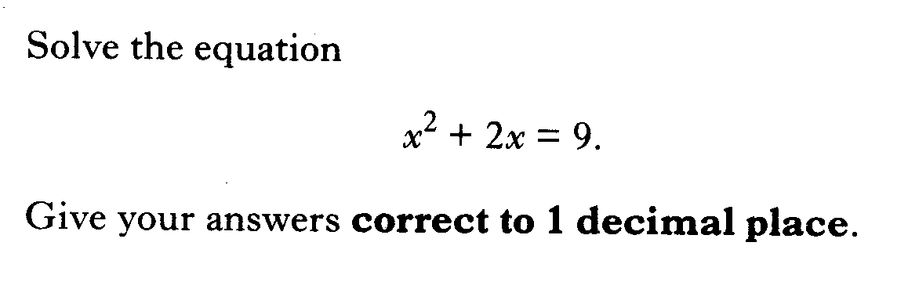

Slide 85
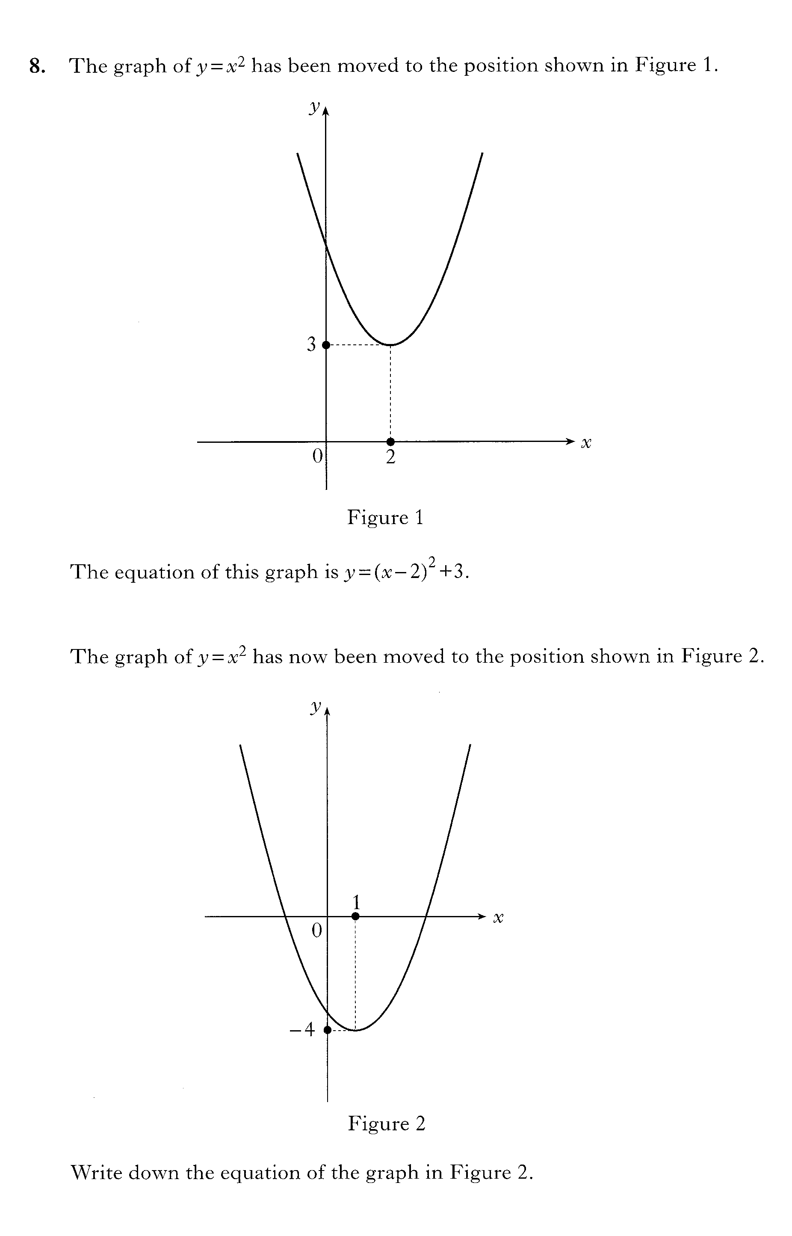
Second part is on the next slide

Slide 87
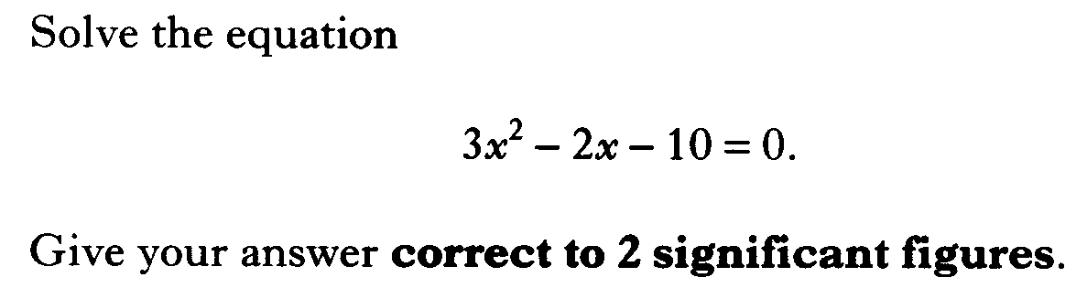

Slide 88
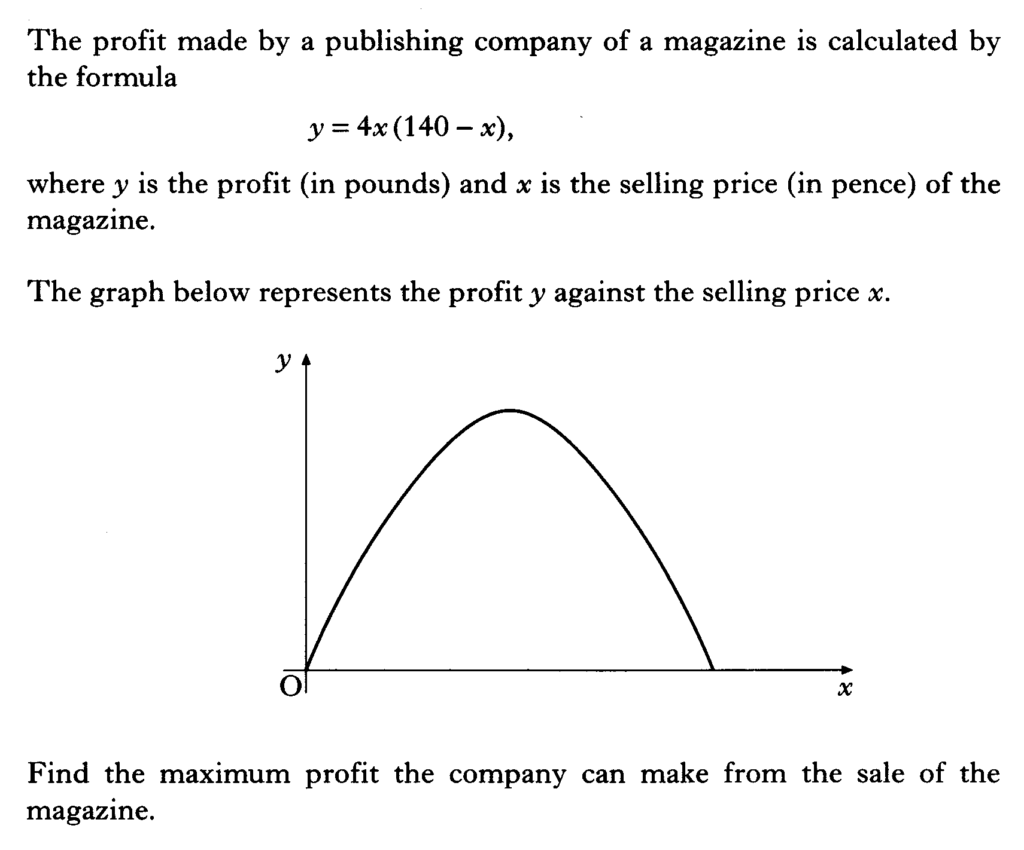

Slide 89


Slide 90


Slide 91


Slide 92


