Slide 1


Surds & Indices
Nat 5
What is a surd ?
What are Indices
Simplifying a Surd
Add/Sub Indices
Rationalising a Surd
Power of a Power
Conjugate Pairs (EXTENSION)
Negative / Positive Indices
www.mathsrevision.com
Fraction Indices
Exam Type Questions
www.mathsrevision.com

Slide 2
Starter Questions
Nat 5
Use a calculator to find the values of :
= 6
= 12
= 2
= 2
www.mathsrevision.com

Slide 3
What is a Surds ?
Nat 5
Learning Intention
Success Criteria
  We are learning what a surd is and why it is used.
  Understand what a surds is.
  2. Recognise questions that may contain surds.
www.mathsrevision.com
www.mathsrevision.com

Slide 4
What is a Surd ?
Nat 5
= 6
= 12
The above roots have exact values
and are called rational
a
These roots CANNOT be written in the form
and are called irrational root OR
b
Surds

Slide 5


What is a Surd ?
Nat 5
Which of the following are surds.

Slide 6
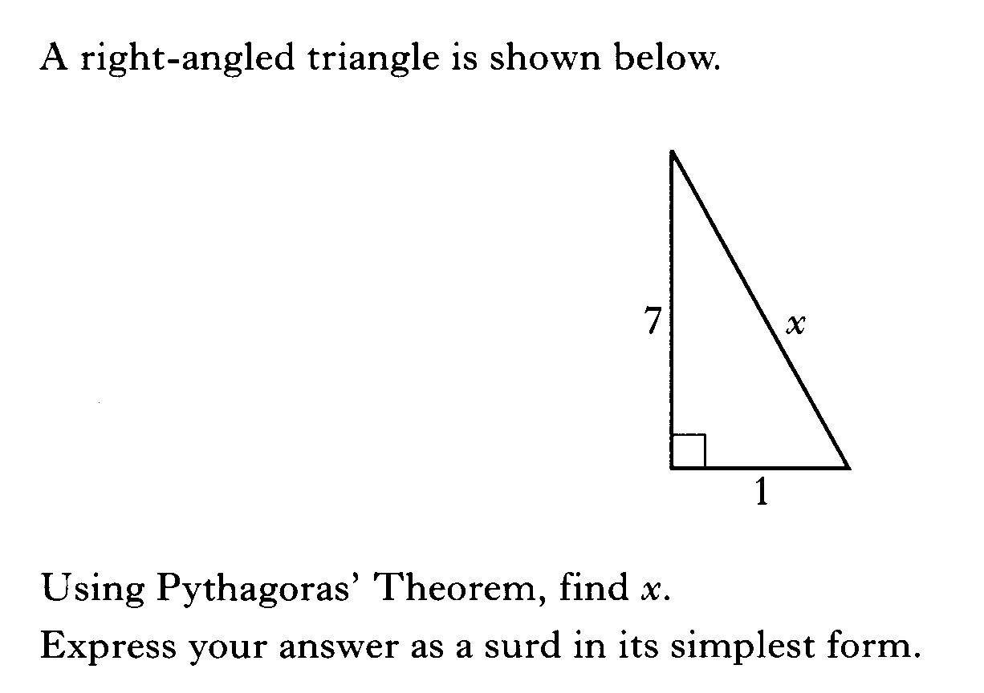
x² = 7² + 1²
x² = 50
√
x = √50
x = √25 √2
x = 5√2

Slide 7
What is a Surd ?
Nat 5
Solve the equation leaving you answers in surd format :
2x² + 7 = 11
-7
-7
2x² = 4
÷2
x² = 2
√
x = ±√2

Slide 8
What is a Surd ?
Nat 5
Find the exact value of sinxº.
O
Sin xº =
H
√2
1
1
Sin xº =
xº
√2

Slide 9

What is a Surd ?
Nat 5
Now try N5 TJ
Ex 17.1
Ch17 (page 170)

Slide 10
Simplifying Surds
Nat 5
Learning Intention
Success Criteria
  We are learning rules for simplify surds.
  Understand the basic rules for surds.
  2. Use rules to simplify surds.
www.mathsrevision.com
www.mathsrevision.com

Slide 11
Adding & Subtracting Surds
Note :
√2 + √3 does not equal √5
Nat 5
We can only adding and subtracting a surds that have the same surd. It can be treated in the same way as “like terms” in algebra.
The following examples will illustrate this point.
www.mathsrevision.com

Slide 12
First Rule
Nat 5
Examples
List the first 10 square numbers
1, 4, 9, 16, 25, 36, 49, 64, 81, 100
www.mathsrevision.com

Slide 13
Simplifying Surds
All to do with
Square numbers.
Nat 5
Some square roots can be broken down into a mixture of integer values and surds. The following examples will illustrate this idea:
To simplify √12 we must split 12 into factors with at least one being a square number.
√12
= √4 x √3
Now simplify the square root.
= 2 √3
www.mathsrevision.com

Slide 14
Have a go !
Nat 5
Think square numbers
√ 45
√ 32
√ 72
= √9 x √5
= √16 x √2
= √4 x √18
= 3√5
= 4√2
= 2 x √9 x √2
= 2 x 3 x √2
= 6√2
www.mathsrevision.com

Slide 15
What Goes In The Box ?
Nat 5
Simplify the following square roots:
(1) √ 20
(2) √ 27
(3) √ 48
= 2√5
= 3√3
= 4√3
(4) √3 x √8
(5) √6 x √12
(6) √3 x √5 x √15
= 2√6
= 6√2
= 15
www.mathsrevision.com

Slide 16
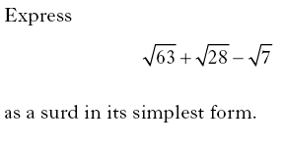

Slide 17
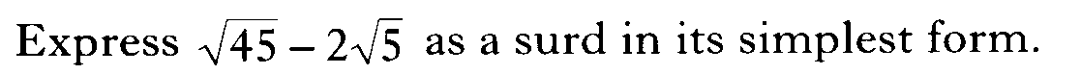

Slide 18
3D Pythagoras Theorem
Nat 5
Problem : Find the length of space diagonal AG.
First find AH² :
$(\text{AH})^{2}=(\text{AD})^{2}+(\text{DH})^{2}$
F
G
$(\text{AH})^{2}=(\text{10})^{2}+(\text{10})^{2}$
B
C
10cm
$(\text{AH})^{2}=\text{200}$
Next AG :
E
H
$(\text{AG})^{2}=(\text{AH})^{2}+(\text{HG})^{2}$
10cm
10cm
A
D
$(\text{AG})^{2}=\text{200}+(\text{10})^{2}=\text{300}$
10cm
$\text{AG}=\sqrt{\text{300}}=\sqrt{\text{100}}\sqrt{3}=\text{10}\sqrt{3}\text{ cm}$
11 Jul 2026

Slide 19
Surds
Nat 5
Now try N5 TJ
Ex 17.2 Q1 ... Q7
Ch17 (page 171)

Slide 20
Starter Questions
Nat 5
Simplify :
= 2√5
= 3√2
= ¼
= ¼
www.mathsrevision.com

Slide 21
The Laws Of Surds
Nat 5
Learning Intention
Success Criteria
  We are learning how to multiply out a bracket containing surds and how to rationalise a fractional surd.
  Know that √a x √b = √ab
  Use multiplication table to simplify surds in brackets.
  Be able to rationalise a surd.To be able to rationalise the numerator or denominator of a fractional surd.
www.mathsrevision.com
www.mathsrevision.com

Slide 22
Second Rule
Nat 5
Examples
www.mathsrevision.com

Slide 23
Surds with Brackets
Multiplication table for brackets
Example
(√6 + 3)(√6 + 5)
√6
+ 3
√6
+ 5
Tidy up !
6
5√6
3√6
+15
21
+ 8√6
Jul 11, 2026
Created by Mr. Lafferty@mathsrevision.com

Slide 24
Surds with Brackets
Multiplication table for brackets
Example
(√2 + 4)(√2 + 4)
√2
+ 4
√2
+ 4
Tidy up !
2
4√2
4√2
+16
18
+ 8√2
Jul 11, 2026
Created by Mr. Lafferty@mathsrevision.com

Slide 25
Rationalising Surds
Nat 5
You may recall from your fraction work that the top line of a fraction is the numerator and the bottom line the denominator.
Fractions can contain surds:
www.mathsrevision.com

Slide 26
Rationalising Surds
Nat 5
If by using certain maths techniques we remove the surd from either the top or bottom of the fraction then we say we are “rationalising the numerator” or “rationalising the denominator”.
Remember the rule
This will help us to rationalise a surd fraction
www.mathsrevision.com

Slide 27
Rationalising Surds
Nat 5
To rationalise the denominator multiply the top and bottom of the fraction by the square root you are trying to remove:
( √5 x √5 = √ 25 = 5 )
www.mathsrevision.com

Slide 28
Rationalising Surds
Nat 5
Let’s try this one :
Remember multiply top and bottom by root you are trying to remove
www.mathsrevision.com

Slide 29
Rationalising Surds
Nat 5
Rationalise the denominator
www.mathsrevision.com

Slide 30
What Goes In The Box ?
Nat 5
Rationalise the denominator of the following :
www.mathsrevision.com

Slide 31
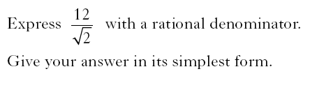

Slide 32
Surds
Nat 5
Now try N5 TJ
Ex 17.2 Q8 ... Q10
Ch17 (page 172)

Slide 33
Starter Questions
Nat 5
Conjugate Pairs.
Multiply out :
= 3
= 14
= 12- 9 = 3
www.mathsrevision.com

Slide 34
The Laws Of Surds
Nat 5
Conjugate Pairs.
Learning Intention
Success Criteria
  To explain how to use the conjugate pair to rationalise a complex fractional surd.
  Know that
  (√a + √b)(√a - √b) = a - b
  2. To be able to use the conjugate pair to rationalise complex fractional surd.
www.mathsrevision.com
www.mathsrevision.com

Slide 35
Looks something like the difference of two squares
Rationalising Surds
Nat 5
Conjugate Pairs.
Look at the expression :
This is a conjugate pair. The brackets are identical apart from the sign in each bracket .
Multiplying out the brackets we get :
=
√5  √5
- 2 √5
+ 2 √5
- 4
= 5 - 4
= 1
When the brackets are multiplied out the surds ALWAYS cancel out and we end up seeing that the expression is rational ( no root sign )
www.mathsrevision.com

Slide 36
Third Rule
Nat 5
Conjugate Pairs.
Examples
= 7 – 3 = 4
= 11 – 5 = 6
www.mathsrevision.com

Slide 37
Rationalising Surds
Nat 5
Conjugate Pairs.
Rationalise the denominator in the expressions below by multiplying top and bottom by the appropriate conjugate:
www.mathsrevision.com

Slide 38
Rationalising Surds
Nat 5
Conjugate Pairs.
Rationalise the denominator in the expressions below by multiplying top and bottom by the appropriate conjugate:
www.mathsrevision.com

Slide 39
What Goes In The Box
Nat 5
Rationalise the denominator in the expressions below :
Rationalise the numerator in the expressions below :
www.mathsrevision.com

Slide 40
Surds
Nat 5
Now try N5 TJ
Ex 17.2 Q8 ... Q10
Ch17 (page 172)

Slide 41
Starter Questions
Nat 5
1. Simplify the following fractions :
www.mathsrevision.com

Slide 42
Indices
Nat 5
Learning Intention
Success Criteria
  We are learning what indices are and how to use our calculator to deal with calculations containing indices.
  Understand what indices are.
  2. Be able you calculator to do calculations containing indices.
www.mathsrevision.com
www.mathsrevision.com

Slide 43
Indices
Nat 5
a^{n} is a short hand way of writing
a x a x a ……. (n factors)
a is called the base number
and n is called the index number
Calculate :
2 x 2 x 2 x 2 x 2
= 32
Calculate : 2⁵
= 32
www.mathsrevision.com

Slide 44
Indices
Nat 5
Write down 5 x 5 x 5 x 5 in indices format.
5⁴
Find the value of the index for each below
3^{x} = 27
2^{x} = 64
12^{x} = 144
x = 3
x = 6
x = 2
www.mathsrevision.com

Slide 45
What Goes In The Box ?
Nat 5
Use your calculator to work out the following
10³
-(2)⁸
1000
-256
(-2)⁸
9⁰
256
1
www.mathsrevision.com

Slide 46
Indices
Nat 5
Now try N5 TJ
Ex 17.3
Ch17 (page 173)

Slide 47
Starter Questions
Nat 5
1. Simplify the following fractions :
www.mathsrevision.com

Slide 48
Indices
Nat 5
Learning Intention
Success Criteria
  We are learning various rules for indices.
  Understand basic rules for indices.
  2. Use rules to simplify indices.
www.mathsrevision.com
www.mathsrevision.com

Slide 49
Indices
Nat 5
Calculate : 4³ x 4²
= 1024
Calculate : 4⁵
= 1024
Can you spot the connection !
Rule 1
a^{m} x a^{n} = a^{(m + n)}
simply add powers
www.mathsrevision.com

Slide 50
Indices
Nat 5
Calculate : 9⁵ ÷ 9³
= 81
Calculate : 9²
= 81
Can you spot the connection !
Rule 2
a^{m} ÷ a^{n} = a^{(m - n)} simply subtract powers
www.mathsrevision.com

Slide 51
What Goes In The Box ?
Nat 5
b³ x b⁵ =
f⁴ x g⁵ =
b⁸
y⁹ ÷ y⁵ =
a³ x a⁰ =
y⁴
www.mathsrevision.com

Slide 52
What Goes In The Box ?
Nat 5
Simplify the following using indices rules
q³ x q⁴
e⁵ x e³ x e⁻⁶
q⁷
e²
3y⁴ x 5y⁵
3p⁸ x 2p² x 5p⁻³
15y⁹
30p⁷
www.mathsrevision.com

Slide 53
What Goes In The Box ?
Nat 5
Simplify the following using indices rules
q⁹
e⁶
q⁶
e⁸
q³
e⁻²
6d⁸
15g³h⁷
2d³
3g⁵h⁵
3d⁵
5h²
g²
www.mathsrevision.com

Slide 54
Indices
Nat 5
Now try N5 TJ
Ex 17.4 Q1 ... Q6
Ch17 (page 174)

Slide 55
Power of a Power
Nat 5
Another Rule
Rule 3
(a^{m})^{n} = a^{mn} simply multiply powers
Can you spot the connection !
www.mathsrevision.com

Slide 56
Fractions as Indices
Nat 5
More Rules
Rule 4
a⁰ = 1
www.mathsrevision.com

Slide 57
What Goes In The Box ?
Nat 5
(b³)⁰
(c⁻³)⁴
1
c⁻¹²
(y⁰)⁻²
(3d²)²
1
9d⁴
www.mathsrevision.com

Slide 58
Indices
Nat 5
Now try N5 TJ
Ex 17.4 Q7 ... Q13
Ch17 (page 175)

Slide 59
Fractions as Indices
Nat 5
More Rules
1
a^{m}
Rule 5
a^{-m} =
By the division rule
1
a^{m}
www.mathsrevision.com

Slide 60
What Goes In The Box ?
Nat 5
Write as a positive power
1
u⁻⁴
y⁻³
1
y³
u⁴
(
(
h⁶
⁻²
(w⁴)⁻²
h¹⁰
1
w⁸
h⁸
www.mathsrevision.com

Slide 61


Slide 62
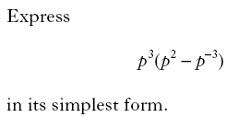

Slide 63
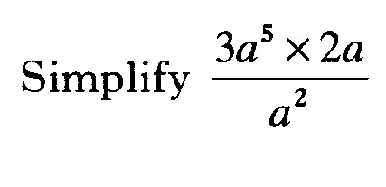

Slide 64
Indices
Nat 5
Now try N5 TJ
Ex 17.4 Q14 onwards
Ch17 (page 176)

Slide 65
Algebraic Operations
Nat 5
Learning Intention
Success Criteria
  To show how to simplify harder fractional indices.
  Simplify harder fractional indices.
www.mathsrevision.com
www.mathsrevision.com

Slide 66

Fractions as Indices
Nat 5
www.mathsrevision.com

Slide 67
Fractions as Indices
Nat 5
Rule 6
www.mathsrevision.com

Slide 68
Fractions as Indices
Nat 5
Example : Change to index form
Example : Change to surd form
www.mathsrevision.com

Slide 69
Fractions as Indices
Nat 5
Examples
www.mathsrevision.com

Slide 70
Fractions as Indices
Nat 5
Examples
www.mathsrevision.com

Slide 71
Indices
Nat 5
Now try N5 TJ
Ex 17.5
Ch17 (page 177)

Slide 72


Slide 73
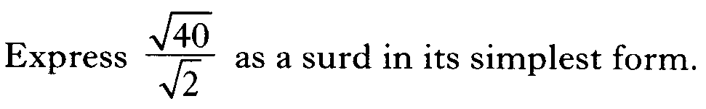

Slide 74
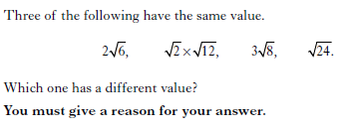

Slide 75
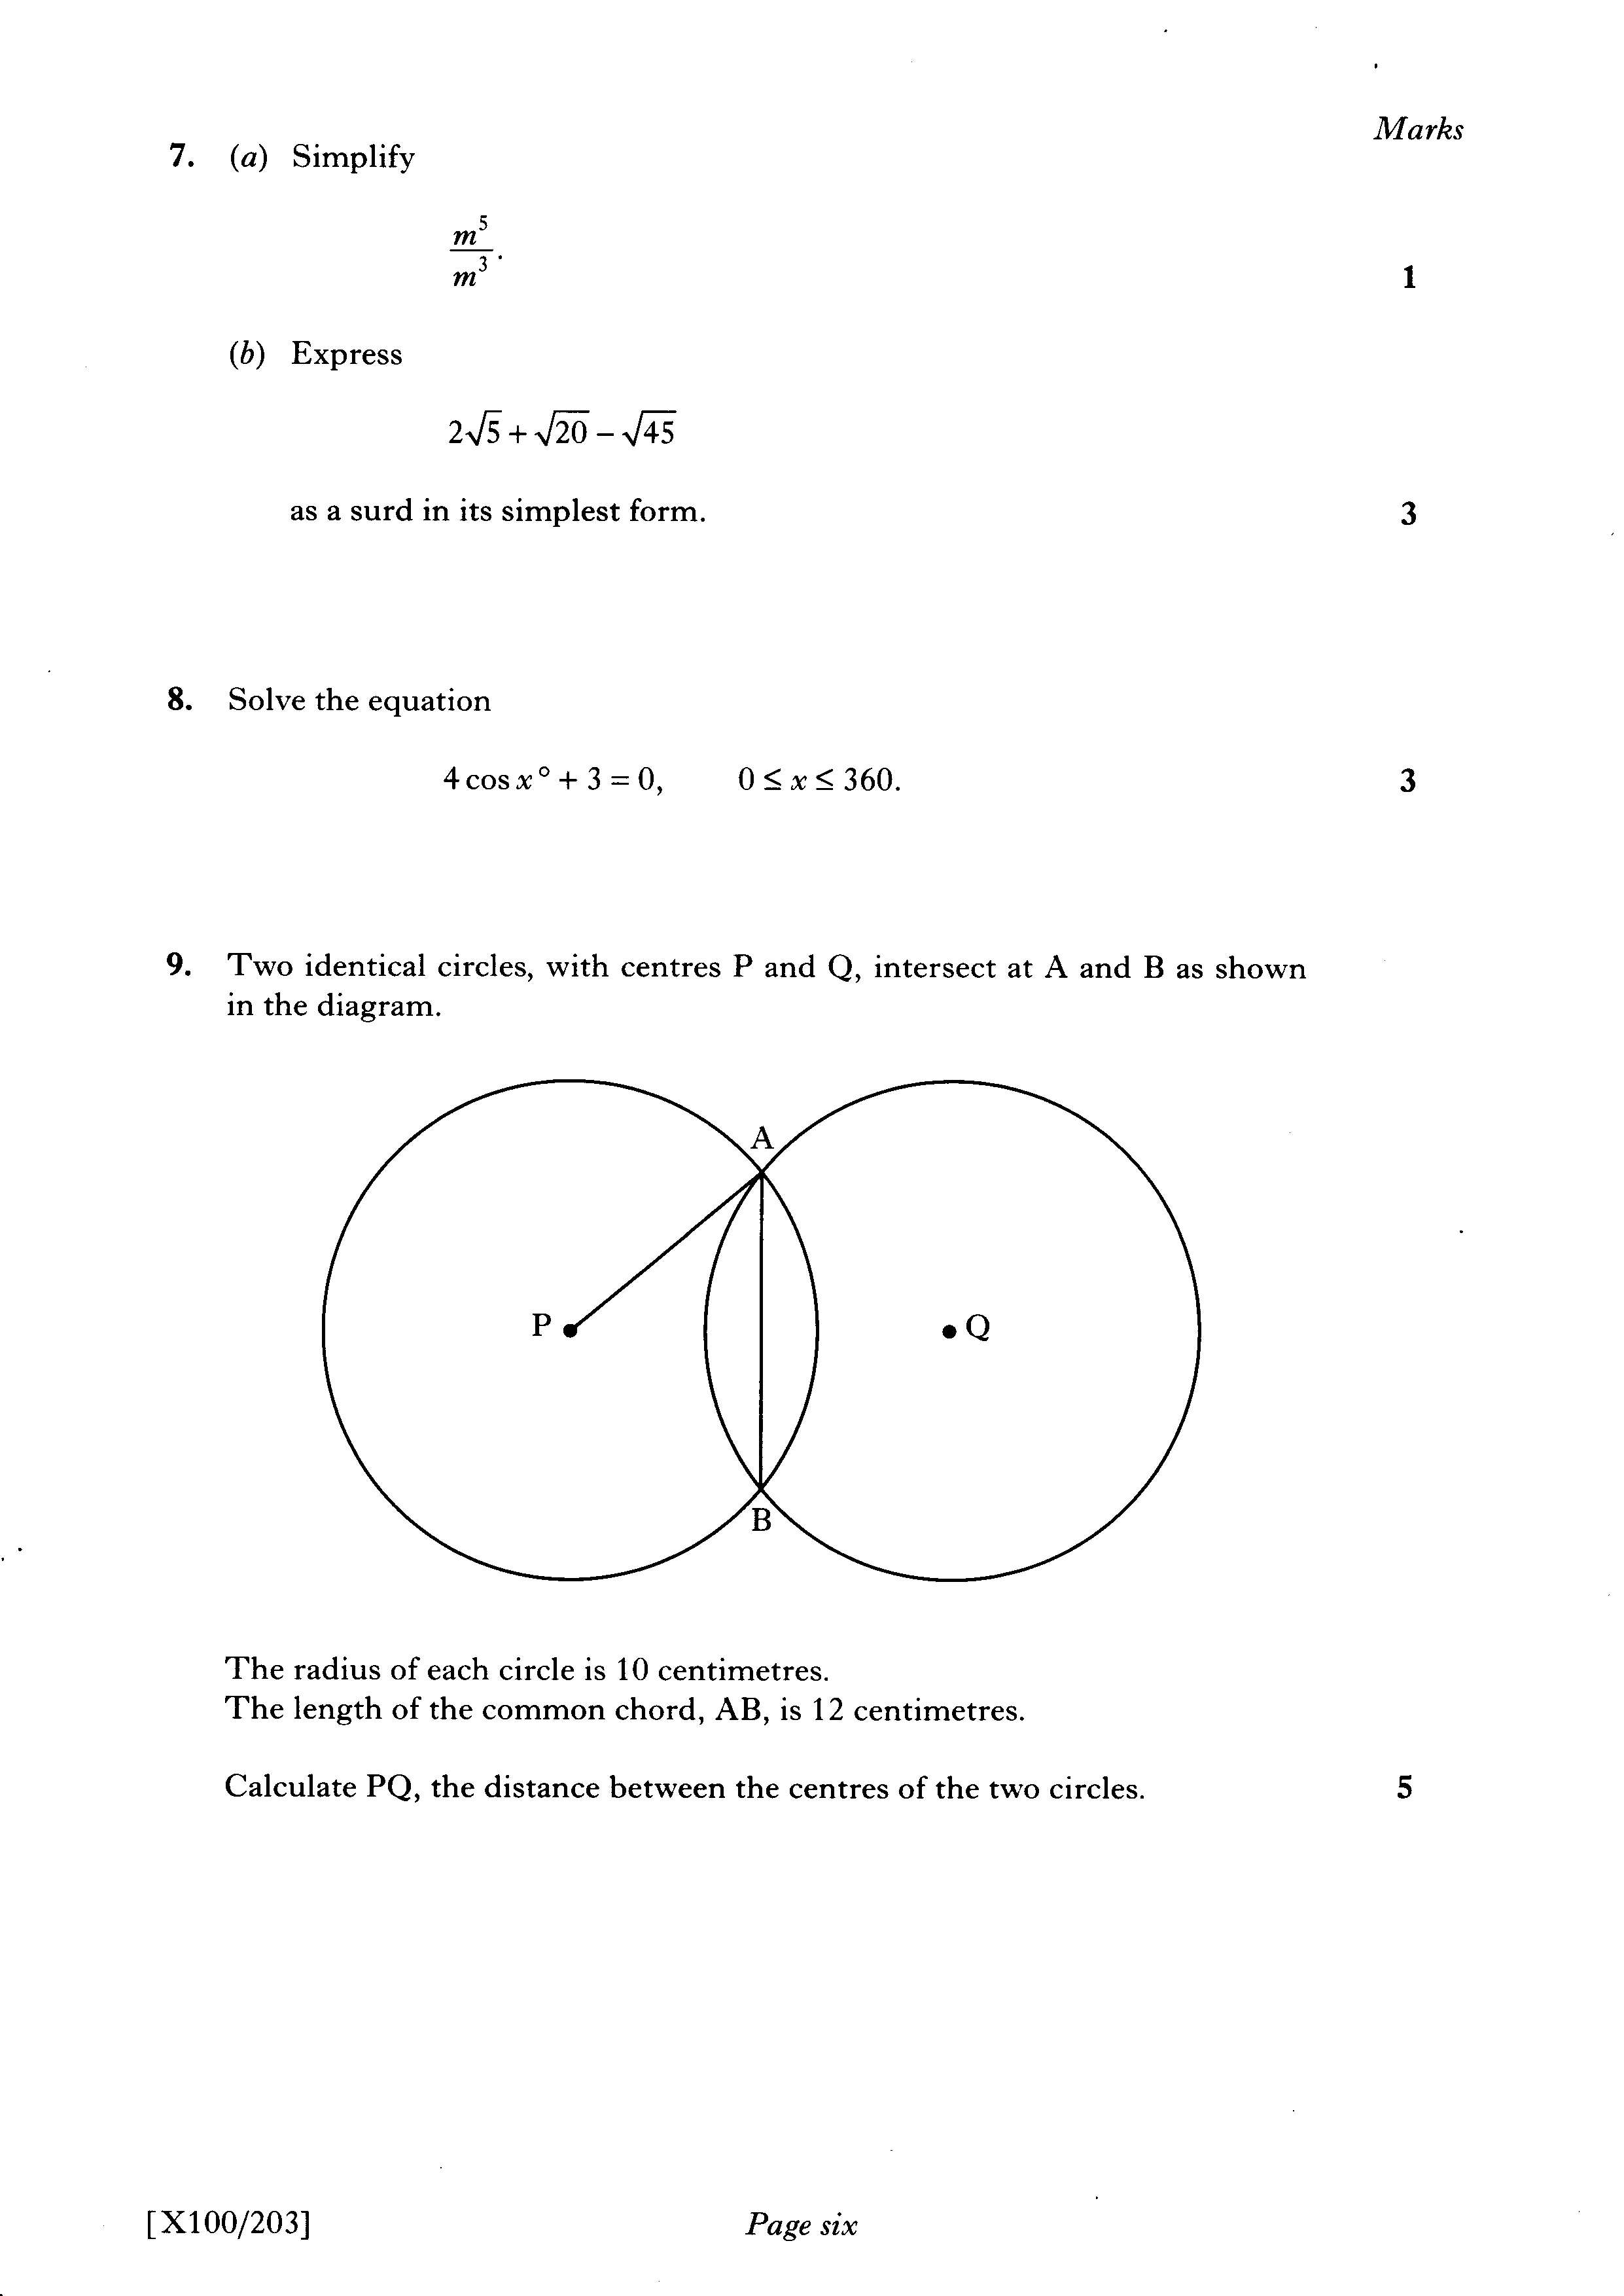

Slide 77
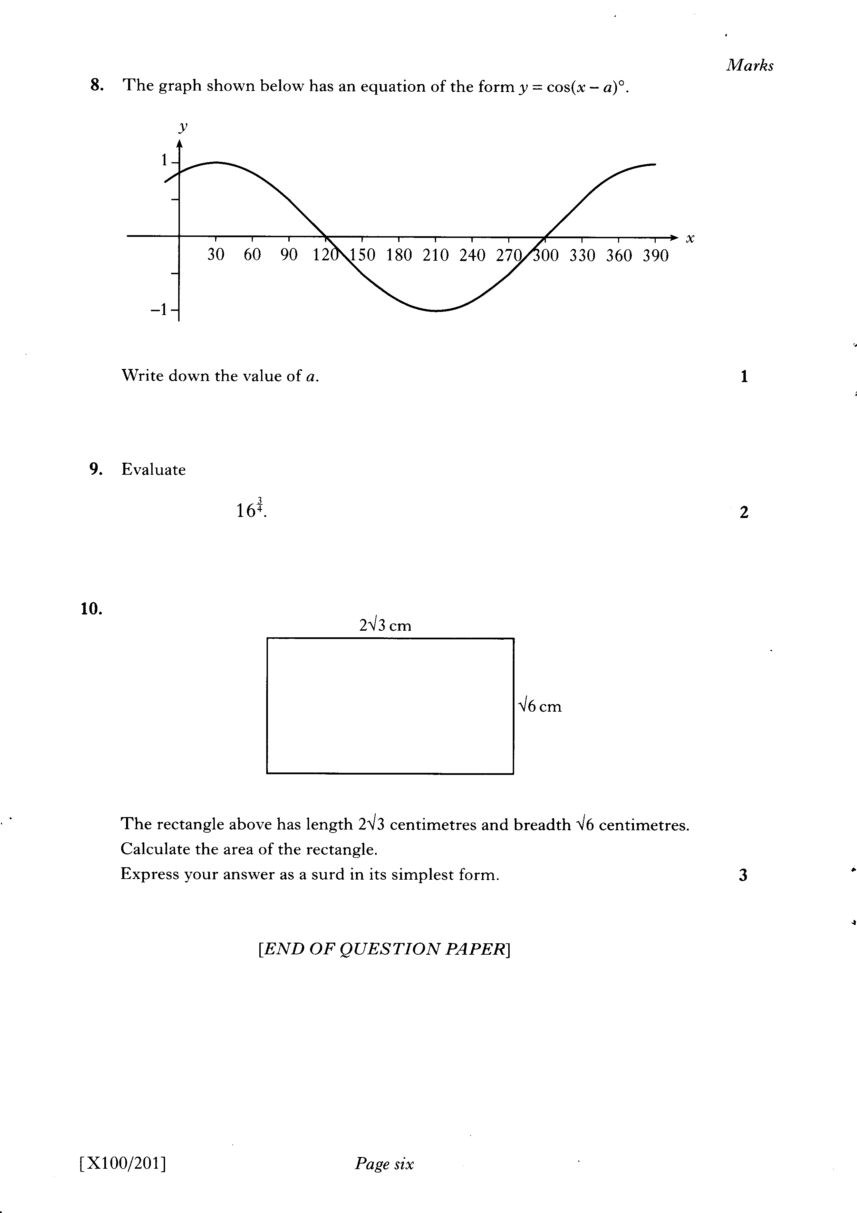

Slide 78
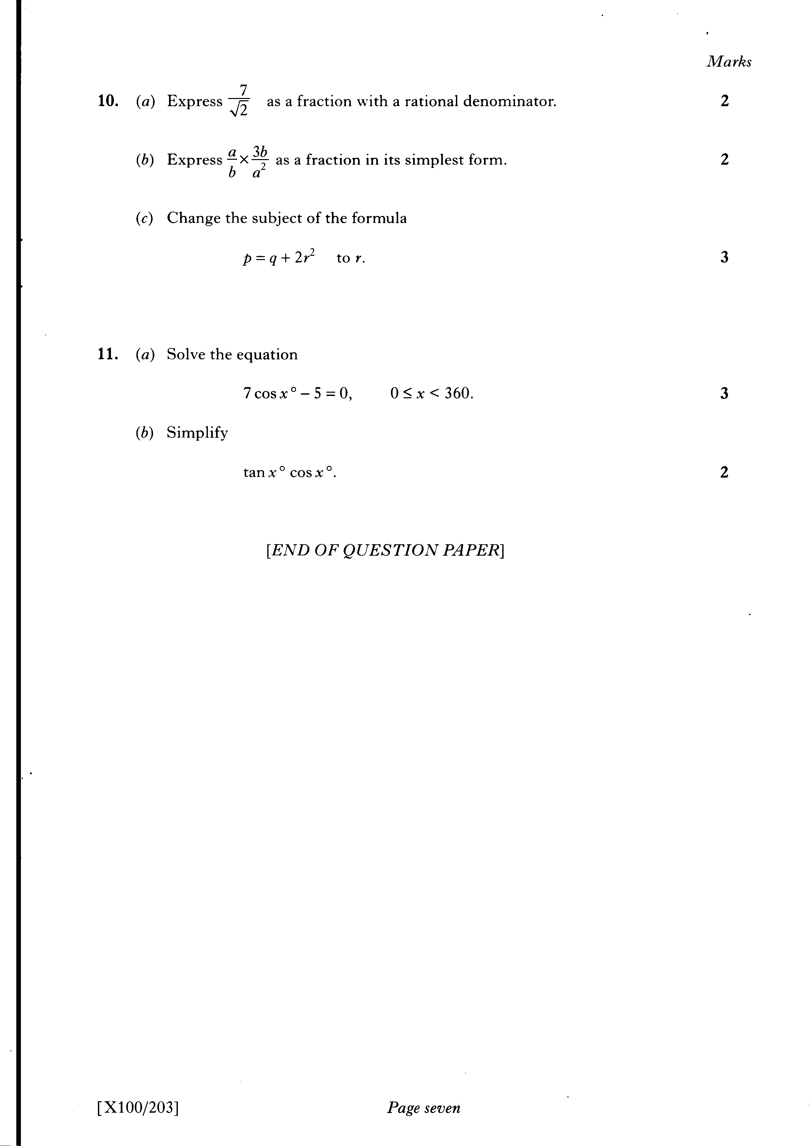

Slide 79
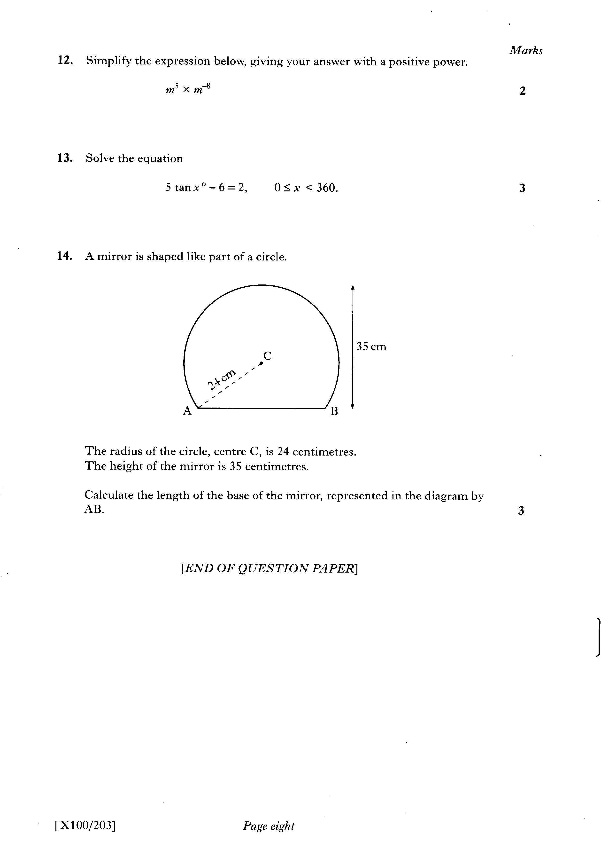

Slide 80


Slide 81
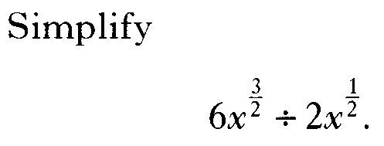

Slide 82


Slide 84
