Slide 1


Trigonometry Graphs
Nat 5
Creation of BASIC Trig Graphs
Graphs of the form y = a sin xº
Graphs of the form y = a sin bxº
Graphs of the form y = a sin bxº + c
www.mathsrevision.com
Phase angle y = a sin(x + d)
Exam Type Questions

Slide 2
Trig Graphs
Nat 5
Creation of a sine graph
Sine Graph
Creation of a cosine graph
Cosine Graph
www.mathsrevision.com
Creation of a tan graph
Tan Graph
Let’s investigate
Graphs

Slide 3
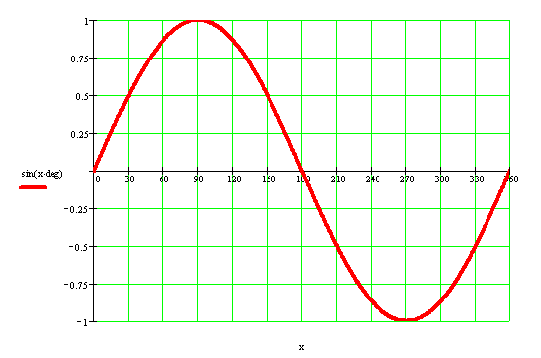
Key Features
Sine Graph
Zeros (Root) at 0, 180º and 360º
Nat 5
Max value occurs at x = 90º
Mini value occurs at x = 270º
Key Features
www.mathsrevision.com
(Period is every 360º)
Maximum value of 1 - AMPLITUDE
Minimum value of -1

Slide 4
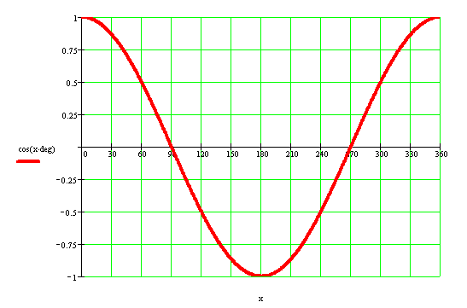
Key Features
Cosine Graphs
Zeros (Roots) at 90º and 270º
Nat 5
Max value occurs at x = 0º and 360º
Minimum value occurs at x = 180º
Key Features
www.mathsrevision.com
(Period is 360º)
Maximum value of 1 - AMPLITUDE
Minimum value of -1

Slide 5
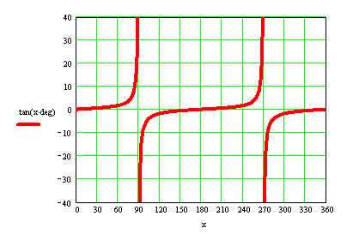
Key Features
Tangent Graphs
Zeros (Roots) at 0 and 180º
Nat 5
Key Features
www.mathsrevision.com
(Period is 180º)

Slide 6

Trig Graphs
Nat 5
Work through N5 TJ
Ex 16.1 , 16.2 and 16.3
(Page 157)
www.mathsrevision.com

Slide 7
Starter
Nat 5
www.mathsrevision.com

Slide 8
Sine & Cosine Graph
Nat 5
Learning Intention
Success Criteria
  To investigate graphs of the form
  y = a sin xº
  y = a cos xº
  Identify the key points for various trig graphs including
  Amplitude
  Period
  Roots.
www.mathsrevision.com

Slide 9
Key Features
Sine Graph
Zeros at 0, 180º and 360º
Nat 5
Max value at x = 90º
Minimum value at x = 270º
Key Features
www.mathsrevision.com
(repeats itself every 360º)
Maximum value of 1
Minimum value of -1

Slide 10
What effect does the number at the front have on the graphs ?
y = sinxº
y = 2sinxº
y = 3sinxº
y = 0.5sinxº
y = -sinxº
Sine Graph
Nat 5
3
2
1
0
www.mathsrevision.com
90º
180º
270º
360º
-1
-2
-3
Demo

Slide 11
Sine Graph
Nat 5
y = a sin (x)
www.mathsrevision.com
For a > 1 stretches graph in the y-axis direction
For 0 < a < 1 compresses graph in the y - axis direction
For a negative flips graph in the x – axis.

Slide 12
y = 5sinxº
y = 4sinxº
y = sinxº
y = -6sinxº
Sine Graph
Nat 5
6
4
2
0
www.mathsrevision.com
90º
180º
270º
360º
-2
-4
-6

Slide 13
Key Features
Cosine Graphs
Zeros at 90º and 270º
Nat 5
Max value at x = 0º and 360º
Minimum value at x = 180º
Key Features
www.mathsrevision.com
(repeats itself every 360º)
Maximum value of 1
Minimum value of -1

Slide 14
What effect does the number at the front have on the graphs ?
y = cosxº
y = 2cosxº
y = 3cosxº
y = 0.5cosxº
y = -cosxº
Cosine
Nat 5
3
2
1
0
www.mathsrevision.com
90º
180º
270º
360º
-1
-2
-3
Demo

Slide 15
y = cosxº
y = 4cosxº
y = 6cosxº
y = cosxº
y = -cosxº
Cosine Graph
Nat 5
6
4
2
0
www.mathsrevision.com
90º
180º
270º
360º
-2
-4
-6

Slide 16
Trig Graphs
Nat 5
Now try N5 TJ
Ex 16.4
(Page 161)
www.mathsrevision.com

Slide 17
Starter
Nat 5
www.mathsrevision.com

Slide 18
Trig Graphs
Nat 5
Learning Intention
Success Criteria
  To investigate graphs of the form
  y = a sin bxº
  y = a cos bxº
  Identify the key points for various trig graphs including
  Amplitude
  Period
  Roots.
www.mathsrevision.com

Slide 19
Period of a Function
Nat 5
When a pattern repeats itself over and over,
it is said to be periodic.
Sine function has a period of 360º
www.mathsrevision.com
Let’s investigate the function
y = sin bx

Slide 20
What effect does the number in front of x have on the graphs ?
y = sinxº
y = sin2xº
y = sin4xº
y = sin0.5xº
Sine Graph
Nat 5
3
2
1
0
www.mathsrevision.com
90º
180º
270º
360º
-1
-2
-3
Demo

Slide 21
Trigonometry Graphs
Nat 5
y = a sin (bx)
How many times
it repeats
itself in 360º
www.mathsrevision.com
For a > 1 stretches graph in the y-axis direction
For 0 < a < 1 compresses graph in the y - axis direction
For a negative flips graph in the x – axis.

Slide 22
What effect does the number at the front have on the graphs ?
y = cosxº
y = cos2xº
y = cos3xº
Cosine
Nat 5
3
2
1
0
www.mathsrevision.com
90º
180º
270º
360º
-1
-2
-3

Slide 23
Trigonometry Graphs
Nat 5
y = a cos (bx)
How many times
it repeats
itself in 360º
www.mathsrevision.com
For a > 1 stretches graph in the y-axis direction
For 0 < a < 1 compresses graph in the y - axis direction
For a negative flips graph in the x – axis.

Slide 24
Trigonometry Graphs
Nat 5
y = a tan (bx)
How many times
it repeats
itself in 180º
www.mathsrevision.com
For a > 1 stretches graph in the y-axis direction
For 0 < a < 1 compresses graph in the y - axis direction
For a negative flips graph in the x – axis.

Slide 25
Write down equations for graphs shown ?
y = 0.5sin2xº
y = 2sin4xº
y = -3sin0.5xº
Trig Graph
Nat 5
Combinations
3
2
1
0
www.mathsrevision.com
90º
180º
270º
360º
-1
-2
-3
Demo

Slide 26
Write down equations for the graphs shown?
y = 1.5cos2xº
y = -2cos2xº
y = 0.5cos4xº
Cosine
Nat 5
Combinations
3
2
1
0
www.mathsrevision.com
90º
180º
270º
360º
-1
-2
-3

Slide 27
Trig Graphs
Nat 5
Now try N5 TJ
Ex 16.5
(Page 163)
www.mathsrevision.com

Slide 28
Starter
Nat 5
www.mathsrevision.com

Slide 29
y = asin(bx)º + c
Nat 5
Learning Intention
Success Criteria
  We are learning how to sketch graphs of the type
  y = asin(bx)º + c
  y = acos(bx)º + c
  Identify and sketch the key points for various trig graphs including
  Amplitude
  Period
  Roots.
www.mathsrevision.com

Slide 30
Write down equations for graphs shown ?
y = 0.5sin2xº + 0.5
y = 2sin4xº- 1
Trig Graph
Combinations
Higher
3
2
1
0
www.mathsrevision.com
90º
180º
270º
360º
-1
-2
Demo
-3

Slide 31
Write down the equations for the graphs shown?
Trig Graphs
y = cos2xº + 1
y = -2cos2xº - 1
DEMO
Combinations
Higher
3
2
1
0
www.mathsrevision.com
90º
180º
270º
360º
-1
-2
-3

Slide 32
Trig Graphs
Nat 5
Now try N5 TJ
Ex 16.6
(Page 165)
www.mathsrevision.com

Slide 33
Starter
Nat 5
www.mathsrevision.com

Slide 34
Phase Angle
Nat 5
Learning Intention
Success Criteria
  To investigate graphs of the form
  y = asin(xº + d)
  y = acos(xº + d)
  Identify and sketch the key points for trig graphs of the form
  y = asin(xº + d)
  y = acos(xº + d)
www.mathsrevision.com

Slide 35
By how much do we have to move the standard sine curve so it fits on the other sine curve?
Phase Angle
Nat 5
y = sin(x + 60)º
1
To the left “+”
60º
0
www.mathsrevision.com
-60º
90º
180º
270º
360º
-1

Slide 36
By how much do we have to move the standard sine curve so it fits on the other sine curve?
Phase Angle
Nat 5
y = sin(x - 45)º
1
To the right “-”
45º
0
www.mathsrevision.com
45º
90º
180º
270º
360º
-1
Demo

Slide 37
Phase Angle
Nat 5
y = sin (x + d)
Moves graph
along x - axis
www.mathsrevision.com
For d > 0 moves graph to the left along x – axis
For d < 0 moves graph to the right along x – axis

Slide 38
By how much do we have to move the standard cosine curve so it fits on the other cosine curve?
Phase Angle
Nat 5
y = cos(x - 70)º
1
To the right “-”
70º
0
www.mathsrevision.com
90º
160º
180º
270º
360º
-1

Slide 39
By how much do we have to move the standard cosine curve so it fits on the other cosine curve?
Phase Angle
Nat 5
y = cos(x + 56)º
1
To the left “+”
56º
0
www.mathsrevision.com
34º
90º
180º
270º
360º
-1

Slide 40
Summary of work So far
Nat 5
y = a sin (x + d)
For a > 1 stretches graph
in the y-axis direction
For d > 0 moves graph to
the left along x – axis
www.mathsrevision.com
For 0 < a < 1 compresses graph
in the y - axis direction
For d < 0 moves graph to
the right along x – axis
For a - negative flips graph
in the x – axis.

Slide 41
Phase Angle
Nat 5
Now try N5 TJ
Ex 16.7
(Page 168)
www.mathsrevision.com

Slide 42
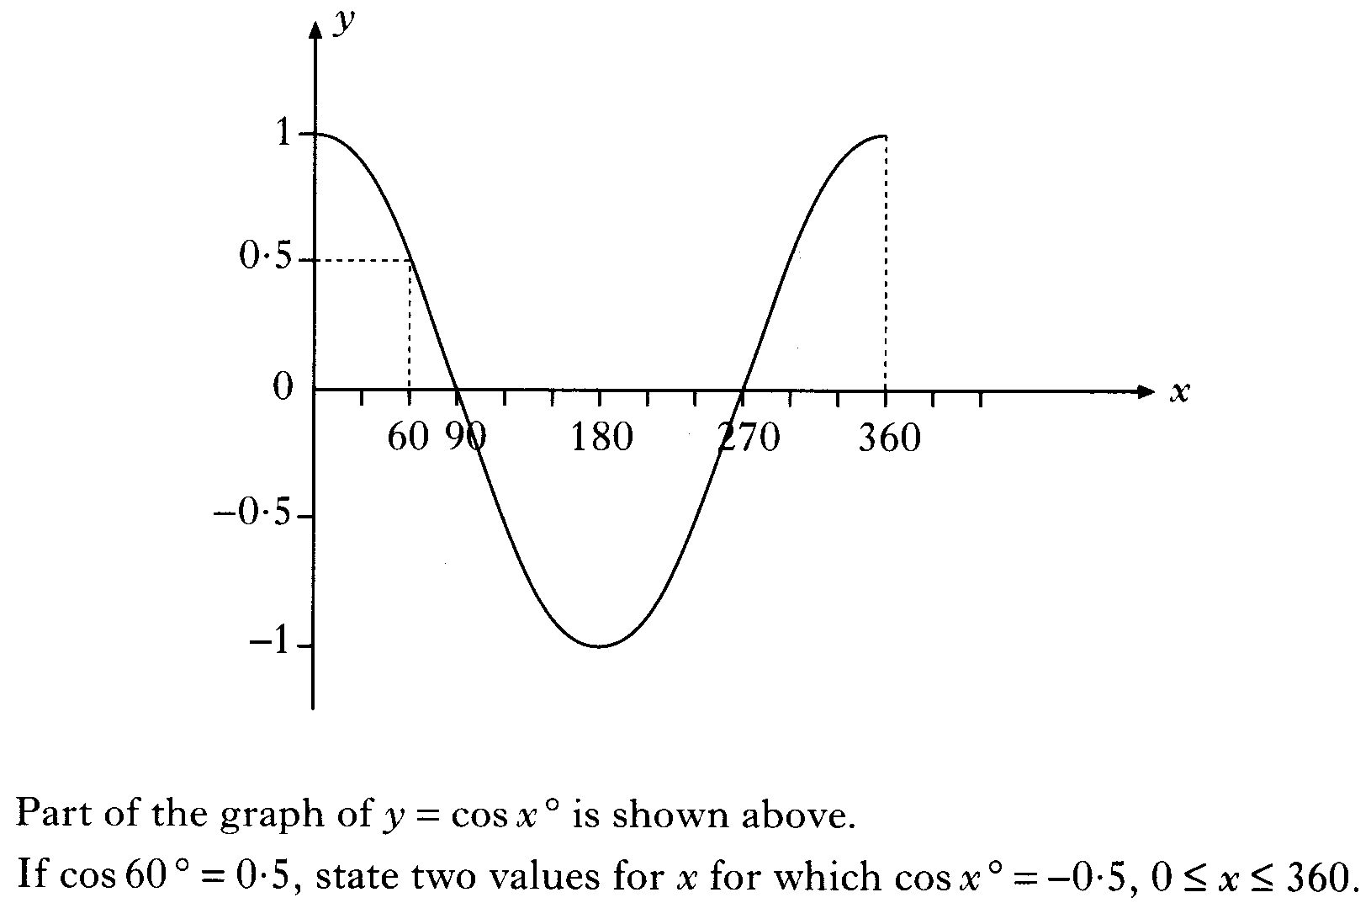

Slide 43
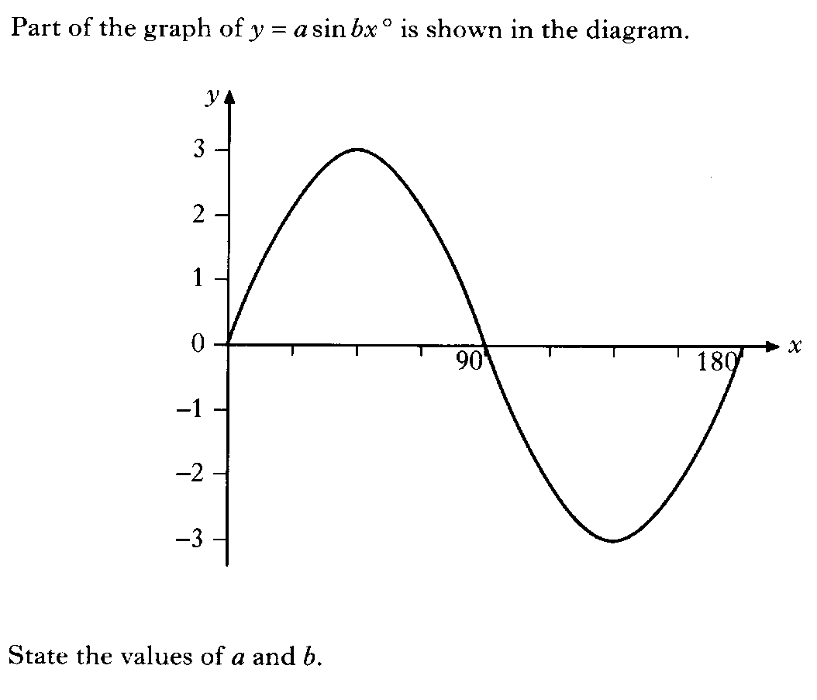

Slide 45
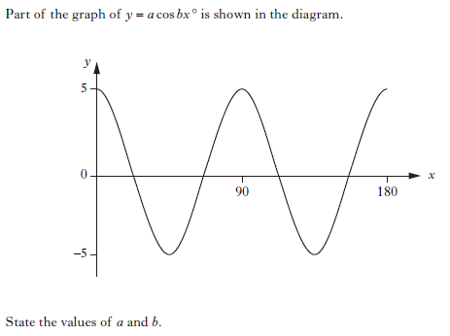

Slide 46
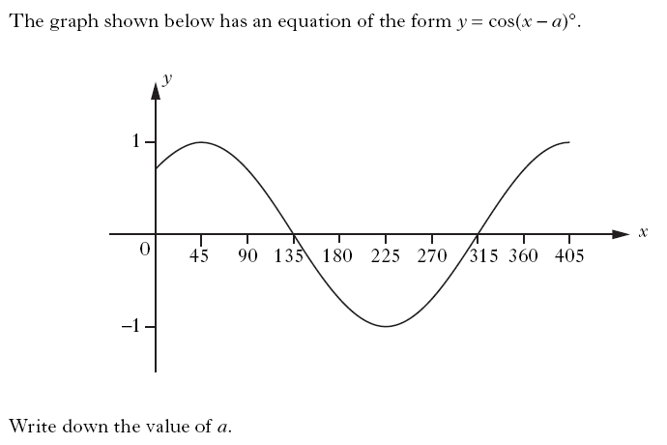

Slide 47


Slide 49
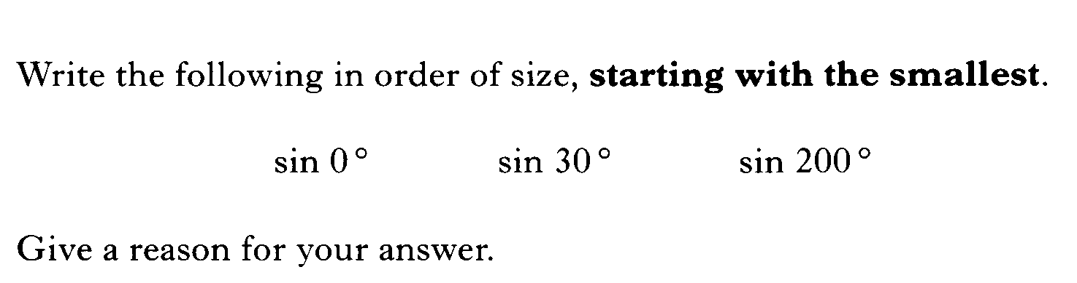

Slide 50
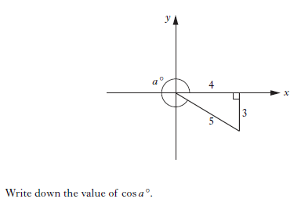

Slide 51
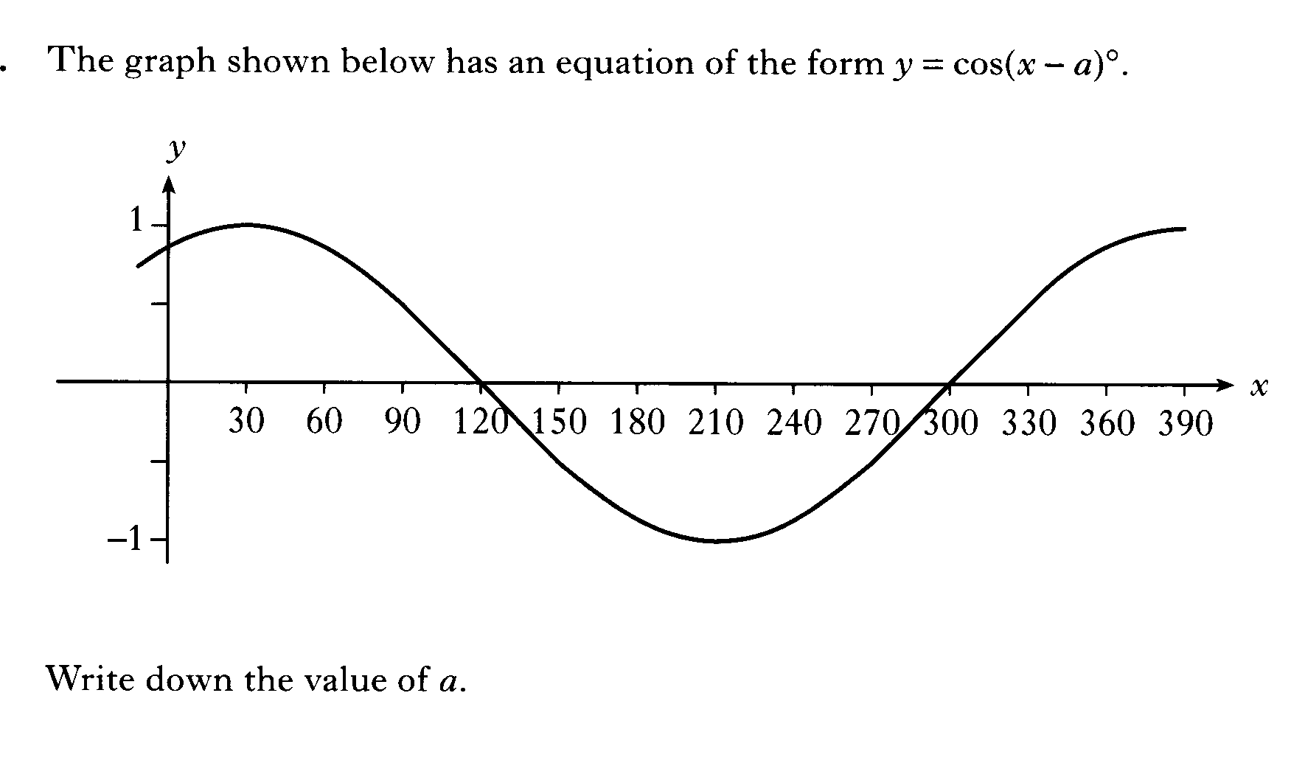

Slide 52
