Slide 1

Vectors
Vectors and Scalars
Adding / Sub of vectors
Position Vector
Magnitude of a Vector
Vector Journeys
3D Vectors
Exam Type Questions

Slide 2
Vectors & Scalars
A vector is a quantity with
BOTH magnitude (length) and direction.
Examples : Gravity
Velocity
Force

Slide 3
Vectors & Scalars
A scalar is a quantity that has
magnitude ONLY.
Examples : Time
Speed
Mass

Slide 4
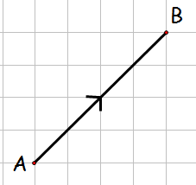
Vectors & Scalars
A vector is named using the letters at the end of the directed line segment
or
using a lowercase bold / underlined letter
This vector is named
u
or
u
u
or
u

Slide 5
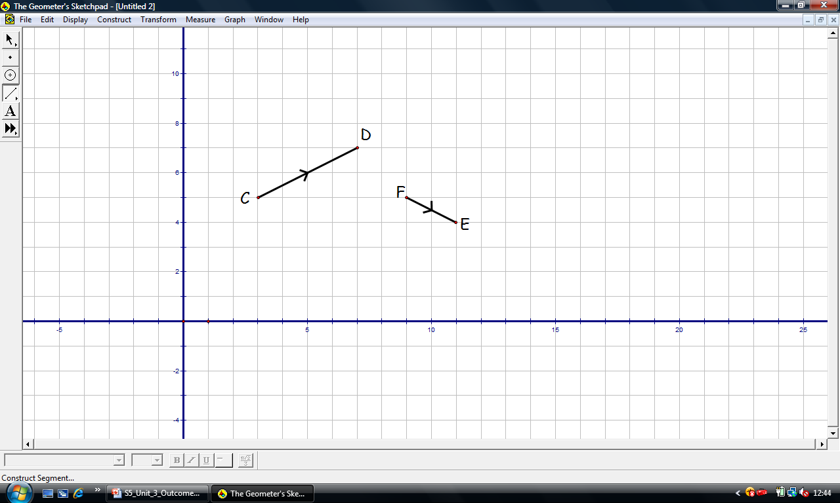
Also known as column vector
Vectors & Scalars
A vector may also be
represented in component form.
w
z

Slide 6
Equal Vectors
Vectors are equal only if they both have
the same magnitude ( length ) and direction.

Slide 7
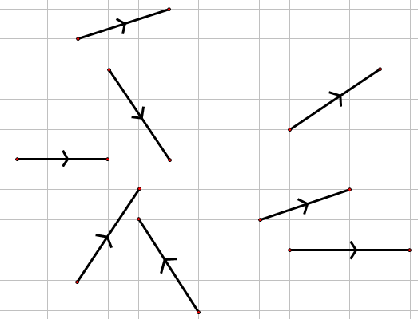
Equal Vectors
Which vectors are equal.
a
a
b
c
d
g
g
e
f
h

Slide 8

Equal Vectors
Sketch the vectors 2a , -b and 2a - b
a
b
-b
2a
-b
2a

Slide 9

Vectors
Now try N5 TJ
Ex 15.1
Ch15 (page 143)
www.mathsrevision.com

Slide 10
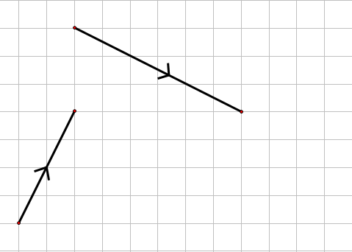
Addition of Vectors
Any two vectors can be added in this way
Arrows must be nose to tail
b
b
a
a + b

Slide 11
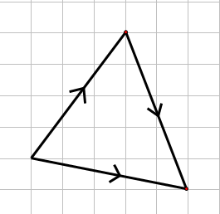
Addition of Vectors
Addition of vectors
B
A
C

Slide 12
Addition of Vectors
In general we have
For vectors u and v

Slide 13
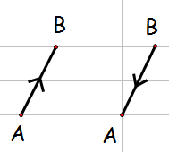
Zero Vector
The zero vector

Slide 14
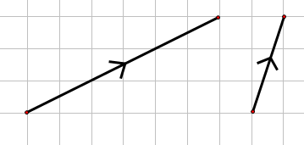
Subtracting vectors
think adding a negative vector
u + (-v)
Subtraction of Vectors
u
Notice arrows nose to tail
-v
v
u + (-v) =
u - v

Slide 15
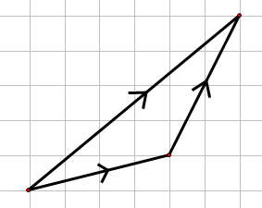
Subtraction of Vectors
Subtraction of vectors
a
b
a - b

Slide 16
Subtraction of Vectors
In general we have
For vectors u and v

Slide 17
Vectors
Now try N5 TJ
Ex 15.2
Ch15 (page 145)
www.mathsrevision.com

Slide 18
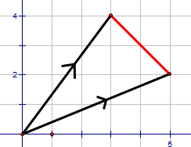
A
Position Vectors
B
A is the point (3,4) and B is the point (5,2).
Write down the components of
Answers
the same !

Slide 19
A
Position Vectors
a
B
b
0

Slide 20
A
Position Vectors
a
B
b
0

Slide 21
Position Vectors
If P and Q have coordinates (4,8) and (2,3)
respectively, find the components of

Slide 22
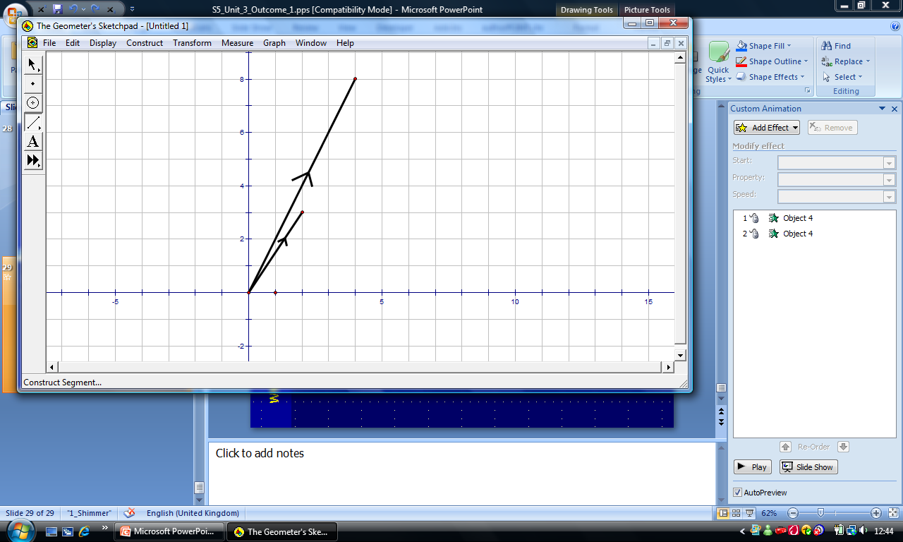
Position Vectors
P
Graphically
P (4,8)
Q (2,3)
p
q - p
Q
q
O

Slide 23
Position Vectors
Now try N5 TJ
Ex 15.3
Ch15 (page 146)
www.mathsrevision.com

Slide 24
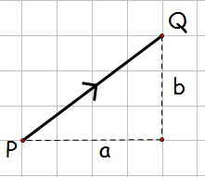
Magnitude of a Vector
A vector’s magnitude (length) is represented by
A vector’s magnitude is calculated using Pythagoras Theorem.
u

Slide 25
Magnitude of a Vector
Calculate the magnitude of the vector.
w

Slide 26
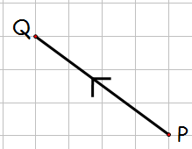
Magnitude of a Vector
Calculate the magnitude of the vector.

Slide 27
Position Vectors
Now try N5 TJ
Ex 15.4
Ch15 (page 147)
www.mathsrevision.com

Slide 28
Vector Journeys
As far as the vector is concerned, only the
FINISHING POINT
in relation to the
STARTING POINT
is important.
The route you take is IRRELEVANT.

Slide 29
Vector Journeys
Z
Y
M
v
W
X
u
Given that
find

Slide 30
Vector Journeys
2u
Z
Y
M
v
W
X
u

Slide 31
Vector Journeys
Now try N5 TJ
Ex 15.5
Ch15 (page 149)
www.mathsrevision.com

Slide 32

3D Coordinates
In the real world points in space can be located using a 3D coordinate system.
For example, air traffic controllers find the location a plane by its height and grid reference.
z
y
(x, y, z)
x
O

Slide 33
3D Coordinates
Write down the coordinates for the 7 vertices
z
y
E
(0, 1, 2)
A
(6, 1, 2)
(0, 0, 2)
F
2
B
H
(6, 0, 2)
(0,0, 0)
D
(6, 1, 0)
G
1
x
O
6
C
(6, 0, 0)
What is the coordinates of the vertex H so that it makes a cuboid shape.
H(0, 1, 0 )

Slide 34
3D Vectors
Good News
All the rules for 2D vectors apply in the same way for 3D.

Slide 35
Addition of Vectors
Addition of vectors

Slide 36
Addition of Vectors
In general we have
For vectors u and v

Slide 37
Magnitude of a Vector
A vector’s magnitude (length) is represented by
A 3D vector’s magnitude is calculated using Pythagoras Theorem twice.
z
y
v
1
2
O
x
3

Slide 38
Subtraction of Vectors
Subtraction of vectors

Slide 39
Subtraction of Vectors
For vectors u and v

Slide 40
Position Vectors
A (3,2,1)
z
a
y
1
2
O
x
3

Slide 41
Position Vectors

Slide 42
3D Vectors
Now try N5 TJ
Ex 15.7
Ch15 (page 150)
www.mathsrevision.com

Slide 43
Are you on Target !
Update you log book
Make sure you complete and correct
ALL of the Vector questions in the
past paper booklet.

Slide 44
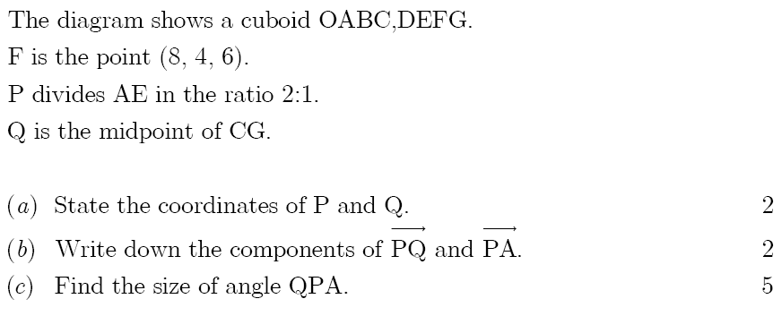
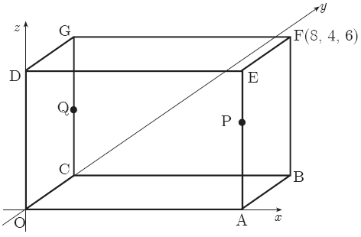

Slide 45
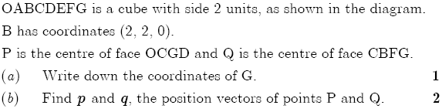
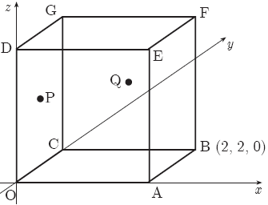

Slide 46
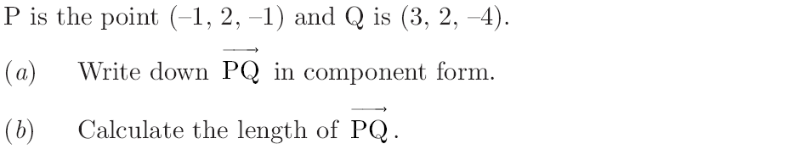


Slide 47
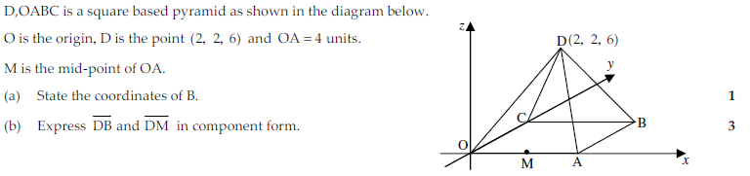

Slide 48
