Slide 1
Quadratic Functions
Recap of Quadratic Functions / Graphs
Solving quadratic equations graphically
Factorising Methods for Trinomials (Quadratics)
Solving Quadratics by Factorising
Solving Harder Quadratics by Factorising
Sketching a Parabola using Factorisation
Intersection points between a Straight Line and Quadratic
Exam Type Questions
Jul 11, 2026
Created by Mr. Lafferty@mathsrevision.com

Slide 2


Starter Questions
Nat 5
Q1. Remove the brackets
(x + 5)(x – 5)
Q2. For the line y = -2x + 6, find the gradient
and where it cuts the y axis.
www.mathsrevision.com
Q3. A laptop costs £440 ( including @ 10% )
What is the cost before VAT.
Jul 11, 2026
Created by Mr. Lafferty@mathsrevision.com

Slide 3
Quadratic Functions
Nat 5
Learning Intention
Success Criteria
  We are learning how to sketch quadratic functions.
  Be able to create a coordinate grid.
www.mathsrevision.com
Be able to sketch quadratic functions.
11 Jul 2026
Created by Mr. Lafferty@www.mathsrevision.com

Slide 4
Quadratic Equations
Nat 5
A quadratic function has the form
a , b and c are
constants
and a ≠ 0
f(x) = a x² + b x + c
The graph of a quadratic function has the basic shape
www.mathsrevision.com
a < 0
a > 0
y
The graph of a quadratic function
is called a PARABOLA
y
x
x

Slide 5
y = x²
Quadratic Functions
y
x
y
-3
-2
0
2
3
10
9
4
0
4
9
9
8
7
y = x² - 4
6
5
4
x
y
-3
-2
0
2
3
3
2
5
0
-4
0
5
1
x
-10
-9
-8
-7
-6
-5
-4
-3
-2
-1
0
1
2
3
4
5
6
7
8
9
10
-1
-2
y = x² + x - 6
-3
-4
-5
x
y
-4
-2
0
2
3
-6
-7
6
-4
-6
0
6
-8
-9
-10
11 Jul 2026
Created by Mr. Lafferty Maths Dept

Slide 6

Factorising Methods
Nat 5
Now try N5 TJ
Ex 14.1
Ch14 (page132)
www.mathsrevision.com
11 Jul 2026
Created by Mr. Lafferty@www.mathsrevision.com

Slide 7
Starter Questions
Nat 5
Q1. True or false
y ( y + 6 ) -7y = y² -7y + 6
Q2. Fill in the ?
49 – 4x² = ( ? + ?x)(? – 2?)
www.mathsrevision.com
Q3. Write in scientific notation 0.0341
Jul 11, 2026
Created by Mr. Lafferty@mathsrevision.com

Slide 8
Quadratic Functions
Nat 5
Learning Intention
Success Criteria
  We are learning how to use the parabola graph to solve equations containing quadratic function.
1. Use graph to solve quadratic equations.
www.mathsrevision.com
11 Jul 2026
Created by Mr. Lafferty@www.mathsrevision.com

Slide 9
This is called a quadratic equation
Quadratic Equations
Nat 5
A quadratic function has the form
a , b and c are
constants
and a ≠ 0
f(x) = a x² + b x + c
The graph of a quadratic function has the basic shape
www.mathsrevision.com
y
The x-coordinates where the graph
cuts the x – axis are called the
Roots of the function.
y
x
x
i.e. a x² + b x + c = 0

Slide 10
Roots of a Quadratic Function
y
Graph of
y = x² - 11x + 28
10
Graph of
y = x² + 5x
9
Find the solution of
8
7
x² – 11x + 28 = 0
6
5
4
From the graph, setting
y = 0 we can see that
3
2
1
x = 4 and x = 7
x
-10
-9
-8
-7
-6
-5
-4
-3
-2
-1
0
1
2
3
4
5
6
7
8
9
10
-1
-2
Find the solution of
-3
-4
x² + 5x = 0
-5
-6
From the graph, setting
y = 0 we can see that
-7
-8
-9
x = -5 and x = 0
-10
11 Jul 2026
Created by Mr. Lafferty Maths Dept

Slide 11
Factorising Methods
Nat 5
Now try N5 TJ
Ex 14.2
Ch14 (page133)
www.mathsrevision.com
11 Jul 2026
Created by Mr. Lafferty@www.mathsrevision.com

Slide 12
Starter Questions
Nat 5
In pairs and if necessary use notes to
Write down the three types of factorising and
give an example of each.
www.mathsrevision.com
Jul 11, 2026
Created by Mr. Lafferty@mathsrevision.com

Slide 13
Factorising
Methods
Nat 5
Learning Intention
Success Criteria
  We are reviewing the three basic methods for factorising.
  To be able to identify the three methods of factorising.
www.mathsrevision.com
Apply knowledge to problems.
11 Jul 2026
Created by Mr. Lafferty@www.mathsrevision.com

Slide 14
Factors and
Solving Quadratic Equations
Nat 5
The main reason we learn the process of factorising is that it helps to solve (find roots) quadratic equations.
Reminder of Methods
Take any common factors out and put them
outside the brackets.
www.mathsrevision.com
2. Check for the difference of two squares.
3. Factorise any quadratic expression left.
11 Jul 2026
Created by Mr. Lafferty@www.mathsrevision.com

Slide 15
Difference of
Two Squares
Nat 5
Type 1 : Taking out a common factor.
(a) w² – 2w
(b) 9b – b²
20ab² + 24a²b
8c - 12c² + 16c³
w( w – 2 )
b( 9 – b )
www.mathsrevision.com
4ab( 5b + 6a)
4c( 2 – 3c + 4c²)
11 Jul 2026
Created by Mr. Lafferty

Slide 16
Difference of
Two Squares
Nat 5
When we have the special case that an
expression is made up of
the difference of two squares
then it is simple to factorise
The format for the difference of two squares
www.mathsrevision.com
a² – b²
First
square term
Second
square term
Difference
11 Jul 2026
Created by Mr. Lafferty@www.mathsrevision.com

Slide 17
Difference of
Two Squares
Check by multiplying out the bracket to get back to where you started
Nat 5
a² – b²
First
square term
Second
square term
Difference
This factorises to
www.mathsrevision.com
( a + b )( a – b )
Two brackets the same except for + and a -
11 Jul 2026
Created by Mr. Lafferty@www.mathsrevision.com

Slide 18
Difference of
Two Squares
Nat 5
Type 2 :
Factorise using the difference of two squares
(a) w² – z²
(b) 9a² – b²
(c) 16y² – 100k²
( w + z )( w – z )
www.mathsrevision.com
( 3a + b )( 3a – b )
( 4y + 10k )( 4y – 10k )
11 Jul 2026
Created by Mr. Lafferty

Slide 19
Difference of
Two Squares
Nat 5
Factorise these trickier expressions.
(a) 6x² – 24
3w² – 3
8 – 2b²
(d) 27w² – 12
6(x + 2 )( x – 2 )
3( w + 1 )( w – 1 )
www.mathsrevision.com
2( 2 + b )( 2 – b )
3(3 w + 2 )( 3w – 2 )
11 Jul 2026
Created by Mr. Lafferty

Slide 20
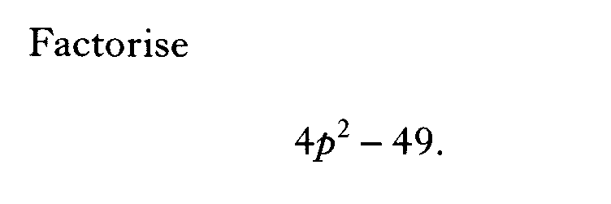

Slide 21


Slide 22

Factorising
Using St. Andrew’s Cross method
Type 3 : Strategy for factorising quadratics
Find two numbers that
multiply to give last number (+2)
and
Diagonals sum to give middle value +3x.
x² + 3x + 2
x
x
+ 2
+ 2
(+2) x( +1) = +2
x
x
+ 1
+ 1
(+2x) +( +1x) = +3x
( ) ( )
Jul 11, 2026
Created by Mr. Lafferty@mathsrevision.com

Slide 23
Factorising
Using St. Andrew’s Cross method
Strategy for factorising quadratics
Find two numbers that
multiply to give last number (+5)
and
Diagonals sum to give middle value +6x.
x² + 6x + 5
x
x
+ 5
+ 5
(+5) x( +1) = +5
x
x
+ 1
+ 1
(+5x) +( +1x) = +6x
( ) ( )
Jul 11, 2026
Created by Mr. Lafferty@mathsrevision.com

Slide 24
Both numbers must be -
Factorising
Using St. Andrew’s Cross method
Strategy for factorising quadratics
Find two numbers that
multiply to give last number (+4)
and
Diagonals sum to give middle value -4x.
x² - 4x + 4
x
x
- 2
- 2
(-2) x( -2) = +4
x
x
- 2
- 2
(-2x) +( -2x) = -4x
( ) ( )
Jul 11, 2026
Created by Mr. Lafferty@mathsrevision.com

Slide 25
One number must be +
and one -
Factorising
Using St. Andrew’s Cross method
Strategy for factorising quadratics
Find two numbers that
multiply to give last number (-3)
and
Diagonals sum to give middle value -2x
x² - 2x - 3
x
x
- 3
- 3
(-3) x( +1) = -3
x
x
+ 1
+ 1
(-3x) +( x) = -2x
( ) ( )
Jul 11, 2026
Created by Mr. Lafferty@mathsrevision.com

Slide 26
One number must be +
and one -
Factorising
Using St. Andrew’s Cross method
Strategy for factorising quadratics
Find two numbers that
multiply to give last number (-4)
and
Diagonals sum to give middle value -x
3x² - x - 4
3x
3x
- 4
- 4
(-4) x( +1) = -4
x
x
+ 1
+ 1
(3x) +( -4x) = -x
( ) ( )
Jul 11, 2026
Created by Mr. Lafferty@mathsrevision.com

Slide 27
One number must be +
and one -
Factorising
Using St. Andrew’s Cross method
Strategy for factorising quadratics
Find two numbers that
multiply to give last number (-3)
and
Diagonals sum to give middle value -x
2x² - x - 3
2x
2x
- 3
- 3
(-3) x( +1) = -3
x
x
+ 1
+ 1
(-3x) +( +2x) = -x
( ) ( )
Jul 11, 2026
Created by Mr. Lafferty@mathsrevision.com

Slide 28


one number is + and
one number is -
Factorising
Using St. Andrew’s Cross method
Two numbers that multiply to give
last number (-3)
and
Diagonals sum to give middle value (-4x)
4x² - 4x - 3
4x
Factors
1 and -3
-1 and 3
Keeping the LHS fixed
x
( ) ( )
Can we do it !
Jul 11, 2026
Created by Mr. Lafferty@mathsrevision.com

Slide 29

Factorising
Using St. Andrew’s Cross method
Find another set of
factors for LHS
4x² - 4x - 3
Repeat the factors for RHS to see if it factorises now
2x
2x
- 3
- 3
Factors
1 and -3
-1 and 3
2x
2x
+ 1
+ 1
( ) ( )
Jul 11, 2026
Created by Mr. Lafferty@mathsrevision.com

Slide 30
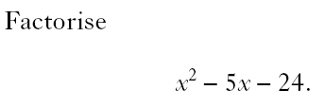

Slide 31
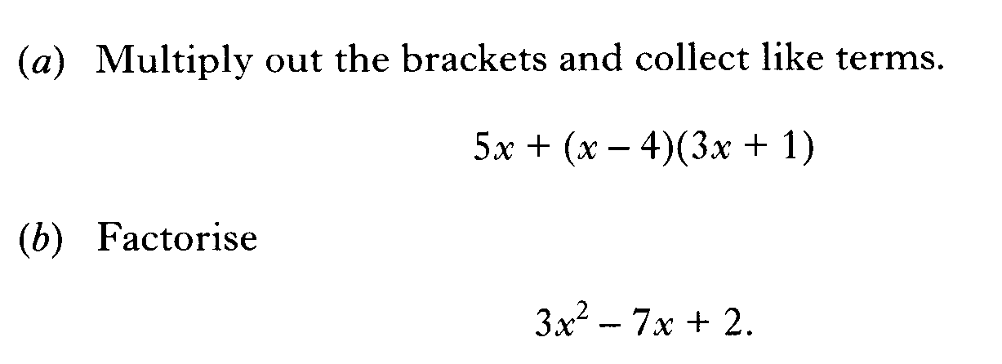

Slide 32
Factorising
Using St. Andrew’s Cross method
Nat 5
Factorise using SAC method
(a) m² + 2m +1
y² + 6m + 5
2b² + b - 1
(d) 3a² – 14a + 8
(m + 1 )( m + 1 )
( y + 5 )( y + 1 )
www.mathsrevision.com
( 2b - 1 )( b + 1 )
( 3a - 2 )( a – 4 )
11 Jul 2026
Created by Mr. Lafferty

Slide 33
Factorising Methods
Nat 5
Now try N5 TJ
Ex 14.3
Ch14 (page134)
www.mathsrevision.com
11 Jul 2026
Created by Mr. Lafferty@www.mathsrevision.com

Slide 34
Starter Questions
Nat 5
Q1. Multiple out the brackets and simplify.
(a) ( 2x – 5 )( x + 5 )
Q2. Find the volume of a cylinder
with height 6m and diameter 9cm
www.mathsrevision.com
Q3. True or false the gradient of the line is 1
x = y + 1
Jul 11, 2026
Created by Mr. Lafferty@mathsrevision.com

Slide 35
Factorising
Methods
Nat 5
Learning Intention
Success Criteria
  We are learning how to solve quadratics by factorising.
  To be able to factorise.
www.mathsrevision.com
Solve quadratics.
11 Jul 2026
Created by Mr. Lafferty@www.mathsrevision.com

Slide 36
Solving Quadratic Equations
Nat 5
Examples
Solve ( find the roots ) for the following
x(x – 2) = 0
4t(3t + 15) = 0
x = 0
and
x - 2 = 0
4t = 0
and
3t + 15 = 0
x = 2
t = 0
and
t = -5
www.mathsrevision.com
11 Jul 2026
Created by Mr. Lafferty@www.mathsrevision.com

Slide 37
Solving Quadratic Equations
Nat 5
Examples
Solve ( find the roots ) for the following
x² – 4x = 0
Common Factor
16t – 6t² = 0
Common Factor
x(x – 4) = 0
2t(8 – 3t) = 0
x = 0
and
x - 4 = 0
2t = 0
and
8 – 3t = 0
www.mathsrevision.com
x = 4
t = 0
and
t = 8/3
11 Jul 2026
Created by Mr. Lafferty@www.mathsrevision.com

Slide 38
Solving Quadratic Equations
Examples
Take out common factor
Nat 5
Solve ( find the roots ) for the following
Difference
2 squares
x² – 9 = 0
100s² – 25 = 0
Difference
2 squares
25(4s² - 1) = 0
www.mathsrevision.com
25(2s – 1)(2s + 1) = 0
(x – 3)(x + 3) = 0
x = 3
and
x = -3
2s – 1 = 0
and
2s + 1 = 0
s = 0.5
and
s = - 0.5
11 Jul 2026
Created by Mr. Lafferty@www.mathsrevision.com

Slide 39
Solving Quadratic Equations
Nat 5
Examples
2x² – 8 = 0
Common Factor
80 – 125e² = 0
Common Factor
2(x² – 4) = 0
5(16 – 25e²) = 0
Difference
2 squares
Difference
2 squares
www.mathsrevision.com
2(x – 2)(x + 2) = 0
5(4 – 5e)(4 + 5e) = 0
(x – 2)(x + 2) = 0
(4 – 5e)(4 + 5e) = 0
(x – 2) = 0
and
(x + 2) = 0
4 – 5e = 0
and
4 + 5e = 0
x = 2
and
x = - 2
e = 4/5
and
e = - 4/5

Slide 40
Factorising Methods
Nat 5
Now try N5 TJ
Ex 14.4 upto Q10
Ch14 (page135)
www.mathsrevision.com
11 Jul 2026
Created by Mr. Lafferty@www.mathsrevision.com

Slide 41

Solving Quadratic Equations
Nat 5
Examples
Solve ( find the roots ) for the following
x² + 3x + 2 = 0
3x² – 11x - 4 = 0
SAC Method
SAC Method
x
2
3x
+ 1
www.mathsrevision.com
x
1
x
- 4
(x + 2)(x + 1) = 0
(3x + 1)(x - 4) = 0
x + 2 = 0
and
x + 1 = 0
3x + 1 = 0
and
x - 4 = 0
x = - 2
and
x = - 1
x = - 1/3
and
x = 4

Slide 42
Solving Quadratic Equations
Nat 5
Examples
Solve ( find the roots ) for the following
x² + 5x + 4 = 0
1 + x - 6x² = 0
SAC Method
SAC Method
x
4
1
+3x
www.mathsrevision.com
x
1
1
-2x
(x + 4)(x + 1) = 0
(1 + 3x)(1 – 2x) = 0
x + 4 = 0
and
x + 1 = 0
1 + 3x = 0
and
1 - 2x = 0
x = - 4
and
x = - 1
x = - 1/3
and
x = 0.5

Slide 43
Factorising Methods
Nat 5
Now try N5 TJ
Ex 14.4 Q11....
Ch14 (page137)
www.mathsrevision.com
11 Jul 2026
Created by Mr. Lafferty@www.mathsrevision.com

Slide 44
Starter Questions
Q1. Round to 2 significant figures
(a) 52.567 (b) 626
Q2. Why is 2 + 4 x 2 = 10 and not 12
Q3. Solve for x
11 Jul 2026
Created by Mr. Lafferty
<number>

Slide 45
Sketching
Quadratic Functions
Nat 5
Learning Intention
Success Criteria
  We are learning to sketch quadratic functions using factorisation methods.
  Know the various methods of factorising a quadratic.
  2. Identify axis of symmetry from roots.
www.mathsrevision.com
  3. Be able to sketch quadratic graph.
11 Jul 2026
Created by Mr. Lafferty@www.mathsrevision.com

Slide 46
Sketching
Quadratic Functions
We can use a 4 step process to sketch a quadratic function
Example 2 : Sketch f(x) = x² - 7x + 6
Step 1 : Find where the function crosses the x – axis.
SAC Method
i.e. x² – 7x + 6 = 0
x
- 6
x
- 1
(x - 6)(x - 1) = 0
x - 6 = 0
x - 1 = 0
x = 6
(6, 0)
x = 1
(1, 0)

Slide 47
Sketching
Quadratic Functions
Step 2 : Find equation of axis of symmetry.
It is half way between points in step 1
(6 + 1) ÷ 2 =3.5
Equation is x = 3.5
Step 3 : Find coordinates of Turning Point (TP)
For x = 3.5 f(3.5) = (3.5)² – 7x(3.5) + 6 = -6.25
Turning point TP is a Minimum at (3.5, -6.25)
Notes:
<number>

Slide 48
Sketching
Quadratic Functions
Step 4 : Find where curve cuts y-axis.
For x = 0 f(0) = 0² – 7x0 = 6 = 6 (0,6)
Now we can sketch the curve y = x² – 7x + 6
Y
6
Cuts x - axis at 1 and 6
1
Cuts y - axis at 6
6
Mini TP (3.5,-6.25)
(3.5,-6.25)
X
Notes:
<number>

Slide 49
Sketching
Quadratic Functions
We can use a 4 step process to sketch a quadratic function
Example 1 : Sketch f(x) = 15 – 2x – x²
Step 1 : Find where the function crosses the x – axis.
SAC Method
i.e. 15 - 2x - x² = 0
5
x
3
- x
(5 + x)(3 - x) = 0
5 + x = 0
3 - x = 0
x = - 5
(- 5, 0)
x = 3
(3, 0)

Slide 50
Sketching
Quadratic Functions
Step 2 : Find equation of axis of symmetry.
It is half way between points in step 1
(-5 + 3) ÷ 2 = -1
Equation is x = -1
Step 3 : Find coordinates of Turning Point (TP)
For x = -1 f(-1) = 15 – 2x(-1) – (-1)² = 16
Turning point TP is a Maximum at (-1, 16)
Notes:
<number>

Slide 51
Sketching
Quadratic Functions
Step 4 : Find where curve cuts y-axis.
For x = 0 f(0) = 15 – 2x0 – 0² = 15 (0,15)
Now we can sketch the curve y = 15 – 2x – x²
Y
3
Cuts x-axis at -5 and 3
-5
15
Cuts y-axis at 15
Max TP (-1,16)
(-1,16)
X
Notes:
<number>

Slide 52
Roots
f(x) = x² + 4x + 3
f(-2) =(-2)² + 4x(-2) + 3
= -1
(0, )
a > 0
Mini. Point
Max. Point
x=
Line of Symmetry
half way
between roots
Evaluating
(0, )
Graphs
a < 0
Quadratic Functions
y = ax² + bx + c
x=
Line of Symmetry
half way
between roots
c
c
Factorisation
ax² + bx + c = 0
SAC
e.g. (x+1)(x-2)=0
Roots
x = -1 and x = 2

Slide 53
Factorising Methods
Nat 5
Now try N5 TJ
Ex 14.5
Ch14 (page138)
www.mathsrevision.com
11 Jul 2026
Created by Mr. Lafferty@www.mathsrevision.com

Slide 54
Starter Questions
Nat 5
www.mathsrevision.com
created by Mr. Lafferty

Slide 55
Intersection Points
between Quadratics and Straight Line.
Nat 5
Learning Intention
Success Criteria
  We are learning about intersection points between quadratics and straight lines.
  Know how to rearrange and factorise a quadratic.
www.mathsrevision.com
created by Mr. Lafferty

Slide 56
Between two lines
Between a line and a curve
Simultaneous Equations
Intersection Points
Make them
equal to each other
Rearrange into = 0
and then solve

Slide 57
Example:
Find the intersection points
between a line and a curve
y = x²
Make them
equal to each other
x² = x
Rearrange into
… = 0
y = x
x² - x = 0
Factorise
x ( x - 1) = 0
solve
x = 0
x = 1
Substitute x = 0 and x = 1 into straight line equation
x = 0 y = 0
x = 1 y = 1
Intersection points
( 0, 0 ) and ( 1, 1 )
( 0, 0 )
( 1, 1 )

Slide 58
Example:
Find the intersection points
between a line and a curve
y = x² – 6x + 11
Make them
equal to each other
x² - 6x + 11 = - x + 7
y = -x + 7
Rearrange into
… = 0
x² - 5x + 4 = 0
Factorise
( x - 1) (x – 4) = 0
solve
x = 1
x = 4
Substitute x = 1 and x = 4 into straight line equation
x = 1 y = 6
x = 4 y = 3
Intersection points
( 1, 6 ) and ( 4, 3 )
( 1, 6 )
( 4, 3 )

Slide 59
Factorising Methods
Nat 5
Now try N5 TJ
Ex 14.6
Ch14 (page139)
www.mathsrevision.com
11 Jul 2026
Created by Mr. Lafferty@www.mathsrevision.com

Slide 60
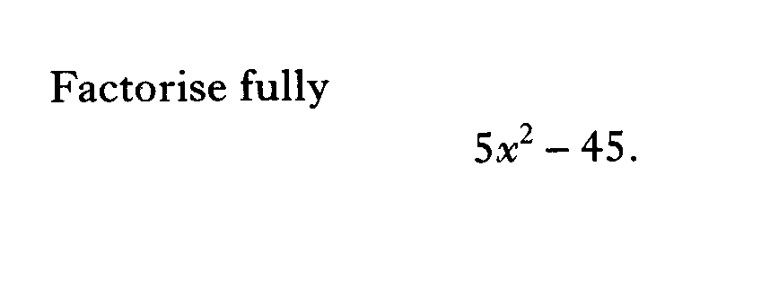

Slide 61
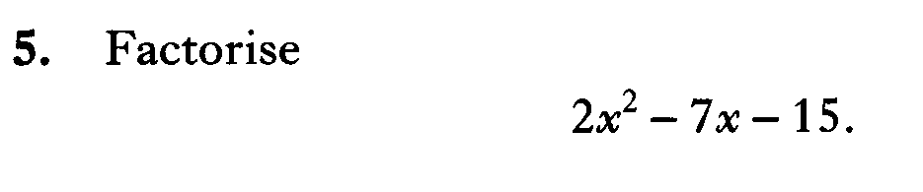

Slide 62
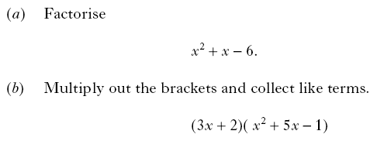

Slide 63
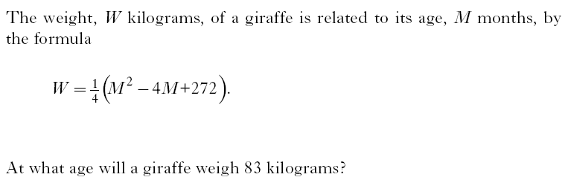

Slide 64
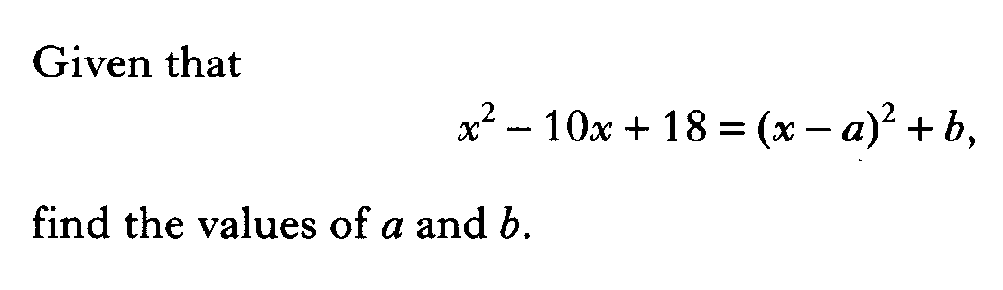

Slide 65
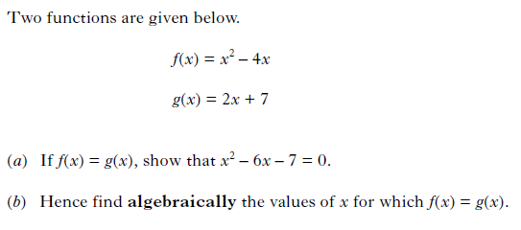

Slide 66
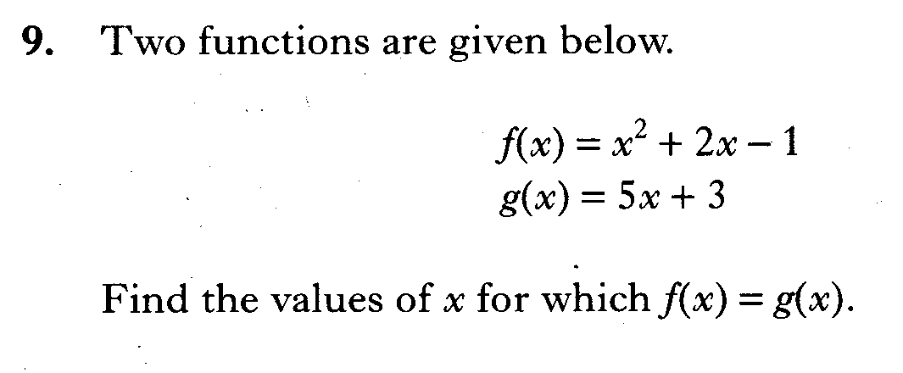

Slide 67
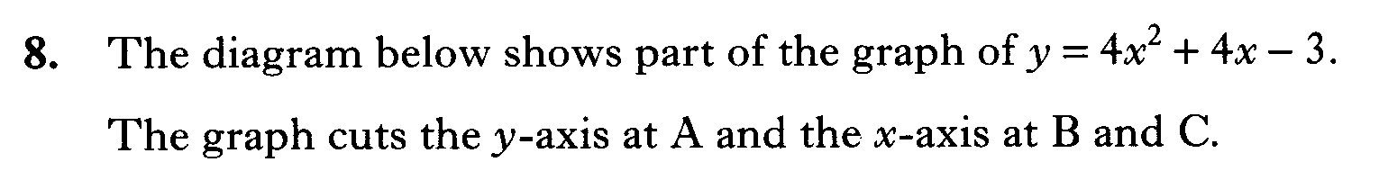
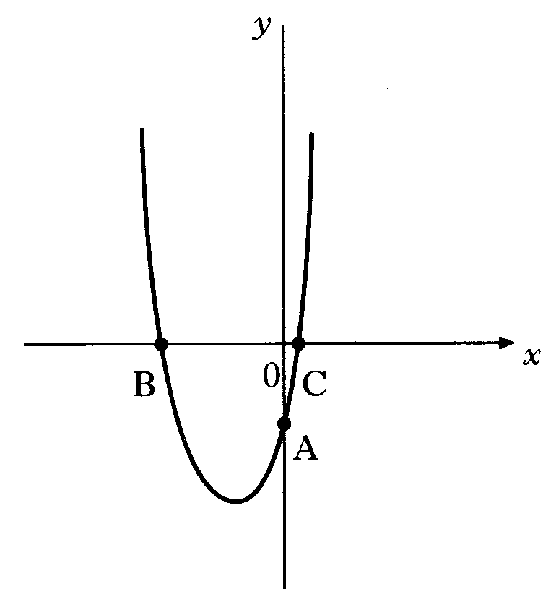
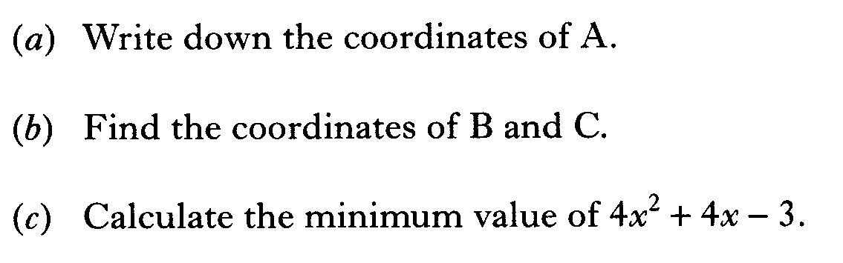

Slide 68
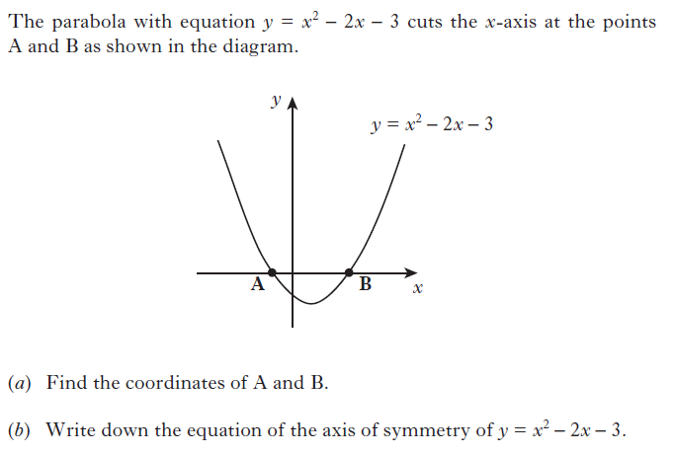

Slide 69
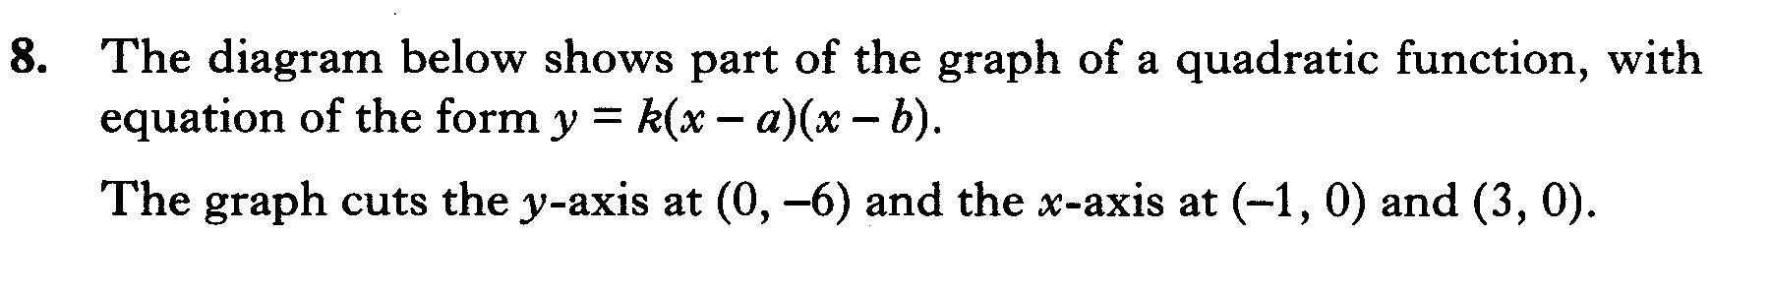
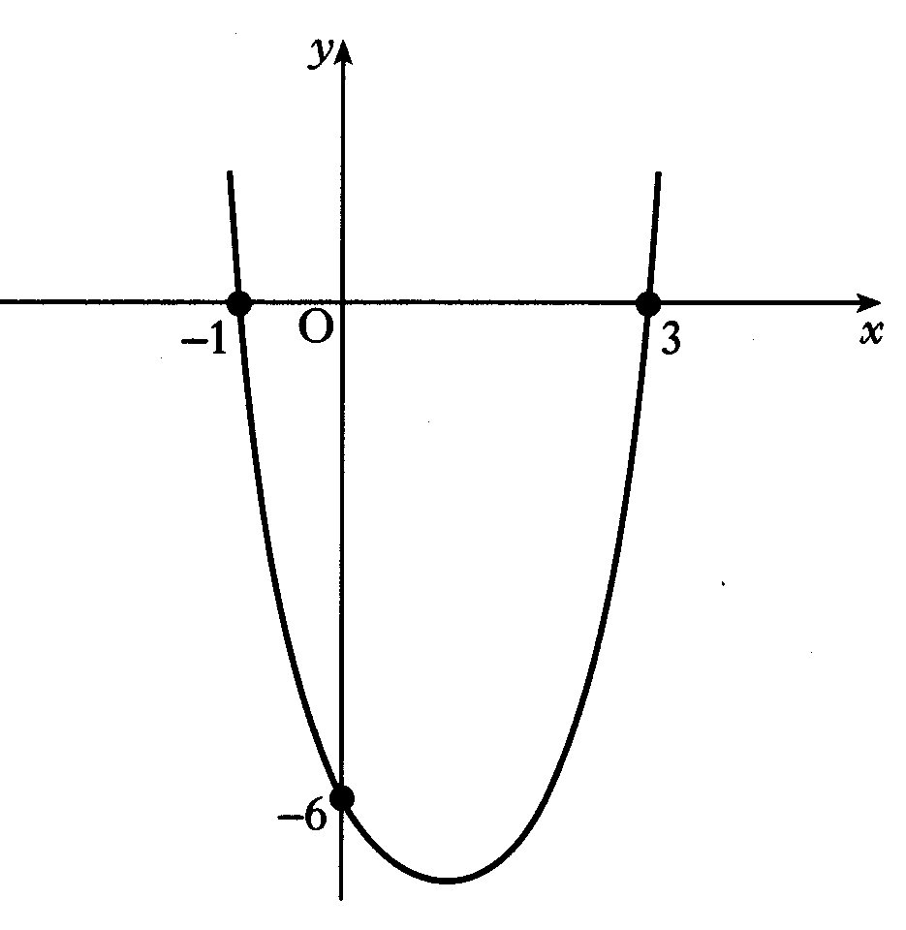
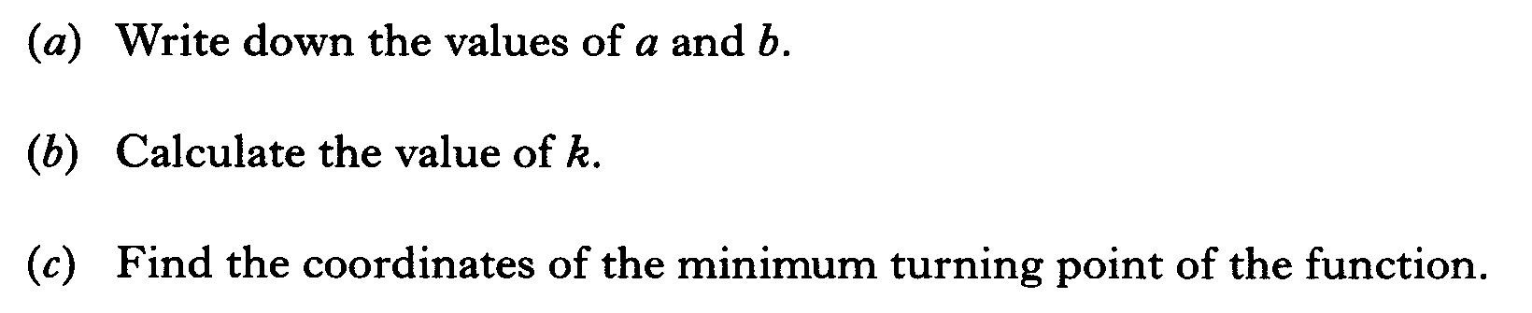

Slide 70
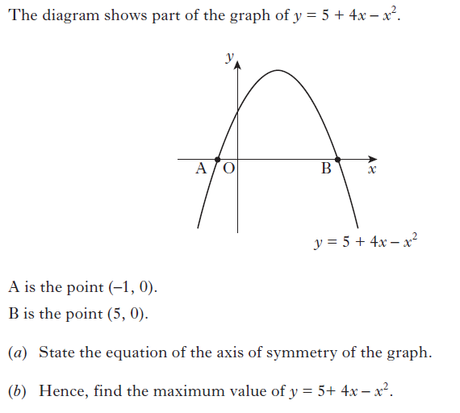

Slide 71


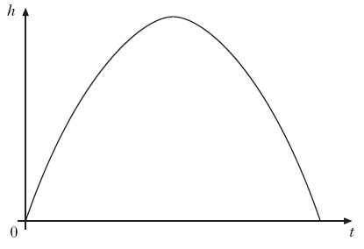


Slide 72
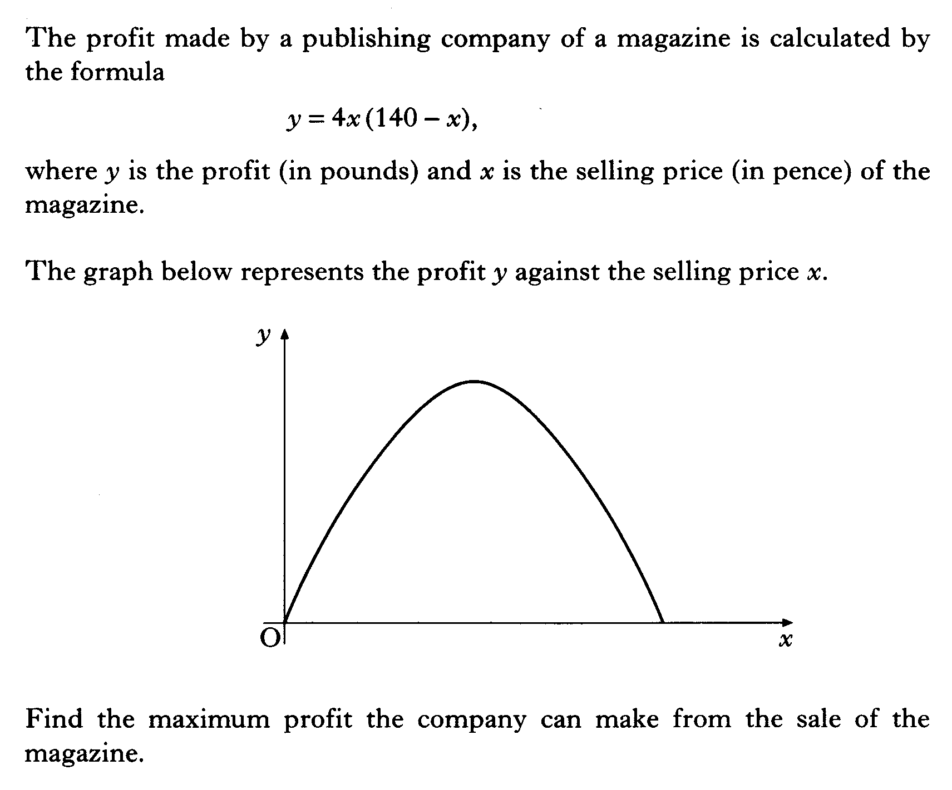

Slide 73
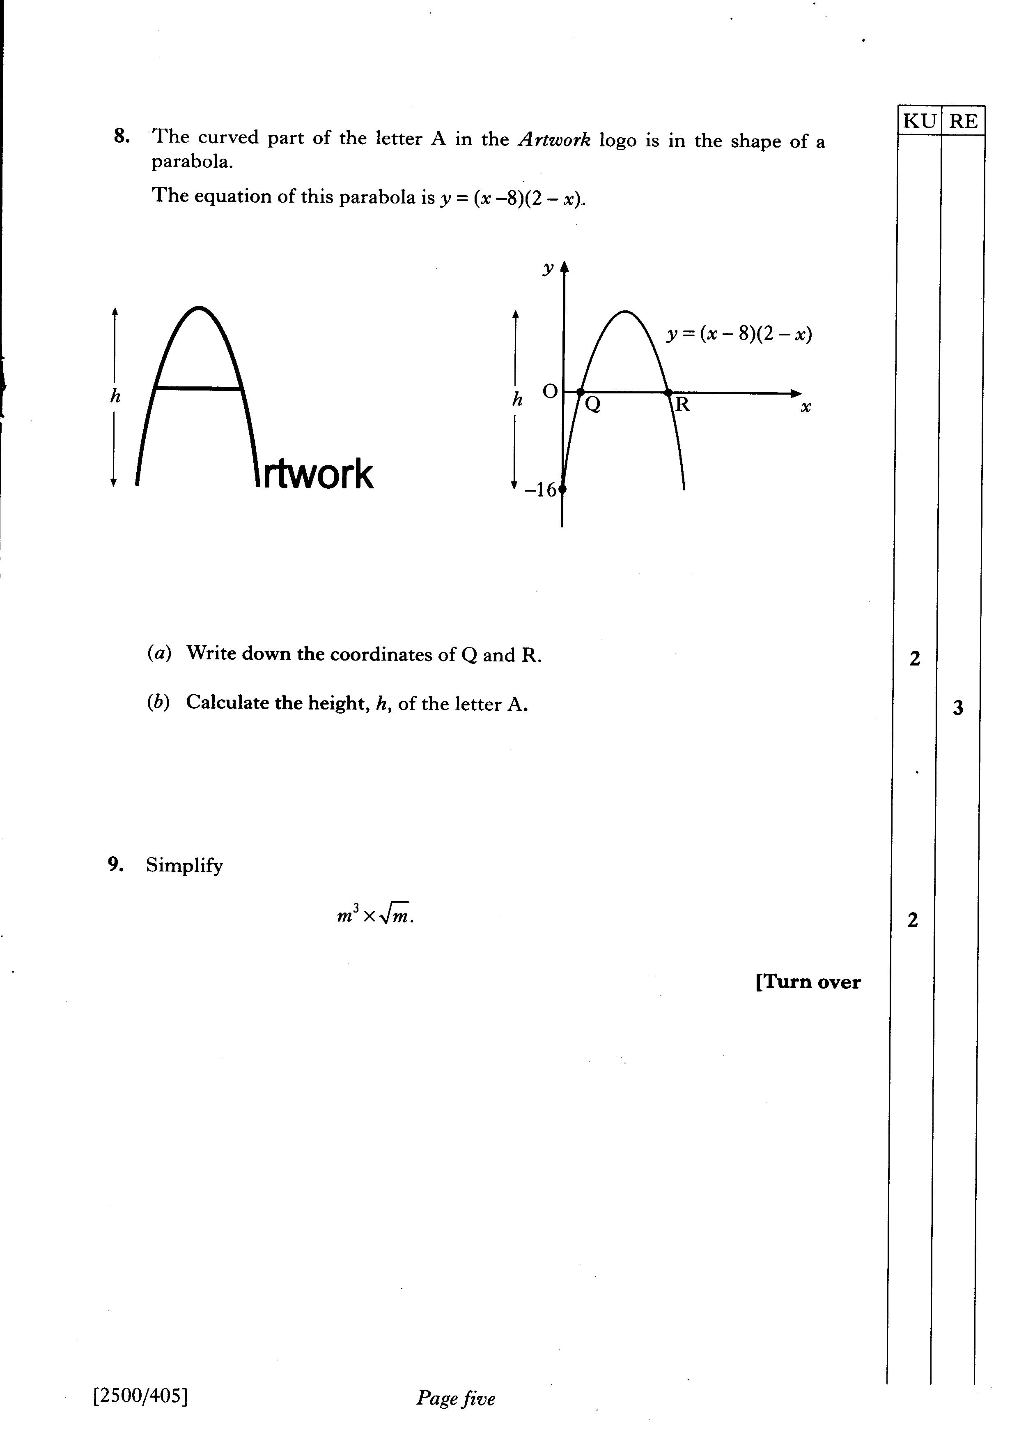

Slide 74
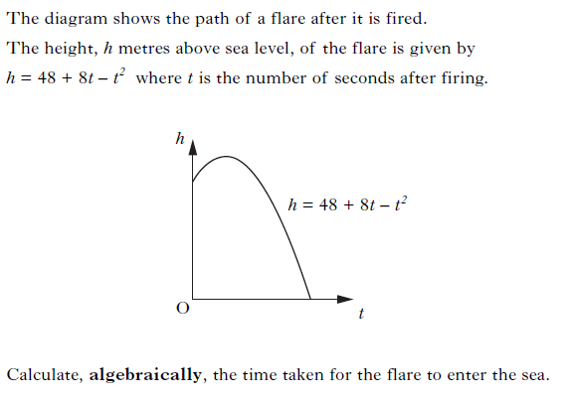

Slide 75
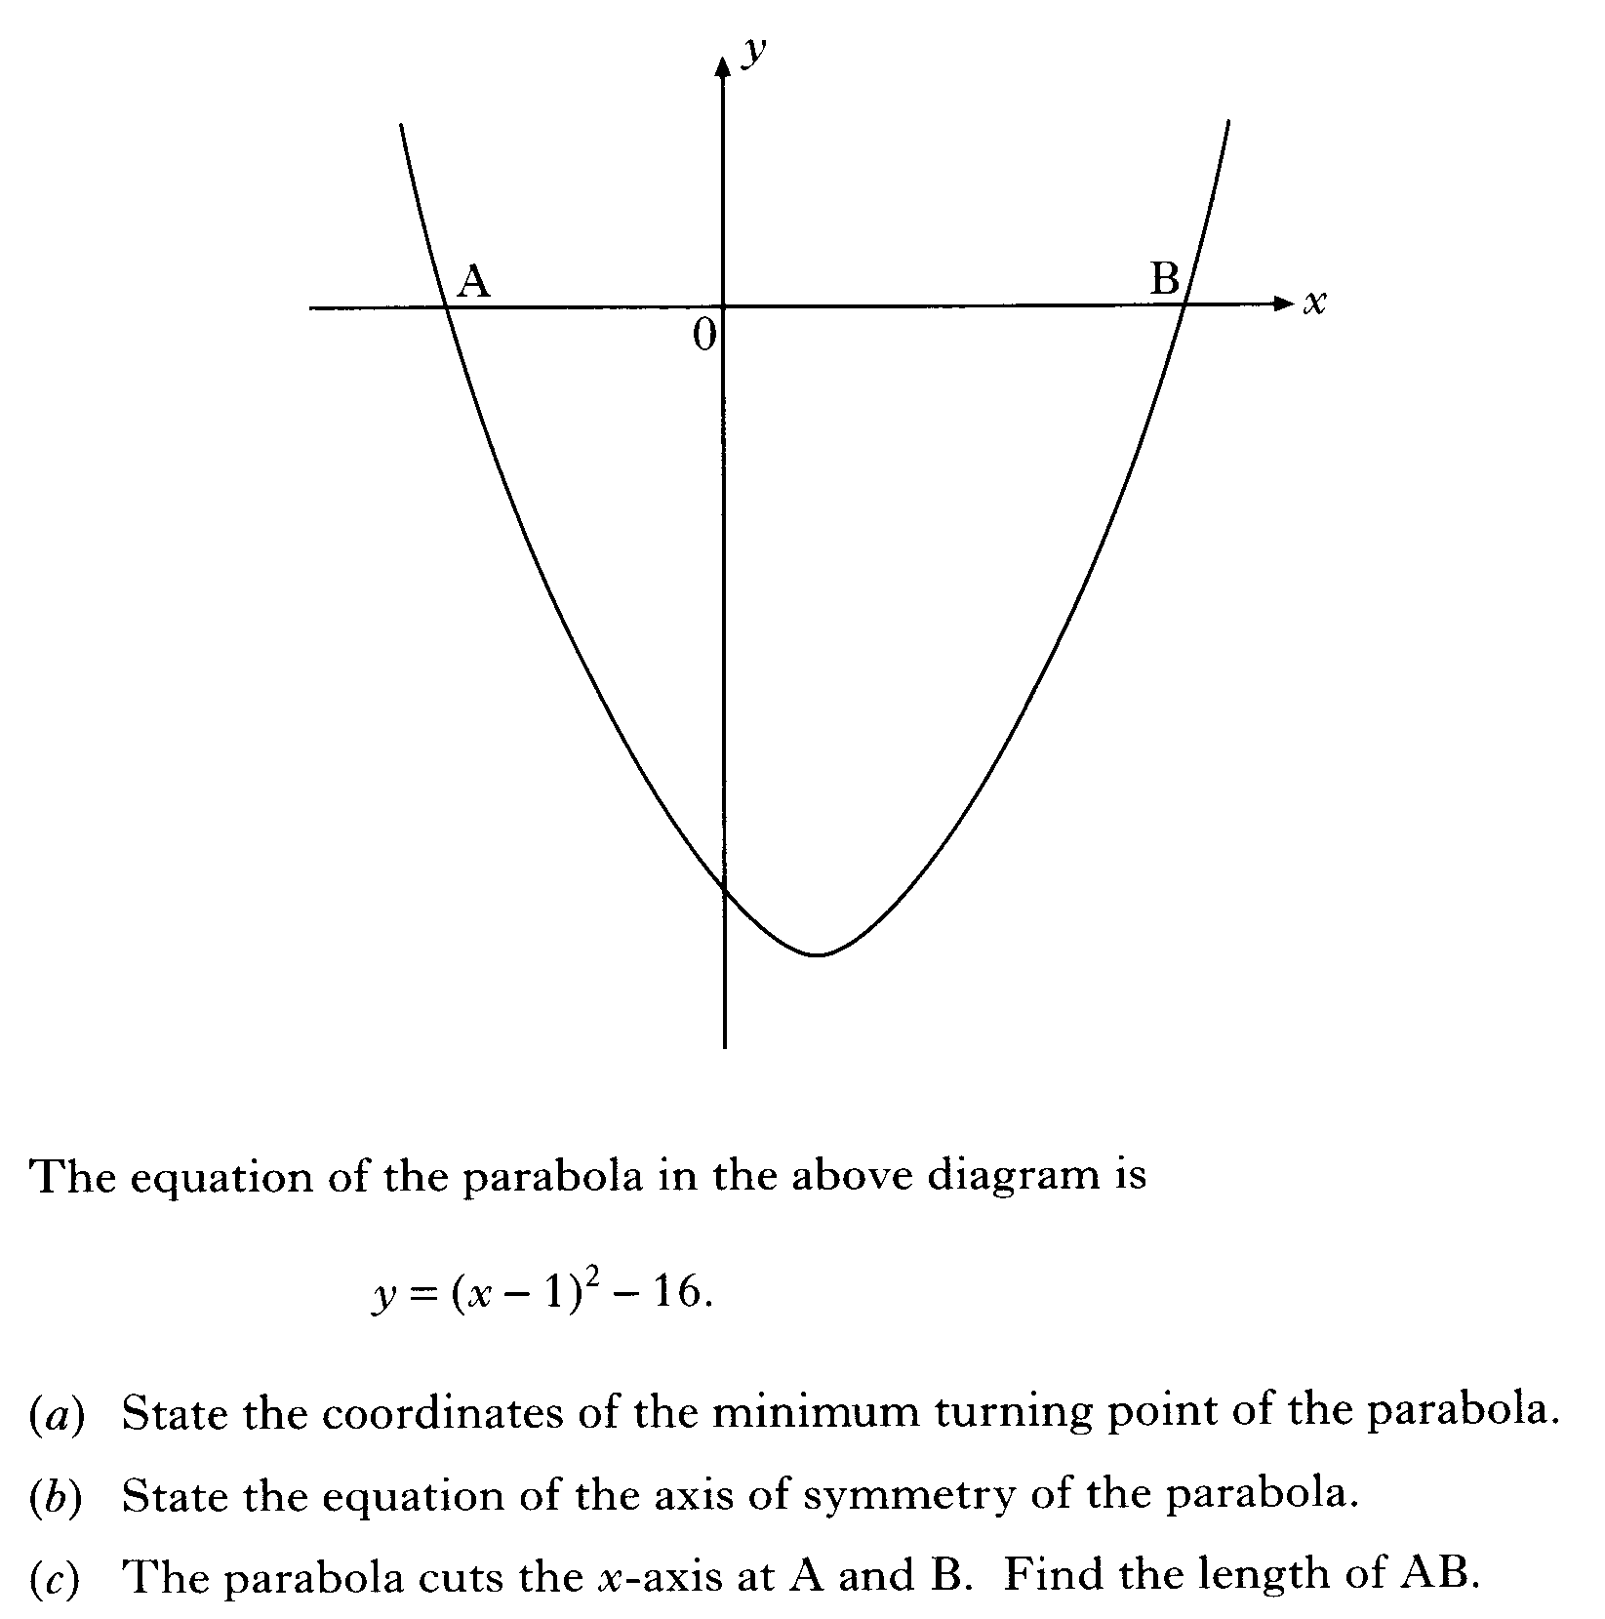

Slide 76
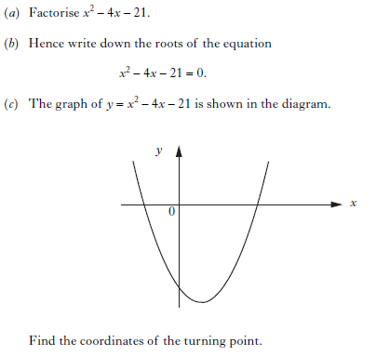

Slide 77
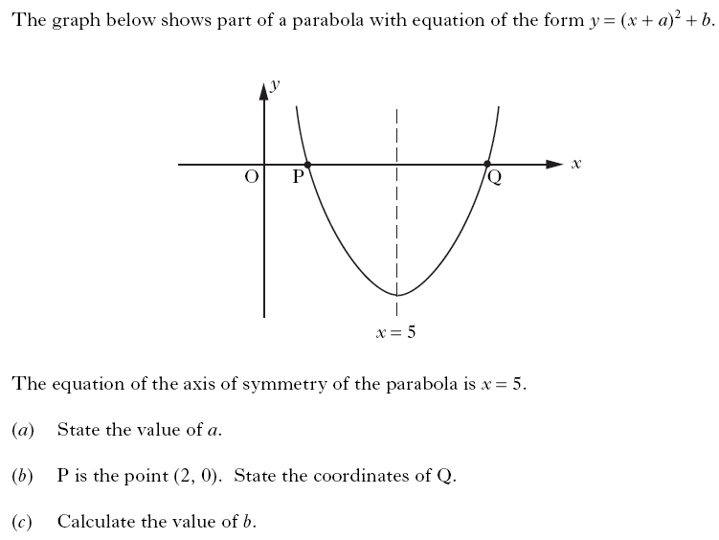

Slide 78
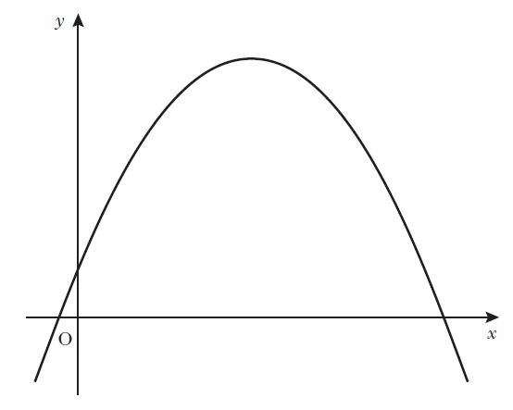


Slide 79
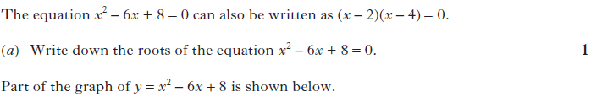
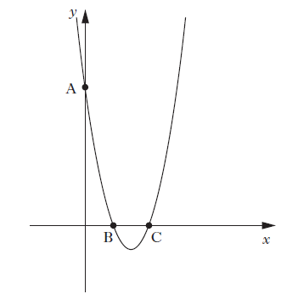


Slide 80
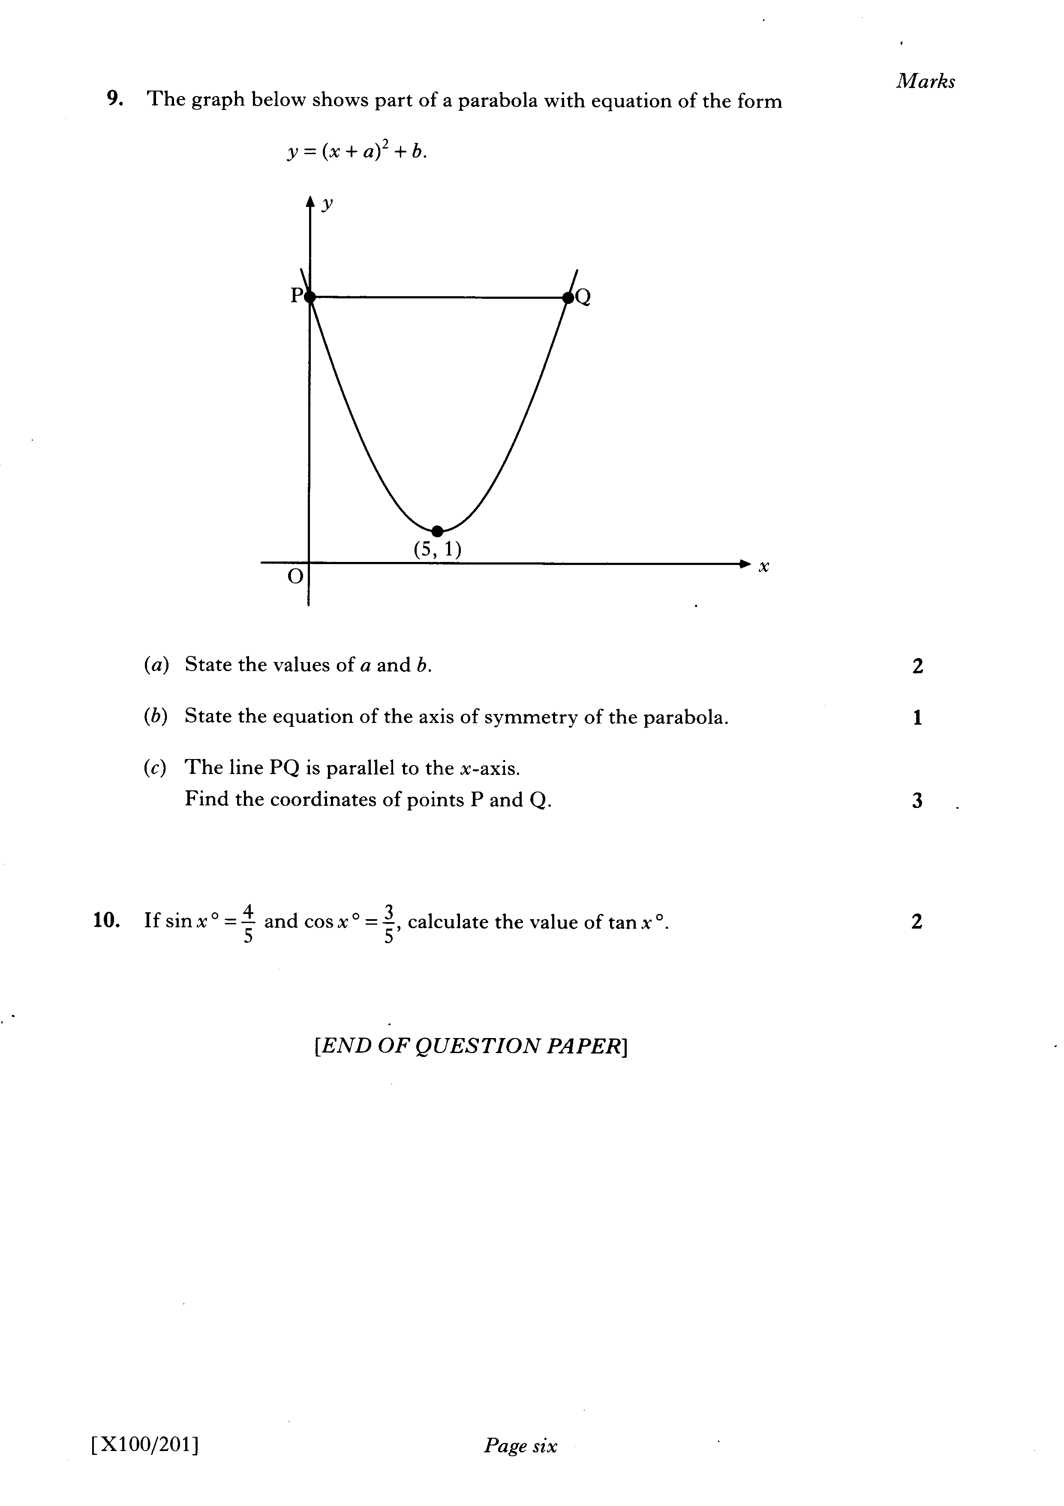

Slide 81
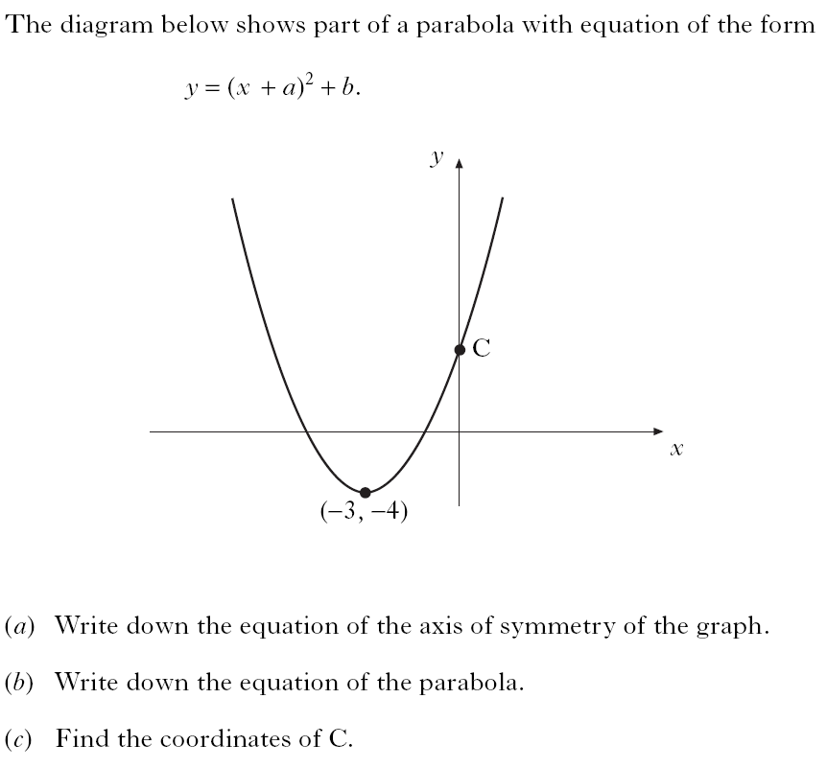

Slide 82
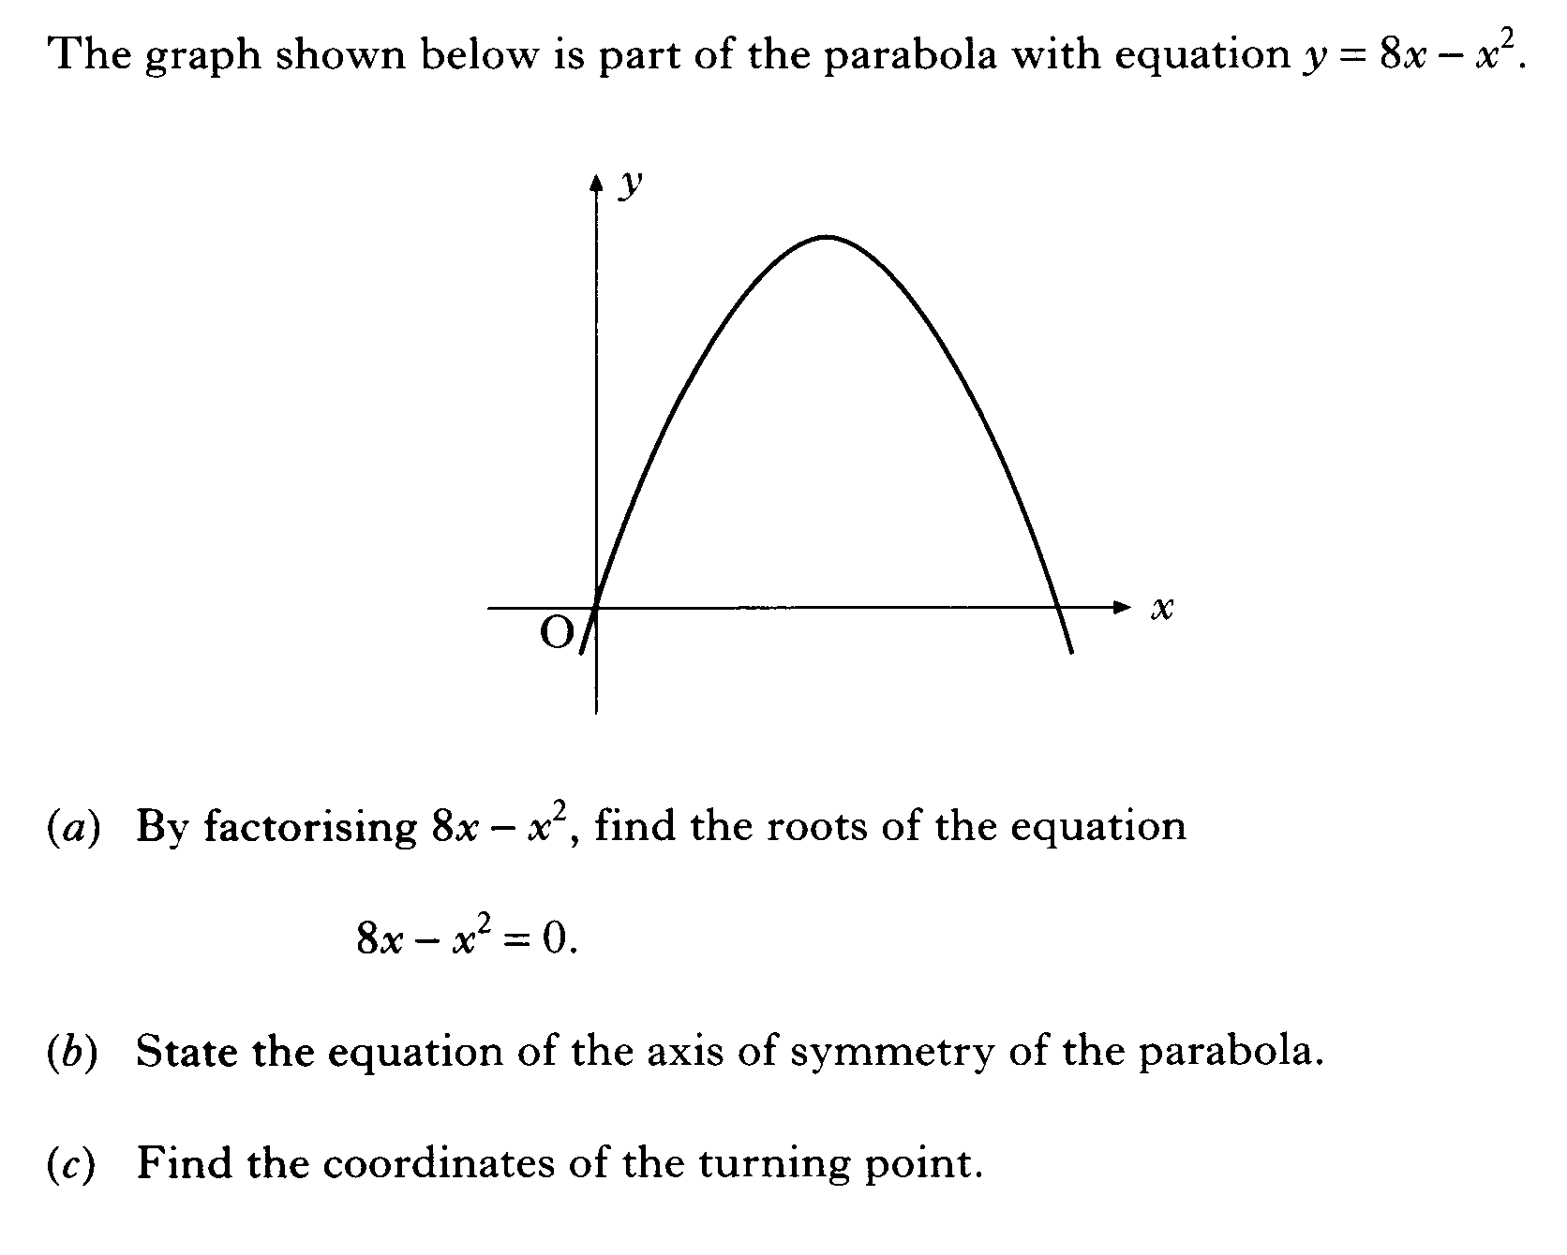

Slide 83
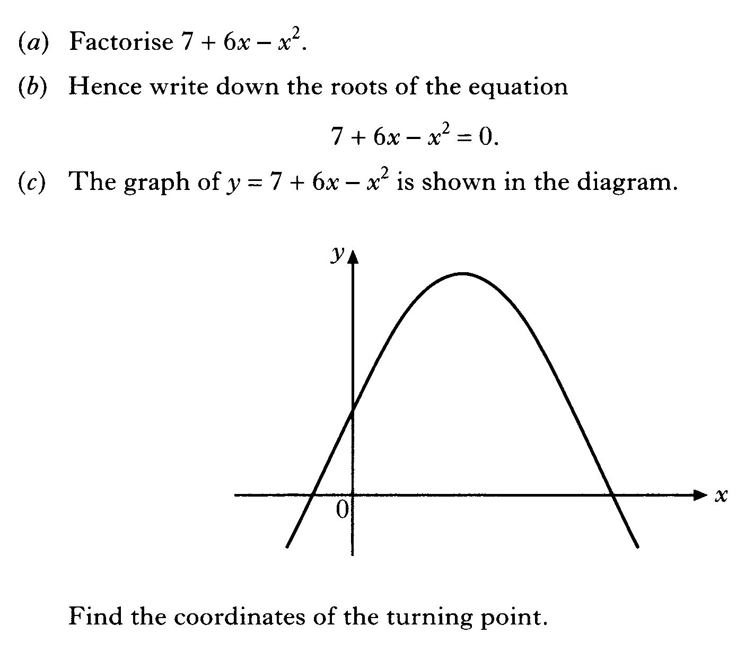

Slide 84
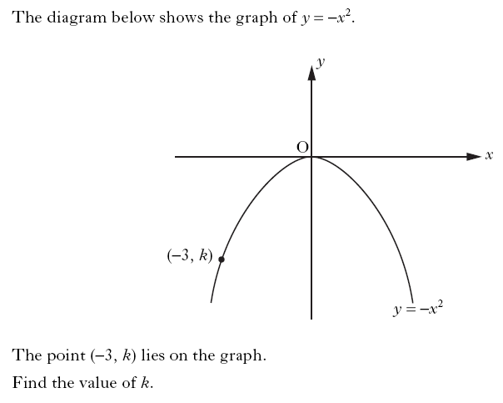

Slide 85
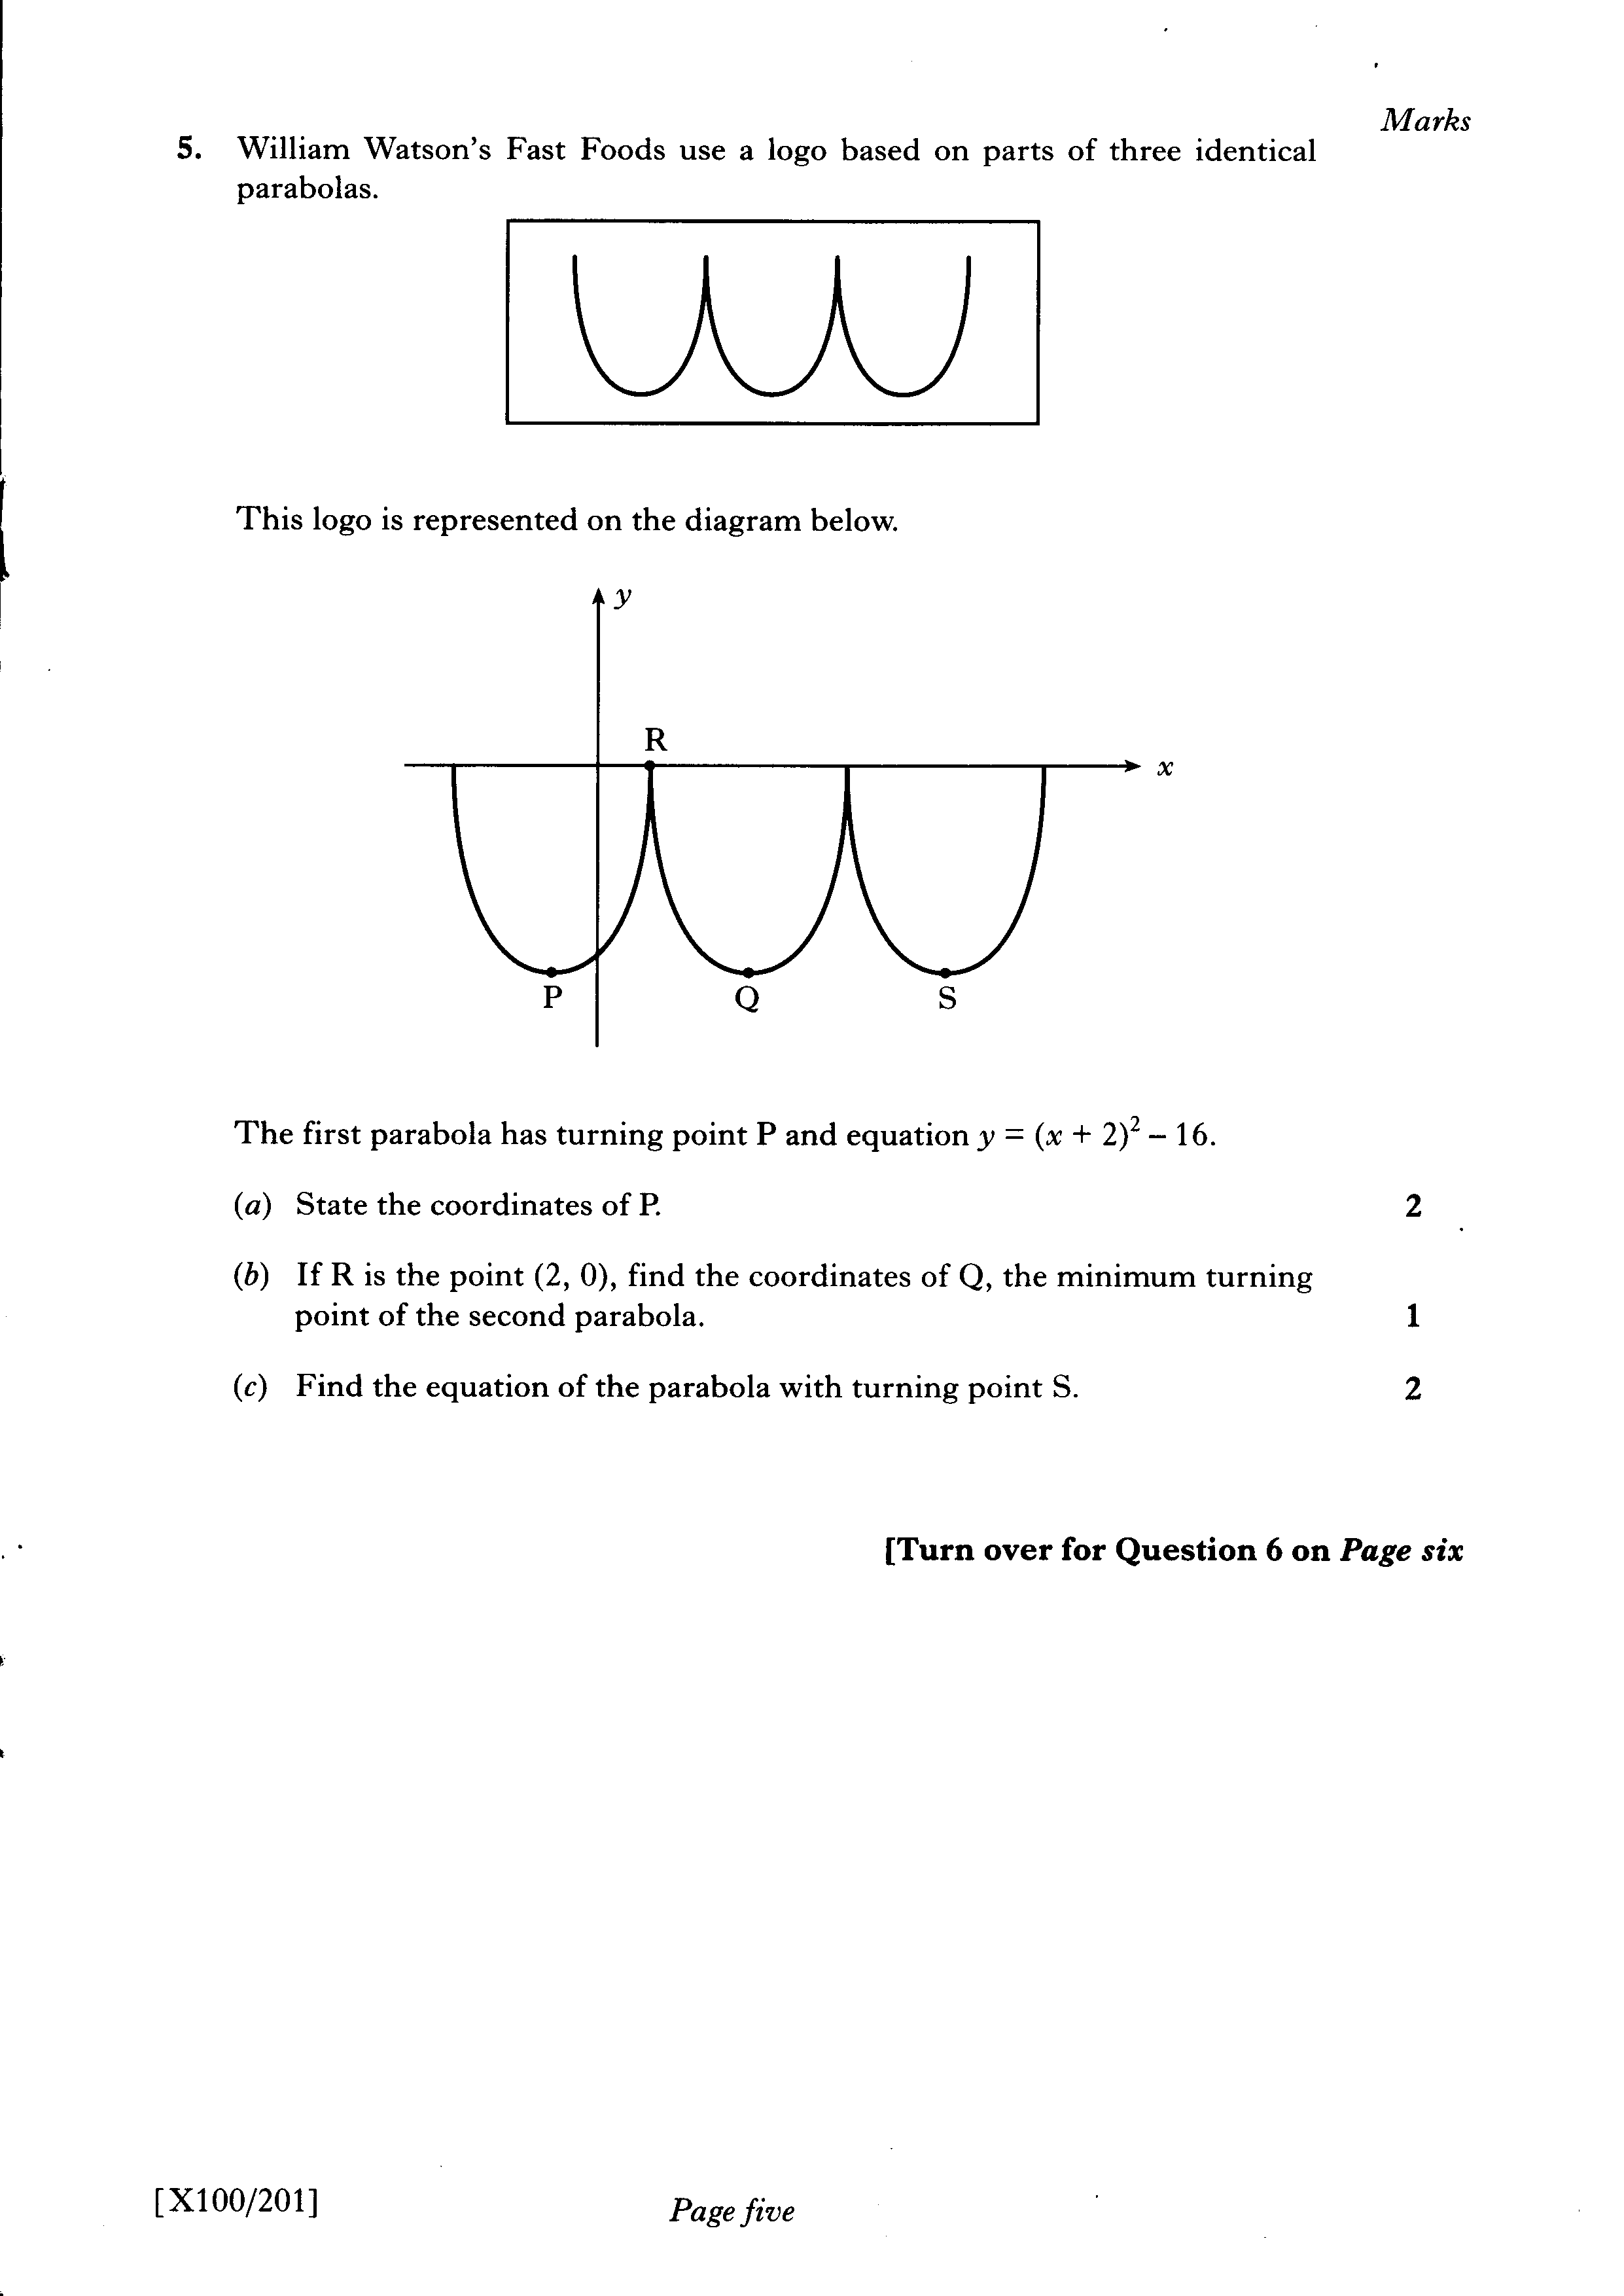

Slide 86
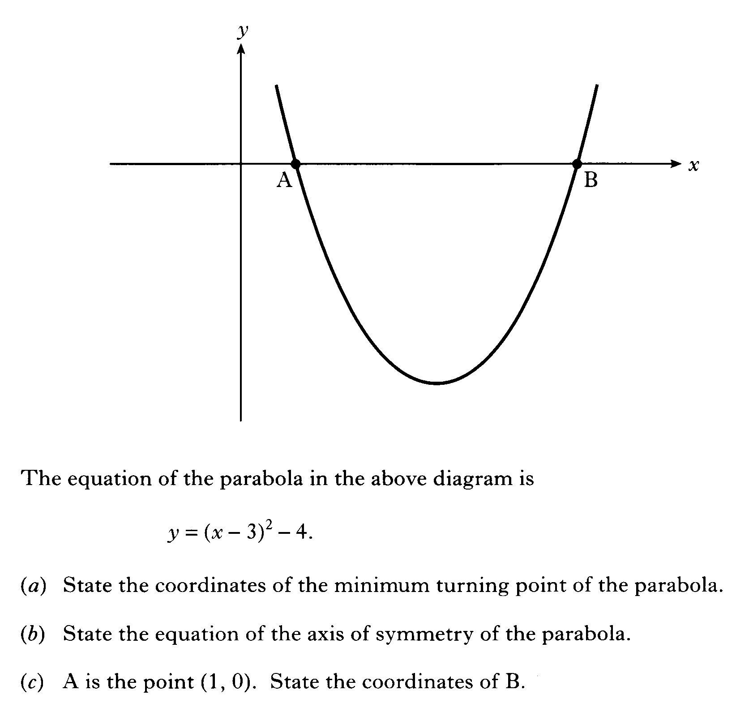

Slide 87
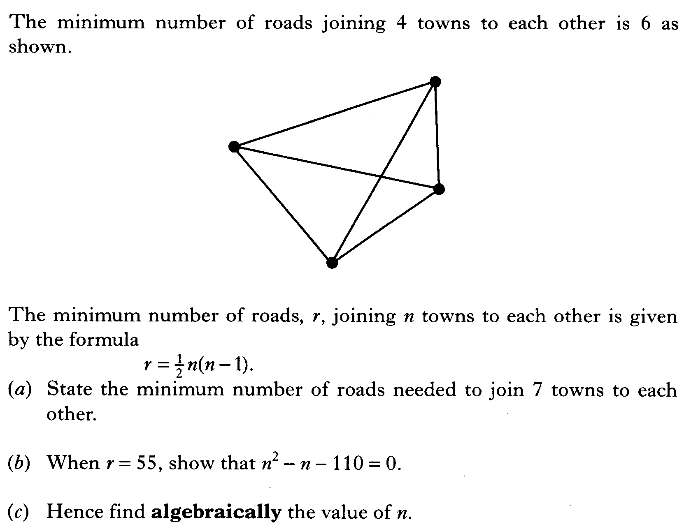

Slide 88
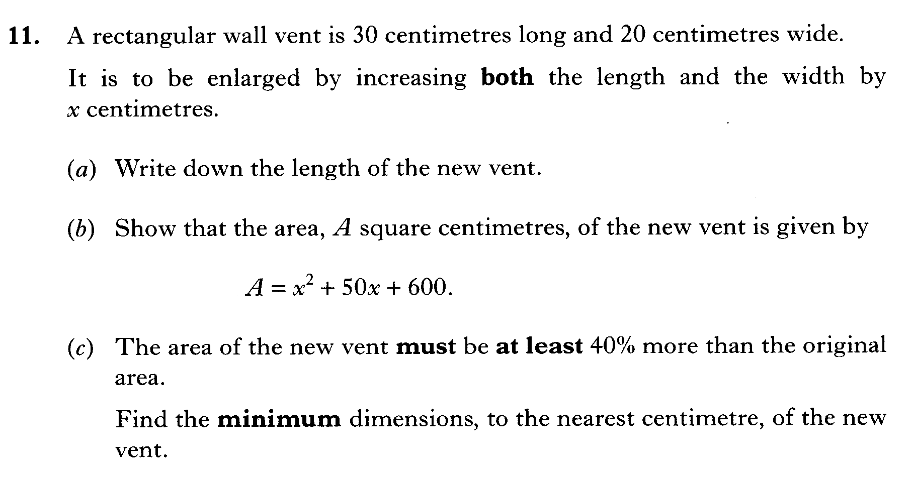

Slide 89
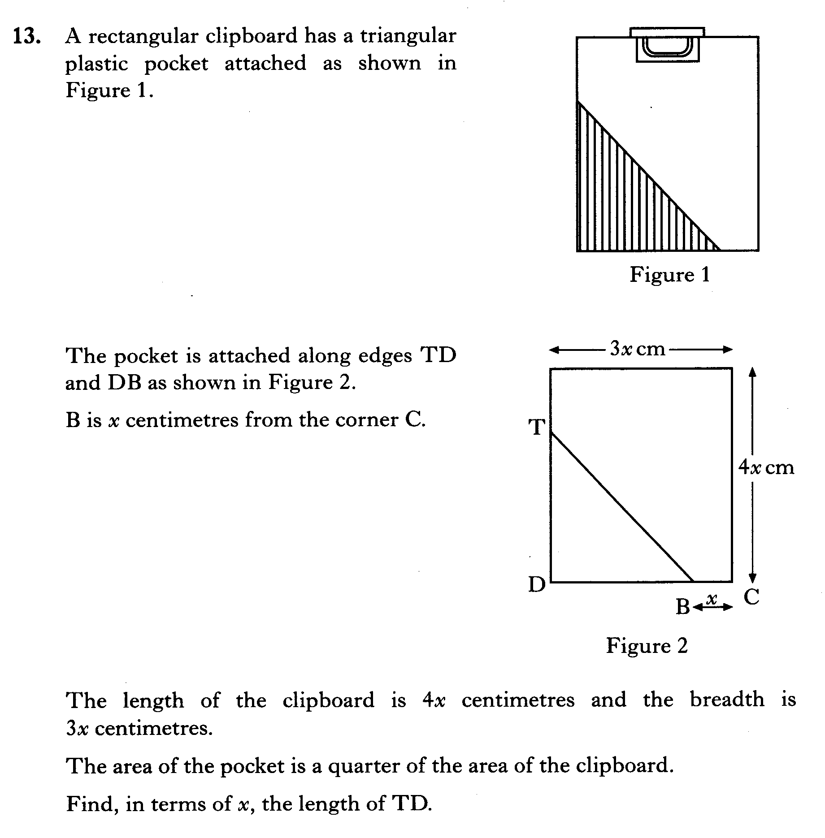

Slide 90
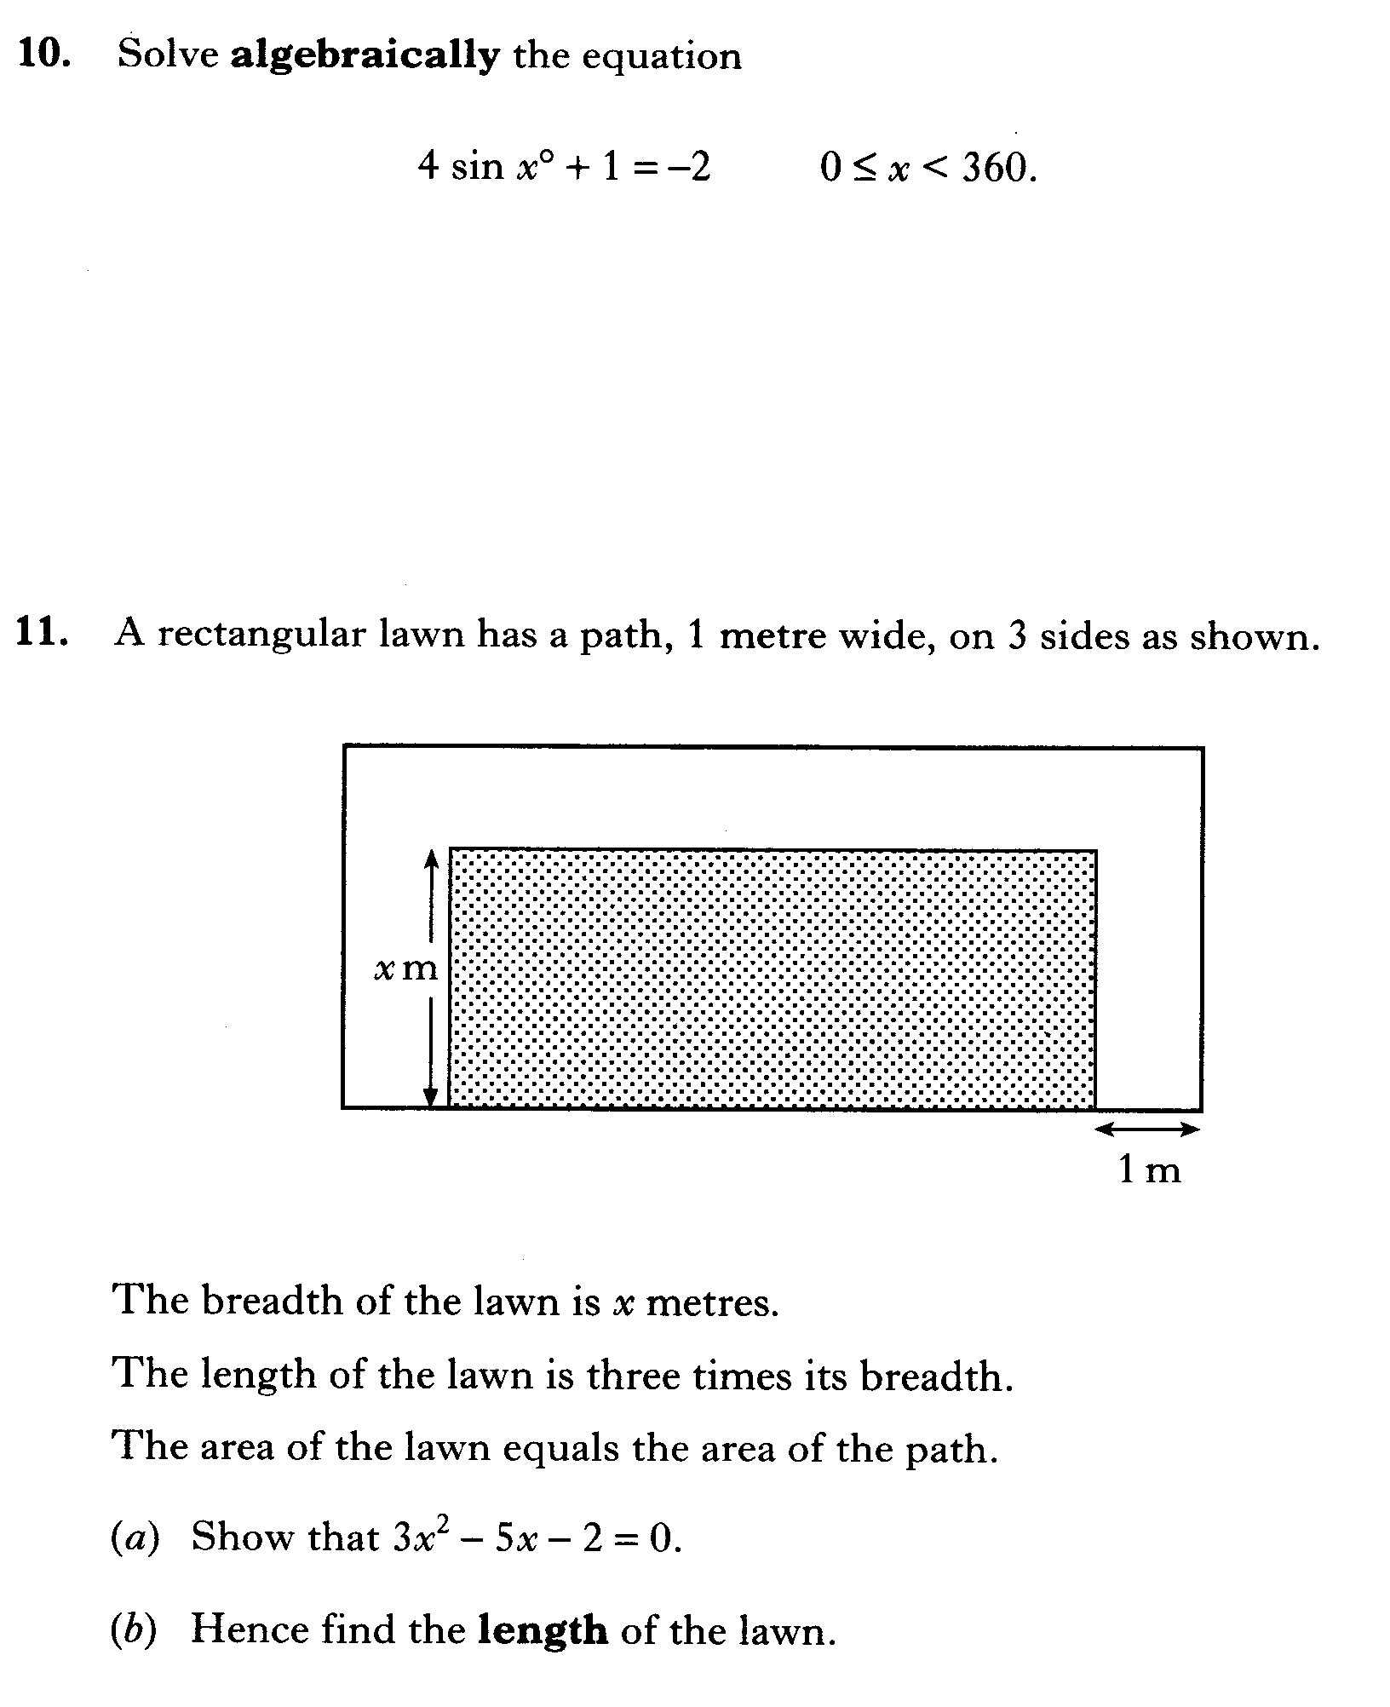

Slide 91
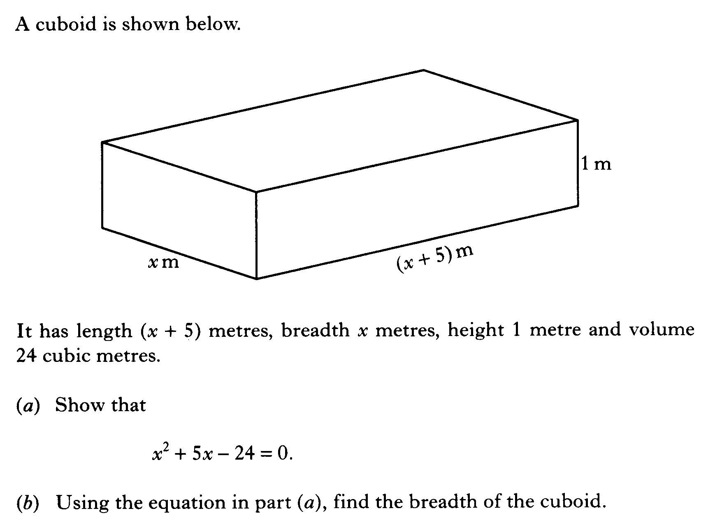

Slide 92
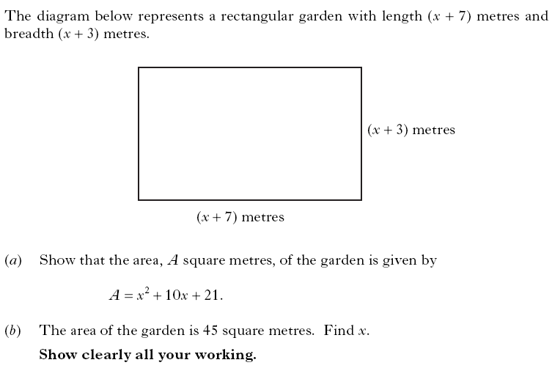

Slide 93
