Slide 1


Statistics
Nat 5
Mode, Mean, Median and Range
Quartiles
Semi-Interquartile Range ( SIQR )
Boxplots – Five Figure Summary
www.mathsrevision.com
Full Standard Deviation
Sample Standard Deviation
Exam questions

Slide 2
Starter Questions
42º
xº
www.mathsrevision.com

Slide 3
Statistics
Averages
Learning Intention
Success Criteria
  We are revising the terms mean, median, mode and range.
  Understand the terms mean, range, median and mode.
To be able to calculate mean, range, mode and median.
www.mathsrevision.com

Slide 4
Statistics
Finding the mode
Nat 5
The mode or modal value in a set of data is the data value that appears the most often.
For example, the number of goals scored by the local football team in the last ten games is:
2,
2,
1,
1,
2,
2,
0,
0,
0,
0,
2,
2,
3,
3,
1,
1,
2,
2,
1.
1.
www.mathsrevision.com
What is the modal score?
2.
Is it possible to have more than one modal value?
Yes
Is it possible to have no modal value?
Yes

Slide 5
Statistics
The mean
Nat 5
The mean is the most commonly used average.
To calculate the mean of a set of values we add together the values and divide by the total number of values.
Sum of values
Mean =
www.mathsrevision.com
Number of values
For example, the mean of 3, 6, 7, 9 and 9 is

Slide 6
Statistics
Finding the median
Nat 5
The median is the middle value of a set of numbers arranged in order. For example,
Find the median of
10,
7,
9,
12,
7,
8,
6,
www.mathsrevision.com
Write the values in order:
6,
7,
7,
8,
9,
10,
12.
The median is the middle value.

Slide 7
Statistics
Finding the median
Nat 5
When there is an even number of values, there will be two values in the middle.
For example,
Find the median of 56, 42, 47, 51, 65 and 43.
The values in order are:
www.mathsrevision.com
42,
43,
47,
51,
56,
65.
There are two middle values, 47 and 51.
47 + 51
98
=
= 49
2
2

Slide 8
Statistics
Finding the range
Nat 5
The range of a set of data is a measure of how the data is spread across the distribution.
To find the range we subtract the lowest value in the set from the highest value.
www.mathsrevision.com
Range = Highest value – Lowest value
When the range is small; the values are similar in size.
When the range is large; the values vary widely in size.

Slide 9
Statistics
The range
Nat 5
Here are the high jump scores for two girls in metres.
Joanna | 1.62 | 1.41 | 1.35 | 1.20 | 1.15
Kirsty | 1.59 | 1.45 | 1.41 | 1.30 | 1.30
Find the range for each girl’s results and use this to find out who is consistently better.
www.mathsrevision.com
Joanna’s range = 1.62 – 1.15 = 0.47
Kirsty is consistently better !
Kirsty’s range = 1.59 – 1.30 = 0.29

Slide 10
Frequency Tables
Working Out the Mean
Nat 5
Example : This table shows the number
of light bulbs used in people’s living rooms
No of Bulbs (c) | Freq. (f)
(f) x (B)
Adding a third column to this table
will help us find the total number of
bulbs and the ‘Mean’.
1
7
7 x 1 = 7
2
5
5 x 2 = 10
www.mathsrevision.com
3
5
5 x 3 = 15
4
2
2 x 4 = 8
5
1
1 x 5 = 5
Totals
20
45

Slide 11

Statistics
Averages
Nat 5
Now try N5 TJ
Ex 11.1
Ch11 (page 104)
www.mathsrevision.com

Slide 12
Lesson Starter
Nat 5
Q1.
Q2. Calculate sin 90º
www.mathsrevision.com
Q3. Factorise 5y² – 10y
Q4.
A circle is divided into 10 equal pieces.
Find the arc length of one piece of the circle
if the radius is 5cm.

Slide 13
Quartiles
Nat 5
Learning Intention
Success Criteria
  We are learning about Quartiles.
  1. Understand the term Quartile.
  2. Be able to calculate the Quartiles for a set of data.
www.mathsrevision.com

Slide 14
Statistics
Nat 5
Quartiles
Quartiles : Splits a dataset into 4 equal lengths.
Median
25%
50%
75%
Q₁
Q₂
Q₃
www.mathsrevision.com
25%
25%
25%
25%

Slide 15
Statistics
Nat 5
Quartiles
Note : Dividing the number of values in the dataset by 4
and looking at the remainder helps to identify quartiles.
R1 means to can simply pick out Q₂ (Median)
R2 means to can simply pick out Q₁ and Q₃
www.mathsrevision.com
R3 means to can simply pick out Q_{1 ,} Q₂ and Q₃
R0 means you need calculate them all

Slide 16
Statistics
Semi-interquartile Range (SIQR) = ( Q₃ – Q₁ ) ÷ 2
= ( 9 – 3 ) ÷ 2
= 3
Nat 5
Quartiles
Example 1 : For a list of 9 numbers find the SIQR
3, 3, 7, 8, 10, 9, 1, 5, 9
9 ÷ 4 = 2 R1
1 3 3 5 7 8 9 9 10
2 numbers
2 numbers
1 No.
2 numbers
2 numbers
Q1
Q2
Q3
The quartiles are
Q₁ : the 2nd and 3rd numbers
Q₂ : the 5th number
Q₃ : the 7th and 8th number.
www.mathsrevision.com
3
7
9

Slide 17
Statistics
Semi-interquartile Range (SIQR) = ( Q₃ – Q₁ ) ÷ 2
= ( 10 – 3 ) ÷ 2
= 3.5
Nat 5
Quartiles
Example 3 : For the ordered list find the SIQR.
3, 6, 2, 10, 12, 3, 4
7 ÷ 4 = 1 R3
2 3 3 4 6 10 12
1 number
1 number
1 number
1 number
www.mathsrevision.com
Q1
Q2
Q3
The quartiles are
Q₁ : the 2nd number
Q₂ : the 4th number
Q₃ : the 6th number.
3
4
10

Slide 18
Statistics
Averages
Now try N5 TJ
Ex 11.2
Ch11 (page 106)
www.mathsrevision.com

Slide 19
Lesson Starter
Nat 5
In pairs you have 3 minutes to
explain the various steps of factorising.
www.mathsrevision.com

Slide 20
Semi-Interquartile Range
Nat 5
Learning Intention
Success Criteria
  We are learning about Semi-Interquartile Range.
  1. Understand the term Semi-Interquartile Range.
  2. Be able to calculate the SIQR.
www.mathsrevision.com

Slide 21
Inter-Quartile Range
The range is not a good measure of spread because one extreme, (very high or very low value can have a big effect).
Another measure of spread is called the
Semi - Interquartile Range
and is generally a better measure of spread because it is not affected by extreme values.
www.mathsrevision.com

Slide 22
Finding the Semi-Interquartile range.
Example 1: Find the median and quartiles for the data below.
6, 3, 9, 8, 4, 10, 8, 4, 15, 8, 10
Order the data
Q₁
Q₂
Q₃
3, 4, 4, 6, 8, 8, 8, 9, 10, 10, 15,
Lower Quartile = 4
Upper Quartile = 10
Median = 8
Inter- Quartile Range = (10 - 4)/2 = 3

Slide 23
Finding the Semi-Interquartile range.
Example 2: Find the median and quartiles for the data below.
12, 6, 4, 9, 8, 4, 9, 8, 5, 9, 8, 10
Order the data
Q₁
Q₂
Q₃
4, 4, 5, 6, 8, 8, 8, 9, 9, 9, 10, 12
Lower Quartile = 5½
Upper Quartile = 9
Median = 8
Inter- Quartile Range = (9 - 5½) = 1¾

Slide 24
Statistics
Now try N5 TJ
Ex 11.3
Ch11 (page 108)
www.mathsrevision.com

Slide 25
Lesson Starter
Nat 5
In pairs you have 3 minutes to
come up with questions on
Straight Line Theory
( Remember you needed to know the answers to the questions )
www.mathsrevision.com

Slide 26
Boxplots
( 5 figure Summary)
Nat 5
Learning Intention
Success Criteria
  We are learning about Boxplots and five figure summary.
  1. Calculate five figure summary.
  Be able to construct a boxplot.
www.mathsrevision.com

Slide 27
Box and Whisker Diagrams.
Box plots are useful for comparing two or more sets of data like that shown below for heights of boys and girls in a class.
Anatomy of a Box and Whisker Diagram.
Lowest Value
Lower Quartile
Upper Quartile
Highest Value
Median
Whisker
Whisker
Box
4
5
6
7
8
9
10
11
12
Boys
130
140
150
160
170
180
cm
190
Girls
Demo

Slide 28
Drawing a Box Plot.
Example 1: Draw a Box plot for the data below
Q₁
Q₂
Q₃
4, 4, 5, 6, 8, 8, 8, 9, 9, 9, 10, 12
Lower Quartile = 5½
Upper Quartile = 9
Median = 8
4
5
6
7
8
9
10
11
12
Demo

Slide 29
Drawing a Box Plot.
Example 2: Draw a Box plot for the data below
Q₁
Q₂
Q₃
3, 4, 4, 6, 8, 8, 8, 9, 10, 10, 15,
Lower Quartile = 4
Upper Quartile = 10
Median = 8
3
4
5
6
7
8
9
10
11
12
13
14
15
Demo

Slide 30
Drawing a Box Plot.
Question: Stuart recorded the heights in cm of boys in his class as shown below. Draw a box plot for this data.
Q_{L}
Q₂
Q_{u}
137, 148, 155, 158, 165, 166, 166, 171, 171, 173, 175, 180, 184, 186, 186
Lower Quartile = 158
Upper Quartile = 180
Median = 171
130
140
150
160
170
180
cm
190
Demo

Slide 31
Drawing a Box Plot.
Question: Gemma recorded the heights in cm of girls in the same class and constructed a box plot from the data. The box plots for both boys and girls are shown below. Use the box plots to choose some correct statements comparing heights of boys and girls in the class. Justify your answers.
Boys
130
140
150
160
170
180
cm
190
Demo
Girls
1. The girls are taller on average.
2. The boys are taller on average.
3. The girls height is more consistent.
5. The smallest person is a girl
4. The boys height is more consistent.
6. The tallest person is a boy

Slide 32
Statistics
Now try N5 TJ
Ex 11.4
Ch11 (page 109)
www.mathsrevision.com
Demo

Slide 33
Starter Questions
Nat 5
www.mathsrevision.com

Slide 34
Standard Deviation
For a FULL set of Data
Nat 5
Learning Intention
Success Criteria
  1. We are learning the term Standard Deviation for a collection of data.
  Know the term Standard Deviation.
  2. Calculate the Standard Deviation for a collection of data.
www.mathsrevision.com

Slide 35
Standard Deviation
For a FULL set of Data
The range measures spread. Unfortunately any big
change in either the largest value or smallest score
will mean a big change in the range, even though only
one number may have changed.
www.mathsrevision.com
The semi-interquartile range is less sensitive to a single number changing but again it is only really based on two of the score.

Slide 36
Standard Deviation
For a FULL set of Data
A measure of spread which uses all the data is the
Standard Deviation
The deviation of a score is how much the score differs from the mean.
www.mathsrevision.com

Slide 37
Step 1 : Find the mean
375 ÷ 5 = 75
Step 5 :
Take the square root of step 4
√13.6 = 3.7
Standard Deviation is 3.7 (to 1d.p.)
Step 2 : Score - Mean
Step 4 : Mean square deviation
68 ÷ 5 = 13.6
Standard Deviation
For a FULL set of Data
Step 3 : (Deviation)²
Example 1 : Find the standard deviation of these five
scores 70, 72, 75, 78, 80.
 | Score | Deviation | (Deviation)²
 | 70
 | 72
 | 75
 | 78
 | 80
Totals | 375
-5
25
-3
9
www.mathsrevision.com
0
0
3
9
5
25
0
68

Slide 38
Step 1 : Find the mean
180 ÷ 6 = 30
Step 5 :
Take the square root of step 4
√160.33 = 12.7 (to 1d.p.)
Standard Deviation is £12.70
Step 2 : Score - Mean
Step 4 : Mean square deviation
962 ÷ 6 = 160.33
Step 3 : (Deviation)²
Standard Deviation
For a FULL set of Data
Example 2 : Find the standard deviation of these six
amounts of money £12, £18, £27, £36, £37, £50.
 | Score | Deviation | (Deviation)²
 | 12
 | 18
 | 27
 | 36
 | 37
 | 50
Totals | 180
-18
324
-12
144
www.mathsrevision.com
-3
9
6
36
7
49
20
400
0
962

Slide 39
Standard Deviation
For a FULL set of Data
When Standard Deviation
is LOW it means the data
values are close to the
MEAN.
When Standard Deviation
is HIGH it means the data
values are spread out from
the MEAN.
www.mathsrevision.com
Mean
Mean

Slide 40
Standard Deviation
For a FULL set of Data
Now try N5 TJ
Ex 11.5 Q1 & Q2
Ch11 (page 111)
www.mathsrevision.com

Slide 41
Starter Questions
Nat 5
In pairs you have 6 mins to write down
everything you know about the circle theory.
Come up with a circle type of question
you could be asked at National 5 Level.
www.mathsrevision.com

Slide 42
Standard Deviation
For a Sample of Data
Nat 5
Standard deviation
Learning Intention
Success Criteria
  1. We are learning how to calculate the Sample Standard deviation for a sample of data.
  Know the term Sample Standard Deviation.
  2. Calculate the Sample Standard Deviation for a collection of data.
www.mathsrevision.com

Slide 43
Standard Deviation
For a Sample of Data
We will use this version because it is easier to use in practice !
In real life situations it is normal to work with a sample
of data ( survey / questionnaire ).
We can use two formulae to calculate the sample deviation.
www.mathsrevision.com
s = standard deviation
∑ = The sum of
x = sample mean
n = number in sample

Slide 44
Q1a. Calculate the mean :
592 ÷ 8 = 74
Step 2 :
Square all the values and find the total
Step 3 :
Use formula to calculate sample deviation
Step 1 :
Sum all the values
Q1a. Calculate the sample deviation
Standard Deviation
For a Sample of Data
Example 1a : Eight athletes have heart rates
70, 72, 73, 74, 75, 76, 76 and 76.
 | Heart rate (x) | x²
 | 70
 | 72
 | 73
 | 74
 | 75
 | 76
 | 76
 | 76
Totals
4900
5184
5329
www.mathsrevision.com
5476
5625
5776
5776
5776
∑x = 592
∑x² = 43842

Slide 45
Q1b(i) Calculate the mean :
720 ÷ 8 = 90
Q1b(ii) Calculate the sample deviation
Standard Deviation
For a Sample of Data
Example 1b : Eight office staff train as athletes.
Their Pulse rates are 80, 81, 83, 90, 94, 96, 96 and 100 BPM
 | Heart rate (x) | x²
 | 80
 | 81
 | 83
 | 90
 | 94
 | 96
 | 96
 | 100
Totals
6400
6561
6889
www.mathsrevision.com
8100
8836
9216
9216
10000
∑x = 720
∑x² = 65218

Slide 46
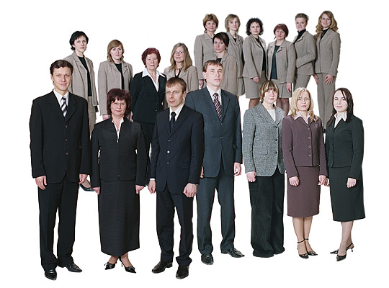

Q1b(iii) Who are fitter the athletes or staff.
Compare means
Athletes are fitter
Q1b(iv) What does the deviation tell us.
Staff data is more spread out.
Standard Deviation
For a Sample of Data
www.mathsrevision.com
Athletes
Staff

Slide 47

Have you updated your Learning Log ?
Standard Deviation
For a FULL set of Data
Now try N5 TJ
Ex 11.5 Q3 onwards
Ch11 (page 113)
www.mathsrevision.com
Are you on Target ?
I can ?
Are you on Target ?
I can ?
Mindmap

Slide 48
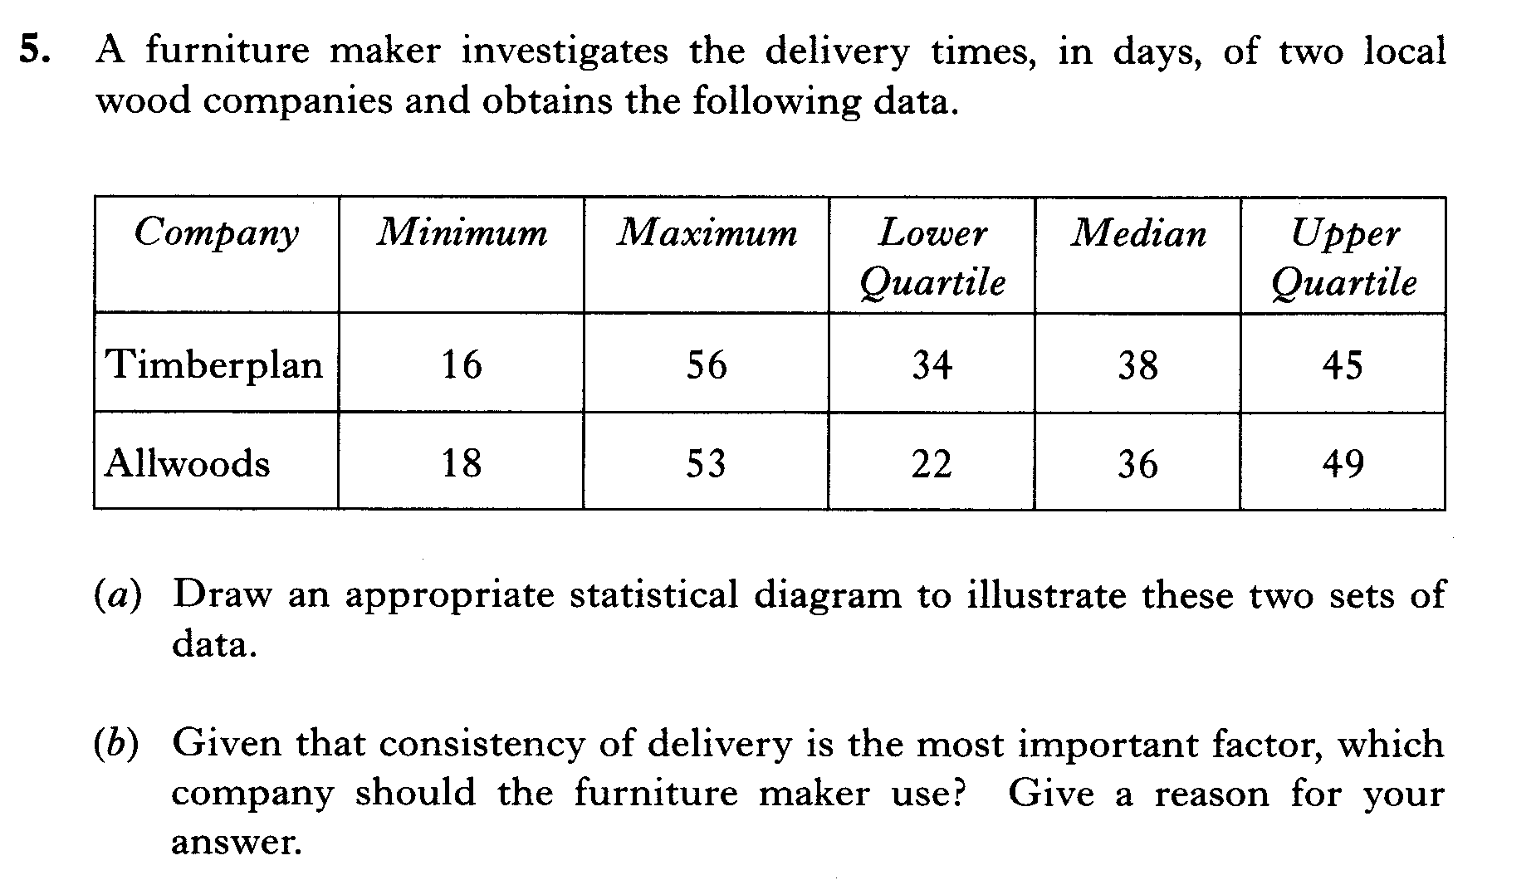

Slide 49
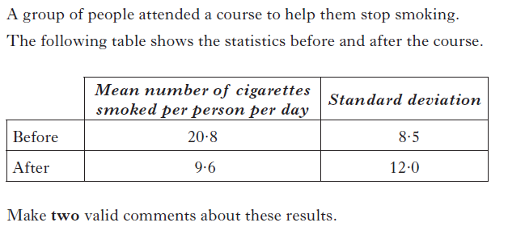

Slide 50
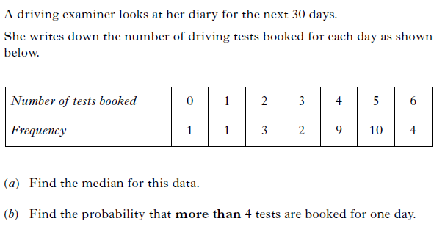

Slide 51
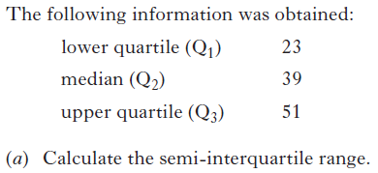
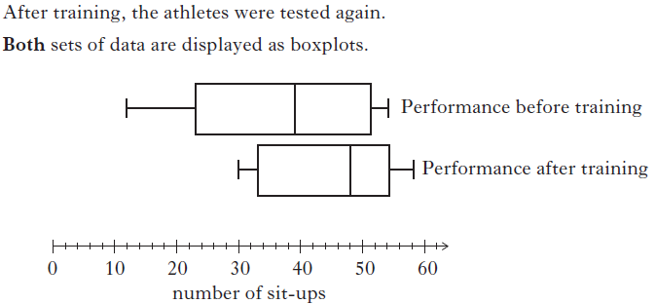

Slide 52
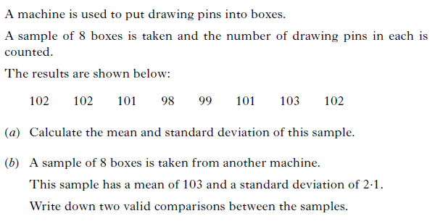

Slide 53
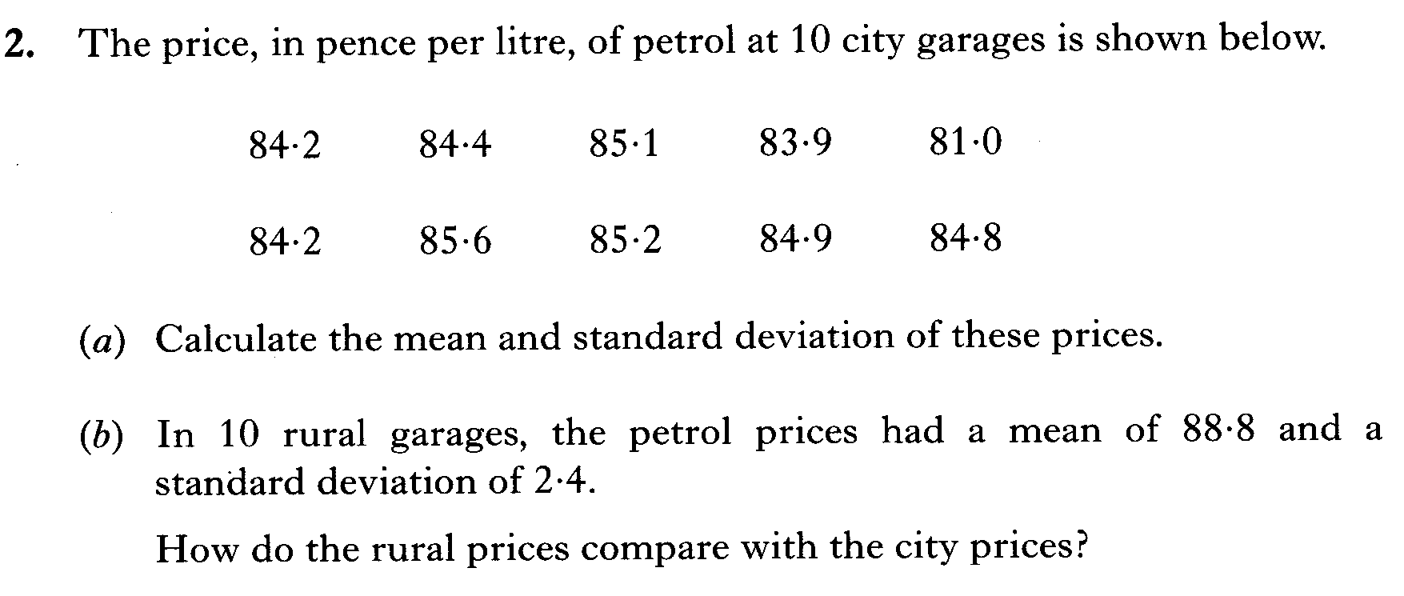

Slide 54
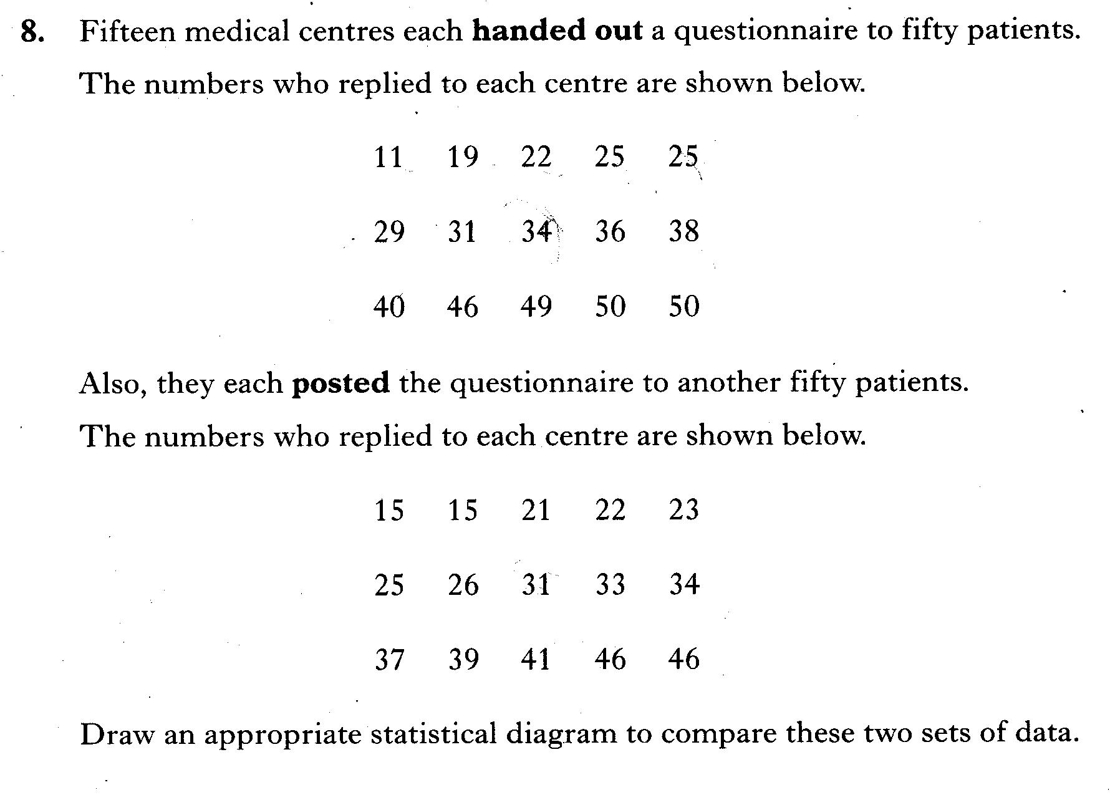

Slide 55
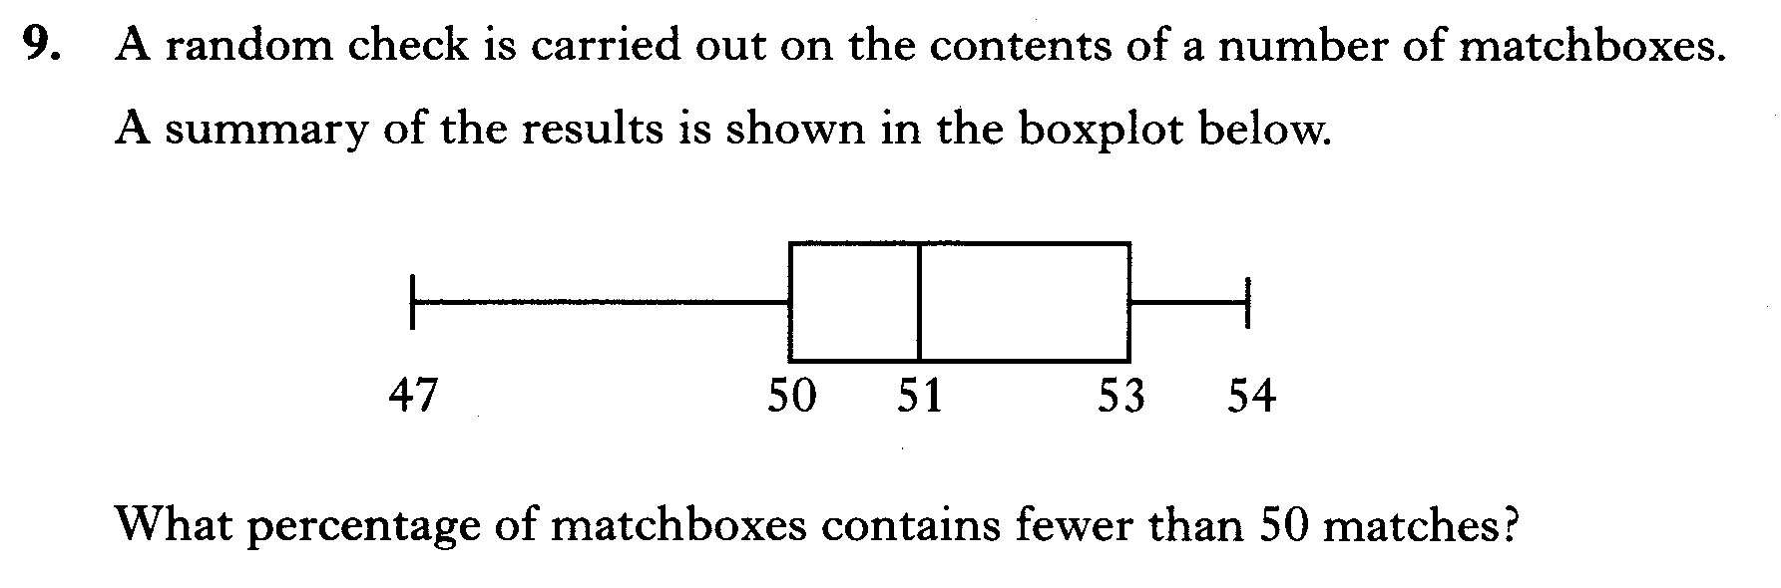

Slide 56
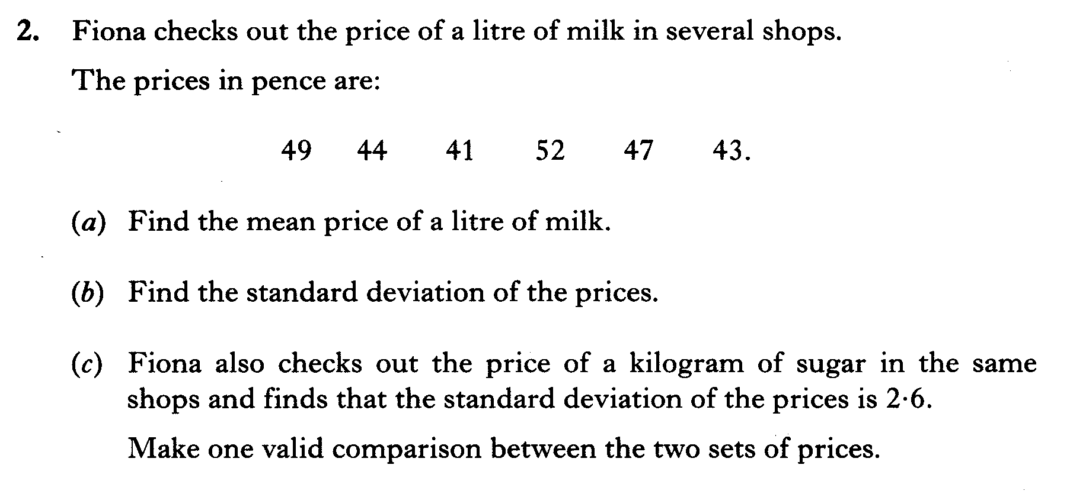

Slide 57
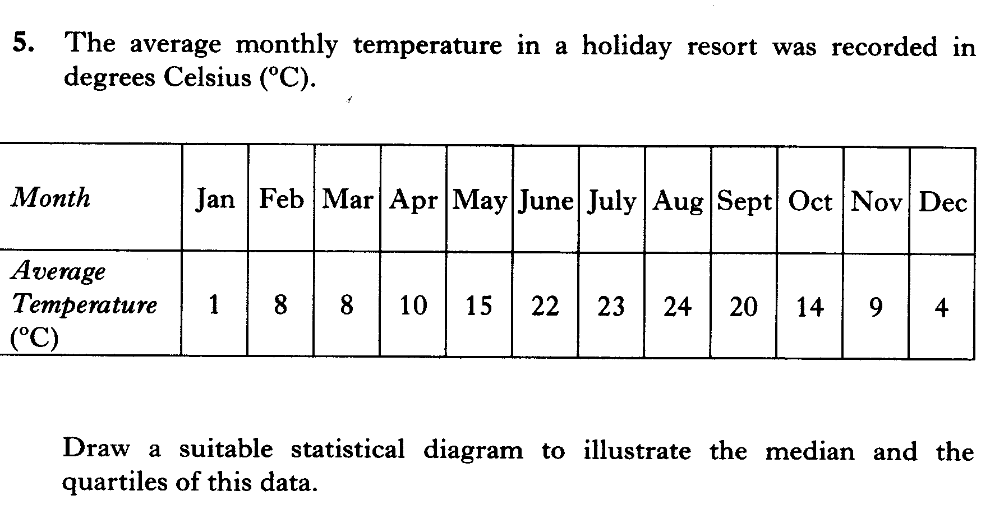

Slide 58
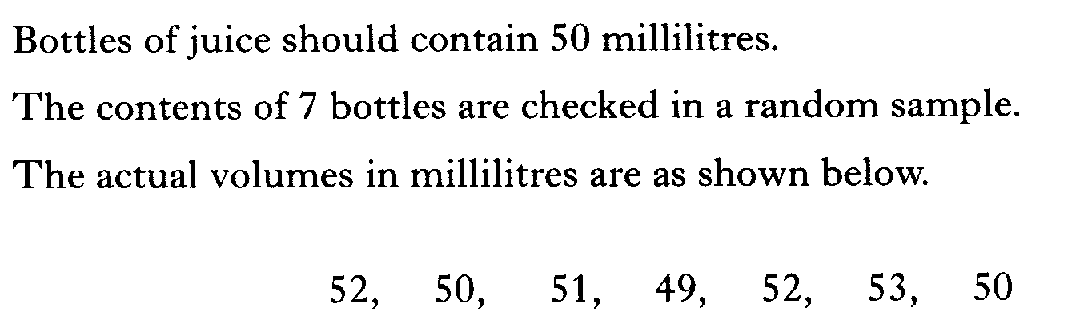
Calculate the mean and standard deviation

Slide 59
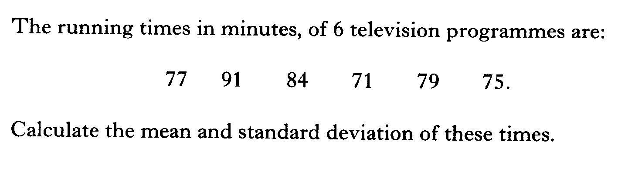

Slide 60
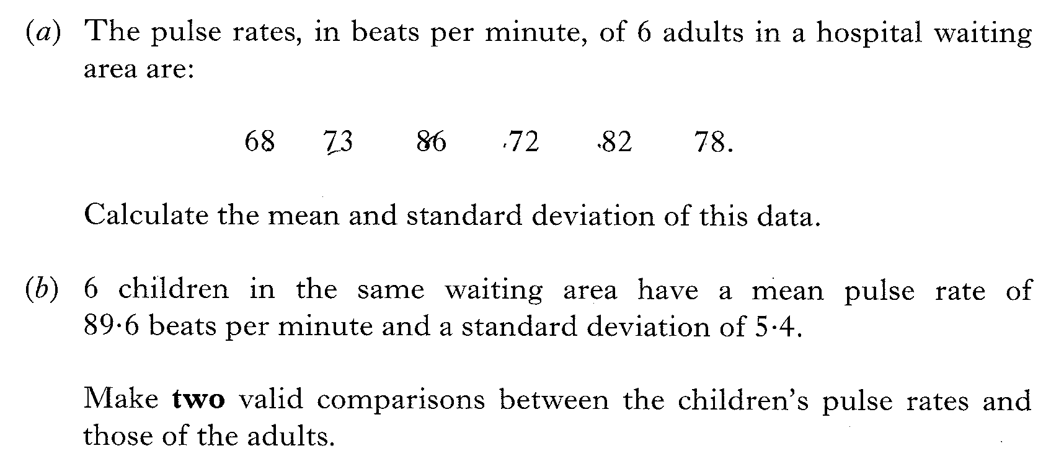

Slide 61
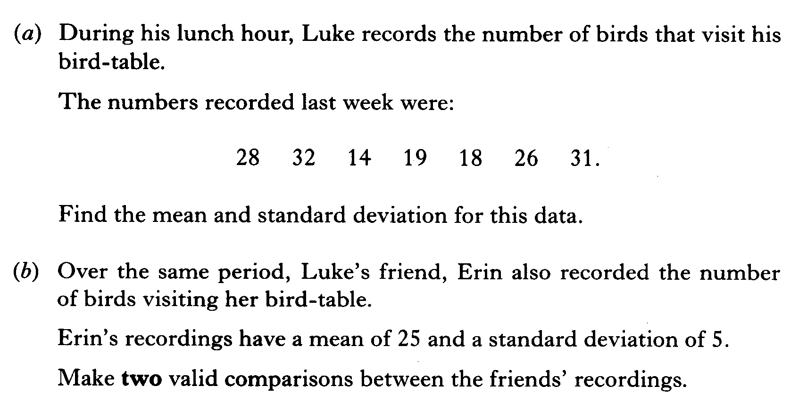

Slide 62
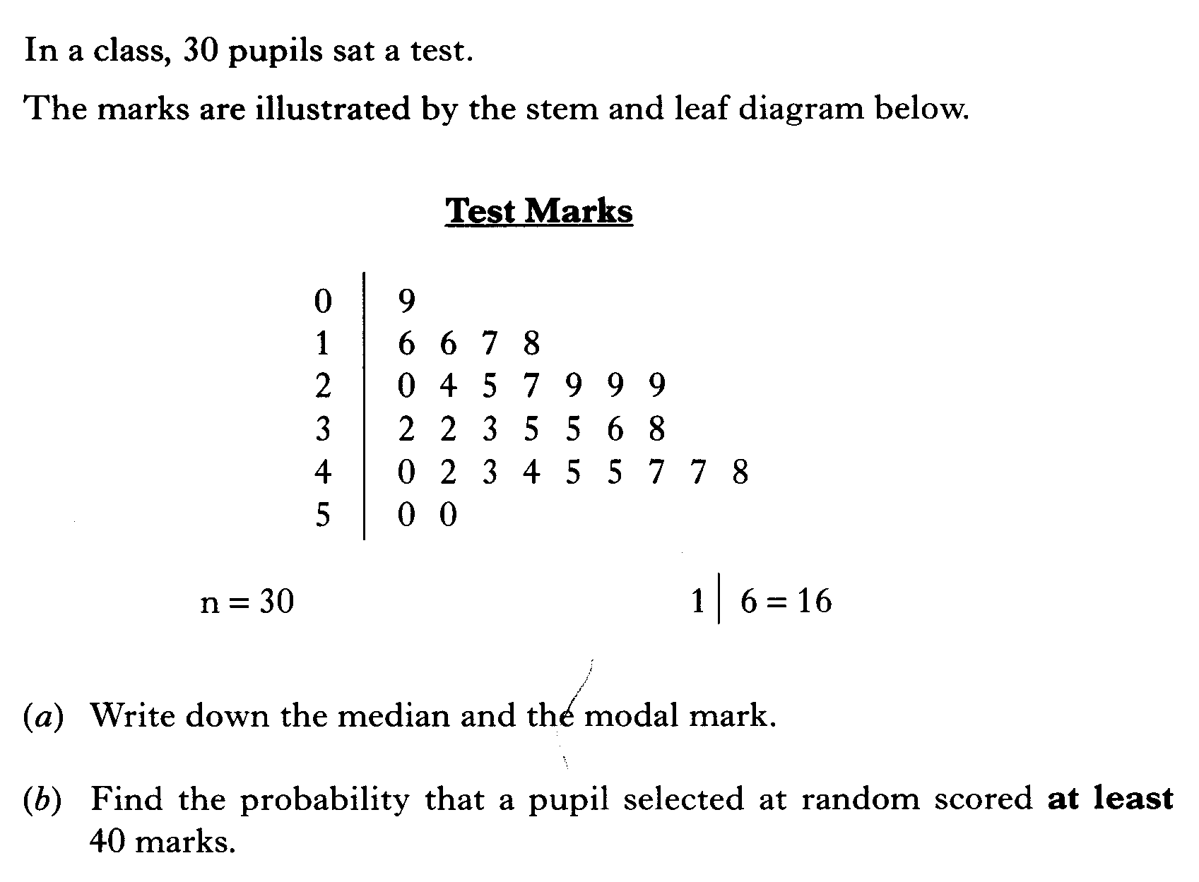

Slide 63
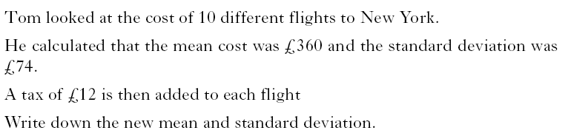

Slide 64
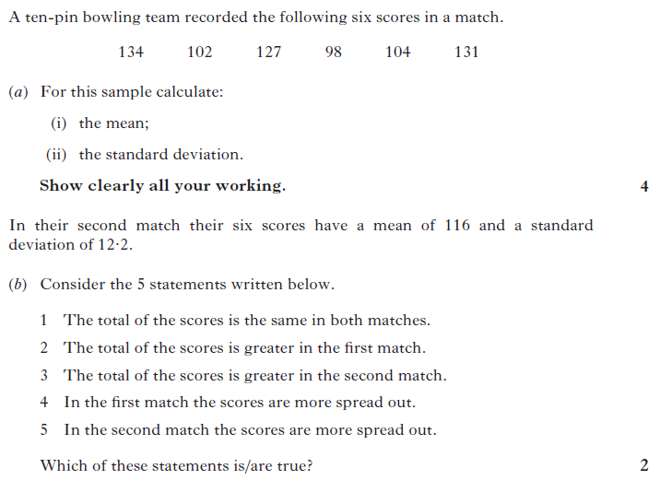

Slide 65
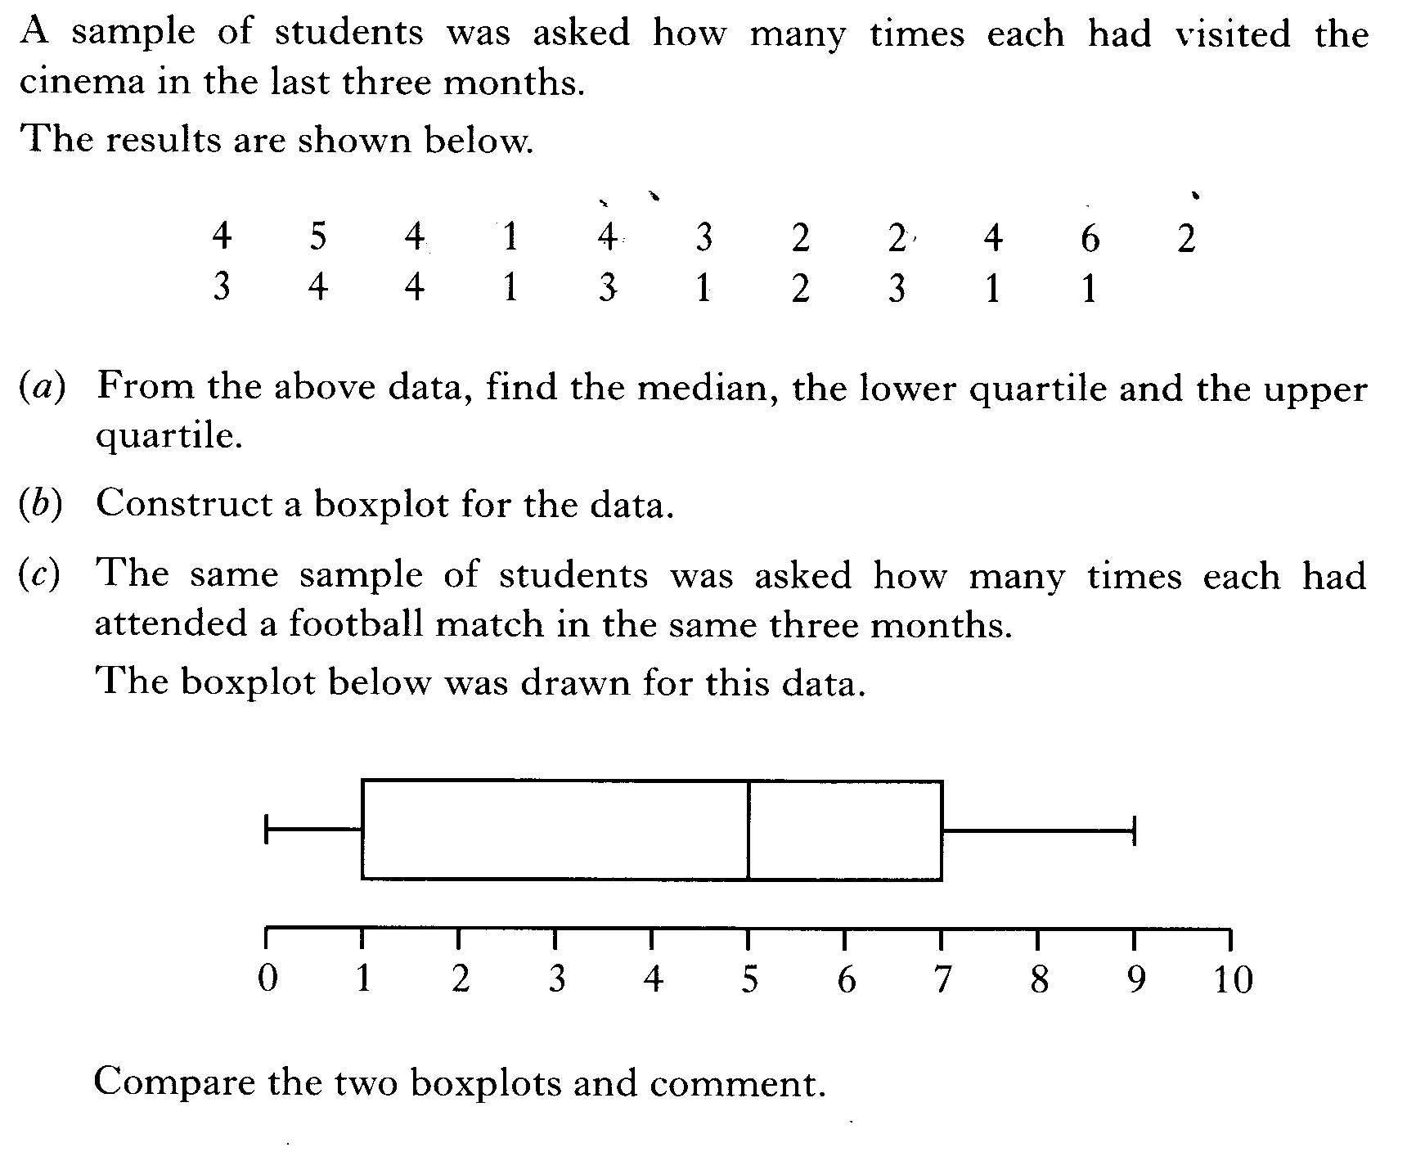

Slide 66
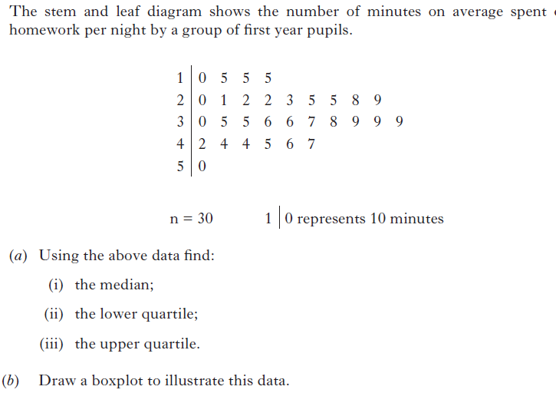
Go on to next slide for part c

Slide 67
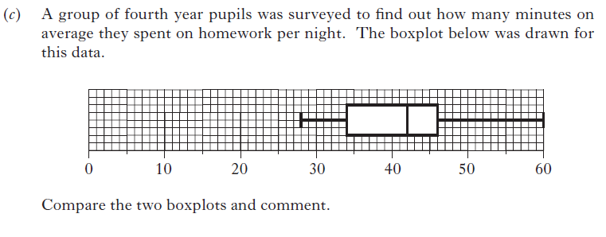

Slide 68
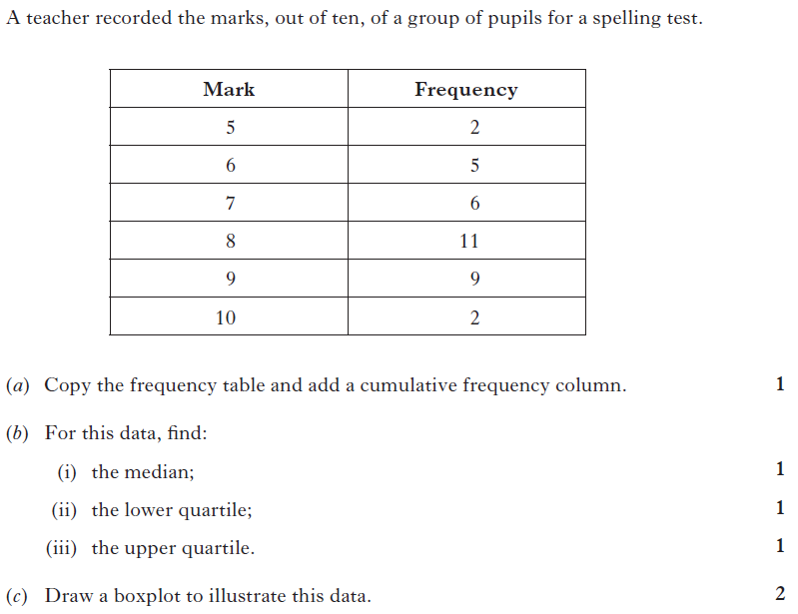

Slide 69
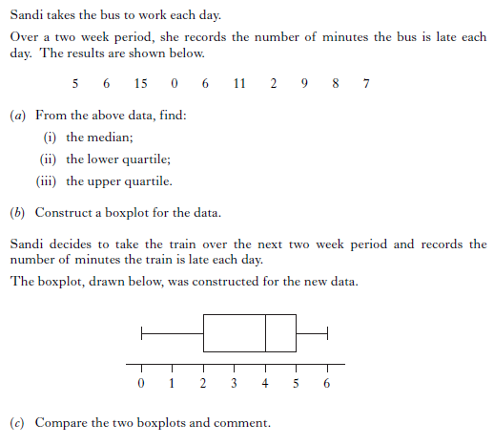

Slide 70
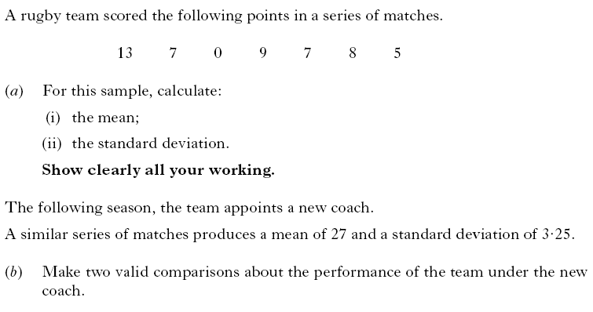

Slide 71
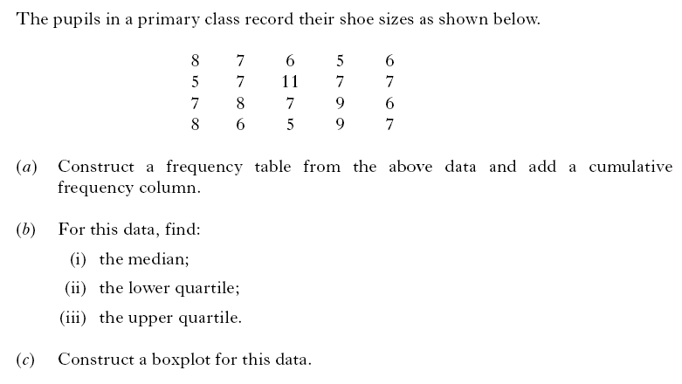

Slide 72
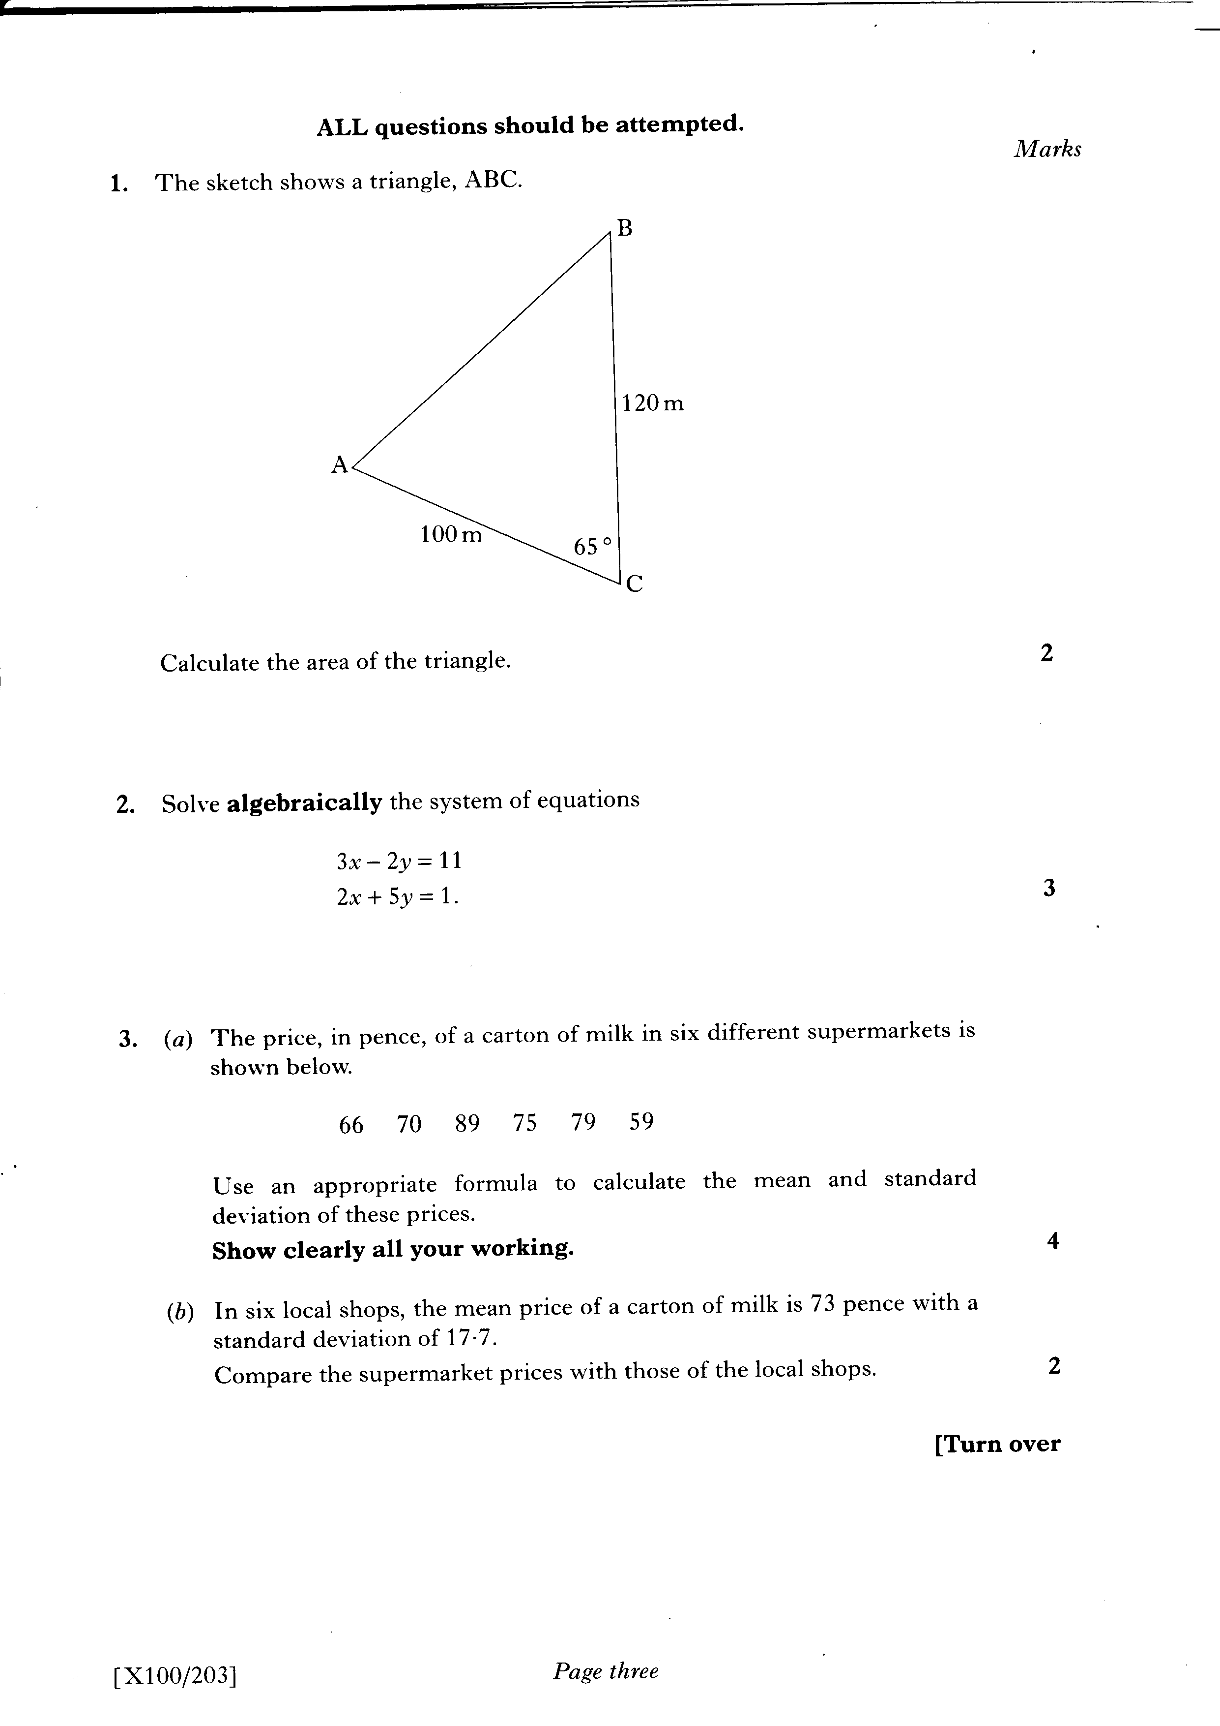

Slide 73
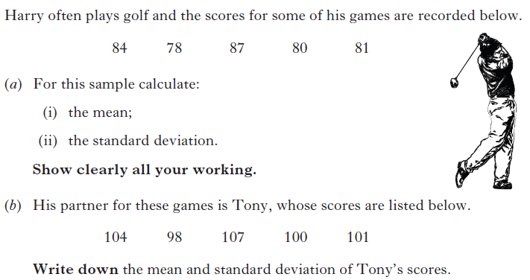

Slide 74
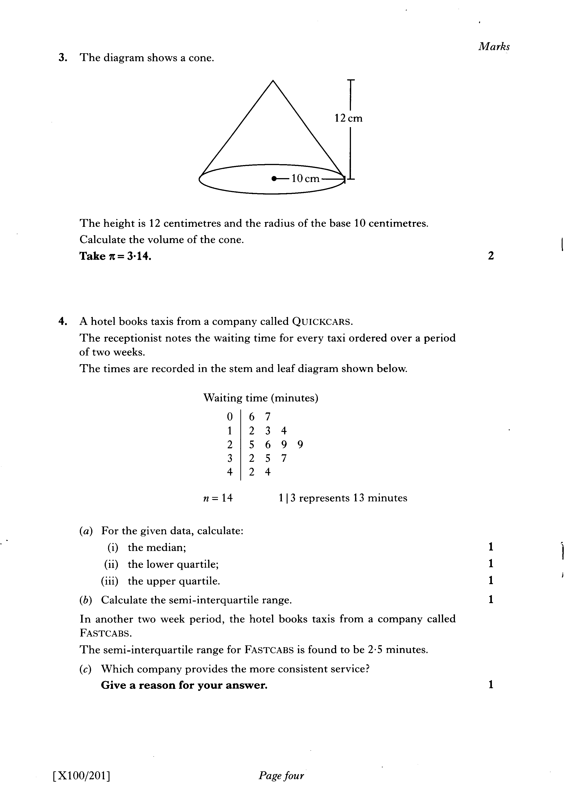

Slide 75
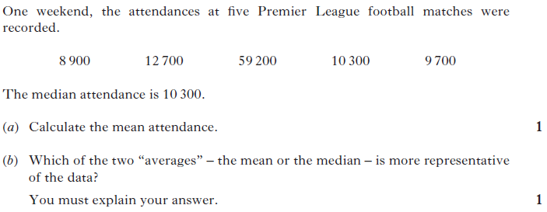

Slide 76
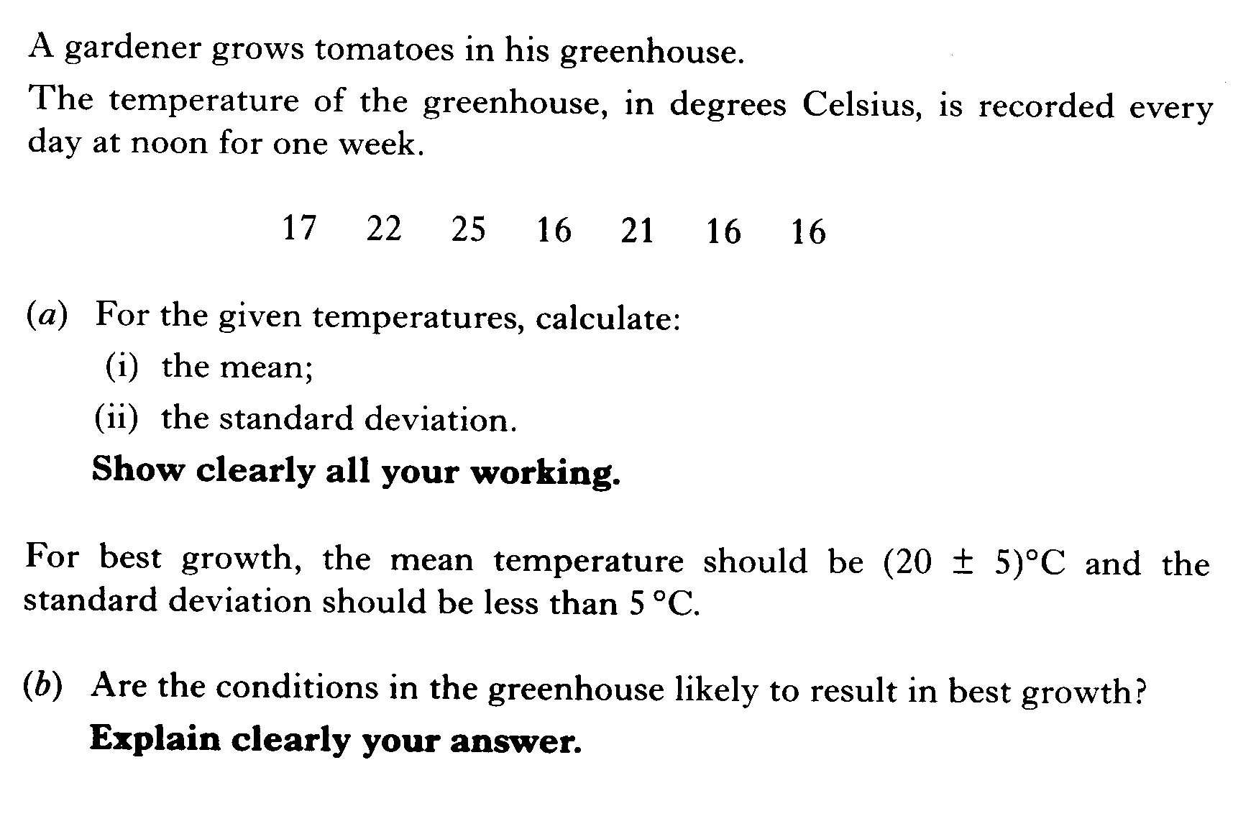

Slide 77
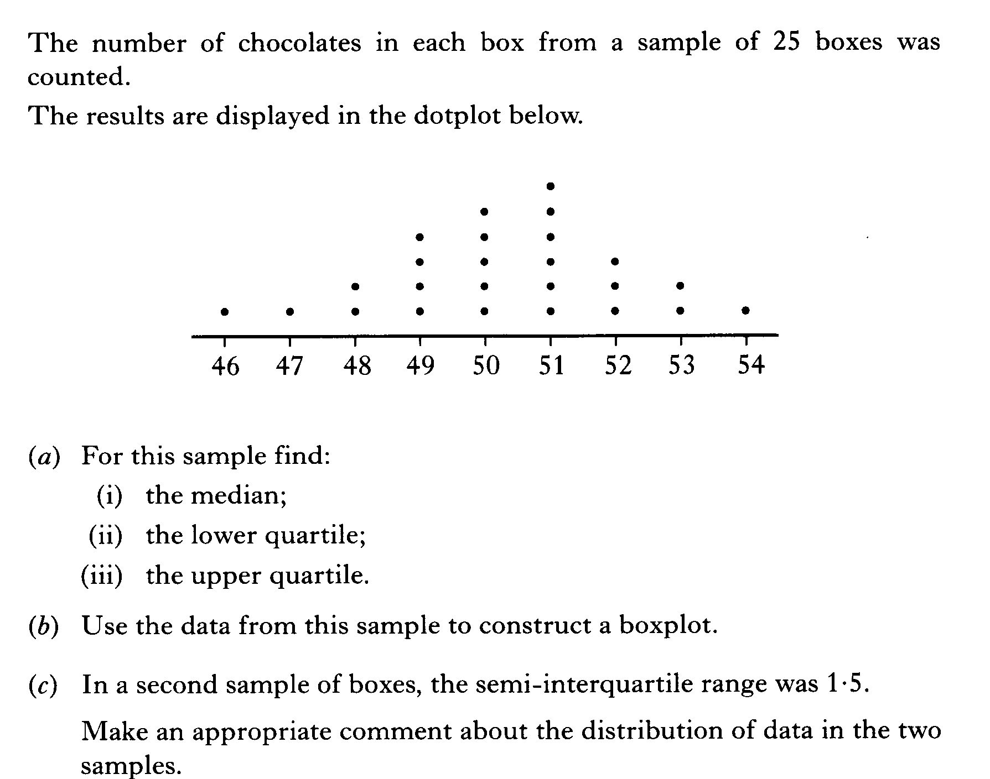

Slide 78
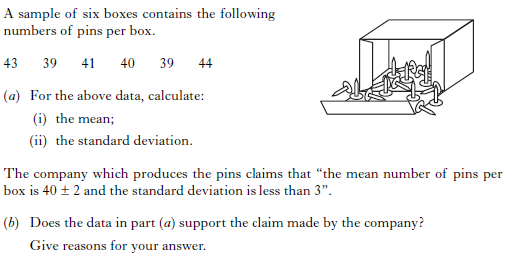

Slide 79
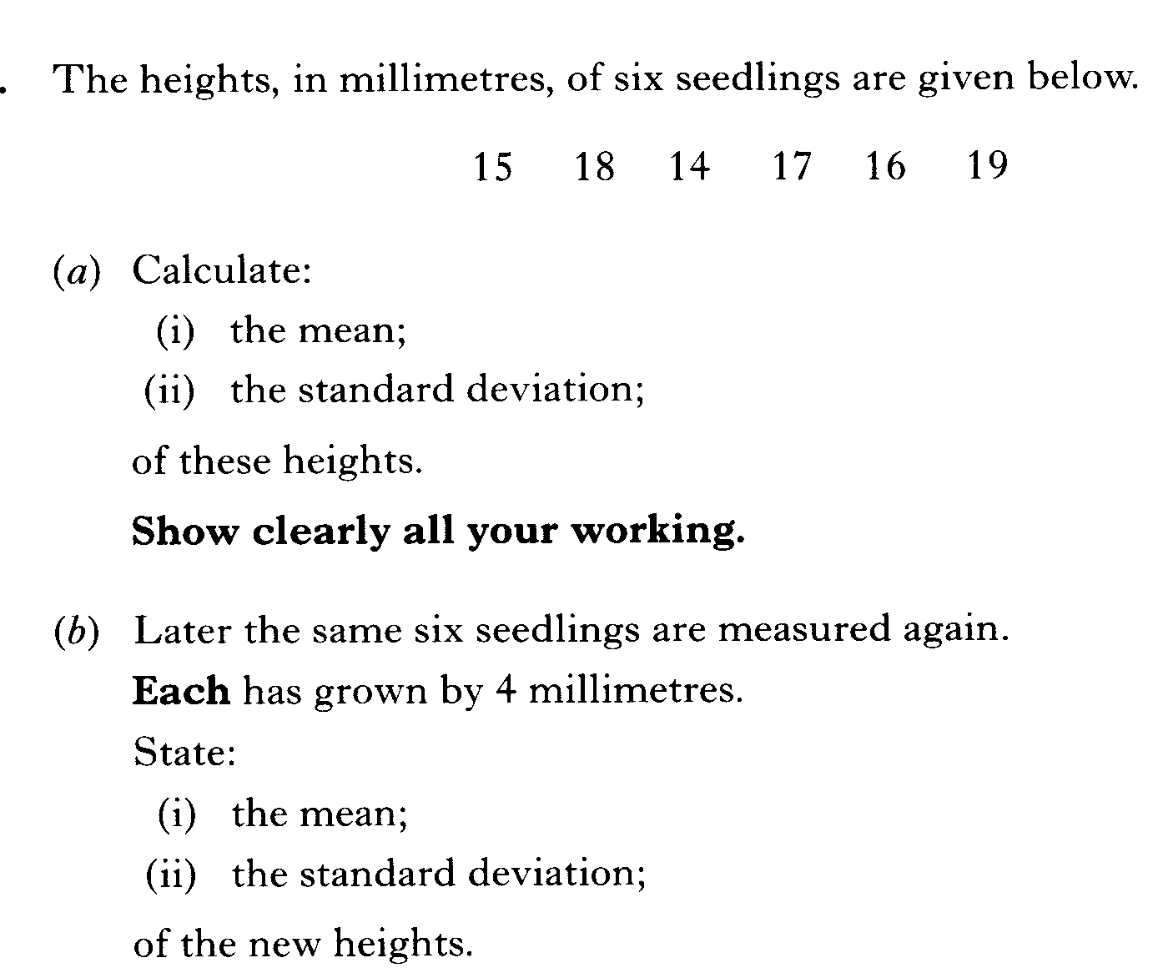

Slide 80
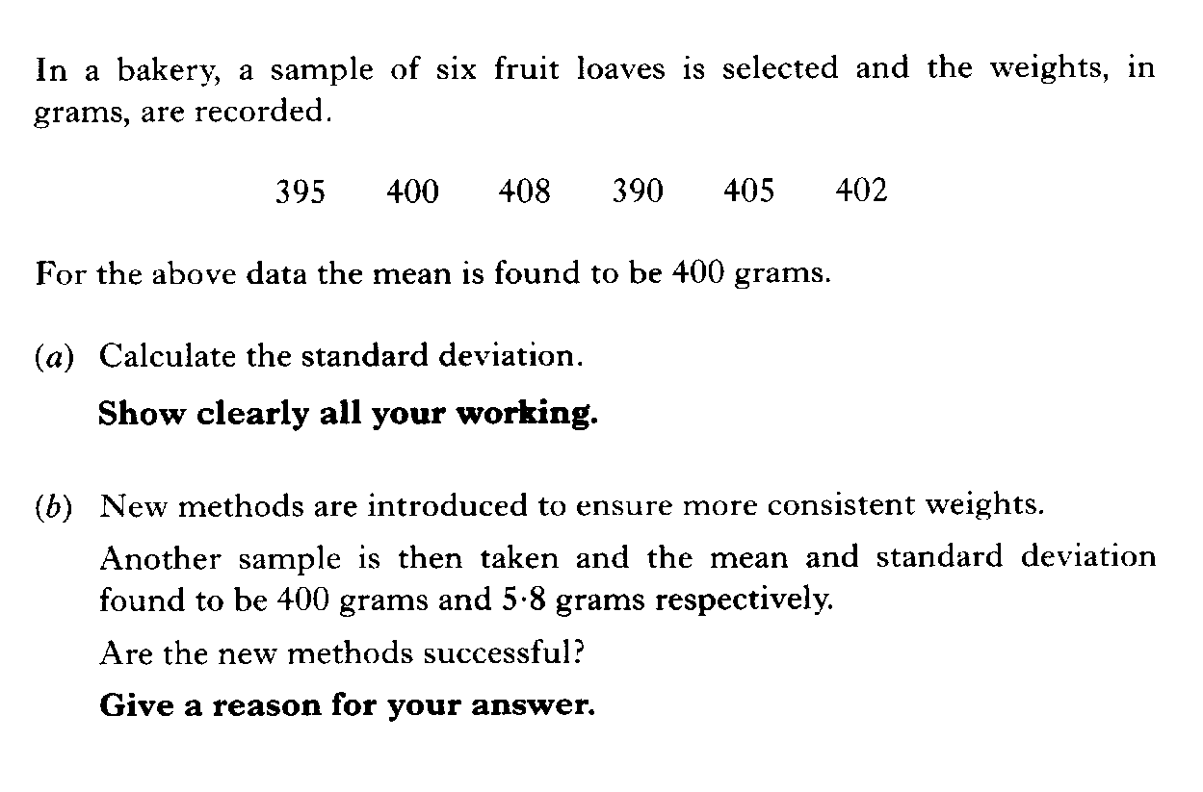

Slide 81
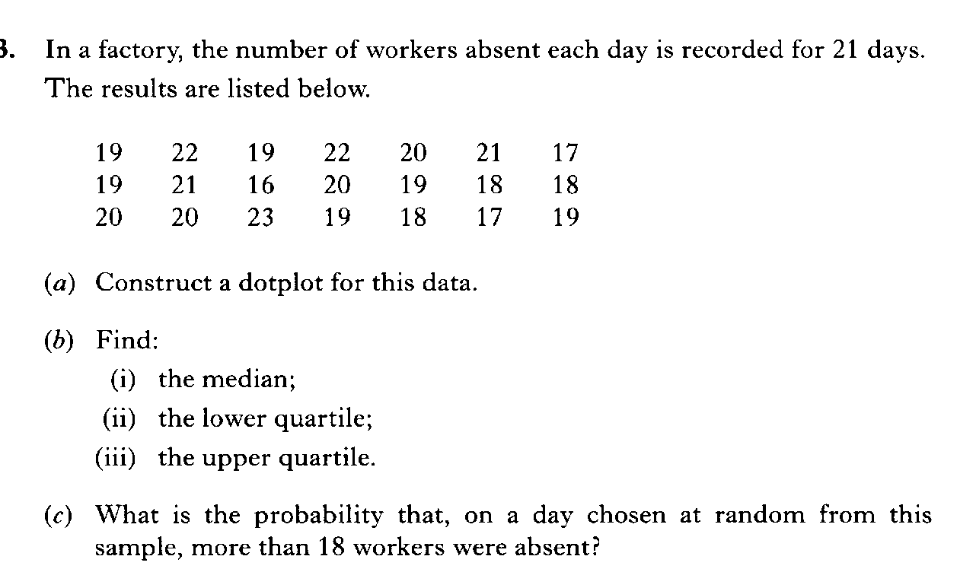

Slide 82
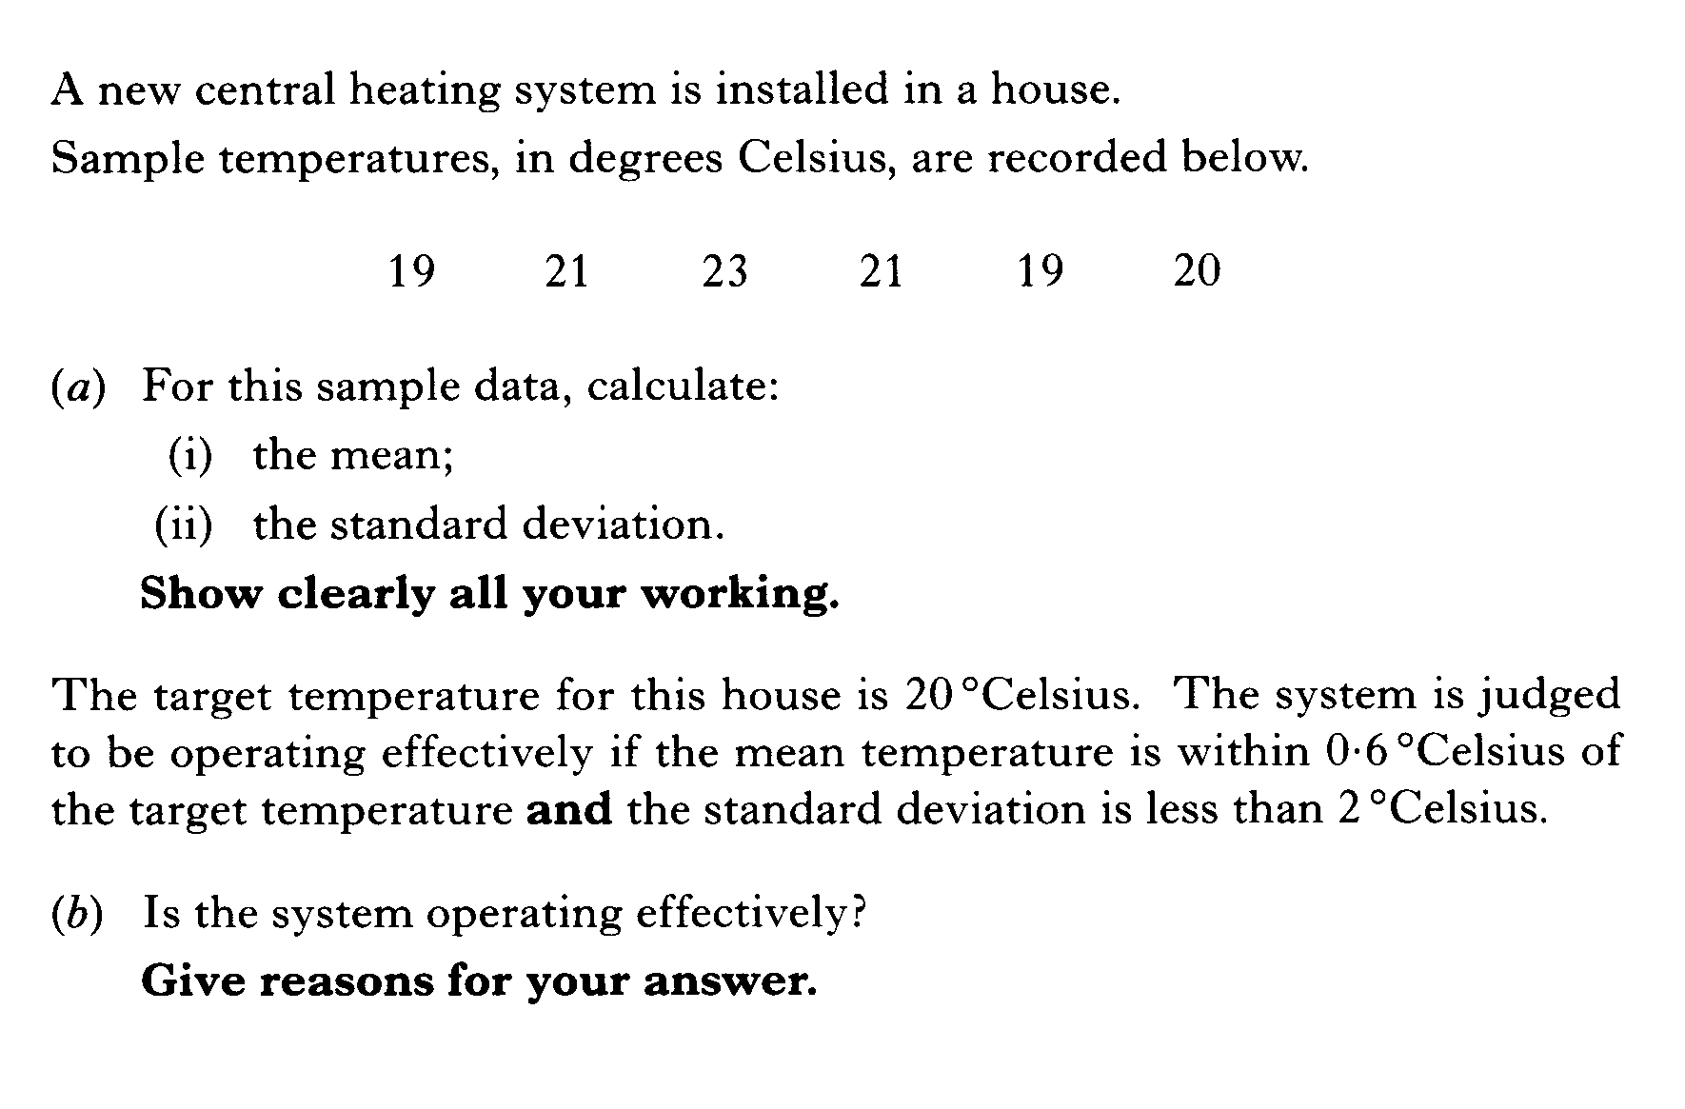

Slide 83
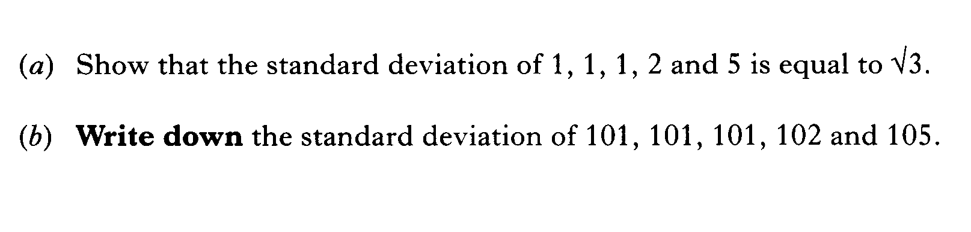

Slide 84
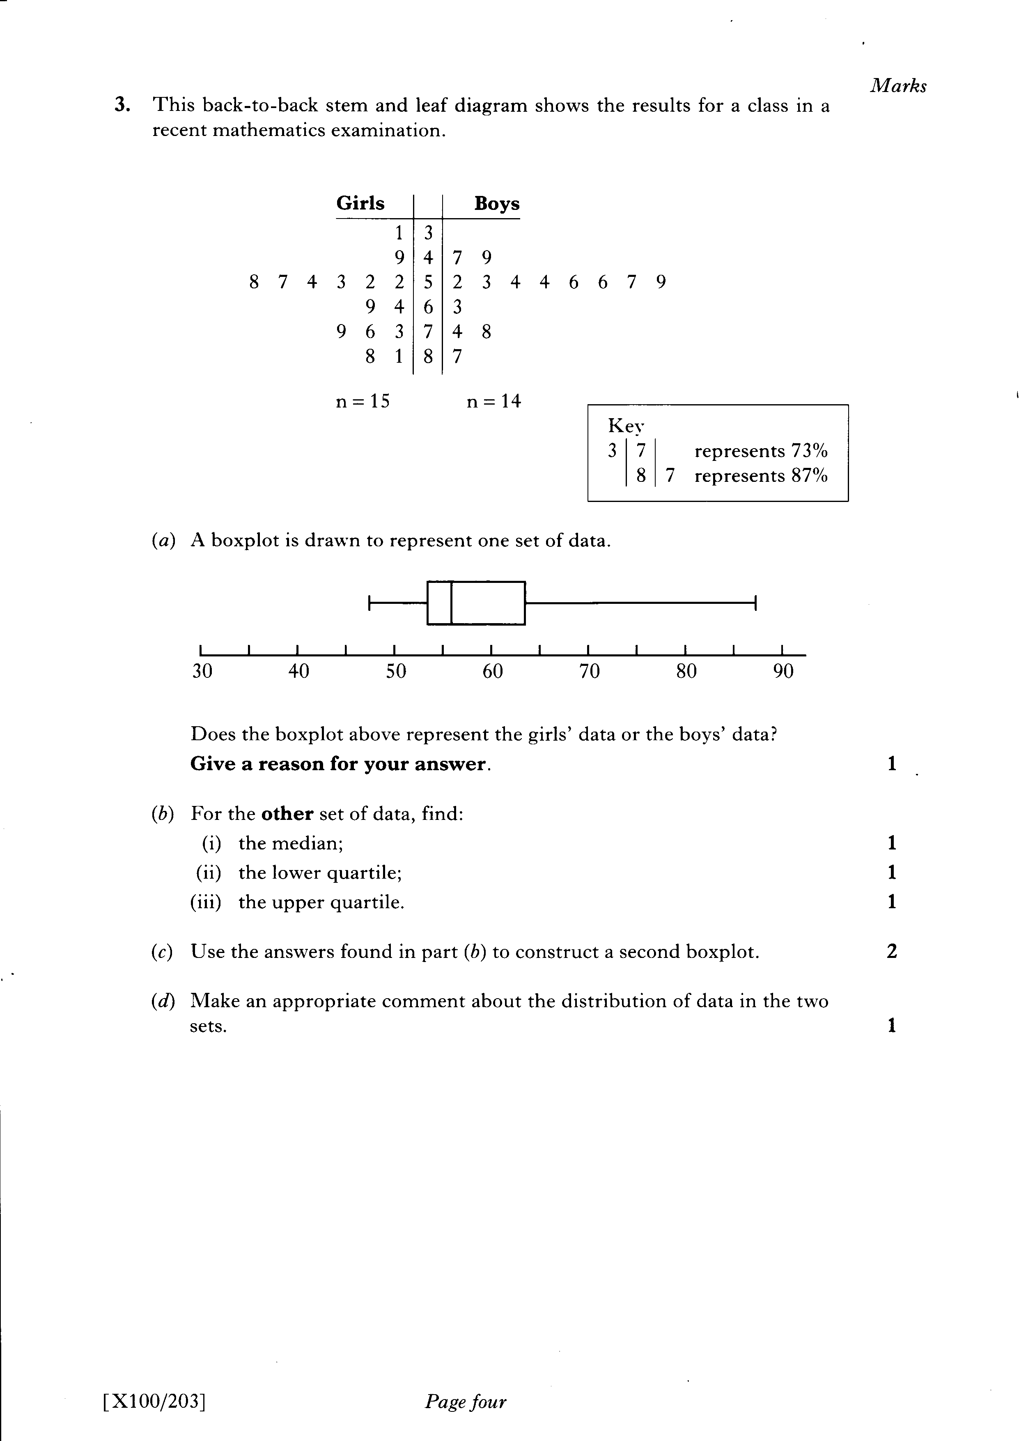
Qs b next slide

Slide 86
