Slide 1


Formulae
Nat 5
Change the Subject of Formula
Harder Subject of Formula
www.mathsrevision.com
Understanding Formulae
Exam Type Questions
www.mathsrevision.com

Slide 2
Starter Questions
Nat 5
Find the area of the major arc.
10m
60º
www.mathsrevision.com

Slide 3
Formulae
Nat 5
The Subject of a Formula
Learning Intention
Success Criteria
  We are learning how to change the subject of a formula using
  “The balancing Method”
  Know “The balancing Method” for solving equations.
  2. Apply knowledge to change subject of a formula.
www.mathsrevision.com
www.mathsrevision.com

Slide 4
Changing the Subject
of a Formula
Nat 5
The formula below is used to work out
the circumference of a circle
Since the formula works out C , then C is called
the subject of the formula.
www.mathsrevision.com

Slide 5
Changing the Subject
of a Formula
The method we use to solve equations is
The Balancing Method
Write down the opposite of the following :
+
-
-
+
www.mathsrevision.com
opposite is
opposite is
x
x
opposite is
÷
÷
opposite is
11 Jul 2026
Created by Mr.Lafferty Maths Dept

Slide 6
Changing the Subject
of a Formula
Nat 5
We can make D the subject of the formula
by simple using
“ The Balancing Method “
www.mathsrevision.com

Slide 7
Changing the Subject
of a Formula
Nat 5
Examples
y + x = z (y)
p = q + r (r)
- x
- x
Swap
q + r = p
y = z - x
- q
- q
r = p - q
www.mathsrevision.com

Slide 8
Changing the Subject
of a Formula
Nat 5
Examples
Swap
h = b (b)
d = st (T)
a
Always get rid of fraction
Swap
st = d
b = h
a
÷ s both sides
x a both sides
t = d
b = ah
s
www.mathsrevision.com

Slide 9
Changing the Subject
of a Formula
Nat 5
Examples
k = 4d - 2w (w)
3g + f = y (g)
+ 2w
+2w
- f
- f
2w + k = 4d
3g = y - f
-k
-k
2w = 4d - k
÷ 3 both sides
÷ 2 both sides
g = y - f
3
w = 4d - k
2
www.mathsrevision.com

Slide 10
What Goes In The Box ?
Rearrange into y =
Nat 5
Make y the subject of the formulae using
“the balancing method”
x + y = 8
-x + 2y = 2
y = 8 - x
y² = x
x = 4( y + 1 )
y = √x
2x =√y
x = 3( y - k )
y = 4x²

Slide 11

Changing the Subject
of a Formula
Nat 5
Now try N5 TJ
Ex 10.1
Ch10 (page 99)

Slide 12
Starter Questions
Nat 5
Make g the subject of each formula :
Nothing new ! simply use the “balancing method”
www.mathsrevision.com

Slide 13
Changing the Subject
of a Formula
Nat 5
Learning Intention
Success Criteria
  We are learning how to change the subject of a formula containing square and square root terms.
  Know “ The balancing Method” for solving equations.
  2. Apply knowledge to change subject of harder formulae including square and square root terms.
www.mathsrevision.com
www.mathsrevision.com

Slide 14
Changing the Subject
of a Formula
We should already know that :
+
-
-
+
opposite is
opposite is
x
x
opposite is
÷
÷
opposite is
√
□²
www.mathsrevision.com
opposite is
□²
√
opposite is
11 Jul 2026
Created by Mr.Lafferty Maths Dept

Slide 15
Changing the Subject
of a Formula
Nat 5
Example : The force of the air against a train is given by the formula below.
Make the speed (S) the subject of the formula.
F = kS²
S² = F
Swap
k
kS² = F
√
$S=\sqrt{\frac{F}{k}}$
÷ k
www.mathsrevision.com

Slide 16
Changing the Subject
of a Formula
Nat 5
Example : The thickness of a rope T cm to lift a weight W tonnes can be worked out by the formula below.
Make W the subject of the formula.
$T=\frac{4\sqrt{w}}{9}$
x 9
$4\sqrt{w}=9T$
÷ 4
$\sqrt{w}=\frac{9T}{4}$
Swap
$\frac{4\sqrt{w}}{9}=T$
$w={\left(\frac{9T}{4}\right)}^{2}$
□²
www.mathsrevision.com

Slide 17
Changing the Subject
of a Formula
Nat 5
Example : The formula below is used to change degrees Celsius to Fahrenheit.
Change the subject to C.
$F=\frac{9}{5}C+\text{32}$
$9C=5F−\text{160}$
HCF
Swap
$9C=5(F−\text{32})$
$\frac{9}{5}C+\text{32}=F$
÷9
$C=\frac{5(F−\text{32})}{9}$
x 5
$9C+\text{160}=5F$
- 160
www.mathsrevision.com

Slide 18
Changing the Subject
of a Formula
Nat 5
Now try N5 TJ
Ex 10.2 Q1 ... Q8
Ch10 (page 101)

Slide 19
Starter Questions
Nat 5
Make w the subject of each formula :
Nothing new ! simply use the “balancing method”
www.mathsrevision.com

Slide 20
Understanding Formulae
Nat 5
Learning Intention
Success Criteria
  We are learning the affect on the subject by changing one or more of the values in the formula.
  Understand the meaning of doubling and halving.
  2. Apply knowledge so far to work out the effect on the subject by varying one or more values in the formula.
www.mathsrevision.com
www.mathsrevision.com

Slide 21
Understanding Formulae
Nat 5
In real-life we often want to see what effect changing the value of one of the variables has on the subject.
The Circumference of circle is given by the formula :
C = πD
The Circumference doubles
What happens to the Circumference
if we double the diameter
New D = 2D
C = π(2D)
= 2(πD)
www.mathsrevision.com
Original Value

Slide 22
Understanding Formulae
Nat 5
In real-life we often want to see what effect changing the value of one of the variables has on the subject.
The Area of a circle is given by the formula :
A = πr²
The Area increases by a factor of 4.
What happens to the Area
if we double the radius r
New r = 2r
C = π(2r)²
= 4(πr²)
www.mathsrevision.com
Original Value
Notes:
<number>

Slide 23
Understanding Formulae
Nat 5
The thickness of a rope T cm to lift a weight W tonnes can be worked out by the formula below.
If we increase W by a factor of 100. What effect does this have on the thickness of the rope T.
The thickness of the rope T increasing by a factor of 10.
New W = 100W
Original Value

Slide 24
Understanding Formulae
Nat 5
Now try N5 TJ
Ex 10.2 Q9 onwards
Ch10 (page 102)

Slide 25
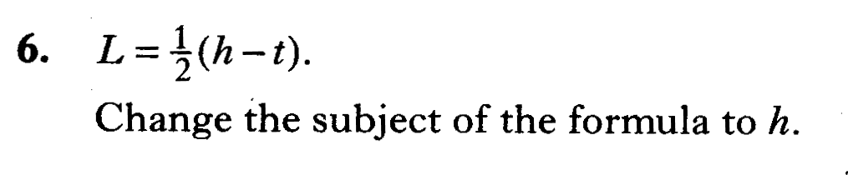

Slide 26
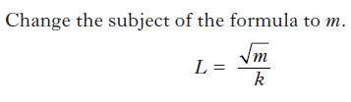

Slide 27
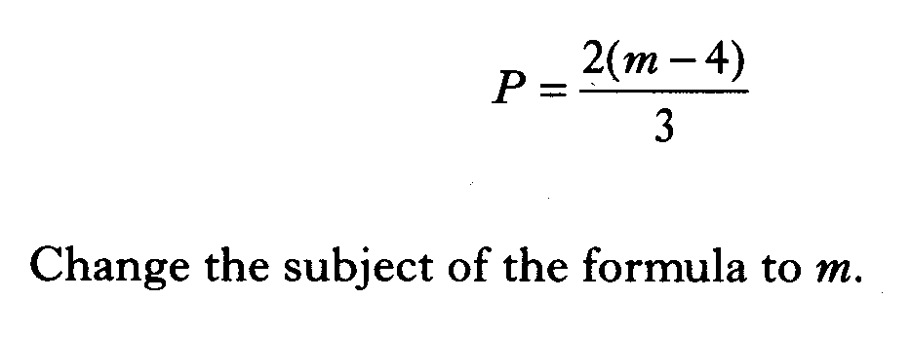

Slide 28
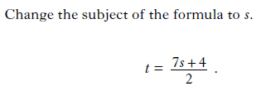

Slide 29
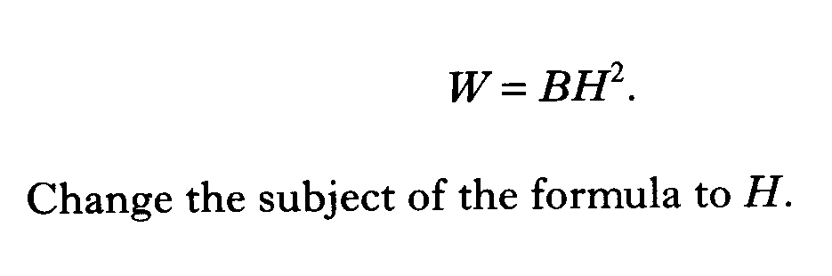

Slide 30
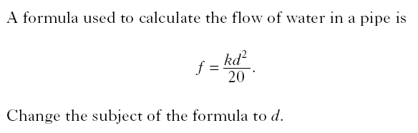

Slide 31
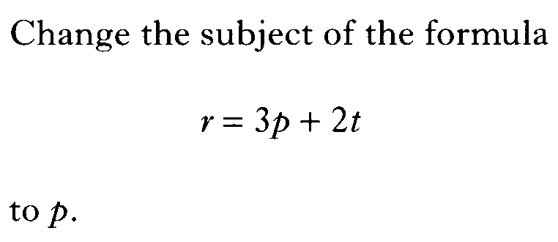

Slide 32
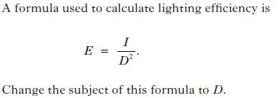

Slide 33


Slide 34
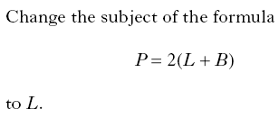

Slide 35
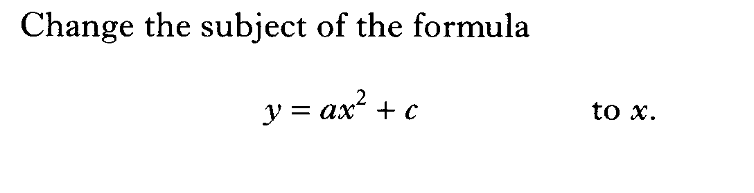

Slide 36
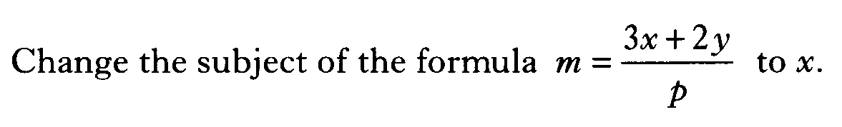

Slide 37
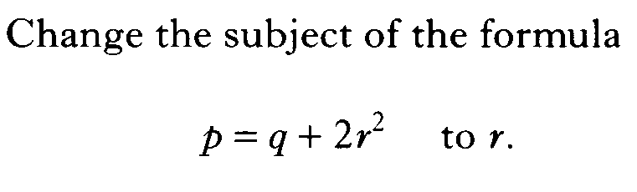

Slide 38
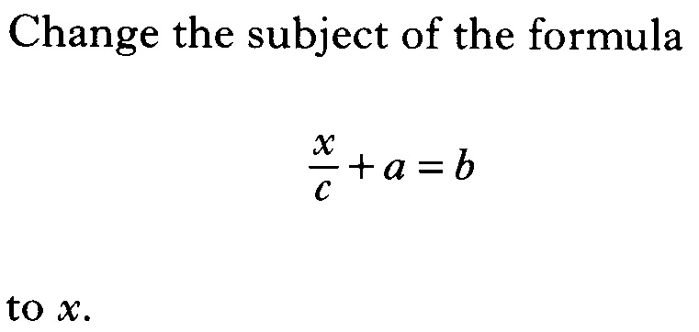

Slide 39
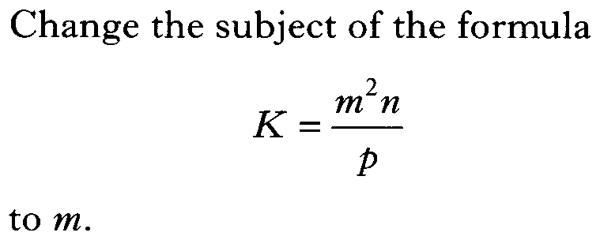

Slide 40
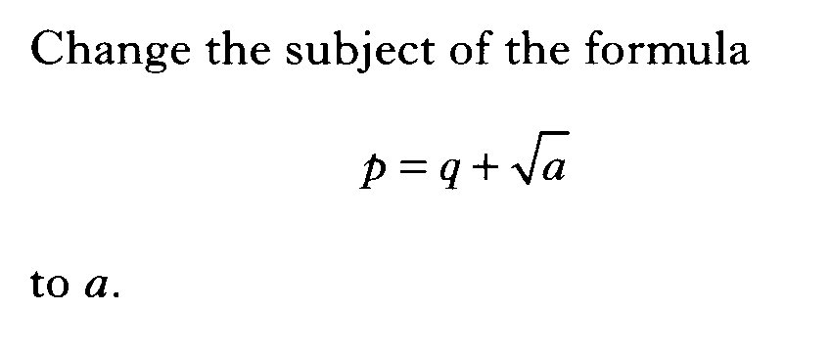

Slide 41
