Slide 1


Volume
Volume of a cuboid
Liquid Volumes
www.mathsrevision.com
Volume of cylinder
Volume of triangular prism

Slide 2
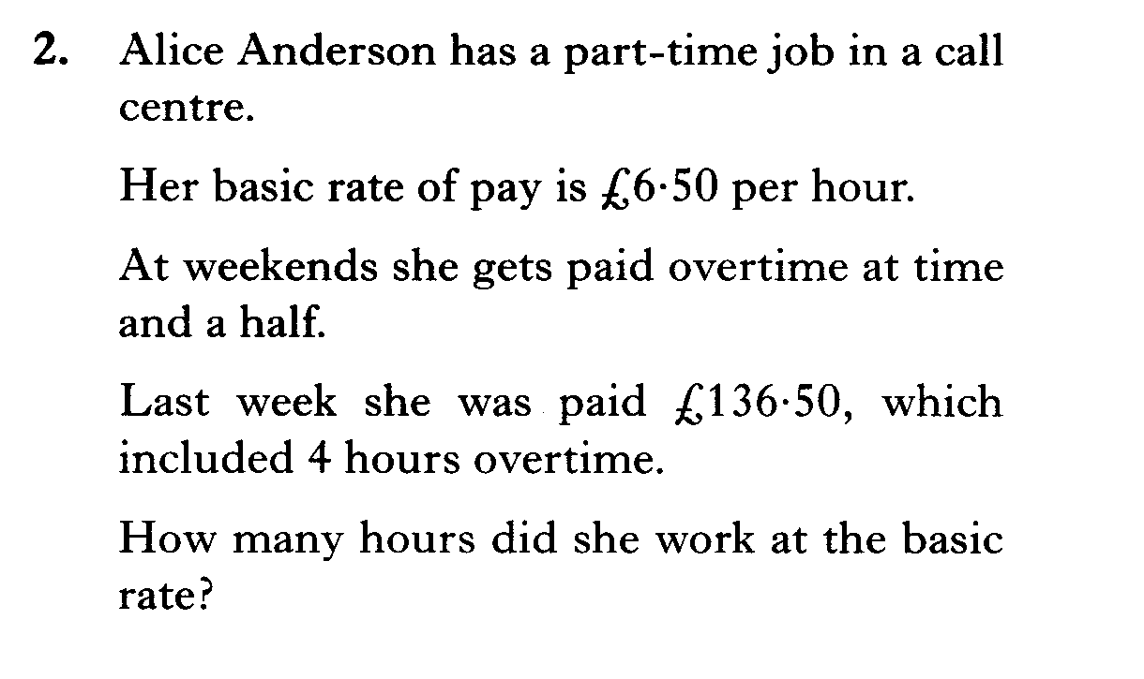
Starter Questions
www.mathsrevision.com

Slide 3
Volume of a cuboid
Learning Intention
Success Criteria
  To understand how to
  calculate the volume
  of cuboid.
  To know the formula.
Use formula correctly.
www.mathsrevision.com
Show working and
appropriate units.

Slide 4
Volume of a cuboid
18 cubes fit the base.
4cm
3cm
6cm
www.mathsrevision.com
= 1 centimetre cube = 1 cm³
4 layers of 18 cubes
= 4 x 18
= 72 centimetre cubes
= 72 cm³

Slide 5
A short cut !
height
4cm
Area of rectangle
breadth
3cm
6cm
www.mathsrevision.com
length
Volume =
6
x 3
x 4
= 72 cm³
Volume =
length
x breadth
x height

Slide 6
Example
Working
Volume = l x b x h
V = 18 x 5 x 27
V = 2430 cm³
27cm
Heilander’s
Porridge Oats
5 cm
18 cm

Slide 7
Example
Working
Volume = l x b x h
V = 2 x 2 x 2
V = 8 cm³
2cm
www.mathsrevision.com

Slide 8
Find the length the cuboid
This just an equation.
We know how to solve them !
4 cm
Volume = L x B x H
V=200cm³
5 cm
200 = L x 5 x 4
www.mathsrevision.com
200 = 20L
10 cm
L
20L = 200
L = 10

Slide 9

Volume of a cuboid
Now try
N4 Lifeskills TJ
Ex 1
Ch18 (page 144)
www.mathsrevision.com

Slide 10
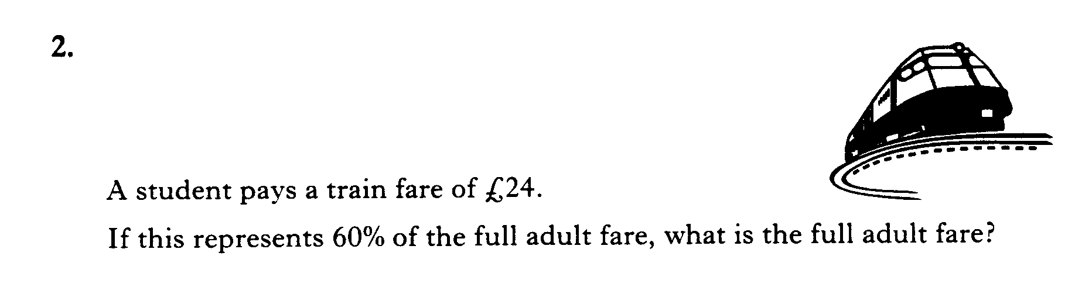
Starter Questions
www.mathsrevision.com

Slide 11
Liquid Volume
Learning Intention
Success Criteria
  To understand the
  term liquid volume using millilitres and litres.
  To know the term liquid volume.
Work out volumes using 1ml and litres.
www.mathsrevision.com
Answer to contain
appropriate units.

Slide 12


Liquid Volume
I’m a very small duck!
How much water does this hold?
1 cm
1 cm
1 cm
Volume =
x b
x h
l
= 1 cm³
A cube with volume 1cm³ holds exact 1 millilitre of liquid.
A volume of 1000 ml = 1 litre.

Slide 13
Example
Liquid Volume
Working
Volume = l x b x h
V = 6 x 3 x 12
12 cm
V = 216 cm³
Orange
Flavour
= 216 ml
3 cm
www.mathsrevision.com
6 cm
So the carton can hold
216 ml of orange juice.
Remember:
1 cm³ = 1 ml
How much juice can
this carton hold?

Slide 14
Example
Liquid Volume
Working
Volume = l x b x h
V = 100 x 30 x 50
V = 150 000 cm³
50 cm
= 150 000 ml
30 cm
= 150 litres
100 cm
How much water can this fish tank hold in litres?
1cm³ = 1 ml
1000 ml = 1 litre
So the fish tank can hold 150 litres of water.

Slide 15
Liquid Volume
Now try
N4 Lifeskills TJ
Ex 2
Ch18 (page 146)
www.mathsrevision.com

Slide 16
Starter Questions
Q1. 35% of 360
Q2. Calculate 5 + 6 x 7
www.mathsrevision.com
Q3. Expand 2( y – 5 )

Slide 17
Volume of Solids
Prisms
Learning Intention
Success Criteria
  To understand the
  prism formula for calculating volume.
  To know the volume formula for any prism.
Work out volumes for
various prisms.
www.mathsrevision.com
Answer to contain
appropriate units and working.

Slide 18
Volume of Solids
Definition : A prism is a solid shape with
uniform cross-section
www.mathsrevision.com
Hexagonal Prism
Cylinder
(circular Prism)
Triangular Prism
Pentagonal Prism
Volume = Area of Cross section x length

Slide 19
Volume of Solids
Definition : A prism is a solid shape with
uniform cross-section
Find the volume the triangular prism.
www.mathsrevision.com
Triangular Prism
Volume = Area x length
= 20 x 10 = 200 cm³
10cm
20cm²

Slide 20
Volume of a Triangular Prism
Working
Triangle Area =
= 2 x4 = 8 cm²
4cm
Volume = Area x length
= 8 x 10 = 80cm³
10cm
4cm
www.mathsrevision.com

Slide 21
Example
Find the volume of the triangular prism.
Working
Triangle Area =
= 3 x 3 = 9 cm²
Volume = Area x length
= 9 x 30 = 270cm³
3cm
30cm
6cm
www.mathsrevision.com
Total Area
= 6+6+30+40+50 = 132cm²

Slide 22
Example
Find the volume of
this prism.
Working
Triangle Area =
= 6 x 8 = 48 m²
Rectangle = l x b
= 6 x 12 = 72cm²
8cm
6cm
Total Area = 72 + 48
= 120 m²
www.mathsrevision.com
15cm
12cm
Volume = Area x length
= 120 x 15 =1800m³
Total Area
= 6+6+30+40+50 = 132cm²

Slide 23
Volume
Now try
N4 Lifeskills TJ
Ex 3
Ch18 (page 147)
www.mathsrevision.com

Slide 24
Starter Questions
Q1. Find the area of the triangle.
10cm
Q2. Factorise 4x - 64
6cm
www.mathsrevision.com
Q3. Calculate

Slide 25
Volume of a Cylinder
Learning Intention
Success Criteria
  To derive the formula for the volume of a cylinder and apply it to solve problems.
  To know formula.
Apply formula correctly.
www.mathsrevision.com
Work backwards using formula.

Slide 26
Volume of a Cylinder
The volume of a cylinder can be thought as being a pile
of circles laid on top of each other.
Volume = Area x height
h
www.mathsrevision.com
= πr²
x h
Cylinder
(circular Prism)
= πr²h

Slide 27
Πr² = Area
Volume of a Cylinder
Find the volume the cylinder.
60m²
V = πr²h
= 60 x 0.5
www.mathsrevision.com
= 30m³
0.5m

Slide 28
Volume of a Cylinder
Example : Find the volume of the cylinder below.
5cm
V = πr²h
10cm
www.mathsrevision.com
= π(5)²x10
Cylinder
(circular Prism)
= 250π cm
= 785.4 cm

Slide 29
Volume of Solids
Now try
N4 Lifeskills TJ
Ex 4
Ch18 (page 149)
www.mathsrevision.com

