Slide 1


Time
Time 12 / 24 hour
Time Difference (Counting Method)
www.mathsrevision.com
Exam Type Questions

Slide 2
Starter Questions
www.mathsrevision.com

Slide 3
Converting Time
Revision on Time
Learning Intention
Success Criteria
  We are learning to convert between 12 and 24 hr clock and vice versa.
  Change from 12 to 24 hour clock.
  2. Change from 24 to 12 hour clock.
www.mathsrevision.com

Slide 4
12/24 Hour Clock
midnight
1 am
2 am
3 am
4 am
5am
6 am
7 am
8 am
9 am
10 am
11 am
0000
0100
0200
0300
0400
0500
0600
0700
0800
0900
1000
1100
midday
1 pm
2 pm
3 pm
4 pm
5 pm
6 pm
7 pm
8 pm
9 pm
10 pm
11 pm
1200
1300
1400
1500
1600
1700
1800
1900
2000
2100
2200
2300
To go from 12 hour clock to 24 hour clock just add 12 to the pm hours:
Examples
8 pm becomes
2000
9 pm becomes
2100
6:30 pm becomes
1830
11:30 pm becomes
2330
4:20 pm becomes
1620
3:10 pm becomes
1510

Slide 5
12/24 Hour Clock
midnight
1 am
2 am
3 am
4 am
5am
6 am
7 am
8 am
9 am
10 am
11 am
0000
0100
0200
0300
0400
0500
0600
0700
0800
0900
1000
1100
midday
1 pm
2 pm
3 pm
4 pm
5 pm
6 pm
7 pm
8 pm
9 pm
10 pm
11 pm
1200
1300
1400
1500
1600
1700
1800
1900
2000
2100
2200
2300
To go from 24 hour clock to 12 hour clock just subtract 12 from the hours if it is greater than 12:
Examples
2000 becomes
8 pm
2100 becomes
9 pm
1730 becomes
5:30 pm
2208 becomes
10:08 pm
2006 becomes
8:06 pm
1350 becomes
1:50 pm

Slide 6
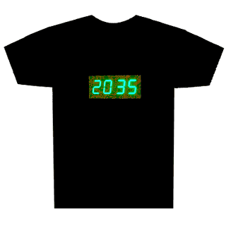
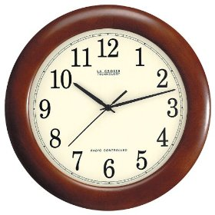
Converting Time
S3 General
Let’s make up our own questions !
Key Points
pm times add on 12
12 hour clock
24 hour clock
www.mathsrevision.com
Analogue clock
Digital clock
ALWAYS use AM or PM
ALWAYS 4 digits
Hours 1 - 12
NEVER use AM or PM
greater than 12
subtract 12
Hours 0 - 24

Slide 7


Have you updated your Learning Log ?
Time
Now Try
TJ N4 Lifeskills
Exercise 1
Ch20 (page 165)
www.mathsrevision.com

Slide 8
Starter Questions
A
T
W
www.mathsrevision.com

Slide 9
Counting Method
Learning Intention
Success Criteria
  We are learning the counting method to find the difference between two times.
  1. Understand the counting method.
  2. Find time differences between two times, showing all working.
www.mathsrevision.com

Slide 10
Counting Method
Level D
When working out time difference we will use the
Counting Method. This method will always work.
Example : Find the time difference between
08 40 hrs and 11 10 hrs
Hrs Mins
nearest
hour
www.mathsrevision.com
hours
What’s left
20
08 40
09 00
11 00
11 10
2
+
10
20 mins
2 hrs
10 mins
2 30

Slide 11
But there are
60 minutes = 1hour
70 mins = 1hr 10mins
Counting Method
Level D
A bus leaves Kirkintilloch Main Street at 14 40 hrs
and arrives in Aberdeen at 18 50 hrs.
How long was the journey.
nearest
hour
hours
What’s left
Hrs Mins
www.mathsrevision.com
20
14 40
15 00
18 00
18 50
3
20 mins
3 hrs
50 mins
+
50
3 70
4hrs 10 mins

Slide 12
Using Timetables
*
*
Kirkie Bus Station
0825
0925
1025
2025
2125
2225
Bishopbriggs
0837
0937
1037
And
2037
2137
2237
Milton
0843
0943
1043
Every
2043
2143
2243
Springburn
0848
0948
1048
Hour
2048
2148
2248
Port Dundas
0854
0954
1054
Until
2054
2154
2254
George Square
0902
1002
1102
2102
2202
2302
Glasgow Bus Station
0914
1014
1114
2114
2214
2314
*
How long does the first bus take from Kirkie to Glasgow.
nearest
hour
Hrs Mins
hours
What’s left
35
35
08 25
09 00
09 00
09 14
0
0
35 mins
0 hrs
14 mins
+
14
14
49

Slide 13
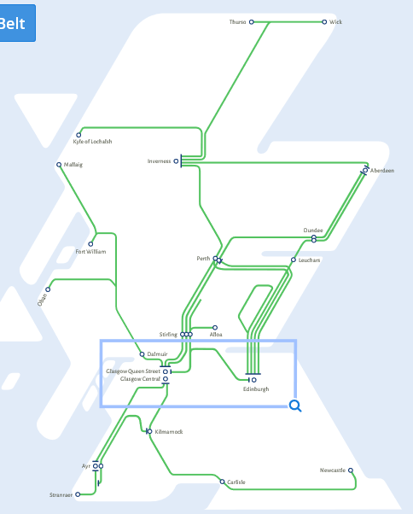

Slide 14
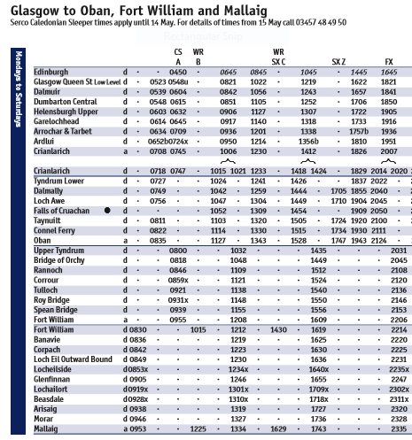
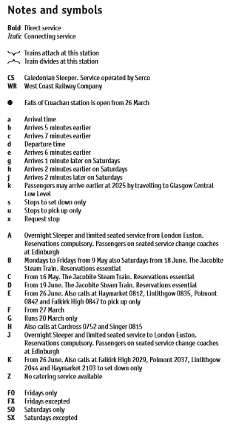

Slide 15
But there are
60 minutes = 1hour
Counting Method
Level D
Make up our own question using the Timetable !
The key steps are left on the slide to help you.
nearest
hour
hours
What’s left
Hrs Mins
www.mathsrevision.com
mins
hrs
mins
+

Slide 16
Have you updated your Learning Log ?
Time
Now Try
TJ N4 Lifeskills
Exercise 2
Ch20 (page 166)
www.mathsrevision.com

Slide 17
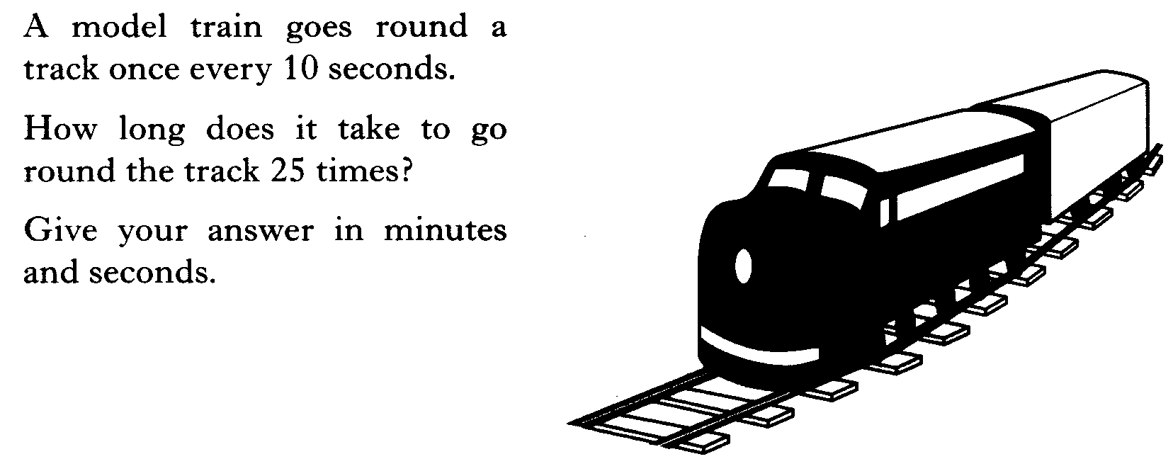

Slide 18
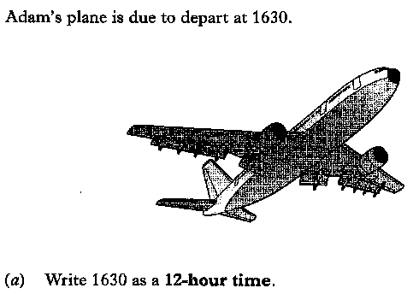
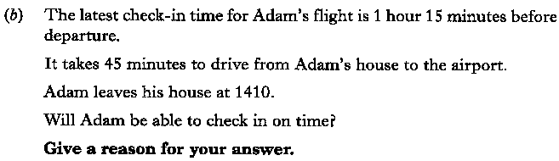

Slide 19
4 RE

Slide 20
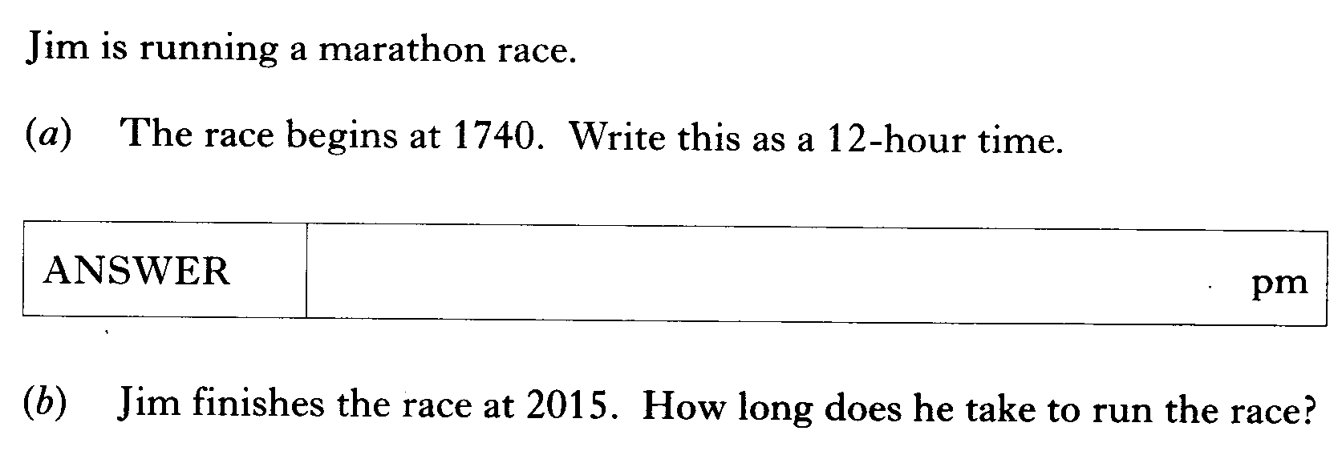

Slide 21
1 KU
3 RE

Slide 22
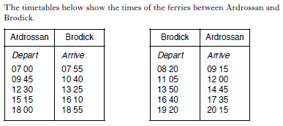


Slide 23
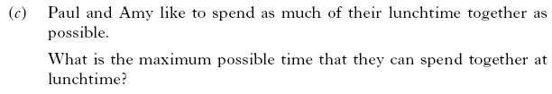
1 KU
2 KU
3 RE

Slide 24
1 KU
3 RE

Slide 25
