Slide 1


Scattergraphs
Scattergraphs
Constructing Scattergraphs
www.mathsrevision.com
Exam Type Questions

Slide 2
Starter Questions
4cm
www.mathsrevision.com
5cm
8cm
2cm

Slide 3
Scattergraphs
Learning Intention
Success Criteria
Understand the Key-Points of a Scattergraph.
  We are learning to interpret a Scattergraph .
www.mathsrevision.com
2. Know the term positive and negative correlation.

Slide 4
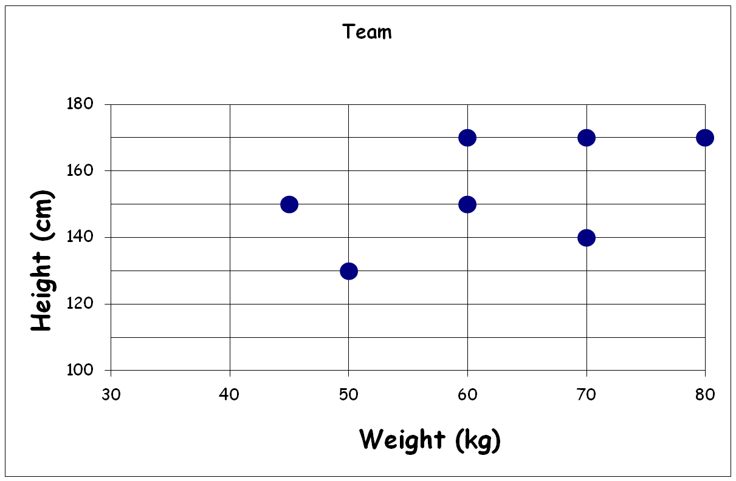
This scattergraph shows the heights and weights of a sevens football team
Scattergraphs
Write down height and weight of each player.
Construction of Scattergraph
Bob
Tim
Joe
Sam
Gary
Dave
www.mathsrevision.com
Jim

Slide 5
Scattergraphs
Construction of Scattergraph
When two quantities are connected we say
there is a correlation between them.
x
x
x
x
x
x
x
x
x
x
x
x
www.mathsrevision.com
Strong positive
correlation
Strong negative
correlation

Slide 6
Scattergraph
Data was collected on fares charge by taxi company’s.
(a) Is there correlation between Distance and Cost.
Yes, a positive correlation
C
Why is there a dot at (0,0) ?
20
18
No distance no charge !
16
14
12
(c) How far could you travel for £13.00 ?
Cost (£)
10
8
About 5 to 6km
6
4
(d) How much will it cost to travel 3km ?
2
D
0
1
2
3
4
5
6
7
8
9
10
Between £8 and £12
Distance (km)

Slide 7
Scattergraph
Data was collected on the temperature and the sales of gloves ?
(a) Is there correlation between temperature and sales.
Yes, a negative correlation
g
How many gloves sold at 20 ºC ?
20
18
16
8 pairs.
14
12
(c) Estimate gloves sold at 30 ºC ?
No. of Gloves
10
8
6 pairs
6
4
Estimate temperature
when no gloves sold.
2
T
0
5
10
15
20
25
30
35
40
Temperature ºC
45 ºC

Slide 8

Scattergraphs
Now Try
TJ N4 Lifeskills
Exercise 1
Ch32 (page 254)
www.mathsrevision.com

Slide 9
Starter Questions
www.mathsrevision.com

Slide 10
Scattergraphs
Construction of Scattergraphs
Learning Intention
Success Criteria
Construct and understand the Key-Points of a scattergraph.
  To construct and interpret Scattergraphs.
www.mathsrevision.com
2. Know the term positive and negative correlation.

Slide 11
Scattergraphs
Construction of Scattergraph
When two quantities are strongly connected we say there is a
strong correlation between them.
Best fit line
x
x
x
x
x
x
x
x
x
x
x
x
www.mathsrevision.com
Best fit line
Strong positive
correlation
Strong negative
correlation

Slide 12
Scattergraphs
Data was collected on pupils scores in Maths and Physics.
(a) Is there correlation between maths and physics scores.
p
Yes, a positive correlation
100
Draw in the best-fit line.
90
80
70
Use your line to estimate
the maths score if you score
60% in physics.
60
Physics (%)
50
40
30
About 45%
20
10
m
If you scored 80% for maths
estimate your score for physics.
0
10
20
30
40
50
60
70
80
90
100
Maths (%)
100%

Slide 13
Common sense more study better mark !
Scattergraphs
A survey was carried out on the number of hours spent studying and
the number of questions answered incorrectly in the Maths SQA Exam.
(a) Is there correlation between wrong answers and study hours.
Yes, a negative correlation
a
Draw in the best-fit line.
20
18
16
Use your line to estimate
the number incorrect answers
for 2 hours study ?
14
12
Incorrect answers
10
8
14 questions
6
4
If you study for 9 hours
how many answers would you expect
to get wrong.
2
h
0
1
2
3
4
5
6
7
8
9
10
Hours
None !

Slide 14
Scattergraphs
Draw a scattergraph to represent the data given below and draw in a
Line of best fit.
Car Values
Age | Value
1 | £9000
1 | £8000
2 | £8000
3 | £7000
3 | £6000
3 | £5000
4 | £5000
4 | £4000
5 | £2000
10
9
8
7
6
Value in Thousands
5
4
3
2
1
0
1
2
3
4
5
Age (Years)

Slide 15

Have you updated your Learning Log ?
Scattergraphs
Construction of Scattergraphs
Now Try
TJ N4 Lifeskills
Exercise 2
Ch32 (page 256)
www.mathsrevision.com

Slide 16
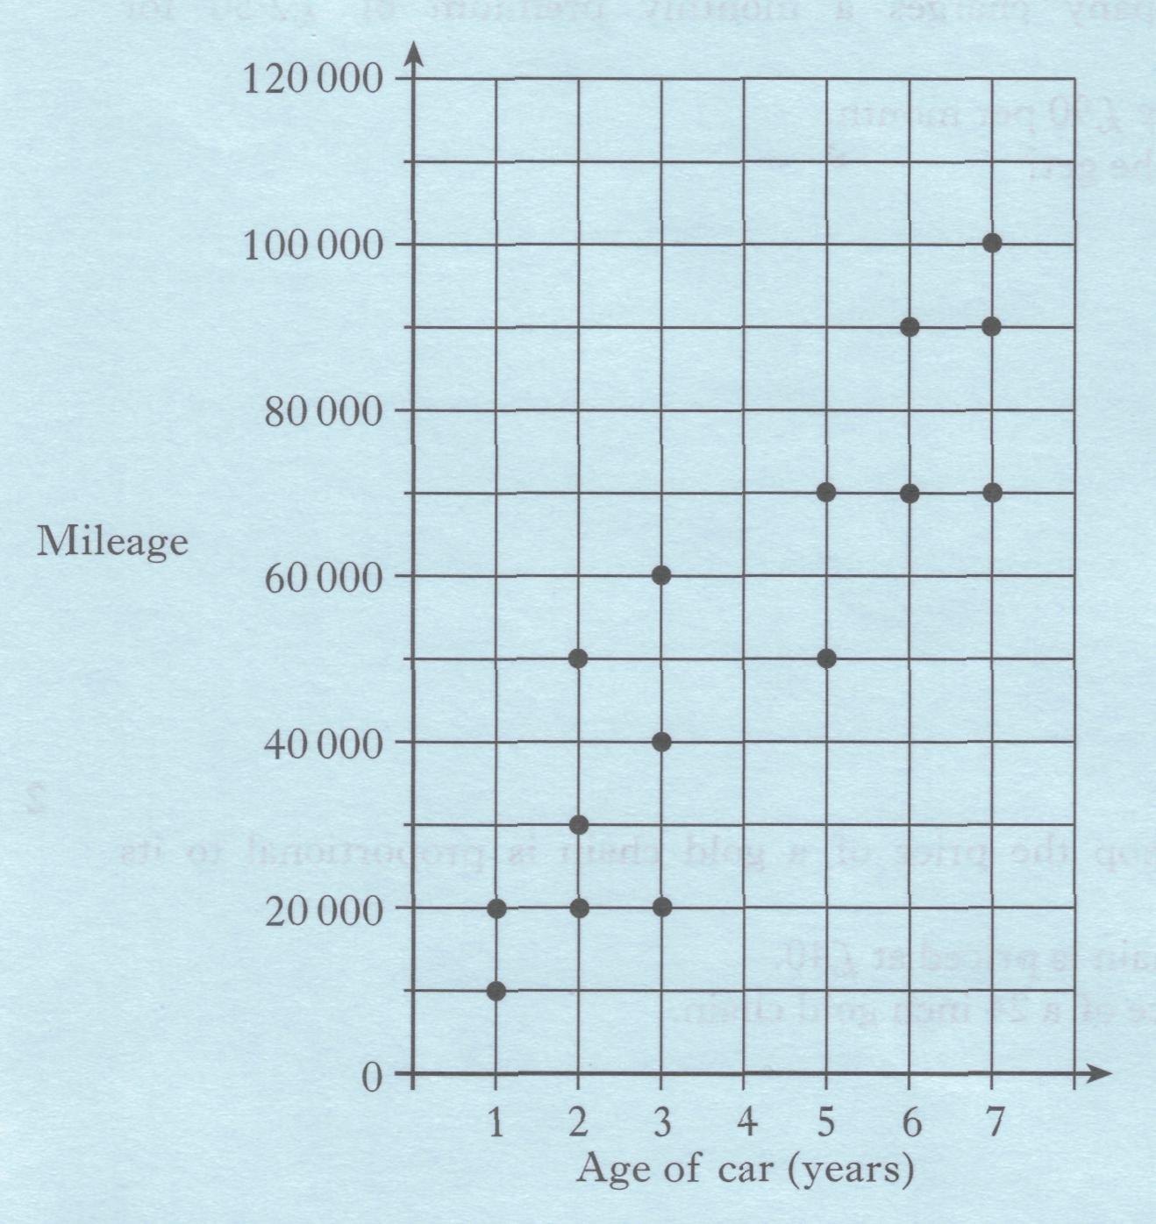
The scattergraph shows the age and mileage of cars in a garage.
Draw a line of best fit
through the points on the graph.
(b) Use your line of best fit to
estimate the mileage of a
4 year old car.
1
1

Slide 17
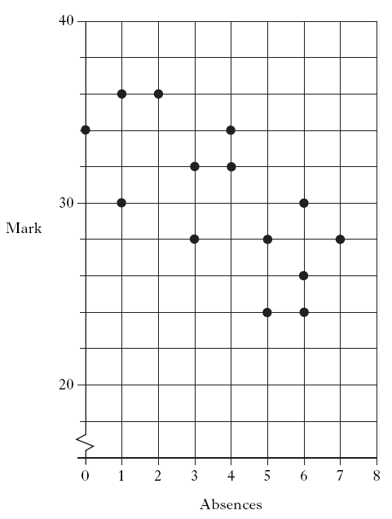
A teacher records the number of absences and end of term test mark for each of her students. The scattergraph shows the results.
Draw a line of best fit through the points on the graph.
(b) Use your line of best fit to
estimate the mark of a student
who had 8 absences.
1
1

Slide 18
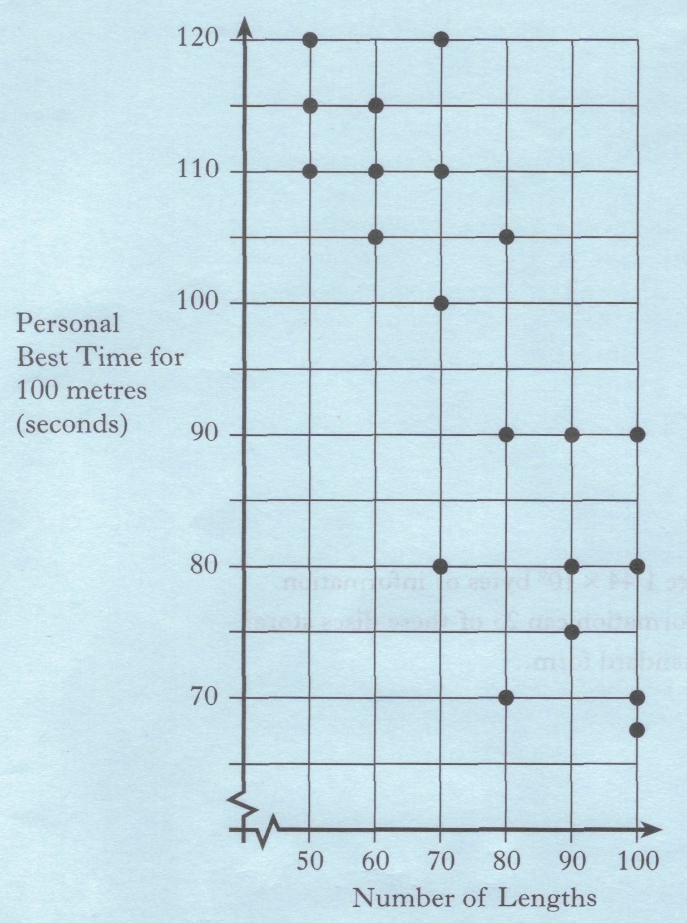
A group of swimmers record
the number of lengths they swim
in each training session.
their personal best time (in seconds)
for swimming 100 metres in competition.
The scattergraph shows the results.
.
Draw a line of best fit
through the points on the graph.
(b) Use the graph to estimate
the personal best time of a
swimmer who swims 75
lengths in each training
session.
1
1

