Slide 1


Scales & Drawing
Enlarge & Reduce Shapes
Scale Drawing to find Length
www.mathsrevision.com

Slide 2
Starter Questions
www.mathsrevision.com

Slide 3
Scales & Drawing
Enlargement & Reduction
Learning Intention
Success Criteria
  1. We are learning mathematically to enlarge or reduce various shapes.
  To be able to enlarge or reduce a shape by a given scale factor.
www.mathsrevision.com

Slide 4
Enlargement
Enlarge this shape by a factor of 2.
1 →
2
2 →
4
1 cm
2 cm
2 cm
4 cm

Slide 5
Reduction
Reduce this shape by a factor of a quarter.
8 →
2
6 →
1.5
8 cm
2 cm
6 cm
1.5 cm

Slide 6
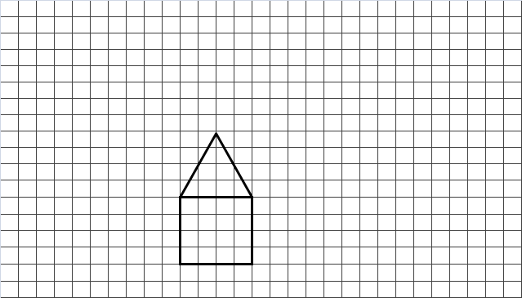
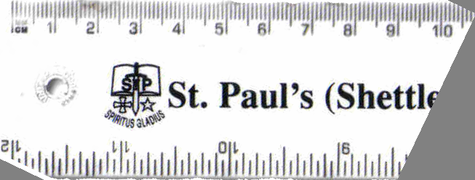
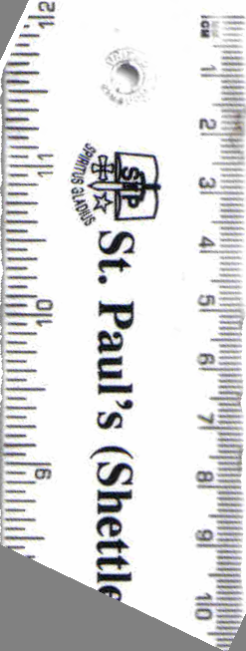
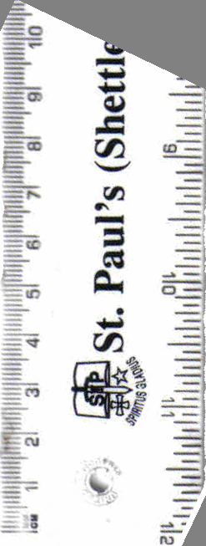
Half the size of the shape.
Double the size of the shape.

Slide 7

Scale Drawings
Now try
N4 Lifeskills TJ
Ex 1
Ch16 (page 129)
www.mathsrevision.com

Slide 8
Starter Questions
www.mathsrevision.com

Slide 9
Scales
Learning Intention
Success Criteria
  1. We are learning about scales on drawings.
  To understand the term scale.
2. Calculate the real-life distance given a scale factor.
www.mathsrevision.com

Slide 10
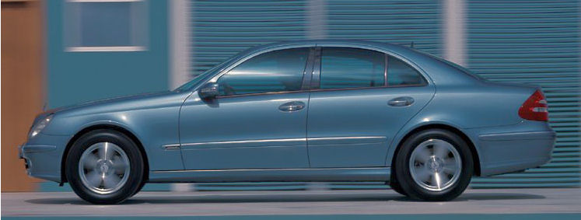
Scales
In order to make sense of a map or scale diagram
the scale must be known.
For this scale model
www.mathsrevision.com
1 cm represents 1.5 m
This means for 1 cm on the drawing
represents in real-life 1.5 m

Slide 11
Scales
Working with scales is simply using proportion.
Are we expecting more or less
Make bigger fraction
www.mathsrevision.com
Drawing Real-Life
1 → 1.5
4 →
4-Jul-26

Slide 12

Scales
The scale of this drawing is
1cm = 5m
What is the actual length
of the tree ?
www.mathsrevision.com

Slide 13
Scales
Working with scales is simply using proportion.
Are we expecting more or less
Make bigger fraction
www.mathsrevision.com
Drawing Real-Life
1 → 5
7 →
4-Jul-26

Slide 14
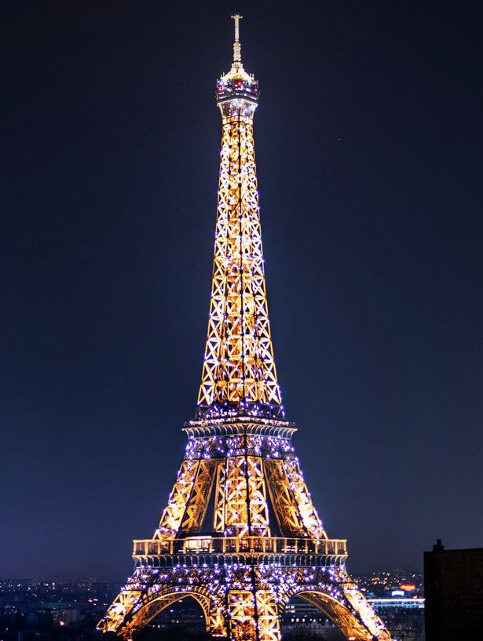
Scales
The scale of this drawing is
1cm = 54m
What is the actual height
of the Eiffel Tower in metres ?
www.mathsrevision.com

Slide 15
Scales
Working with scales is simply using proportion.
Are we expecting more or less
Make bigger fraction
www.mathsrevision.com
Drawing Real-Life
1 → 54
6 →
4-Jul-26

Slide 16
Scales
Problem
The scaled drawing has a scale of 1cm = 2.5m
XT measures 4cm of the drawing and represents
a steel wire support for the flag pole.
What is the real-life length of the wire.
www.mathsrevision.com
T
X

Slide 17
Scales
Working with scales is simply using proportion.
Are we expecting more or less
Make bigger fraction
www.mathsrevision.com
Drawing Real-Life
1 → 2.5
4 →
4-Jul-26

Slide 18

Have you updated your Learning book ?
Scale Drawings
Now try
N4 Lifeskills TJ
Ex 2
Ch16 (page 131)
www.mathsrevision.com

