Slide 1


Scaled Drawings
Making Simple Scale Drawings
Compass Points & Scale Drawings
Construct a Scale Drawing (using a compass)
www.mathsrevision.com
Exam Type Questions

Slide 2
Starter Questions
www.mathsrevision.com

Slide 3
Scaled Drawings
Learning Intention
Success Criteria
1. From information given make a scaled drawing.
  1. We are learning to draw a simple scale drawing given suitable information.
www.mathsrevision.com

Slide 4
Scaled Drawings
Problem
A garden is rectangular in shape and
has length 12m and breadth 8m.
Make rough sketch of the garden.
12m
Draw an accurate
scaled drawing of the garden
Use a scale of
1cm represents 2m
www.mathsrevision.com
8m

Slide 5
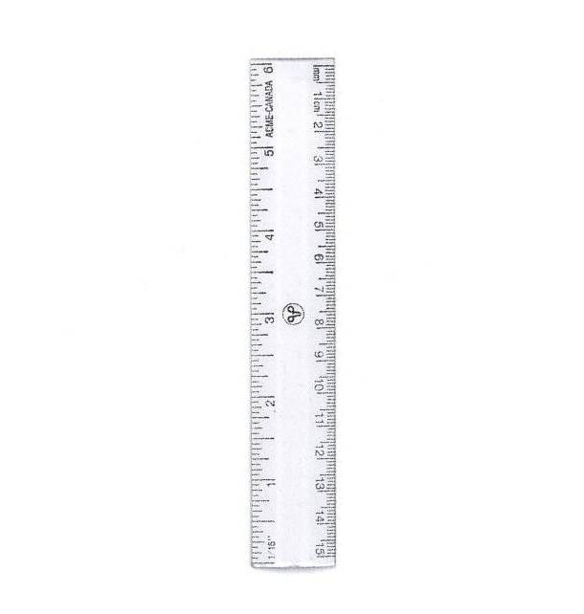
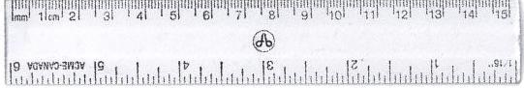
Scaled Drawings
Use a scale of
1cm represents 2m
1cm represents 2m
12m
8m
12m
www.mathsrevision.com
8m

Slide 6
Scaled Drawings
Problem
A road junction is triangular in shape.
A rough sketch is given below.
Draw an accurate
scaled drawing of the junction
Use a scale of
1cm represents 2m
www.mathsrevision.com
20m
12m

Slide 7
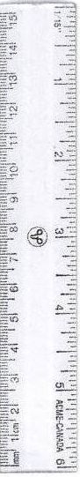
Scaled Drawings
Use a scale of
1cm represents 2m
1cm represents 2m
Find the real life length of the 3rd side
20m
20m
www.mathsrevision.com
12m
2 x 11.6 =
23.2m
12m

Slide 8

Scale Drawings
Now Try
TJ N4 Lifeskills
Exercise 1
Ch22 (page 176)
www.mathsrevision.com

Slide 9
Starter Questions
www.mathsrevision.com

Slide 10
Directions & Scale Drawings
Learning Intention
Success Criteria
1. Be able to make sense of a map.
  We are learning to work with directions.
Write down accurate directions from a map.
www.mathsrevision.com

Slide 11
Compass Points
360/000º
Half way between North and West
N
Half way between North and East
NW
NE
270º
W
E
090º
SW
SE
Half way between South and West
Half way between South and East
S
180º

Slide 12
If Gary walks to John then to Barry and then back to where he started. Write down all the directions he took.
If Anne walks to Julie then to Amy and then back to where she started. Write down all the directions she took.
If Daniel is facing North and turns clockwise to face Anne. How many degrees is this.
If Daniel is facing Frances and turns clockwise to face Amy. How many degrees is this.
If Amy is facing Paul and turns anti-clockwise to face Daniel. How many degrees is this.
Who is North of Daniel
Who is East of John
Who is South West
of Barry
Who is North East
of Gary
Compass Points
John
Frances
Barry
N
Julie
Daniel
Anne
www.mathsrevision.com
Gary
Amy
Paul

Slide 13
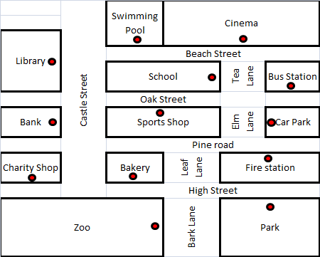
I leave the zoo to go back to my car which is in the town car park. Write down the directions I should take.
After going to the park I want to go to the cinema.
Tea Lane is closed.
Write down the directions
I should take.
There’s a fire at the library. Right down the directions the fire engine should take.
I come out of the swimming pool and turn right then left. I go into the building second on my the right.
Name the building.
I come out of the charity shop and need to catch a bus. Write down the directions to the bus station.
I come out of school and go to the Park.
Write down the directions I must take.
Map Directions
N
www.mathsrevision.com

Slide 14
Scale factors
Now Try
TJ N4 Lifeskills
Exercise 2
Ch22 (page 178)
www.mathsrevision.com

Slide 15
Directions & Scale Drawings
Learning Intention
Success Criteria
  We are learning to construct a scale drawing using bearings.
1. Be able to construct and interpret an accurate scale drawing.
www.mathsrevision.com

Slide 16
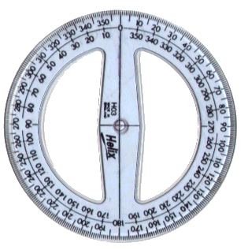
Scaled Drawings using Bearings
Make an accurate scale drawing of this sketch.
N
N
www.mathsrevision.com
50º
50º
15km
15km
1cm represents 3km
1cm represents 3km

Slide 17
How far is the plane from the airport ?
8.5 x 2 = 17km
Scaled Drawings using Bearings
Make an accurate drawing of the plane journey
N
N
N
N
120º
120º
www.mathsrevision.com
12km
45º
045º
8km
12km
8km
1cm represents 2km
1cm represents 2km

Slide 18
10.2 x 2 = 20.4km
Two boats set off from the same harbour H.
Boat A goes in South East for 9km.
Boat B goes on a bearing of 240º for 16km.
How far apart are they ?
N
N
South
East
H
135º
www.mathsrevision.com
200º
9km
200º
9km
16km
16km
A
A
B
B
1cm represents 2km
1cm represents 2km

Slide 19

Have you updated your Learning Log ?
Scale factors
Now Try
TJ N4 Lifeskills
Exercise 3
Ch22 (page 179)
www.mathsrevision.com

Slide 20
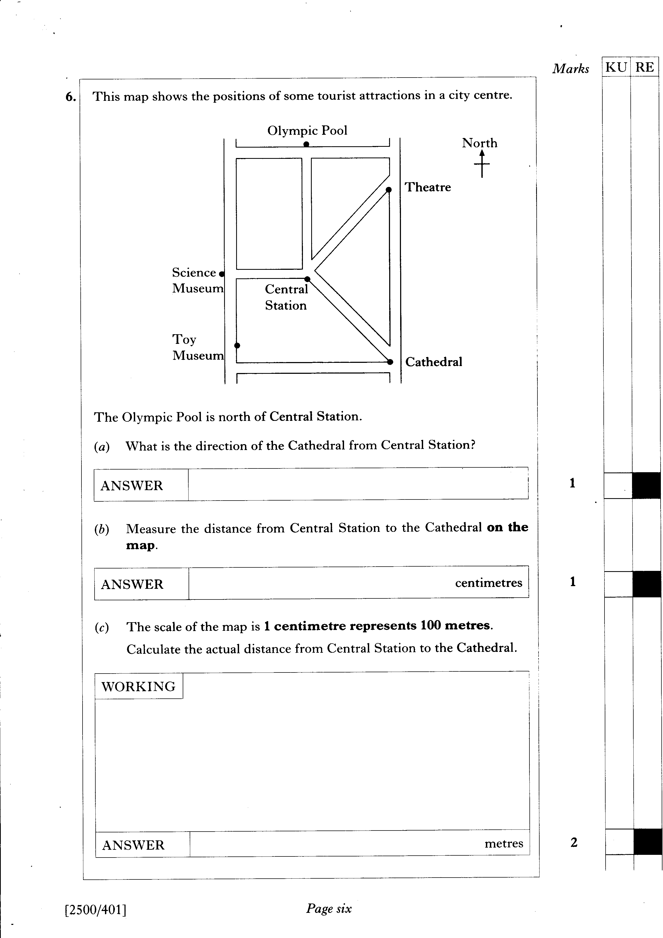

Slide 21
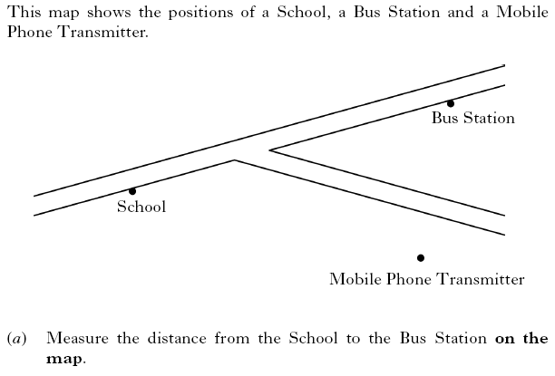

DIAGRAM HAS BEEN RE-SIZED
1 KU
2 KU
3 RE

Slide 22
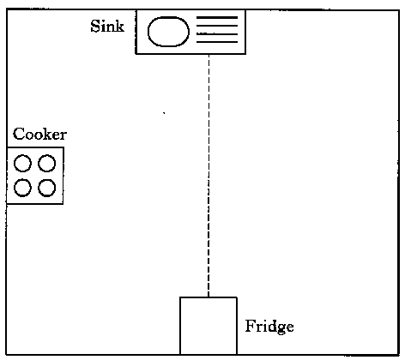



Slide 23
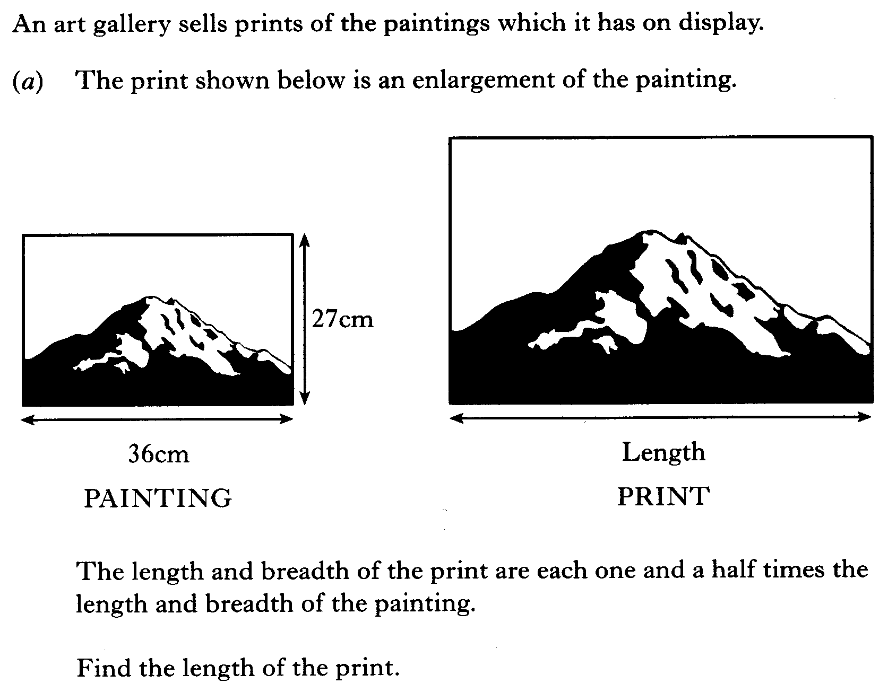
Turn to next slide for part (b)

Slide 24
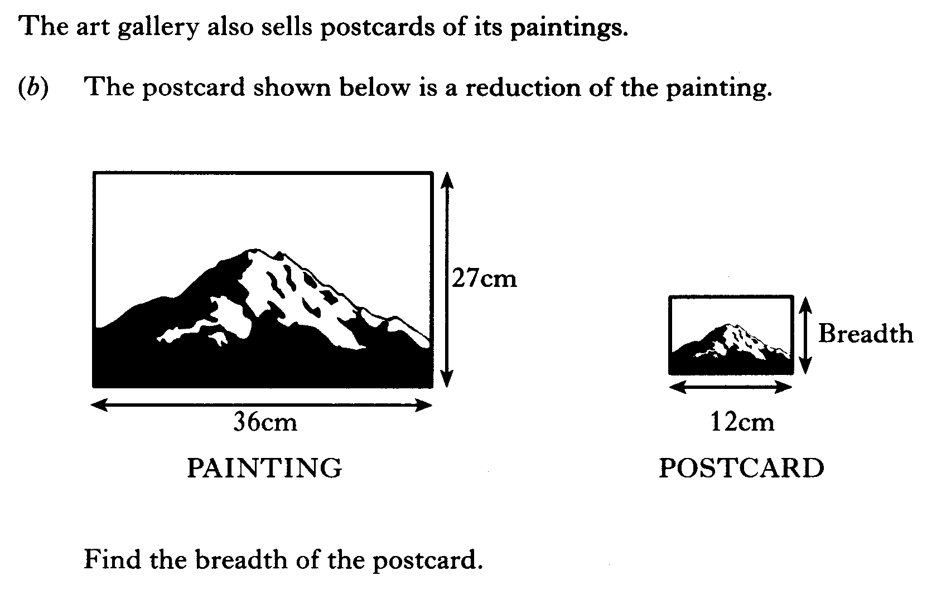

Slide 25
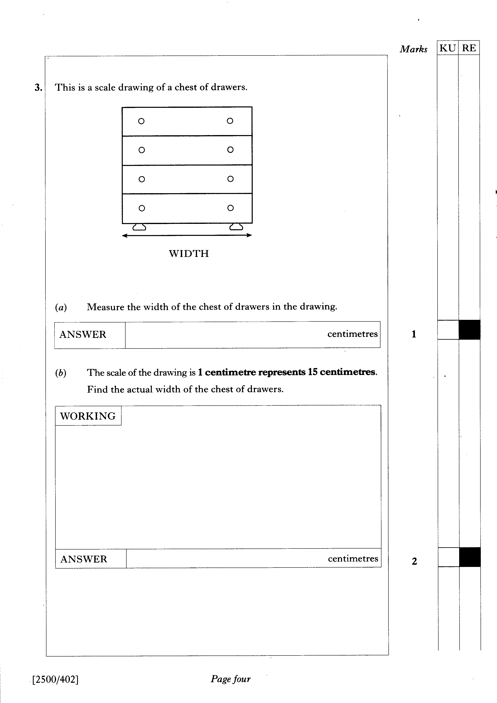

Slide 26

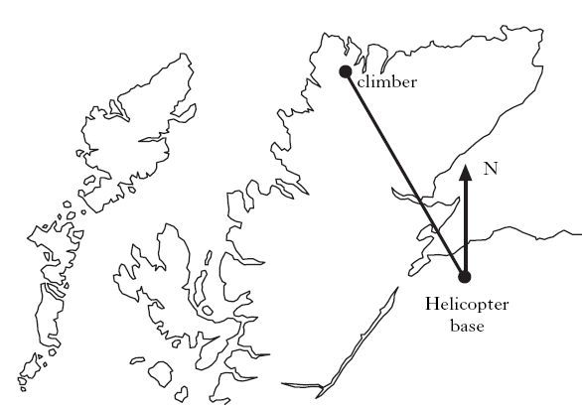

Slide 27

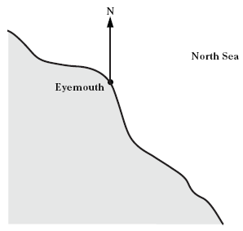

Slide 28
