Slide 1


Formulae
S4
Formulae expressed in words
Evaluating Formulae
www.mathsrevision.com
Exam Type Questions

Slide 2
Starter Questions
S4
5 cm
3 cm
3 cm
2.5 cm
4 cm
www.mathsrevision.com

Slide 3
Formulae
S4
Learning Intention
Success Criteria
  We are learning how to work with formulae expressed in words.
  Understand formulae expressed in words.
  2. Solve problems given formulae in words.
www.mathsrevision.com

Slide 4
Formulae
S4
Sometimes formulae are expressed in words.
A tile fitter charges £20 per hour.
How much will he charge for 8 hours of work.
C =
20xh
For h = 8
C = 20 x 8 =
£160

Slide 5
Formulae
S4
The cost for hiring a carpet cleaner is
£30 plus £3 a day
How much will it cost to hire for a week.
C =
30
+
3d
For d = 7
C = 30 + 3 x 7 =
£51

Slide 6
Formulae
S4
Profit :
Subtract how much you paid for goods in the first place from the amount you actually sold them for.
How much profit did Daniel make if he bought a CD for £9.99 and sold it for £12
+
Profit = 12 – 9.99 =
£2.01

Slide 7

Formulae
S4
Now Try
TJ N4 Lifeskills
Exercise 1
Ch21 (page 170)

Slide 8
Starter Questions
S4
1. Does 3 + 2 x 4 = 11 or 20

Slide 9
Formulae
S4
Learning Intention
Success Criteria
  We are learning how to evaluate formulae
  Understand the term
  formulae.
  2. Be able to substitute values into formulae and evaluate properly using BODMAS.
www.mathsrevision.com

Slide 10
Formulae
S4
A formula is the process calculating a quantity based on a known relationship e.g. Length, Area, Volume etc........
It is VERY important that we remember a keypoint
when working with formulae.
B
Brackets
O
Other ⇨ squares and square root etc....
D
Divide
M
Multiplication
A
Addition
S
Subtraction

Slide 11
Formula for
Parallelogram
S4
Example 1 : Find the area of parallelogram.
A = b x h
3cm
A = 9 x 3
9cm
A = 27 cm²

Slide 12
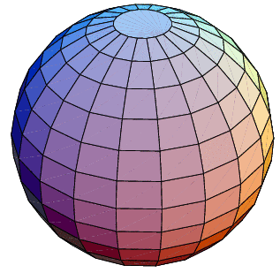
Formulae for the
Volume of a Sphere
S4
D = diameter
r
D
www.mathsrevision.com
Q. If the above sphere has radius 10cm.
Calculate it’s volume.

Slide 13
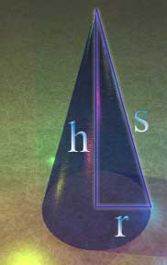
Formulae for
Volume of a Cone
S4
h
r
www.mathsrevision.com
If the above cone has radius 15cm and height
of 10 cm. Calculate it’s volume.

Slide 14

Have you updated your Learning Log ?
Formulae
S4
Now Try
TJ N4 Lifeskills
Exercise 2
Ch21 (page 172)

Slide 15
3 RE

Slide 16
2 KU

Slide 17
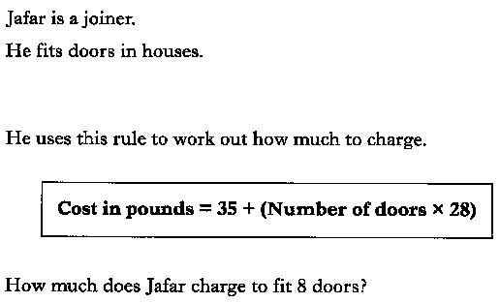

Slide 18
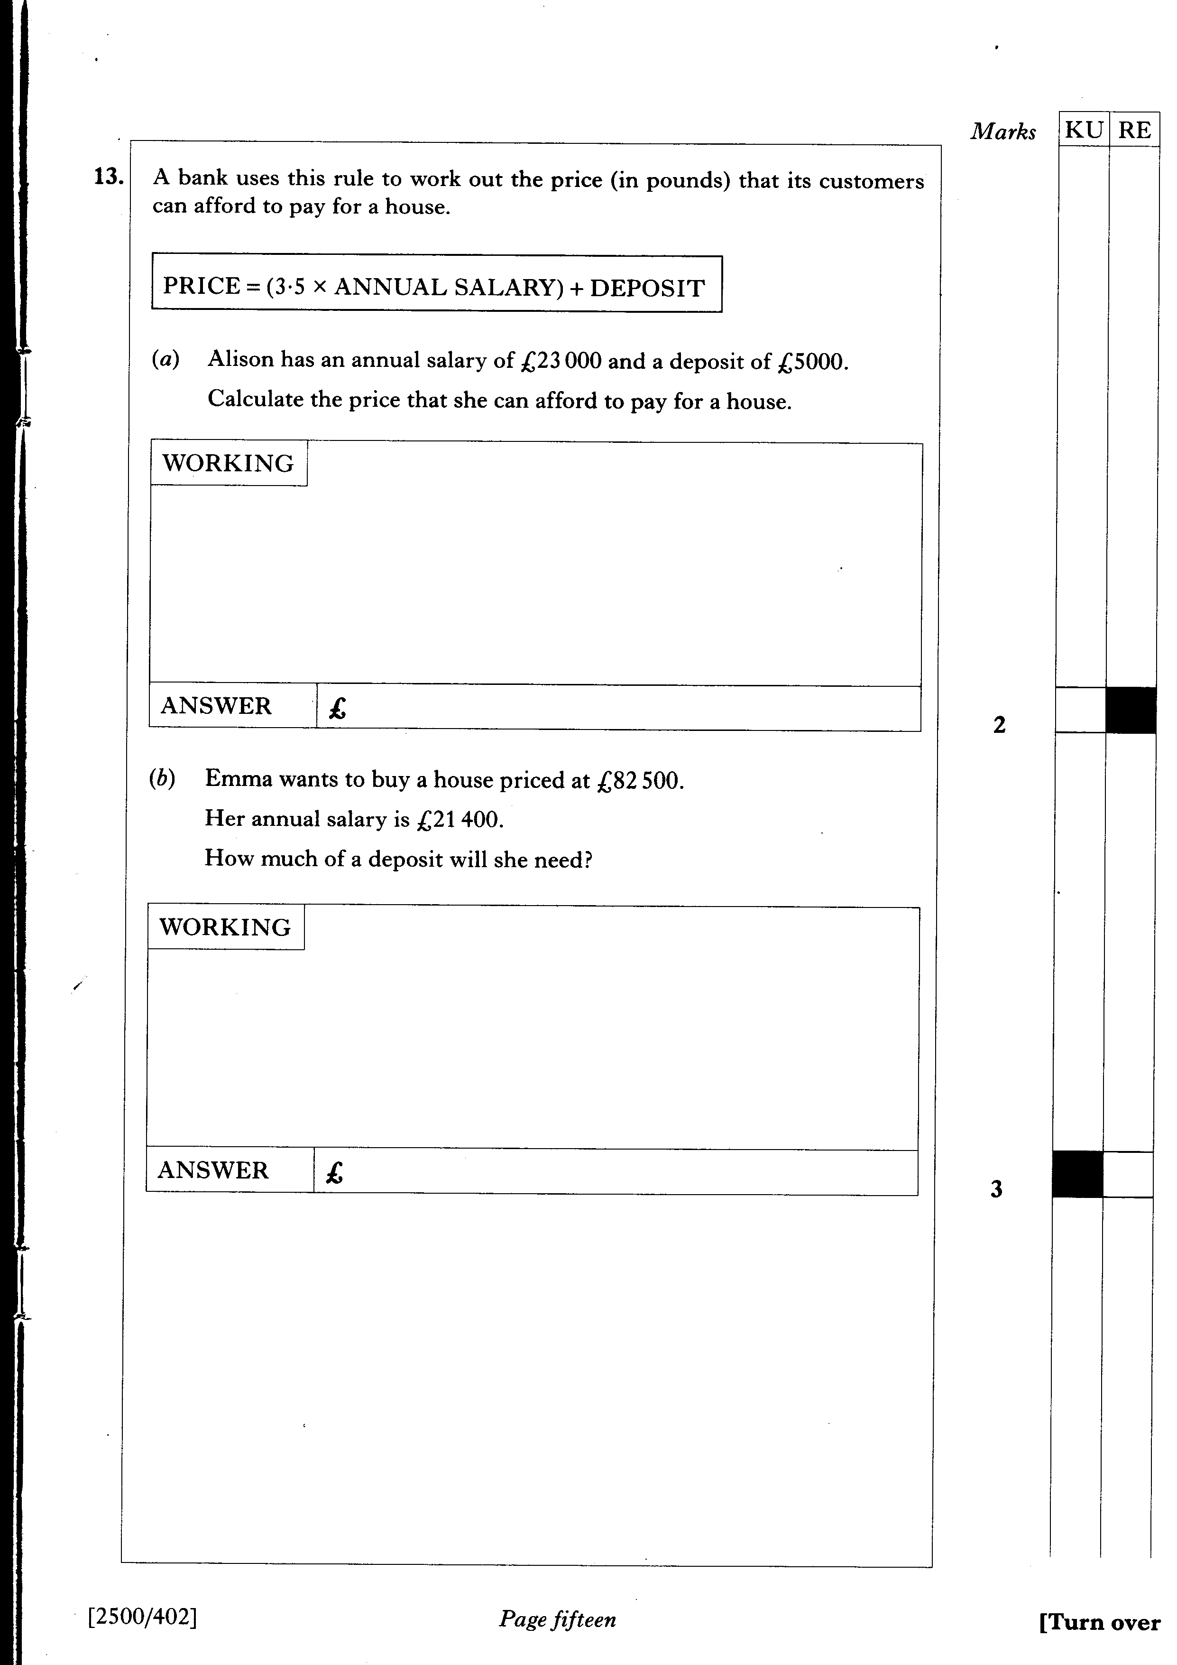

Slide 19
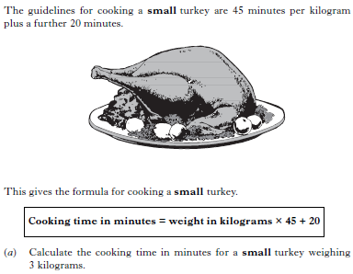
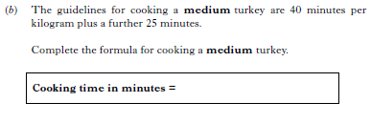

Slide 20
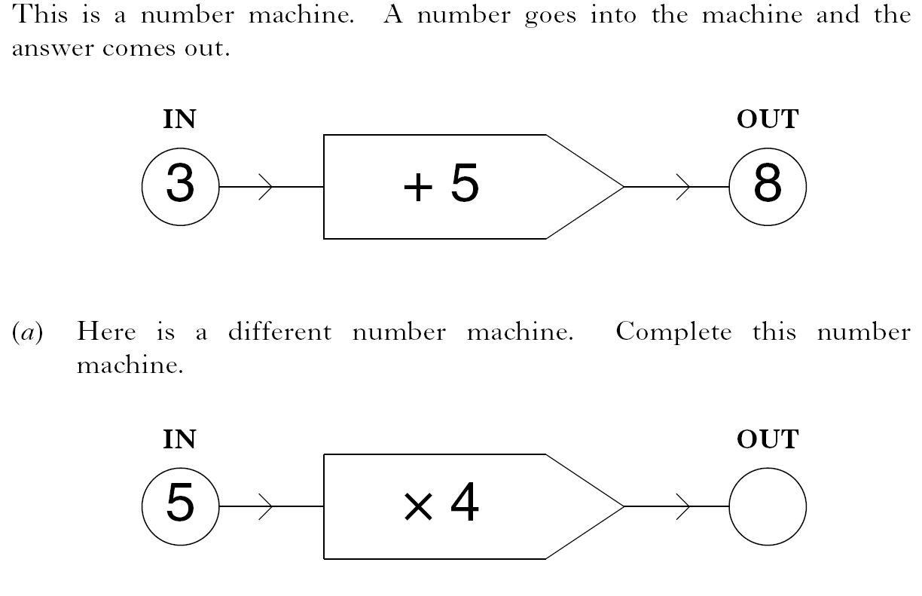
1 KU
2 RE

Slide 21
The current, C amps, of an electrical appliance is calculated using the formula:
where P watts is the power rating.
A hairdryer has a power rating of 850 watts.
The fuse used should be the one just bigger than the calculated current.
The choice of fuses is 3 amp, 5 amp and 1 3 amp.
Which fuse should be used?

