Slide 1


Pythagoras Theorem
Squaring a Number and Square Roots
Investigating Pythagoras Theorem
Calculating the Hypotenuse
Solving real-life problems
www.mathsrevision.com
Finding the length of the smaller side
Mixed problems
Exam Type Questions

Slide 2
Starter Questions
www.mathsrevision.com

Slide 3
Squaring a Number
Learning Intention
Success Criteria
  To understand the term
  ‘squaring a number’.
  To understand what is meant by the term
  ‘squaring a number’
Be able to calculate squares both mentally and using the calculator.
www.mathsrevision.com

Slide 4
Squaring a Number
To square a number means to :
“Multiply it by itself”
Example :
means 9 x 9 = 81
www.mathsrevision.com
means 10 x 10 = 100

Slide 5

Squaring a Number
Now Try
TJ N4 Lifeskills
Exercise 1
Ch19 (page 153)
www.mathsrevision.com

Slide 6
Square Root of a number
You now know how to find :
9² = 9 x 9 = 81
We can ‘undo’ this by asking
“which number, times itself, gives 81”
www.mathsrevision.com
From the top line, the answer is 9
This is expressed as : “the SQUARE ROOT of 81 is 9”
or in symbols we write :

Slide 7
Starter Questions
Q1. Are the missing angles
65º, 40º and 65º
115º
Q2. Calculate
www.mathsrevision.com
Q3. The cost of a new computer is £1000 +vat. If the vat is charged at 12% what is the total cost.
Q4. The cost of a bag of sugar is £1.12. How much 50 bags cost.
NON-CALCULATOR

Slide 8
Right – Angle Triangles
Aim of today's Lesson
‘To investigate the right-angle triangle and to come up with a relationship between the lengths of its two shorter sides and the longest side which is called the hypotenuse. ‘
www.mathsrevision.com

Slide 9
Right – Angle Triangles
What is the length of a ?
3
What is the length of b ?
4
www.mathsrevision.com
Copy the triangle into your jotter
and measure the length of c
5

Slide 10
Right – Angle Triangles
What is the length of a ?
6
What is the length of b ?
8
www.mathsrevision.com
Copy the triangle into your jotter
and measure the length of c
10

Slide 11
Right – Angle Triangles
What is the length of a ?
5
What is the length of b ?
12
www.mathsrevision.com
Copy the triangle into your jotter
and measure the length of c
13

Slide 12
Right – Angle Triangles
Copy the table below and fill in the values that are missing
a | b | c | a² | b² | c²
3 | 4 | 5
5 | 12 | 13
6 | 8 | 10
www.mathsrevision.com

Slide 13
Right – Angle Triangles
Can anyone spot a relationship between
a², b², c².
a | b | c | a² | b² | c²
3 | 4 | 5 | 9 | 16 | 25
5 | 12 | 13 | 25 | 144 | 169
6 | 8 | 10 | 36 | 64 | 100
www.mathsrevision.com

Slide 14
Pythagoras’s Theorem
c
b
www.mathsrevision.com
a

Slide 15
Summary of
Pythagoras’s Theorem
www.mathsrevision.com
Note: The equation is ONLY valid for right-angled triangles.

Slide 16
Pythagoras Theorem
Now Try
TJ N4 Lifeskills
Exercise 2
Ch19 (page 154)
www.mathsrevision.com

Slide 17
Starter Questions
www.mathsrevision.com

Slide 18
Calculating Hypotenuse
Learning Intention
Success Criteria
  Use Pythagoras Theorem to calculate the length of the hypotenuse
  “the longest side”
  Know the term hypotenuse “ the longest side”
Use Pythagoras Theorem to calculate the hypotenuse.
www.mathsrevision.com

Slide 19
Calculating the Hypotenuse
Example 1
Q2. Calculate the longest length of the right- angled triangle below.
c
8
www.mathsrevision.com
12

Slide 20

Calculating the Hypotenuse
Example 2
Q1. An aeroplane is preparing to land at Glasgow Airport. It is over Lennoxtown at present which is 15km from the airport. It is at a height of 8km.
How far away is the plane from the airport?
Aeroplane
www.mathsrevision.com
c
b = 8
Airport
a = 15
Lennoxtown

Slide 21
Calculating Hypotenuse
Now Try
TJ N4 Lifeskills
Exercise 3
Ch19 (page 156)
www.mathsrevision.com

Slide 22
Starter Questions
www.mathsrevision.com

Slide 23
Solving Real-Life Problems
Learning Intention
Success Criteria
1. To show how Pythagoras Theorem can be used to solve real-life problems.
  Solve real-life problems using Pythagoras Theorem.
www.mathsrevision.com

Slide 24
Solving Real-Life Problems
When coming across a problem involving finding a missing side in a right-angled triangle, you should consider using Pythagoras’ Theorem to calculate its length.
Example : A steel rod is used to support a tree
which is in danger of falling down.
What is the length of the rod?
www.mathsrevision.com
15m
rod
8m

Slide 25
Solving Real-Life Problems
Example 2
A garden is rectangular in shape. A fence is to be put along the diagonal as shown below.
What is the length of the fence.
www.mathsrevision.com
10m
15m

Slide 26
Solving Real-Life Problems
Now Try
TJ N4 Lifeskills
Exercise 4
Ch19 (page 158)
www.mathsrevision.com

Slide 27
Starter Questions
www.mathsrevision.com

Slide 28
Length of the smaller side
Learning Intention
Success Criteria
1. To show how Pythagoras Theorem can be used to find the length of the smaller side.
  Use Pythagoras Theorem to find the length of smaller side.
www.mathsrevision.com

Slide 29
Length of the smaller side
To find the length of the smaller side of a right- angled
triangle we simply rearrange Pythagoras Theorem.
Example : Find the length of side a ?
Check answer ! Always smaller than hypotenuse
www.mathsrevision.com
20cm
12cm
a cm

Slide 30
Length of the smaller side
Example : Find the length of side b ?
10cm
b cm
Check answer ! Always smaller than hypotenuse
www.mathsrevision.com
8 cm

Slide 31
Length of smaller side
Now Try
TJ N4 Lifeskills
Exercise 5
Ch19 (page 160)
www.mathsrevision.com

Slide 32
Starter Questions
www.mathsrevision.com

Slide 33
Pythagoras Theorem
Learning Intention
Success Criteria
1. To use knowledge already gained on Pythagoras Theorem to solve mixed problems using appropriate version of Theorem.
  Use the appropriate form Pythagoras Theorem to solving problems.
www.mathsrevision.com

Slide 34
Pythagoras Theorem
Finding hypotenuse c
Finding
shorter side b
c
b
www.mathsrevision.com
a
Finding shorter side a

Slide 35
N
G
H
O
C
D
E
F
M
P
L
K
A
I
J
C
Q
R
U
V
T
A
W
Z
S
B

Slide 36

Have you updated your Learning Log ?
Pythagoras Theorem
Now Try
TJ N4 Lifeskills
Exercise 6
Ch19 (page 162)
www.mathsrevision.com

Slide 37
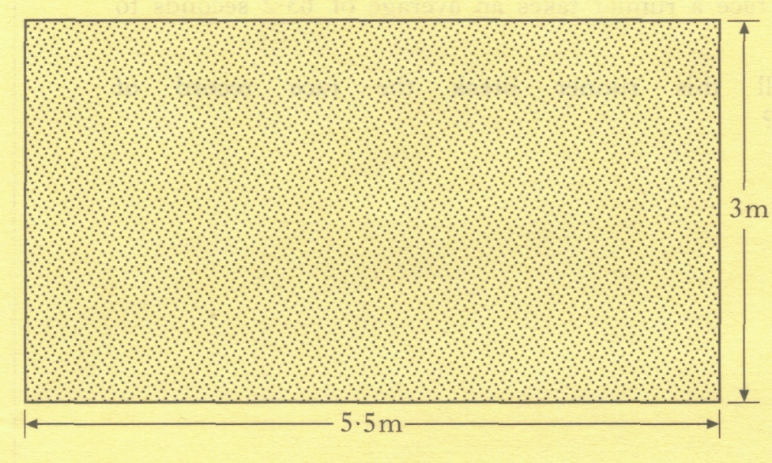
John is laying a concrete floor for his garage.
The floor is to be a rectangle
5.5 metres by 3 metres.
To check the floor is rectangular, John measures a diagonal.
What should this measurement be?

Slide 38
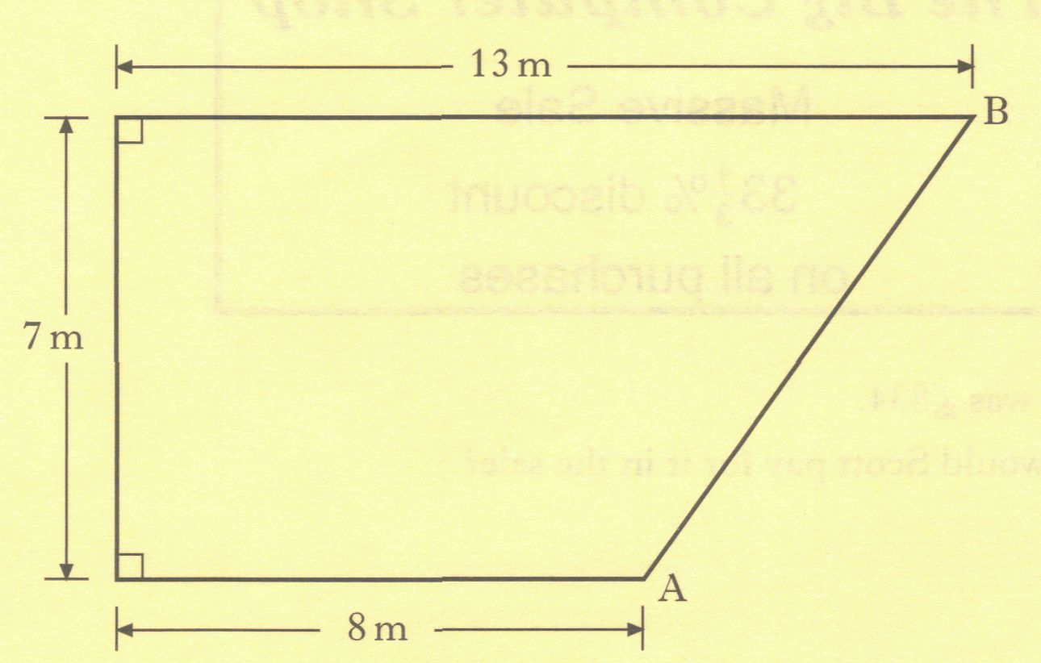
The diagram shows the shape of Sangita's garden. Sangita plants a hedge along side AB.
Calculate the length of the hedge.
5
7

Slide 39
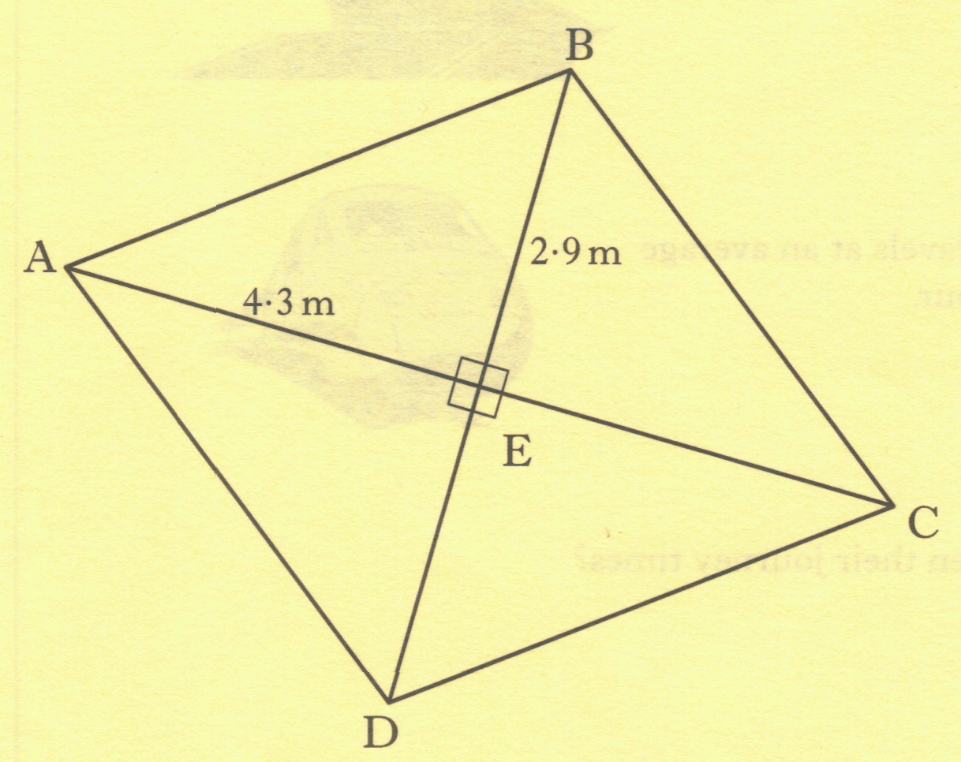
ABCD is a rhombus.
AE = 4.3 metres and
BE = 2.9 metres.
Calculate the perimeter of the rhombus.
Do not use a scale drawing.

Slide 40
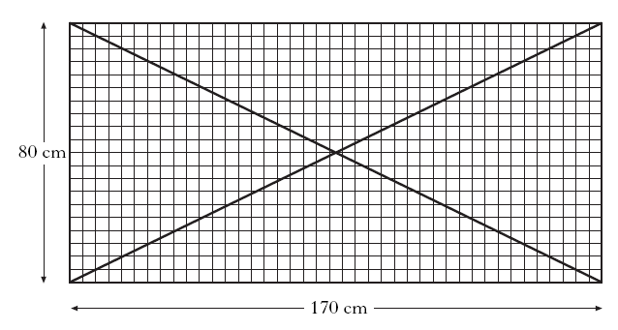
A rectangular metal grill for a window is shown below.
Two diagonal metal bars strengthen the grill.
Find the length of one of the metal bars.

Slide 41
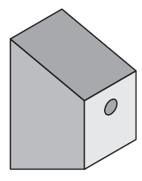
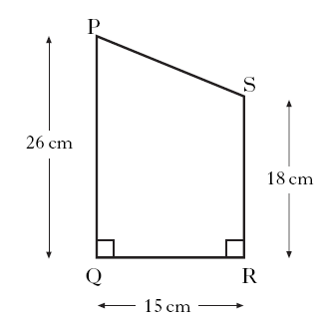
Lewis is designing a bird box for his garden.
The dimensions for the side of the box are shown in the diagram.
Calculate the length of side PS.
Do not use a scale drawing.
P
26-18
=8
S
15

Slide 42
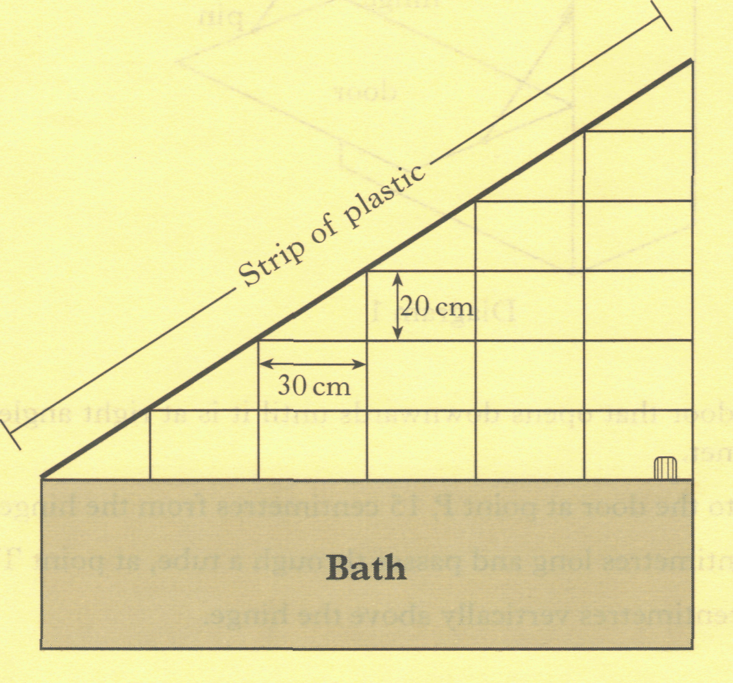
The diagram below shows the wall Jamie has tiled above the bath in his house.
He used rectangular tiles, some of which he halved. The length of each tile is 30 centimetres. The breadth of each tile is 20 centimetres.
Calculate the length of the strip of plastic.
6 x 20
=120
6 x 30=180

Slide 43
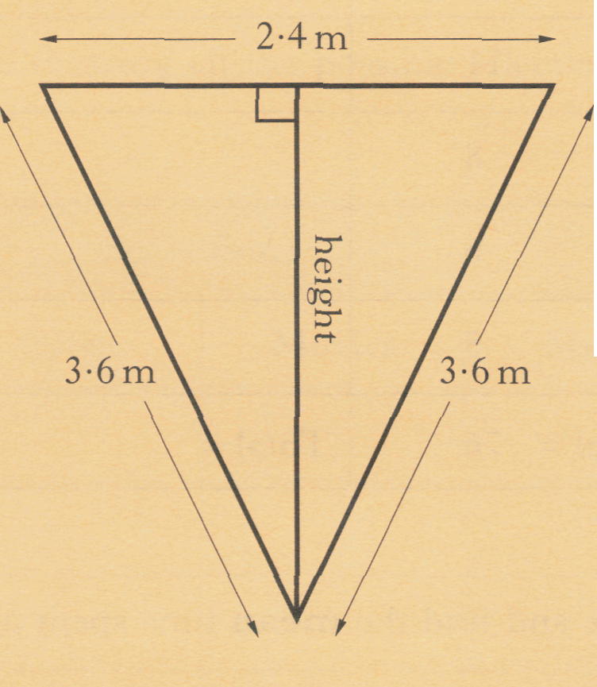
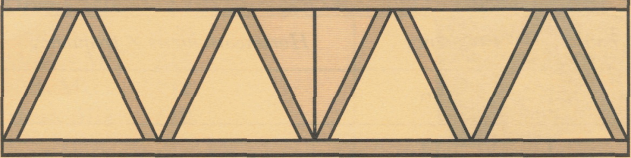
A steel plate in the shape of an isosceles triangle is used to strengthen a bridge.
Calculate the height of the steel plate. Do not use a scale drawing.
1.2 m
height
3.6 m

Slide 44
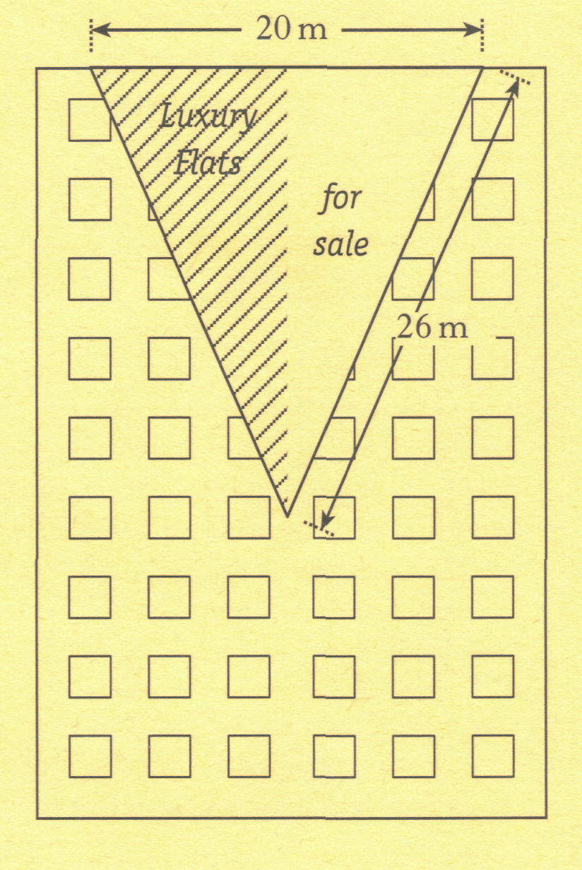
A large advertising banner is hanging from a building.
The banner is an isosceles triangle.
The top edge of the banner is 20 metres long and each of the other two sides is 26 metres long.
Find the area of the banner.

