Slide 1


Probability
Probability Line
Calculating Simple Probability
www.mathsrevision.com
Exam Type Questions

Slide 2
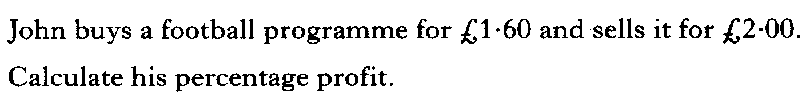
Starter Questions
www.mathsrevision.com

Slide 3
Probability
Learning Intention
Success Criteria
  To understand probability in terms of the number line.
  Understand the probability line.
www.mathsrevision.com
Calculate simply probabilities.

Slide 4
Probability
Likelihood Line
0
0.5
1
Impossible
Evens
Certain
Not very
likely
Very
likely
www.mathsrevision.com
Seeing
a butterfly
In July
School
Holidays
Winning the
Lottery
Baby Born
A Boy
Go back
in time

Slide 5
Probability
Likelihood Line
0
0.5
1
Impossible
Evens
Certain
Not very
likely
Very
likely
www.mathsrevision.com
It will
Snow in winter
Homework
Every week
Everyone getting
100 % in test
Toss a coin
That land
Heads
Going without
Food
for a year.

Slide 6

Probability
No Exercise
Revision !
www.mathsrevision.com

Slide 7
Starter Questions
Q1. Calculate 7 – 5 x 2
Q2. Calculate 7 x 5 – 5 x 2
www.mathsrevision.com
Q3. Calculate 7² – 5² x 2

Slide 8
Probability
Learning Intention
Success Criteria
  We are learning to calculate simple probabilities.
  Be able to calculate simply probabilities.
www.mathsrevision.com

Slide 9
Probability
We can normally attach a value
to the probability of an event happening.
To work out a probability
www.mathsrevision.com
P(A) =
Probability is ALWAYS in the range 0 to 1

Slide 10

Probability
Number Likelihood Line
1
2
3
4
5
6
7
8
0
0.5
1
0.1
0.2
0.3
0.4
0.6
0.7
0.8
0.9
Impossible
Evens
Certain
www.mathsrevision.com
8
Q. What is the chance of picking a number between 1 – 8 ?
P =
= 1
8
Q. What is the chance of picking a number that is even ?
4
P(E) =
= 0.5
8
Q. What is the chance of picking the number 1 ?
1
P(1) =
= 0.125
8

Slide 11
Probability
Likelihood Line
52 cards in a pack of cards
0
0.5
1
0.1
0.2
0.3
0.4
0.6
0.7
0.8
0.9
Impossible
Evens
Certain
Not very
likely
Very
likely
www.mathsrevision.com
26
Q. What is the chance of picking a red card ?
P (Red) =
= 0.5
52
Q. What is the chance of picking a diamond ?
13
P (D) =
= 0.25
52
Q. What is the chance of picking ace ?
4
P (Ace) =
= 0.08
52

Slide 12

Have you updated your Learning Log ?
Probability
Now Try
TJ N4 Lifeskills
Exercise 1
Ch33 (page 261)
www.mathsrevision.com
Are you on Target ?
I can ?

Slide 13
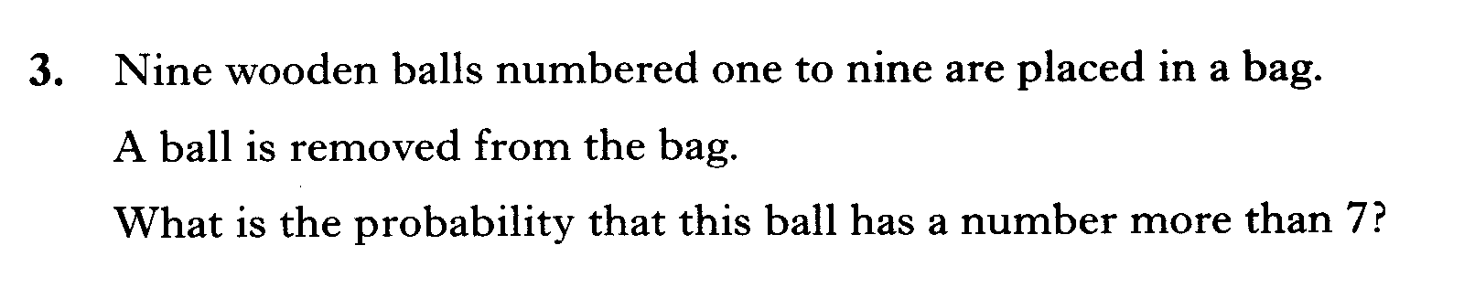

Slide 14
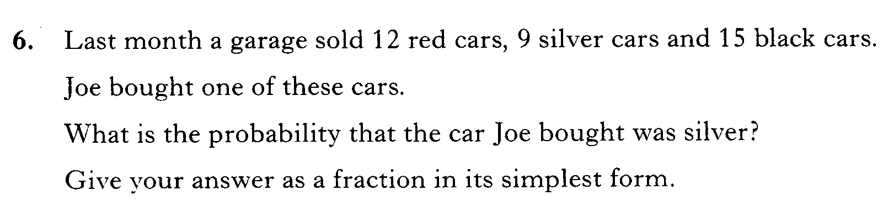

Slide 15
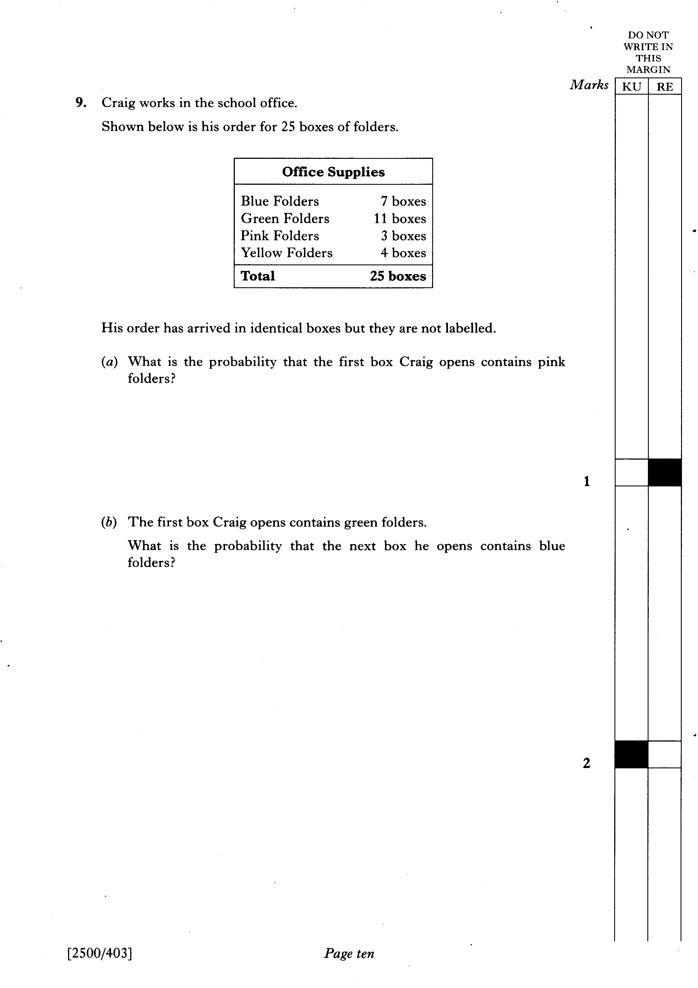

Slide 16
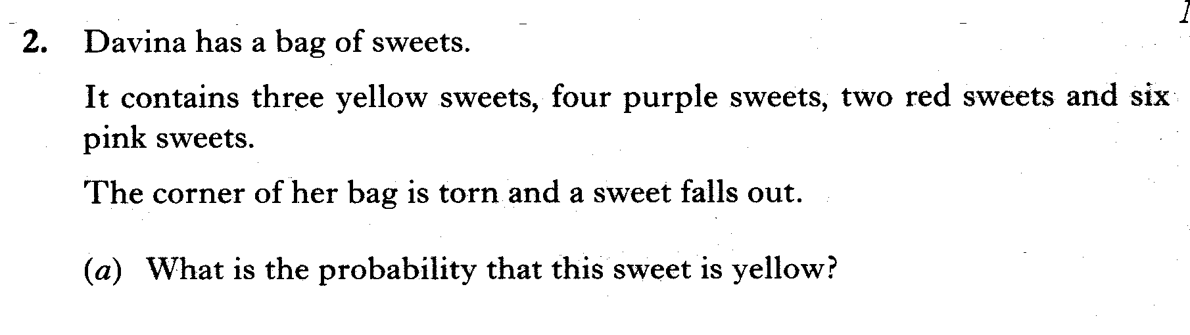
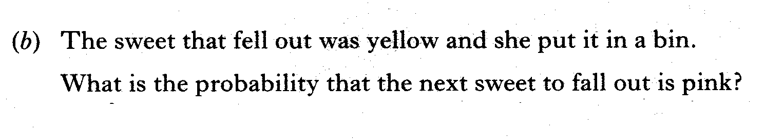

Slide 17
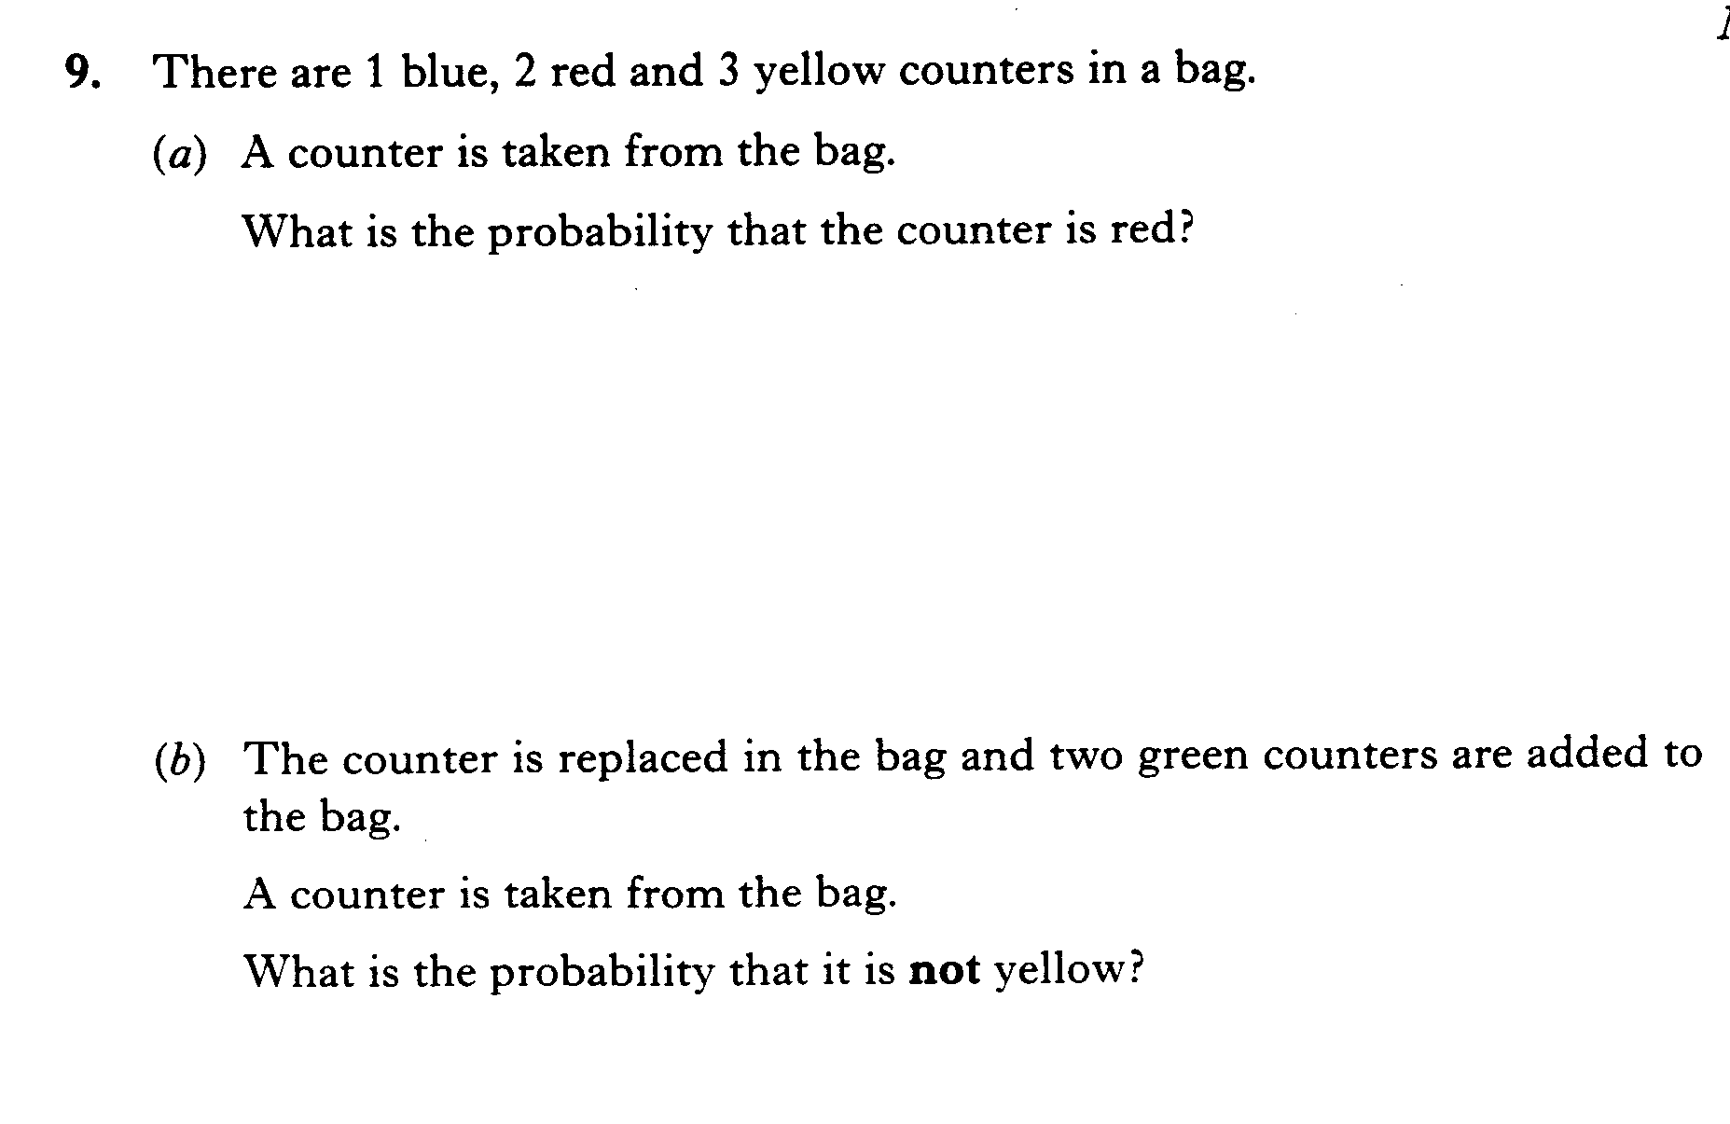

Slide 18
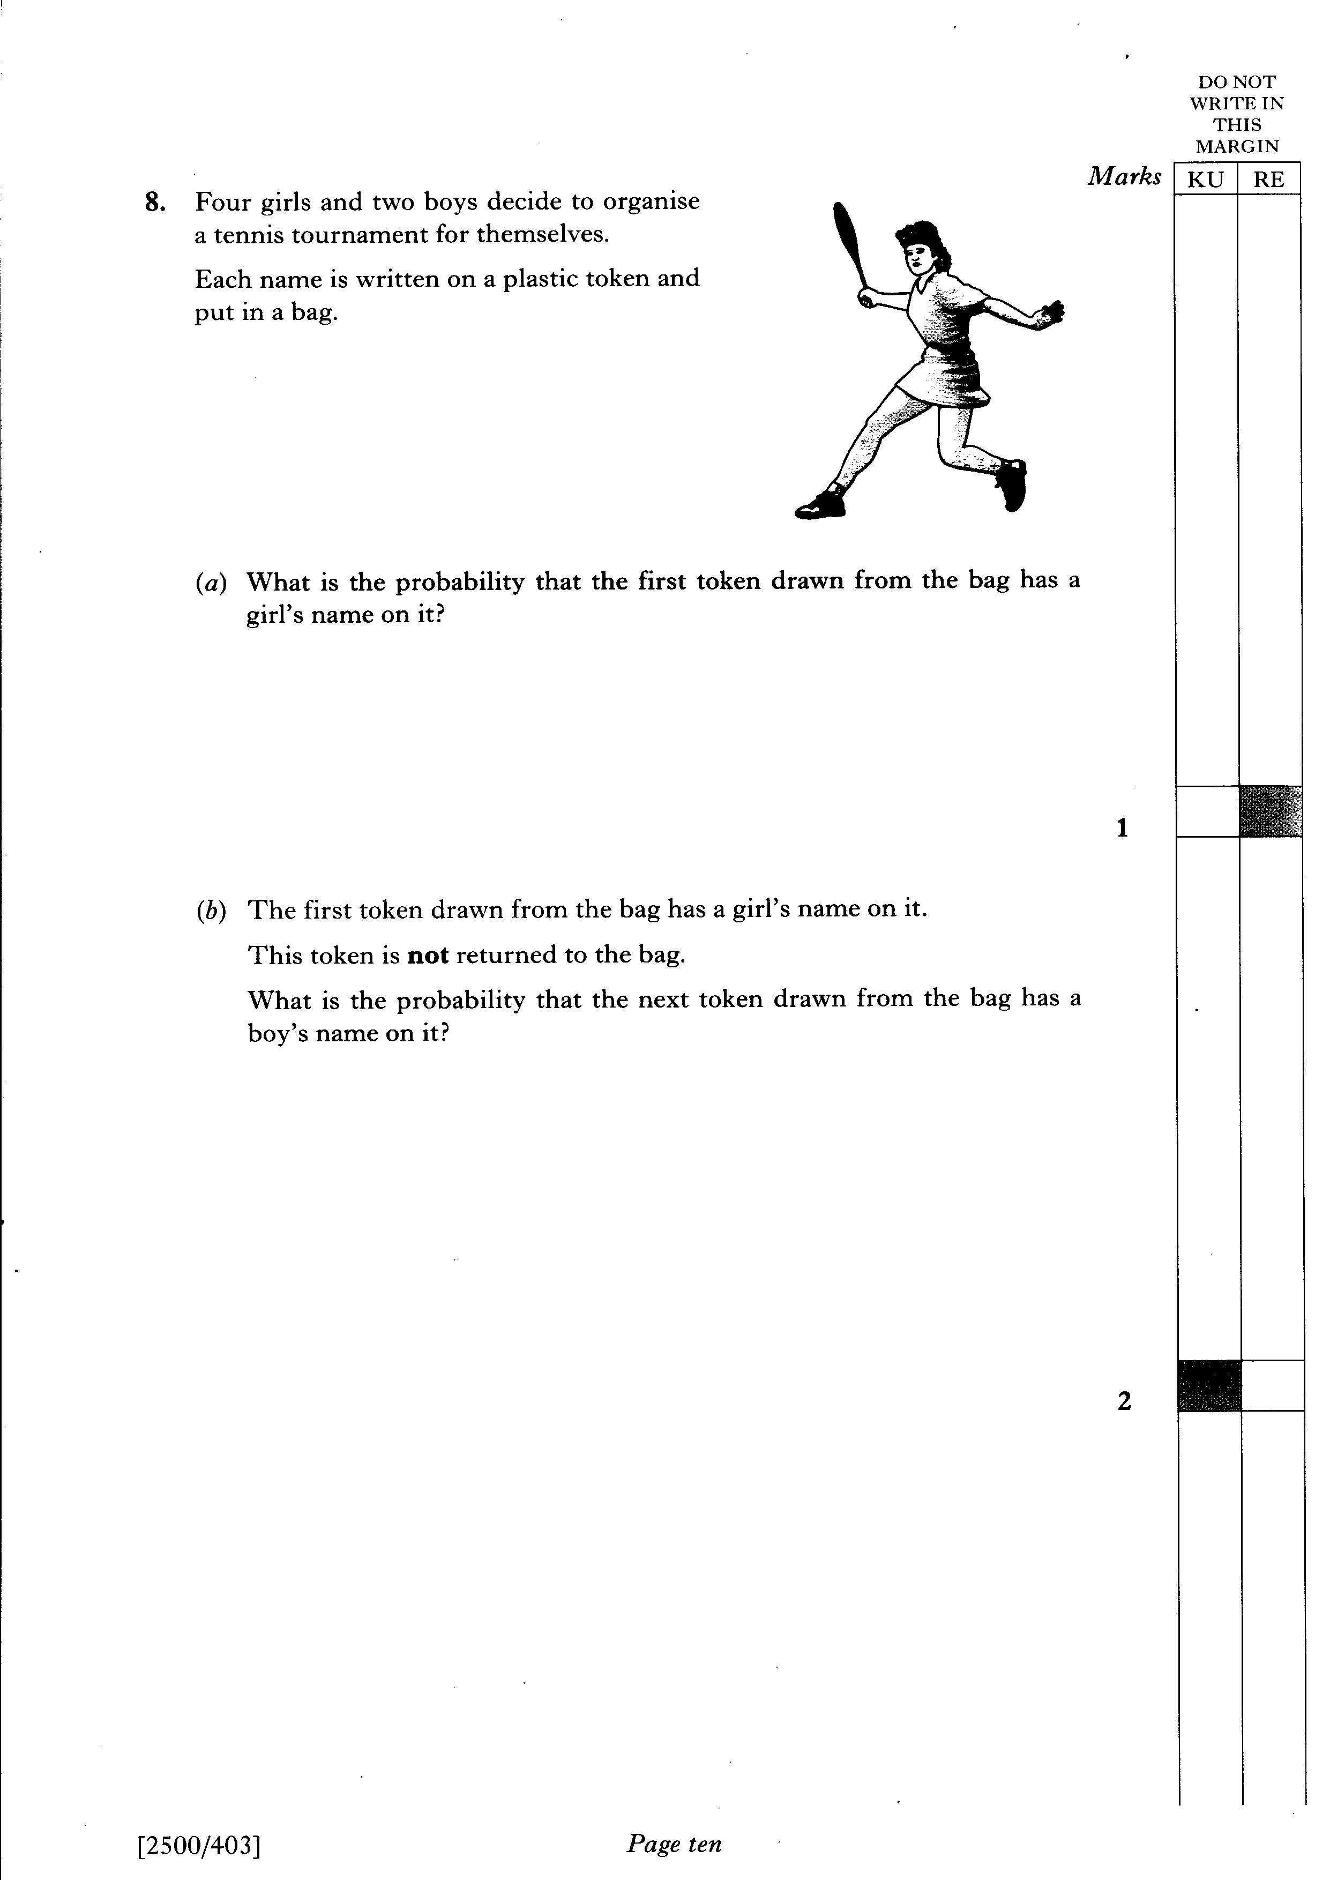

Slide 19
