Slide 1


Perimeter
Perimeters
Parts of a Circle
Investigation
Circumference of a Circle
www.mathsrevision.com
The Perimeter a Composite Shape
Exam Type Questions

Slide 2
Starter Questions
www.mathsrevision.com

Slide 3
Perimeter
Learning Intention
Success Criteria
  1. We are learning the term perimeter of a shape.
  Understand the term perimeter of a shape.
www.mathsrevision.com
2. Calculate the perimeter of a shape.

Slide 4
Perimeter
What is perimeter ?
www.mathsrevision.com
Hint
answer is on the screen !

Slide 5
Perimeter
www.mathsrevision.com
Perimeter

Slide 6
Perimeter
www.mathsrevision.com
Perimeter

Slide 7
Perimeter
Perimeter
is the distance round the outside of a 2D shape
www.mathsrevision.com

Slide 8
Perimeter
6cm
Calculate the perimeter of the rectangle below.
3cm
Demo
www.mathsrevision.com
Perimeter =
6 +
3 +
6 +
3
18cm
=

Slide 9
Perimeter
If the perimeter of the shape is 38m.
Calculate the missing length.
10m
7m
10 + 7 + 8 = 25m
8m
www.mathsrevision.com
?
38 - 25 = 13m
Demo

Slide 10
Perimeter
Calculate the missing length if the perimeter is 80cm.
?
28 + 28 = 56cm
80 - 56 = 24cm
28cm
www.mathsrevision.com
24 ÷ 2 = 12cm
Demo

Slide 11

Perimeter
Now Try
TJ N4 Lifeskills
Exercise 1
Ch14 (page 111)
www.mathsrevision.com

Slide 12
Starter Questions
Q1. Solve the equation below
aº
Q2. Find the missing angles
bº
www.mathsrevision.com
Q3. Find the average of the numbers below
2,5,6,7
Q4. Which is the better deal
or

Slide 13
Perimeter
Learning Intention
Success Criteria
  1. We are learning the main parts of a circle.
  Recognise the main parts of a circle.
www.mathsrevision.com
2. Calculate the circumference , diameter and radius for a circle using formulae.

Slide 14
Parts of the Circle
Circumference
The radius is measured from
the centre of the circle
to the edge.
radius
O
diameter
O = centre of circle
www.mathsrevision.com
The diameter is measured
from one edge to the other
passing through the centre of the circle.

Slide 15
Main part of a Circle
Main parts of the circle
radius
O
www.mathsrevision.com
Diameter
Circumference

Slide 16
Main part of a Circle
2cm
10cm
www.mathsrevision.com

Slide 17
Parts of a Circle
Now Try
TJ N4 Lifeskills
Exercise 2
Ch14 (page 113)
www.mathsrevision.com

Slide 18
Starter Questions
5cm
www.mathsrevision.com

Slide 19
Circles
Archimedes of Syracuse
www.mathsrevision.com

Slide 20
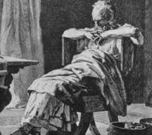
History of Circles
75 years old
The Greek mathematician Archimedes of Syracuse (287- 212 BC)
who flourished in Sicily is generally considered to be the greatest
mathematician of ancient times. He is credited with determining the
relationship between the diameter and the circumference of a circle.
This was first recorded by Archimedes in the book
Measurement of a Circle (225 BC).
In this investigation we are going to attempt to follow Archimedes steps
and arrive at the equation for determining the circumference for
any given circle.
www.mathsrevision.com
22931 years old

Slide 21
Parts of the Circle
Circumference
The radius is measured from
the centre of the circle
to the edge.
radius
O
diameter
O = centre of circle
www.mathsrevision.com
The diameter is measured
from one edge to the other
passing through the centre of the circle.

Slide 22
Circle Investigation
Construct a table shown below to enable us
to record our results.
www.mathsrevision.com

Slide 23
Investigation of the Circle
Our Investigation
O
To find a relationship between
the diameter and circumference of a given circle.
www.mathsrevision.com
Question ?
How can we measure
the diameter and circumference

Slide 24
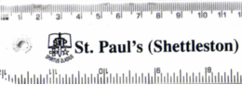
Measuring the Diameter
of a circle
O
Use a ruler
O
The diameter is the largest distance
between one side of a circle to the other
passing through the centre O.
www.mathsrevision.com

Slide 25
Measuring the Circumference
of a circle
O
Flexible tape measure
Take a tape measure and put it round the circle
www.mathsrevision.com
Read off the measurement

Slide 26
Measuring the Circumference of a circle
Roll along an even surface
End
point
Starting point
www.mathsrevision.com
One complete rotation equals the length of the circumference
Be careful to avoid slip!

Slide 27
Circle Investigation
www.mathsrevision.com

Slide 28
Circle Investigation
  Using your results write down, in your own words,
  an approximate relationship between the
  circumference and diameter for a given circle.
“Circumference approximately equals three and bit diameters”
Actual value is 3.14 which we write as 
Pronounced “Pi”
www.mathsrevision.com
π = C ÷ D

Slide 29
Starter Questions
Q1. What is the time difference 09:28 and 11:55
Q2.
www.mathsrevision.com
Q3. Convert 23metres to
(a) cm (b) mm
Q4. The answer to the question is 180.
What is the question.

Slide 30
Circumference
Learning Intention
Success Criteria
  1. We are learning to calculate the circumference (perimeter) of a circle.
  Recall knowledge of circles so far.
  2. Apply knowledge so calculate the circumference for a circle showing appropriate working.
www.mathsrevision.com

Slide 31
Main Parts of a Circle
Main parts of the circle
radius
O
www.mathsrevision.com
Diameter
Circumference

Slide 32
Calculating the Circumference
Example : Find the length of the circumference (Perimeter)
of each circle
2cm
10cm
www.mathsrevision.com

Slide 33
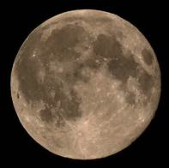
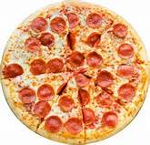
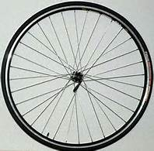
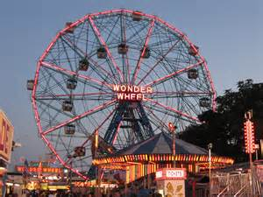
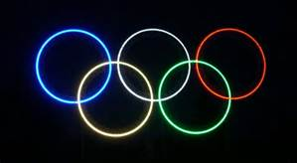

Real – Life Circles
www.mathsrevision.com

Slide 34
Circumference of a Circle
Now Try
TJ N4 Lifeskills
Exercise 3
Ch14 (page 115)
www.mathsrevision.com

Slide 35
Starter Questions
Q1. Why is
Q2. What is the time difference 07:54 and 13:36
Q3.
www.mathsrevision.com
Q4. Convert 45.1 metres to
(a) cm (b) mm
Q5. The answer to the question is 90.
What is the question.

Slide 36
Find the perimeter of each arrangement.
Composite Perimeter
Some desks are arranged in certain ways.
Each desk is square shaped and has length 60cm
www.mathsrevision.com

Slide 37
Perimeter
Problem
Below is a drawing of the school building. Calculate the perimeter.
x m
4 m
x = 12 – 9 =3 m
9 m
8 m
www.mathsrevision.com
4 m
Perimeter
12 m
= 12 + 8 + 3 + 4 + 9 + 4
= 40 m

Slide 38
Carpet grip comes in packets of five 1 metre lengths.
How much will it cost to put carpet grip round this shape ?
4m
Perimeter = 6 + 3 + 2 + 1.5 + 4 + 4.5 = 21m
Number of 1 metre grips = 21
1.5m
No of packs = 21 ÷ 5 = 4.2 packs
2m
So we need 5 packs
4.5m
Cost = 5 x £ 4.50 = £22.50
3m
6m

Slide 39
Composite Perimeter
Now Try
TJ N4 Lifeskills
Exercise 4
Ch14 (page 118)
www.mathsrevision.com

Slide 40
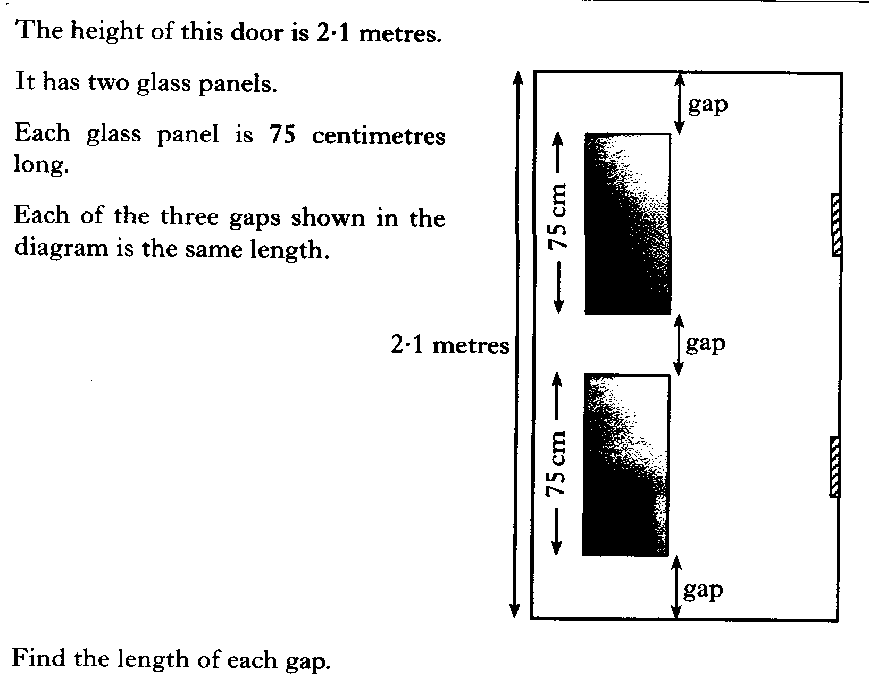

Slide 41
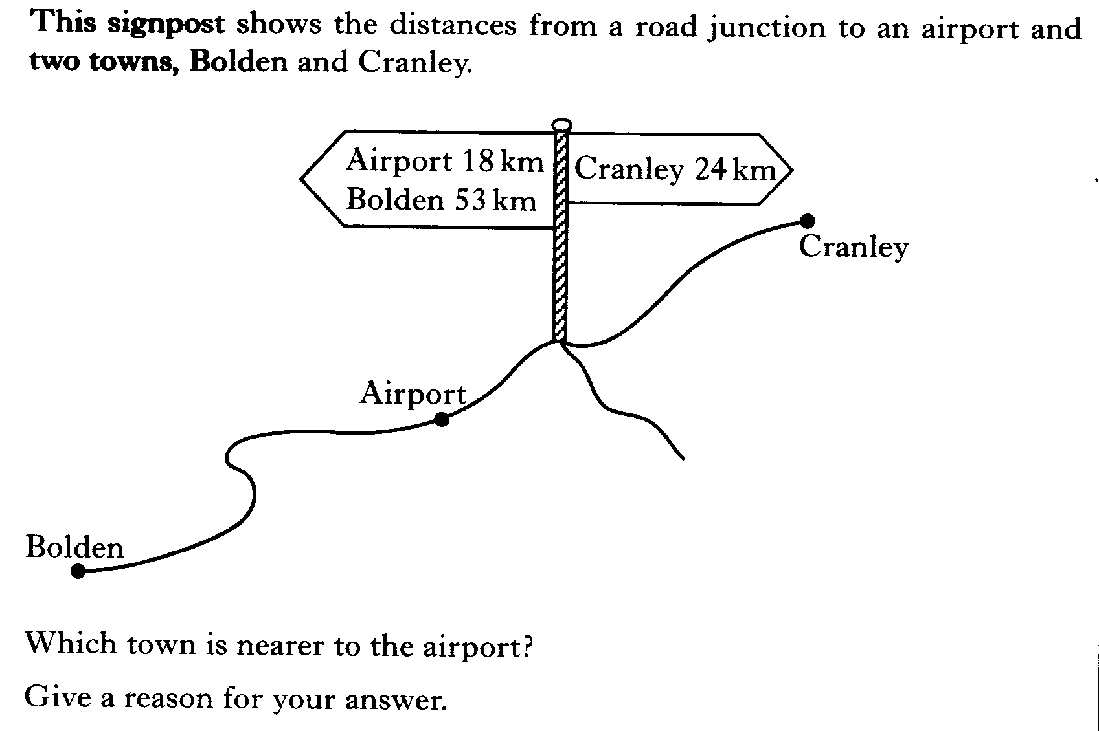

Slide 42
2 KU
3 KU

Slide 43
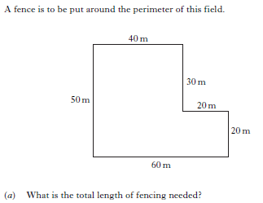


Slide 44
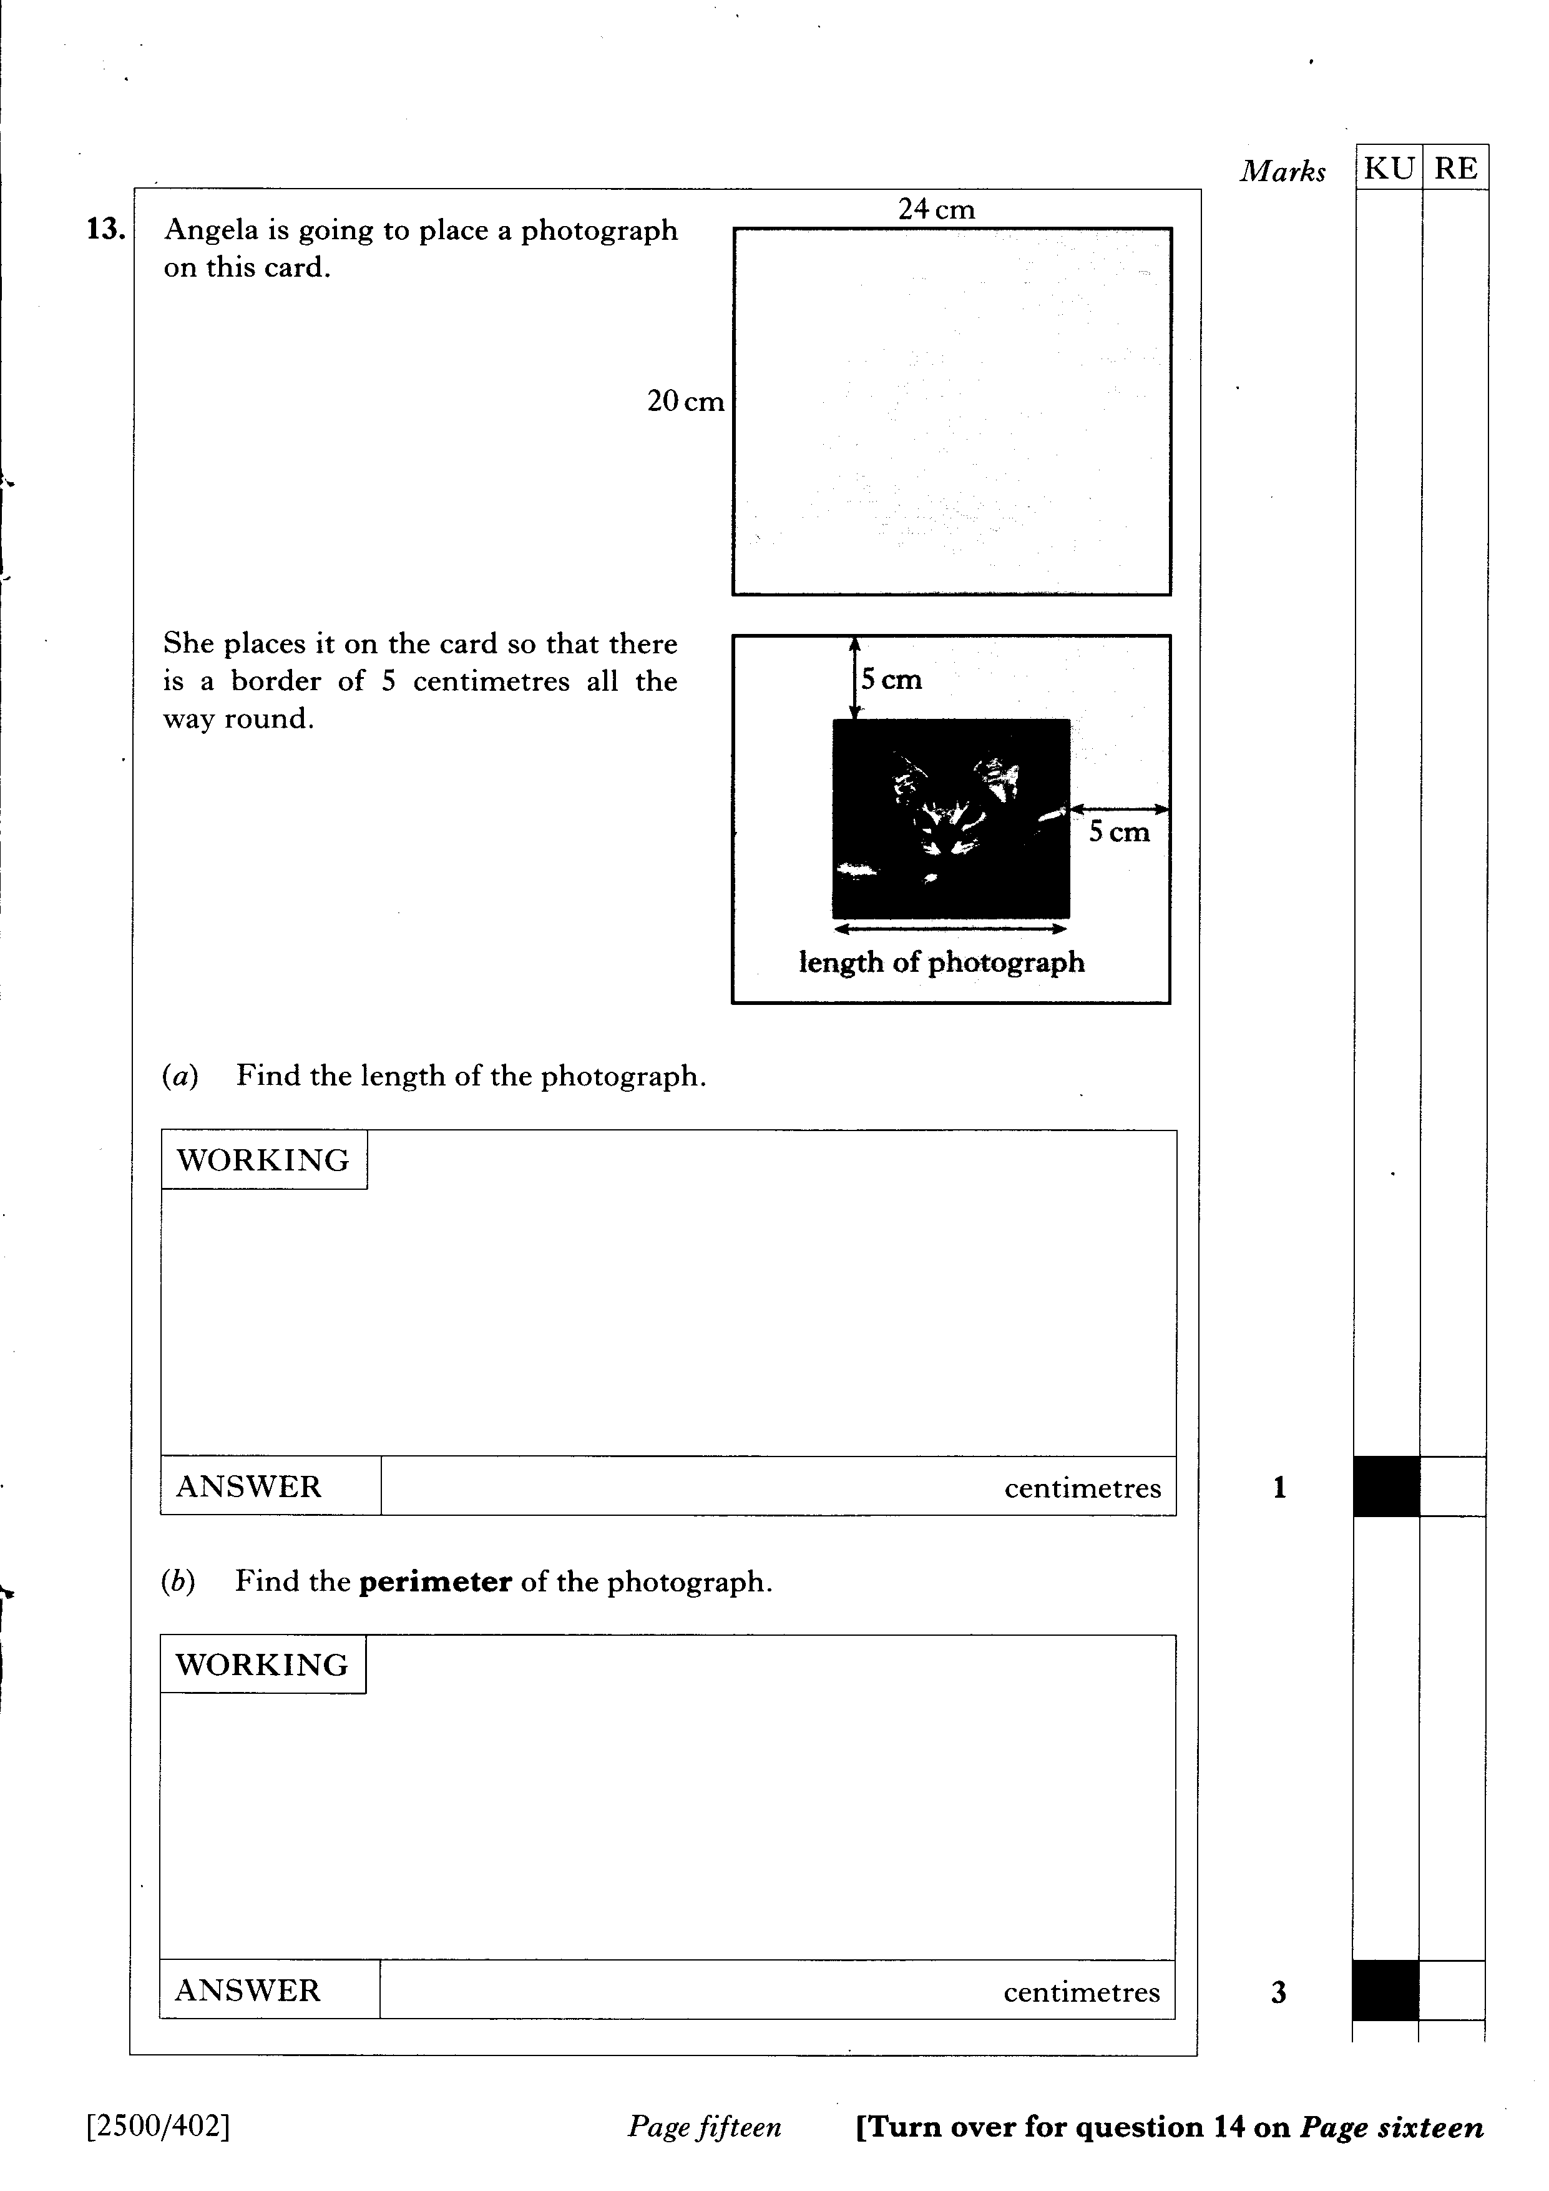

Slide 45
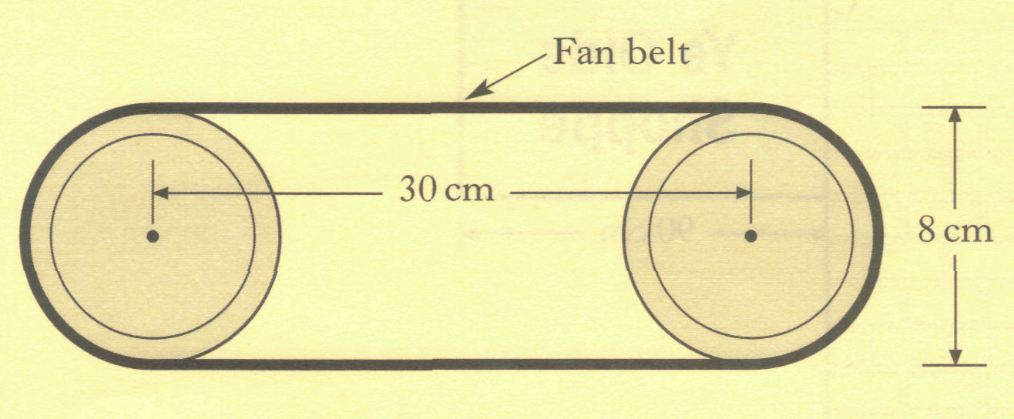
.
The diagram below shows the fan belt from a machine.
The fan belt passes around 2 wheels whose centres are 30 centimetres apart.
Each wheel is 8 centimetres in diameter.
Calculate the total length of the fan belt.
30 cm
30 cm

Slide 46
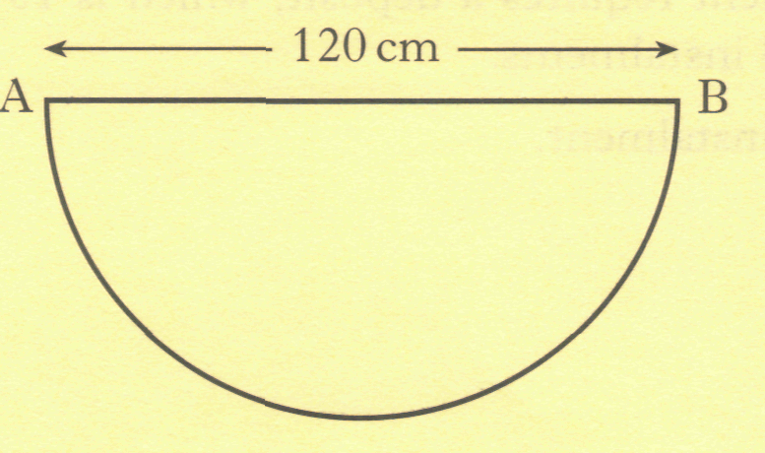
.
A joiner is making tables for a new coffee shop.
The shape of the top of a table is a semi-circle as shown . AB = 120 centimetres.
The top of the table is made of wood and a metal edge is to be fixed to its perimeter.
(a) Calculate the total length of the metal edge.
(b) The coffee shop needs 16 tables.
The joiner has 50 metres of the metal edge in the workshop. Will this be enough for all sixteen tables? Give a reason for your answer.

Slide 47
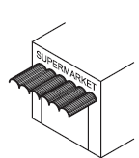

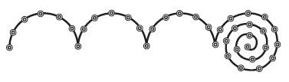
.
A supermarket has a canopy over its entrance.
The edge of the canopy has 6 semicircles as shown below.
Each semicircle has a diameter of 4 metres.
Find the length of the curved edge
of one of the semicircles.
(b) Tony attaches fairy lights to the
edge of the canopy.
He has 40 metres of fairy lights.
Is this enough for the whole canopy?
Give a reason for your answer.

Slide 48
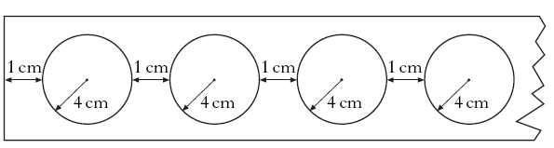
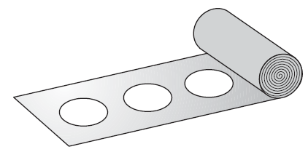
.
Circular tops for yoghurt cartons are cut from a strip of metal foil as shown below.
The radius of each top is
4 centimetres.
The gap between each top is
1 centimetre.
9cm
How many tops can be cut from a strip of foil 7 metres long?

