Slide 1


Gradient
The gradient formula
www.mathsrevision.com
Exam Type Questions

Slide 2
Starter Questions
Q1. Calculate 7 – 5 x 2
Q2. Calculate
www.mathsrevision.com
Q3. Is this triangle right angled ?
Explain
9
8
5

Slide 3
Gradient
Learning Intention
Success Criteria
  To explain how to calculate the gradient using a right angle triangle
  Gradient is :
  change in vertical height divided by
  change in horizontal distance
www.mathsrevision.com
  2. Calculate simple gradients.

Slide 4
Gradient
Difference in
y -coordinates
The gradient is the measure of steepness of a line
Change in vertical height
Change in horizontal distance
www.mathsrevision.com
Difference in
x -coordinates
The steeper a line the bigger the gradient

Slide 5
Gradient
V
3
m =
=
H
4
V
3
m =
=
H
2
www.mathsrevision.com
V
3
m =
=
H
5
V
2
1
m =
=
=
H
6
3

Slide 6
Gradient
Which line has the steeper slope ?
8
9
10
15
www.mathsrevision.com
V
8
V
9
m =
=
m =
=
H
10
H
15
= 0.8
= 0.6
steeper slope

Slide 7

Gradient
Now Try
TJ N4 Lifeskills
Exercise 1
Ch13 (page 106)
www.mathsrevision.com

Slide 8
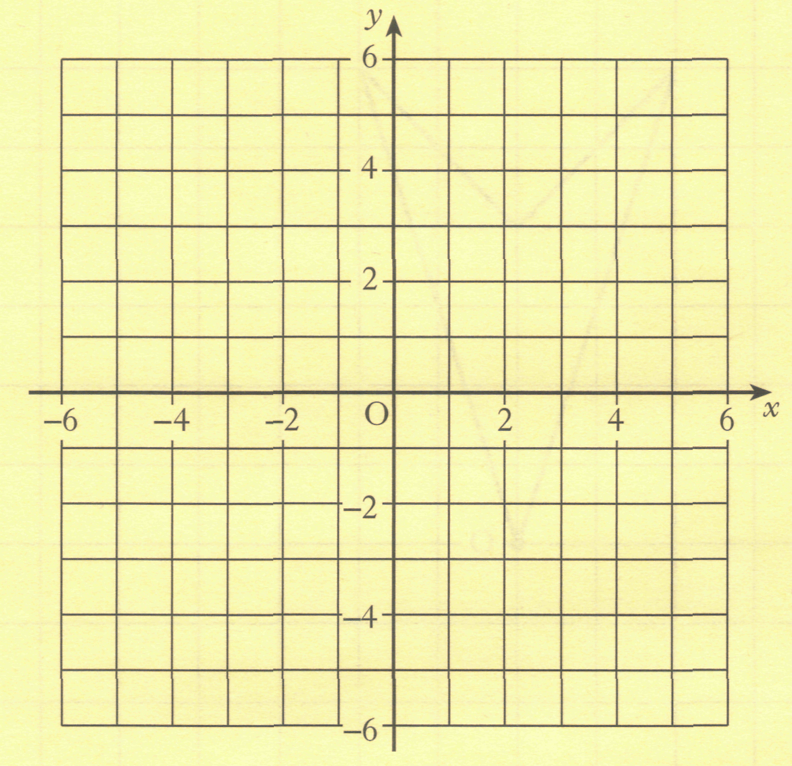
(a) On the grid , plot the points
A(-4, -3), B(3,-1) and C(4, 4).
C
(b) Find the gradient of the line AB.
D
(c) Plot the fourth point D so that shape ABCD is a parallelogram. Write down the coordinates of point D.
B
A
(c) D(-3,2)

Slide 9
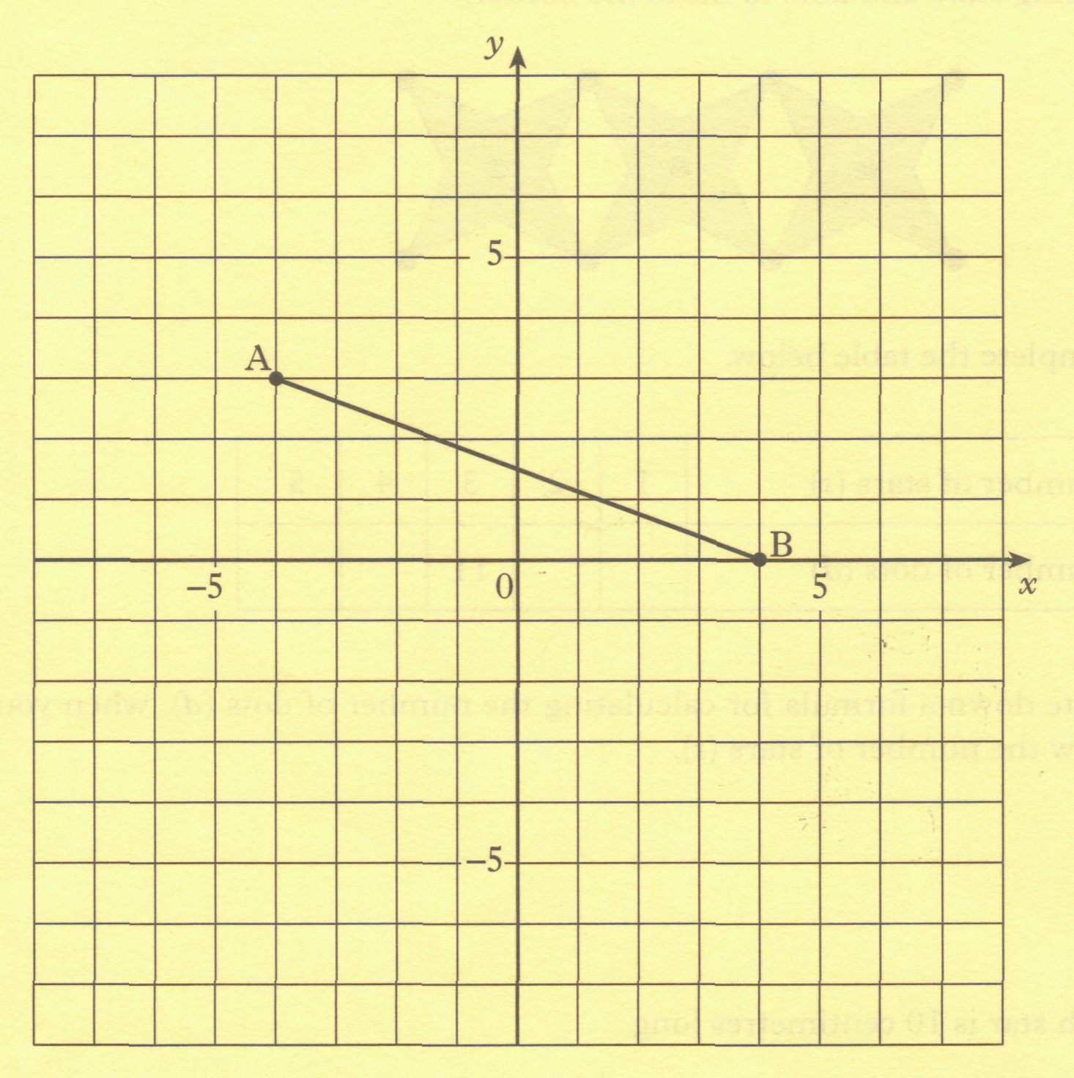
20 LINES and GRADIENTS
2006 Paper 2 Q5 KU2
The line AB is drawn on the grid.
Calculate the gradient of AB.
3
8

