Slide 1


Foreign Currency
£’s to Foreign Currency
Foreign Exchange to £’s
www.mathsrevision.com
Exam Type Questions

Slide 2
Starter Questions
Two numbers add to give 12 and divide to give 3. Find the two numbers.
2. Two numbers subtract to give 5 and
multiply to 24. Find the two numbers.
3. Make your own question up.
www.mathsrevision.com

Slide 3
Foreign Currency
Converting to another currency
Learning Intention
Success Criteria
  We are learning how to convert £’s to foreign currency.
  1. Understand the term exchange rate and the proportion method.
www.mathsrevision.com
  2. Convert £’s to another currency.

Slide 4
Foreign Currency
Converting to another currency
Up until 1st January 2002, all the countries in Europe
had their own type of money (currency).
The euro was introduced and the other currencies were
no longer accepted.
Britain still uses the pound (£) and when you go to Europe
on holiday you have to change your pounds to euros.
www.mathsrevision.com
A euro is divided into 100 parts and each part is called a cent

Slide 5
Are we expecting more or less
Foreign Currency
Converting to another currency
Example : How many euros will
I get for £100.
Exchange rate £1=
Euro €
1.44
Dollar $
1.51
Proportion method
£ €
1 ⇨ 1.44
100
Yen
190
www.mathsrevision.com
(more)

Slide 6
Are we expecting more or less
Foreign Currency
Level 2
Converting to another currency
Example : How many Dollars
will I get for £50.
Exchange rate £1 =
Euro €
1.44
Dollar $
1.51
Proportion method
£ $
1 ⇨ 1.51
50
Yen
190
www.mathsrevision.com
(more)

Slide 7
Are we expecting more or less
Foreign Currency
Converting to another currency
Example : A iPod costs £300 in
Scotland and 420 € in Spain.
Which is the better buy ?
Exchange rate £1 =
Proportion method
£ €
1 ⇨ 1.44
300
Euro €
1.44
Dollar $
1.51
Yen
190
(more)
www.mathsrevision.com
Should buy in Spain and save 12 €

Slide 8

Foreign Currency
Now Try
TJ N4 Lifeskills
Exercise 1
Ch26 (page 212)
www.mathsrevision.com

Slide 9
Starter Questions
www.mathsrevision.com

Slide 10
Foreign Currency
Converting to another currency
Learning Intention
Success Criteria
  We are learning how to convert foreign currency to £’s.
  1. Understand the term exchange rate and the proportion method.
www.mathsrevision.com
  Convert foreign currency
  to £’s.

Slide 11
Are we expecting more or less
Foreign Currency
Converting back to £’s
Exchange rate £1=
Example : How many £’s will
I get for 20 € .
Euro €
1.44
Dollar $
1.51
Proportion method
€ £
1.44 ⇨ 1
20
Yen
190
www.mathsrevision.com
(more)

Slide 12
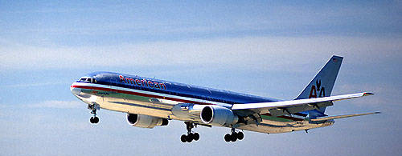
Are we expecting more or less
Foreign Currency
Converting back to £’s
Example : A business man returns
from America with $450.
He converts them back to £’s.
How much will he get back ?
Exchange rate £1 =
Euro €
1.44
Dollar $
1.50
Yen
190
Proportion method
$ £
1.50 ⇨ 1
450
www.mathsrevision.com
(more)

Slide 13

Have you updated your Learning Log ?
Foreign Currency
Now Try
TJ N4 Lifeskills
Exercise 2
Ch26 (page 214)
www.mathsrevision.com

Slide 14
Andy buys a bottle of aftershave in Spain for 38.50 euro.
The same bottle of aftershave costs £25.99 in Scotland.
The exchange rate is £1 = 1.52 euro.
Does he save money by buying the aftershave in Spain? Explain your answer.
3

Slide 15
During a holiday in Mexico, Lee changed £650 into pesos.
The exchange rate was £1 = 19.13 pesos.
How many pesos did Lee receive for £650?
Round off your answer to the nearest ten pesos.
2

Slide 16
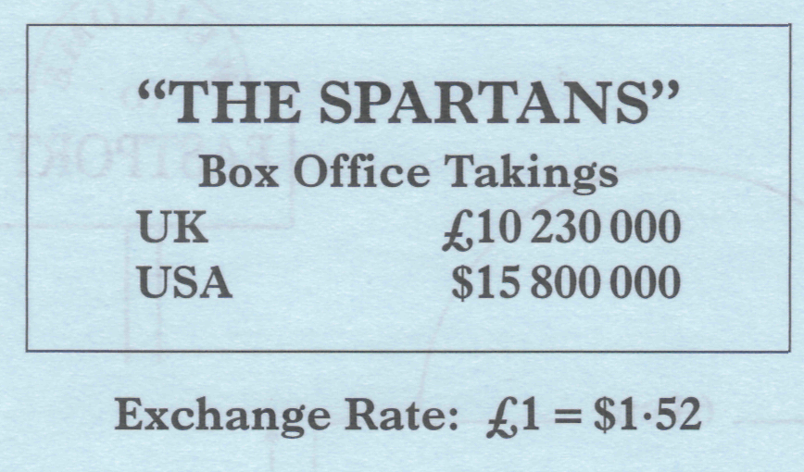
The box office takings at cinemas in the UK and the USA from showing "The Spartans" are shown below.
.
Change the box office takings in the USA to pounds sterling.
Give your answer to the nearest thousand pounds.
3

Slide 17
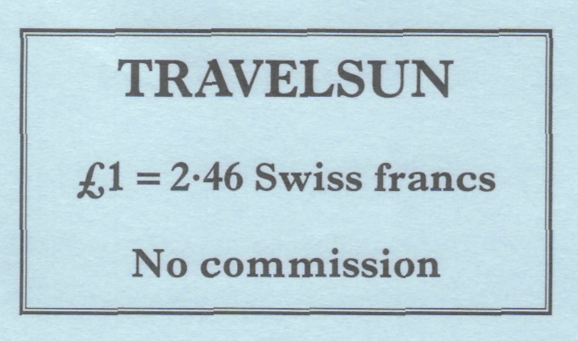
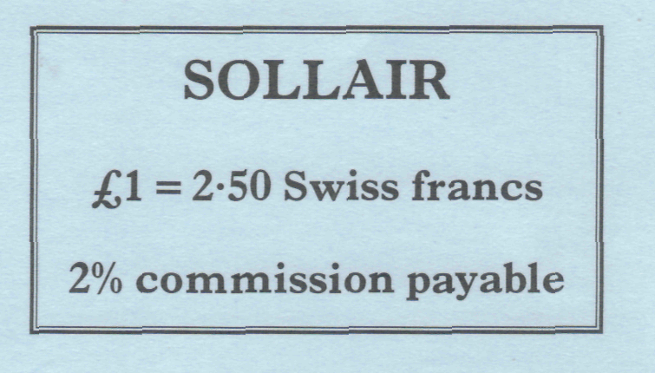
Jane is going to Switzerland and wants to change £500 into Swiss francs.
Two travel agents offer the following exchange rates.
(a) How many Swiss francs would Jane receive from Travelsun for £500?
Which travel agent will give Jane more Swiss francs for her £500?
Show clearly all your working.
4

Slide 18
A room in the Hotel Royale in Paris costs 130 euros per night. The exchange rate is 1.58 euros to the pound.
(a) Find the cost of the hotel room per night in pounds and pence.
3
Mr and Mrs McQueen are going to Paris.
Their return flights cost £59 each.
(b) Find the total cost of their flights and a 3 night stay at the Hotel
Royale in pounds and pence.
2

Slide 19
(a) While in New York, Martin changed £50 into US dollars. The exchange rate was £1 = $1.62. How many US dollars did Martin receive for £50?
(b) A few days later he received $320 in exchange for £200. What was the new exchange rate?
2
2

Slide 20
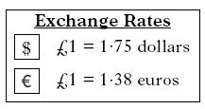
Curtis flew from New York to London
where he changed 1400 dollars into pounds.
He spent £650 in London and then changed
the rest into euros before travelling to Paris.
How many euros did Curtis receive?

Slide 21
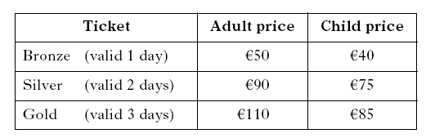
The table shows the ticket prices for a theme park in France.
The prices are given in euros.
Gavin buys silver tickets for two adults and one child.
Find the total cost, in pounds and pence, of buying these tickets if the exchange rate is £1 = 1.39 euros.
3

Slide 22
Colin is going on holiday to Spain.
He wants to exchange a maximum of £1300 into euros.
The exchange rate is £1 = ε1.26.
His bank only issues euros in multiples of ε10.
(a) What is the maximum number of euros Colin will
receive from his bank?
2
(b) How much will Colin actually pay for this
number of euros?
2

Slide 23
David bought a computer game in the United States for 50 dollars.
The same game cost £35 in Scotland.
The exchange rate was £1 = $1.62.
How much did David save by buying the game in the United States?
Give your answer in pounds and pence.
3

