Slide 1


Comparing Data Sets
Range, Mean, Median and Mode
www.mathsrevision.com
Exam Type Questions

Slide 2
Starter Questions
4cm
www.mathsrevision.com
5cm
8cm
2cm

Slide 3
Different Averages
Learning Intention
Success Criteria
  We are learning the terms Mean Median, Mode and Range for a set of data.
  1. Understand the differences between the terms Mean, Median, Mode and Range.
  2. Calculate values for the Mean, Median, Mode and Range in a context.
www.mathsrevision.com

Slide 4
Finding the range
The range of a set of data is a measure of how the data is spread across the distribution.
To find the range we subtract the lowest value in the set from the highest value.
Range = highest value – lowest value
When the range is small; the values are similar in size.
When the range is large; the values vary widely in size.

Slide 5
The range
Here are the high jump scores for two girls in metres.
Joanna | 1.62 | 1.41 | 1.35 | 1.20 | 1.15
Kirsty | 1.59 | 1.45 | 1.41 | 1.30 | 1.30
Find the range for each girl’s results and use this to find out who is consistently better.
Joanna’s range = 1.62 – 1.15 = 0.47
Kirsty’s range = 1.59 – 1.30 = 0.29

Slide 6
The mean
The mean is the most commonly used average.
To calculate the mean of a set of values we add together the values and divide by the total number of values.
Sum of values
Mean =
Number of values
For example, the mean of 3, 6, 7, 9 and 9 is

Slide 7
Different Averages
An average should indicate a
“measure of central tendency”
but should also indicate
what the distribution of data looks like.
This is why we have 3 different types of averages to consider
www.mathsrevision.com
The Mean
The Median (put the data in order then find the MIDDLE value)
3. The Mode (the number that appears the most)

Slide 8
Different Averages
Find the mean of the set of data 1, 1, 1, 1, 2, 3, 26
www.mathsrevision.com
Can you see that this is not the most suitable of averages since
five out of the six numbers are all below the mean of 5

Slide 9
Different Averages
Example :
Find the mean, median, mode and range for the set of data.
Range = Highest number – Lowest Number
10, 2, 14, 1, 14, 7
www.mathsrevision.com

Slide 10


Have you updated your Learning Log ?
Different Averages
Now Try
TJ N4 Lifeskills
Exercise 1 & 2
Ch30 (page 238)
www.mathsrevision.com

Slide 11
4 KU

Slide 12


Slide 13
3 KU

Slide 14
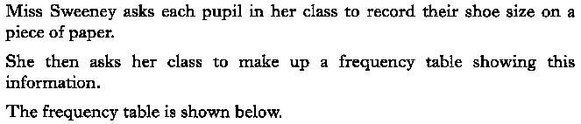
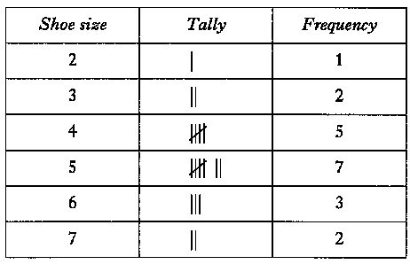

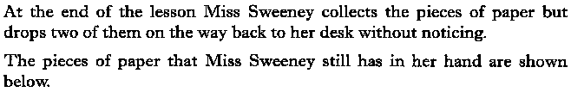
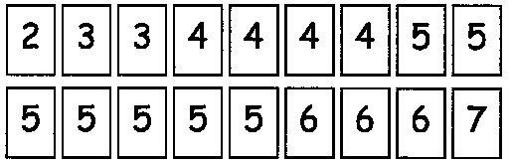

Slide 15
1 KU

Slide 16
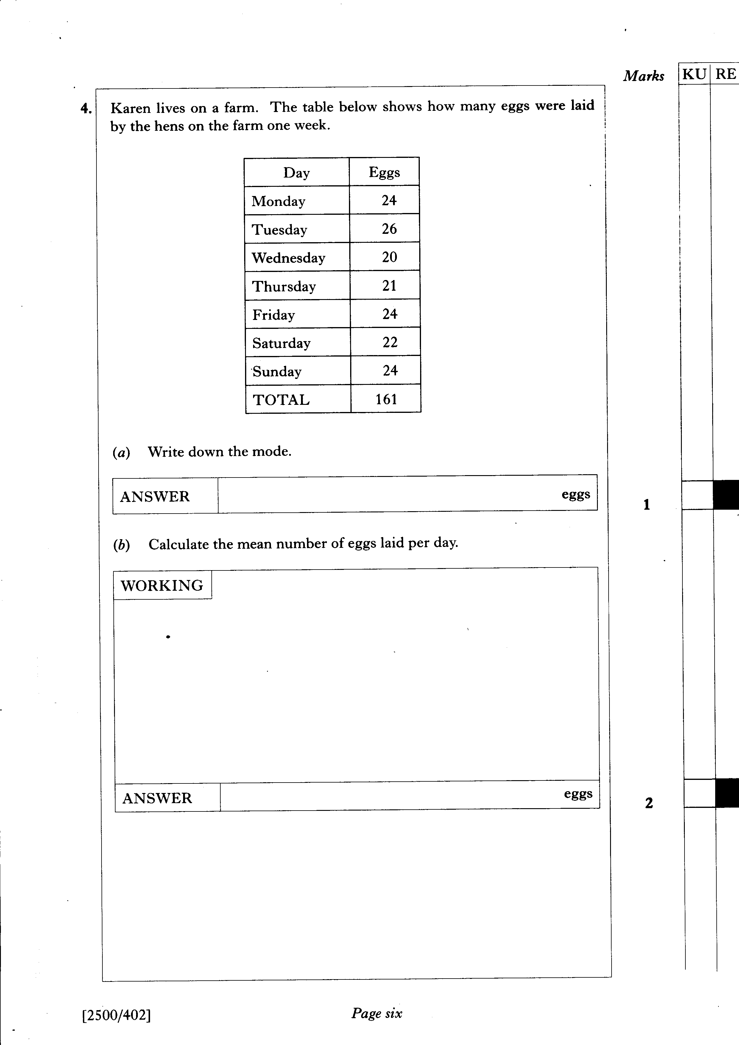

Slide 17
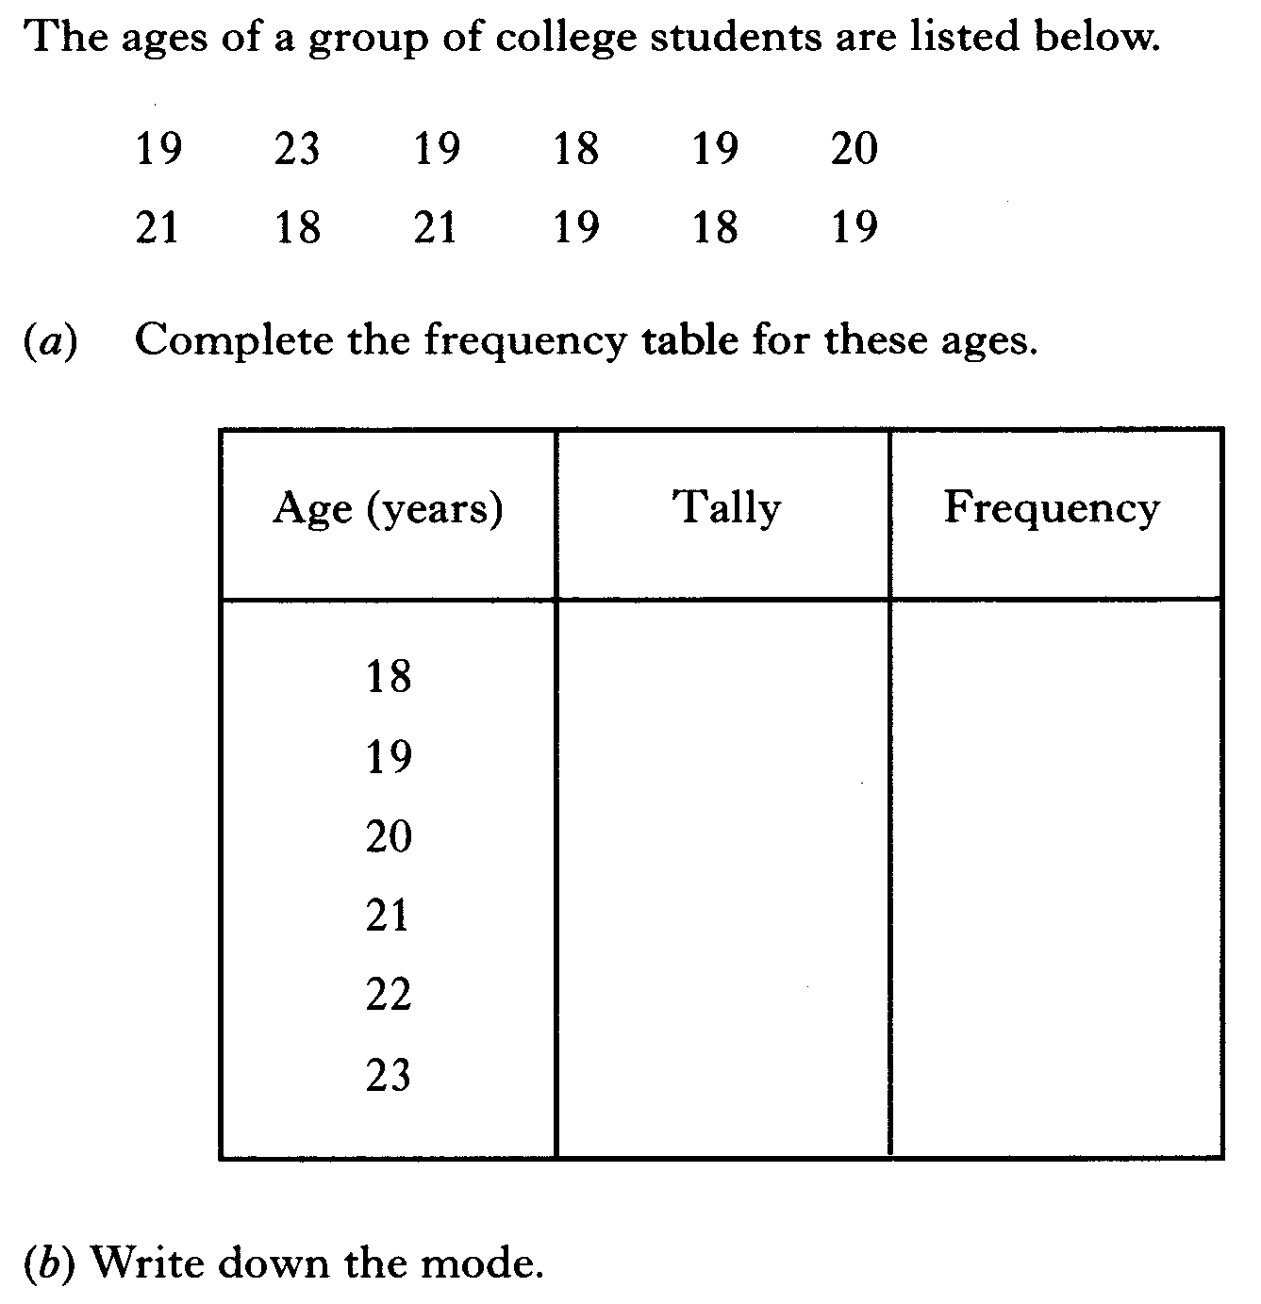

Slide 18
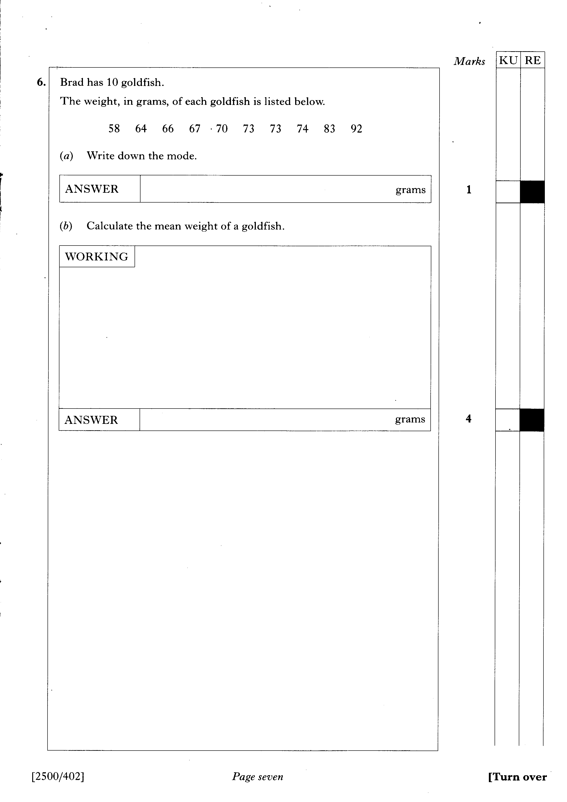

Slide 19
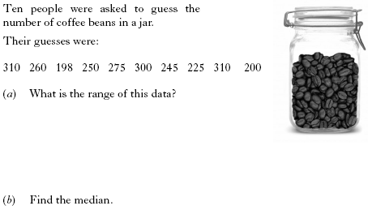

Slide 20

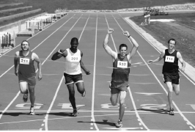
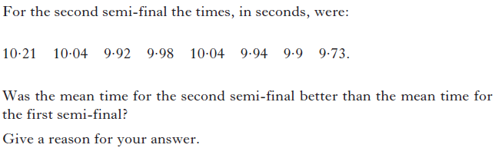
4 marks

