Slide 1


Budgeting
Saving Problems
Budgeting for a Trip
Monthly Budgeting
www.mathsrevision.com
Needs & Wants

Slide 2
Starter Questions
Two numbers add to give 12 and divide to give 3. Find the two numbers.
2. Two numbers subtract to give 5 and
multiply to 24. Find the two numbers.
3. Make your own question up.
www.mathsrevision.com

Slide 3
Budgeting
Savings
Learning Intention
Success Criteria
  We are learning to manage money.
  To understand the important of managing money.
Solve simple problems involving saving money.
www.mathsrevision.com

Slide 4
Budgeting
Savings
Computer game
For something in the future
New bike
Why save ?
www.mathsrevision.com
Phone
Holidays
Trainers

Slide 5
Budgeting
Savings
Kayleigh saves £20 a week so she can buy a new bicycle
costing £450.
(a) Can she afford it after 19 weeks ?
No !
Savings total =
19 x 20
= £ 380
www.mathsrevision.com
(b) For how many more week does she need to save.
70÷20 = 3.5
Another 4 weeks
450 - 380 = £70

Slide 6

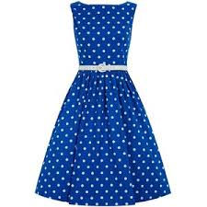
Kyle got item first by a week.
Budgeting
Savings
Kyle saves £25 a week to buy a £198 jacket.
Hannah saves £30 a week to buy a £270 dress.
Who will be able to buy their item first
and by how many weeks ?
Kyle
Hannah
www.mathsrevision.com
198 ÷ 25
270 ÷ 30
= 7.92 weeks
= 9 weeks

Slide 7

Budgeting
Savings
Now Try
TJ N4 Lifeskills
Exercise 1
Ch29 (page 230)
www.mathsrevision.com

Slide 8
Starter
Don’t fritter your money away
Save for a rainy day
What do these phrases mean ?
Better in your pocket than theirs.
www.mathsrevision.com
They are not your pals

Slide 9
Budgeting
Saving for a Trip
Learning Intention
Success Criteria
1. Understand the importance of saving to enable to afford trips.
  1. We are learning how to save for a trip.
www.mathsrevision.com

Slide 10
How can you help ? List a few options
Budgeting
Savings
In school pupils normally get the chance to go on various
School trips
e.g. Skiing in Italy , Disneyland Paris , New York etc .....
Cut back on things you don’t need
Who do you think should pay for you to go ?
Save some of your pocket money
www.mathsrevision.com
Wash cars
Deliver papers
Get a part time job
Use initiative
Cake/Candy Raffle

Slide 11
Budgeting
Needs & Wants
Work in pairs
to complete the sheet
www.mathsrevision.com

Slide 12
Budgeting
Saving for a Trip
Now Try
TJ N4 Lifeskills
Exercise 2
Ch29 (page 231)
www.mathsrevision.com

Slide 13
Starter
Don’t fritter your money away
Save for a rainy day
What do these phrases mean ?
Better in your pocket than theirs.
www.mathsrevision.com
They are not your pals

Slide 14
Budgeting
Monthly
Learning Intention
Success Criteria
1. Understand the key features of a monthly budget.
  1. We are learning how to mange a monthly budgets.
www.mathsrevision.com
2. Be able to work with monthly budgets.

Slide 15
What does
Income and Expenditure mean ?
Budgeting
Monthly Savings
Most people who have a job get paid monthly or 4 weekly.
Most of their wages are taken up with expenses.
Everyone needs to manage their money so they don’t get
into debt which can lead to serious problems.
www.mathsrevision.com
Spreadsheets are one of the best ways to track
your Income and Expenditure over a monthly period.

Slide 16
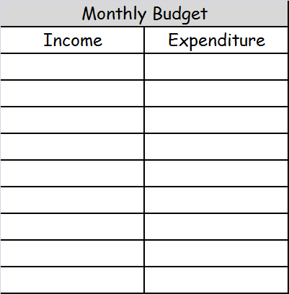
Give some examples of
Income and Expenditure
Budgeting
Monthly
Wages
Food
Child Benefit
Gas & Electric
Child Tax Credit
Rent
Working Tax Credit
TV Internet
www.mathsrevision.com
Mobile Phone
Car Loan & Petrol
Insurance
Credit Card
Clothes

Slide 17
Budgeting
Needs & Wants
Work in pairs
to complete the sheet
www.mathsrevision.com

Slide 18
Budgeting
Monthly
Now Try
TJ N4 Lifeskills
Exercise 3
Ch29 (page 233)
www.mathsrevision.com

Slide 19
Starter Questions
Two numbers add to give 11 and divide to give 10. Find the two numbers.
2. Two numbers subtract to give 1 and
multiply to 42. Find the two numbers.
www.mathsrevision.com

Slide 20
Budgeting
Needs & Wants
Learning Intention
Success Criteria
  We are learning the difference between
  “Needs & Wants”
  Understand the difference between Needs & Wants.
www.mathsrevision.com
  2. Be able to correctly identify Needs & Wants in a context.

Slide 21
Starter
Needs
Food
Water
Money
Make a list of what you need to live ?
www.mathsrevision.com
Accommodation
Clothes
Gas / Electricity

Slide 22
Starter
Wants
TV
Fast Food
Car
Make a list of what you want to live ?
www.mathsrevision.com
Latest Gadget
Cinema
Bike

Slide 23

Have you updated your Learning Log ?
Budgeting
Needs & Wants
Now Try
TJ N4 Lifeskills
Exercise 4
Ch29 (page 234)
www.mathsrevision.com

