Slide 1


Banking
Simple Interest
Debit Card
Credit versus Debit Cards
www.mathsrevision.com
Borrowing Money
Exam Type Questions

Slide 2
Starter Questions
Two numbers add to give 12 and divide to give 3. Find the two numbers.
2. Two numbers subtract to give 5 and
multiply to 24. Find the two numbers.
3. Make your own question up.
www.mathsrevision.com

Slide 3
Simple Interest
Learning Intention
Success Criteria
  We are learning the term simple interest and how to calculate it.
  To understand the term simple interest.
Calculate simply interest.
www.mathsrevision.com

Slide 4
Money
What type of accounts can you get?
Are there other places to put your money?
Why put your money in a bank?
Premium Bonds
Interest p.a.
(per annum)
Building Society
St Ninian’s Savings Bank
www.mathsrevision.com
Current account
Supersaver account
Savings account
High Interest account

Slide 5
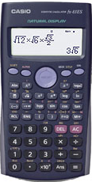
of
means multiple
Revision of Percentages
Q. Find 17% of £450
Remember money
2 decimal places
17
x 450
100
www.mathsrevision.com
= £ 76.50

Slide 6
of
means multiple
Revision of Percentages
Q. Find 4% of £70
4
Remember !! money
2 decimal places
x 70
100
www.mathsrevision.com
= £ 2.80

Slide 7
Simple Interest
Just working out percentages
David has £400 in the Bank.
If he receives 7.2% p.a. interest per year
.
How much interest does he receive after 1 year ?
How much does he have now in the bank ?
7.2
www.mathsrevision.com
= £ 28.80
Interest :
x 400
100
Total in Bank now :
£400 + £28.80 = £428.80

Slide 8
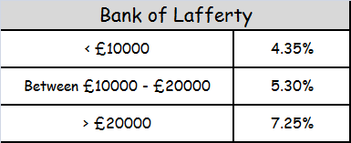
Simple Interest
Hannah has saved £12,500.
She decides to put it in the Bank of Lafferty.
How much interest will she receive after 1 year ?
How much does she have now ?
5.3
www.mathsrevision.com
= £ 662.50
Interest :
x 12500
100
Total in Bank now :
£12500 + £662.50 = £13162.50

Slide 9

Banking
Simple Interest
Now Try
TJ N4 Lifeskills
Exercise 1
Ch27 (page 217)
www.mathsrevision.com

Slide 10
Starter Questions
The answer to the question is
60
www.mathsrevision.com
Write down as many questions as you can

Slide 11
Credit & Debit Cards
Learning Intention
Success Criteria
1. Understand the key information on a Debit Card.
  1. We are learning about Debit Cards.
www.mathsrevision.com

Slide 12
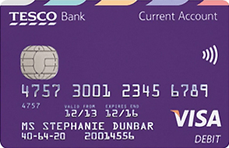
Debit Card
Chip and Pin Information
Cardholder Name
Contactless Payment
16 digit
card number
Start Date
www.mathsrevision.com
End Date
Account Number
Sort Code

Slide 13
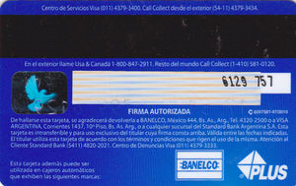
Debit Cards
Magnet Strip
Signature Strip
Security Code
www.mathsrevision.com

Slide 14
Banking
Now Try
TJ N4 Lifeskills
Exercise 2
Ch27 (page 219)
www.mathsrevision.com

Slide 15
Starter Questions
www.mathsrevision.com

Slide 16
Credit & Debit Cards
Learning Intention
Success Criteria
1. Understand the key differences between Debit and Credit Cards.
  1. We are learning about Credit & Debit Cards.
www.mathsrevision.com

Slide 17
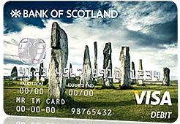
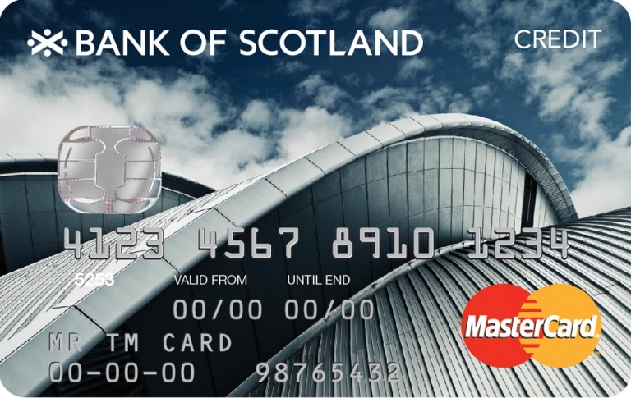
In pairs discuss the good and bad points of each.
But they work very differently !
They look the same
Credit & Debit Cards
Buying with with your money
Buying with the banks money
www.mathsrevision.com
% charge each month
on burrowed money
Normally no charge
Not insured for
transactions online
Insured for
transactions online
Very easy to get into serious debit

Slide 18
APR means
Annual Percentage Rate
Banking
Credit Card
Kacey buys a new sofa for £3000
on her credit card @ 24% APR.
How much will she owe after 1 month.
www.mathsrevision.com
Monthly interest :
24 ÷ 12 = 2%
2
x 3000 = £60
Total now owed = £3060
100

Slide 19
APR means
Annual Percentage Rate
Banking
Rates & Contracts
During one month, Ryan owes £1500
on his Credit Card at an APR of 30%.
Assuming he does not buy anything more with
his credit card, how much will he owe the bank
at the end of the month.
www.mathsrevision.com
Monthly interest :
30 ÷ 12 = 2.5%
2.5
x 1500 = £37.50
Total now owed = £1537.50
100

Slide 20
Banking
Credit Cards
(b) Assuming he does not buy anything during the rest
of the year with his credit card and does not pay
anything off, how much will he owe the bank
at end of the year.
30
x 1500 = £450
OR
12 x 37.50 = £450
100
www.mathsrevision.com
Total now owed = £2450

Slide 21
Banking
Credit Cards
Finish the sentence
The bigger the APR ................
the more you are charged.
www.mathsrevision.com

Slide 22
Banking
Now Try
TJ N4 Lifeskills
Exercise 3
Ch27 (page 220)
www.mathsrevision.com

Slide 23
Starter Questions
www.mathsrevision.com

Slide 24
Banking
Borrowing Money
Learning Intention
Success Criteria
  1. We are learning way to burrow money and to calculate monthly payments.
  Understand and compare loan deals.
www.mathsrevision.com
  2. Be able to choose best deal by comparing monthly payments.

Slide 25
Banking
Rates & Contracts
Michael needs a loan of £850 for his holiday
in Barcelona. He takes out the loan for 1 year
@ a rate of 11.6% APR.
Calculate the total he needs to pay back and the monthly
repayments.
www.mathsrevision.com
11.6
x 850
= £ 98.60
100
Pay back total :
£850 + £98.60 = £948.60
Monthly payment :
£948.60 ÷ 12 =
£79.05

Slide 26
Banking
Rates & Contracts
Alistair takes out a loan for £5000 for a car.
Calculate the total paid back for each option.
 | APR % | Loan Term
Loan payment Option 1 | 9.8 | 12 months
Loan payment Option 2 | 8.4 | 6 months
www.mathsrevision.com
9.8
Option 1 :
= £ 490
x 5000
100
Pay back total :
£5000 + £490 = £5490
Monthly payment :
£5490 ÷ 12 =
£457.50

Slide 27
Banking
Rates & Contracts
Alistair takes out a loan for £5000 for a car.
Calculate the total paid back for each option.
 | APR % | Loan Term
Loan payment Option 1 | 9.8 | 12 months
Loan payment Option 2 | 8.4 | 6 months
www.mathsrevision.com
9.8
Option 1 :
= £ 490
x 5000
100
Pay back total :
£5000 + £490 = £5490
Monthly payment :
£5490 ÷ 12 =
£457.50

Slide 28
Banking
Borrowing Money
 | APR % | Loan Term
Loan payment Option 1 | 9.8 | 12 months
Loan payment Option 2 | 8.4 | 6 months
8.4 ÷ 2
= 4.2
Option 2 :
4.2
x 5000
= £ 210
www.mathsrevision.com
100
Pay back total :
£5000 + £210 = £5210
Monthly payment :
£5210 ÷ 6 =
£868.33

Slide 29
Why might someone pick option 2 ?
Banking
Borrowing Money
Monthly payment Option 1 :
£457.50
Monthly payment Option 2 :
£868.33
www.mathsrevision.com

Slide 30

Have you updated your Learning Log ?
Banking
Borrowing Money
Now Try
TJ N4 Lifeskills
Exercise 34
Ch27 (page 221)
www.mathsrevision.com

Slide 31
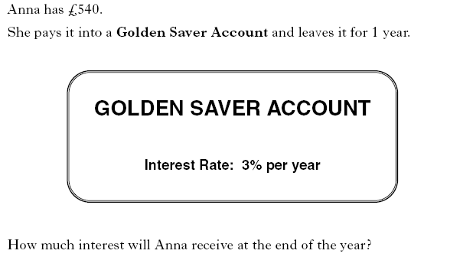
2 KU

Slide 32
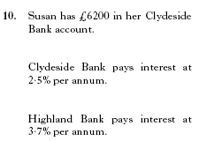
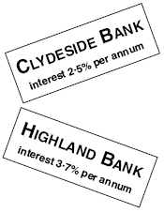

Slide 33
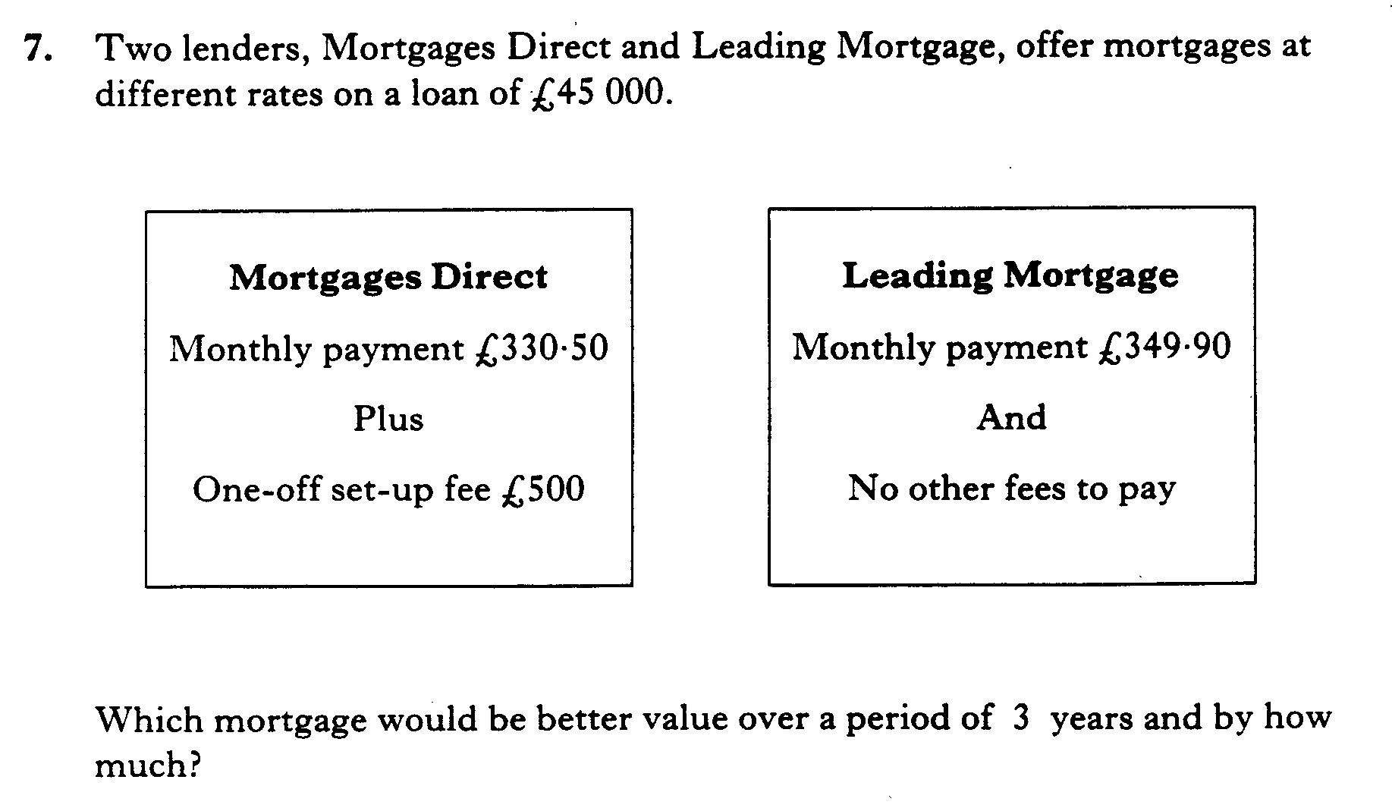

Slide 34
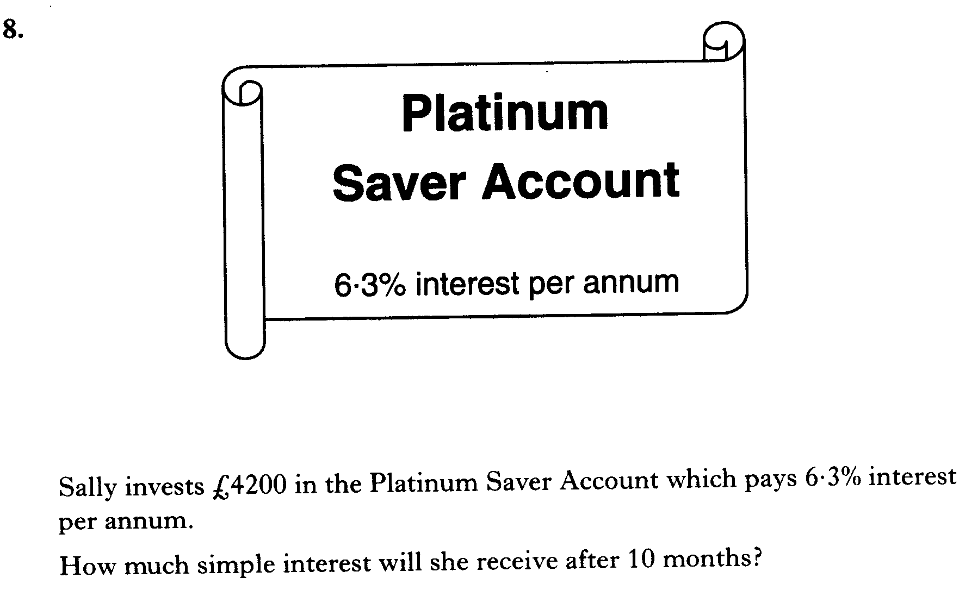

Slide 35
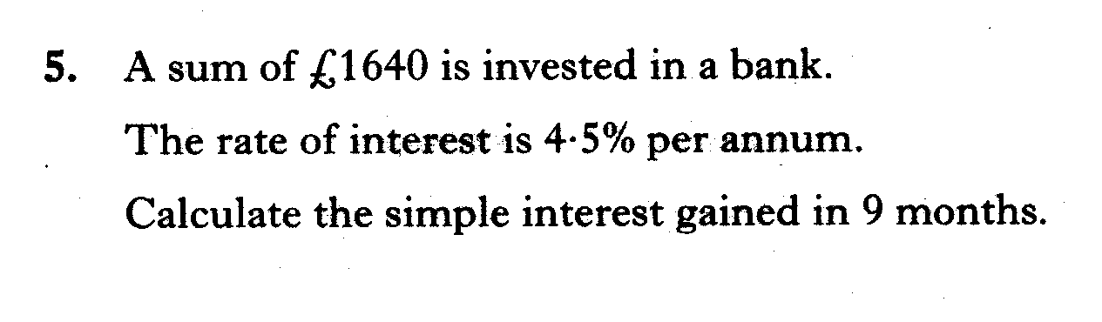

Slide 36
Jamie invests £1440 in a savings account.
The rate of interest is 5% per annum.
Calculate the interest he should receive after 3 months.

Slide 37
Charlie invests £4200 in a bank account.
The rate of interest is 1.3% per annum.
Calculate the interest he should receive after 9 months.

Slide 38
Ralph invests £2600 in a building society account.
The rate of interest is 4.5% per annum.
Calculate the interest he should receive after 8 months.

Slide 39
Sam invests £7600 in a bank account.
• The rate of interest is 4.8% per annum.
• The bank deducts 20% tax from the interest.
Calculate the interest Sam receives for one year after tax has been deducted.

Slide 40
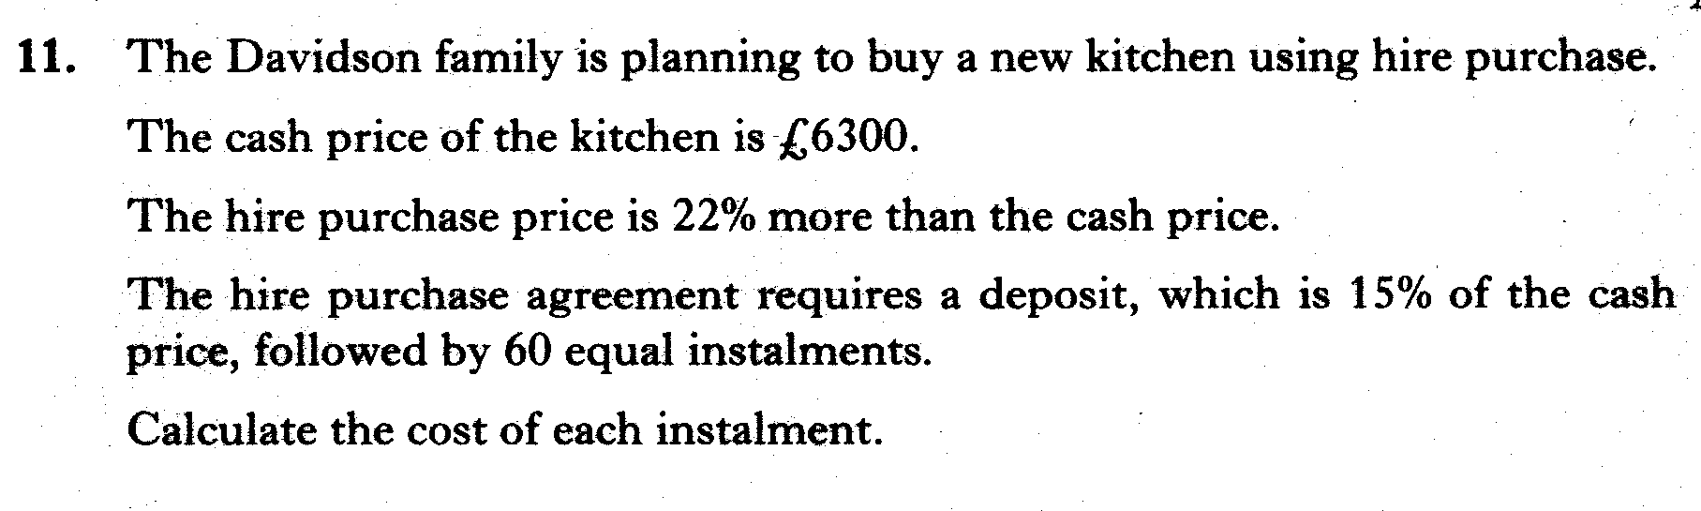

Slide 41
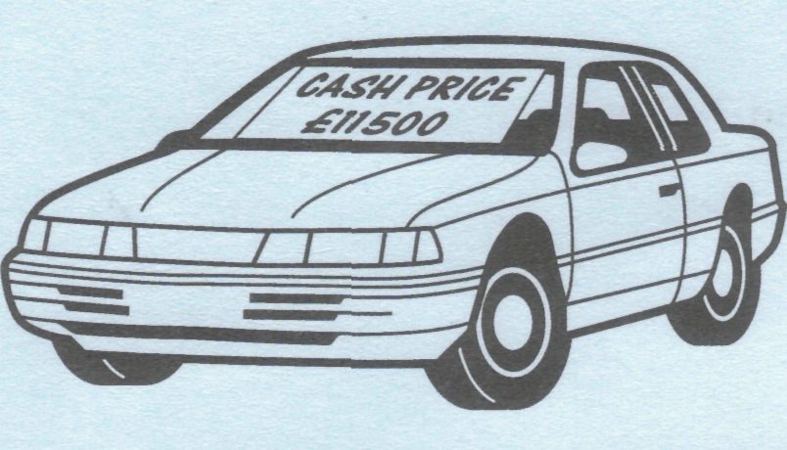
Jenna is buying a car. The cash price is £11500. It can be bought on hire purchase by paying a deposit of 20% of the cash price and 36 instalments of £300.
Find the total hire purchase price of the car.

Slide 42
Gail wants to insure her computer for £2400.
The insurance company charges an annual premium of £1.25 for each £100 insured.
(a) Calculate the annual premium.
(b) Gail can pay her premium monthly.
If she does this she is charged an extra 4%. Calculate the monthly premium.

