Slide 1


Simple Areas
Definition : Area is “ how much space a shape takes up”
Parallelogram
Rhombus and kite
www.mathsrevision.com
Power and Roots
□² √
The Circle

Slide 2
Starter Questions
Q1. Is the area of the rhombus
equal to 10.5cm²
Explain your answer.
6cm
7cm
Q2. Show that there are 2880 minutes in 2 days
www.mathsrevision.com
Q3. Expand 2p( y - 3p) – 2py
Q4. Calculate

Slide 3
Parallelogram Area
Learning Intention
Success Criteria
  1. To develop a formula for the area of a parallelogram.
  To remember the formula for the area of a parallelogram.
www.mathsrevision.com
Apply formula correctly.
(showing working)
Answer containing
appropriate units

Slide 4
Parallelogram Area
Important NOTE
h = vertical height
h
www.mathsrevision.com
b

Slide 5
Parallelogram Area
Example 1 : Find the area of parallelogram.
3cm
www.mathsrevision.com
9cm

Slide 6

Area
Now try N4 Lifeskills TJ
Ex 1
Ch16 (page 135)
www.mathsrevision.com

Slide 7
Starter Questions
Q1. Calculate
110º
Q2. Are the missing angles 70º,40º,40º (Explain your answer)
www.mathsrevision.com
Q3. Is 180 the HCF of 10 and 36 ? (Explain your answer)
Q4. The solution to an equation is 5.
What is the equation.

Slide 8
Rhombus and Kite Area
Learning Intention
Success Criteria
  1. To develop a single formula for the area of ANY rhombus and Kite.
  To remember the formula for the area of ANY rhombus and kite.
www.mathsrevision.com
Apply formulae correctly.
(showing working)
Answer containing
appropriate units

Slide 9
Area of a Rhombus
You have 2 minutes to come up with the formula for the area of any rhombus.
d
www.mathsrevision.com
D
Rectangle Area = D x d

Slide 10
Area of a Kite
You have 2 minutes to come up with the formula for the area of any kite.
d
www.mathsrevision.com
D
Rectangle Area = D x d

Slide 11
Rhombus and Kite Area
Example : Find the area of the shapes.
2cm
4cm
5cm
9cm
www.mathsrevision.com

Slide 12
Rhombus and Kite Area
Example : Find the area of the V – shape kite.
4cm
www.mathsrevision.com
7cm

Slide 13
Area
Now try N4 Lifeskills TJ
Ex 2
Ch17 (page 137)
www.mathsrevision.com

Slide 14
Starter Questions
www.mathsrevision.com

Slide 15
Squaring a Number
Learning Intention
Success Criteria
  We are learning the term
  about powers of a number’.
  To understand what is meant by the term power of a number.
Be able to calculate powers of a number squares both mentally and using the calculator.
www.mathsrevision.com

Slide 16
Square of a Number
To square a number means to :
“Multiply it by itself”
Example :
9²
means 9 x 9 = 81
www.mathsrevision.com
10²
means 10 x 10 = 100

Slide 17
Area of Square
Area of a square is
l cm
A = l x l = l²
Example : Find the area of a square
with length 7cm.
www.mathsrevision.com
A = l²
= 7²
= 49cm²

Slide 18
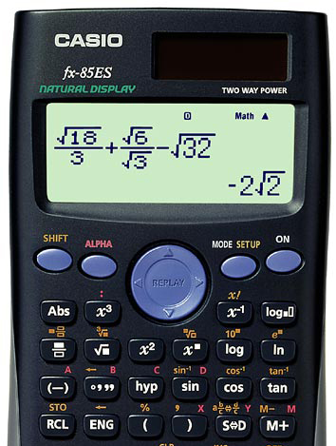
Special button
on the calculator

Slide 19
Powers & Roots
Now try N4 Lifeskills TJ
Ex 2
Ch17 (page 140)
www.mathsrevision.com

Slide 20
Starter Questions
6
5
www.mathsrevision.com

Slide 21
Area of a Circle
Peeling an
orange
A
x
circumference
A
x
B
O
O
www.mathsrevision.com
  What do we call the distance OA in terms of
  the large circle.
  What do we call the distance AB in terms of the large circle.

Slide 22
Area of a Circle
A
B
x
  What is the formula for the area
  of a right-angle triangle.
O
www.mathsrevision.com
  Use this formula to work out
  the area for a circle.

Slide 23



Area of a Circle
If we break the circle
into equal sectors
And lay them out side by side
We get very close
to a rectangle.
8
1
7
2
www.mathsrevision.com
3
6
5
4
2
4
6
8
1
3
5
7
Demo

Slide 24
Area of a Circle
2
4
6
8
If we cut the sectors
Thinner and thinner then
we get closer and closer
to a rectangle. Hence we can represent the area of a circle
by a rectangle.
1
3
5
7
thinner and thinner
sectors
www.mathsrevision.com

Slide 25
Area of a Circle
www.mathsrevision.com
But the area inside this rectangle is also the area of the circle
Area = πr²

Slide 26
Area of a circle
Q. Find the area of the circle ?
Solution
4cm
www.mathsrevision.com

Slide 27
Area of a circle
The diameter of the circle is 60cm.
Find area of the circle?
Solution
www.mathsrevision.com

Slide 28

Have you updated your Learning Log ?
Area
Now try N4 Lifeskills TJ
Ex 2
Ch17 (page 141)
www.mathsrevision.com
Are you on Target ?
I can ?

