Slide 1


Area
Area Rectangle
Area of Triangle
Area of ANY Triangle
www.mathsrevision.com
Composite Areas
Carpet Problem
Exam Type Questions

Slide 2
Starter Questions
Q1. What is the time difference 09:28 and 11:55
Q2.
www.mathsrevision.com
Q3. Convert 23metres to
(a) cm (b) mm
Q4. The answer to the question is 180.
What is the question.

Slide 3
Area of a Rectangle
Learning Intention
Success Criteria
  1. We are learning to calculate the area of rectangle.
  Remember area formula for a rectangle.
www.mathsrevision.com
Apply formula correctly.
(showing working)
Answer containing
appropriate units

Slide 4
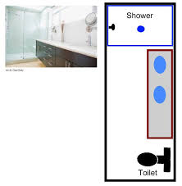
Area of a Rectangle
2.5m
Example
Find the area of the rectangular bathroom.
A = L x B
A = 5 x 2.5
5m
www.mathsrevision.com
A = 12.5 m²

Slide 5
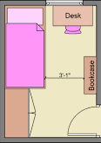
Area of a Rectangle
A new carpet is to be laid.
The cost is £20 per m²
(including fitting)
Calculate the total cost of the new carpet.
Find the area of the rectangular bedroom.
4m
A = L x B
A = 7.2 x 4
7.2m
A = 28.8 m²
www.mathsrevision.com
Total cost
= 28.8 x 20
= £576

Slide 6

Area of a Rectangle
Now try
N4 Lifeskills Ex1 Ch15
(page 120)
www.mathsrevision.com

Slide 7
Starter Questions
Q1. Calculate
Q2. True or false the perimeter of the shape is 130cm
and the area is 46cm.
13cm
www.mathsrevision.com
Q3.
10cm
Q4. Convert 57 metres to
(a) cm (b) mm

Slide 8
Area of
A Right-Angled Triangle
Learning Intention
Success Criteria
  Develop the formula for the area of any
  right-angled triangle.
  Remember the area formula for a right-angled triangle.
www.mathsrevision.com
2. Use formula to work out area of triangle.
3. Show all working and units.

Slide 9
Area of
A Right-Angled Triangle
Calculate the area of this shape
A = l x b
A = 10 x 8
8cm
www.mathsrevision.com
A = 80cm²
10cm

Slide 10
Area of
A Right-Angled Triangle
Vertical
Height
www.mathsrevision.com
Demo
base

Slide 11
Area of
A Right-Angled Triangle
Calculate the area of this shape
12cm
www.mathsrevision.com
6cm

Slide 12
Area of
A Right-Angled Triangle
Calculate the area of this shape
3cm
www.mathsrevision.com
4cm

Slide 13
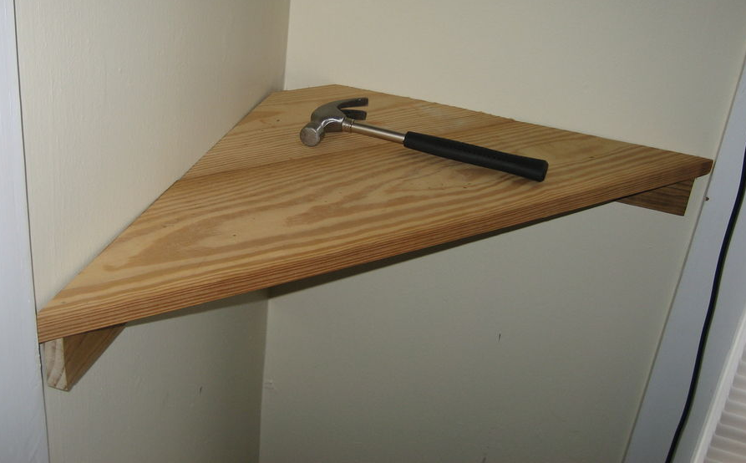
A shelf costs £15.50.
How much for 4 shelves.
Area of
A Right-Angled Triangle
Calculate the area of this right-angle triangular shelf.
A = ½bh
40cm
40cm
A = ½x40x40
A = 800cm²
www.mathsrevision.com
Total = 15.50 x 4
= £62

Slide 14
Area of
A Right-Angled Triangle
Now try
N4 Lifeskills Ex2 Ch15 Q4 onwards
(page 121)
www.mathsrevision.com

Slide 15
Starter Questions
Q1. Calculate
135º
Q2. Find all the missing angles
www.mathsrevision.com
Q3. Find the HCF of the two numbers 10 and 36
Q4. Find

Slide 16
Any Triangle Area
Learning Intention
Success Criteria
  1. To develop a formula for the area of ANY triangle.
  To know the formula for the area of ANY triangle.
www.mathsrevision.com
Apply formula correctly.
(showing working)
Use the formula to solve problems.
Answer containing
appropriate units

Slide 17
Any Triangle Area
h = vertical height
Sometimes called the altitude
h
www.mathsrevision.com
b
A = ½bh

Slide 18
Any Triangle Area
Find the area of the triangle.
A = ½bh
A = ½ x 6 x 8
www.mathsrevision.com
6cm
A = 48cm²
8cm

Slide 19
Area of ANY Triangle
Now try
N4 Lifeskills Ex3 Ch15 Q3 onwards
(page 124)
www.mathsrevision.com

Slide 20
Starter Questions
Q1. Why is
Q2. What is the time difference 07:54 and 13:36
Q3.
www.mathsrevision.com
Q4. Convert 45.1 metres to
(a) cm (b) mm
Q5. The answer to the question is 90.
What is the question.

Slide 21
Area of a Composite
Made up of
Simple shapes
Learning Intention
Success Criteria
  1. We are learning to find area for more complicated shapes.
  Use knowledge gained so far to find the area of more complicated shapes..
www.mathsrevision.com
Show appropriate working.

Slide 22
Area of a Composite
Calculate the area of this shape
9cm
Total Area =
72 + 30
= 102cm²
A = l x b
A = 9 x 8
6cm
8cm
www.mathsrevision.com
A = l x b
A = 72cm²
A = 6 x 5
5cm
A = 30cm²

Slide 23
Area of a Composite
Calculate the area of this shape
8cm
www.mathsrevision.com
10cm
6cm
12cm

Slide 24
Area of a Composite
Calculate the area of this shape
Total Area =
80 + 24
= 104cm²
A = l x b
www.mathsrevision.com
10cm
A = 8 x 10
A = l x b
A = 80cm²
A = 4 x 6
6cm
A =24cm²
8cm
4cm

Slide 25
Area of a Composite
Calculate the area of this shape
Rectangle 1
16cm
A = l x b
5cm
A = 16 x 5
A = 80cm²
www.mathsrevision.com
Rectangle 2
5cm
A = l x b
Total Area
A = 6 x 5
6cm
= 80 + 30
=110cm²
A = 30cm²

Slide 26
Area of a Composite
Calculate the area of this shape
A_{T} = A₁ + A₂
4cm
A_{T} = lxb + ½bh
www.mathsrevision.com
A_{T} = 8x7 + ½(8)(4)
7cm
A_{T} = 56 + 16
8cm
A_{T} = 72cm²

Slide 27
Area of a Composite
Now try
N4 Lifeskills Ex4 Ch15
(page 126)
www.mathsrevision.com

Slide 28
Scale Drawing
Length 4.5m = 9cm on the scale drawing
5m pack cost
£4.50
Scale 1cm to 0.5m
Length 6m = 12 cm on the scale drawing
For carpet grip we need to calculate PERIMETER
4m
Perimeter = 6 + 3 + 2 + 1.5 + 4 + 4.5 = 21m
(8cm)
(3cm)
1.5m
No of packs = 21 ÷ 5 = 4.2 packs
2m
(4cm)
So we need 5 packs
4.5m
(9cm)
Cost = 5 x £ 4.50 = £22.50
(6cm)
3m
(12cm)
6m

Slide 29
Fitting carpet means we need to calculate AREA
Minimum Area required = 18 + 6 = 24m²
Remember the
carpet only comes 4m wide !
4m
1.5m
2m
Area = L x B
= 4 x 4.5
4.5m
= 18m²
6m²
3m
What’s the best way to fit it ?
6m

Slide 30

Minimum AREA required = 18 + 6 = 24m²
One possible solution
4m
Area
4 x 6.5
= 26m²
1.5m
2m
4.5m
3m
Cost
£12 x 26
= £ 312
6m
2m
Total cost £22.50 + £312 =
£334.50
With a bit left over !

Slide 31
Minimum AREA required = 18 + 6 = 24m²
Best possible solution
4m
Area
4 x 6
= 24m²
1.5m
2m
4.5m
3m
Cost
£12 x 24
= £ 288
6m
Total cost £22.50 + £288 =
£310.50
Nothing left over !

Slide 32
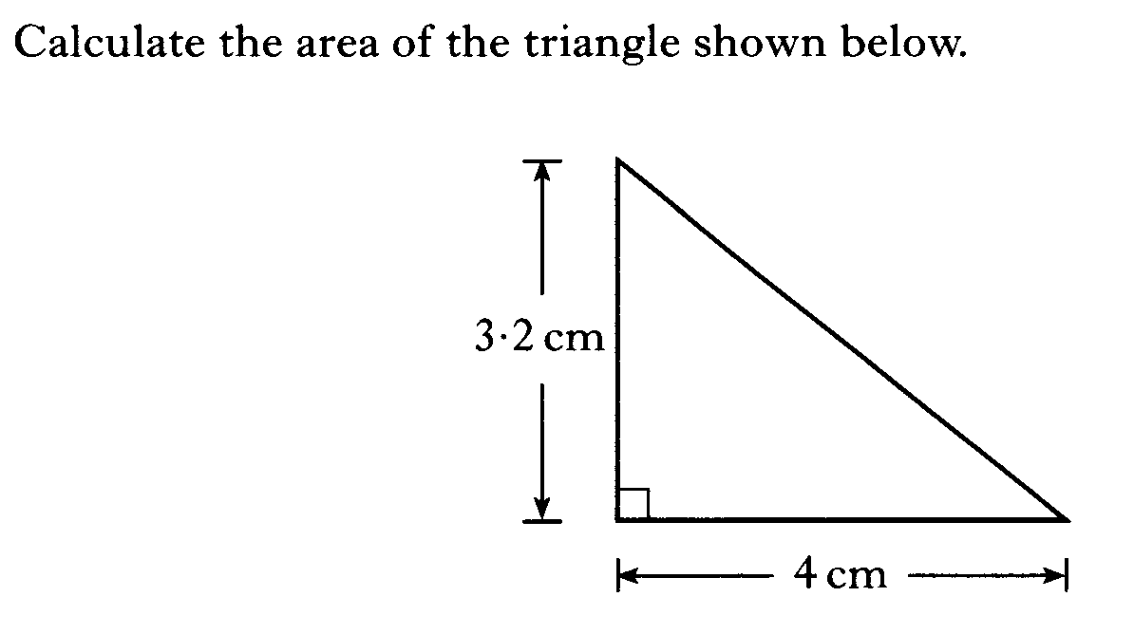

Slide 33
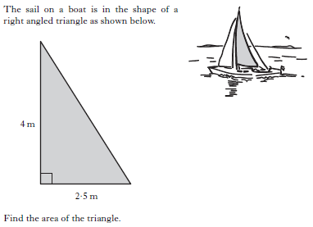

Slide 34
2 KU
2 KU

Slide 35
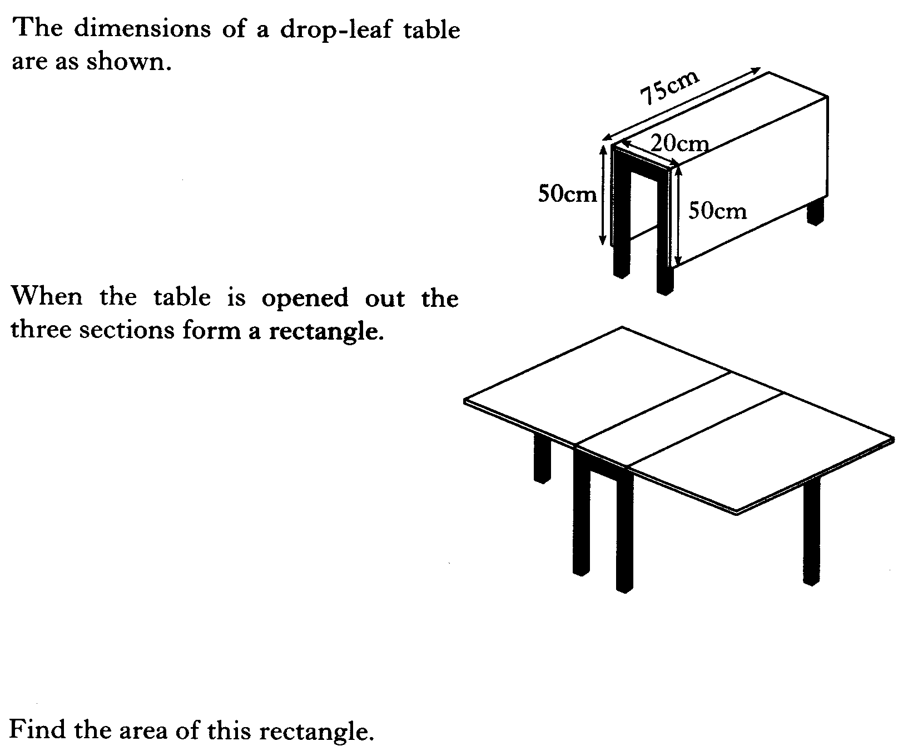

Slide 36
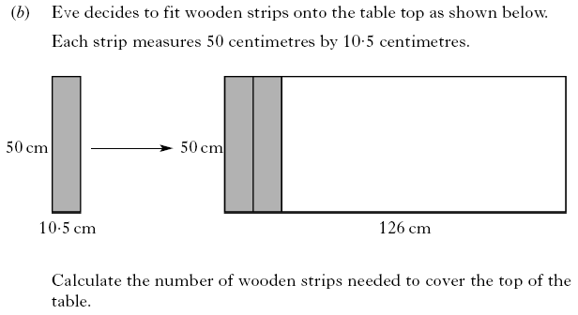
2 KU
2 KU

Slide 37
