Slide 1


Ratio
Ratio
Simplifying Ratio
Ratio Calculations
www.mathsrevision.com
Proportion per item
Direct Proportion

Slide 2
Starter Questions
www.mathsrevision.com

Slide 3
Ratio
What is a ratio ?
Learning Intention
Success Criteria
  1. We are learning what a ratio.
  Understand the term ratio. .
www.mathsrevision.com

Slide 4
Ratio
What is a ratio ?
Ratios can be used to compare different quantities
Example : There are 2 triangles and 3 rectangles.
www.mathsrevision.com
The ratio of triangles to rectangles
is said to be 2 : 3
Note: The ratio of rectangles to triangles is said to be 3 : 2

Slide 5
Ratio
Find the ratio of Length to Breadth.
L : B
2 cm
2 : 7
7 cm
www.mathsrevision.com
Find the ratio of length to Perimeter
L : P
P = 2 + 7 + 2 + 7
P = 18
7 : 18

Slide 6
Ratio
Find the ratio of Breadth to Area.
B : A
2 cm
2 : 14
1 : 7
7 cm
www.mathsrevision.com
Find the ratio of Area to Perimeter
A = L x B
A : P
A = 2 x 7
14 : 18
A = 14 cm²
7 : 9

Slide 7

Ratio
Now try Lifeskills
Ex 1
Ch8 (page 65)
www.mathsrevision.com

Slide 8
Starter Questions
www.mathsrevision.com

Slide 9
Ratio
Learning Intention
Success Criteria
  1. We are learning to simplify a ratio.
  1. Be able to find the HCF to simplify a ratios.
www.mathsrevision.com

Slide 10
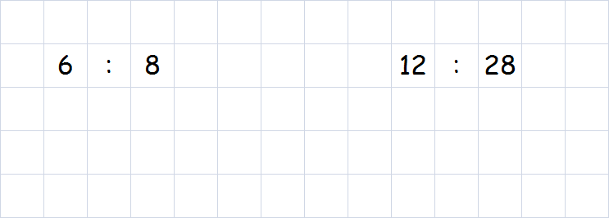
HCF
Highest Common Factor
Ratio
Simplifying a ratio ?
To simplify a ratio we need to find the HCF
HCF = 2
HCF = 4
÷ 2
÷ 2
÷ 4
÷ 4
www.mathsrevision.com
3 : 4
3 : 7

Slide 11
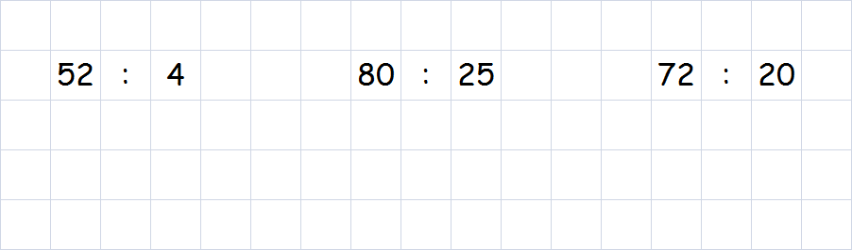
Ratio
Simplifying a ratio ?
To simplify a ratio we need to find the HCF
HCF = 4
HCF = 5
HCF = 4
÷ 4
÷ 4
÷ 5
÷ 5
÷ 4
÷ 4
www.mathsrevision.com
13 : 1
16 : 5
18 : 5

Slide 12
Ratio
Now try Lifeskills
Ex 2
Ch8 (page 67)
www.mathsrevision.com

Slide 13
Starter Questions
www.mathsrevision.com

Slide 14
Ratios
Ratio Calculations
Learning Intention
Success Criteria
  1 We are learning how to do ratio calculations.
  Apply tabular method to solve problems involving ratios.
  2. Show appropriate working.
www.mathsrevision.com

Slide 15
Ratios
Ratio Calculations
Example : The ratio of boys to girls is 4:5.
If there are 16 boys, how many girls
are there.
boys
girls
www.mathsrevision.com
4
5
x 4
x 4
16
20

Slide 16
Ratios
Ratio Calculations
Example : The ratio of cars to buses is 3:7.
If there are 49 buses, how many cars
are there.
cars
buses
www.mathsrevision.com
3
7
x 7
x 7
21
49

Slide 17

Have you updated your Learning Log ?
Ratio
Now try Lifeskills
Ex 3
Ch8 (page 69)
www.mathsrevision.com
Are you on Target ?
I can ?

Slide 18
Starter Questions
www.mathsrevision.com

Slide 19
Proportion
Proportion
Learning Intention
Success Criteria
Understand the term
per item.
  1 We are learning the value of one item using proportion.
www.mathsrevision.com
2. Solve simple proportional problems.

Slide 20
Proportion
If you know the total cost of several items, you can
easily find the cost per item ( cost for 1 ).
Are we expecting more or less
Make smaller fraction
Example : The cost of 5 chocolate bars is £8.00.
Find the cost of one.
www.mathsrevision.com
No. of Bars £
5 → 8.00
Per item
1 →

Slide 21
Proportion
Example : The cost of 7 DVD’s is £66.50.
Find the cost of one.
Are we expecting more or less
Make smaller fraction
www.mathsrevision.com
No. of DVD’s £
7 → 66.50
Per item
1 →

Slide 22
Proportion
Now try Lifeskills
Ex 4
Ch8 (page 71)
www.mathsrevision.com

Slide 23
Starter Questions
www.mathsrevision.com

Slide 24
Proportion
Direct Proportion
Learning Intention
Success Criteria
1. Understand the idea of Direct Proportion.
  1. We are learning the term Direct Proportion.
2. Solve simple proportional problems.
www.mathsrevision.com

Slide 25
Proportion
Direct Proportion
Two quantities, (for example, number of cakes and total
cost) are said to be in DIRECT PROPORTION, if :
Are we expecting more or less
Make smaller fraction
“ .. When you double the number of cakes
you double the cost.”
Example : The cost of 6 cakes is £4.20.
Find the cost of 5 cakes.
www.mathsrevision.com
No. of cakes £
6 → 4.20
5 →
4-Jul-26

Slide 26
Proportion
Direct Proportion
Example : On holiday I exchanged £30 for $45.
How many $ will I get for £50.
Are we expecting more or less
Make bigger fraction
www.mathsrevision.com
£ $
30 → 45
50 →

Slide 27
Proportion
Direct Proportion
Example : 300 pencils cost £6. How much will 200 cost.
Are we expecting more or less
Make smaller fraction
www.mathsrevision.com
Pencil £
300 → 6
200 →

Slide 28
Have you updated your Learning Log ?
Proportion
Now try Lifeskills
Ex 5
Ch8 (page 73)
www.mathsrevision.com
Are you on Target ?
I can ?
Are you on Target ?
I can ?
Mind Map

