Slide 1


Area & Perimeter
Area Counting squares
Area Rectangle
Perimeter
www.mathsrevision.com
Measuring Lengths / Drawing lines
Measuring Angles

Slide 2
Starter Questions
MNU 2-11b
MNU2-11c
MTH 3-11b
Q1. Solve the equation below
aº
Q2. Find the missing angles
bº
www.mathsrevision.com
Q3. Find the average of the numbers below
2,5,6,7
Q4. Which is the better deal
or

Slide 3
Area Counting Squares
Learning Intention
Success Criteria
  1 We are learning the term area.
  To understand the term area.
www.mathsrevision.com
Find the area by counting squares.

Slide 4
Area Counting Squares
The area of a shape is simply defined by :
“the amount of space a shape takes up.”
Think of a square measuring 1 cm by 1cm we say it is :
www.mathsrevision.com
1cm
1cm²
1cm
( 1 square centimetre )

Slide 5
Area by Counting Squares
The desks below have been arranged
in a certain way. Find the area each design.
www.mathsrevision.com

Slide 6

Area Counting Squares
Now try Lifeskills
Ex1 Ch6 (page 50)
www.mathsrevision.com

Slide 7
Starter Questions
Q1. What is the time difference 09:28 and 11:55
Q2. Convert 23metres to
(a) cm (b) mm
www.mathsrevision.com
Q3. The answer to the question is 180.
What is the question.

Slide 8
Area of a Rectangle
Learning Intention
Success Criteria
  1. Develop a formula for the area of a rectangle.
  Remember area formula for a rectangle.
www.mathsrevision.com
Apply formula correctly.
(showing working)
Answer containing
appropriate units

Slide 9
Area of a Rectangle
1 cm
B
B
L
L
L = length
www.mathsrevision.com
L
B
B = Breadth
Area = length x breadth
L
B
A
3
1
=
3
A = L x B
X
4
X
3
=
12
3
2
=
6
Must learn formula !
X

Slide 10
Area of a Rectangle
Example
Find the area of the rectangle opposite
B = 2cm
L = 9cm
Area = Length x Breadth
www.mathsrevision.com
A = L x B
A = 9 x 2
A = 18 cm²
Demo

Slide 11
Area of a Rectangle
Find the area of the rectangle.
3.5cm
Area = Length x Breadth
10cm
A = L x B
A = 10 x 3.5
www.mathsrevision.com
A = 35 cm²
Demo

Slide 12
Area of a Rectangle
Now try Lifeskills
Ex2 Ch6 (page 53)
www.mathsrevision.com

Slide 13
Starter Questions
www.mathsrevision.com

Slide 14
Perimeter
Learning Intention
Success Criteria
  1. We are learning the term perimeter of a shape.
  Understand the term perimeter of a shape.
www.mathsrevision.com
2. Calculate the perimeter of a shape.

Slide 15
Perimeter
MNU 2-11b
MNU2-11c
MTH 3-11b
What is perimeter ?
www.mathsrevision.com
Hint
answer is on the screen !

Slide 16
Perimeter
www.mathsrevision.com
Perimeter

Slide 17
Perimeter
MNU 2-11b
MNU2-11c
MTH 3-11b
www.mathsrevision.com
Perimeter

Slide 18
Perimeter
MNU 2-11b
MNU2-11c
MTH 3-11b
Perimeter
is the distance round the outside of a 2D shape
www.mathsrevision.com

Slide 19
Perimeter
MNU 2-11b
MNU2-11c
MTH 3-11b
6cm
Calculate the perimeter of the rectangle below.
3cm
Demo
www.mathsrevision.com
Perimeter =
6 +
3 +
6 +
3
18cm
=

Slide 20
Perimeter
Now try Lifeskills
Ex3 Ch6 (page 55)
www.mathsrevision.com

Slide 21
Starter Questions
Q1. Solve the equation below
Q2. Find two numbers that multiply to give 18
and subtract to give 3.
www.mathsrevision.com
Q3. Explain why the average of the numbers below is 7
2,8,8,10
Q4. True or false

Slide 22
Measuring Lengths Drawing Lines
Learning Intention
Success Criteria
  1 We are learning the 4 metric units of length.
  Remember the 4 units of length.
www.mathsrevision.com
2. Be able to convert between them.

Slide 23
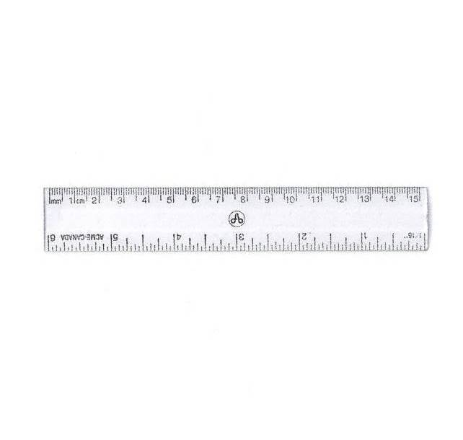
Measuring Lines
1 cm
www.mathsrevision.com
1cm = 10mm
1m = 100cm

Slide 24
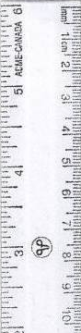
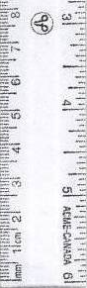
Measuring Lines
9cm
(90mm)
6.8cm
(68mm)
www.mathsrevision.com
7.2cm
(72mm)

Slide 25
Perimeter
Each square has length 5cm.
Calculate perimeter of each design.
5cm
5cm
5cm
5cm
www.mathsrevision.com

Slide 26
Measuring Lengths Drawing Lines
Now try Lifeskills
Ex4 Ch6 (page 56)
www.mathsrevision.com

Slide 27
Starter Questions
Q1. Why is
Q2. What is the time difference 07:54 and 13:36
Q3.
www.mathsrevision.com
Q4. Convert 45.1 metres to
(a) cm (b) mm
Q5. The answer to the question is 90.
What is the question.

Slide 28
Measuring Angles
Learning Intention
Success Criteria
  1. We are learning how to use a protractor to measure angles.
  Be able to use a protractor to measure various angles.
www.mathsrevision.com

Slide 29
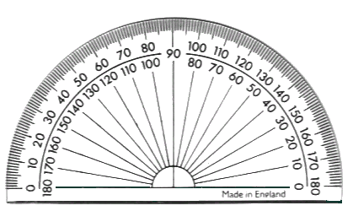
A 180º Protractor
Outside scale from 0º to 180º going in a clockwise direction.
Inside scale from 0º to 180º going in an anti-clockwise direction.

Slide 30
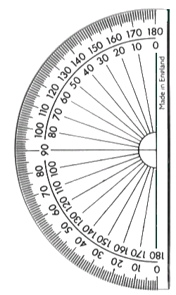
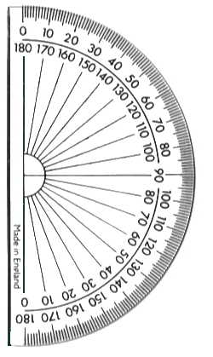
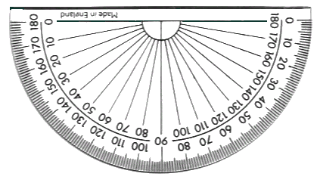
You need to be able to measure an angle to the nearest degree. To help you do this you should always:
1. Look directly down onto the cross point.
2. Always use the protractor in a horizontal manner as shown below.
✓

Slide 31
Measuring Angles with a 180º Protractor
1
50º
2
0 on the inside so use inside scale
67º
0 on the outside so use outside scale

Slide 32
Measuring Angles with a 180º Protractor
3
120º
4
135º
0 on the inside so use inside scale
0 on the outside so use outside scale

Slide 33

Have you updated your Learning Log ?
Measuring Angles
Now try Lifeskills
Ex5 Ch6 (page 57)
www.mathsrevision.com
Are you on Target ?
I can ?

