Slide 1


Decimal Numbers
What is a decimal ?
Decimal Scales
Rounding
Addition and Subtraction
Multiplying by a single Digit
www.mathsrevision.com
Dividing by a single Digit
Multiplying by 10, 100, 1000
Dividing by 10, 100, 1000

Slide 2
Starter Questions
www.mathsrevision.com

Slide 3
Decimal Numbers
Writing Decimals
Learning Intention
Success Criteria
  1. We are learning what a decimal number is. Write down the decimal number represented by a fraction diagram.
  Understand what a decimal number is.
  2. Write down the decimal number represented by a fraction diagram.
www.mathsrevision.com

Slide 4
means ten
Decimal Numbers
Writing Decimals
When you take a single unit
and divide it into 10 bits,
what we then have are
decimal fractions of a whole number
Imagine, 1 bar of chocolate as our UNIT of measure.
www.mathsrevision.com
0.1
0.2
0.3
0.4
0.5
0.6
0.7
0.8
0.9
1.0
or 0.1

Slide 5
Decimal Numbers
Writing Decimals
Example : Write down the decimal number
represented by the shaded area.
(a)
www.mathsrevision.com
(b)

Slide 6
Decimal Numbers
Writing Decimals
Example : Write down the decimal number
represented by the diagram.
(a)
(b)
www.mathsrevision.com
(c)
(d)

Slide 7
Decimal Numbers
Writing Decimals
We can take one bit of the chocolate bar
and split it into 10
1st Decimal place
0.01
0.1
www.mathsrevision.com
2nd Decimal place

Slide 8
Decimal Numbers
Writing Decimals
Example : Write down the decimal number
represented by the diagram.
(a)
(b)
www.mathsrevision.com
(c)
(d)

Slide 9

Decimal Numbers
Writing Decimals
Now try Lifeskills
Ex 1
Ch2 (page 9)
www.mathsrevision.com

Slide 10
Starter Questions
3cm
www.mathsrevision.com

Slide 11
Decimal Numbers
Reading Scales
Learning Intention
Success Criteria
  1 We are learning how to read decimal scales.
  Understand the steps to work out any decimal scale to 2 decimal places.
  2. Solve problems by working out scales.
www.mathsrevision.com

Slide 12
Decimal Scales
How much liquid in the jug ?
1 ÷ 5 =
0.2
Litres
2
going up 0.2 each time
www.mathsrevision.com
1
0.8 litres
0

Slide 13
Decimal Scales
How much liquid in the jug ?
Litres
2
1.4 litres
www.mathsrevision.com
1
0

Slide 14
Decimal Scales
How much liquid in the jug ?
( Careful different scale)
Litres
2
1.75 litres
1 ÷ 4 =
0.25
www.mathsrevision.com
1
going up 0.25 each time
0

Slide 15
Decimal Scales
Calculate the weight each arrow is pointing at?
1.2g
grams
1 ÷ 5 =
0.2
0
1g
going up 0.2 each time
2g
www.mathsrevision.com
3g
2.8g
5g
4g
5.4g

Slide 16
Decimal Scales
Calculate the weight each arrow is pointing at?
0.04g
grams
0.1 ÷ 5 =
0.02
0
0.1
0.2
going up 0.02 each time
www.mathsrevision.com
0.3
0.5
0.4
0.36g
0.52g

Slide 17
Decimal Scales
Calculate the weight each arrow is pointing at?
0.8kg
Kilograms
2 ÷ 5 =
0.4
0
2
4
going up 0.4 each time
www.mathsrevision.com
6
10
8
7.2kg
10.4kg

Slide 18
Decimal Numbers
Writing Decimals
Now try Lifeskills
Ex 2
Ch2 (page 10)
www.mathsrevision.com

Slide 19
Starter Questions
www.mathsrevision.com

Slide 20
Decimal Numbers
Rounding to 1 decimal place
Learning Intention
Success Criteria
  We are learning how to round to 1 decimal place.
  1. Remember steps to round to 1 decimal place.
www.mathsrevision.com

Slide 21
Decimal Numbers
Rounding to 1 decimal place
Find the values of the arrows.
8.2cm
8.3cm
8.4cm
8.24
8.28
8.35
www.mathsrevision.com
Is 8.24 nearer to 8.2 or 8.3 ?
8.2
Is 8.28 nearer to 8.2 or 8.3 ?
8.3
Is 8.35 nearer to 8.2 or 8.3 ?
Neither

Slide 22
Rounding
Rounding to Any Number of Decimal Places
MNU 3-01a
When rounding to :
  1 decimal place look at 2nd decimal figure
e.g. 2.46
  2 decimal place look at 3rd decimal figure
e.g. 6.456
  3 decimal place look at 4th decimal figure
e.g. 3.7846
www.mathsrevision.com
  4 decimal place look at 5th decimal figure
e.g. 13.1146

Slide 23
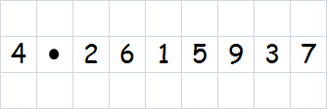
Rounding
Rounding to Any Number of Decimal Places
MNU 3-01a
Example :
  Rounded to 1 decimal place, the number is
4.3
  Rounded to 2 decimal place, the number is
4.26
www.mathsrevision.com
  Rounded to 3 decimal place, the number is
4.262
  Rounded to 4 decimal place, the number is
4.2616

Slide 24

Rounding
Rounding to Any Number of Decimal Places
MNU 3-01a
Example : Use your calculator to find the answers to
62.73
134.59
www.mathsrevision.com
4.29
Round your answers to 2 decimal places.

Slide 25
Decimal Numbers
Writing Decimals
Now try Lifeskills
Ex 3
Ch2 (page 12)
www.mathsrevision.com

Slide 26
Starter Questions
www.mathsrevision.com

Slide 27
Decimal Numbers
Add and Subtract Decimals
Learning Intention
Success Criteria
1. Understand that you must keep the decimal point lined up when adding and subtracting decimal numbers.
  1. We are learning how to add and subtract decimal numbers.
www.mathsrevision.com
2. Show all working.

Slide 28
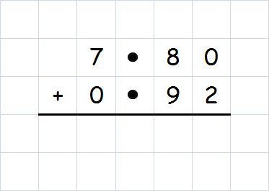
Decimal Numbers
Add and Subtract Decimals
When you add or subtract decimal numbers,
it is important to line-up the decimal points.
Example : Calculate 7.8 + 0.92
www.mathsrevision.com
8 7 2

Slide 29
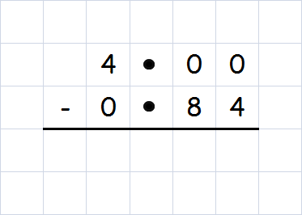
Decimal Numbers
Add and Subtract Decimals
When you add or subtract decimal numbers,
it is important to line-up the decimal points.
Example : Calculate 4 – 0.84
www.mathsrevision.com
3 1 6

Slide 30
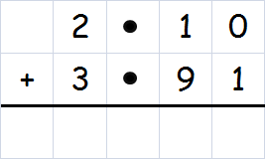
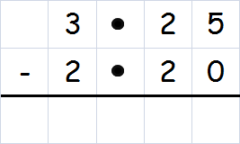
Decimal Numbers
Add and Subtract Decimals
Example : Find the value x cm and y cm
3.91cm
2.1cm
y cm
3.25cm
2.2cm
www.mathsrevision.com
x cm
x cm
y cm
6 0 1
1 0 5

Slide 31
Decimal Numbers
Writing Decimals
Now try Lifeskills
Ex 4
Ch2 (page 14)
www.mathsrevision.com

Slide 32
Starter Questions
www.mathsrevision.com
23º

Slide 33
Decimal Numbers
Multiplication by a Single Digit
Learning Intention
Success Criteria
1. Understand how to multiply a decimal number by a single Digit.
  1. We are learning how to multiply a decimal number by a single Digit.
www.mathsrevision.com
2. Show appropriate working.

Slide 34
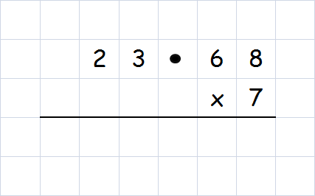
Decimal Numbers
Multiplication by a Single Digit
When multiplying by a single digit
the decimal point always stays in line.
Example : Calculate 23.68 x 7
www.mathsrevision.com
1 6 5 7 6

Slide 35
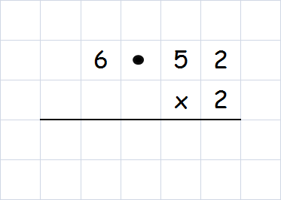
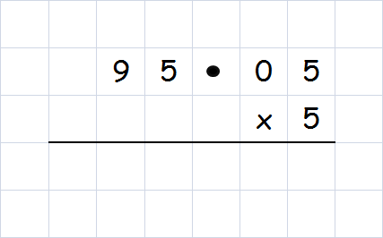
Decimal Numbers
Multiplication by a Single Digit
Example : Calculate.
6.52 x 2
95.05 x 5
www.mathsrevision.com
1 3 0 4
4 7 5 2 5

Slide 36
Decimal Numbers
Multiplication by a Single Digit
Now try Lifeskills
Ex 5
Ch2 (page 16)
www.mathsrevision.com

Slide 37
Starter Questions
www.mathsrevision.com
57º

Slide 38
Decimal Numbers
Division by a Single Digit
Learning Intention
Success Criteria
1. Understand how to divide a decimal number by a single Digit.
  1. We are learning how to divide a decimal number by a single Digit.
www.mathsrevision.com
2. Show appropriate working.

Slide 39
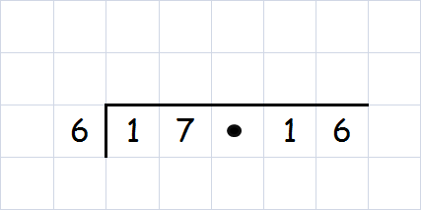
Decimal Numbers
Division by a Single Digit
When dividing by a single digit
the decimal point always stays in line.
Example : Calculate 17.16 ÷ 6
www.mathsrevision.com
2 8 6

Slide 40
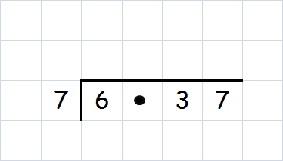
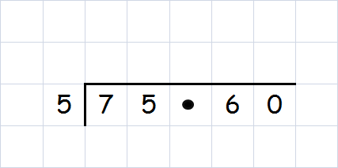
Decimal Numbers
Division by a Single Digit
Example : Calculate.
6.37 ÷ 7
75.60 x 5
www.mathsrevision.com
0 9 1
1 5 1 2

Slide 41
Decimal Numbers
Division by a Single Digit
Now try Lifeskills
Ex 6
Ch2 (page 18)
www.mathsrevision.com

Slide 42
Starter Questions
www.mathsrevision.com
40º

Slide 43
Decimal Numbers
Multiplying by 10, 100, 1000
Learning Intention
Success Criteria
  1 We are learning how to multiply decimal numbers by 10, 100, 1000.
  Understand the rules for multiplying decimal numbers by 10, 100, 1000.
www.mathsrevision.com
  2. Be able solve problems using rules.

Slide 44
Decimal Numbers
Multiplying by 10, 100, 1000
To multiply a decimal number by 10,
Simply move point 1 place to the right:
e.g. 2.55 x 10 = 25.5 point is moved 1 place to right
www.mathsrevision.com
To multiply a decimal number by 100,
Simply move point 2 places to the right:
e.g. 1.023 x 100 = 102.3 point is moved 2 places to right

Slide 45
Decimal Numbers
Multiplying by 10, 100, 1000
To multiply a decimal number by 1000,
Simply move point 3 places to the right:
e.g. 34.5674 x 1000 = 34567.4
point is moved 3 place to right
www.mathsrevision.com

Slide 46
Decimal Numbers
Multiplying by 10, 100, 1000
Example : Calculate the following
22.7 x 10
69.2 x 100
0.12 x 1000
= 227
= 6920
= 120
www.mathsrevision.com

Slide 47
Decimal Numbers
Practice
www.mathsrevision.com

Slide 48
Decimal Numbers
Multiplying by 10, 100, 1000
Now try Lifeskills
Ex 7
Ch2 (page 18)
www.mathsrevision.com

Slide 49
Starter Questions
www.mathsrevision.com
126º

Slide 50
Decimal Numbers
Dividing by 10, 100, 1000
Learning Intention
Success Criteria
  1 We are learning how to divide decimal numbers by 10, 100, 1000.
  Understand the rules for dividing numbers by 10, 100, 1000
www.mathsrevision.com
  2. Be able solve problems using rules.

Slide 51
Decimal Numbers
Dividing by 10, 100, 1000
To divide a decimal number by 10,
Simply move point 1 place to the left:
e.g. 89 ÷ 10 = 8.9 point is moved 1 place to left
www.mathsrevision.com
To divide a decimal number by 100,
Simply move point 2 places to the left:
e.g. 199 ÷ 100 = 1.99 point is moved 2 places to left

Slide 52
Decimal Numbers
Dividing by 10, 100, 1000
To divide a decimal number by 1000,
Simply move point 3 places to the left:
e.g. 35 837 ÷ 1000 = 35.837
point is moved 3 places to the left
www.mathsrevision.com

Slide 53
Decimal Numbers
Dividing by 10, 100, 1000
Example : Calculate the following
452.4 ÷ 10
67 ÷ 100
0.86 ÷ 1000
= 45.24
= 0.67
= 0.00086
www.mathsrevision.com

Slide 54
Decimal Numbers
Dividing by 10, 100, 1000
Practice
www.mathsrevision.com

Slide 55

Have you updated your Learning Log ?
Decimal Numbers
Dividing by 10, 100, 1000
Now try Lifeskills
Ex 8
Ch2 (page 18)
www.mathsrevision.com
Are you on Target 1 ?
I can ?
Are you on Target 2 ?
I can ?

