Slide 1


Whole Numbers
Rounding to nearest Whole Number
Rounding to nearest 10,100,1000
Significant Figures & Estimating
www.mathsrevision.com
Multiplying & Dividing by 10,100,1000
Multiplying & Dividing by 20, 300 etc..

Slide 2
Whole Numbers
Rounding to Nearest Whole Number , 10, 100, 1000
Learning Intention
Success Criteria
  We are learning how to round to the nearest whole number.
  Understand the process of rounding to nearest whole number.
www.mathsrevision.com

Slide 3
Whole Numbers
7 is not
less than 5 so round up.
Rounding to Nearest Whole Number , 10, 100, 1000
Rounding the nearest Whole Number
Remember there is no point ?
6 is not
less than 5 so round up.
5.7 →
6
www.mathsrevision.com
4.62 →
5
5 is not
less than 5 so round up.
12.5 →
13

Slide 4
Whole Numbers
3 is
less than 5 so round down.
Rounding to Nearest Whole Number , 10, 100, 1000
Rounding the nearest Whole Number
4 is
less than 5 so round down.
361.3 →
361
www.mathsrevision.com
285.49 →
285

Slide 5
Whole Numbers
Rounding to Nearest Whole Number , 10, 100, 1000
Do these sums on your calculator and then round
your answers to the nearest whole number.
61 ÷ 5 →
12.2
12
www.mathsrevision.com
701 ÷ 4 →
175.25
175

Slide 6

Whole Numbers
Rounding to Nearest Whole Number
Now try Lifeskills
Ex 1
Ch1 (page 4)
www.mathsrevision.com

Slide 7
Starter Questions
www.mathsrevision.com
34º

Slide 8
Whole Numbers
Rounding to Nearest Whole Number , 10, 100, 1000
Learning Intention
Success Criteria
  We are learning how to round to the nearest
  10, 100 or 1000.
  Understand the process of rounding to 10, 100 or 1000.
www.mathsrevision.com

Slide 9
2 is
less than 5 so round down.
4 is
less than 5 so round down.
8 is not
less than 5 so round up.
4 is
less than 5 so round down.
6 is not
less than 5 so round up.
5 is not
less than 5 so round up.
Whole Numbers
Rounding to Nearest Whole Number , 10, 100, 1000
Rounding the nearest 10, 100 or 1000
10
100
48 →
50
169 →
200
www.mathsrevision.com
144 →
140
751 →
800
112 →
110
1543 →
1500

Slide 10
1 is
less than 5 so round down.
4 is
less than 5 so round down.
6 is not
less than 5 so round up.
Whole Numbers
Rounding to Nearest Whole Number , 10, 100, 1000
Rounding the nearest 10, 100 or 1000
1000
4648 →
5000
www.mathsrevision.com
99144 →
99000
10455 →
10000

Slide 11
Whole Numbers
Rounding to Nearest 10, 100, 1000
Now try Lifeskills
Exercise 2
Ch1 (page 4)
www.mathsrevision.com

Slide 12
Starter Questions
www.mathsrevision.com
123º

Slide 13
Whole Numbers
Using Rounding to Estimate Answers
Learning Intention
Success Criteria
1. Be able to round numbers to a whole number.
  1. We are learning how to estimate answer by rounding.
2. Estimate the answer to a difficult calculation using easier whole numbers.
www.mathsrevision.com

Slide 14
Significant Figures
Rounding to a given number of significant figures
251 to 1 sig. Fig.
300
251 to 2 sig. Fig.
250
3600 to 1 sig. Fig.
4000
www.mathsrevision.com
3469 to 3 sig. Fig.
3470
96 to 1 sig. Fig.
100

Slide 15
Whole Numbers
Using Rounding to Estimate Answers
It is very important when solving problems that we have
a rough idea of the answer we are expecting.
Example : Mentally estimate the answer to 42 x 49
www.mathsrevision.com
Easiest way, is to round each number to 1 sig. fig. first
40 x 50 =
400 x 5 =
2000

Slide 16
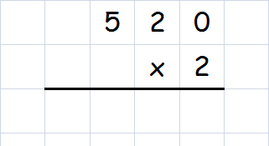
Whole Numbers
Multiply or Divide by 20,300,4000
Example : Calculate 20 x 52
20 can be written as 2 x 10 so we have :
2 x 10 x 52
Step 1 : 10 x 52 =
520
Step 2 : 2 x 520
www.mathsrevision.com
1 0 4 0

Slide 17
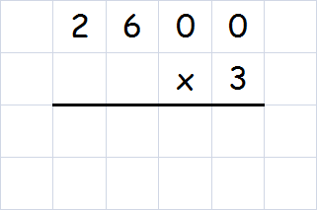
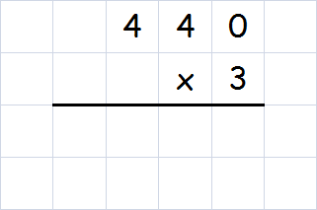
Whole Numbers
7 8 0 0
Multiply or Divide by 20, 300, 4000
1 3 2 0
Example : Calculate 44 x 30
30 can be written as 10 x 3 so we have :
44 x 10 x 3 =
Step 1 : 44 x 10 =
440
Step 2 : 440 x 3 =
www.mathsrevision.com
Example : Calculate 300 x 26
300 can be written as 3 x 100 so we have :
3 x 100 x 26 =
Step 1 : 100 x 26 =
2600
Step 2 : 2600 x 3 =

Slide 18
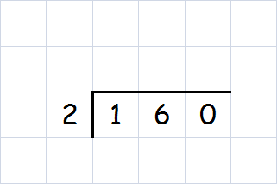
Whole Numbers
Multiply or Divide by 20,300,4000
Example : Calculate 16000 ÷ 200
Since 200 divide by 100 then divide by 2:
16000 ÷ 100 ÷ 2
www.mathsrevision.com
Step 1 : 16000 ÷ 100 =
160
8 0
Step 2 :

Slide 19
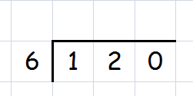
Whole Numbers
Multiply or Divide by 20,300,4000
Example : Calculate 120000 ÷ 6000
Since 6000 divide by 1000 then divide by 6:
120000 ÷ 1000 ÷ 6
www.mathsrevision.com
Step 1 : 120000 ÷ 1000 =
120
2 0
Step 2 :

Slide 20
Starter Questions
www.mathsrevision.com
34º

Slide 21
Whole Numbers
Multiply by 10, 100, 1000
Learning Intention
Success Criteria
  1 We are learning how to multiply and divide simple whole numbers by 10, 100, 1000.
  Understand the simple rules to multiply and divide simple whole numbers.
  2. Be able do simple calculations.
www.mathsrevision.com

Slide 22
Whole Numbers
Multiply by 10, 100, 1000
To multiply by 10, 100, 1000
To multiply by 10 simply add a zero to the number
To multiply by 100 simply add 2 zero’s to the number
www.mathsrevision.com
To multiply by 1000 simply add 3 zero’s to the number
Example : Multiply 36 by 10, 100, 1000.
Guess rule for 1000
36 x 10 =
360
36 x 100 =
3600
36 x 1000 =
36000

Slide 23
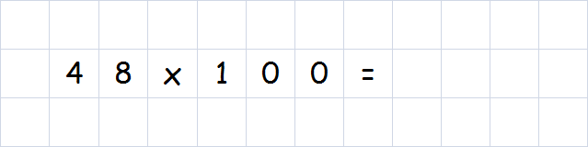
Whole Numbers
Multiply by 10, 100, 1000
Ex : A box of crisps contain 48 packets.
How many in 100 boxes ?
www.mathsrevision.com
4 8 0 0

Slide 24
Whole Numbers
Try and write down rule for 100, 1000
Divide by 10, 100, 1000
To Divide by 10, 100, 1000
To divide by 10 remove a zero from the number
To divide by 100 remove 2 zero’s from the number
To divide by 1000 remove 3 zero’s from the number
www.mathsrevision.com
Example : Divide 54000 by 10, 100, 1000.
54000 ÷ 10 =
5400
54000 ÷ 100 =
540
54000 ÷ 1000 =
54

Slide 25
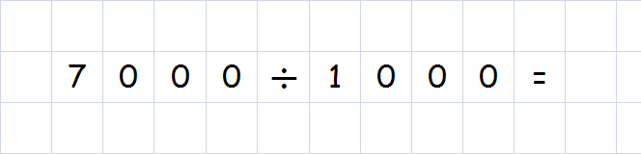
Whole Numbers
Divide by 10, 100, 1000
Ex : A box contains 1000 cups.
How many boxes are needed to hold 7000 ?
www.mathsrevision.com
7

Slide 26
Units of Length Converting Measurements
Kilometres
(km)
metres
(m)
www.mathsrevision.com
centimetres
(cm)
millimetres
(mm)

Slide 27
Units of Length Converting Measurements
Examples
Convert 2m to cm :
2 x 100 = 200 cm
Convert 4km to m :
4 x 1000 = 4000 m
www.mathsrevision.com
Convert 34cm to mm :
34 x 10 = 340 mm
Convert 50cm to m :
50 ÷ 100 = 0.5 m

Slide 28
Weight & Scales
Kilograms
x 1000
grams
2kg
2 x 1000
2000g
1.5kg
1.5 x 1000
1500g
www.mathsrevision.com
grams
÷ 1000
Kilograms
3000g
3000 ÷ 1000
3kg
1500g
1500 ÷ 1000
1.5kg

Slide 29
Converting Weights
Examples
Convert 4 kg to g :
4 x 1000 = 4000 g
Convert 9 kg to g :
9 x 1000 = 9000 g
www.mathsrevision.com
Convert 2000 g to kg :
2000 ÷ 1000 = 2 kg
Convert 5000 g to kg :
5000 ÷ 1000 = 5 kg

Slide 30
Whole Numbers
Significant Figures and Estimating
Now try Lifeskills
Exercise 4 & 5
Ch1 (page 6)
www.mathsrevision.com

Slide 31
Starter Questions
www.mathsrevision.com
28º

Slide 32
Whole Numbers
Multiply or Divide by 20,300,4000
Learning Intention
Success Criteria
1. Understand the two step process to multiply or divide by 20, 300 etc…
  1 We are learning how to multiply / divide by 20, 300, 4000 etc using our knowledge so far.
www.mathsrevision.com
2. Show all working.

Slide 33
Whole Numbers
1 0 4 0
Multiply or Divide by 20,300,4000
By combining our knowledge so far of
“multiplying / dividing by 10, 100, 1000”
and
“multiplying / dividing by a single digit”
we can do harder calculations.
We use a TWO step process.
www.mathsrevision.com
Example : Calculate 20 x 52
20 can be written as 2 x 10 so we have :
2 x 10 x 52 =
Step 1 : 10 x 52 =
520
Step 2 : 2 x 520 =

Slide 34
Whole Numbers
7 8 0 0
Multiply or Divide by 20, 300, 4000
1 3 2 0
Example : Calculate 44 x 30
30 can be written as 10 x 3 so we have :
44 x 10 x 3 =
Step 1 : 44 x 10 =
440
Step 2 : 440 x 3 =
www.mathsrevision.com
Example : Calculate 300 x 26
300 can be written as 3 x 100 so we have :
3 x 100 x 26 =
Step 1 : 100 x 26 =
2600
Step 2 : 2600 x 3 =

Slide 35
Whole Numbers
Multiply or Divide by 20,300,4000
Example : Calculate 16000 ÷ 200
Since 200 divide by 100 then divide by 2:
16000 ÷ 100 ÷ 2
www.mathsrevision.com
Step 1 : 16000 ÷ 100 =
160
8 0
Step 2 :

Slide 36
Whole Numbers
Multiply or Divide by 20,300,4000
Example : Calculate 120000 ÷ 6000
Since 6000 divide by 1000 then divide by 6:
120000 ÷ 1000 ÷ 6
www.mathsrevision.com
Step 1 : 120000 ÷ 1000 =
120
2 0
Step 2 :

Slide 37

Have you updated your Learning Log ?
Whole Numbers
x 20, 60, 700
Now try Lifeskills
Exercise 6 & 7
Ch1 (page 7)
www.mathsrevision.com
Are you on Target ?
I can ?
Are you on Target ?
I can ?
Mind Map

