Slide 1


Graphs & Tables
Interpreting Graphs.
Scattergraphs
Stem and Leaf Diagram
www.mathsrevision.com
Interpreting Tables

Slide 2
Starter Questions
www.mathsrevision.com

Slide 3
Interpreting Graphs
Learning Intention
Success Criteria
  To explain how to interpret various graphs.
  1. Understand key information on various graphs.
  2. Solve problems involving graphs.
www.mathsrevision.com

Slide 4
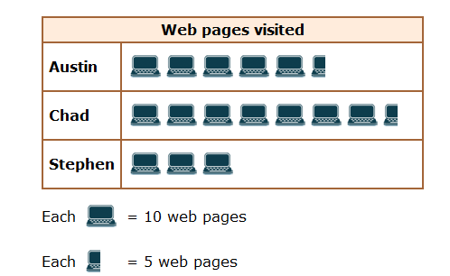
What does
1 computer represent
You have 1 minute to come up with a question
Interpreting Graphs
www.mathsrevision.com

Slide 5
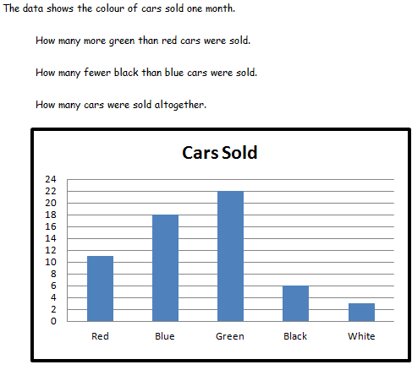
11
12
60

Slide 6
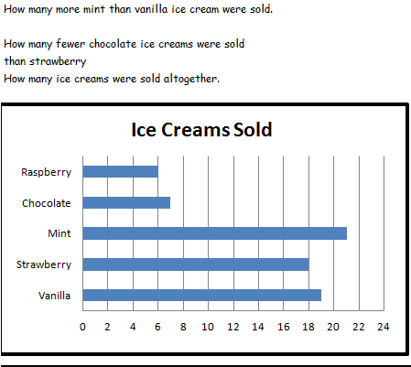
2
11
71

Slide 7

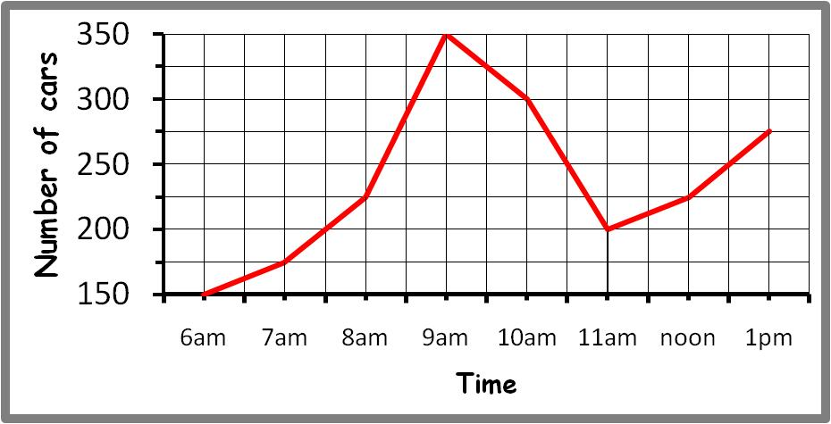
Interpreting Graphs
Nat 4
www.mathsrevision.com

Slide 8
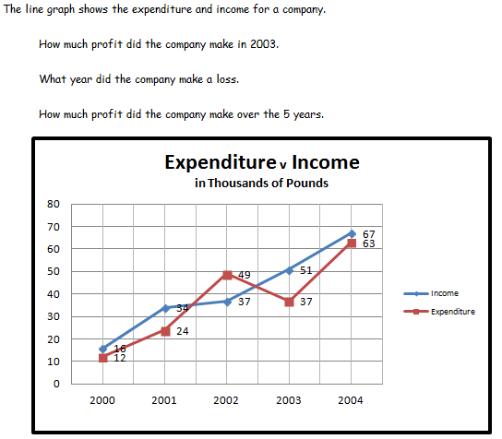
14 000
2002
20000

Slide 9

Pie Charts
The pie chart shows the results of a class survey into favourite restaurant food.
Write down the fraction of the class that choose
Chinese
Indian
Chinese
Indian
Italian
French
Italian
French

Slide 10
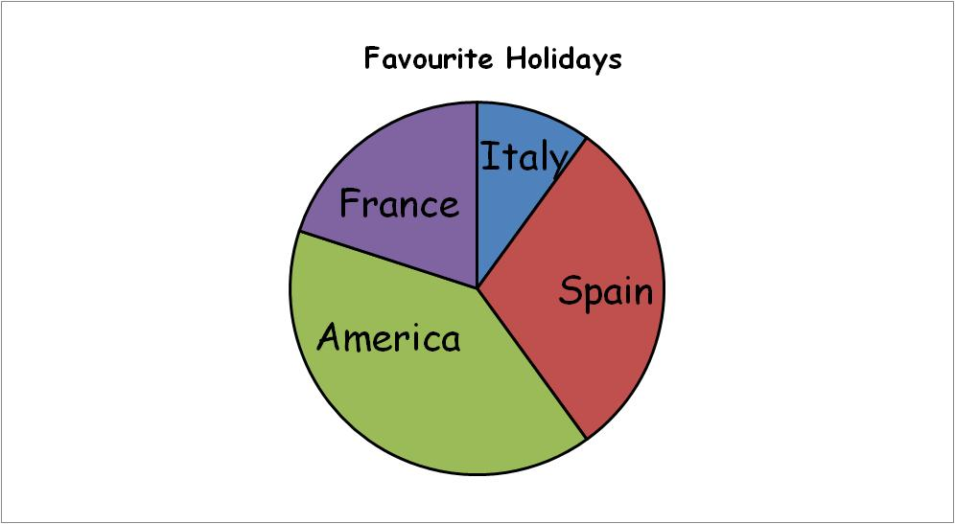
Pie Charts
50 people were asked
what was there
favourite holiday
How many chose
Spain
America
www.mathsrevision.com

Slide 11
Drawing Pie Charts
Favourite Sport
In a survey, 300 people were asked to indicate which one of five sports they liked best. Using the graph calculate the number people who liked each sport.
Rugby
75
Football
90
Cricket
45
Ice Hockey
60
Squash
30
Total
300
Football
Rugby
90º
108º
36º
54º
72º
Squash
Cricket
Ice Hockey

Slide 12

Interpreting Graphs
Now try Lifeskills
Ex 1
Ch11 (page 89)
www.mathsrevision.com

Slide 13
Starter Questions
www.mathsrevision.com

Slide 14
Scattergraphs
Learning Intention
Success Criteria
  To explain how to interpret a scattergraph and codes.
  1. Understand how to interpret a scattergraph and codes.
  2. Solve problems involving scattergraphs and codes.
www.mathsrevision.com

Slide 15
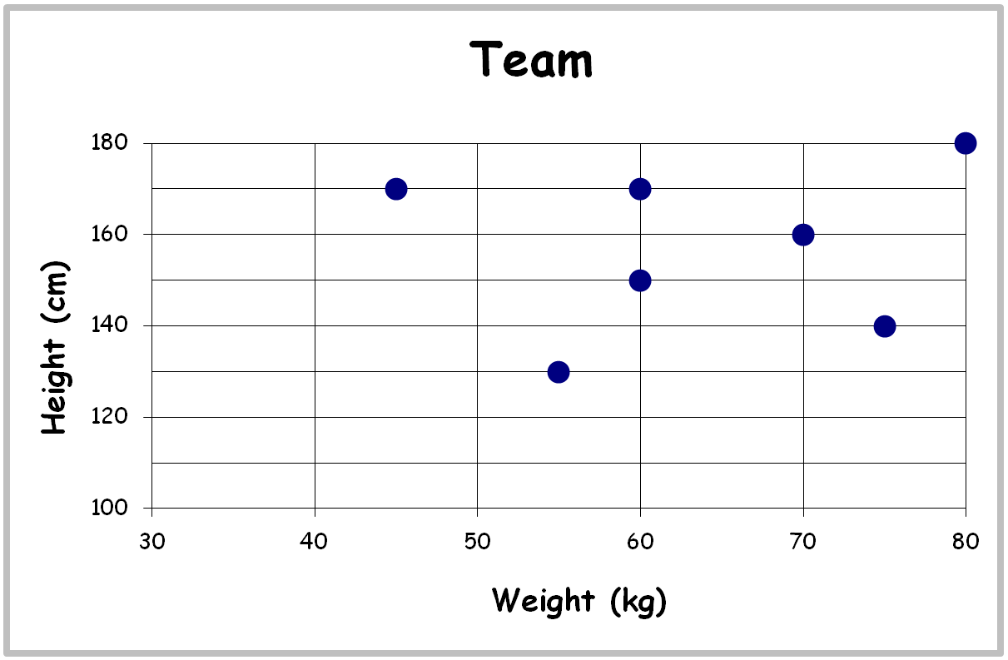
This scattergraph shows the heights and weights of a sevens football team
Write down the height and weight of each player.
Scattergraphs
Bob
Tim
Sam
Joe
Gary
Dave
www.mathsrevision.com
Jim

Slide 16
Height and Weight
Data was collected on pupils weight and height. Data is plotted below.
(a) Is there connection between height and weight.
As weight increases height increases
h
Estimate height if weight is 30kgs
200
180
h = 90 cm
160
140
120
(c) Estimate weight if height is 130cm.
Height (cms)
100
80
w = 40kgs
60
40
20
w
0
10
20
30
40
50
60
70
80
90
100
Weight (Kgs)

Slide 17
Interpreting Graphs
Now try Lifeskills
Ex 2
Ch11 (page 92)
www.mathsrevision.com

Slide 18
Starter Questions
2cm
www.mathsrevision.com
10cm

Slide 19
Stem Leaf Diagrams
Learning Intention
Success Criteria
  To explain how to interpret a stem leaf diagrams.
  1. Understand how to interpret a stem leaf diagram.
  2. Solve problems involving stem leaf diagrams.
www.mathsrevision.com

Slide 20
You have 1 minute to come up with another question for stem leaf.
Stem Leaf Graphs
A Stem – Leaf graph is another way of displaying information :
Ages
This stem and leaf graph shows
the ages of people waiting in a
queue at a post office
2
4
6
8
3
0
1
3
4
4
4
5
6
7
9
How many people in the queue?
20
5
0
3
4
9
www.mathsrevision.com
6
1
4
5
6
How many people in their forties?
6
stem
leaves
n = 20 Key : 2 4 means 24

Slide 21
Stem Leaf Graphs
Back to Back Stem – Leaf Graphs
Rugby Team 1
Heights
Rugby Team 2
Heights
A back to back stem-leaf
helps us to compare two
sets of data.
4
2
1
14
0
2
6
7
8
7
6
15
3
4
8
5
0
16
0
1
6
Write down a question that can be answered easily from the graph.
6
4
3
3
1
17
1
6
www.mathsrevision.com
7
0
18
1
4
4
n = 15
n = 15
14 | 1 represents 141cm

Slide 22
Interpreting Graphs
Now try Lifeskills
Ex 3
Ch11 (page 93)
www.mathsrevision.com

Slide 23
Starter Questions
www.mathsrevision.com

Slide 24
Constructing Graphs
Learning Intention
Success Criteria
  1. We are learning to interpret tables.
  Be able to calculate the best deal from a table of information .
www.mathsrevision.com

Slide 25
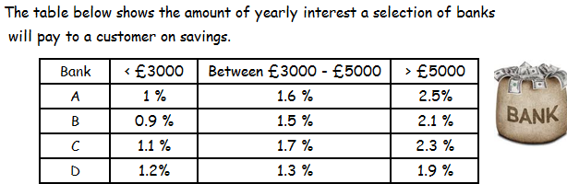
John has savings of £4500 , which bank would pay the most interest ?
Bank C
Bill has savings of £1200 , which bank should he choose ?
Bank D
Victor has savings of £7400 , how can he maximise his money ?
Bank A

Slide 26
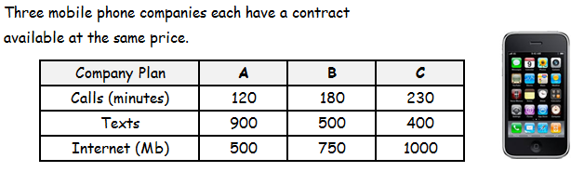
Alessio is looking for a mobile phone contract which will give him
165 minutes of calls, 450 texts, and 745 Mb of internet use.
Which company’s plan would be best for him?
Company B
Hannah is looking for a mobile phone contract which will give her
195 minutes of calls, 350 texts, and 850 Mb of internet use.
Which company’s plan would be best for her?
Company C

Slide 27
Ready Reckoner
Making calculations easier !
Filled Rolls | Price
1 | 50p
2 | 90p
4 | £1.70
5 | £2.00
10 | £4.00
20 | £9.00
50 | £18.00
How much for
(a) 6 rolls
£2.00 + 50p = £2.50
St. Andrew’s Secondary
(b) 14 rolls
£4.00 + £1.70 = £5.70
(c) 65 rolls
£18 + £4 + £2 = £24

Slide 28

Have you updated your Learning Log ?
Interpreting Graphs
Now try Lifeskills
Ex 4
Ch11 (page 94)
www.mathsrevision.com

